Slide 1
Project: IEEE P802.15 Working Group for Wireless Personal Area Networks (WPANs)
Submission Title: [TG15.6ma Closing Report for May 2024]
Date Submitted: [15th May 2024]
Source: [Ryuji Kohno1,2,] [1;Yokohama National University, 2;YRP International Alliance Institute(YRP-IAI)]
Address [1; 79-5 Tokiwadai, Hodogaya-ku, Yokohama, 240-8501 Japan
2; YRP1 Blg., 3-4 HikarinoOka, Yokosuka-City, Kanagawa, 239-0847 Japan]
Voice:[1; +81-90-5408-0611], FAX: [+81-45-383-5528],
Email:[1: kohno@ynu.ac.jp, 2: kohno@yrp-iai.jp] Re: []
Abstract: [This document contains closing report for TG15.6ma for Revision of P802.15.6-2012 with Enhanced Dependability May 2024.]
Purpose: [information]
Notice: This document has been prepared to assist the IEEE P802.15. It is offered as a basis for discussion and is not binding on the contributing individual(s) or organization(s). The material in this document is subject to change in form and content after further study. The contributor(s) reserve(s) the right to add, amend or withdraw material contained herein.
Release: The contributor acknowledges and accepts that this contribution becomes the property of IEEE and may be made publicly available by P802.15.

Slide 2
IEEE 802.15 TG6ma (Revision of IEEE802.15.6-2012) Closing Report In Personal and Virtual Hybrid Interim Session Warsaw, Poland May 16th, 2024 Ryuji Kohno Yokohama National University(YNU), YRP International Alliance Institute(YRP-IAI)

Slide 3
Objectives of TG 6ma – Enhanced Dependability Body Area Network (ED-BAN)
Objective: Enhancements to the BAN Ultra Wideband (UWB) physical layer (PHY) and media access control (MAC) to support enhanced dependability to a human BAN (HBAN) and adds support for vehicle body area networks (VBAN), a coordinator in a vehicle with devices around the vehicular cabin.
Action:
•Update draft#1.18 of Draft Proposals for Pre-Ballot
•Comment resolution for draft#1.18
•Performance Evaluation of Technologies in PHY; Channel Coding According to 8 QoS Levels of Packets and Coexistence Levels, Interference Mitigation, etc.
•Performance Evaluation of Technologies in MAC; Channel Management, CCA, Hybrid Contention Free/Access Protocol According to 8 QoSs and Coexistences.
•Harmonization or Commonality with 4ab in Coexistence and Feasible Implementation of 6ma and 4ab
•Feasibility of TSN of 802.1 in MAC
Next Things to Do：
Finalize draft#1 for Letter Ballot

Slide 4
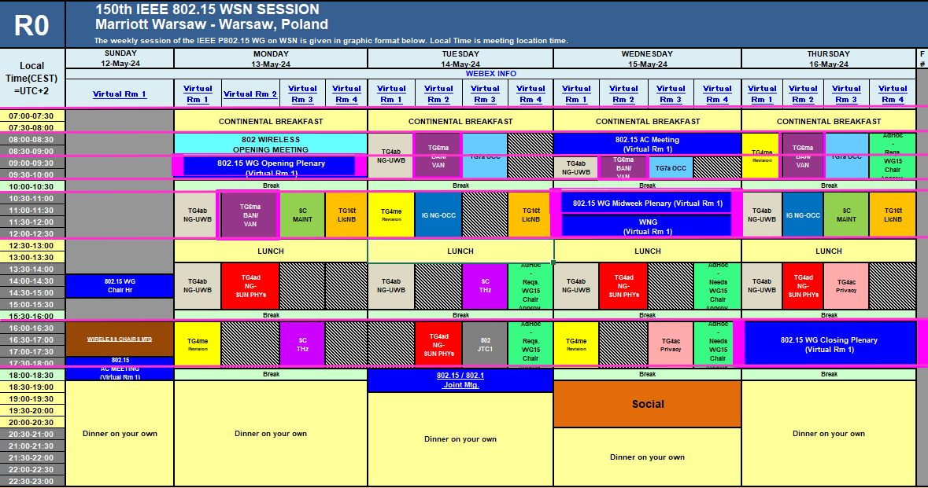
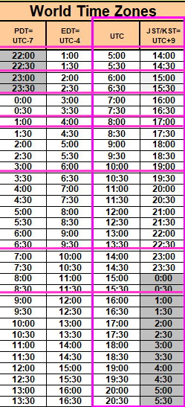
TG15.6ma Plenary Session Schedule for 12-17th, May 2024
TG15.6ma has three own sessions such as
Session1(Virtual RM#2) AM2 10:30-12:30 May 13(MON) in Warsaw time, 17:30 - 19:30 May 13(MON) in JST/KST
Session2(Virtual RM#2) AM1 8:00-10:00 May 14(TUE) in Warsaw time, 15:00 - 17:00 May 14(TUE) in JST/KST
Session3(Virtual RM#2) AM1 9:00-10:00 May 15(WED) in Warsaw time, 16:00 - 17:00 May 15(WED)in JST/KST
Session4(Virtual RM#2) AM1 8:00-10:00 May 16(THU) in Warsaw time, 15:00 - 17:00 May 16(THU) in JST/KST

Slide 5
Agenda items for the week
TG15.6ma meeting call to order
Call for essential patents and policies & procedures reminder
Approve last meeting minutes: TG 15.6ma Meeting Minutes for March 2024 doc.#15-24-0186-00-06ma
Agenda of TG15.6ma May Meeting doc.#15-24-0210--01-06ma
Review and Summary
Overview of IG, SG, TG15.6ma doe Dependable BAN Revision of IEEE802.15.6-2012 doc.#15-23-0455-02-06ma
Basic Consensus in MAC and PHY of Revision of IEEE802.15.6-2012(IEEE802.15.6ma) doc.#15-23-0557-03-06ma
TG6ma Draft Action Items(Progress and Action Items for Draft#1.18 doc.#15-24-0xxx-00-06ma
Review of draft#1.18 for Pre-Ballot WG doc.#15-23-0476-14-06ma
Rescheduling Timeline doc.#15-23-0361-05-06ma
Presentation
1.. Hybrid ARQ Scheme for High QoS Packets in High Class of Coexistence of IEEE 802.15.6ma #15-23-0576-02-06ma 2. Evaluation of IEEE 802.15.6 Ultra-wideband Physical Layer Utilizing Super Orthogonal Convolutional 22-0562-08-06ma
3. Performance Evaluation of Channel Coding Based on TG6ma Channel Model for Some Classes of Coexistence 051-01
4. Overview and convergence of MAC proposals for 15.6ma doc.#15-24-0076-03-06ma
5. MAC Frame Formats Based on Harmonization Agreements doc.#15-24-0034-01-06ma
6. Simulation results for Nagoya I. T. and YRP-IAI MAC proposal Based on TG6ma Channel Model -0352-04-06ma
7. Preliminary Evaluation on Ranging Accuracy with Interference Cancellation in Coexistence Environments 24-0057-01
8. Joint work with 802.1; Draft PAR and CSD 802.1ACea: Amendment to IEEE Standard 802.1AC-2016 15-23-453＆454
9. TG6ma Channel Model Document for Enhanced Dependability doc.#15-23-0605-03-06ma
10. Interference Mittigation Schemes in Class 3, 5, 6, and 7 of Coexisitence in TG6ma doc.#15-24--0073-02-06ma
11. Overview and convergence of MAC proposals for 15.6ma doc.#15-24-0076-01-06ma
12. Propagation Channel Parameters of UWB Communication Applications for Human BAN (HBAN) Use Cases 24-0145-03
13. Progress Report of TG6ma doc.#15-23-0056-06-06ma
14. Timeline of TG6ma doc.#15.23-0056-06-06ma
15. TG15.6ma Closing Report for May 2024 doc.#15-24-0vvv-00-06ma
16. TG15.6ma Meeting Minutes for May 2024 doc.#15-24-0sss-00-06ma

Slide 6
Definition of Coexistence Environment Classes
Coexistence Class | Coexisting system(s) |  |  |  |  | Category
Level | 802.15.6ma | 802.15.6-2012 | Non-UWB (ex. Wi-Fi / Unlicensed / 3GPP) | 802.15 UWB (ex. 802.15.4) | Non-802.15 UWB (ex. ETSI SmartBAN) | Category
0 | - | - | - | - | - | Single BAN
1 (1a) | ✓ | - | - | - | - | Multiple 15.6 BANs
2 (1b) | ✓ | ✓ | - | - | -
3 | ✓ | - | ✓ | - | - | Non-UWB
4 (2a) | ✓ | - | - | ✓ | - | Multiple UWB systems
5 (2b) | ✓ | - | - | - | ✓
6 (2c) | ✓ | - | - | ✓ | ✓
7 | ✓ | ✓ | ✓ | ✓ | ✓ | Final Boss
The coexistence class has been redefied to 8 levels, which can be represented by 3 bits and would be suitable to include in PHY or MAC headers.

Slide 7
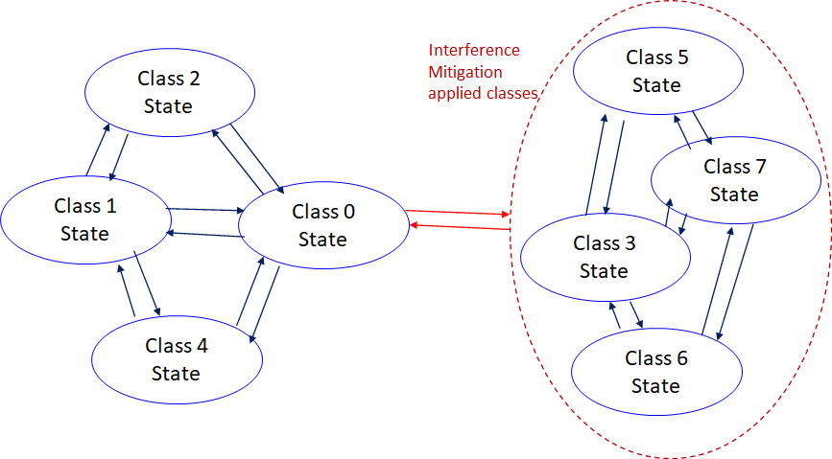
Coexistence Class States Transition(1/2)
The standard's revision supports BANs operating with high reliability (coexistence class 0) and coexisting in dense environments with intra-interference and inter-interference (coexistence class 1 to 7). Figure 6 shows the state transition between several classes of coexistence environments defined in above –mentioned table.
Class 0: 6ma BAN alone
Class 1: Multiple 6ms BANs
Class 2: 6ma BAN with old 6 BAN
Class 4: 6ma BAN with other
802.15 UWB WSNs e.x. 4z, 4ab
Class 3: 6ma BAN with other
narrowband Nets WSNs
Class 5: 6ma BAN with other
UWB Nets e.x. ESTI SmartBAN
Class 6: 6ma with 802.15 other WSN
Class 7: 6ma with any frequency
shared networks
Figure 6 Diagram of state transitions for coexistence class environments.

Slide 8
Coexistence Class States Transition(2/2)
The standard's revision focuses on the dependability mechanisms for a single HBAN or VBAN (Class 0) and the scenario with multiple HBANs or VBANS (Class 1).
Class 2 supports compatibility with legacy BANs (IEEE 802.15.6-2012 Std).
Class 4 supports coexistence with other IEEE 802.15 UWB Stds, and amendments such as 15.4, 15.8, 15.4z, and 4ab, via the PHY and MAC specification.
Classes 3, 5, 6, and 7 support coexistence with other wireless systems can result in Class 0, 1, and 2 by mitigation technology to cancel interference from other radios except regacy 15.6 at the receiver side (see clause 4.7.2 of draft#1.11.
During CCA, a BAN coordinator may analyze the type of synchronization preamble detected from a 15.6ma, 15.6, or 15.4 system.
In Figure 6, the state transition probabilities are approximated in consecutive superframes. Furthermore, the duration of the CAP and CFP are determined by statistics of various QoS level of packets in previous consecutive superframes for every coming superframe.
The draft revision #1.11 supports BANs operating with high reliability in dense environments coexisting with intra-interference and inter-interference due to other wireless systems in the same frequency band. Figure 6 shows state transition among several classes of coexistence environment defined in Table 1.

Slide 9
QoS Levels of Packets corresponding to User Priority
In Std.15.6 WBAN systems, a various data such as vital signs, skin temperature, blood pressure, ECG, EEG, ECoG, and vehicle controlling commons have different QoS levels corresponding to user priority.
In 15.6ma for dependable WBAN for human and vehicles, data packet transmission should be dependable according to QoS levels even in various classes of coexistence environment.
Therefore, appropriate sets of error controlling scheme with FEC and hybrid ARQ corresponding to QoS levels have been standardized in 15.6ma,
User priority | Traffic designation | Frame type
0 | Background (BK) | Data
1 | Best effort (BE) | Data
2 | Excellent effort (EE) | Data
3 | Video (VI) | Data
4 | Voice (VO) | Data
5 | Medical data or network control | Data or management
6 | High-priority medical data or network control | Data or management
7 | Emergency or medical implant event report | Data

Slide 10
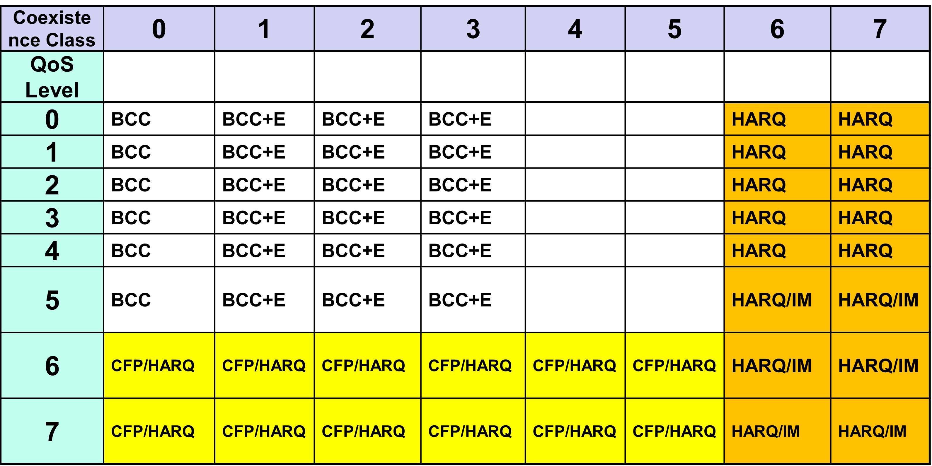
FEC/HARQ for 64 Combinations of 8 Coexistence Classes × 8 QoS Packet Levels
FEC codes and Hybrid ARQ have been designed for 8 × 8 = 64 combinations for QoS levels and Coexistence classes under various standard of channel models.

Slide 11
FEC in TG6ma
Common with IEEE802.15.4ab
Error-correcting codes corresponding to QoS levels
User priority | Inner code | Outer code | HARQ
0 | 15.4ab LDPC or BCC (R=1/2) |  | -
1 | 15.4ab LDPC or BCC (R=1/2) |  | -
2 | 15.4ab LDPC or BCC (R=1/2) |  | -
3 | 15.4ab LDPC or BCC (R=1/2) |  | -
4 | 15.4ab LDPC or BCC (R=1/2) | (54, 46) shortened RS code | -
5 | 15.4ab LDPC or BCC (R=1/2) | (54, 38) shortened RS code | -
6 | 15.4ab LDPC or BCC (R=1/2) | (54, 28) shortened RS code | -
7 | 15.4ab LDPC or BCC (R=1/2) | (54, 14) shortened RS code | -
As an outer code, shortened Reed-Solomon (RS) codes with N=54 (original code length N=63) will be selected to correct burst errors due to interference from other WBANs and the coding rates are changed according to each QoS and channel condition
As an inner code, 15.4ab LDPC (K=324, 648, 972, R=1/2) in mandatory or BCC in optional will be selected for the coexistence of 15.6ma and 15.4ab
This updated concept table is considered as the first priority

Slide 12
TG 6ma Timeline(expected)
Tech Req Doc July 2022
Presentation of proposals
May 2023
Comment Resolutionfor LB
Sept. 2024
EC approval to SB, SB submission
January 2025
WG PreBallot submission for Draft1.18May2024
SB recirculation
March 2025
SB recirculation if required
May 2025
Revcom Approve
July 2025
^{Draft V1,11 Com}
Jan. 2024
RevcomSubmission
June 2025
Comment Resolution fo Draft v1.14 on WG for PreBallot March 2024
1st Letter Ballot(LB)
July 2024
Conditional approval for Sponsor Ballot (SB)
Nov. 2024
TRD,CMD
Call Proposals Sept 2022
Std. Draf V1.9 Proposals
Nov. 2023
Notes: SASB/RevCom scheduled for 2024 a guess

Slide 13
Expecting Timeline detail
Topic item | Deadline | Action items | Notes
Std Draft v.1.18 WG pre-ballot recirculation. | May/2024 | Disposition of comments.
Towards the July 2024 meeting | July/2024 | Adding MAC text. Revise PHY text. Editorial revisions.
Target WG letter ballot (LB) submission: submit draft to TEG | July/2024 | Disposition of comments. CA document discussion | 1. Based on pre-ballot resolutions, prepare Draft v. 2.0 2. Request LB submission before the July meeting. Consequently, the July meeting is used to resolve comments.
1st LB recirculation | Sep/2024 |  | Comment-resolutions to LB recirculation.
2nd LB recirculation | Nov/2024 |  | Comment-resolutions to LB recirculation.
Conditional approval for Sponsor Ballot (SB) | Nov/2024 |  | Seek conditional approval for SB by the Executive Committee.
Final LB recirculation. | Jan/2025 |  | WG approval to request SB submission.
Request EC approval for SB | Jan/2025 |  | Request SB approval by the EC (conditional or not)
IEEE SA Sponsor Ballot submission | March/2025 |  | One month for IEEE SA editorial review.
1st SB recirculation | May/2025 |  | Comment-resolutions to SB and recirculation.
2nd SB recirculation | Jun/2025 |  | Comment-resolutions to SB and recirculation.
Request conditional/unconditional approval to RevCom | Jun/2025 |  | Submission to SASB agenda
Final SB recirculation, if required. Submission to RevCom | July/2025 |  | Submission to SASB
RevCom submission | July/2025 |  | RevCom approval
Note: the deadlines are subject to change.

Slide 14
Contributions
・TG15.6ma opening report for May 2024 meeting 15-24-0218-02-06ma
・TG15.6ma Agenda of March Meeting in 2024 15-24-0186-00-06ma
・Progress reort of 802.15.6ma 15-23-0056-06-06ma
・Rescheduling Timeline 15-23-0361-05-06ma
・Overview of IG-DEP, SG6a, TG6a ＆ TG15.6ma BAN with Enhanced Dependability15-23-0455-02-06ma
・Basic Consensus in MAC and PHY of Revision of IEEE802.15.6-2012 15-23-0557-01-06ma
・Propagation Channel Parameters of UWB for Human BAN (HBAN) Use Cases 15-24-0145-03-06ma
・MAC Performance Evaluation of Multiple BAN Coexistence Under TG6ma Channel Model 24-246-00
・Performance Evaluation of Channel Coding with Interleaver for Some Classes of Coexistence 24-247-00
・Ranging Accuracy Evaluation under TG6ma Communication Senarios 15-24-0248-00-06ma
・Hybrid ARQ Scheme for High QoS Packets in High Class of Coexistence of IEEE 802.15.6ma 23-0576-03
・Evaluation of IEEE 802.15.6 UWB PHY Utilizing Super Orthogonal Convolutional Code 15-22-0562-09
・Overview and convergence of MAC proposals for 15.6ma 15-23-0408-02-06ma
・MAC frame formats 15-24-0034-03-06ma
・Joint work with 802.1; Draft PAR and CSD 802.1ACea: Amendment to IEEE Standard 802.1AC-2016
15-23-453-02＆15-23-454-02
・Draft pre-ballot comment resolution 15-23-0476-15-06ma
・TG6ma Channel Model Document for Enhanced Dependability 15-22-0519-07-06ma
・Interference Mitigation Schemes in Class 3, 5, 6, and 7 of Coexisitence in TG6ma 15-24-0073-00-06ma
・Comments to channel-model-document 15-23-0605-01-06ma
・Interference Mittigation Schemes in Class 3, 5, 6, and 7 of Coexisitence in TG6ma 15-23-0073-01-06ma
・Overview and convergence of MAC proposals for 15.6ma 15-24-0076-01-06ma
・Progress Report of TG6ma 15-23-0056-06-06ma
・TG15.6ma closing report for May 2024 meeting 15-24-0300-00-06ma
・TG15.6ma May 2024 meeting minutes 15-24-0301-00-06ma /

Slide 15
Contacts and Conference call
Chair; Ryuji Kohno, YNU/YRP-IAI
kohno@ynu.ac.jp, kohno@yrp-iai.jp
1st Vice-Chair; Marco Hernandez, YRP-IAI/CWC
marco.hernandez@ieee.org
2nd Vice-Chair; Daisuke Anzai, NIT
anzai@nitech.ac.jp
3. Secretary; Takumi Kobayashi, YNU/TCU
kobayashi-takumi@yrp-iai.jp, kobayashi@nitech.ac.jp
Technical Editors;
Minsoo Kim, YRP-IAI minsoo@minsookim.com
Seong-Soon Joo, KPST wowbk@kpst.co.kr
Kento Takabayashi, Toyo U. takabayashi.kento.xp@gmail.com
Marco Hernandez, YRP-IAI/CWC marco.hernandez@ieee.org

Slide 16
Thank You !
Any Questions ?

