Slide 1
Project: IEEE P802.15 Working Group for Wireless Personal Area Networks (WPANs)
Submission Title: July, 2024 IEEE 802.15.4me Opening Agenda and Closing
Date Submitted: July 13, 2024
Source: Gary Stuebing Company: Cisco Systems
Address 5310 N Ocean Blvd, Unit 9A, North Myrtle Beach, SC
Voice 803 230-3027 E-Mail: gstuebin@cisco.com
Re: DCN 15-24-0297-01-04me Abstract: May 2024 Plenary Agenda and Closing
Purpose: Agenda and Closing for Task Group Meeting
Notice: This document has been prepared to assist the IEEE P802.15. It is offered as a basis for discussion and is not binding on the contributing individual(s) or organization(s). The material in this document is subject to change in form and content after further study. The contributor(s) reserve(s) the right to add, amend or withdraw material contained herein.
Release: The contributor acknowledges and accepts that this contribution becomes the property of IEEE and may be made publicly available by P802.15.

Slide 2
IEEE-SA Patent, Copyright, and Participation Policies
See: https://grouper.ieee.org/groups/802/sapolicies.shtml
IEEE-SA Patent Slides for Standards Development Meetings (.pdf)
https://development.standards.ieee.org/myproject/Public/mytools/mob/slideset.pdf
IEEE-SA Standards Board Patent Committee (PatCom) home page
https://standards.ieee.org/content/ieee-standards/en/about/sasb/patcom/index.html
IEEE-SA Participation Policy meeting slide set - individual method (.pdf)
https://standards.ieee.org/content/dam/ieee-standards/standards/web/documents/other/Participant-Behavior-Individual-Method.pdf
Working Group Copyright Materials
https://standards.ieee.org/ipr/copyright-materials.html
https://standards.ieee.org/content/dam/ieee-standards/standards/web/documents/other/ieee-sa-copyright-policy-2019.pdf

Slide 3
Participants have a duty to inform the IEEE
Participants shall inform the IEEE (or cause the IEEE to be informed) of the identity of each holder of any potential Essential Patent Claims of which they are personally aware if the claims are owned or controlled by the participant or the entity the participant is from, employed by, or otherwise represents
Participants should inform the IEEE (or cause the IEEE to be informed) of the identity of any other holders of potential Essential Patent Claims
Early identification of holders of potential Essential Patent Claims is encouraged

Slide 4
Ways to inform IEEE
Cause an LOA to be submitted to the IEEE SA (patcom@ieee.org); or
Provide the chair of this group with the identity of the holder(s) of any and all such claims as soon as possible; or
Speak up now and respond to this Call for Potentially Essential Patents
If anyone in this meeting is personally aware of the holder of any patent claims that are potentially essential to implementation of the proposed standard(s) under consideration by this group and that are not already the subject of an Accepted Letter of Assurance, please respond at this time by providing relevant information to the WG Chair
08 June 2021 – Slide 2

Slide 5
Other Guidelines for IEEE Working Group Meetings
All IEEE SA standards meetings shall be conducted in compliance with all applicable laws, including antitrust and competition laws.
Don’t discuss the interpretation, validity, or essentiality of patents/patent claims.
Don’t discuss specific license rates, terms, or conditions.
Relative costs of different technical approaches that include relative costs of patent licensing terms may be discussed in standards development meetings.
Technical considerations remain the primary focus.
Don’t discuss or engage in the fixing of product prices, allocation of customers, or division of sales markets.
Don’t discuss the status or substance of ongoing or threatened litigation.
Don’t be silent if inappropriate topics are discussed. Formally object to the discussion immediately.
---------------------------------------------------------------
For more details, see IEEE SA Standards Board Operations Manual, clause 5.3.10 and Antitrust and Competition Policy: What You Need to Know at http://standards.ieee.org/develop/policies/antitrust.pdf

Slide 9
IEEE SA Copyright Policy
By participating in this activity, you agree to comply with the IEEE Code of Ethics, all applicable laws, and all IEEE policies and procedures including, but not limited to, the IEEE SA Copyright Policy.
Previously Published material (copyright assertion indicated) shall not be presented/submitted to the Working Group nor incorporated into a Working Group draft unless permission is granted.
Prior to presentation or submission, you shall notify the Working Group Chair of previously Published material and should assist the Chair in obtaining copyright permission acceptable to IEEE SA.
For material that is not previously Published, IEEE is automatically granted a license to use any material that is presented or submitted.

Slide 10
IEEE SA Copyright Policy
The IEEE SA Copyright Policy is described in the IEEE SA Standards Board Bylaws and IEEE SA Standards Board Operations Manual
IEEE SA Copyright Policy, see Clause 7 of the IEEE SA Standards Board Bylaws https://standards.ieee.org/about/policies/bylaws/sect6-7.html#7 Clause 6.1 of the IEEE SA Standards Board Operations Manual https://standards.ieee.org/about/policies/opman/sect6.html
IEEE SA Copyright Permission
https://standards.ieee.org/content/dam/ieee-standards/standards/web/documents/other/permissionltrs.zip
IEEE SA Copyright FAQs
https://standards.ieee.org/faqs/copyrights/
IEEE SA Best Practices for IEEE Standards Development
http://standards.ieee.org/content/dam/ieee-standards/standards/web/documents/other/best_practices_for_ieee_standards_development_051215.pdf
Distribution of Draft Standards (see 6.1.3 of the SASB Operations Manual)
https://standards.ieee.org/about/policies/opman/sect6.html

Slide 11
Participants have a duty to inform the IEEE of the identity of each holder of any potential Essential Patent Claims of which they are personally aware if the claims are owned or controlled by the participant or the entity the participant is from, employed by, or otherwise represents
Please see the entire policy at this link:
https://development.standards.ieee.org/myproject/Public/mytools/mob/slideset.pdf

Slide 12
IEEE 802.15.4me July, 2024 Interim Plenary Agenda and Closing

Slide 13
15.4me Sessions this Week
 | Monday | Tuesday | Wednesday | Thursday
AM 1 | 9:00am 802.15 WG Opening Plenary |  | Tg4me Task Group Meeting | Tg4me Task Group Meeting
AM 2 |  | Tg4me Task Group Meeting | 802.15 Mid-Week Plenary
PM 1
PM 2 |  |  |  | 802.15 Closing Plenary
6:30p |  |  | SOCIAL

Slide 14
Agenda
Agenda
- Call for Patents
Approve Agenda
Approve Minutes
May Minutes – DCN 15-24-0264-00-04me
CRG Jun 14 Minutes – DCN 15-24-0342-00-04me
CRG Jun 28 Minutes – DCN 15-24-0351-00.04me
3rd Recirc Results
Next Steps
EC Package for Revcom
Update Checklist (DCN 15-0400 Latest Version)
Next meetings

Slide 15
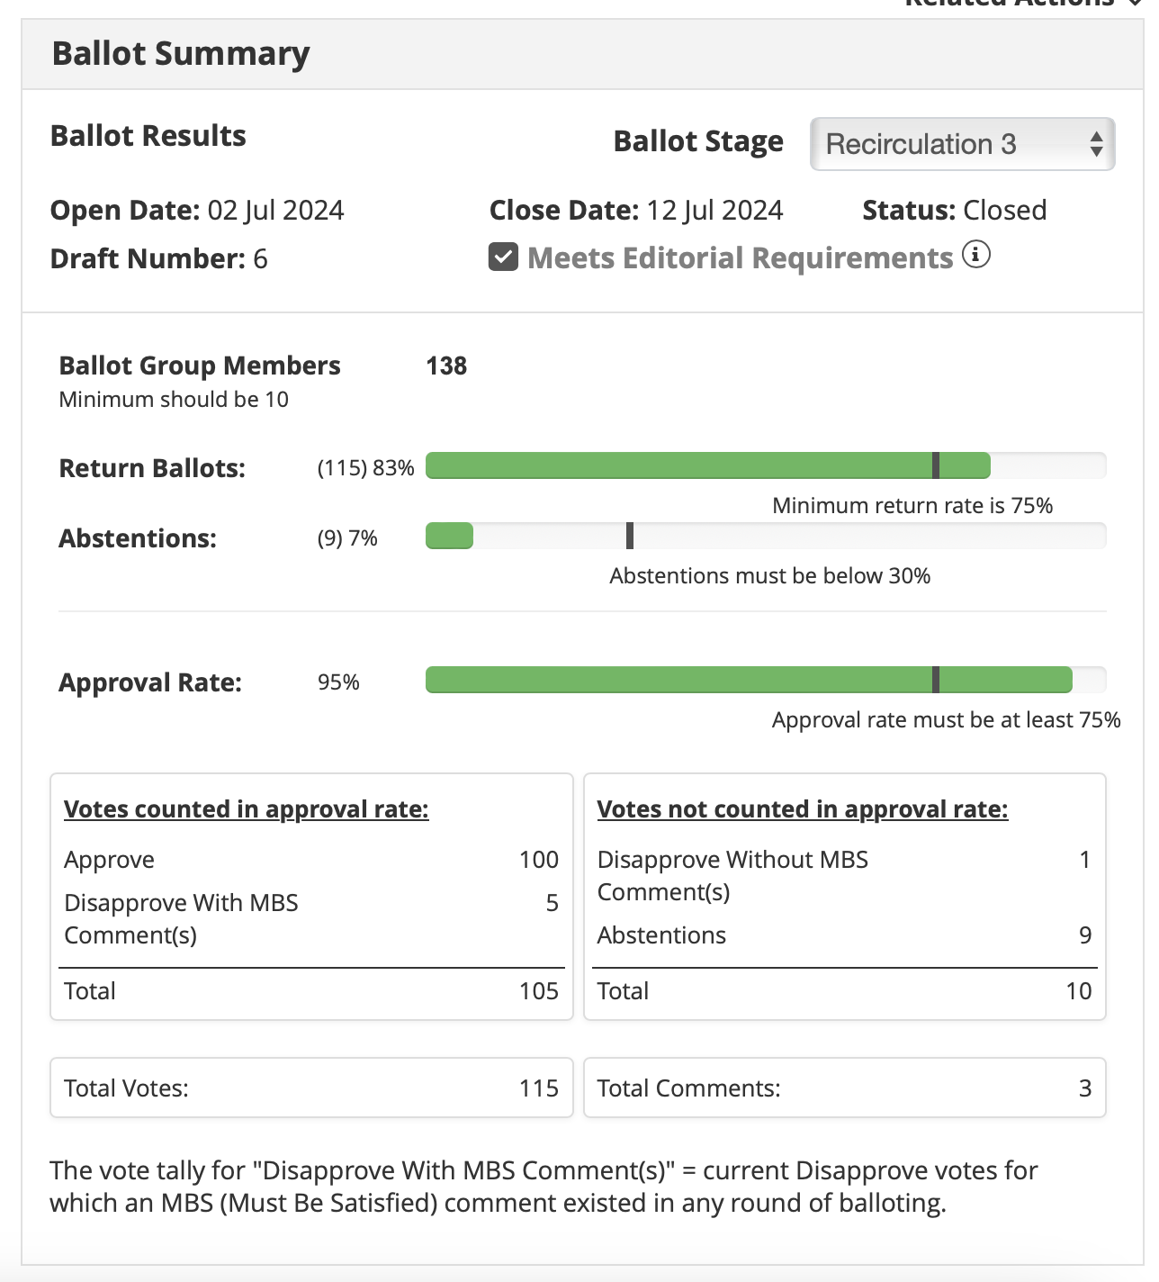
Results of 3rd Recirc Standards Ballot
THERE WERE
3 COMMENTS
2 TECHNICAL
1 EDITORIAL

Slide 16
TG motion: CRG formation for SA ballot
Move that 802.15.4me approve the formation of a Comment Resolution Group (CRG) for the Standards Association balloting of the P802.15.4me_Dxx with the following membership: Gary Stuebing(Chair), name,name,name,name. The 802.15.4me CRG is authorized to approve comment resolutions, edit the draft according to the comment resolutions, and to approve the start of recirculation ballots of the revised draft on behalf of the 802.15 WG. Comment resolution on recirculation ballots between sessions will be conducted via reflector email and via teleconferences announced to the reflector as per the LMSC 802 WG P&P.
Moved by:
Seconded by:
Result:

Slide 17
WG motion: CRG formation for SA ballot
Move that 802.15 WG approve the formation of a Comment Resolution Group (CRG) for the Standards Association balloting of the P802.15.4me_D03 with the following membership: Gary Stuebing(Chair), Tero Kivinen, Ann Krieger, Ben Rolfe, Phil Beecher, Billy Verso. The 802.15.4me CRG is authorized to approve comment resolutions, edit the draft according to the comment resolutions, and to approve the start of recirculation ballots of the revised draft on behalf of the 802.15 WG. Comment resolution on recirculation ballots between sessions will be conducted via reflector email and via teleconferences announced to the reflector as per the LMSC 802 WG P&P.
Moved by: Gary Stuebing
Seconded by:
Result:

Slide 18
CLOSING REPORT

Slide 19
CLOSING REPORT

Slide 20
CLOSING REPORT

Slide 21
Draft Timeline
Jul/24 - SA to Revcom?

