Slide 1
Project: IEEE P802.15 Working Group for Wireless Personal Area Networks (WPANs)
Submission Title: [Proposal for TG15.4ad Interference Model]
Date Submitted: [14 May, 2024]
Source: [Joerg ROBERT] Company [TU Ilmenau/Fraunhofer IIS]
Address [Helmholtzplatz 2, Ilmenau, 98693, Germany]
E-Mail:[joerg.robert@ieee.org]
Abstract: []
Purpose: [Presentation in TG15.4ad]
Notice: This document has been prepared to assist the IEEE P802.15. It is offered as a basis for discussion and is not binding on the contributing individual(s) or organization(s). The material in this document is subject to change in form and content after further study. The contributor(s) reserve(s) the right to add, amend or withdraw material contained herein.
Release: The contributor acknowledges and accepts that this contribution becomes the property of IEEE and may be made publicly available by P802.15.

Slide 2
Motivation
Comparison of different proposals requires simulations of the physical layer performance
The proposed systems will operate in license-exempt frequency bands, resulting in interference from other systems

Slide 3
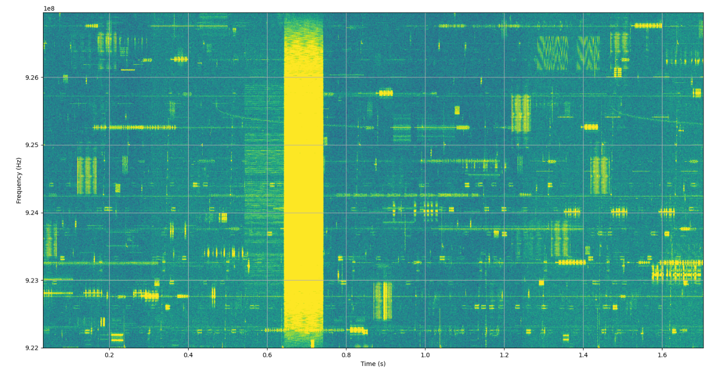
Example of Measured Spectrogram (922 … 927 MHz, length 1.5s)

Slide 4
Proposed Interference Model
Subset of interference model proposed in [1, 2]
Open source code available for simulation [3]
Parameters for the open source model:
Center frequency f=900 MHz
Path loss model: Outdoor_urban_32m
l=0dB log-normal fading
n=6dB noise figure
Activity multiplier a=10
All parameters of the model are given in dBm

Slide 5
Literature
[1] Proposal for sub-GHz Interference Model, DCN 15-17-0037-01 https://mentor.ieee.org/802.15/dcn/17/15-17-0037-01-lpwa-proposal-for-sub-ghz-interference-model.pptx
[2] J. Robert, S. Rauh, H. Lieske and A. Heuberger, "IEEE 802.15 Low Power Wide Area Network (LPWAN) PHY Interference Model," 2018 IEEE International Conference on Communications (ICC), Kansas City, MO, USA, 2018
[3] Open Source Code: https://www.like.tf.fau.de/lehre/download/ieee-802-15-4w-phy-interference-model/

