Slide 1
IG NG-OCC
Submission Title: Autoencoder with unsupervised deep learning for NG-OCC
Date Submitted: May 14, 2024
Source: Muhammad Rangga Aziz Nasution, Nguyen Ngoc Huy, Yeong Min Jang, Kookmin University
Address: Room #603 Mirae Building, Kookmin University, 77 Jeongneung-Ro, Seongbuk-Gu, Seoul, 136702, Republic of Korea
Voice: +82-2-910-5068 E-Mail: yjang@kookmin.ac.kr
Re:
Abstract: Present the Autoencoder with unsupervised deep learning for NG-OCC
Purpose: Presentation for contribution on IG NG-OCC
Notice: This document has been prepared to assist the IG NG-OCC. It is offered as a basis for discussion and is not binding on the contributing individual(s) or organization(s). The material in this document is subject to change in form and content after further study. The contributor(s) reserve(s) the right to add, amend or withdraw material contained herein.
Release: The contributor acknowledges and accepts that this contribution becomes the property of IEEE and may be made publicly available by IG NG-OCC.

Slide 2
Autoencoder with Unsupervised Deep Learning for NG-OCC May 14, 2024

Slide 3
Contents
Background
Autoencoder with Unsupervised Deep Learning for NG-OCC
Conclusion

Slide 4
Background
The usage of unsupervised deep learning in autoencoder would enable it to learn by itself and making an improvement along the way without human intervention.
Lack of data for experimental and real-world scenarios for OCC, the versatility of unsupervised deep learning would enable the model to learn from an unstructured dataset.
An end-to-end autoencoder learning-based approach for OCC, which would allow a joint optimization to overcome suboptimal performance issues of classical modular design.

Slide 5
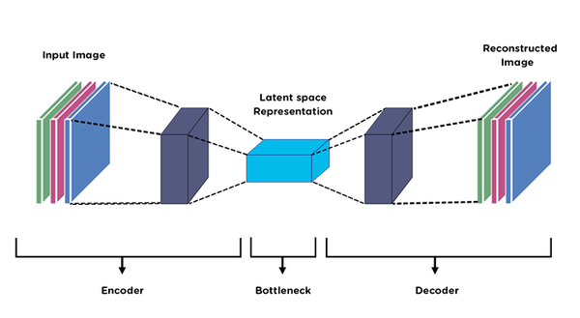
Autoencoder with Unsupervised Deep Learning for NG-OCC
An autoencoder is a neural network for unsupervised learning that compresses input data into a representation and reconstructs the input from it.
Comprising an encoder for compression and a decoder for reconstruction, its goal is to minimize reconstruction error, prompting the model to capture key features and patterns in the input data.
The autoencoder's transmitter converts data messages into signals suitable for RGB channel transmission through the camera.

Slide 6
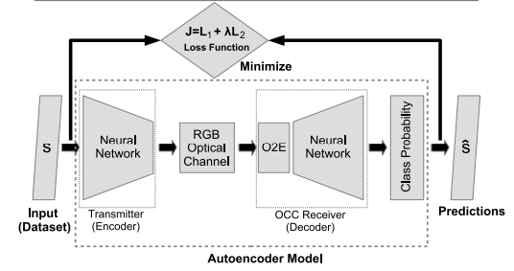
Autoencoder with Unsupervised Deep Learning for NG-OCC
The autoencoder simulates real-world challenges, such as RGB channel effects and noise, to enhance its ability to handle transmission imperfections
Acting as a decoder, the autoencoder interprets and processes the received signal, accounting for noise and channel effects, ultimately recovering the original message.
The autoencoder continually enhances its performance for effective data transmission and reception in OCC scenarios.

Slide 7
Conclusion
Autoencoders in optical communication optimize data compression and reconstruction, enhancing performance in handling transmission imperfections.
Data scarcity, especially in experimental and real-world scenarios, poses a challenge for training deep learning models in optical communication.
Autoencoders ensures continuous improvement, allowing adaptation to real-world challenges in optical communication.

Slide 8
Reference
J. M. Luna-Rivera, J. Rabadan, J. Rufo, V. Guerra, D. Moreno, and R. Perez-Jimenez, “Color space-based autoencoder for optical camera communications,” Expert Syst. Appl., vol. 245, no. 123101, p. 123101, 2024.
C. Jurado-Verdu, V. Guerra, V. Matus, J. Rabadan, and R. Perez-Jimenez, “Convolutional autoencoder for exposure effects equalization and noise mitigation in optical camera communication,” Opt. Express, vol. 29, no. 15, p. 22973, 2021.
A. Ahmed, S. Trichy Viswanathan, M. D. R. Rahman, and A. Ashok, “An empirical study of deep learning models for LED signal demodulation in optical camera communication,” Network, vol. 1, no. 3, pp. 261–278, 2021

