Slide 1
IG NG-OCC
Submission Title: Deep Reinforcement Learning for NG-OCC (March 2024)
Date Submitted: May 14, 2024
Source: Herfandi Herfandi, Nguyen Ngoc Huy, Yeong Min Jang, Kookmin University
Address: Room #603 Mirae Building, Kookmin University, 77 Jeongneung-Ro, Seongbuk-Gu, Seoul, 136702, Republic of Korea
Voice: +82-2-910-5068 E-Mail: yjang@kookmin.ac.kr
Re:
Abstract: Present the use case DRL for NG-OCC
Purpose: Presentation for contribution on IG NG-OCC
Notice: This document has been prepared to assist the IG NG-OCC. It is offered as a basis for discussion and is not binding on the contributing individual(s) or organization(s). The material in this document is subject to change in form and content after further study. The contributor(s) reserve(s) the right to add, amend or withdraw material contained herein.
Release: The contributor acknowledges and accepts that this contribution becomes the property of IEEE and may be made publicly available by IG NG-OCC.

Slide 2
Deep Reinforcement Learning for
NG-OCC
May 14, 2024

Slide 3
Contents
Background
Definition of DRL
Working Mechanism of DRL for NG-OCC​
Existing Cases of DRL​
DRL-based Deep Learning for NG-OCC​
Conclusion

Slide 4
Background
In recent years, there has been significant progress in the field of Artificial Intelligence (AI).
The integration of AI technology across various sectors, particularly in industry, has become a major focus of research.
AI’s ability to independently make decisions based on existing data presents opportunities to enhance automation and augment existing technologies.
Deep learning, a branch of AI, has emerged as a primary research focus. This field includes various subfields such as image processing, sequential data processing, and Deep Reinforcement Learning (DRL) for network applications.
In practical applications, Optical Camera Communication (OCC) utilizes light information from LEDs captured by cameras, employing image processing for data transmission and sequential data processing to transmit signals. OCC also facilitates the development of more complex communication systems through network utilization.

Slide 5
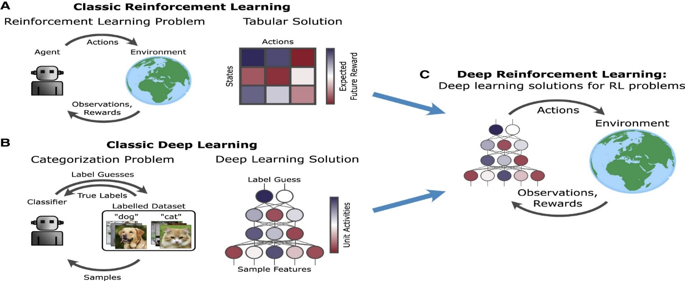
Definition of DRL
is a goal directed learning from interaction
Classic Reinforcement Learning focuses on how agents take actions in an environment to maximize of cumulative reward through trial and error, without using deep neural networks.
Classic Deep Learning utilizes deep neural networks to automatically discover the representations needed for feature detection or classification from raw data.
Deep Reinforcement Learning combines deep learning and reinforcement learning principles to enable agents to learn optimal actions in complex, high-dimensional environments directly from raw input data.

Slide 6
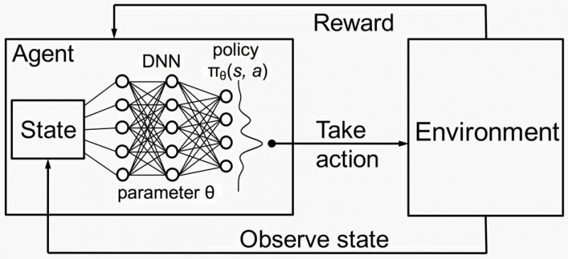
Working Mechanism of DRL for NG-OCC​
The Deep Reinforcement Learning (DRL) scheme consists of two key components (agent and environment) as well as two fundamental processes (observation and action). Observation provides data about the current situation, while action represents adjustments executed by the DRL agent based on rewards or penalties from the environment. DRL demonstrates the machine learning process from mistakes and grows through improvement, similar to learning through a system of rewards and punishments.
DRL collects trial and error experiences by interacting, similar to Reinforcement Learning. The outcomes of these experiences are then used to train neural network models using the backpropagation algorithm of deep learning. In DRL, the agent is implemented as a deep learning model so that it can map states into actions better.

Slide 7
Existing Cases of DRL​
Joint Radio Map Construction and Dissemination in MEC Networks: A Deep Reinforcement Learning Approach, Liu at al., Hindawi, 2022.
Building and sharing radio maps in MEC networks requires extensive computation and time, which hampers effective real-time spectrum analysis essential for network management.
The study introduces the ACJORA algorithm, utilizing deep reinforcement learning to improve computational task offloading and resource distribution, aiming to reduce energy use and delays.
The solution uses a mixed-integer nonlinear programming approach, tackled by a DRL algorithm that effectively coordinates both discrete and continuous actions within the network.
The DRL approach enhances cost efficiency in map dissemination by optimizing resource and offloading strategies, making it apt for real-time MEC applications.
Testing shows that ACJORA surpasses conventional methods, decreasing both latency and resource demands, thus providing a viable solution for real-time radio map tasks.

Slide 8
Existing Cases of DRL​
Scaling UPF Instances in 5G/6G Core With Deep Reinforcement Learning, Nguyen H. T., et al., IEE Access, 2021.
Utilizes Deep Reinforcement Learning (DRL) to scale User Plane Function (UPF) instances in 5G/6G core networks.
Employs Proximal Policy Optimization algorithm and a Support Vector Machine classifier for the DRL approach.
Aims to optimize resource use by dynamically adjusting UPF instances based on traffic demands.
Demonstrates improved efficiency over Kubernetes's Horizontal Pod Autoscaler in terms of resource utilization.
Achieves a reduction of 2.7–3.8% in the average number of Pods needed, with the SVM approach offering further savings.

Slide 9
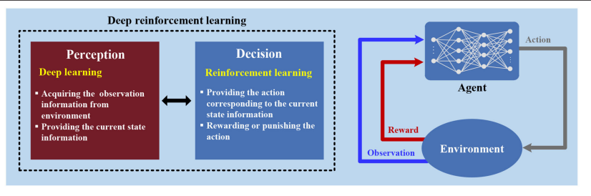
DRL-based Deep Learning for NG-OCC​
Artificial Intelligence in Optical Communications: From Machine Learning to Deep Learning. Frontiers in Communications and Networks, Wang, D. and Zhang, M. Frontiers in Communications and Networks, 2021.
In optical communications, DRL plays a crucial role in network control and automation. It's applied to streamline solutions in routing, resource allocation, orchestration, and configuration, proving its effectiveness in managing complex optical network scenarios.
Deep Reinforcement Learning (DRL) is leveraged to enhance the performance of Elastic Optical Networks (EON), aiding in more flexible spectrum assignment and ensuring high-quality virtual network services under varying conditions.
DRL is also utilized to improve the configuration of optical devices in data centers and passive networks. This involves using flexible transceivers that adapt to network needs, enhancing user experiences by improving transmission quality and speed.

Slide 10
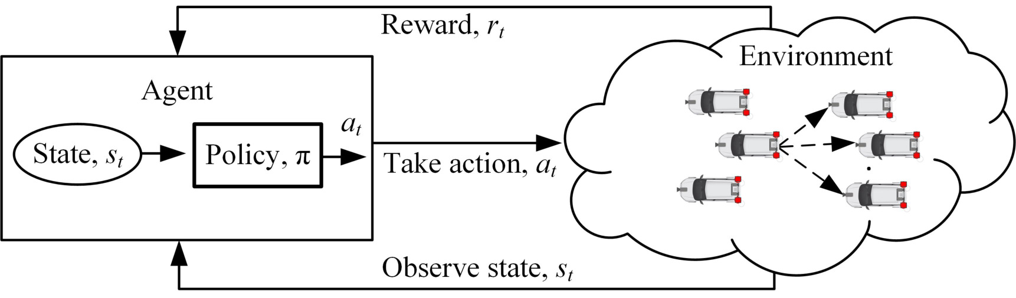
DRL-based Deep Learning for NG-OCC​
Multi-Agent Deep Reinforcement Learning for Spectral Efficiency Optimization in Vehicular Optical Camera Communications, Islam, N., et al., IEEE Transactions on Mobile Computing, 2023.
Objective To improve spectral efficiency in vehicular optical camera communications (OCC) through deep reinforcement learning
Challenge Addressed Achieving low bit error rate (BER) and ultra-low latency in vehicular communications
Methodology Formulation of the problem as a Markov decision process and application of deep Q-learning for solution
Approach A multi-agent learning framework for optimizing vehicle speed and modulation
Performance Demonstrated improvement over radio frequency systems and traditional OCC methods
Contributions Introduction of deep reinforcement learning for spectral efficiency, problem formulation under BER and latency constraints, and optimization using Lagrangian relaxation and independent learning frameworks.

Slide 11
Conclusion
Recent advances in AI, especially DRL, have significantly enhanced industrial applications and communication systems.
Deep Reinforcement Learning (DRL) combines deep learning and reinforcement learning to enable agents to optimize actions in complex environments through trial and error using neural networks.
There are various successful cases of using DRL to optimize resource utilization and enhance efficiency across different environments, including MEC Networks, 5G/6G, optical networks, and OCC-based vehicle communications.
In the context of Next-Generation Optical Camera Communications (NG-OCC), DRL has the potential to improve and optimize various aspects of optical communication, especially in OCC domain.

Slide 12
Reference
Wang, D., & Zhang, M. (2021). Artificial intelligence in optical communications: From machine learning to deep learning. Frontiers in Communications and Networks, 2. https://doi.org/10.3389/frcmn.2021.656786
Sarker, I. H. (2021). Deep Cybersecurity: A Comprehensive Overview from Neural Network and Deep Learning Perspective. SN Computer Science, 2(3). https://doi.org/10.1007/s42979-021-00535-6
Liu, X., Zhou, L., Zhang, X., Tan, X., & Wei, J. (2022). Joint Radio Map Construction and Dissemination in MEC Networks: A Deep Reinforcement Learning approach. Wireless Communications and Mobile Computing, 2022, 1–12. https://doi.org/10.1155/2022/4621440
Islam, A., Thomos, N., & Musavian, L. (2023). Multi-Agent deep reinforcement learning for spectral efficiency optimization in vehicular optical camera communications. IEEE Transactions on Mobile Computing, 1–14. https://doi.org/10.1109/tmc.2023.3278277
Nguyễn, H. T., Van, T., DO, & Rotter, C. (2021). Scaling UPF instances in 5G/6G core with deep reinforcement learning. IEEE Access, 9, 165892–165906. https://doi.org/10.1109/access.2021.3135315

