Slide 1
Project: IEEE P802.15 Working Group for Wireless Personal Area Networks (WPANs)
Submission Title: Ranging Accuracy Evaluation under TG6ma Communication Scenarios
Date Submitted: May 14th, 2024
Source: Daisuke Anzai, Yuhei Oguri, Shunsuke Ishiguro, Takumi Kobayashi
Company: Nagoya Institute of Technology (NIT), Japan
Address: Gokiso-cho, Showa-ku, Nagoya, 466-8555, Japan
Voice: +81-52-735-5389, FAX: +81-52-735-5389, E-Mail: anzai@nitech.ac.jp
Re: In response to call for technical contributions
Abstract: This provides a preliminary investigation of the effect of interference cancellation on UWB ranging accuracy under multiple BAN coexistence situations, and some simulation results are discussed.
Purpose: Material for discussion in P802.15.6a TG corresponding to comments in EC Meeting
Notice: This document has been prepared to assist the IEEE P802.15. It is offered as a basis for discussion and is not binding on the contributing individual(s) or organization(s). The material in this document is subject to change in form and content after further study. The contributor(s) reserve(s) the right to add, amend or withdraw material contained herein.
Release: The contributor acknowledges and accepts that this contribution becomes the property of IEEE and may be made publicly available by P802.15.

Slide 2
Ranging Accuracy Evaluation under TG6ma Communication Scenarios
Daisuke Anzai, Yuhei Oguri, Shunsuke Ishiguro,
Takumi Kobayashi
Nagoya Institute of Technology (NIT)

Slide 3
Introduction
Ranging is a key issue in various kinds of UWB applications, including IEEE 802.15.6ma, 4ab, and 4z
UWB techniques have the potential to achieve high accuracy in supporting important applications in HBAN and VBAN
It is important to discuss the ranging accuracy under multiple BAN coexistence situations under the BAN channel models

Slide 4
UWB ranging in CFP
It is more realistic that ranging is performed in contention free period (CFP), which results in the realization of both data transmission and ranging in the same period

Slide 5
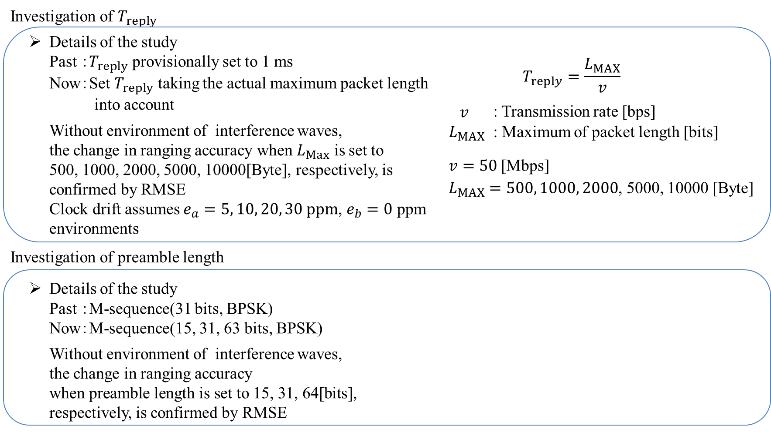
Discussion items

Slide 6
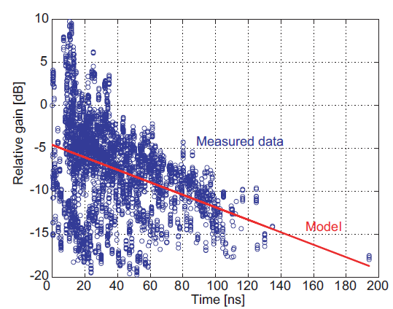
Propagation model in a hospital room^{[1]}
[1]: K. Takizawa, T. Aoyagi, H. -B. Li, J. -i. Takada, T. Kobayashi and R. Kohno, "Path loss and power delay profile channel models for wireless body area networks," 2009 IEEE Antennas and Propagation Society International Symposium, North Charleston, SC, USA, 2009, pp. 1-4.

Slide 7
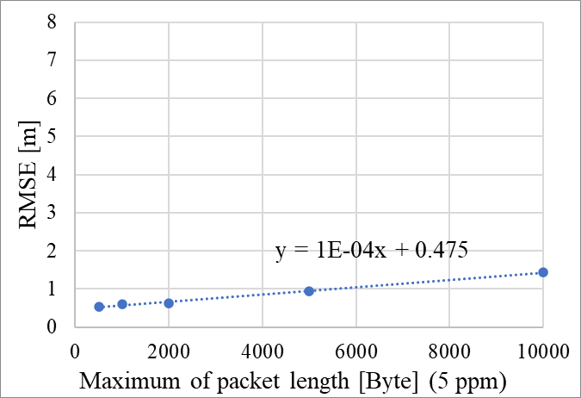
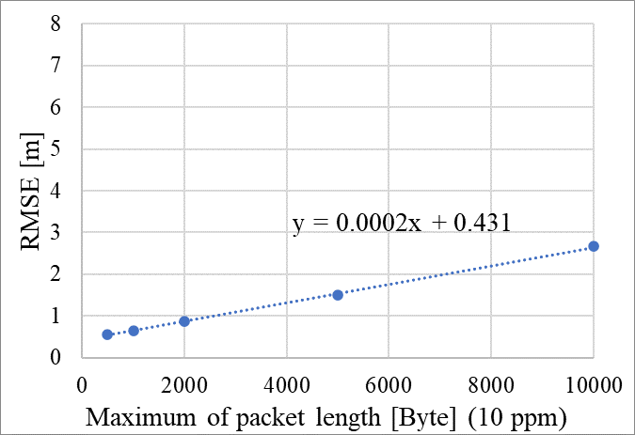
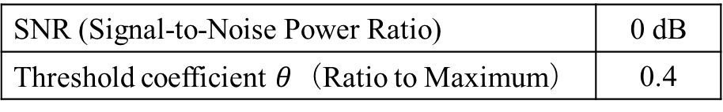
Effect of packet length
SNR (Signal-to-Noise Power Ratio) | 0 dB
Threshold coefficient $θ$（Ratio to Maximum） | 0.4

Slide 8
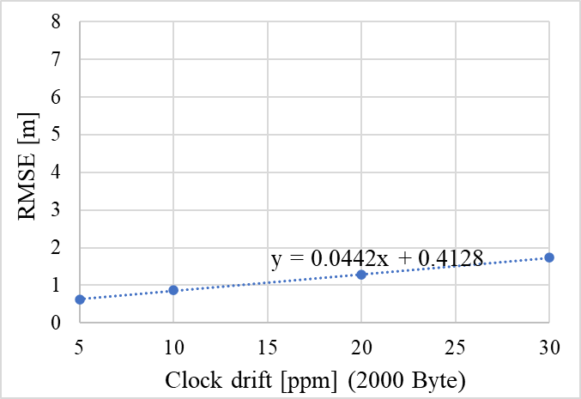
Effect of packet length
SNR (Signal-to-Noise Power Ratio) | 0 dB
Threshold coefficient $θ$（Ratio to Maximum） | 0.4

Slide 9
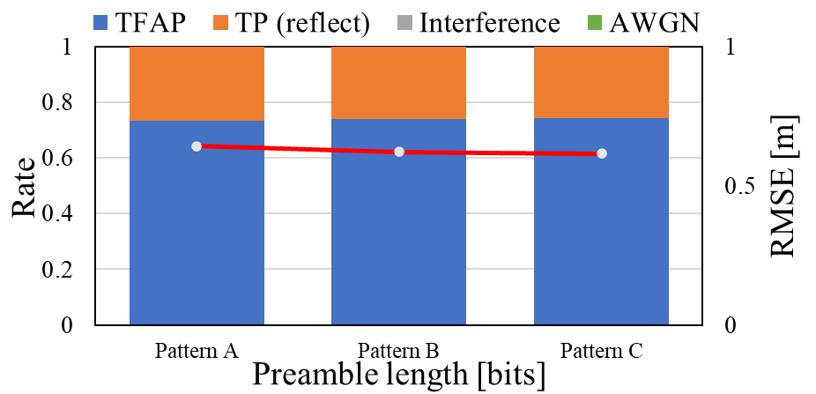
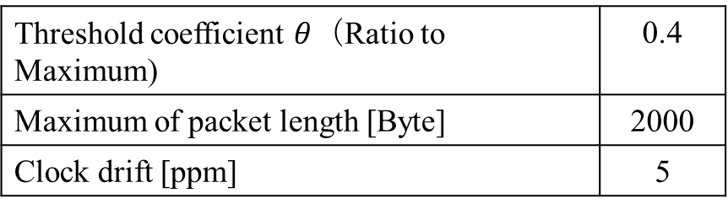
Ranging performance evaluation
Threshold coefficient $θ$（Ratio to Maximum) | 0.4
Maximum of packet length [Byte] | 2000
Clock drift [ppm] | 5
Pattern A: 15[bits], Pattern B: 31[bits], Pattern C: 63[bits]

Slide 10
References
D. Anzai, I. Balasingham, G. Fischer, J. Wang, “Reliable and High-Speed Implant Ultra-Wideband Communications with Transmit–Receive Diversity,” EAI/Springer Innovations in Communication and Computing, pp. 27-32, March 2020.
Y. Shimizu, D. Anzai, R. C-Santiago, P. A. Floor, I. Balasingham, and J. Wang, “Performance evaluation of an ultra-wideband transmit diversity in a living animal experiment” IEEE Trans. Microw. Theory Tech., vol. 65, no. 7, pp. 2596-2606, July 2017.
D. Anzai, K. Katsu, R. Chavez-Santiago, Q. Wang, D. Plettemeier, J. Wang, and I. Balasingham, “Experimental evaluation of implant UWB-IR transmission with living animal for body area networks,” IEEE Trans. Microw. Theory Tech., vol. 62, no. 1, pp. 183-192, Jan. 2014.
J. Shi, D. Anzai, and J. Wang, “Channel modeling and performance analysis of diversity reception for implant UWB wireless link,” IEICE Trans. Commun., no. E95-B, vol. 10, pp. 3197-3205, Oct. 2012.

