Slide 1
Project: IEEE P802.15 Working Group for Wireless Specialty Networks (WSN)
Submission Title: Discussion issues on the initial SA Ballot comment resolution for CIDs I-93 to I-114 (doc. 15-24-0072-13-007a) and IEEE P802.15.7a D7 redline draft
Date Submitted: May 10, 2024
Source: Sang-Kyu Lim [ETRI]
Address: 218 Gajeong-ro, Yuseong-gu, Daejeon, 34129, Korea
Voice:[+82-42-860-1573], FAX: [+82-42-860-5218], E-Mail:[sklim@etri.re.kr]
Re:
Abstract: This document is to resolve the initial SA ballot comments and to update IEEE P802.15.7a draft
Purpose: Contribution to IEEE P802.15.7a
Notice: This document has been prepared to assist the IEEE P802.15. It is offered as a basis for discussion and is not binding on the contributing individual(s) or organization(s). The material in this document is subject to change in form and content after further study. The contributor(s) reserve(s) the right to add, amend or withdraw material contained herein.
Release: The contributor acknowledges and accepts that this contribution becomes the property of IEEE and may be made publicly available by P802.15.

Slide 2
Discussion issues on the initial SA Ballot
comment resolution for CIDs I-93 to I-114
(doc. 15-24-0072-13-007a)
and IEEE P802.15.7a D7 redline draft
Sang-Kyu Lim [ETRI]

Slide 3
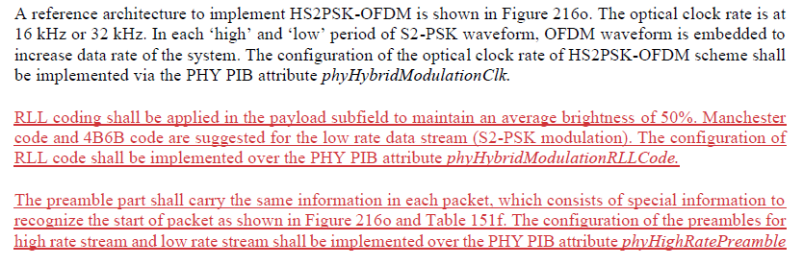
CID# I-93
Change all of the text
in 16.5.3.2 as indicated below:
16.5.3.2 on p39 in the current D7 redline
∨
Which one is correct ?
The texts in the disposition details do not match exactly the sentences in D7 redline. So, we need to check again the disposition details and D7 draft.

Slide 4
CID# I-94
Delete it because the comment says about Table 151f.
Table 151f on p40 in the current D7 redline
Add a new list for “Preamble” to Table 151f.
Put “6 bits (low rate data stream)” and “8 bits (high rate data stream)” to the preamble for Mode 1.
Put “10 bits (low rate data stream)” and “12 bits (high rate data stream)” to the preamble for Mode 2.
The disposition detail on this comment and Table 151f related to this comment in D7 redline should be changed like this in order to clarify the changes.

Slide 5
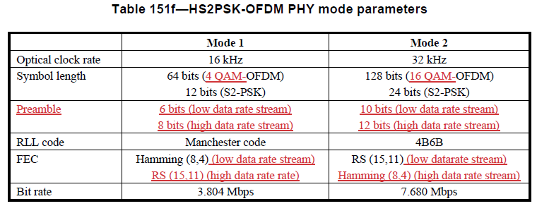
CID# I-95
Change the FEC for Mode 1 in Table 151f from “Hamming (8,4)” to “Hamming (8,4) (low rate data stream)”.
Add “RS (15,11) (high rate data stream)” to the FEC for Mode 1 in Table 151f.
Change the FEC for Mode 2 in Table 151f from “RS (15,11)” to “RS (15,11) (low rate data stream)”.
Add “Hamming (8,4) (high rate data stream)” to the FEC for Mode 2 in Table 151f.
Table 151f on p40 in the current D7 redline
FEC
Hamming (8,4) (low rate data stream)
RS (15,11) (high rate data stream)
RS (15,11) (low rate data stream)
Hamming (8,4) (high rate data stream)
The disposition detail on this comment should be changed like this in order to clarify the changes in Table 151f, which means “what” has been changed to “what”.
Table 151f related to this comment in D7 redline should be changed like this.

Slide 6
CID# I-96
Change the symbol length for Mode 1 in Table 151f from “64 bits (OFDM)” to “64 bits (4 QAM-OFDM)”.
Change the symbol length for Mode 2 in Table 151f from “128 bits (OFDM)” to “128 bits (16 QAM-OFDM)”.
Table 151f on p40 in the current D7 redline
The disposition detail on this comment should be changed like this in order to clarify the changes in Table 151f, which means “what” has been changed to “what”.

Slide 7
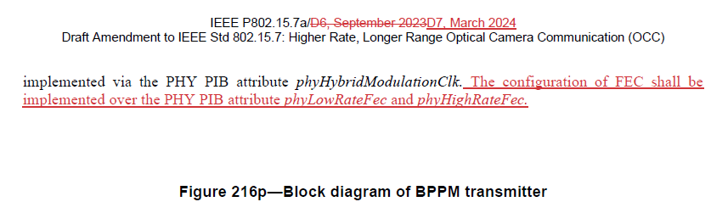
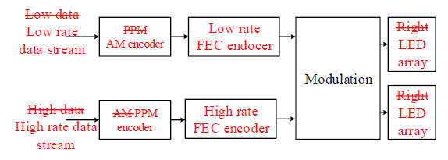
CID# I-97, I-98, I-99, and I-100
CIDs I-97, I-98, I-99, and I-100 say about Figure 216p.
However, Figure 216p is in the wrong place in D7 redline as shown below.
If the answer is “Yes”, then correct this editorial issue in D7 and go to the next slide.
Page 41 in the current D7 draft
Page 40 in the current D7 draft
“Blank”
“Yes” ?

Slide 8
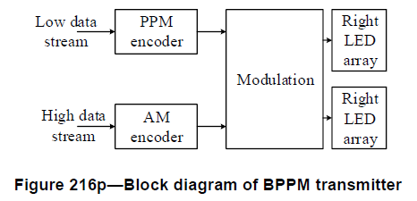
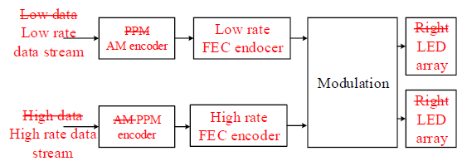
CID# I-97 and I-98
Change “High data stream” to “High rate data stream” in Figure 216p.
Change “AM encoder” to “PPM encoder” in Figure 216p.
“REVISED”
Change “Low data stream” to “Low rate data stream” in Figure 216p.
Change “PPM encoder” to “AM encoder” in Figure 216p.
“ Low data stream Low rate data stream ”
“ High data stream High rate data stream ”
“ PPM AM encoder ”
“ Right LED array ”
“ Right LED array ”
p37 in the current D6 draft
“See the comment, I-103.”
“ AM PPM encoder ”
What makes this change ?
p40 in the current D7 redline
If the proposed change for this comment is “ACCEPTED”, the changes for this comment in the redline draft should be shown like this to satisfy the comment resolution guidelines.
If you want to change other things in Figure 216p, the disposition status should be changed from “ACCEPTED” to “REVISED” and “what” is changed to “what” should be specified in the disposition details like this.

Slide 9
CID# I-99 and I-100
See the comments, I-97 and I-98.
Insert “High rate FEC encoder” between “PPM encoder” and “Modulation” for high rate data stream in Figure 216p.
“REVISED”
See the comments, I-97 and I-98.
Insert “Low rate FEC encoder” between “AM encoder” and “Modulation” for low rate data stream in Figure 216p.
p37 in the current D6 draft
p40 in the current D7 redline
The disposition status should be changed from “ACCEPTED” to “REVISED” and “what” is changed to “what” should be specified in the disposition details like this to satisfy the comment resolution guidelines.

Slide 10
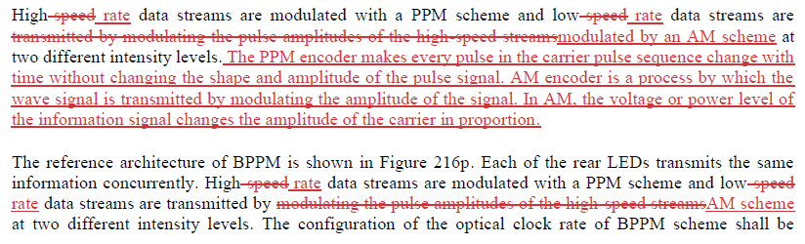
CID# I-101
“See the comment, I-25.”
16.5.3.3 on p40 and p41 in the current D7 redline
The texts in the disposition detail on this comment do not match exactly the changes in 16.5.3.3 of D7 redline.
Anyway, “See the comment, I-25.” is good enough for the disposition detail because the changes in 16.5.3.3 have already been done for I-25 comment.

Slide 11
CID# I-102
“See the comments, I-25 and I-101.”
16.5.3.3 on p40 and p41 in the current D7 redline
The texts in the disposition detail on this comment do not match exactly the changes in 16.5.3.3 of D7 redline.
Anyway, “See the comments, I-25 and I-101.” is good enough for the disposition detail because the changes in 16.5.3.3 have already been done for I-25 comment.

Slide 12
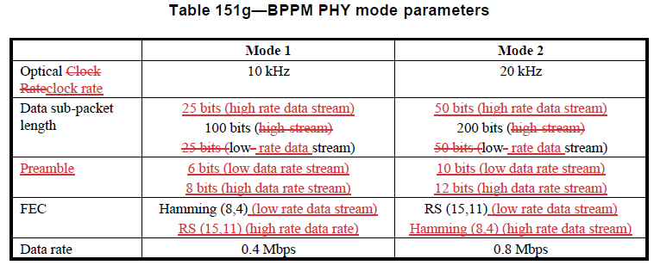
CID# I-105
Change the FEC for Mode 1 in Table 151g from “Hamming (8,4)” to “Hamming (8,4) (low rate data stream)”.
Add “RS (15,11) (high rate data stream)” to the FEC for Mode 1 in Table 151g.
Change the FEC for Mode 2 in Table 151g from “RS (15,11)” to “RS (15,11) (low rate data stream)”.
Add “Hamming (8,4) (high rate data stream)” to the FEC for Mode 2 in Table 151g.
Table 151g on p41 in the current D7 redline
FEC
Hamming (8,4) (low rate data stream)
RS (15,11) (high rate data stream)
RS (15,11) (low rate data stream)
Hamming (8,4) (high rate data stream)
The disposition detail on this comment should be changed like this in order to clarify the changes in Table 151g, which means “what” has been changed to “what”.
Table 151g related to this comment in D7 redline should be changed like this.

Slide 13
CID# I-105 (continued)
“I-104”
What makes this changes ?
“Disposition detail” on these changes is not found.
Want happen to this ?
Table 151g on p41 in the current D7 redline
“I-105”
The changes in the draft cannot be done without any disposition details or proposed changes.
If you find other things that you need to change in Table 151g, “what” is changed to “what” and “what” is added should be specified in the disposition details as shown in the slides resolving I-84 and I-85.

Slide 14
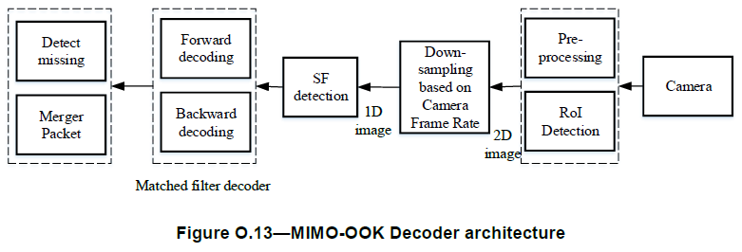
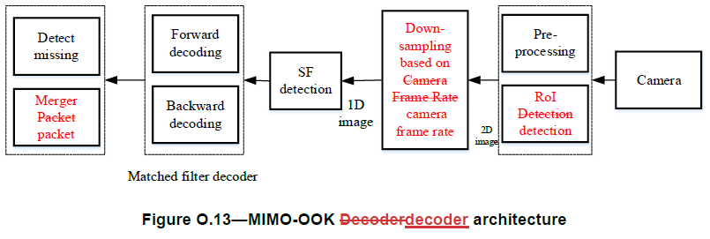
CID# I-106
“REVISED”
Change "MIMO-OOK Decoder“ on Figure O.13 caption to "MIMO-OOK decoder“.
Change “Merger Packet” in Figure O.13 to “Merger packet”.
Change “Down sampling based on Camera Frame Rate” in Figure O.13 to “Down sampling based on camera frame rate”.
Change “RoI Detection” in Figure O.13 to “RoI detection”.
The proposed changes say only “Change the figure caption”.
What makes this change ?
What makes this change ?
What makes this change ?
p43 in the current D6 draft
p47 in the current D7 redline
I-106
For synchronizing the changes between the comment resolution and the draft change, the disposition status for I-106 should be changed from “ACCEPTED” to “REVISED” and “what” is changed to “what” should be specified in the disposition details like this to satisfy the comment resolution guidelines.

Slide 15
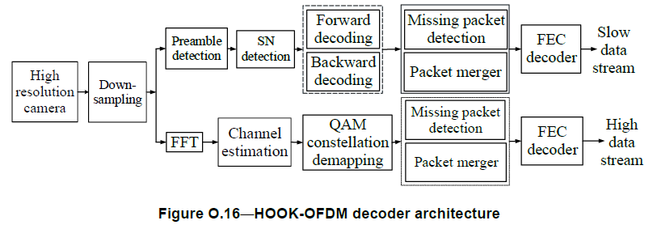
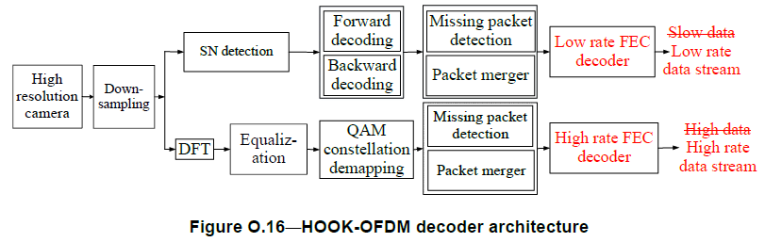
CID# I-107 and I-108
“ Specify all of the changes in
Figure O.16 as shown in the previous slides ”
“REVISED”
The proposed changes say only that “Slow data stream” and
“High data stream” should be changed to “Low rate data stream”
and “High rate data stream”, respectively in Figure O.16.
“ Slow Low rate data stream ”
“ High rate data stream ”
Disappeared ?
What makes this change ?
What makes this change ?
p44 in the current D6 draft
p48 in the current D7 redline
The changes in the draft cannot be done without any disposition details or proposed changes.
If you find other things that you need to change in Figure O.16, the disposition status should be changed from “ACCEPTED” to “REVISED” and “what” is changed to “what” and “what” is deleted should be specified in the disposition details.

Slide 16
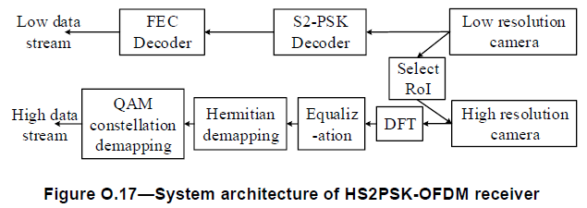
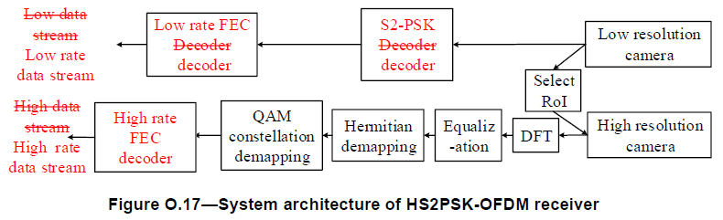
CID# I-111
For I-111,
“REVISED”
See the comments, I-109 and I-110.
Change “FEC Decoder” in the low rate data stream to “Low rate FEC decoder” in Figure O.17.
Insert “High rate FEC decoder” after “QAM constellation demapping” in the high rate data stream in Figure O.17.
The changes in this part are different from the proposed change for I-111.
“ FEC Decoder
Low rate FEC decoder ”
I-112
What makes this changes ?
“Disposition detail” on these changes is not found.
p45 in the current D6 draft
I-109 and I-110
p49 in the current D7 redline
For synchronizing the changes between the comment resolution and the draft change, the disposition status for I-111 should be changed from “ACCEPTED” to “REVISED” and “what” is changed to “what” should be specified in the disposition details like this to satisfy the comment resolution guidelines.

Slide 17
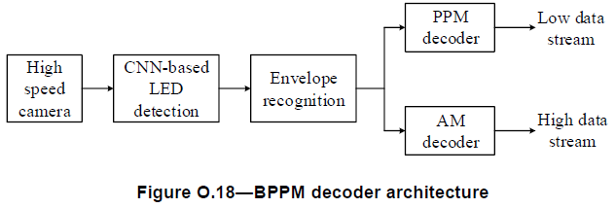
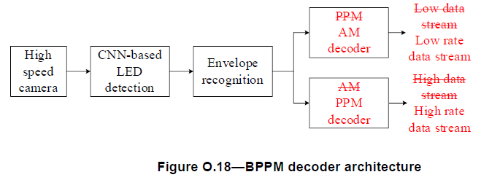
CID# I-113
Change “Low data stream” to “Low rate data stream” in Figure O.18.
Change “PPM decoder” to “AM decoder” in Figure O.17.
Change “AM decoder” to “PPM decoder” in Figure O.17.
“REVISED”
What makes this changes ?
“Disposition detail” on these changes is not found.
For I-113,
“ PPM AM decoder ”
“ AM PPM decoder ”
p45 in the current D6 draft
I-113 and I-114
p49 in the current D7 redline
For synchronizing the changes between the comment resolution and the draft change, the disposition status for I-113 should be changed from “ACCEPTED” to “REVISED” and “what” is changed to “what” should be specified in the disposition details like this to satisfy the comment resolution guidelines.

Slide 18
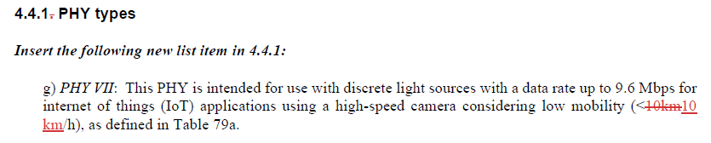

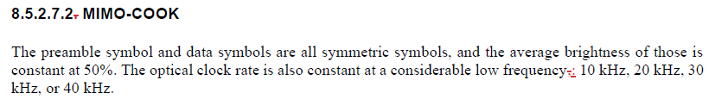
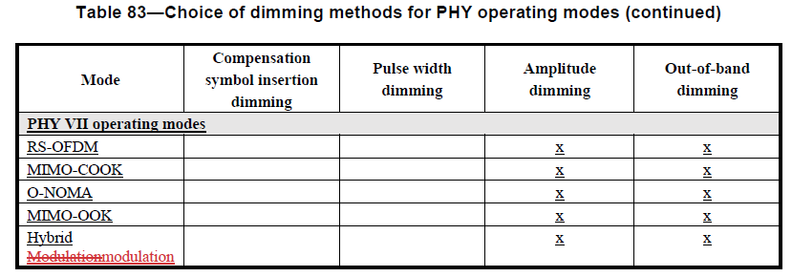
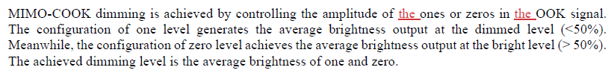

Changes #1 without regard to the comment resolution
p14 in the current D7 redline
p17 in the current D7 redline
p22 and p23in the current D7 redline
p22 in the current D7 redline
p23 in the current D7 redline
The changes in the current D7 redline shown above have nothing to do with the comment resolution for the initial SA ballot comments.
Thus, if they are needed, then make the comments for these changes in the next recirculation. Do not change them at this stage.

Slide 19
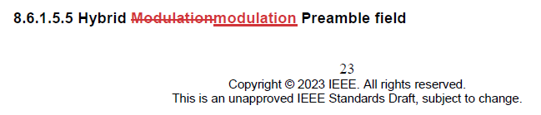
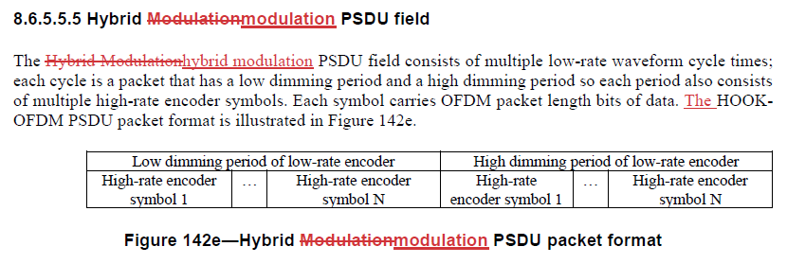

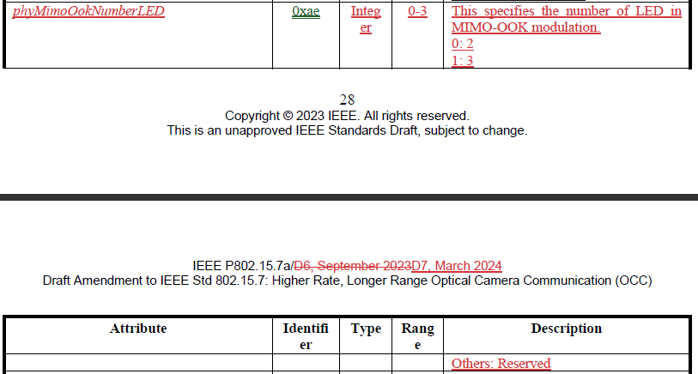
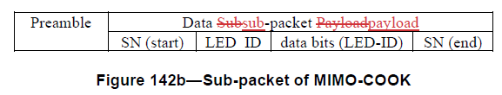
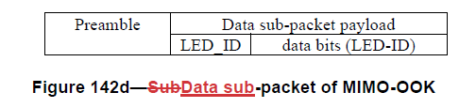
Changes #2 without regard to the comment resolution
p23 and p24 in the current D7 redline
p26 in the current D7 redline
p25 in the current D7 redline
Table 115 on p28 and p29 in the current D7 redline
The changes in the current D7 redline shown above have nothing to do with the comment resolution for the initial SA ballot comments.
Thus, if they are needed, then make the comments for these changes in the next recirculation. Do not change them at this stage.

Slide 20
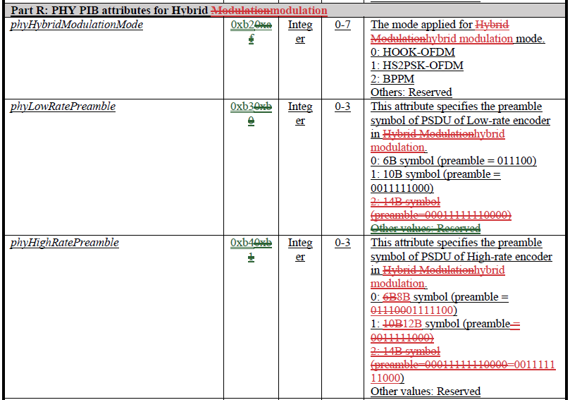
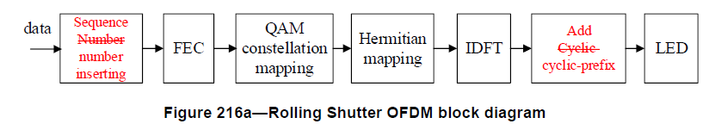
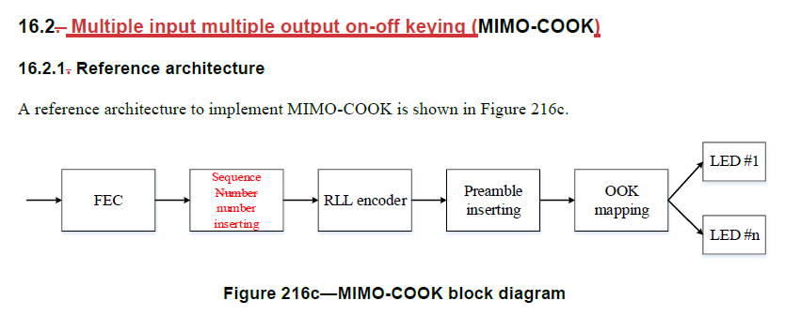
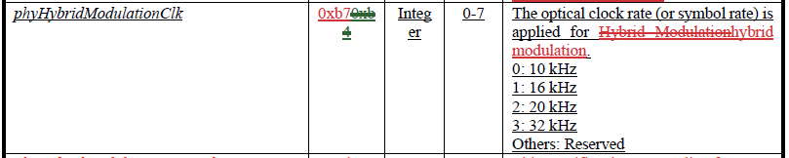

Changes #3 without regard to the comment resolution
Table 115 on p29 and p30 in the current D7 redline
p31 in the current D7 redline
p32 and p36 in the current D7 redline
The changes in the current D7 redline shown above have nothing to do with the comment resolution for the initial SA ballot comments.
Thus, if they are needed, then make the comments for these changes in the next recirculation. Do not change them at this stage.

Slide 21
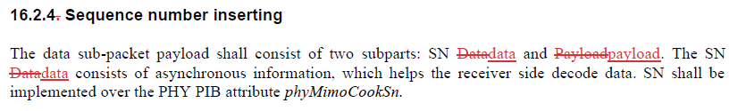
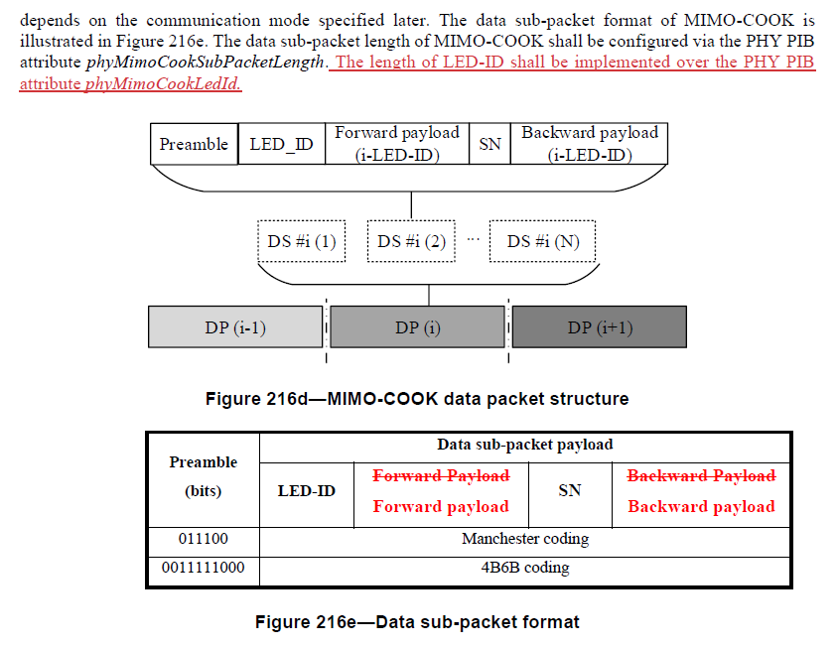
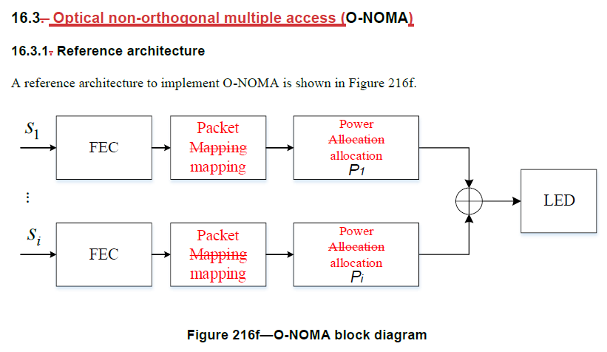
Changes #4 without regard to the comment resolution
p33 in the current D7 redline
p33 in the current D7 redline
p34 in the current D7 redline
The changes in the current D7 redline shown above have nothing to do with the comment resolution for the initial SA ballot comments.
Thus, if they are needed, then make the comments for these changes in the next recirculation. Do not change them at this stage.

Slide 22
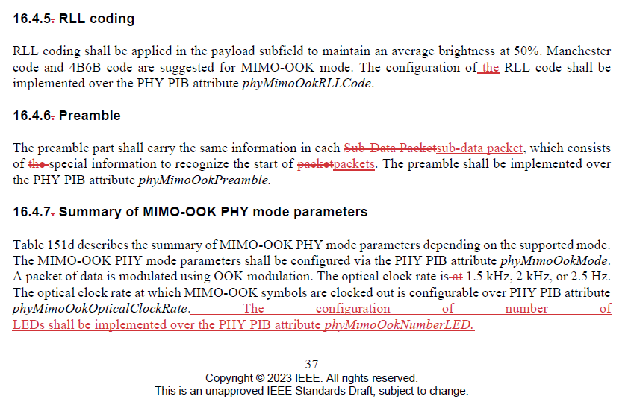

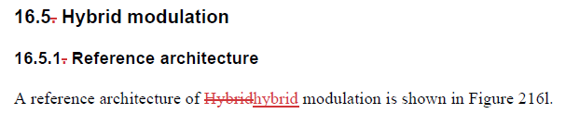
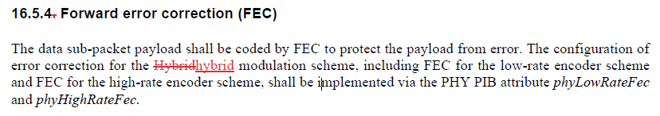
Changes #5 without regard to the comment resolution
p37 in the current D7 redline
p38, p39, and p40 in the current D7 redline
p38 and p41 in the current D7 redline
The changes in the current D7 redline shown above have nothing to do with the comment resolution for the initial SA ballot comments.
Thus, if they are needed, then make the comments for these changes in the next recirculation. Do not change them at this stage.

Slide 23
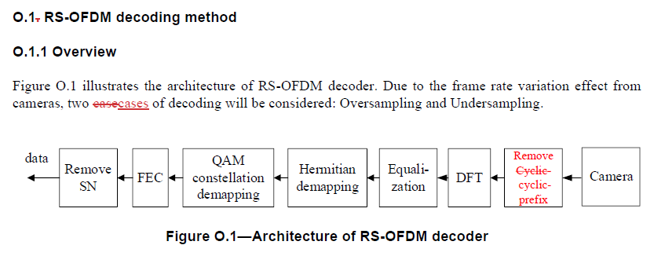
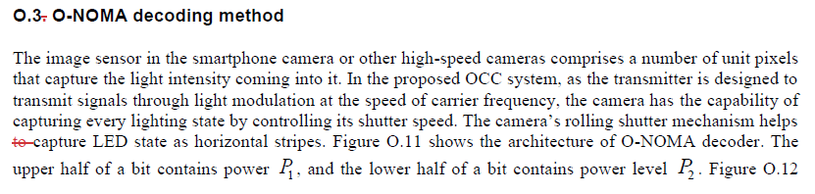
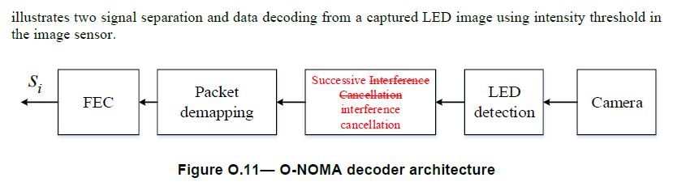
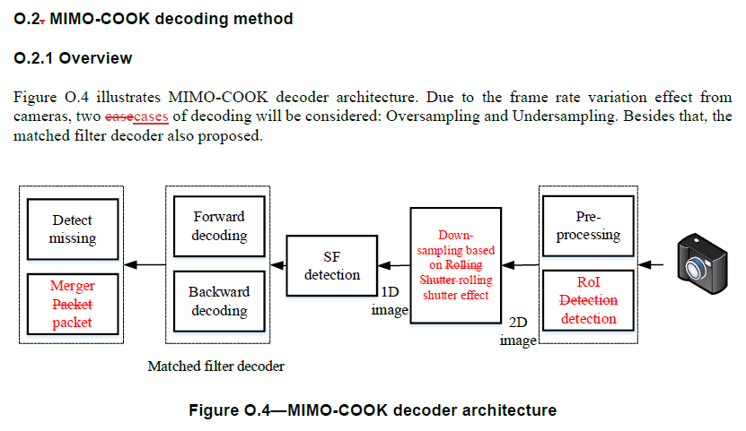
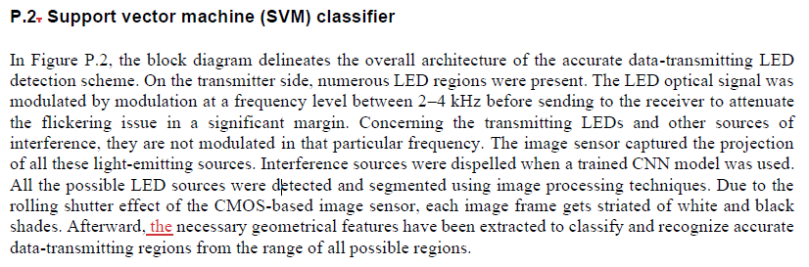
Changes #6 without regard to the comment resolution
p42 in the current D7 redline
p46 and p47 in the current D7 redline
p43 in the current D7 redline
c
p51 in the current D7 redline
The changes in the current D7 redline shown above have nothing to do with the comment resolution for the initial SA ballot comments.
Thus, if they are needed, then make the comments for these changes in the next recirculation. Do not change them at this stage.

