Slide 1
Project: IEEE P802.15 Working Group for Wireless Specialty Networks (WSN)
Submission Title: Discussion issues on the initial SA Ballot comment resolution for CIDs I-51 to I-92 (doc. 15-24-0072-12-007a) and IEEE P802.15.7a D7 redline draft
Date Submitted: May 06, 2024
Source: Sang-Kyu Lim [ETRI]
Address: 218 Gajeong-ro, Yuseong-gu, Daejeon, 34129, Korea
Voice:[+82-42-860-1573], FAX: [+82-42-860-5218], E-Mail:[sklim@etri.re.kr]
Re:
Abstract: This document is to resolve the initial SA ballot comments and to update IEEE P802.15.7a draft
Purpose: Contribution to IEEE P802.15.7a
Notice: This document has been prepared to assist the IEEE P802.15. It is offered as a basis for discussion and is not binding on the contributing individual(s) or organization(s). The material in this document is subject to change in form and content after further study. The contributor(s) reserve(s) the right to add, amend or withdraw material contained herein.
Release: The contributor acknowledges and accepts that this contribution becomes the property of IEEE and may be made publicly available by P802.15.

Slide 2
Discussion issues on the initial SA Ballot
comment resolution for CIDs I-51 to I-92
(doc. 15-24-0072-12-007a)
and IEEE P802.15.7a D7 redline draft
Sang-Kyu Lim [ETRI]

Slide 3
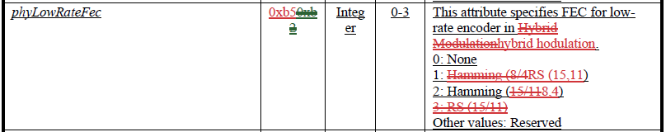
CID# I-51, I-52, and I-53
This attribute specifies FEC for low-rate encoder in Hybrid Modulation.
0: None
1: Hamming (8,4)
2: RS (15,11)
Other values: Reserved
So many changes corrected in “green” are shown in Table 115.
What does it mean ?
Check them again in Table 115.
The proposed changes for I-51, I-52, and I-53 do not match exactly the changes in D7 redline. So, we need to check again their comment resolutions and D7 draft.

Slide 4


CID# I-54, I-55, and I-56
This attribute specifies FEC for high-rate encoder in Hybrid Modulation.
0: None
1: Hamming (8,4)
2: RS (15,11)
The proposed changes for I-54, I-55, and I-56 do not match exactly the changes in D7 redline. So, we need to check again their comment resolutions and D7 draft.

Slide 5
CID# I-58, I-59, I-60, and I-61
Change all of the sub-clause numbering style from “x.y.” to “x.y”. See CID-36.
Change all of the sub-clause numbering style from “x.y.” to “x.y”. See CID-36.
Change all of the sub-clause numbering style from “x.y.” to “x.y”. See CID-36.
Change all of the sub-clause numbering style from “x.y.” to “x.y”. See CID-36.
It’s better if the disposition details in these comments are changed like this because the same comment, CID-36, has been resolved.

Slide 6
CID# I-65
Change the power levels for Mode 2
in Table 151c from “2” to “3”.
See the comment, I-45.
It’s better if the disposition detail in this comment is changed like this in order to clarify the changes in Table 151c, which means “what” has been changed to “what”.

Slide 7
CID# I-66
See the comment, I-48.
Change “FEC” to “Outer FEC” in Table 151d.
Change “Hamming (15,11)” to “RS (15,11)” in Table 151d.
Change “RS (15,11)” to “RS (15,7)” in Table 151d.
Add a new line for “Inner FEC” with “CC (1,4) for Mode 1, CC (1,3) for Mode 2, and CC (1,4) for Mode 3” to Table 151d.
It’s better if the disposition detail in this comment is changed like this because the changes in 16.4.3 and Table 115 have also been done for I-48 comment.

Slide 8
CID# I-67
“See the comments, I-48 and I-66.”
It’s better if the disposition detail in this comment is changed like this because the changes in 16.4.3, Table 115, and Table 151d have already been done for I-48 and I-66 comments.

Slide 9
CID# I-68
“See the comments, I-48 and I-66.”
It’s better if the disposition detail in this comment is changed like this because the changes in 16.4.3, Table 115, and Table 151d have already been done for I-48 and I-66 comments.

Slide 10
CID# I-69
“See the comments, I-48 and I-66.”
It’s better if the disposition detail in this comment is changed like this because the changes in 16.4.3, Table 115, and Table 151d have already been done for I-48 and I-66 comments.

Slide 11
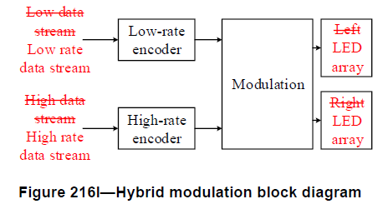
CID# I-71 and I-72
Change “High data stream” to "High rate data stream" in Figure 216l.
Change “Low data stream” to “Low rate data stream" in Figure 216l.
Change “Left LED array” to “LED array" in Figure 216l.
Change “Right LED array” to “LED array" in Figure 216l.
“REVISED”
The proposed changes say only that “High data stream” and
“Low data stream” should be changed to “High rate data stream”
and “Low rate data stream”, respectively.
What makes this change ?
p38 in the current D7 draft
Thus, if you want to change other things in Figure 216l, the disposition status should be changed from “ACCEPTED” to “REVISED” and “what” is changed to “what” should be specified in the disposition details like this.

Slide 12
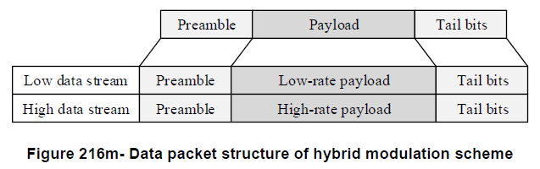
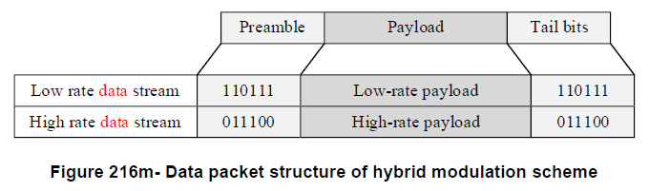
CID# I-73 and I-74
The proposed changes say only that “High data stream” and
“Low data stream” should be changed to “High rate data stream”
and “Low rate data stream”, respectively in Figure 216m.
“rate data”
What makes this change ?
p35 in the current D6 draft
p38 in the current D7 redline
Thus, if you want to change other things in Figure 216m, the disposition status should be changed from “ACCEPTED” to “REVISED” and “what” is changed to “what” should be specified in the disposition details.

Slide 13
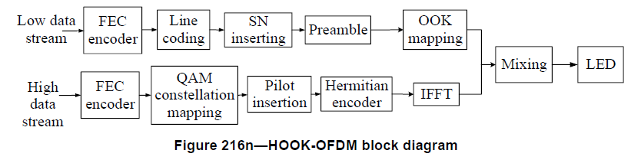
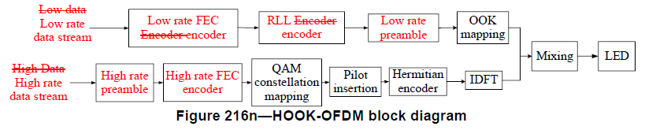
CID# I-76 and I-77
“ Low data stream Low rate data stream ”
“ High data stream High rate data stream ”
p36 in the current D6 draft
p39 in the current D7 redline
If the proposed change for this comment is “ACCEPTED”, the changes for this comment in the redline draft should be shown like this to satisfy the comment resolution guidelines.

Slide 14
CID# I-78 and I-79
“ Low rate FEC encoder ”
“ High rate FEC encoder ”
p39 in the current D7 redline
p36 in the current D6 draft
If the proposed change for this comment is “ACCEPTED”, the changes for this comment in the redline draft should be shown like this to satisfy the comment resolution guidelines.

Slide 15
CID# I-80
“Why has it been deleted in D7 redline ?”
“ Line coding RLL encoder ”
p36 in the current D6 draft
What makes this change ?
p39 in the current D7 redline
If the proposed change for this comment is “ACCEPTED”, the changes for this comment in the redline draft should be shown like this to satisfy the comment resolution guidelines.
If you want to change other things in Figure 216n, the disposition status should be changed from “ACCEPTED” to “REVISED” and “what” is changed to “what” should be specified in the disposition details.

Slide 16
CID# I-81
“ Preamble Low rate preamble ”
p36 in the current D6 draft
p39 in the current D7 redline
If the proposed change for this comment is “ACCEPTED”, the changes for this comment in the redline draft should be shown like this to satisfy the comment resolution guidelines.

Slide 17
CID# I-82
Insert “High rate preamble” ahead of
“High rate FEC encoder”
in Figure 216n.
See the comment, I-79.
“REVISED”
p36 in the current D6 draft
p39 in the current D7 redline
The disposition status should be changed to “REVISED” and the disposition detail should be shown like this to satisfy the comment resolution guidelines.

Slide 18
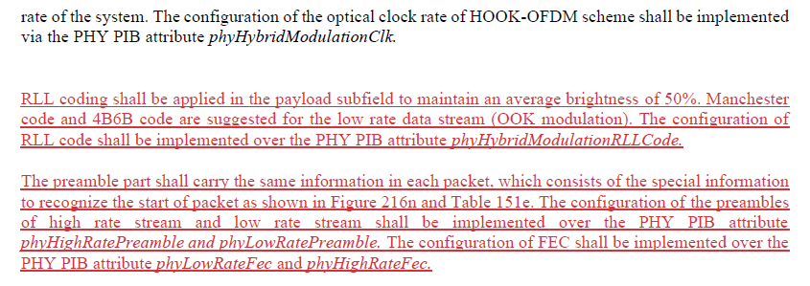
CID# I-83
“See the comment, I-50.”
16.5.3.1 on p39 in the current D7 redline
It’s better if the disposition detail on this comment is changed like this because the changes in 16.5.3.1 have already been done for I-50 comment.
In addition, the texts in the disposition detail on this comment do not match exactly the changes in 16.5.3.1 of D7 redline.
Anyway, “See the comment, I-50.” is good enough for the disposition detail because the changes in 16.5.3.1 have already been done for I-50 comment.

Slide 19
CID# I-84
Delete it because the comment says about Table 151e.
Table 151e on p39 in the current D7 redline
Add a new list for “Preamble” to Table 151e.
Put “6 bits (low rate data stream)” and “8 bits (high rate data stream)” to the preamble for Mode 1.
Put “10 bits (low rate data stream)” and “12 bits (high rate data stream)” to the preamble for Mode 2.
The disposition detail on this comment and Table 151e related to this comment in D7 redline should be changed like this in order to clarify the changes.

Slide 20
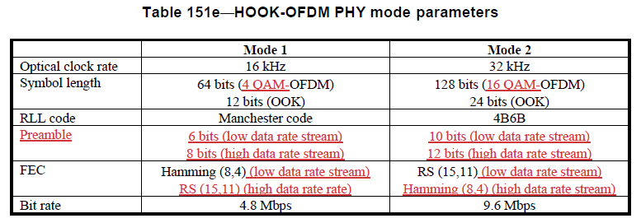
CID# I-85
Change the symbol length for Mode 1 in Table 151e from “64 bits (OFDM)” to “64 bits (4 QAM-OFDM)”.
Change the symbol length for Mode 2 in Table 151e from “128 bits (OFDM)” to “128 bits (16 QAM-OFDM)”.
Table 151e on p39 in the current D7 redline
The disposition detail on this comment should be changed like this in order to clarify the changes in Table 151e, which means “what” has been changed to “what”.

Slide 21
CID# I-86
Change the FEC for Mode 1 in Table 151e from “Hamming (8,4)” to “Hamming (8,4) (low rate data stream)”.
Add “RS (15,11) (high rate data stream)” to the FEC for Mode 1 in Table 151e.
Change the FEC for Mode 2 in Table 151e from “RS (15,11)” to “RS (15,11) (low rate data stream)”.
Add “Hamming (8,4) (high rate data stream)” to the FEC for Mode 2 in Table 151e.
Table 151e on p39 in the current D7 redline
FEC
Hamming (8,4) (low rate data stream)
RS (15,11) (high rate data stream)
RS (15,11) (low rate data stream)
Hamming (8,4) (high rate data stream)
The disposition detail on this comment should be changed like this in order to clarify the changes in Table 151e, which means “what” has been changed to “what”.
Table 151e related to this comment in D7 redline should be changed like this.

Slide 22
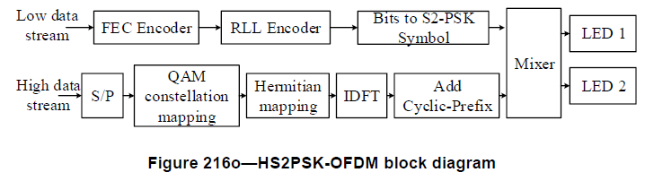
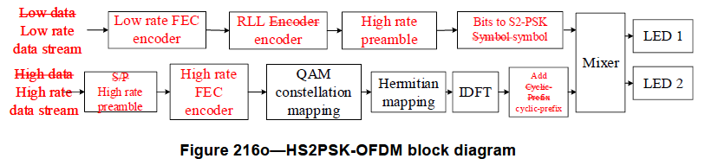
CID# I-87 and I-88
“ Low data stream Low rate data stream ”
“ High data stream High rate data stream ”
p36 in the current D6 draft
p40 in the current D7 redline
If the proposed change for this comment is “ACCEPTED”, the changes for this comment in the redline draft should be shown like this to satisfy the comment resolution guidelines.

Slide 23
CID# I-89
“REVISED”
Insert “High rate FEC encoder” ahead of “QAM constellation mapping” into “High rate data stream” in Figure 216o.
p36 in the current D6 draft
p40 in the current D7 redline
The disposition status should be changed to “REVISED” and the disposition detail should be shown like this to satisfy the comment resolution guidelines.

Slide 24
CID# I-90
“ Low rate FEC encoder ”
p36 in the current D6 draft
p40 in the current D7 redline
If the proposed change for this comment is “ACCEPTED”, the changes for this comment in the redline draft should be shown like this to satisfy the comment resolution guidelines.

Slide 25
CID# I-91
The proposed changes do not say that “Bits to S2-PSK Symbol” and
“Add Cyclic-Prefix” should be changed in Figure 216o.
“REVISED”
Change “RLL Encoder” to “RLL encoder” in Figure 216o.
Change “Bits to S2-PSK Symbol” to “Bits to S2-PSK symbol” in Figure 216o.
Change “Add Cyclic-Prefix” to “Add cyclic-prefix” in Figure 216o.
“ RLL Encoder encoder ”
What makes this change ?
What makes this change ?
p36 in the current D6 draft
p40 in the current D7 redline
If the proposed change for this comment is “ACCEPTED”, the changes for this comment in the redline draft should be shown like this to satisfy the comment resolution guidelines.
If you want to change other things in Figure 216o, the disposition status should be changed from “ACCEPTED” to “REVISED” and “what” is changed to “what” should be specified in the disposition details.

Slide 26
CID# I-92
See the comment, I-91.
Insert “Low rate preamble” between “RLL encoder” and “Bits to S2-PSK symbol” for low rate data stream in Figure 216o.
Replace “S/P” by “High rate preamble” for high rate data stream in Figure 216o.
“REVISED”
“ Low rate preamble ”
p36 in the current D6 draft
p40 in the current D7 redline
“High rate preamble” shown on the low rate data stream in D7 redline should be changed to “Low rate preamble”.
The disposition status should be changed from “ACCEPTED” to “REVISED” and “what” is changed to “what” should be specified in the disposition details like this to satisfy the comment resolution guidelines.

