Slide 1
Project: IEEE P802.15 Working Group for Wireless Personal Area Networks (WPANs)
Submission Title: Response to Coex SC 11-24/360r4 (Proposed Way Forward on LBT)
Source: Carlos Aldana (Meta), Pooria Pakrooh (Qualcomm), Gaurav Patwardhan (HPE), Guoqing Li (Meta), Bin Tian (Qualcomm), Connor Kennedy (Meta), Davide Magrin (Meta), Kumail Haider (Meta)
Address : [1 Hacker Way, Menlo Park, CA 94025]
E-Mail: [caldana, guoqingli, connork, davidmagrin, haiderkumail (at) meta.com, ppakroo, btian (at) qti.qualcomm.com, gauravpatwardhan1 (at) gmail.com]
Re: Study Group 4ab: UWB Next Generation
Abstract: [This provides a way forward on LBT discussion]
Purpose: [Suggests a way forward to improve coexistence]
Notice: This document has been prepared to assist the IEEE P802.15. It is offered as a basis for discussion and is not binding on the contributing individual(s) or organization(s). The material in this document is subject to change in form and content after further study. The contributor(s) reserve(s) the right to add, amend or withdraw material contained herein.
Release: The contributor acknowledges and accepts that this contribution becomes the property of IEEE and may be made publicly available by P802.15.
Notes:
Jul 12, 2010
Page 1

Slide 2
Background
In 11-24-148, there are simulation results from multiple sources (Stuart from Apple, Menzo from Qualcomm, Ratnesh from Intel, Sebastian from Ericsson, Meta) provided. Conclusion from this work is that NB should adopt a mandatory coex mechanism to enable shared use of the spectrum and adequate performance for both 802.11 and NB. This mandatory mechanism should consist of one or more of LBT or other techniques.
  It includes both NBFH/NBFH and NB-UWB/NBFH simulation results from 11-23-1279 that show that LBT performs better than no-LBT.
In 11-24-360r4 (coauthored by 8 individuals from Meta, BCA, Qualcomm, Cisco, Intel, HPE, and Mediatek), a recommendation is made to make either CCA mode 1 or SSBD with a provided set of parameters mandatory for NB-Data and NBA-MMS transmissions.
There are multiple outstanding LBT related comments (40, 76, 276, 277, 278, 279, 280) in 802.15.4ab Draft C that can be resolved via this contribution.
Slide 2

Slide 3
Abstract
This submission provides a response to Coex SC document 11-24-360r4, which had this as way forward:
For both NB-Data and NBA-MMS described 802.15.4ab Sections 10.43 and 10.38, CCA mode 1, is the mandatory channel access mechanism with the following parameters:
  ED threshold value of TBD dBm/MHz
  TBD phyCCADuration value between 14-25 us
  probability of detection > = 90%
Alternatively, if SSBD is the preferred mandatory channel access mechanism, in addition to the 3 parameters listed above, these additional SSBD parameters shall be used:
  macSsbdMaxBackoffs = 0
  macSsbdPersistence = 0
  macSsbdTxOnEnd = False
  macSsbdUnitBackoffPeriod = 1 (microsecond)
  macSsbdMinBf and macSsbdMaxBf = 1

Slide 4

Background: NBA-MMS (10.38) with optional LBT
1ms
Initiator
NB
Poll
UWB
UWB
UWB
UWB
UWB
UWB
UWB
NB
Report 2
NB
Resp
UWB
UWB
UWB
UWB
UWB
UWB
UWB
NB
Report 1
Responder
Section 10.38.8.3
Optional
Slide 4

Slide 5
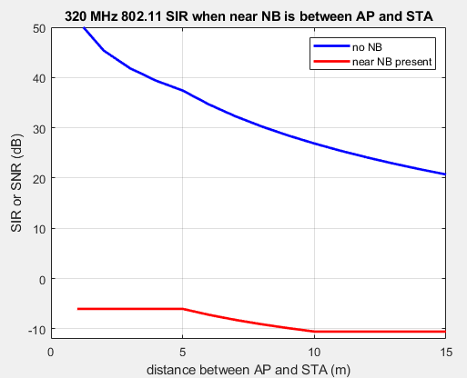
NB Effect on 802.11
Assume 802.11 AP is 5m/10m from STA and 14dBm for all devices
Wi-Fi signals comes in at -49/-59 dBm using 802.11 AWGN channel model with dbp=5
802.11 needs SINR >= 4 dB => NB needs to come in < -53 dBm/-63 dBm
Both AP and STA experience SINR < -6 dB from close NB,
regardless of the value of d1 or Wi-Fi BW!
Far NB at least 7m/13m away from 802.11 devices results in reasonable SINR
802.11 can succeed if NB uses LBT
d1
d1
AP
NB
STA
d3
d
NB
Slide 5

Slide 6
NB ED threshold
Given that NB devices that are within 7m/13m away from Wi-Fi should defer, we now look at what happens when different BW Wi-Fi is transmitting at 14dBm. If we use -75 dBm/MHz, 2.5 MHz results in EDT=-71 dBm.
BW (MHz) | 40 | 80 | 160 | 320
Wi-Fi dBm at 7m seen by NB | -66 | -69 | -72 | -75
Wi-Fi dBm at 13m seen by NB | -75 | -78 | -81 | -84
The -75dBm/MHz ED threshold is 13dB too high
Propose ED threshold value of <= -80 dBm/MHz
NOTE: there is a 2dB Path loss difference between 5.18 GHz and 6.4 GHz ED Threshold should reflect this

Slide 7
802.11 Effect on NB
Assume NB devices are d=20m away and 14dBm EIRP for all devices
NB needs SINR of ~ 10 dB
Near NB needs 802.11 to defer and 802.11 does since NB signal is received at -43 dBm
802.11 has no effect on far NB since NB filters out most of 802.11 signal by ~802_11_BW_MHz/2.5 = 12/15/18/21 dB for 40/80/160/320 MHz
NB succeeds because 802.11 uses LBT
2.5
2.5
AP
NB
STA
d
SINR (dB) for far NB | 40 | 80 | 160 | 320
Far | 12 | 15 | 18 | 21
NB
Slide 7

Slide 8
A closer look at 802.11 spec
Slide 8

Slide 9
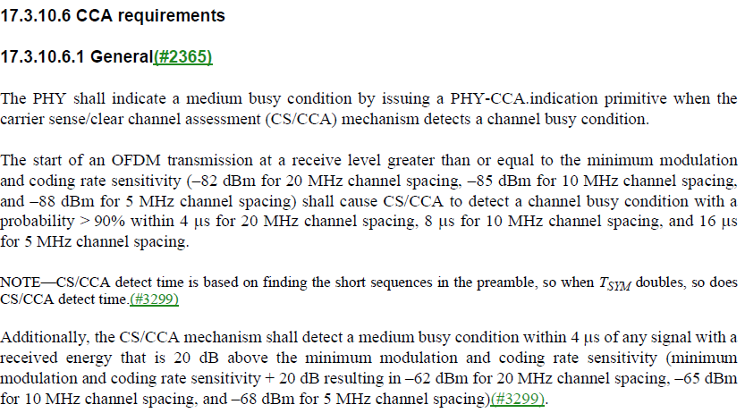
802.11 Coex PD (preamble detect) and ED (Energy Detect) Requirements
A possible example of the use of ED is when a video call in 2.4 GHz is interrupted when the microwave (fc ~ 2.45 GHz) oven is turned on.
PD
802.11a/g
ED
Slide 9

Slide 10
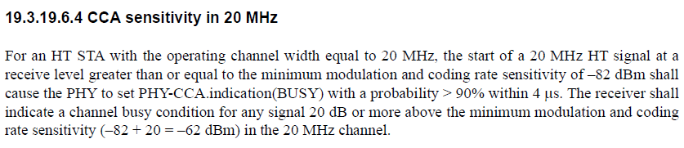
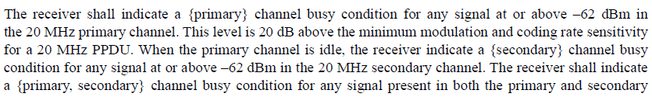
HT (802.11n) CCA Requirements
How about secondary 20?
Slide 10

Slide 11
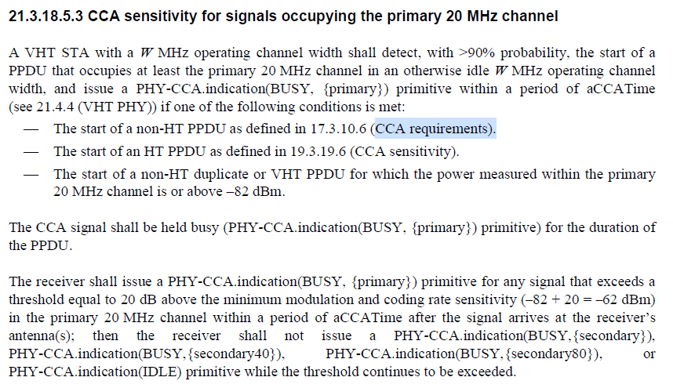
VHT (802.11ac) CCA Requirements
Slide 11

Slide 12
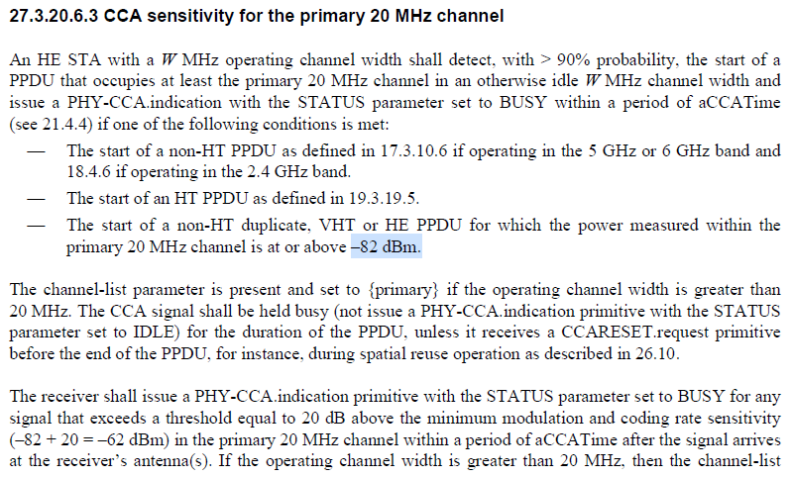
802.11ax CCA Requirements
Slide 12

Slide 13
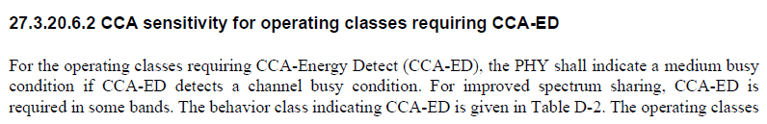

Additional Text in 802.11ax
Slide 13

Slide 14
802.11 ED and PD Threshold
Energy Detect (ED) Threshold set to -75 dBm/MHz (ETSI EN 303687 and IEEE 802.11 17.3.10.6) : shown by orange circle
Packet Detect (PD) Threshold set to -82 dBm (IEEE 802.11) : shown by purple circle
PD
ED
802.11
802.11ax
Rules for any signal (802.11 or NB) Present
ED threshold of -62 dBm for PRI20
ED threshold of -62 dBm for SEC20
ED threshold of -59 dBm for SEC40
ED threshold of -56 dBm for SEC80
Slide 14

Slide 15
Proposed Way Forward
For all NB transmissions in UNII-3 and UNII-5, CSMA-CA, as described in 6.3.2.1 (in IEEE P802.15.4me/D03), with macMinBe = 0, macMaxCsmaBackoffs = 0, and CCA mode 1 shall be used as the channel access mechanism before every transmission with the following additional parameters:
    ED threshold value of TBD dBm/MHz (e.g., -80 dBm/MHz for UNII-3 and -88 dBm/MHz for UNII-5)
    TBD phyCCADuration value between 14-25 us (e.g., 16us)
    probability of detection = 100%
    If CSMA-CA algorithm ends in “Success”, the transmission occurs within 1-2us duration.
Slide 15

Slide 16
Strawpoll 1 (not Duty Cycle based)
We agree to add the following text to describe NB-Data and NBA-MMS channel access mechanism:
For all NB transmissions in UNII-3 and UNII-5, CSMA-CA, as described in 6.3.2.1 (in IEEE P802.15.4me/D03), with macMinBe = 0, macMaxCsmaBackoffs = 0, and CCA mode 1 shall be used as the channel access mechanism before every transmission with the following additional parameters:
    ED threshold value of TBD dBm/MHz (e.g., <= -80 dBm/MHz for both UNII-3 and UNII-5)
    TBD phyCCADuration value between 14-25 us (e.g., 16us)
    probability of detection = 100%
    If CSMA-CA algorithm ends in “Success”, the transmission occurs within 1-2us duration.

Slide 17
Strawpoll 2 (Duty Cycle based)
We agree to add the following text to describe NB-Data and NBA-MMS channel access mechanism:
A NB capable device operating in UNII-3 or UNII-5 band shall measure its NB transmission duty cycle, which is defined as the maximum ratio of the total NB transmission duration divided by any 100 ms observation window.
For a NB capable device, if its NB operating duty cycle is more than 2.5%, it shall perform listen-before-talk (LBT) before any NB transmission. Otherwise, LBT is optional.

Slide 18
Appendix
Slide 18

Slide 19
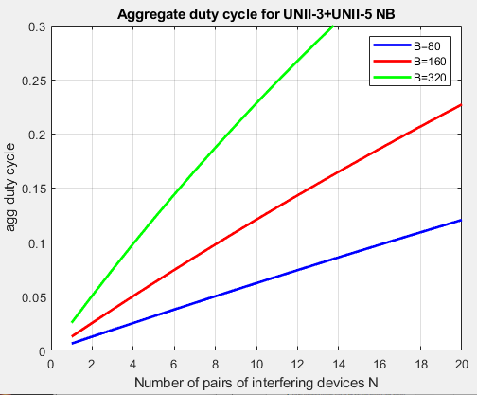
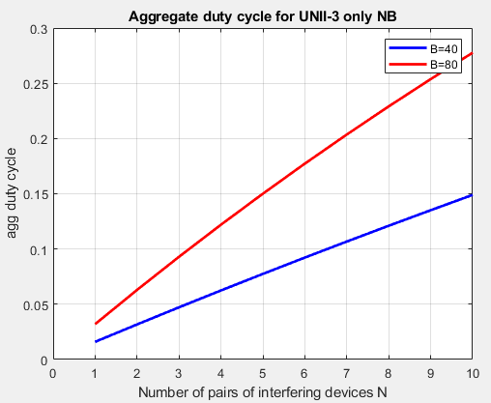
Number of NB Devices and Aggregate Duty cycle
When N pairs of narrowband transmitting UWB devices are freely hopping using total bandwidth of W MHz, each pair with duty cycle x, the aggregate duty cycle on any B MHz channel is given by 1-(1-x*B/W)^{N}
~10% aggregate duty cycle is reached on a single 320/160/80 MHz 802.11 channel when x=5% (2.5% per device) duty cycle with 4/8/16 (UNII-3 + UNII-5) NB pairs of interfering devices
~10% aggregate duty cycle is reached on a single 80/40 MHz 802.11 channel when x=5% (2.5% per device) duty cycle with 3/6 (UNII-3 only) NB pairs of interfering devices
W=625 MHz
W=125 MHz
Slide 19

Slide 20
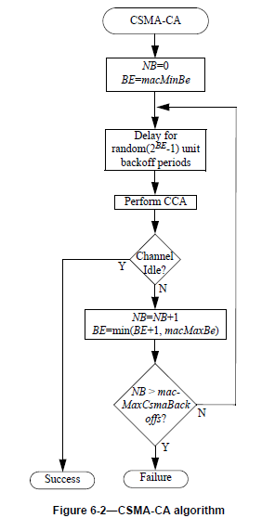
CSMA-CA (6.3.2.1)
BE = backoff exponent
If macMinBe set to 0, collision avoidance is disabled during first iteration.

