Slide 1
Project: IEEE P802.15 Working Group for Wireless Personal Area Networks (WPANs)
Submission Title: Response to Coex SC 11-24/360r4 (Proposed Way Forward on LBT)
Source: Carlos Aldana (Meta), Pooria Pakrooh (Qualcomm), Mingyu Lee (Samsung), Guoqing Li (Meta), Bin Tian (Qualcomm), Connor Kennedy (Meta), Davide Magrin (Meta), Kumail Haider (Meta)
Address : [1 Hacker Way, Menlo Park, CA 94025]
E-Mail: [caldana, guoqingli, connork, davidmagrin, haiderkumail (at) meta.com, ppakroo, btian (at) qti.qualcomm.com, mg0218.lee@samsung.com ]
Re: Study Group 4ab: UWB Next Generation
Abstract: [This provides a way forward on LBT discussion]
Purpose: [Suggests a way forward to improve coexistence]
Notice: This document has been prepared to assist the IEEE P802.15. It is offered as a basis for discussion and is not binding on the contributing individual(s) or organization(s). The material in this document is subject to change in form and content after further study. The contributor(s) reserve(s) the right to add, amend or withdraw material contained herein.
Release: The contributor acknowledges and accepts that this contribution becomes the property of IEEE and may be made publicly available by P802.15.
Notes:
Jul 12, 2010
Page 1

Slide 2
Background
In 11-24-148, there are simulation results from multiple sources (Stuart from Apple, Menzo from Qualcomm, Ratnesh from Intel, Sebastian from Ericsson, Meta) provided. Conclusion from this work is that NB should adopt a mandatory coex mechanism to enable shared use of the spectrum and adequate performance for both 802.11 and NB. This mandatory mechanism should consist of one or more of LBT or other techniques.
  It includes both NBFH/NBFH and NB-UWB/NBFH simulation results from 11-23-1279 that show that LBT performs better than no-LBT.
In 11-24-360r4 (coauthored by 8 individuals from Meta, BCA, Qualcomm, Cisco, Intel, HPE, and Mediatek), a recommendation is made to make either CCA mode 1 or SSBD with a provided set of parameters mandatory for NB-Data and NBA-MMS transmissions.
There are multiple outstanding LBT related comments (40, 76, 276, 277, 278, 279, 280) in 802.15.4ab Draft C that can be resolved via this contribution.
Slide 2

Slide 3
Abstract
This submission provides a response to Coex SC document 11-24-360r4, which had this as way forward:
For both NB-Data and NBA-MMS described 802.15.4ab Sections 10.43 and 10.38, CCA mode 1, is the mandatory channel access mechanism with the following parameters:
  ED threshold value of TBD dBm/MHz
  TBD phyCCADuration value between 14-25 us
  probability of detection > = 90%
Alternatively, if SSBD is the preferred mandatory channel access mechanism, in addition to the 3 parameters listed above, these additional SSBD parameters shall be used:
  macSsbdMaxBackoffs = 0
  macSsbdPersistence = 0
  macSsbdTxOnEnd = False
  macSsbdUnitBackoffPeriod = 1 (microsecond)
  macSsbdMinBf and macSsbdMaxBf = 1

Slide 4

Background: NBA-MMS (10.38) with optional LBT
1ms
Initiator
NB
Poll
UWB
UWB
UWB
UWB
UWB
UWB
UWB
NB
Report 2
NB
Resp
UWB
UWB
UWB
UWB
UWB
UWB
UWB
NB
Report 1
Responder
Section 10.38.8.3
Optional
Slide 4

Slide 5
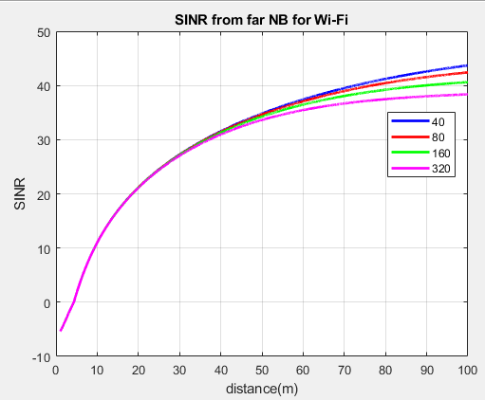
NB Effect on 802.11
Assume 802.11 AP is 5m from STA and 14dBm for all devices
802.11 needs SINR >= 4 dB.
Both AP and STA experience SIR ~ -6 dB from close NB.
Far NB that has d< 6m causes low SINR for both AP and STA
802.11 can succeed if NB uses LBT
2.5
2.5
AP
NB
STA
d
NB
Slide 5

Slide 6
802.11 Effect on NB
Assume NB devices are d=20m away and 14dBm EIRP for all devices
NB needs SINR of ~ 10 dB
Near NB needs 802.11 to defer and 802.11 does since NB signal is received at -43 dBm
802.11 has no effect on far NB since NB filters out most of 802.11 signal by ~802_11_BW_MHz/2.5 = 12/15/18/21 dB for 40/80/160/320 MHz
NB succeeds because 802.11 uses LBT
2.5
2.5
AP
NB
STA
d
SINR (dB) for far NB | 40 | 80 | 160 | 320
Far | 12 | 15 | 18 | 21
NB
Slide 6

Slide 7
A closer look at 802.11 spec
Slide 7

Slide 8
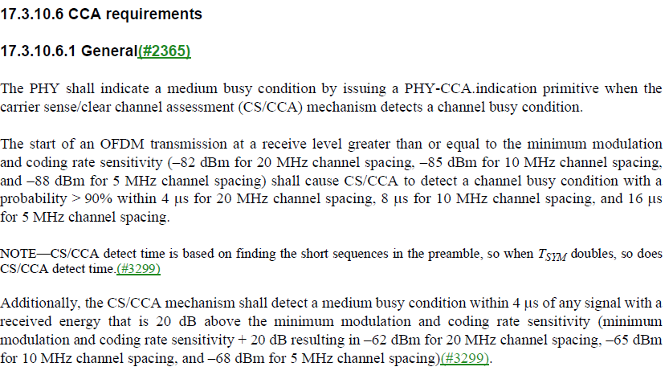
802.11 Coex PD (preamble detect) and ED (Energy Detect) Requirements
A possible example of the use of ED is when a video call in 2.4 GHz is interrupted when the microwave (fc ~ 2.45 GHz) oven is turned on.
PD
802.11a/g
ED
Slide 8

Slide 9
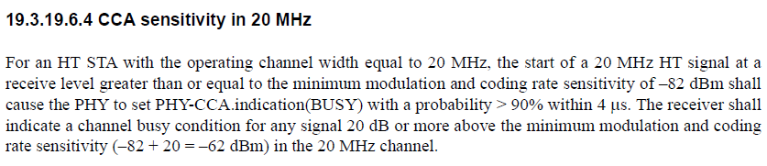
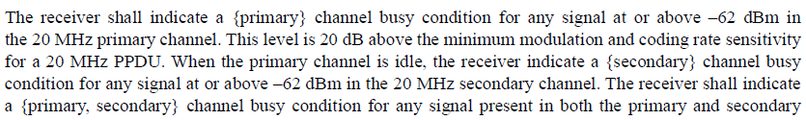
HT (802.11n) CCA Requirements
How about secondary 20?
Slide 9

Slide 10
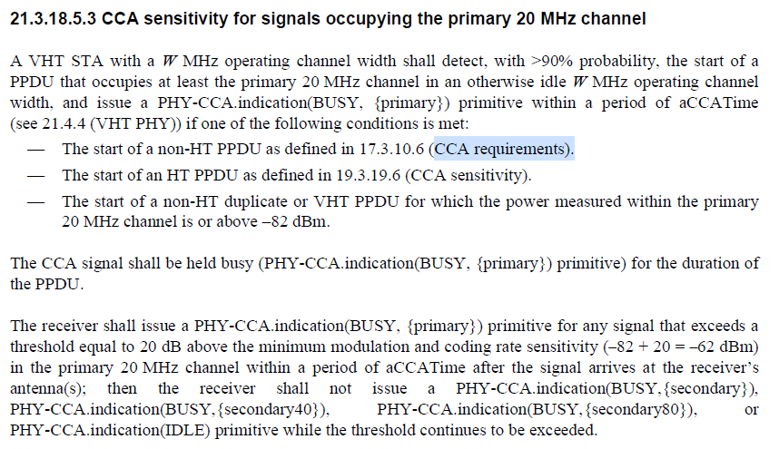
VHT (802.11ac) CCA Requirements
Slide 10

Slide 11
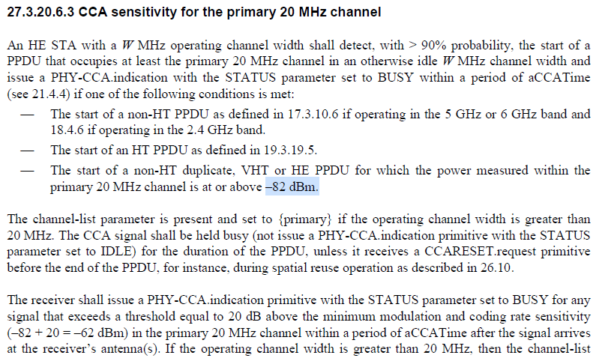
802.11ax CCA Requirements
Slide 11

Slide 12
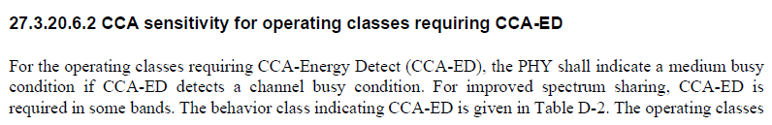

Additional Text in 802.11ax
Slide 12

Slide 13
802.11 ED and PD Threshold
Energy Detect (ED) Threshold set to -75 dBm/MHz (ETSI EN 303687 and IEEE 802.11 17.3.10.6) : shown by orange circle
Packet Detect (PD) Threshold set to -82 dBm (IEEE 802.11) : shown by purple circle
PD
ED
802.11
802.11ax
Rules for any signal (802.11 or NB) Present
ED threshold of -62 dBm for PRI20
ED threshold of -62 dBm for SEC20
ED threshold of -59 dBm for SEC40
ED threshold of -56 dBm for SEC80
Slide 13

Slide 14
Proposed Way Forward
For both NB-Data and NBA-MMS described 802.15.4ab Sections 10.43 and 10.38, CCA mode 1 shall be used as the channel access mechanism for both UNII-3 and UNII-5 with the following parameters:
  ED threshold value of TBD dBm/MHz (e.g., -80 dBm/MHz for UNII-4 and -75 dBm/MHz for UNII-3)
  TBD phyCCADuration value between 14-25 us (e.g., 16us)
  probability of detection = 100%
  If channel is sensed free via energy detect, transmit after macTsRxTx (?), or 1-2us, duration. If channel is sensed busy, do not transmit
Slide 14

Slide 15
Appendix
Slide 15

Slide 16
Possible Compromise for both 5 and 6 GHz
In 802.11-23/1259r1, it was shown that no-LBT NB transmissions with 1%, 3%, and 5% duty cycle increase the 802.11 P95 latency by 13%, 50%, and 400%, respectively.
Since for NB-MMS, the NB transmissions occupy ~1.5ms of airtime every 100ms per device for one-to-one ranging, a possible compromise is to allow for “no-LBT” transmissions for <= 2-3% duty cycle for each device. LBT shall be mandatory for duty cycles > 2-3%. The exact threshold value is TBD.
Slide 16

Slide 17
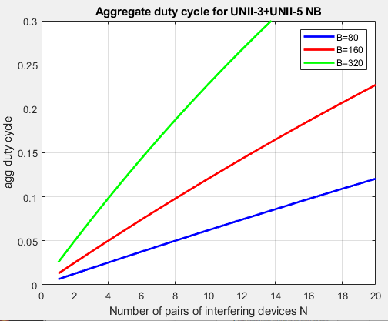
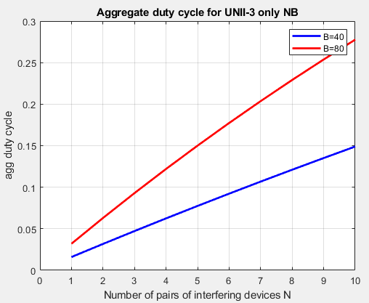
Number of NB Devices and Aggregate Duty cycle
When N pairs of narrowband transmitting UWB devices are freely hopping using total bandwidth of W MHz, each pair with duty cycle x, the aggregate duty cycle on any B MHz channel is given by 1-(1-x*B/W)^{N}
~10% aggregate duty cycle is reached on a single 320/160/80 MHz 802.11 channel when x=5% (2.5% per device) duty cycle with 4/8/16 (UNII-3 + UNII-5) NB pairs of interfering devices
~10% aggregate duty cycle is reached on a single 80/40 MHz 802.11 channel when x=5% (2.5% per device) duty cycle with 3/6 (UNII-3 only) NB pairs of interfering devices
W=625 MHz
W=125 MHz
Slide 17

