Slide 1
Project: IEEE P802.15 Working Group for Wireless Personal Area Networks (WPANs)
Submission Title: Response to Coex SC 11-24/360r3 (Proposed Way Forward on LBT)
Source: Carlos Aldana (Meta), Guoqing Li (Meta), Connor Kennedy (Meta), Davide Magrin (Meta), Kumail Haider (Meta)
Address : [1 Hacker Way, Menlo Park, CA 94025]
E-Mail: [caldana, guoqingli, connork, davidmagrin, haiderkumail (at) meta.com]
Re: Study Group 4ab: UWB Next Generation
Abstract: [This provides a way forward on LBT discussion]
Purpose: [Suggests a way forward to improve coexistence]
Notice: This document has been prepared to assist the IEEE P802.15. It is offered as a basis for discussion and is not binding on the contributing individual(s) or organization(s). The material in this document is subject to change in form and content after further study. The contributor(s) reserve(s) the right to add, amend or withdraw material contained herein.
Release: The contributor acknowledges and accepts that this contribution becomes the property of IEEE and may be made publicly available by P802.15.
Notes:
Jul 12, 2010
Page 1

Slide 2
Abstract
This submission provides a response to Coex SC document 11-24-360r3, which had this as way forward:
For both NB-Data and NBA-MMS described 802.15.4ab Sections 10.43 and 10.38, CCA mode 1, is the mandatory channel access mechanism with the following parameters:
  ED threshold value of TBD dBm/MHz
  TBD phyCCADuration value between 14-25 us
  probability of detection > = 90%
Alternatively, if SSBD is the preferred mandatory channel access mechanism, in addition to the 3 parameters listed above, these additional SSBD parameters shall be used:
  macSsbdMaxBackoffs = 0
  macSsbdPersistence = 0
  macSsbdTxOnEnd = False
  macSsbdUnitBackoffPeriod = 1 (microsecond)
  macSsbdMinBf and macSsbdMaxBf = 1

Slide 3
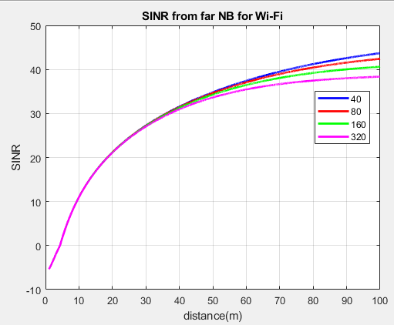
NB Effect on Wi-Fi
Assume Wi-Fi AP is 5m from STA and 14dBm for all devices
Wi-Fi needs SINR >= 4 dB.
Both AP and STA experience SIR ~ -6 dB from close NB.
Far NB that has d< 6m causes low SINR for both AP and STA
Wi-Fi can succeed if NB uses LBT
2.5
2.5
AP
NB
STA
d
NB
Slide 3

Slide 4
Wi-Fi Effect on NB
Assume NB devices are d=20m away and 14dBm EIRP for all devices
NB needs SINR of ~ 10 dB
Near NB needs Wi-Fi to defer and Wi-Fi does since NB signal is received at -43 dBm
Wi-Fi has no effect on far NB since NB filters out most of Wi-Fi signal by WiFi_BW_MHz/2.5 = 12/15/18/21 dB for 40/80/160/320 MHz
NB succeeds because Wi-Fi uses LBT
2.5
2.5
AP
NB
STA
d
SINR (dB) for far NB | 40 | 80 | 160 | 320
Far | 12 | 15 | 18 | 21
NB
Slide 4

Slide 5
A closer look at 802.11 spec
Slide 5

Slide 6
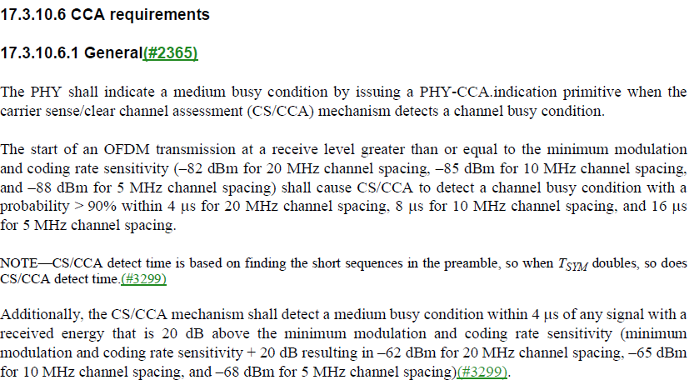
802.11 Coex PD (preamble detect) and ED (Energy Detect) Requirements
A possible example of the use of ED is when a video call in 2.4 GHz is interrupted when the microwave (fc ~ 2.45 GHz) oven is turned on.
PD
802.11a/g
ED
Slide 6

Slide 7
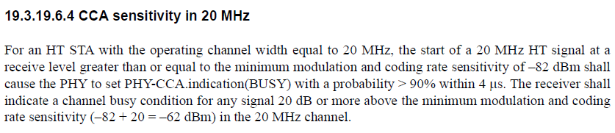
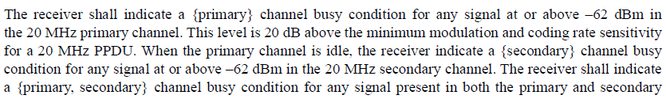
HT (802.11n) CCA Requirements
How about secondary 20?
Slide 7

Slide 8
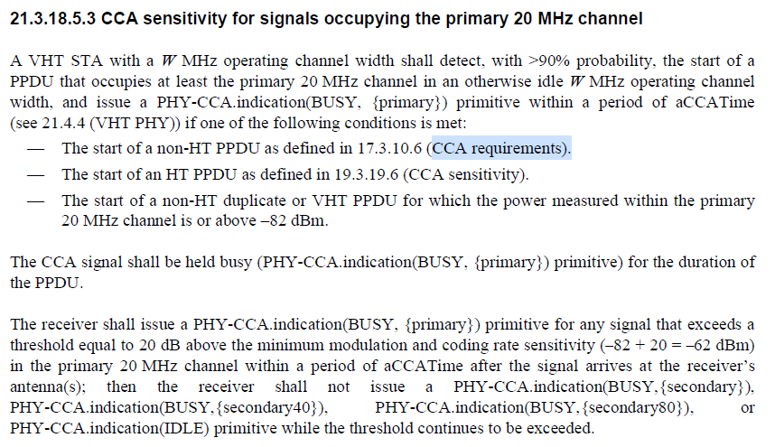
VHT (802.11ac) CCA Requirements
Slide 8

Slide 9
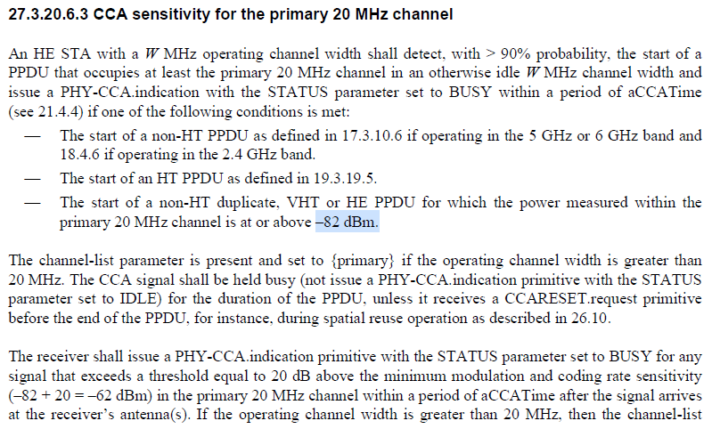
802.11ax CCA Requirements
Slide 9

Slide 10
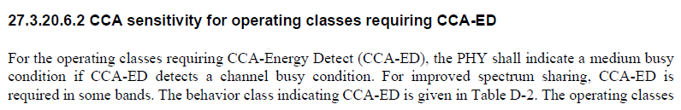

Additional Text in 802.11ax
Slide 10

Slide 11
802.11 ED and PD Threshold
Energy Detect (ED) Threshold set to -75 dBm/MHz (ETSI EN 303687 and IEEE 802.11 17.3.10.6) : shown by orange circle
Packet Detect (PD) Threshold set to -82 dBm (IEEE 802.11) : shown by purple circle
PD
ED
802.11
802.11ax
Rules for any signal (802.11 or NB) Present
ED threshold of -62 dBm for PRI20
ED threshold of -62 dBm for SEC20
ED threshold of -59 dBm for SEC40
ED threshold of -56 dBm for SEC80
Slide 11

Slide 12
Proposed Way Forward
For both NB-Data and NBA-MMS described 802.15.4ab Sections 10.43 and 10.38, CCA mode 1, is the mandatory channel access mechanism for both UNII-3 and UNII-5 with the following parameters:
  ED threshold value of TBD dBm/MHz (e.g., -80 dBm/MHz in UNII-3 and -75 dBm/MHz in UNII-5)
  TBD phyCCADuration value between 14-25 us (e.g., 16us)
  probability of detection = 100%
  If channel is sensed free via energy detect, transmit after macTsRxTx (?), or 1-2us, duration. If channel is sensed busy, do not transmit
Slide 12

