Slide 1

149th Session of meetings of the
IEEE 802.15 Working Group for Wireless Specialty Networks (WSN)
Closing Report
March 10-15, 2024
Held in Denver & Hybrid via Webex

Slide 2
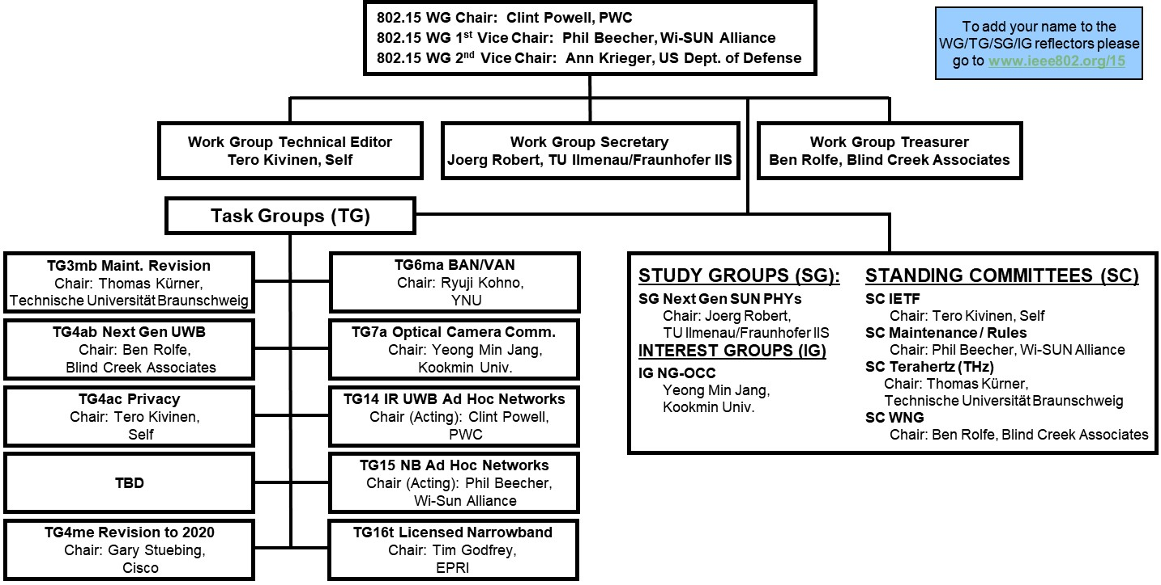
802.15 WG Org. Chart

Slide 3
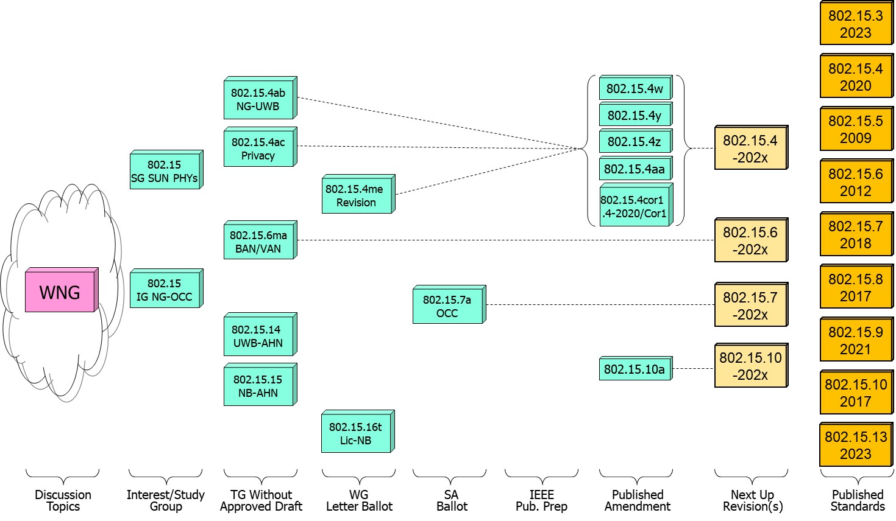
802.15 WG Standards Pipeline

Slide 4
802.15 WG Administrative
Voting members: 138
Nearly voting members: 5
Aspirant voting member: 20
802.15 WG Officers - Elected March 2024
Clint Powell - Chair
Phil Beecher - 1st Vice-Chair
Ann Krieger - 2nd Vice-Chair
Joerg Robert - Secretary (appointed)
Tero Kivinen - Tech. Editor (appointed)
Ben Rolfe - Treasurer (appointed)

Slide 5
March 802.15 WG Session

Slide 6
2.6a: Designation of Individual experts
Individual experts who attend electronically for a specific purpose/presentation can be designated as such by the WG Chair and receive a registration fee waiver and limited attendance rights.
See section 5 in https://mentor.ieee.org/802-ec/dcn/17/ec-17-0090-25-0PNP-ieee-802-lmsc-operations-manual.pdf,
  The Working Group Chair may designate specific individual experts who are allowed to participate in Working Group discussions via electronic means during an in-person meeting for the benefit of the group. These individuals are not considered to be attending the meeting and so they are not required to pay meeting fees and they do not get participation credit. The participation of these individuals should be limited to specific technical topics. Such participation shall be documented in the minutes of the Working Group meeting.
The individuals listed below are hereby designated as specific individual experts on their respective topics and subject to the restrictions and benefits described in the 802 OM.
  Example: Name, Affiliation, Specific mtg.
  n/a
  n/a
  n/a
  n/a
For WNG, attendance for each is limited to the WNG timeslot in which the respective presentation is scheduled.

Slide 7








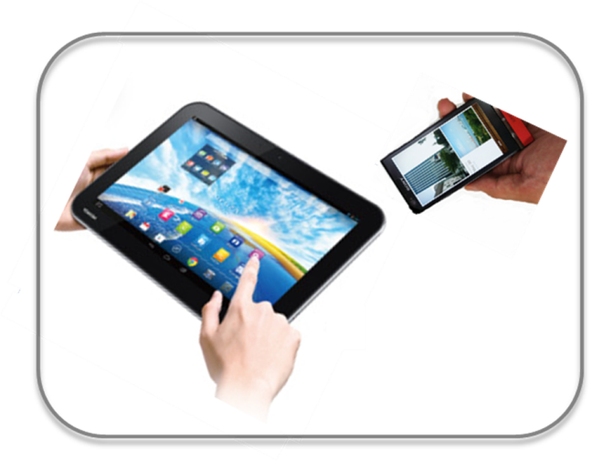








IEEE 802.15 Standards & their Applications
802.15.16
802.15.4
Locating and Tracking
Ultra-low Power Sensors
Automotive
FAN/MAN/RAN
802.15.4
Multi-media networks
&
High Speed
Interconnect
802.15.3
Industrial Networks
802.15.7
802.15.13
Medical
802.15.6
Critical Infrastructure Networks
Consumer Devices
Optical
Communications
Agricultural Sensing
Structural Monitoring
Slide 7

Slide 8
802.15 WG
Subgroups Objectives

Slide 9
TG3mb (HSD) - Revision of IEEE Std 802.15.3-2016
Chair: Thomas Kürner
Objective:
Revision of IEEE Std 802.15.3-2016
TG3mb Webpage
Areas being worked on include:
Roll-up of all amendments since the last revision
Include all new frequency bands above 275 GHz identified by WRC 2019
Fix RIFS timing parameter issue
Replace reference to IEEE Std 802.1D by reference to IEEE Std 802.1Q
Introduce two new modulation schemes (16-APSK, 32-APSK)
IEEE Std 802.15.3-2023 was approved in September 2023 and published in February 2024

Slide 10
TG4ab (NG-UWB) - Next Generation Ultra WideBand Amendment
Chair: Ben Rolfe
Objective:
Enhancements to 802.15.4 Ultra Wideband (UWB) physical layers (PHYs) media access control (MAC), and associated ranging techniques while retaining backward compatibility with enhanced ranging capable devices (ERDEVs).
TG4ab Webpage
Areas being worked on include:
Ranging
Link budget improvements
Improvements to accuracy, precision and reliability
Sensing
Pulse shape improvements
Channel impulse response reporting to support multistatic sensing
To better support presence detection, environment mapping and other uses
Data
Higher data rates for shorter transmission duration and power savings
Channel coding and packet format improvements for robustness
Additional options for even greater power savings
Protocol enhancements to support very low latency, low energy communications
Interference mitigation techniques to support:
Greater device density
Coexistence in the presence of other users
This amendment builds on top of the existing 802.15.4 standard and the 802.15.4z amendment.

Slide 11
TG4ac (Privacy) - Privacy Amendment
Chair: Tero Kivinen
Objective:
This amendment specifies modifications to the IEEE Std 802.15.4 MAC specification to specify mechanisms that address and improve user privacy. These mechanisms include randomized addresses, and exchanges that support session continuity. This amendment maintains backward compatibility with the base standard.
TG4ac Webpage
This amendment builds on top of the existing 802.15.4 standard.

Slide 12
TG4me (Revision) - Revision to IEEE Std 802.15.4-2020
Chair: Gary Stuebing
Objective:
This project is needed to incorporate accumulated maintenance changes and corrigenda (editorial and technical corrections) into the standard and to include approved amendments.
TG4me Webpage
This is a roll up revision incorporating the following amendments:
IEEE Std 802.15.4w
IEEE Std 802.15.4y
IEEE Std 802.15.4z,
IEEE Std 802.15.4aa which are approved.
One additional amendment, P802.15.4ab, is currently under development.
This amendment builds on top of the existing 802.15.4-2020 standard.

Slide 13
TG6ma (BAN/VAN) - BAN with Enhanced Dependability Revision
Chair: Ryuji Kohno
Objective:
Enhancements to the Body Area Networks (BAN) Ultra Wideband (UWB) physical layer (PHY) and media access control (MAC) to support enhanced dependability to a human BAN (HBAN), adding support for vehicle BAN (VBAN.
TG6ma Webpage
Areas being worked on include:
Channel Modeling
Precise modeling of radio propagation of implant and wearable human BANs and around vehicle BANs for dependable data transmission
Classified modeling of multiple BANs and coexistence with other radios for resolution in PHY and MAC
Data transmission
Cognition of channel environment and coexistence
Initial acquisition and synchronization in coexisting BANs
FEC and hybrid ARQ according to QoS levels of data packets for various channel models and coexistence classes
Packet contention
Control and data channels, superframe formant, and MAC function to avoid packet contention in various classes of coexistence
Hybrid protocol of contention-free and contention access according to required QoS levels of data packets
Inter coordinators or hubs negotiation among coexisting BANs
Interference mitigation in coexistence
Interference surprising and canceling technologies for theoretical and feasible implementation in coexistence
Result in simpler classes of coexistence by mitigation of interference from non-BAN
Ranging
Optional ranging for cognition of dynamism of coexisting BANs
This revision builds on the existing standard 802.15.6-2012 with enhanced dependability for human BAN and additional vehicle BAN

Slide 14
TG7a (OCC) - Higher Rate, Longer Range Optical Camera Communications
Chair: Yeong Min Jang
Objective:
This standard offers a global, secure, high-speed optical communication solution up to 100 Mbps and 200 m, with advantages like access to unlicensed spectrum, inherent security, and AI-enhanced features, promising for commercial and business markets.
TG7a Webpage
Areas being worked on include:
Wavelength range: 10000 nm to 190 nm in optically transparent media.
Data rate: Capable of delivering up to 100 Mbit/s.
Communication types: Designed for point-to-point and point-to-multipoint communication.
Adaptation features:
Adaptation to varying channel conditions.
Maintaining connectivity during high mobility (up to 350 km/h).
Flicker mitigation.
Radio Frequency (RF) co-existence.
Communication range: Up to 200 m.
Technology utilized:
Multiple-Input-Multiple-Output (MIMO).
MIMO-Orthogonal frequency-division multiplexing (MIMO-OFDM) for dealing with high levels of optical interference while maintaining high-rate data transmission.
Additional mechanisms:
Relaying mechanisms for enabling heterogeneous operation with existing RF wireless data communications standards.
Safety and regulation: Adheres to applicable eye safety regulations.
This amendment builds on the existing IEEE 802.15.7-2011 standard and the IEEE 802.15.7-2018 revision.

Slide 15
TG14 (UWB-AHN) - Impulse Radio UWB Wireless Ad Hoc Networks
Chair: Clint Powell
Objective:
Focused on impulse radio (IR) Ultra Wideband (UWB) PHY and MAC providing precision ranging capability that is accurate to the centimeter level by including (via. referencing) the 802.15.4 IR UWB functionality into a simple focused specification.
TG14 Webpage
Objective
This TG is currently in hibernation awaiting the outcome/conclusion of the TG4me revision, to see if has satisfied the objective of this project.
This project is for a new standards that references 802.15.4.

Slide 16
TG15 (NB-AHN) - Narrow Band Wireless Ad Hoc Networks
Chair: Phil Beecher
Objective:
Focused on narrow band ad hoc network PHY and MAC by including (via referencing) functionality and features of 802.15.4 into a simple focused specification.
TG15 Webpage
Objective
This TG is currently in hibernation awaiting the outcome/conclusion of the TG4me revision, to see if has satisfied the objective of this project.
This project is for a new standards that references 802.15.4.

Slide 17
TG16t (Lic-NB) - Licensed Narrowband Amendment
Chair: Tim Godfrey
Objective:
Enhancements to IEEE 802.16-2017 physical layer (PHYs) and media access control (MAC) to enable operation in licensed spectrum with channel bandwidths greater than or equal to 5 kHz and less than 100 kHz. The amendment is frequency independent but focuses on spectrum less than 2 GHz. The range and data rate supported by the narrower channels are commensurate with those of the base standard, as scaled by the reduced channel bandwidth. The project also amends IEEE Std 802.16 as required to support aggregated operation in adjacent and non-adjacent channels.
TG16t Webpage
Areas being worked on include:
Definition of the Wireless MAN-NB PHY to enable operation in narrow channels
Aggregation of non-contiguous narrow channels to provide higher capacity
Enhancements to MAC to improve efficiency and reduce control overhead
Definition of a Direct Peer-to-Peer (DPP) mode to support operation without fixed infrastructure
Updates to security protocols
This amendment is to the IEEE 802.16-2017 base standard.

Slide 18
SG (NG-SUN PHY) - Next Generation SUN PHY
Chair: Joerg Robert
Objective:
The Study Group Next Gen SUN PHY prepares the work for the development of a second-generation physical layer (PHY) for Smart Utility Networks (SUN). The primary focus is the improvement of the OFDM (Orthogonal Frequency Division Multiplexing) modes for higher data rates and longer-range communication, particularly in congested license-exempt frequency bands.
Areas being worked on include:
Definition of use-cases
Number of devices in given area
Max. payload bit-rate
Latency requirements
Definition of frequency bands
…
Channel Models
Channel models for indoor and outdoor use
Interference models for license-exempt band operation
…
This project will end up being an amendment to the latest 802.15.4 standard.

Slide 19
IG (NG-OCC) - Next Generation Optical Camera Communication
Chair: Yeong Min Jang
Objective:
Development of next-generation optical camera communication (NG-OCC) characteristics and its future applications.
Areas being worked on include:
Artificial Intelligence (AI) for NG-OCC
Integration of various AI technologies into the OCC system
Lightweight AI utilization for each developed AI technology
Channel modelling for NG-OCC
Integration of machine-learning for channel estimation
Utilization of machine learning for channel estimation for dynamic and complex channel conditions
Future applications of NG-OCC
NG-OCC encompasses fields such as IoT, underwater communication, joint communication, sensing, and localization (V2V, M2M, Drone/UAV, etc.)
NG-OCC for OCC based drone Networks
NG-OCC for Indoor/Outdoor Positioning through OCC and LiDAR integration
Deep learning-based OCC to support high mobility vehicle
Preferred camera types for OCC
Resolution: Minimum 720x540 (single-link), maximum 3840 x 2160 (multi-link)
Frame rate: Minimum 30 FPS, preferred more than 120 FPS
Spectrum: Mono, color
Light sources: IR, VL, and UV
This group will evaluate the interest in developing Next Gen OCC capabilities

Slide 20
SC IETF -
Internet Engineering Task Force
Chair: Tero Kivinen
Objective:
This standing committee brings in the information from the Internet Engineering Task Force (IETF) to the 802.15 working group. It concentrates on the IETF working groups that might be of interest to the 802.15 working group members.
IETF working groups followed include:
6lo, lake, suit
SC IETF Webpage

Slide 21
SC MAINT -
802.15 Maintenance Activities
Chair: Phil Beecher
Objective:
Maintain 802.15 Operations Manual
Answer questions concerning 802.15 Standards and Recommended Practices
Review 802 PARs and ICAIDs
SC MAINT Webpage
Areas being worked on include:
Ongoing maintenance of operations manual
802 WG PAR reviews.

Slide 22
SC THz -
THz Standing Committee
Chair: Thomas Kürner
Objective:
The IEEE 802.15 Standing Committee Terahertz is chartered to explore the feasibility of Terahertz for wireless communications. The Terahertz frequency band runs roughly from 300 GHz to 3 THz, a staggering 2700 GHz of bandwidth.
SC THz Webpage
Areas being worked on include:
The IEEE 802.15 Standing Committee Terahertz is soliciting, and hearing, contributions that address numerous THz issues.
There are no immediate plans to transition the group to a study group or a task group; rather, we want to fully understand the technology status in regards to a further amendment of IEEE Std. 805.15.3-2023 or a completely new standard.
Apart from the implementation aspects of THz Communications there are important regulatory aspects to be considered. For example the allocation and identification of THz spectrum especially in conjunction with the agenda items at WRC-27 and WRC-31 are topics of the THz standing committee.

Slide 23
SC WNG -
Wireless Next Generation
Chair: Ben Rolfe
Objective:
The IEEE 802.15 Standing Committee Wireless Next Generation is chartered to facilitate discussions on new Wireless related Technologies that may be of interest to the 802.15 community, and that may lead to new 802.15 standardization projects. The WNG also provides the opportunity to address the whole 802.15 work group with issues or concerns with current techniques or technologies.
SC WNG Webpage
Areas being worked on include:
WNG topics are not limited to only the PHY layer and/or the MAC sublayer since information on the layers above the MAC including the application is very important to making sure that the PHY and MAC are appropriate, especially in the WSN environment.
Presenters in WNG are usually asked to relate the material presented and/or discussed to the work of the WG via the “usual question”:
  What do you propose the Working Group do next?
The answer usually falls into one of these categories:
Information for the group
Form an interest group to pursue
Consider in the future a new project

Slide 24
Session Objectives March 10-15, 2024
TG 4ab (NG-UWB)
  Identify draft missing pieces and determine work assignments
  Resolve comments and address feedback on pre draft
  Assess readiness to start Initial Letter Ballot
TG 4ac (Privacy)
  Continue preparing draft
TG 4me (Revision)
  Finalize package seeking approval to go to Sponsor Ballot
TG 6ma (Revision + BAN/VAN)
  Resolve comments from pre ballot review
  Assess readiness to start Initial Letter Ballot
TG 7a (OCC)
  Conduct comment resolution for Initial Sponsor Ballot
  Assess readiness to start 1st Sponsor Ballot Recirc

Slide 25
Session Objectives March 10-15, 2024
TG 14 (UWB-AHN) – in hibernation, no meetings
TG 15 (NB-AHN) – in hibernation, no meetings
TG 16t (Lic-NB)
  Conduct comment resolution from Initial Letter Ballot
  Assess readiness to start 1st Letter Ballot Recirc
Joint 802.1/802.15
  Meeting
SG NG-SUN PHYs
  Hear additional presentations and develop plan while awaiting NesCom approval to become a Task Group
IG NG-OCC
  Hear additional presentations
  Assess readiness to start Study Group

Slide 26
Session Objectives March 10-15, 2024
SC MAINTENANCE
  Review draft of detailed development process steps checklist
  Identify list of all templates for WG15 Subpage
  Review PARs submitted by other WG’s
SC IETF
  Discuss IETF activities related to 802/802.15 at WG15 mid-week
SC THz
  Hearing presentations on THz related topics
SC WNG
  Hearing presentations on WSN related topics

Slide 27
Adjournment
Thanks…
for going fast enough to get there, but slow enough to see.

Slide 28
TG4ab (NG-UWB)
March 2024
Closing Report

Slide 29

Agenda
https://mentor.ieee.org/802.15/dcn/24/15-24-0128-10-04ab-tg4ab-agenda-march-2024.xlsx

Slide 30
Session Objectives
Resolve collected comments
Complete the draft!
Commence WG Letter Ballot when:
  We have a technically complete draft
  We have a draft that is ready to ballot
  We have completed WG pre-requirements

Slide 31

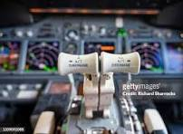
Comment resolution reports

Slide 32
Comment Status
Starting this week
Resolved: 412
To be addressed: 514
Proposals for 102
Needed proposals: 410
Tonight
Resolved: 669
To be addressed: 257
Proposals: 40
Need proposals: 217
Resolved exactly 50% of what we started with!

Slide 33

Next Steps

Slide 34
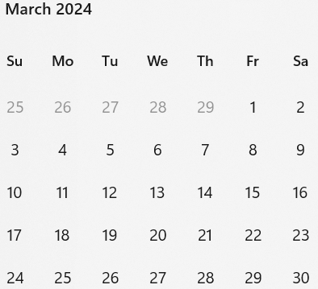
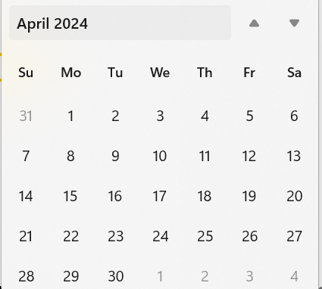
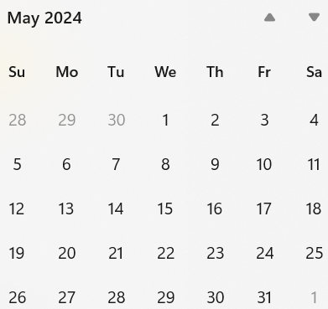
Call schedule, March thru May
Weekly on Tuesdays 2 hours split:
  6am PT (1 hour)
  4pm PT (1 hour)
Commencing 26-March-2024
April 30 (hour 1): Coexistence topics, Joint meeting with 802.11 CoEx SC

Slide 35
TG4ac (Privacy)
March 2024
Closing Report

Slide 36
Agenda for March
Start working on the primitives and frame formats
Issue list: 15-23-0422-03

Slide 37
Detailed Agenda for March
Tuesday 12th of March 1030-1230
    Opening slides
    Approve agenda (this document) 15-24-0149-02
    Approve minutes 15-24-0059-00
    Start working on the primitives and frame formats
Tuesday 12th of March 1330-1530
    Continue working on the primitives and frame formats
    Closing report

Slide 38
More information
List of issues can be found in the document 15-23-0422-05.
Project task list: 15-23-0397
Old WNG presentation 15-22-0477

Slide 39
Timeline
Finalize the list of issues to be solved | Jan 2024
First version of the draft for WG pre-ballot commenting | May 2024
Draft ready for letter ballot | Sep 2024
Draft ready for SA ballot | Jan 2025
SA ballot start | Mar 2025
SA ballot done | Jul 2025
Submit to RevCom | Sep 2025
Standard published | Jan 2026

Slide 40
Meeting achievements
Update issues list 15-23-0422-05.
Create first version of document describing required primitives 15-23-0166-00.

Slide 41
Agenda for TG4ac for May
Two sessions
Try to coordinate so it does not overlap TG4ab, 802.11bi, or 802.11bh.
Have a joint one hour meeting with TG4ab.
    Perhaps at the end of week, so we can update what has happened.
  Work on the draft text

Slide 42
TG4me (Revision)
March 2024
Closing Report

Slide 43
CLOSING REPORT
Minutes are at: DCN 15-24-0189-00-04me
103 of 137 voters participated in the Last Recirculation Ballot for p802.15.4_D03. There were no changes to the Draft as a result of the recirculation. There were a total of 16 comments which were withdrawn by the submitters. The final vote count:
95 Yes, 3 No, 4 Abstain
EC Package was developed for submission to Sponsor Ballot – DCN 15-24-0137-02-04me

Slide 44
CLOSING REPORT
Task Group motions for Unconditional Sponsor Ballot Request – Passed unanimously
Task Group motions for Sponsor Ballot CRG Passed unanimously
Sponsor Ballot Requests sent to Work Group for work group approval
Project Task List Updated DCN 15-24-0400-07-04me

Slide 45
CLOSING REPORT
Timeline Reviewed
Preliminary Draft Agenda posted at DCN 15-24-0159-00-04me

Slide 46
Draft Timeline
Mar/24– SA Ballot Requested and Draft sent to Ballot – CRG Formed
May/24 – Comment Resolution possible SA Recirc (CRG)
July/24 – Comment Resolution SA Recirc (CRG)
Nov/24 - Optimistic SA to Revcom
Dec/24 – SA to Revcom

Slide 47
TG6ma (BAN/VAN)
March 2024
Closing Report

Slide 48
Objectives of TG 6ma – Enhanced Dependability Body Area Network (ED-BAN)
Objective: Enhancements to the BAN Ultra Wideband (UWB) physical layer (PHY) and media access control (MAC) to support enhanced dependability to a human BAN (HBAN) and adds support for vehicle body area networks (VBAN), a coordinator in a vehicle with devices around the vehicular cabin.
Action:
•Update draft#1.14 of Draft Proposals for Pre-Ballot
•Comment resolution for draft#1.14
•Performance Evaluation of Technologies in PHY; Channel Coding According to 8 QoS Levels of Packets and Coexistence Levels, Interference Mitigation, etc.
•Performance Evaluation of Technologies in MAC; Channel Management, CCA, Hybrid Contention Free/Access Protocol According to 8 QoSs and Coexistences.
•Harmonization or Commonality with 4ab in Coexistence and Feasible Implementation of 6ma and 4ab
•Feasibility of TSN of 802.1 in MAC
Next Things to Do：
Finalize draft#1 for Letter Ballot

Slide 49
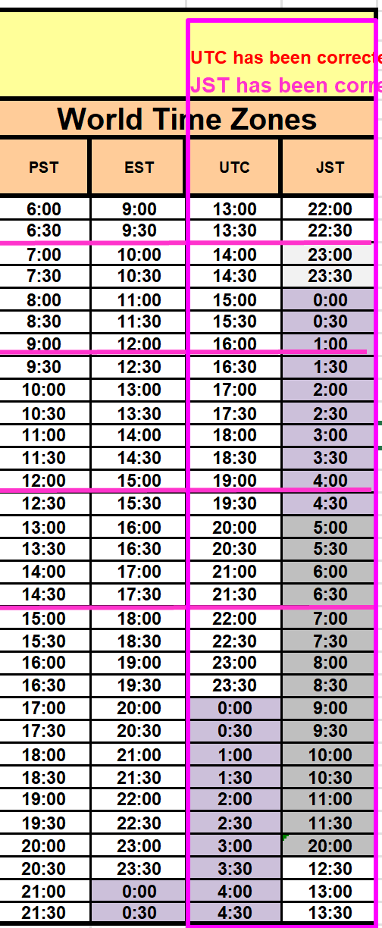
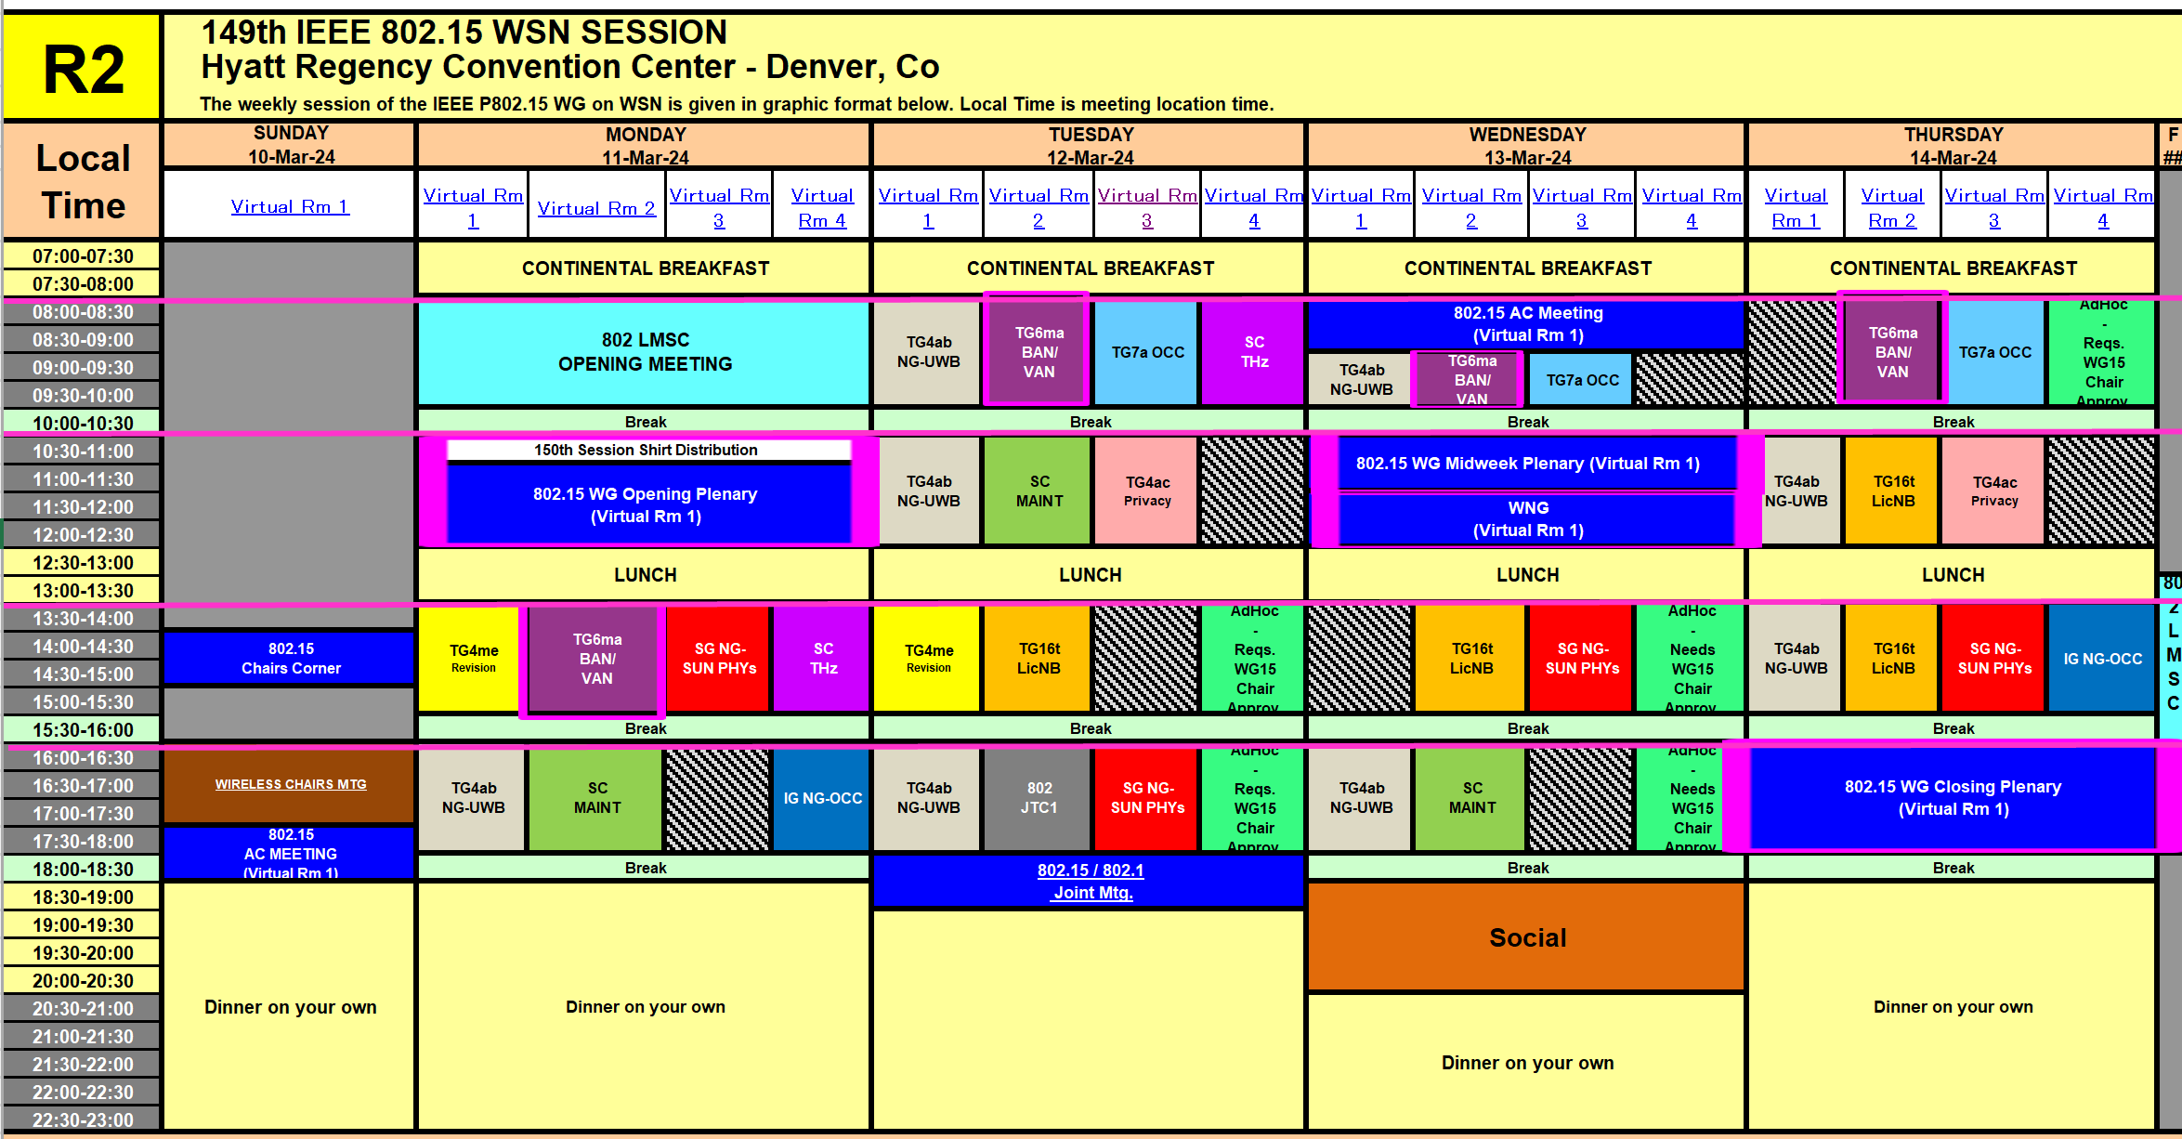
TG15.6ma Plenary Session Schedule for 10-15th, March 2024
TG15.6ma has three own sessions such as
Session1(Virtual RM#2) PM1 13:30-15:30 March 11(MON) in Denver time, 4;30 - 2:30 March 12(TUE) in JST/KST
Session2(Virtual RM#2) AM1 8:00-10:00 March 12(TUE) in Denver time, 23:00-01:00 March 13(WED) in JST/KST
Session3(Virtual RM#2) AM1 9:00-10:00 March 13(WED) in Denver time, 00:00-01:00 March 14(THU )in JST/KST
Session4(Virtual RM#2) AM1 8:00-10:00 March 14(THU) in Denver time, 23:00-01:00 March 15(FRI) in JST/KST
March 11th is day light change to summer time.

Slide 50
Agenda items for the week
TG15.6ma meeting call to order
Call for essential patents and policies & procedures reminder
Approve last meeting minutes: TG 15.6ma Meeting Minutes for January 2024 doc.#15-24-0075-00-06ma
Agenda of TG15.6ma March Meeting doc.#15-24-0134-01-06ma
Review and Summary
  Basic Consensus in MAC and PHY of Revision of IEEE802.15.6-2012(IEEE802.15.6ma) doc.#15-23-0557-02-06ma
  2. TG6ma Draft Action Items(Progress and Action Items for Draft#1.14 doc.#15-23-0360-04-06ma
  Draft pre-ballot comment resolution doc.#15-23-0476-14-06ma
  Rescheduling Timeline doc.#15-23-0361-04-06ma
  Presentation
  1. Modified MAC Superframe Structure Based on 15.6-2012 for Coexisting Multiple Dependable BANs 24-0122-00-06ma
  2. MAC Frame Formats Based on Harmonization Agreements doc.#15-24-0034-01-06ma
  3. Progress and Action Items for Draft#1 (Draft#1.14) doc.#15-23-0360-03-06ma
  4. Joint work with 802.1; Draft PAR and CSD 802.1ACea: Amendment to IEEE Standard 802.1AC-2016 15-23-453＆454
  5. MAC superframe structure for coexisting multiple dependable BANs doc.#15-24-0013-02-06ma
  6. Simulation results for Nagoya I. T. and YRP-IAI MAC proposal Based on TG6ma Channel Model -0352-04-06ma
  7. Preliminary Evaluation on Ranging Accuracy with Interference Cancellation in Coexistence Environments 24-0057-01
  8. Hybrid ARQ Scheme for High QoS Packets in High Class of Coexistence of IEEE 802.15.6ma #15-23-0576-02-06ma 9. Evaluation of IEEE 802.15.6 Ultra-wideband Physical Layer Utilizing Super Orthogonal Convolutional 22-0562-08-06ma
  10. Performance Evaluation of Channel Coding Based on TG6ma Channel Model for Some Classes of Coexistence 051-01
  11. TG6ma Channel Models, Channel Coding, and Interference Mittigation doc.#15-22-0519-01-06ma
  12. UWB Positioning in 15.6ma for Multiple BAN Adjacent Scenarios doc.#15-23-0560-01-06ma
  13. TG6ma Channel Model Document for Enhanced Depemdability doc.#15-22-0519-05-06ma
  14. Interference Mitigation Schemes in Class 3, 5, 6, and 7 of Coexisitence in TG6ma doc.#15-24-0073-01-06ma
  15. Overview and convergence of MAC proposals for 15.6ma doc.#15-24-0078-01-06ma
  16. Progress Report of TG6ma doc.#15-23-0056-07-06ma
  17. Timeline of TG6ma doc.#15.23-0407-04-06ma
  18. TG15.6ma Closing Report for March 2024 doc.#15-24-185-00-06ma
  19. TG15.6ma Meeting Minutes for March 2024 doc.#15-24-0186-00-06ma

Slide 51
Definition of Coexistence Environment Classes
Coexistence Class | Coexisting system(s) |  |  |  |  | Category
Level | 802.15.6ma | 802.15.6-2012 | Non-UWB (ex. Wi-Fi / Unlicensed / 3GPP) | 802.15 UWB (ex. 802.15.4) | Non-802.15 UWB (ex. ETSI SmartBAN) | Category
0 | - | - | - | - | - | Single BAN
1 (1a) | ✓ | - | - | - | - | Multiple 15.6 BANs
2 (1b) | ✓ | ✓ | - | - | -
3 | ✓ | - | ✓ | - | - | Non-UWB
4 (2a) | ✓ | - | - | ✓ | - | Multiple UWB systems
5 (2b) | ✓ | - | - | - | ✓
6 (2c) | ✓ | - | - | ✓ | ✓
7 | ✓ | ✓ | ✓ | ✓ | ✓ | Final Boss
The coexistence class has been redefied to 8 levels, which can be represented by 3 bits and would be suitable to include in PHY or MAC headers.

Slide 52
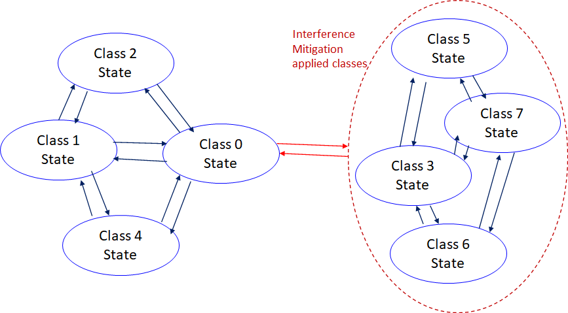
    Coexistence Class States Transition(1/2)
The standard's revision supports BANs operating with high reliability (coexistence class 0) and coexisting in dense environments with intra-interference and inter-interference (coexistence class 1 to 7). Figure 6 shows the state transition between several classes of coexistence environments defined in above –mentioned table.
Class 0: 6ma BAN alone
Class 1: Multiple 6ms BANs
Class 2: 6ma BAN with old 6 BAN
Class 4: 6ma BAN with other
802.15 UWB WSNs e.x. 4z, 4ab
Class 3: 6ma BAN with other
narrowband Nets WSNs
Class 5: 6ma BAN with other
UWB Nets e.x. ESTI SmartBAN
Class 6: 6ma with 802.15 other WSN
Class 7: 6ma with any frequency
shared networks
Figure 6 Diagram of state transitions for coexistence class environments.

Slide 53
    Coexistence Class States Transition(2/2)
The standard's revision focuses on the dependability mechanisms for a single HBAN or VBAN (Class 0) and the scenario with multiple HBANs or VBANS (Class 1).
Class 2 supports compatibility with legacy BANs (IEEE 802.15.6-2012 Std).
Class 4 supports coexistence with other IEEE 802.15 UWB Stds, and amendments such as 15.4, 15.8, 15.4z, and 4ab, via the PHY and MAC specification.
Classes 3, 5, 6, and 7 support coexistence with other wireless systems can result in Class 0, 1, and 2 by mitigation technology to cancel interference from other radios except regacy 15.6 at the receiver side (see clause 4.7.2 of draft#1.11.
During CCA, a BAN coordinator may analyze the type of synchronization preamble detected from a 15.6ma, 15.6, or 15.4 system.
In Figure 6, the state transition probabilities are approximated in consecutive superframes. Furthermore, the duration of the CAP and CFP are determined by statistics of various QoS level of packets in previous consecutive superframes for every coming superframe.
The draft revision #1.11 supports BANs operating with high reliability in dense environments coexisting with intra-interference and inter-interference due to other wireless systems in the same frequency band. Figure 6 shows state transition among several classes of coexistence environment defined in Table 1.

Slide 54
QoS Levels of Packets corresponding to User Priority
In Std.15.6 WBAN systems, a various data such as vital signs, skin temperature, blood pressure, ECG, EEG, ECoG, and vehicle controlling commons have different QoS levels corresponding to user priority.
In 15.6ma for dependable WBAN for human and vehicles, data packet transmission should be dependable according to QoS levels even in various classes of coexistence environment.
Therefore, appropriate sets of error controlling scheme with FEC and hybrid ARQ corresponding to QoS levels have been standardized in 15.6ma,
User priority | Traffic designation | Frame type
0 | Background (BK) | Data
1 | Best effort (BE) | Data
2 | Excellent effort (EE) | Data
3 | Video (VI) | Data
4 | Voice (VO) | Data
5 | Medical data or network control | Data or management
6 | High-priority medical data or network control | Data or management
7 | Emergency or medical implant event report | Data

Slide 55
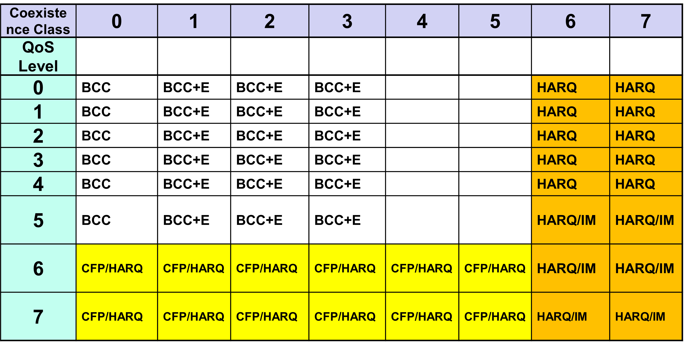
FEC/HARQ for 64 Combinations of 8 Coexistence Classes
× 8 QoS Packet Levels
FEC codes and Hybrid ARQ have been designed for 8 × 8 = 64 combinations for QoS levels and Coexistence classes under various standard of channel models.

Slide 56
FEC in TG6ma
Common with
IEEE 802.15.4ab
Error-correcting codes corresponding to QoS levels
User priority | Inner code | Outer code | HARQ
0 | 15.4ab LDPC or BCC (R=1/2) |  | -
1 | 15.4ab LDPC or BCC (R=1/2) |  | -
2 | 15.4ab LDPC or BCC (R=1/2) |  | -
3 | 15.4ab LDPC or BCC (R=1/2) |  | -
4 | 15.4ab LDPC or BCC (R=1/2) | (54, 46) shortened RS code | -
5 | 15.4ab LDPC or BCC (R=1/2) | (54, 38) shortened RS code | -
6 | 15.4ab LDPC or BCC (R=1/2) | (54, 28) shortened RS code | -
7 | 15.4ab LDPC or BCC (R=1/2) | (54, 14) shortened RS code | -
As an outer code, shortened Reed-Solomon (RS) codes with N=54 (original code length N=63) will be selected to correct burst errors due to interference from other WBANs and the coding rates are changed according to each QoS and channel condition
As an inner code, 15.4ab LDPC (K=324, 648, 972, R=1/2) or BCC will be selected for the coexistence of 15.6ma and 15.4ab
This updated concept table is considered as the first priority

Slide 57
TG 6ma Timeline(expected)
Tech Req Doc July 2022
Presentation of proposals
May 2023
Conditional approval for Sponsor Ballot
July
2024
SB recirc.
Nov. 2024
Std Draft V1,11 and Comment Resolution
Jan.
2024
EC approval to SB, SB submission
Nov.
2024
^{WG letter ballot submission}March
2024
SB recirc. if required
May 2025
Revcom Approval
July 2025
RevcomSubmission
June 2025
Upload prelim. draft v1.12 to WG private area for finalizing v1
Feb.
2024
WG letter ballot Sept. 2024
TRD,CMD
Call Proposals Sept
2022
Std. DraftV1.9 Proposals
Nov. 2023
1st LB recirc.
May 2024
2nd LB recirc.
July
2024
Notes: SASB/RevCom scheduled for 2024 an est.

Slide 58
Expecting Timeline detail
Topic item | Deadline | Action items | Notes | Progress
Std Draft v.1.14 WG pre-ballot recirculation. | Mar/2024 | Disposition of comments. MAC text based on harmonization. Updates of simulations for MAC and PHY.
Towards the May 2024 meeting | May/2024 | Adding MAC text. Revise PHY text. Editorial revisions.
Target WG letter ballot (LB) submission | May/2024 |  | 1. Based on pre-ballot resolutions, prepare Draft v. 2.0 2. Request LB submission before the January meeting. Consequently, the January meeting is used to resolve comments.
1st LB recirculation | July/2024 |  | Comment-resolutions to LB recirculation.
2nd LB recirculation | Sept/2024 |  | Comment-resolutions to LB recirculation.
Conditional approval for Sponsor Ballot (SB) | Sept/2024 |  | Seek conditional approval for SB by the Executive Committee.
Final LB recirculation. | Nov/2024 |  | WG approval to request SB submission.
Request EC approval for SB | Dec/2024 |  | Request SB approval by the EC (conditional or not)
IEEE SA Sponsor Ballot submission | Jan/2025 |  | One month for IEEE SA editorial review.
1st SB recirculation | Feb/2025 |  | Comment-resolutions to SB and recirculation.
2nd SB recirculation | Mar/2025 |  | Comment-resolutions to SB and recirculation.
Request conditional/unconditional approval to RevCom | May/2025 |  | Submission to SASB agenda
Final SB recirculation, if required. Submission to RevCom | Jun/2025 |  | Submission to SASB
RevCom submission | July/2025 |  | RevCom approval
Note: the deadlines are subject to change.

Slide 59
Contributions
・TG15.6ma opening report for March 2024 meeting 15-23-0135-01-06ma
・TG15.6ma Agenda of January Meeting in 2024 15-23-0134-05-06ma
・Progress and Action Items for Draft#1 15-23-0360-04-06ma
・Draft pre-ballot comment resolution 15-23-0476-14-06ma
・Rescheduling Timeline 15-23-0361-04-06ma
・Basic Consensus in MAC and PHY of Revision of IEEE802.15.6-2012 15-23-0557-01-06ma
・MAC superframe structure for coexisting multiple dependable BANs 15-24-0013-01-06ma
・MAC frame formats based on harmonization agreements 15-24-0034-02-06ma
・Preliminary Evaluation on Ranging Accuracy with Interference Cancellation in Coexistence Environments
15-24-0057-01-06ma
・Evaluation of IEEE 802.15.6 Ultra-wideband Physical Layer Utilizing Super Orthogonal Convolutional Code
15-24-0051-00-06ma
・Simulation results for Nagoya I. T. and YRP-IAI MAC proposal Based on TG6ma Channel Model23-0252-02
・Hybrid ARQ Scheme for High QoS Packets in High Class of Coexistence of IEEE 802.15.6ma 23-0576-02
・Evaluation of IEEE 802.15.6 Ultra-wideband Physical Layer Utilizing Super Orthogonal Convolutional Code
15-22-0562-08-06ma
・Preliminary performance evaluation of ranging in coexistence environment 15-23-0353-04-06ma
・Performance Evaluation of Channel Coding under Various Channel Models in Some Classes of Coexistence in TG6ma 15-23-0577-00-06ma
・TG6ma Channel Model Document for Enhanced Dependability 15-22-0519-05-06ma
・Draft pre-ballot comment resolution 15-23-0476-13-06ma
・Interference Mitigation Schemes in Class 3, 5, 6, and 7 of Coexisitence in TG6ma 15-24-0073-00-06ma
・Overview and convergence of MAC proposals for 15.6ma 15-24-0078-01-06ma
・Progress Report of TG6ma 15-23-0056-05-06ma
・TG15.6ma closing report for March 2024 meeting 15-24-0185-00-06ma
・TG15.6ma March 2024 meeting minutes 15-24-0186-00-06ma /

Slide 60
Contacts and Conference call
Chair; Ryuji Kohno, YNU/YRP-IAI
kohno@ynu.ac.jp, kohno@yrp-iai.jp
1st Vice-Chair; Marco Hernandez, YRP-IAI/CWC
marco.hernandez@ieee.org
2nd Vice-Chair; Daisuke Anzai, NIT
anzai@nitech.ac.jp
3. Secretary; Takumi Kobayashi, YNU/TCU
kobayashi-takumi@yrp-iai.jp, kobayashi@nitech.ac.jp
Technical Editors;
Minsoo Kim, YRP-IAI minsoo@minsookim.com
Seong-Soon Joo, KPST wowbk@kpst.co.kr
Kento Takabayashi, Toyo U. takabayashi.kento.xp@gmail.com
Marco Hernandez, YRP-IAI/CWC marco.hernandez@ie ee.org
Jussi Haapola, CWC jussi.haapola@oulu.fi

Slide 61
TG7a (OCC)
March 2024
Closing Report

Slide 62
Accomplishment for the meeting
3 Slots (on AM1 Tues., AM1 Wed., and PM1 Thur.)
1st Slot:
  IEEE 802 Procedural Documents (Patent Policy / Copyright Policy / Participation Behavior) https://ieee802.org/devdocs.shtml
  Meeting Objectives and Agenda Approval (131-01)
  Recess/Adjourn
2nd Slot:
  IEEE 802 Procedural Documents (Patent Policy / Copyright Policy / Participation Behavior) https://ieee802.org/devdocs.shtml
  Meeting Objectives and Agenda Approval (131-02)
  Discuss TG Motions and WG Motions
  Plan for Teleconference
  Plan for May meeting
  Recess/ Adjourn
  3rd Slot:
  Adjourn

Slide 63
TG Motion
    CRG formation for SA ballot
Move that TG7a requests that 802.15 WG approve the formation of a Comment Resolution Group (CRG) for the Standards Association balloting of the P802.15.7a_D6 with the following membership: Yeong Min Jang(Chair), Sangsung Choi, Sang-Kyu Lim, Ryuji Kohno, and Seongsoon Joo. The 802.15.7a CRG is authorized to approve comment resolutions, edit the draft according to the comment resolutions, and to approve the start of recirculation ballots of the revised draft on behalf of the 802.15 WG. Comment resolution on recirculation ballots between sessions will be conducted via reflector email and via teleconferences announced to the reflector as per the LMSC 802 WG P&P.
Moved By: Yeong Min Jang
Seconded By: Sang-Kyu Lim
Approved by unanimous consent

Slide 64
WG Motion
    CRG formation for SA ballot
Move that 802.15 WG approve the formation of a Comment Resolution Group (CRG) for the Standards Association balloting of the P802.15.7a_D6 with the following membership: Yeong Min Jang(Chair), Sangsung Choi, Sang-Kyu Lim, Ryuji Kohno, and Seongsoon Joo. The 802.15.7a CRG is authorized to approve comment resolutions, edit the draft according to the comment resolutions, and to approve the start of recirculation ballots of the revised draft on behalf of the 802.15 WG. Comment resolution on recirculation ballots between sessions will be conducted via reflector email and via teleconferences announced to the reflector as per the LMSC 802 WG P&P.
Moved By: Yeong Min Jang
Seconded By: Phil Beecher

Slide 65
Plan for Teleconference schedule
4 slots (6:00am (EST) on Wed. (Mar. 27, Apr. 10, Apr. 24, May 8))
Complete comment resolution for 1st SA Ballot
Prepare the D7 document for 2nd SA Ballot

Slide 66
Plan for May Meeting
3 slots (AM1 on Tue., Wed., and Thur.)
Complete comment resolution for 1st SA Ballot
Prepare the D7 document for 2nd SA Ballot

Slide 67
TG16t (LIC-NB)
March 2024
Closing Report

Slide 68
Meeting Plan for week
Tuesday PM1 1:30pm EST
Wednesday PM1 1:30pm EST
Thursday AM2 10:30am EST
Thursday PM1 1:30pm EST

Slide 69
Contributions for March 2024 Plenary
12-Mar-2024 ET | 2024 | 163 | 0 | TG16t (Lic-NB) | Review Comments on D1.1 | Vishal Kalkundrikar (Ondas)
13-Mar-2024 ET | 2024 | 175 | 0 | TG16t (Lic-NB) | SecurityReviewCommentsonD1.1 | Ondas

Slide 70
Draft D1.1 Review and D2.0 preparation
Comment Resolutions
  LB210 resolutions. 15-24-0049-06-016t-tg16t-lb201-comments-and-resolutions
  D1.1 comments/resolutions 15-24-0163-02-016t-review-comments-on-d1-1
Prepared D2.0 Draft Documents (for private area)
  P802_16t_D2.0_CMP.pdf Redline from D1.0
  P802.16t_D2.0.pdf (Draft 2.0 for recirculation)

Slide 71
Motions
TG Motion to start Recirculation Letter Ballot
  Move that TG16t formally request that the 802.15 WG start a WG Recirculation requesting approval of document P802-15-16t_D2.0 and to forward document P802-15-16_D2.0, to Standards Association ballot.
    Moved - Vishal
    Second – Tero
    Approve with unanimous consent
Motion text for WG:
  Move that 802.15 WG formally request that 802.15 WG start a WG Recirculation requesting approval of document P802-15-16t_D2.0 and to forward document P802-15-16t_D2.0, to Standards Association ballot.

Slide 72
Formation of Comment Resolution Group
Move that 802.15 WG approve the formation of a Comment Resolution Group (CRG) for the WG balloting of the P802.15.16t_D02 with the following membership: Tim Godfrey (Chair), Vishal Kalkundrikar, Harry Bims, Tero Kivinen, and Joerg Robert. The 802.15.16 CRG is authorized to approve comment resolutions, edit the draft according to the comment resolutions, and to approve the start of recirculation ballots of the revised draft on behalf of the 802.15 WG. Comment resolution on recirculation ballots between sessions will be conducted via reflector email and via teleconferences announced to the reflector as per the LMSC 802 WG P&P.
Approved by Task Group
  Unanimous Consent

Slide 73
Teleconference / CRG Meeting
Thursday 4/25 8am PDT, 11am EDT, 17:00 CEST
  https://epri.webex.com/epri/j.php?MTID=m2791399d2e2a1ec4e2472fb447573443
  3 weeks before May meeting
Plan for May Meeting Slots
  3 slots, AM2, Tuesday, Wednesday, Thursday

Slide 74
Project Timeline
Milestone | Date
Task Group Start | Jan 2020
SRD Approval | April 2021
SDD Approval | Jan 2022
Draft Development
Informal TG review of draft | Mar 2023
Working Group Letter Ballot | Nov 2023
Working Group Recirculation Letter Ballot | March 2024
SA Ballot | May 2024
Forward to RevCom | Nov 2024
Request PAR Extension July 2024
PAR Expiration Date: 31 Dec 2024

Slide 75
Future Meetings
May 2024 Interim
    May 13-17 – Warsaw, Poland
July 2024 Plenary
    July 15-18 – Montreal, QC, Canada

Slide 76
SG NG-UWB
March 2024
Closing Report

Slide 77
Agenda and Achievements
Final agenda is posted in 15-24/0151r3
4 meeting slots
Main agenda topics:
  Discussion of use-cases
  Discussion of Channel Models and Channel Masks
  Drafting of Technical Guidance Document
  Discussion of Timeline
  Telephone conference dates
  AoB: Discussions of problems related to wireless power transfer in sub-GHz

Slide 78
Timeline
May 2024: Become TG
November 2024: Finish channel model discussions
May 2025: Deadline for new material
November 2025: First draft
January 2026: Working group pre-ballot review
May 2026: 1st Letter Ballot
September 2026: 2nd Letter Ballot
November 2026: 1st SA Ballot
January 2027: 2nd SA Ballot
March 2027: Submission to RevCom

Slide 79
Telephone Conferences
March 27th, 4pm CEST / 10am EDT, max. 2h
April 10th, 4pm CEST / 10am EDT, max. 2h
April 24th, 4pm CEST / 10am EDT, max. 2h

Slide 80
Plan for Warsaw in May 2024
Finish discussion on use-cases
Further discussion on channel models
Continued work on technical guidance document
Discussion of proposals
4 meeting slots requested

Slide 81
Meeting Minutes
Meeting minutes will be published in 15-24/0190r0

Slide 82
IG NG-OCC
March 2024
Closing Report

Slide 83
Session Objectives
Present three contributions related to the future of next generation OCC

Slide 84
Accomplishment for the meeting
2 Slots (on PM2 Mon. and PM1 Thur.)
1st Slot:
  Meeting Objectives and Agenda Approval (132-01)
  Hear contributions
  OCC in Virtual Power Plant Use case for NG-OCC (152-00) [Kookmin University and ENS]
  GAN-based Deep Learning for NG-OCC (153-00) [Kookmin University]
  OCC Enabled Software Defined Vehicular Networks for NG-OCC (154-00) [Kookmin University]
  The key ideas of all three contributions are accepted and adopted for the PAR for IG NG-OCC
  Plan for May meeting
  Plan for IG NG-OCC
  Adjourn
2nd Slot:
  Adjourn

Slide 85
Plan for May Meeting
2 slots (AM2 on Tues. and Thur.)
Need to contributions for NG-OCC
Invite some companies for presentations

Slide 86
  Plan for IG NG-OCC
Invite contributors from research institutes and companies

Slide 87
SC IETF
March 2024
Closing Report

Slide 88
Agenda for March
Discuss what happened on IETF 118 in Prague (November 04 – 10, 2023)
Look what will happen on IETF 119 in Brisbane (March 16 – 22, 2024)

Slide 89
IETF 118
IETF 118 was held in Prague between 4th of November and 10th of November, 2023.
The proceedings are being collected:
  https://datatracker.ietf.org/meeting/118/proceedings

Slide 90
Working groups to cover
6lo – IPv6 over Networks of Resource-constrained Nodes
Lake – Lightweight Authenticated Key Exchange
Suit – Software Updates for Internet of Things

Slide 91
IETF 119
IETF 119 will be held next week in Brisbane, Australia between 16th of March and 22th of March, 2024.
Registration is open:
  Registration

Slide 92
BoFs in IETF 119
List of requested BoFs can be found from https://datatracker.ietf.org/doc/bof-requests
List of approved BoFs can be found from https://datatracker.ietf.org/wg/bofs/
There is five BoFs scheduled for IETF 119
  Alldispatch -- IETF-Wide "Dispatch" Session
  Deleg -- New DNS Delegation
  Spice -- Secure Patterns for Internet CrEdentials
  Sconepro --Secure Communication of Network Properties
  Srv6ops -- SRv6 Operations

Slide 93
SC MAINT
March 2024
Closing Report

Slide 94
SC Meeting Objectives – Agenda
    Meetings 1&2 (Monday and Tuesday)
    Policy and Procedure
    Approve Agenda
    Review 802 PAR Requests
    Recess
    Meeting 3 Wednesday
    Review any change requests for Operations Manual – none
    AoB
    Adjourn
Notes:
March 24
Page 94

Slide 95
PAR Review SCM
PARs to be considered at March 2024 Plenary, Denver, USA
  802.1ASeb - Amendment: Optional Use of Announce , PAR and CSD
  802.3dm - Amendment: Asymmetrical Electrical Automotive Ethernet, PAR and CSD
  802.11bf - Amendment: Enhancements for Wireless Local Area Network (WLAN) Sensing, PAR modification
  802.11bp - Amendment: Enhancements for Ambient Power Communication (AMP), PAR and CSD
802.15 Comments are due Tuesday 12 March 18:00,
Comments to be submitted as document:
  https://mentor.ieee.org/802.15/dcn/24/15-24-0161-00-0mag-802-15-comments-on-pars-csds-march-2024.pptx
Adjourned on Tuesday 12 March at 1100.

Slide 96
SCM other items
    No urgent changes to operations manual – see next slide
Notes:
March 24
Page 96

Slide 97
General discussion
  Evening meetings should be optional, i.e. not counted in denominator of voting credit
Discussion about Operations Manual, Rules, Hybrid meetings and increasing participation
  Recommendations from attendees:
  Assign 2 meeting credits for attending closing plenary
  Gain and retain voting rights using the same criteria as current rules, but MUST be in-person attendance
  Task group/standing committee chair/vice chair, must be voting members of 802.15 – need to clarify in operations manual
  Sub - group chair or vice chair (or designated voting member) must be present in-person to run the meetings during a hybrid session.

Slide 98
SC WNG
March 2024
Closing Report

Slide 99

Agenda 15 November 2023
Opening and Meeting Reminders
Presentations and discussion
  TRPsd Measurements of UWB devices by JRC
  A lightweight Cryptographic algorithm for IoT Devices
Any other business
Adjourn

Slide 100
References
https://mentor.ieee.org/802.15/dcn/24/15-24-0158-00-wng0-trpsd-measurements-of-uwb-devices-by-jrc.pdf
https://mentor.ieee.org/802.15/dcn/24/15-24-0168-00-wng0-ascon-the-lightweight-cryptography-standard-for-iot.pptx

Slide 101

The usual question
What do you propose the Working Group do next?

Slide 102
The usual question
Options:
Information for the group
Form an interest group to pursue
Consider in the future a new project

