Slide 1
Project: IEEE P802.15 Working Group for Wireless Specialty Networks (WSN)
Submission Title: March 2024 Plenary TG4ab Closing Report
Date Submitted: 14 March 2024
Source: Benjamin A. Rolfe (Blind Creek Associates)
Contact:
Voice: +1 408 395 7207, E-Mail: ben.rolfe @ ieee.org
Re: Task Group 4ab: 802.15.4 UWB Next Generation
Abstract: Meeting Slides for the Wireless Interim Session, January 2024
Purpose: Continue project progress and continue the illusion of organization
Notice: This document has been prepared to assist the IEEE P802.15. It is offered as a basis for discussion and is not binding on the contributing individual(s) or organization(s). The material in this document is subject to change in form and content after further study. The contributor(s) reserve(s) the right to add, amend or withdraw material contained herein.
Release: The contributor acknowledges and accepts that this contribution becomes the property of IEEE and may be made publicly available by P802.15.

Slide 2
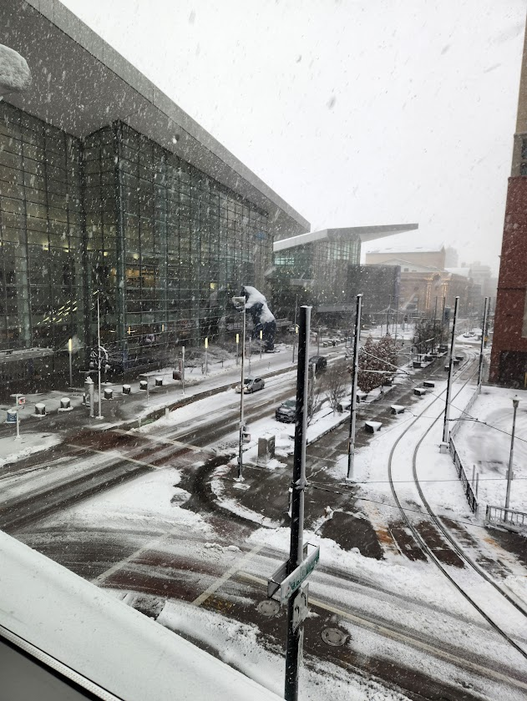
Task Group 15.4ab Next Generation UWB Amendment
March 2024 802 Plenary Session
Mixed Mode
Live from Denver, CO, USA

Slide 3
Agenda
https://mentor.ieee.org/802.15/dcn/24/15-24-0128-10-04ab-tg4ab-agenda-march-2024.xlsx
(check mentor for latest version)

Slide 4
Session Objectives
Resolve collected comments
Complete the draft!
Commence WG Letter Ballot when:
We have a technically complete draft
We have a draft that is ready to ballot
We have completed WG pre-requirements

Slide 5
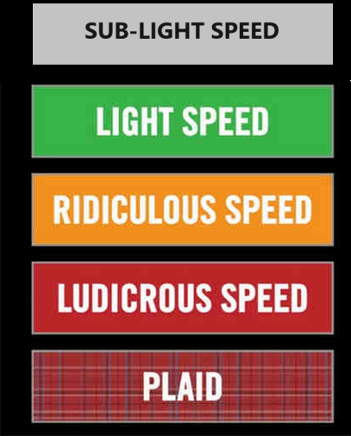
Comment resolution reports

Slide 6
Next Steps

Slide 7
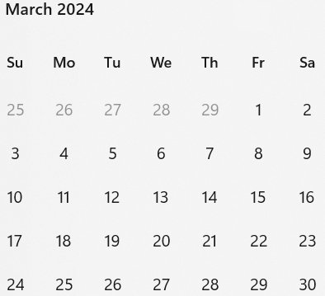
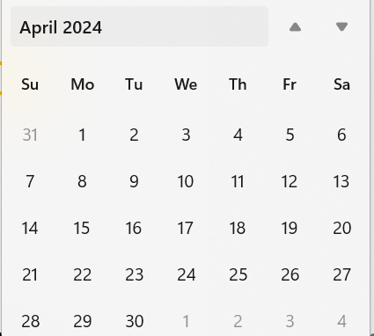
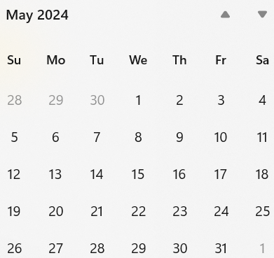
Call schedule, March thru May
Weekly on Tuesdays 2 hours split:
6am PT (1 hour)
3pm PT (1 hour)
Commencing 26-March-2024
April 30 (hour 1): Coexistence topics, Joint meeting with 802.11 CoEx SC

