Slide 1
Ascon: The Lightweight Cryptography Standard for IoT
Date: 2024-03-13
Authors:

Slide 2
Motivation

Slide 3
Internet of Things
There are over 15 billion connected IoT devices worldwide
  This number is expected to double by 2030
  Increasing number of devices running on battery power
Connected devices are subject to an increased attack surface
  Devices connected to the Internet can be attacked if not properly protected
  Each connected device adds a doorway for attackers
Strong need to protect data on IoT devices
  Secured data storage
  Secured communication
Palo Alto Networks 2020
IoT Threat Report:
98% of all IoT device traffic is unencrypted!
Notes:
https://unit42.paloaltonetworks.com/iot-threat-report-2020/

Slide 4
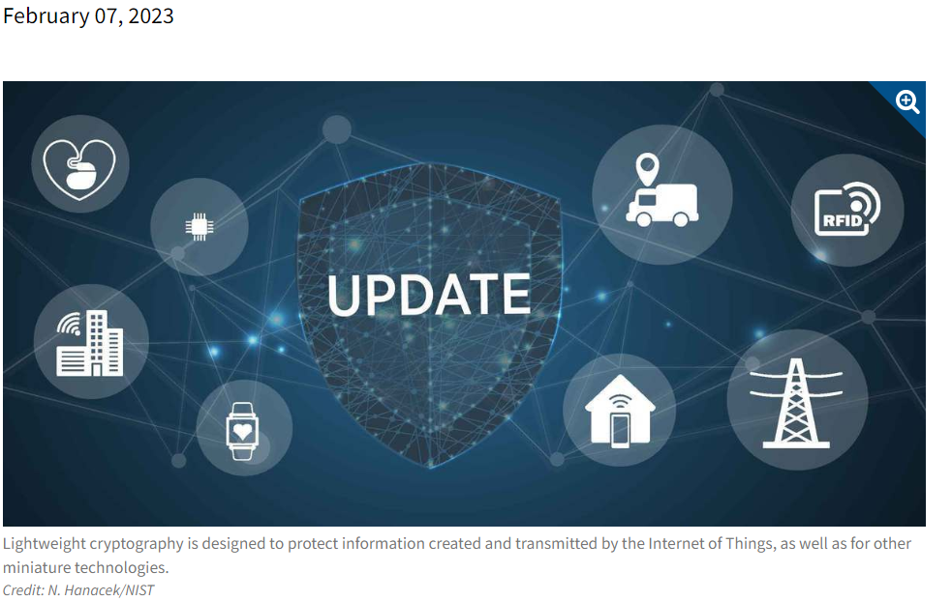
NIST selects Ascon as the standard to protect small devices
“The algorithms are designed to protect data created and transmitted
by the Internet of Things and other small electronics.”
NIST LWC competition (2019-2023)
Authenticated encryption and hashing
57 submissions, 3 rounds, 1 winner
https://csrc.nist.gov/projects/lightweight-cryptography
Inspired by
NIST AES, SHA-3, PQC competitions

Slide 5
Why Ascon? “We have AES and SHA!”
Ascon provides authenticated encryption and hashing with minimal overhead
Comparable security level as AES-128, SHA-256 and SHAKE128
More efficient on low-end devices (Ascon-128 vs AES128-GCM)
  Up to 3-5x speed on microcontrollers
  Up to 2x throughput with 0.5x energy in hardware
Very efficient to protect against physical attacks
  No table lookups, easy to mask, key used less often
Ascon allows to secure data, where this was considered too costly before
(energy, area, latency)

Slide 6
Ascon History
Cryptographic Competitions

Slide 7
History I - CAESAR
02/2014
Ascon-128 gets designed, based on well known principles and lots of experience
03/2014
Ascon enters CAESAR together with 56 competitors
07/2015
Ascon moves to 2nd round of CAESAR together with 28 competitors
08/2015
Ascon-128a added to the Ascon family
08/2016
Ascon moves to 3rd round of CAESAR together with 14 competitors
03/2018
Ascon becomes a finalist with 7 additional schemes
02/2019
Ascon-128 and Ascon-128a selected as first choice for lightweight applications

Slide 8
History II – NIST LWC
02/2019
Ascon is submitted to NIST LWC standardization effort, Ascon-Hash/Xof added
04/2019
NIST announces the 56 Round 1 Candidates
08/2019
Ascon is selected as one of 32 Round 2 Candidates
03/2021
Ascon is selected as one of 10 Finalists
05/2021
Ascon-Hasha/Xofa are added to NIST LWC
12/2021
Ascon-Mac/Prf are added to the Ascon family
02/2023
NIST announces to standardize Ascon for lightweight applications

Slide 9
The Ascon Family

Slide 10
The Ascon family
Authenticated encryption (CAESAR)
  Ascon-128
  Ascon-128a
Hashing (NIST)
  Ascon-Hash/Xof
  Ascon-Hasha/Xofa
Extensions (ePrint, CT-RSA)
  Ascon-Mac/Prf
  Ascon-PrfShort

Slide 11
The Ascon design basics
Permutation based
  Single 320-bit permutation (ALL)
Sponge based
  Absorb/squeeze (HASH, XOF)
  Duplex-mode (AEAD)
  High-rate absorption (MAC, PRF)
Keyed initialization/finalization
  Increases robustness (AEAD)

Slide 12
The design

Slide 13
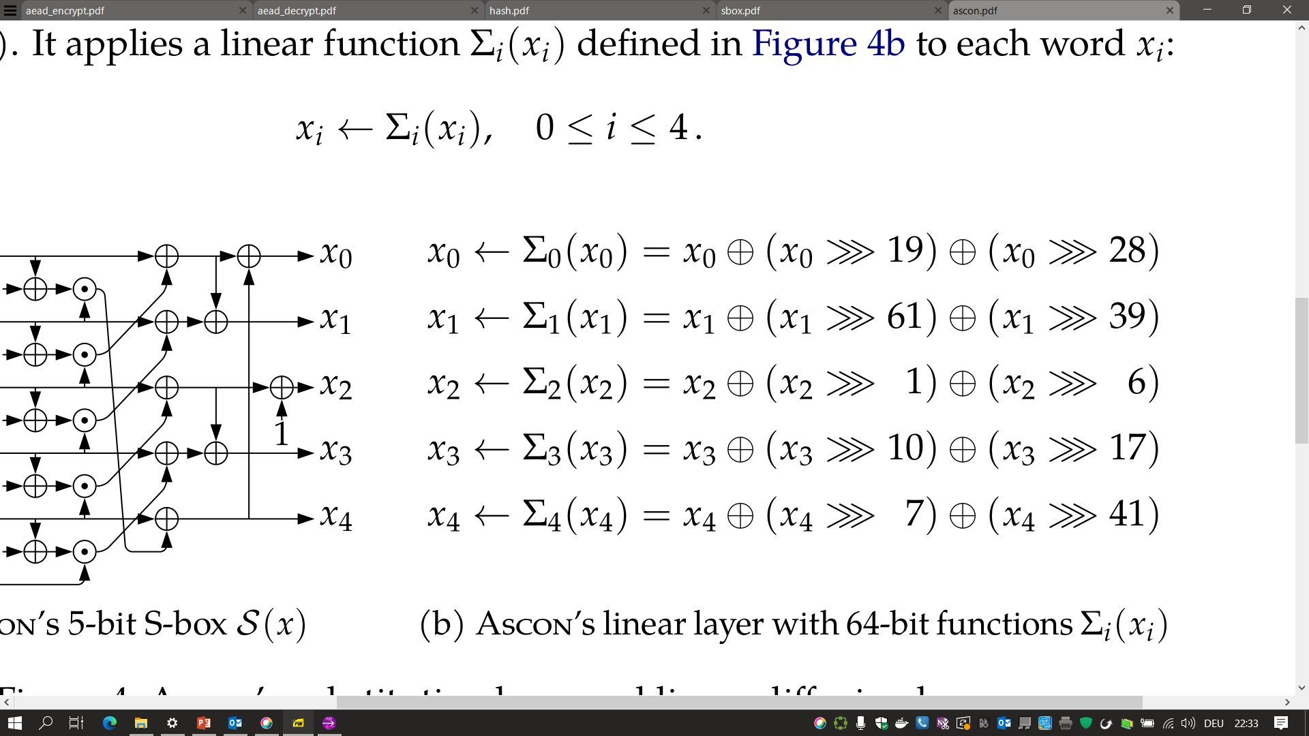
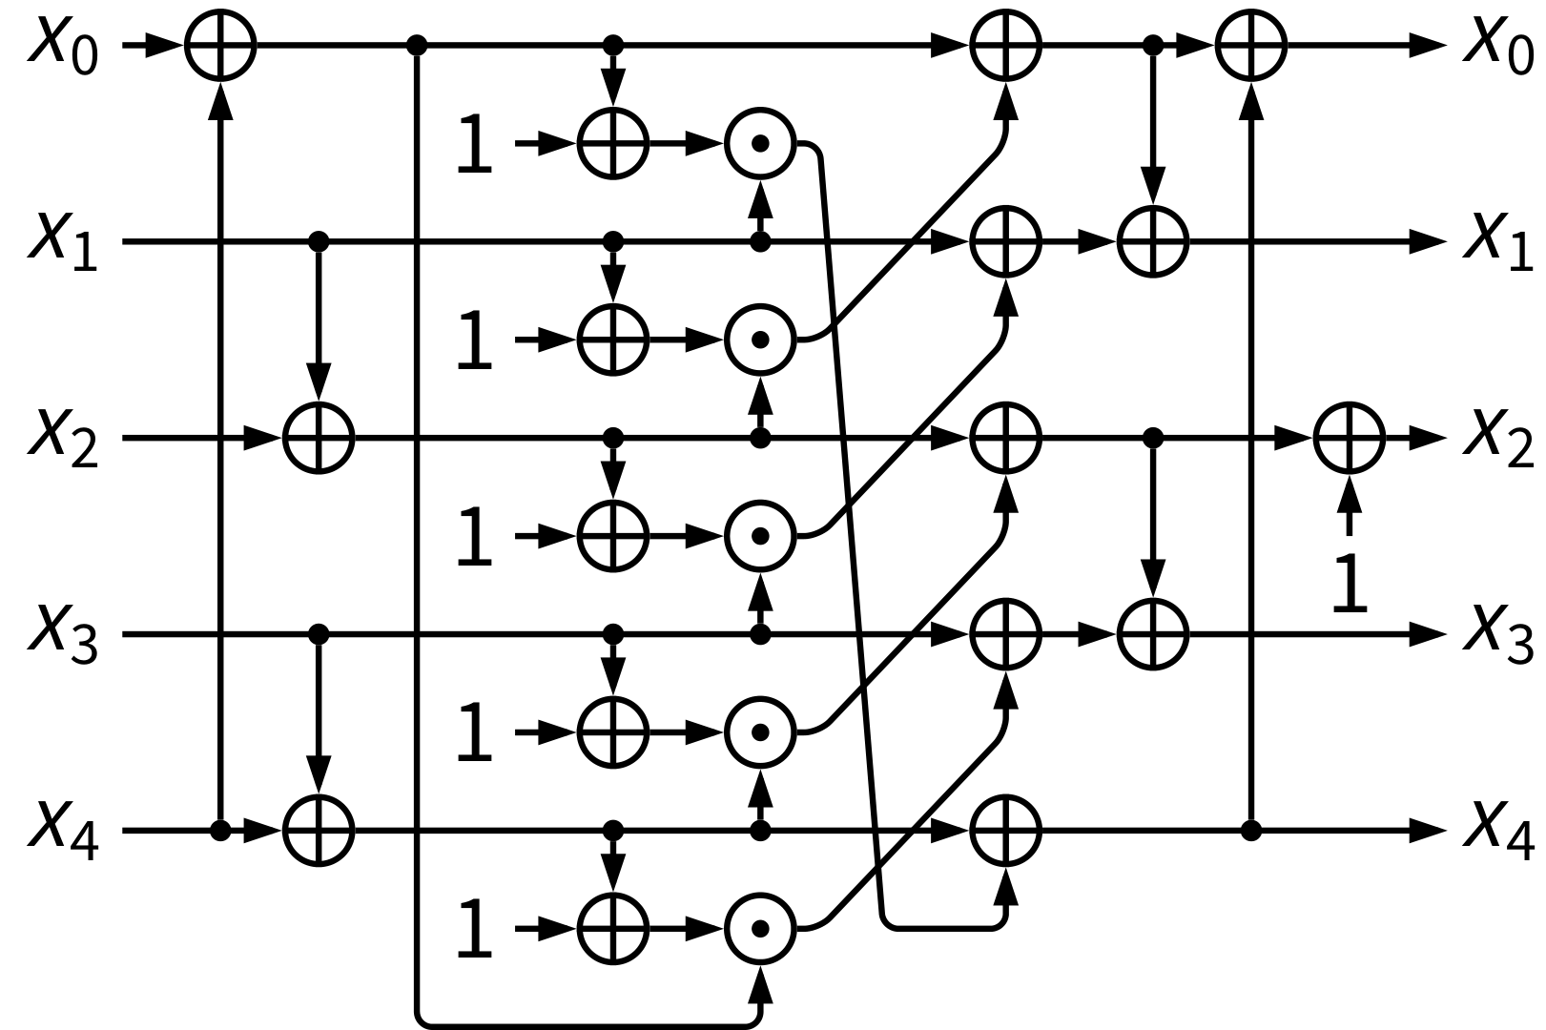
The permutation: 6/8/12 rounds
S-box layer
Linear layer

Slide 14
Properties of the permutation
Strong security properties
  High diffusion and proven bounds
Simplicity
  Small 320-bit state size
  Defined on five 64-bit words
  Using bitwise Boolean functions
Flexible in hardware
  Small area to high speed
Fast in Software
  Up to 5 instructions in parallel
  Bit-sliced S-box (64 in parallel)
  Bit-interleaving on 32-bit processors
Very efficient SCA countermeasures
  No S-box table look-ups
  Easy to mask in HW and SW
  Lower randomness requirements

Slide 15
Ascon: Authenticated encryption
Ascon-128 and Ascon-128a

Slide 16
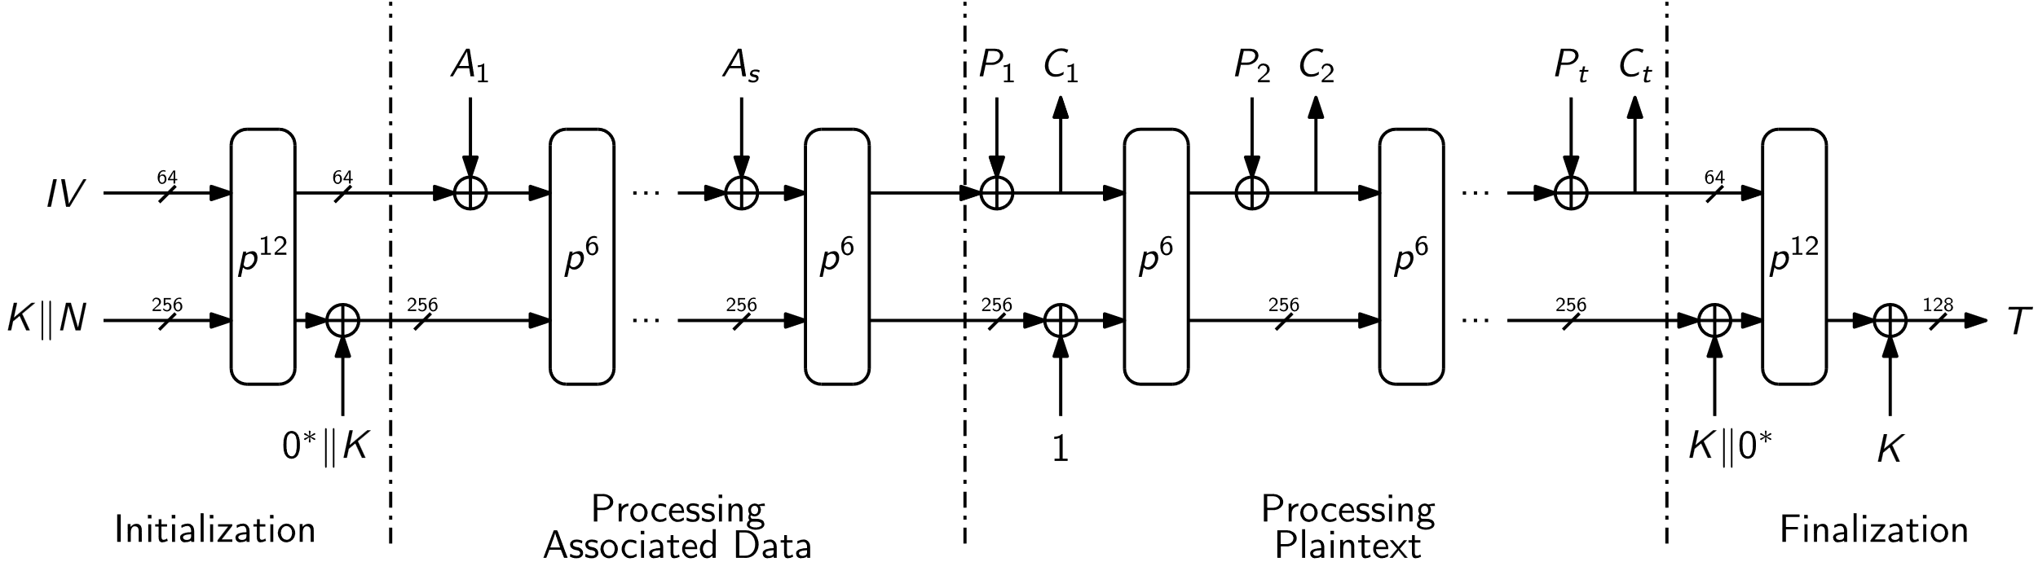
Ascon-128: Authenticated encryption
Encryption & Authentication
  (K, N, A, M) ⇒ (C, T)

Slide 17
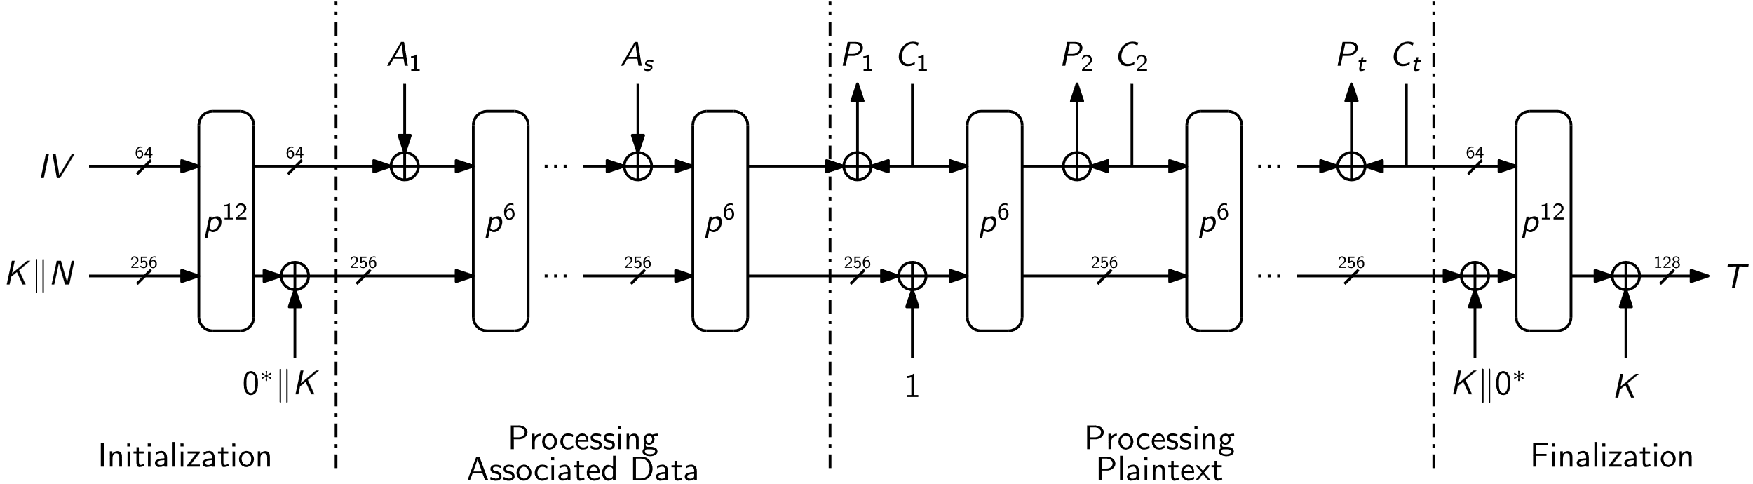
Ascon-128: Authenticated decryption
Decryption & Verification
  (K, N, A, C, T) ⇒ {M, ⊥}

Slide 18
AEAD Instances
Nonce-based AEAD, duplex sponge-based with keyed initialization and finalization
 | Ascon-128 | Ascon-128a
Security [bits] | 128 | 128
Key k [bits] | 128 | 128
Rate r [bits] | 64 | 128
Capacity c [bits] | 256 | 192
Rounds | (12,6) | (12,8)

Slide 19
Ascon-128 vs Ascon-128a
Same security, different trade-off (block size vs. number of rounds)
Both scrutinized for years in cryptographic competitions
Most security analysis can be applied to both algorithms
Tight security proof for Ascon (https://eprint.iacr.org/2023/775)
Ascon-128a: 33% higher performance and more energy efficient
Ascon-128: high robustness in case of state recovery (https://eprint.iacr.org/2023/796)

Slide 20
Larger nonce, shorter tags
We think that support for shorter tags is useful, e.g. 64, 96 and 128 bits
We would recommend to encode the size of the tag in the IV
We do not see the immediate need to support larger nonce than 128 bits, considering the limit on messages that can be encrypted under a single key
In case someone would like to use a fixed prefix in the nonce, we suggest to put this prefix into the associated data

Slide 21
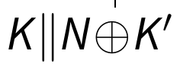
Secret nonce, larger keys
Also done for AES-GCM in TLS (RFC 8446)
Increases key size to 256 bits
Improves multi-user security (https://eprint.iacr.org/2023/924)

Slide 22
Ascon: Hashing
Ascon-Hash and Ascon-XOF

Slide 23
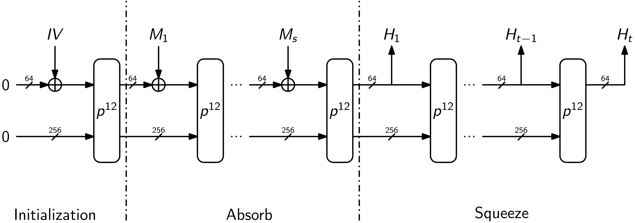
Ascon Hash / XOF
Ascon provides hashing at low overhead
Similar structure, same permutation as AEAD
Hash: Fixed output size (e.g. 256 bits)
XOF: Variable output size

Slide 24
Hash / XOF Instances
Uses the sponge construction, variable number of rounds for init/final and absorb/squeeze
 | Ascon-Hash/Xof | Ascon-Hasha/Xofa
Security [bits] | 128 | 128
Rate r [bits] | 64 | 64
Capacity c [bits] | 256 | 256
Rounds | (12,12) | (12,8)

Slide 25
Implementations
Fast and small

Slide 26
ASIC hardware benchmarks
Throughput in [bits/cycles]
 | Throughput | Area | Throughput / Area
Ascon-128a | 25.60 | 1.49 | 17.18
Ascon-128 | 16.00 | 1.56 | 10.25
AES128-GCM | 11.63 | 2.75 | 4.22
https://eprint.iacr.org/2021/049

Slide 27
Embedded implementations
Time to process NIST testvectors in [µs]
Code size in [bytes]
 | Uno | F1 | ESP | F7 | R5
Ascon-128a | 1981 | 66.4 | 18.4 | 11.8 | 7.3
Ascon-128 | 2337 | 76.7 | 22.3 | 13.8 | 8.5
AES128-GCM | - | 332.8 | 67.2 | 35.8 | 23.7
https://lwc.las3.de/
 | Uno | F1 | ESP | F7 | R5
Ascon-128a | 2544 | 2252 | 1200 | 1240 | 1792
Ascon-128 | 2552 | 2157 | 1120 | 1180 | 1792
AES128-GCM | - | 9908 | 14832 | 9836 | 14272
https://lwc.las3.de/

Slide 28
High-end SW performance
Runtime in [cycles/byte]
 | AMD Ryzen 9 | ARM Cortex-A72
Ascon-128a | 5.6 | 7.0
Ascon-128 | 8.1 | 10.5
AES128-GCM | 1.1* | 30.6
*with AES-NI
https://bench.cr.yp.to/
*with AES-NI
Notes:
throughput in [bits/cycle] and scaled area

Slide 29
Ascon hardware extensions/instructions
A Fast and Compact RISC-V Accelerator for RV32 (also ARM)
  RI5CY Ascon with 4.7kGE: speedup factor 50x
  Reuse 10 registers of CPU register file
  https://eprint.iacr.org/2020/1083
ARM Custom Datapath Extension, RISC-V Bitmanip Extension, ...
  32-bit funnel shift instructions (RV32B: FSRI, ESP32: SRC)
  32-bit interleaving instructions (RV32B: ZIP/UNZIP, ARM CDE: CX3)
  Fused AND/XOR, BIC/XOR instructions (ARM A64: BCAX, ARM CDE: CX3A)
  SHA-2 like Sigma instructions (ARM CDE: CX3DA)

Slide 30
Ascon Summary

Slide 31
Ascon Summary
Security
  Security level comparable as AES-128 and SHA-256
  Well analyzed/understood, large security margin
  High amount of external analysis
Efficiency
  More efficient on constraint devices in HW and SW
  Allows efficient side-channel protection
  Fast on modern CPUs
Flexibility
  Additional constructions like MAC, PRF, …

Slide 32
What’s next?
What’s next with NIST?
  NIST work with the Ascon designers to draft the new lightweight cryptography standard
  Draft will be available for public comments soon
  Ascon will be used in higher level standards, protocols and implementations
What’s next in IEEE 802?
  802 Tutorial (Monday)
  Contributions to 802.11 and 802.15 for consideration of Ascon

Slide 33
Thank you!

Slide 34
Backup slides

Slide 35
Ascon: PRF and MAC
Ascon-PRF and Ascon-MAC

Slide 36
Ascon PRF / MAC
We see the requirement for having efficient PRFs that can be used as, e.g., MACs, KDFs, or stream ciphers from an industry point of view
Efficient constructions exists for Ascon with low implementation overhead
(https://eprint.iacr.org/2021/1574)
Alternative constructions based on the Ascon-Hash (KMAC) or Ascon-AEAD might also be an option for some use cases, but are not as efficient

Slide 37
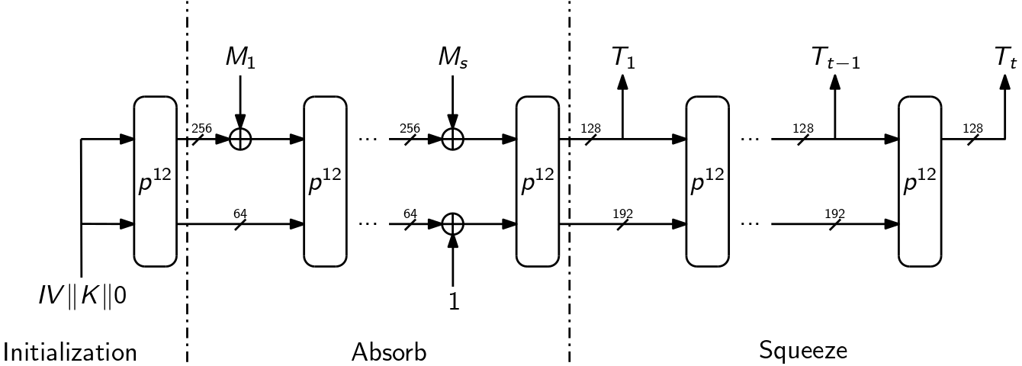
Ascon PRF and MAC
Initialization with key, 12 rounds
Absorb message in blocks of 256 bits (4x more efficient than Ascon-KMAC)
Squeeze tag in blocks of 128 bits

Slide 38
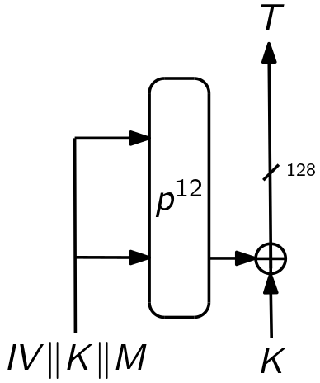
Ascon PRF-Short
Initialization of Ascon-128 (with different IV)
Nonce replaced by message (m ≤ 128 bits)
Generates tag (t ≤ 128 bits)
Applications:
  Symmetric authentication (challenge-response)
  Efficient key derivation
  Pointer Authentication
  …

