Slide 1
Study Group SUN PHY
Next Generation SUN PHY’s
Hybrid Meeting
March, 2024

Slide 2
Agenda
Existing LPWAN network interference model.
Narrow band FSK
Wi-SUN frequency hopping networks
CSS Networks

Slide 3
Asynchronous transmissions using 50-300kbps frequency hopping network with CCA (Wi-SUN like)
Asynchronous transmissions based on 10kbps FSK. These systems typically including frequency hopping, but there is no CCA.
Asynchronous transmissions based wideband CSS. These systems do not use frequency hopping, but there is basic CCA.

Slide 4
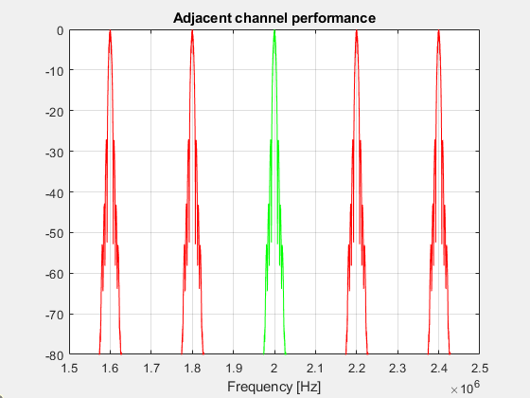
Narrow band FSK (10kbps), 200 KHz channel spacing

Slide 5
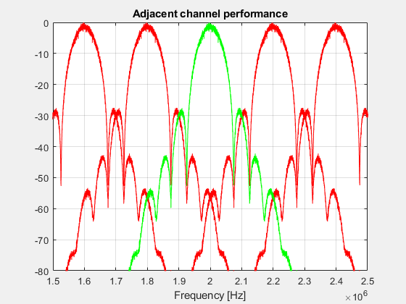
Medium data rate FSK (100kbps), 200kHz channel spacing

Slide 6
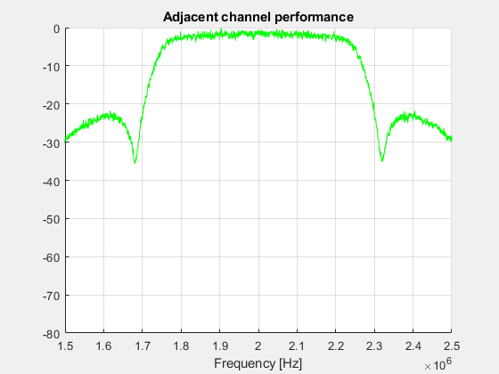
Emulation of CSS signal (500kHz occupied BW)

Slide 7
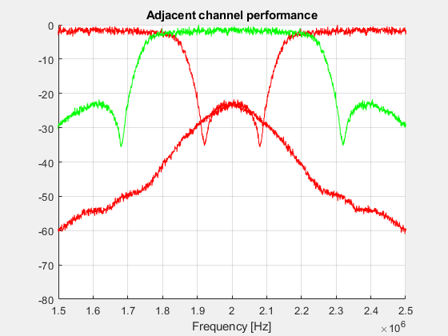
Emulation of CSS signal (500kHz occupied BW) (400 kHz channel spacing)

