Slide 1
Project: IEEE P802.15 Working Group for Wireless Specialty Networks (WSN)
Submission Title: Toward consensus before resolving MMS ranging CIDs
Date Submitted: March 2024
Source: Carl Murray (Qorvo)
Abstract: Need agreement on MMS operation before related CIDs can be resolved
Follow-up on document 15-24-0120-00-04ab
Notice: This document has been prepared to assist the IEEE P802.15. It is offered as a basis for discussion and is not binding on the contributing individual(s) or organization(s). The material in this document is subject to change in form and content after further study. The contributor(s) reserve(s) the right to add, amend or withdraw material contained herein.
Release: The contributor acknowledges and accepts that this contribution becomes the property of IEEE and may be made publicly available by P802.15.
Notes:
Jul 12, 2010
Page 1

Slide 2
Need for Consensus
There are several inconsistencies currently in Draft C that need to be addressed through agreement on the requirements before the following CIDs can be resolved.
  The MMS CIDs listed below are a consequence of this but cannot be resolved individually because the text in inconsistent in some areas.
  CIDs in related groups and in page order
    Related to Figure 21 – UWB MMS ranging transmission
      318, 683, 894 and 52
    Distinction between NBA and ‘non’-NBA
      7
    MMS configurations
      684, 212, 901, 29, 80, 729, 81, 90, 91, 296
    Multiple transmissions
      624, 332
    Related docs of interest - 15-23-0509-04-4ab, 15-24-0025-01-04ab
Answering the questions raised in the following slides will allow me to propose resolutions for the above CIDs.

Slide 3
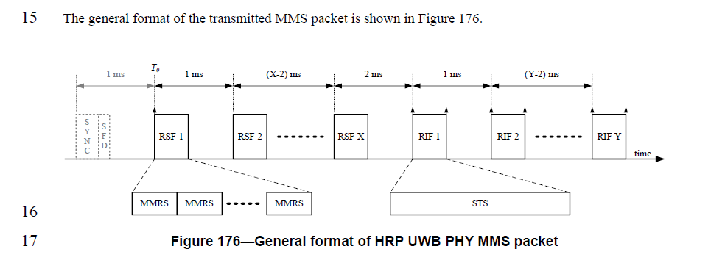
The UWB MMS packet
Figure from Clause 16.2.11.1 (Draft C page 160)
The UWB packet can be utilized by any protocol
  It is currently used by the protocol defined in 10.38 UWB Multi-millisecond (MMS) operation
    The ranging PHY for this protocol is always UWB
    At least 2 of the 3 other phases (see next slide) of this protocol can be implemented by either NB and/or UWB
  The optional SYNC+SFD are necessary to enable protocol(s) to implement 10.38.12.5 UWB Only MMS Operating Parameter Sets.

Slide 4
(Simplified) MMS Ranging Phases in 10.38
Initialization and Setup
Ranging Cycle
Control
Ranging
Report

Slide 5
MMS Ranging Mechanisms currently allowed by Draft C Text
(but with gaps and inconsistencies)
 |  | Init & Setup | Control | Ranging | Report
A | NBA | O-QPSK | O-QPSK | UWB | O-QPSK
B | NB + UWB report offload | O-QPSK | O-QPSK | UWB | UWB
C | NB + UWB control offload | O-QPSK | UWB | UWB | O-QPSK
D | NB init only | O-QPSK | UWB | UWB | UWB
E | UWB-driven | NS* | UWB | UWB | UWB
F | OOB mechanism | NS* | NS* | UWB | NS*
* Not Specified

Slide 6

Areas that need Consensus - Q1
TG4ab needs to agree on the configurations that the standard will support in the text.
TG4ab agrees that the standard will support the following configurations
  A
  B no support
  C no support
  D
  E
  F not specified
What category do configurations D belong (section 10.38.1, pg 42 – see next slide)?
  UWB-driven
TG4ab agree that the following configurations qualify as an HRP-ARDEV
  A, D, E

Slide 7
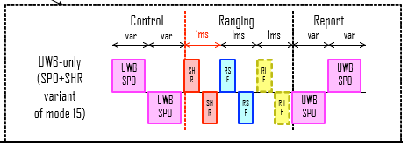

Areas that need Consensus - Q2
TG4ab need to agree the UWB packet format in the Control phase
A
SP0
POLL
SHR
RSF
RIF
SP0
C
SP0
POLL
RSF
RIF
SP0
RPT
RPT
SP0
RESP
SHR
RSF
RIF
SP0
SP0
RESP
RSF
RIF
SP0
RPT
RPT
Control
(10.38.4)
Report
(10.38.6)
report
Control
(10.38.4)
Report
(10.38.6)
report
control
ranging
control
ranging
B
SHR
POLL
SHR
RSF
RIF
SP0
D
SHR
POLL
SP0
RPT
RSF
RIF
Ranging
(10.38.5)
RPT
SHR
RESP
SHR
RSF
RIF
SP0
SHR
RESP
RSF
RIF
SP0
RPT
RPT
Control
(10.38.4)
Report
(10.38.6)
report
Control
(10.38.4)
Report
(10.38.6)
control
ranging
control
ranging
report

Slide 8
Areas that need Consensus - Q3
TG4ab need to agree when the optional SYNC+SFD of the MMS packet is enabled
In configuration A there is no SYNC+SFD in the MMS packet
In configuration D and E the SYNC+SFD is in the MMS packet
In configuration F use of the SYNC+SFD is not specified by 15.4ab

Slide 9
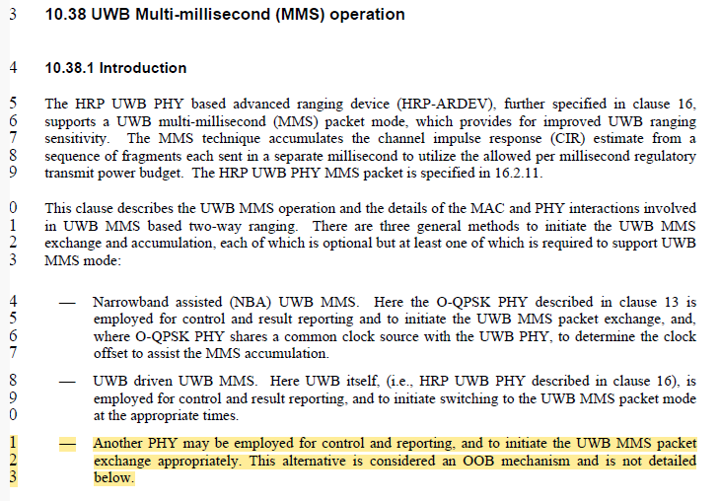
Draft C text related to Q3 (1 of 3)

Slide 10
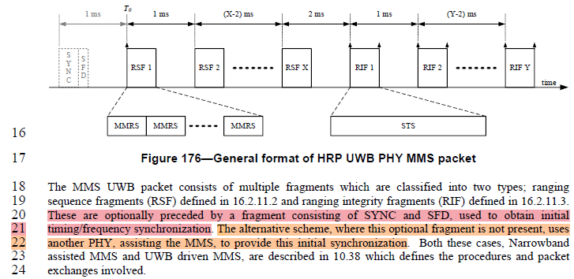
Draft C text related to Q3 (2 of 3)
Pg 160
CID #878 changes
“In the case of UWB-driven UWB MMS, the RSFs or RIFs are preceded by a fragment consisting of SYNC and SFD that are formatted according to the HPRF mode as specified in 16.2.6 and are used to obtain initial timing and frequency synchronization.”
“In the case of NBA UWB MMS, another narrowband PHY packet precedes the RSF/RIFs and assists the MMS to provide this initial synchronization.”

Slide 11
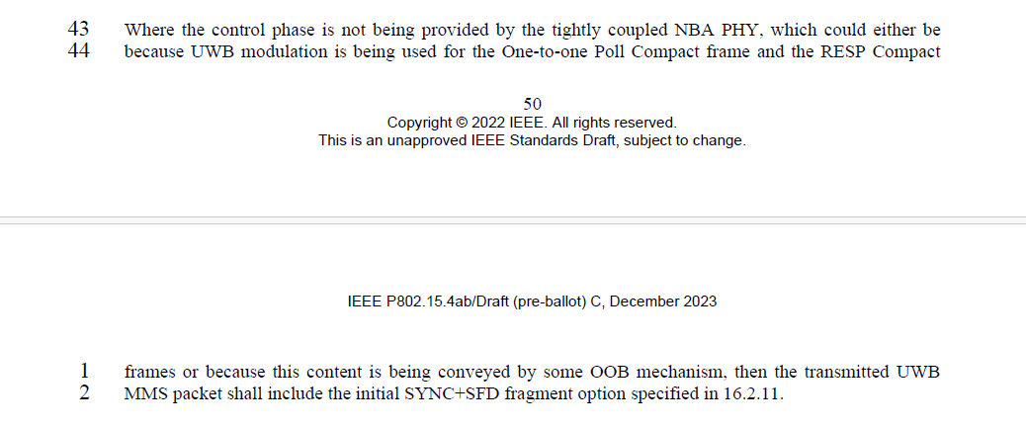
Draft C text related to Q3 (3 of 3)

Slide 12
Areas that need Consensus - Q4
Need to agree if the configurations are static? (eg do not allow to the short term parameters switch between them)
  Answer to Q1 eliminates B and C
  Therefore, the question here becomes can you dynamically switch between A and D/E
TG4ab agree that using short term parameters to dynamically switch between these configurations (see above) will not be done

Slide 13
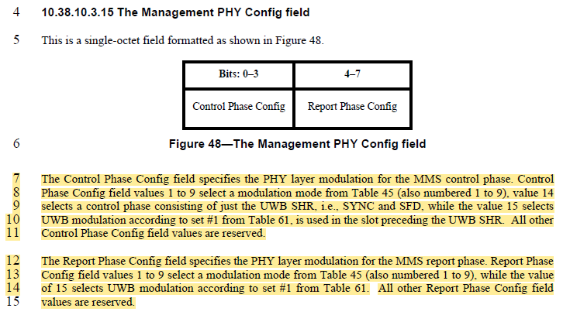
Draft C text related to Q4

Slide 14
Areas that need Consensus - Q5
Is the same UWB channel used for all phases?
  (e.g. do Report and Control use the same channel as ranging)?
Agree that when UWB is being used in MMS ranging that all phases using UWB use the same UWB channel

Slide 15
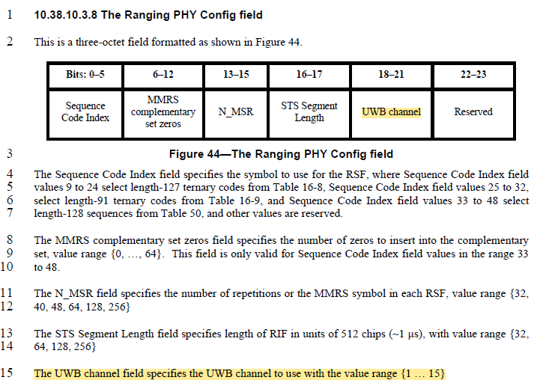
Draft C text related to Q5

Slide 16
Areas that need Consensus - Q6
What preamble code is used in the UWB SP0 packets?
  Note that the preamble code for the control and report packet is currently defined as a function of the ‘Sequence Code Index’ field in the Ranging PHY Config
    This field can contain length-127 and length-91 ternary codes but SP0 is HPRF only
    The current mapping does not take account of length-127 RSF codes
    The current mapping imposes a hard link between SP0 and the RSF codes
Extend the existing Sequence Code Index field mapping to map length-127 RSF codes to length-91 SP0 codes?

Slide 17
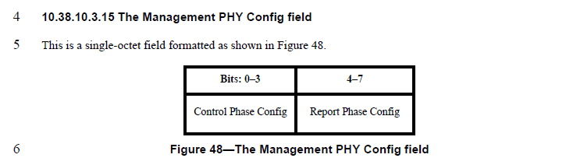
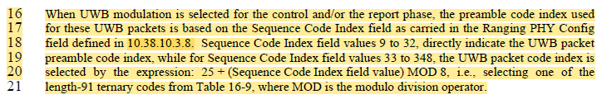
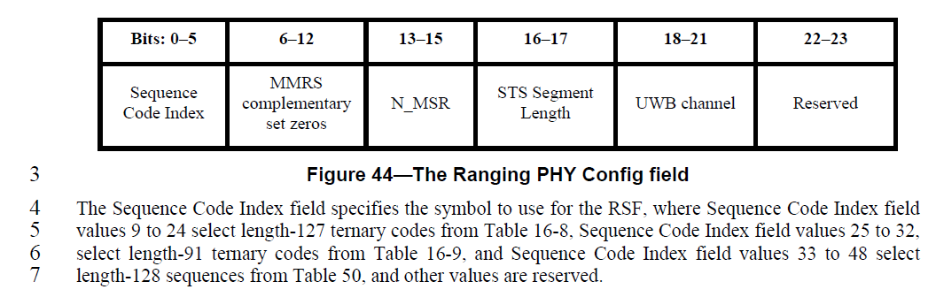
Draft C text related to Q6 and Q7
Pg 70
Pg 67

Slide 18
Areas that need Consensus - Q7
What is the preamble code for the MMS Packet SYNC+SFD
  Currently this is not defined – only requirement is that is HPRF
  Update to Draft C #878 (page 160, line 20 change)
    “In the case of UWB-driven UWB MMS, the RSFs or RIFs are preceded by a fragment consisting of SYNC and SFD that are formatted according to the HPRF mode as specified in 16.2.6 and are used to obtain initial timing and frequency synchronization.”
Propose that the SYNC+SFD should use the same formula as currently defined for SP0 extended to take account of length-127 RSF (BPRF) codes.
  This mapping imposes a hard link between SYNC+SFD code and the RSF codes

