Slide 1
Project: IEEE P802.15 Working Group for Wireless Specialty Networks (WSNs)
Submission Title: OCC Enabled Software Defined Vehicular Networks for NG-OCC
Date Submitted: March 11, 2024
Source: Muhammad Adnan, Nguyen Ngoc Huy, Yeong Min Jang (Kookmin University)
Address: Room #603 Mirae Building, Kookmin University, 77 Jeongneung-Ro, Seongbuk-Gu, Seoul, 136702, Republic of Korea
Voice: +82-2-910-5068 E-Mail: yjang@kookmin.ac.kr
Re:
Abstract: Present the OCC Enabled Software Defined Vehicular Networks for NG-OCC
Purpose: Presentation for contribution on IG NG-OCC
Notice: This document has been prepared to assist the IG NG-OCC. It is offered as a basis for discussion and is not binding on the contributing individual(s) or organization(s). The material in this document is subject to change in form and content after further study. The contributor(s) reserve(s) the right to add, amend or withdraw material contained herein.
Release: The contributor acknowledges and accepts that this contribution becomes the property of IEEE and may be made publicly available by IG NG-OCC.

Slide 2
OCC Enabled Software Defined Vehicular Networks for NG-OCC March 11, 2024

Slide 3
Contents
Background
OCC Based IoV
OCC Enabled Software Defined Vehicular Networks for NG-OCC
Conclusion

Slide 4
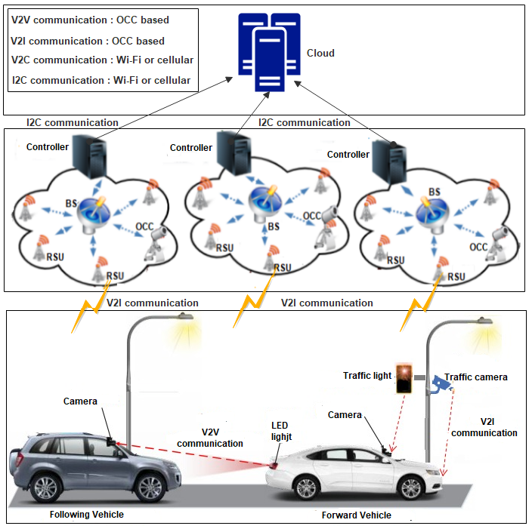
Background: OCC Based IoV
An overview of OCC-based IoV architecture is proposed in [1], where the combination of the cloud and the vehicular communication system uses OCC for V2V and V2I communication to exchange information about the fundamental status of the vehicle and event-triggered notifications of emergencies to distribute the necessary information in a real-time environment.
Four different forms of communication are included in their proposed architecture: OCC-based V2V and V2I communication and Wi-Fi or cellular-based V2C and I2C communication.
The bottom layer of Fig. 1 shows the vehicular communication mechanism using OCC for V2V and V2I communication uses vehicle backlight LED lights (Tx) and a camera (webcam or high-speed camera) as Rx.
Tx transmits vehicle status or traffic conditions, while Rx receives information from image sensors. Forward vehicles transmit information through LEDs, while following vehicles receive it using a camera. Traffic lights also transmit data.
Fig.1:OCC-based IoV architecture

Slide 5
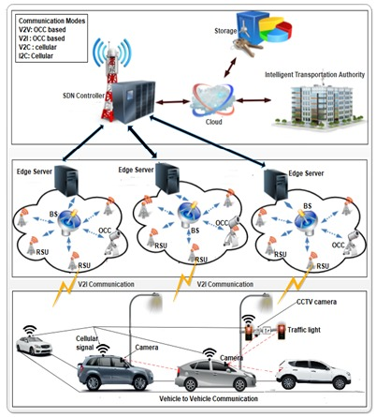
OCC Enabled Software Defined Vehicular Networks for NG-OCC
Designing a next-generation OCC-based SDVN architecture involves integrating OCC technology with vehicular ad-hoc network concepts and leveraging software-defined principles for efficient resource management.
Architecture Components:
OCC Infrastructure: This includes LED lights installed on vehicles or roadside infrastructure for data transmission.
Vehicle Cameras: Vehiclea are equipped with cameras capable of capturing optical signals from other vehicles or infrastructure.
Software-Defined IoV Module: The SDN controller is responsible for managing communication resources, routing, and optimizing data transmission.
Cloud or Edge Computing: Processing and analyzing data collected from OCC-enabled vehicles to provide actionable insights and services.
Design Considerations:
Inter-Vehicle Communication: OCC uses vehicle backlight LED lights or traffic lights as Tx and camera (webcam or high-speed camera) as Rx. The Tx (traffic light or vehicles rear LEDs) transmit the vehicles status or the traffic condition. Then, the receiver can be a single or pair of image sensor which receives the transmitted information from the Tx.
Fig.1:OCC-based IoV architecture

Slide 6
Continue...
Design Considerations:
Infrastructure Integration: In Vehicle to Infrastructure (V2I) communications, messages from the networks to the vehicles are transported over the links between traffic lights and cameras mounted on the vehicles, while data is transmitted from the headlights and taillights of vehicles to roadside networking infrastructures through traffic cameras intended to monitor such light sources.
Through the use of cellular technology, Vehicle to Cloud (V2C) allows both forwarding and following vehicles to exchange information with a cloud server.
Software-Defined Management: The SDN controller enable dynamic allocation and optimization of communication resources, ensuring efficient IoV operations.

Slide 7
Conclusion
The main features of SDN, like flexibility, programmability, and centralized control, make the network’s design and deployment scalable and straightforward.
The SDN controller builds a global view of the communication infrastructure and distributes its policy rules.
The SDN controller has a clear scope for the state of the entire network.
The next-generation OCC-based Software-Defined Vehicular Network (SDVN) architecture offers significant benefits in terms of QoS in traffic management, efficiency, connectivity, safety and data-driven insights.
By integrating OCC technology with IoV concepts and leveraging software-defined principles, we can enable innovative applications and services that enhance the overall transportation ecosystem.

Slide 8
Reference
[1] Hasan, M. K., Ali, M. O., Rahman, M. H., Chowdhury, M. Z., & Jang, Y. M. (2021). Optical camera communication in vehicular applications: A review. IEEE transactions on intelligent transportation systems, 23(7), 6260-6281.

