Slide 1
Project: IEEE P802.15 Working Group for Wireless Personal Area Networks (WPANs)
Submission Title: [RR IE signaling rule for hyper block mode]
Date Submitted: [Mar, 2024]
Source: [Hongwon Lee, Insun Jang, Jinsoo Choi, Hangyu Cho(LG Electronics)]
Email: hongwon.lee@ lge.com
Re: []
Abstract: [Explaining why RR IE signaling rule is added for hyper block mode]
Purpose: []
Notice: This document has been prepared to assist the IEEE P802.15. It is offered as a basis for discussion and is not binding on the contributing individual(s) or organization(s). The material in this document is subject to change in form and content after further study. The contributor(s) reserve(s) the right to add, amend or withdraw material contained herein.
Release: The contributor acknowledges and accepts that this contribution becomes the property of IEEE and may be made publicly available by P802.15.

Slide 2
PAR Objective | Proposed Solution (how addressed)
Safeguards so that the high throughput data use cases will not cause significant disruption to low duty-cycle ranging use cases
Interference mitigation techniques to support higher density and higher traffic use cases
Other coexistence improvement
Backward compatibility with enhanced ranging capable devices (ERDEVs)
Improved link budget and/or reduced air-time
Additional channels and operating frequencies
Improvements to accuracy / precision / reliability and interoperability for high-integrity ranging
Reduced complexity and power consumption
Hybrid operation with narrowband signaling to assist UWB
Enhanced native discovery and connection setup mechanisms
Sensing capabilities to support presence detection and environment mapping
Low-power low-latency streaming
Higher data-rate streaming allowing at least 50 Mbit/s of throughput
Support for peer-to-peer, peer-to-multi-peer, and station-to-infrastructure protocols | Propose block structure mode allowing efficient use of slot resources and may accommodate various new 4ab features
Infrastructure synchronization mechanisms

Slide 3
Related Contributions
[1] Hyper Block-based Mode
Y. So, M. Lee(Samsung) et al., Mar. 2023
[2] Block Assignment in Hyper Blocks
R. Chitrakar (Huawei) et al., May. 2023
[3] IEEE Std 802.15.4z

Slide 4
Background
Hyper Block mode is a group of ranging blocks. Hyper block-based mode uses the time structure that is periodic [1]
Each hyper block consists of a whole number of blocks
In the hyper block-based mode, it is allowed for the different blocks within a hyper block to have different configuration for block duration, round duration, and slot duration
To do round hopping, the controlee should hop to one of round at the block having the same Block Index number in the next hyper block [2]
In case of Hyper Block-based mode, it is assumed to specify Hyper Block Index for the ranging hyper block and controlee can assume the block index will be the same with previous hyper block
The Ranging Block Index in RR IE is revised to support Hyper Block mode
The RR IE signaling rule in 15.4z [3] needs to be revised for hyper block mode, as the RR IE signaling rule in 15.4z currently supports only block-based mode

Slide 5
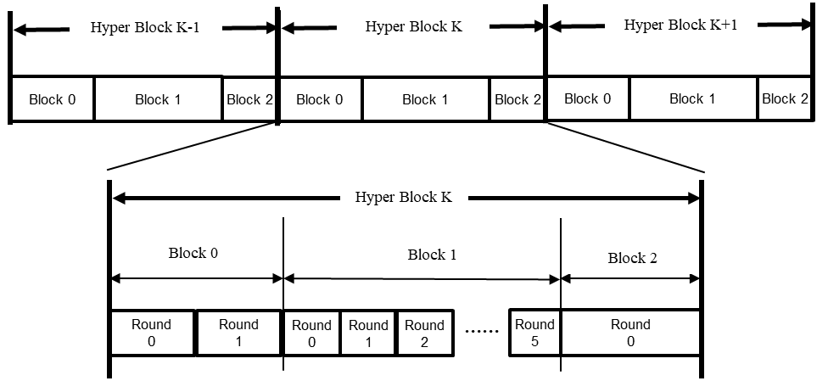
Recap: Hyper Block mode [1][2]
A hyper block is a group of blocks.
Hyper block mode uses the time structure that is periodic
Allows for the different blocks to have different configuration
For block duration, round duration, and slot duration.

Slide 6
Recap: RR IE Signaling Rule [3]
The Ranging Round IE (RR IE), as defined in 10.31.9.3 can be used to signal the ranging round information regarding:
The current ranging round (i.e., ranging round in the current ranging block i). In this case, ① the RR IE will be included in the RCM of ranging block i.
The next ranging round (i.e., ranging round in the next ranging block i + 1). In this use case, if the last scheduled message in the current ranging round (of ranging block i) is a message sent by the controller to the controlees, ② the RR IE will be sent in this final message to signal ranging round information for ranging block i + 1. If the last scheduled message in the current ranging round (of ranging block i) is not from the controller but from a controlee, then the controller will send the RR IE in the RCM of the next ranging block (ranging block i + 1) to signal the ranging round information for ranging block i + 2. 3) ③ In this case, the RCM of ranging block i + 1 will have two instances of the RR IE. The first one is applicable to a ranging round in ranging block i + 1 and the second one is applicable to ranging block i + 2.

Slide 7
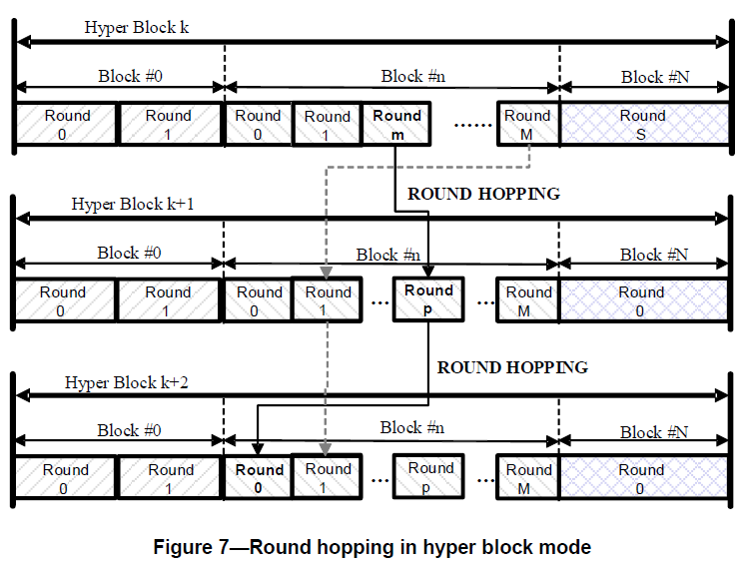
Recap: Round hopping in Hyper Block mode [2]
To do round hopping, the controlee should hop to one of round at the block having the same Block Index number in the next hyper block.
Then, transmission at m-th Round in n-th Block within k-th Hyper Block hops to p-th Round in n-th Block within (k+1)-th Hyper Block (m!=p)

Slide 8
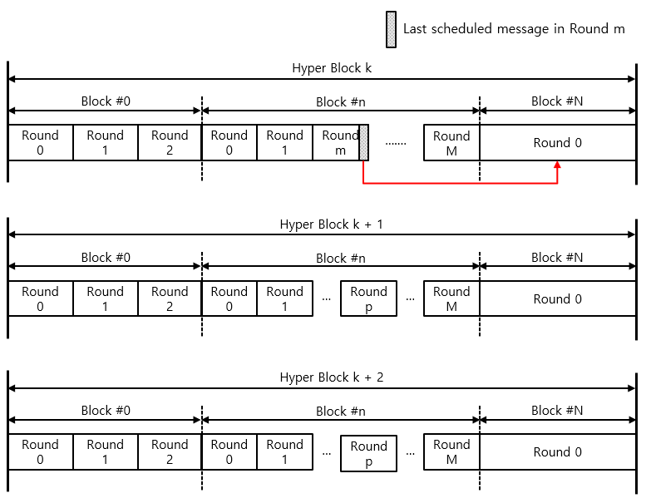
15.4z RR IE signaling for Hyper block mode
Sending RR IE in the final message of the ranging round to signal the next ranging round information may result in incorrect indications in Hyper block mode

Slide 9
RR IE Rule for Hyper block mode(1/2)
The Ranging Round IE (RR IE), can be used to signal the ranging round information for Hyper Block mode regarding:
① In case RR IE is sent at the RCM of the current ranging round in ranging block n of hyper block k, the current ranging round information in ranging block n of hyper block k is indicated
② In case RR IE is sent at the last message of the current ranging round in ranging block n of hyper block k(Last message is sent from a controller), the ranging round information in ranging block n of hyper block k + 1 is indicated
③ In case RR IE is sent at the RCM of the current ranging round in ranging block n of hyper block k + 1(Last message is not sent by a controller in this case), there are 2 RR IE instances. First RR IE indicates the ranging round information in ranging block n of hyper block k + 1 and second RR IE indicates the ranging round information in ranging block n of hyper block k + 2

Slide 10
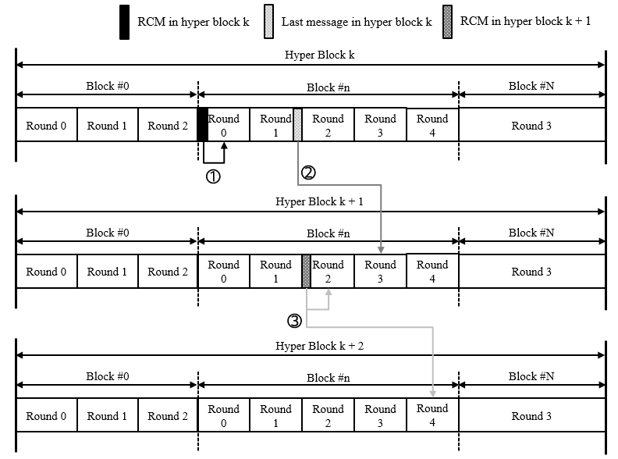
RR IE Rule for Hyper block mode(2/2)

Slide 11
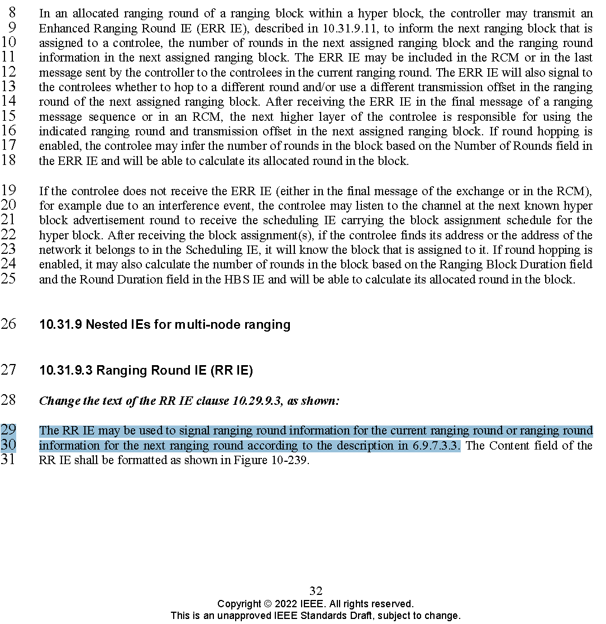
Resolution Proposal
The RR IE may be used to signal ranging round information for the current ranging round or ranging round information for the next ranging round, in both block-based mode and hyper block mode according to the description in section 6.9.7.3.3. However, in case of hyper block mode, the "next ranging block" or “ranging block i+1” mentioned in section 6.9.7.3.3 does not specify the next ranging block in the current hyper block (k), but rather specifies the ranging block in the next hyper block with the same block index as the current ranging block (i.e., ranging block i in hyper block k+1).

Slide 12
Summary
In Hyper block mode, it is necessary to introduce a new RR IE signaling rule for indicating ranging round information. The RR IE signaling rule from 4z supports only block-based mode
If the RR IE signaling rule from 4z is followed in Hyper block mode, there is a risk of incorrectly indicating ranging round information
The hopping mechanism for Hyper block mode differs from that of the block-based mode. (i.e. To do round hopping, the controlee should hop to one of round at the block having the same Block Index number in the next hyper block)
To ensure indication of ranging round information using RR IE works correctly based on hyper block hopping mechanism, a new RR IE signaling rule should be added

Slide 13
References
[1] Y. So, M. Lee et al., “Proposed Text for 4ab MAC - Hyper Block-based Mode”, 15-23-0155-01-04ab.
[2] R. Chitrakar (Huawei) et al., “Proposed Text for 4ab MAC – Block Assignment in Hyper Blocks”, 15-23-0215-02-04ab.
[3] Amendment 1: Enhanced Ultra Wideband (UWB) Physical Layers (PHYs) and Associated Ranging Techniques - IEEE Std 802.15.4z™‐2020

