Slide 1
        DOC: 15-24-0133-00-04ab
Project: IEEE P802.15 Working Group for Wireless Personal Area Networks (WPANs)
Submission Title: UWB control and ranging phase discussions
Date Submitted: March 3, 2024
Source: Riku Pirhonen (NXP)
Abstract: Discussion how 4ab draft C supports use of UWB for control and reporting
Purpose: Explain how 4ab draft C can be used to configure UWB control, ranging and reporting phases
Notice: This document has been prepared to assist the IEEE P802.15. It is offered as a basis for discussion and is not binding on the contributing individual(s) or organization(s). The material in this document is subject to change in form and content after further study. The contributor(s) reserve(s) the right to add, amend or withdraw material contained herein.
Release: The contributor acknowledges and accepts that this contribution becomes the property of IEEE and may be made publicly available by P802.15.

Slide 2
UWB control and ranging phase discussions

Slide 3
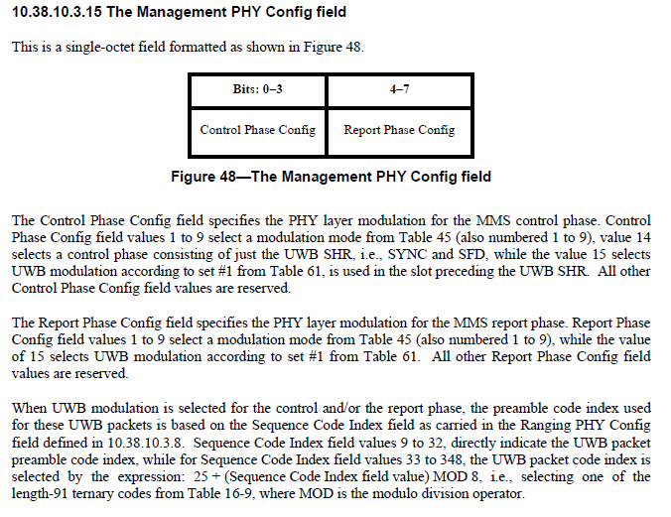
Management PHY Config Field (10.38.10.3.15)
This refers to SP0 + SHR configuration, option 4) in the upcoming slides.
Preamble definition
(should be “ 33 to 48”)

Slide 4
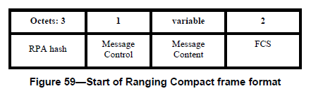
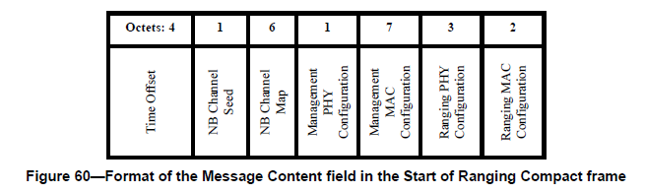
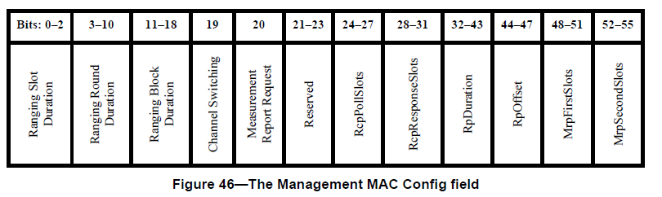
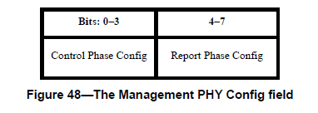
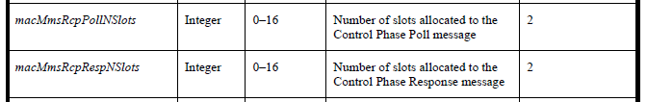
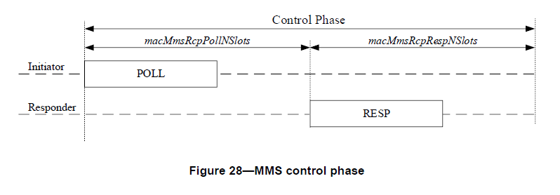
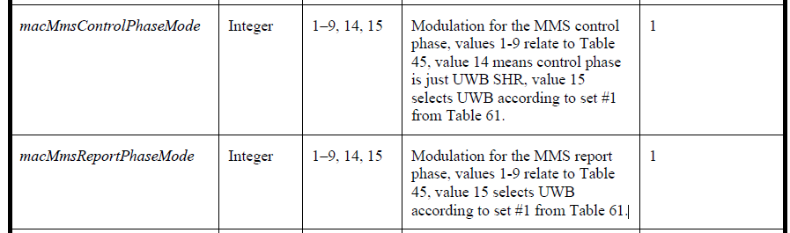

Start of Ranging (10.38.10.6)
0 - 15
0 - 15
Value | macMmsControlPhaseMode | macMmsReportPhaseMode
14 | SHR only with values from Set #1, Table 61 | -
15 | Set #1, Table 61 | Set #1, Table 61
15
15
For more information, see Table 9

Slide 5
1) NB Poll and Response
NB used for poll and response, the reference case
Initialization Channel
t
i
o
me
f
f
se
AD
t
V
AD
Initiator
PO
V
SO
R
Advertising Poll
Advertising Response
Start of Ranging
L
L
PO
L
L
Responder
SCAN
SCAN
AD
R
V
ESP
time
Ranging Channel
NB channel
Initiator
NB
POLL
NB
RPT
UWB channel
UWB RANGING
Responder
NB
RESP
NB
RPT
Control
(10.38.4)
Report
(10.38.6)
Initialization and Setup
Ranging
(10.38.5)

Slide 6
2) UWB Poll and Response with SHR
SHR used for poll and response, direct adaption of compact frame without payload
Initialization Channel
t
i
o
me
f
f
se
AD
t
V
AD
Initiator
PO
V
SO
R
Advertising Poll
Advertising Response
Start of Ranging
L
L
PO
L
L
Responder
SCAN
SCAN
AD
R
V
ESP
time
Ranging Channel
NB channel
Initiator
SHR
POLL
SP0
RPT
UWB channel
UWB RANGING
Responder
SHR
RESP
SP0
RPT
Control
(10.38.4)
Report
(10.38.6)
Initialization and Setup
Ranging
(10.38.5)

Slide 7
3) UWB Poll and Response with SP0
SP0 based control, direct adaption of compact frame with payload
Initialization Channel
t
i
o
me
f
f
se
AD
t
V
AD
Initiator
PO
V
SO
R
Advertising Poll
Advertising Response
Start of Ranging
L
L
PO
L
L
Responder
SCAN
SCAN
AD
R
V
ESP
time
Ranging Channel
NB channel
Initiator
SP0
POLL
SP0
RPT
UWB channel
UWB RANGING
Responder
SP0
RESP
SP0
RPT
Control
(10.38.4)
Report
(10.38.6)
Initialization and Setup
Ranging
(10.38.5)

Slide 8
4) UWB Poll and Response with SP0 and SHR
SP0 for control and SHR for additional SYNC
Initialization Channel
t
i
o
me
f
f
se
AD
t
V
AD
Initiator
PO
V
SO
R
Advertising Poll
Advertising Response
Start of Ranging
L
L
PO
L
L
Responder
SCAN
SCAN
AD
R
V
ESP
time
Ranging Channel
NB channel
Initiator
SP0
CTRL
SHR
POLL
SP0
RPT
UWB channel
UWB RANGING
Responder
SP0
CTRL
SHR
RESP
SP0
RPT
Control
(10.38.4)
Report
(10.38.6)
Initialization and Setup
Ranging
(10.38.5)

Slide 9
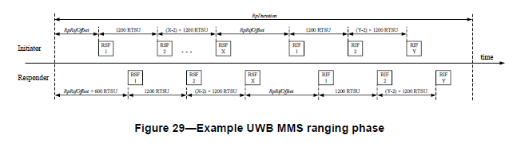
UWB MMS Ranging Phase (10.38.5)
RpRsfOffset was discussed in January meeting, default value 0 ms, but left there for possible other needs
RpRifOffset after RSF defined as 2 ms
How to add (optional) SHR to ranging phase?

Slide 10
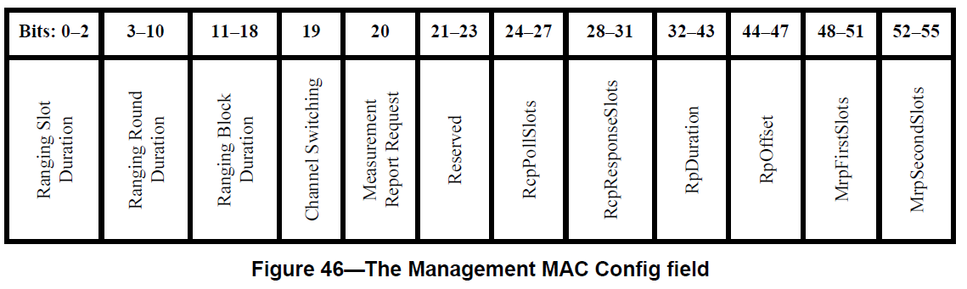
SP0 + SHR with RpRsfOffset and RpRifOffset
RpRsfOffset/RpRifOffset (10.38.5) proposed to be used to set offset and leave room for SHR poll/response
RpRsfOffset is set by RpOffset in the Management MAC Config field (10.38.10.3.10, Figure 46)
Initialization Channel
t
i
o
me
f
f
se
AD
t
V
AD
Initiator
PO
V
SO
R
Advertising Poll
Advertising Response
Start of Ranging
L
L
PO
L
L
Responder
SCAN
SCAN
AD
R
V
ESP
RpRsfOffset/RpRifOffset
(10.38.5)
Ranging Channel
NB channel
Initiator
SP0
CTRL
SHR
POLL
SP0
UWB MMS
RANGING
RPT
UWB channel
Responder
SP0
CTRL
SHR
RESP
SP0
RPT
Control
(10.38.4)
Report
(10.38.6)
Initialization and Setup
Ranging
(10.38.5)
Would have to be used also in case of RIF only mode

Slide 11
Reference: Summary of the options by Alex
NBA
-
UWB MMS TFD (DCN 23
-
100r3)
consensus:
with NBA
Control
Ranging
Report
OOB/any
?
Ranging
OOB/any
var
var
1ms
1ms
var
var
var
w/o NBA
var
1ms
1ms
1ms
var
var
UWB
-
only
NB
RS
RI
NB
(generic
?
SH
RS
RI
?
NBA
F
F
mode 14)
R
F
F
-
UWB MMS
NB
RS
R I
differs in PHY
SH
RS
R I
F
F
NB
PHY compliant
?
R
F
F
?
UWB
-
same MAC
only MAC variants
(where should SHR go?)
Control
Ranging
Report
Control
Ranging
Report
Control
1ms
Ranging
Report
var
var
1ms
1ms
var
var
var
var
1ms
1ms
1ms
var
var
var
var
1ms
1ms
var
var
UWB
-
UWB
only
-
discussion:
UWB
only
-
only
UWB
RS
RI
UWB
(SP0+SHR
UWB
SH
RS
RI
UWB
(SP0+SHR
UWB
SH
RS
RI
UWB
(SP0 variant
SP0
F
F
SP0
variant
SP0
R
F
F
SP0
variant
SP0
R
F
F
SP0
of mode 15)
UWB
RS
R I
UWB
of mode 15)
UWB
SH
RS
R I
UWB
of mode 15)
UWB
SH
RS
R I
UWB
SP0
F
F
SP0
SP0
R
F
F
SP0
SP0
R
F
F
SP0

Slide 12
Reference: 250 kbit/s O-QPSK vs 1.95 Mbit/s UWB Frame Length
Rate | Payload | SYNC | SFD | PHR | Tail | PSDU | Tail | Total
250 kbit/s | 12 bytes | 8 x 16 μs | 2 x 16 μs | 2 x 16 μs | - | 12 x 32 μs | - | 576 μs
1.95 Mbit/s | 12 bytes | 64 x 0.7 μs | 8 x 0.7 μs | 25 x 0.5 μs | 6 x 0.5 μs | 12 x 4.1 μs | 6 x 0.5 μs | 118 μs
250 kbit/s | 26 bytes | 8 x 16 μs | 2 x 16 μs | 2 x 16 μs | - | 26 x 32 μs | - | 1024 μs
1.95 Mbit/s | 26 bytes | 64 x 0.7 μs | 8 x 0.7 μs | 25 x 0.5 μs | 6 x 0.5 μs | 26 x 4.1 μs | 6 x 0.5 μs | 175 μs

