Slide 1
Project: IEEE P802.15 Working Group for Wireless Personal Area Networks (WPANs)
Submission Title: [Discussion on RPA_hash collisions]
Date Submitted: [Feb 20, 2024]
Source: [Alexander Krebs (Apple)]
Re: [Input to the Working Group]
Abstract: [Discussion on the questions/claims raised in DCN 24-85r0 on what is the probability and impact of collisions in NBA-UWB MMS using compact frames and RPA_hash addresses.]
Purpose: []
Notice: This document has been prepared to assist the IEEE P802.15. It is offered as a basis for discussion and is not binding on the contributing individual(s) or organization(s). The material in this document is subject to change in form and content after further study. The contributor(s) reserve(s) the right to add, amend or withdraw material contained herein.
Release: The contributor acknowledges and accepts that this contribution becomes the property of IEEE and may be made publicly available by P802.15.

Slide 2
PAR Objective | Proposed Solution (how addressed)
Safeguards so that the high throughput data use cases will not cause significant disruption to low duty-cycle ranging use cases
Interference mitigation techniques to support higher density and higher traffic use cases
Other coexistence improvement
Backward compatibility with enhanced ranging capable devices (ERDEVs)
Improved link budget and/or reduced air-time
Additional channels and operating frequencies
Improvements to accuracy / precision / reliability and interoperability for high-integrity ranging
Reduced complexity and power consumption
Hybrid operation with narrowband signaling to assist UWB | Discussion on the questions/claims raised in DCN 24-85r0 on what is the probability and impact of collisions in NBA-UWB MMS using compact frames and RPA_hash addresses.
Enhanced native discovery and connection setup mechanisms
Sensing capabilities to support presence detection and environment mapping
Low-power low-latency streaming
Higher data-rate streaming allowing at least 50 Mbit/s of throughput
Support for peer-to-peer, peer-to-multi-peer, and station-to-infrastructure protocols
Infrastructure synchronization mechanisms

Slide 3
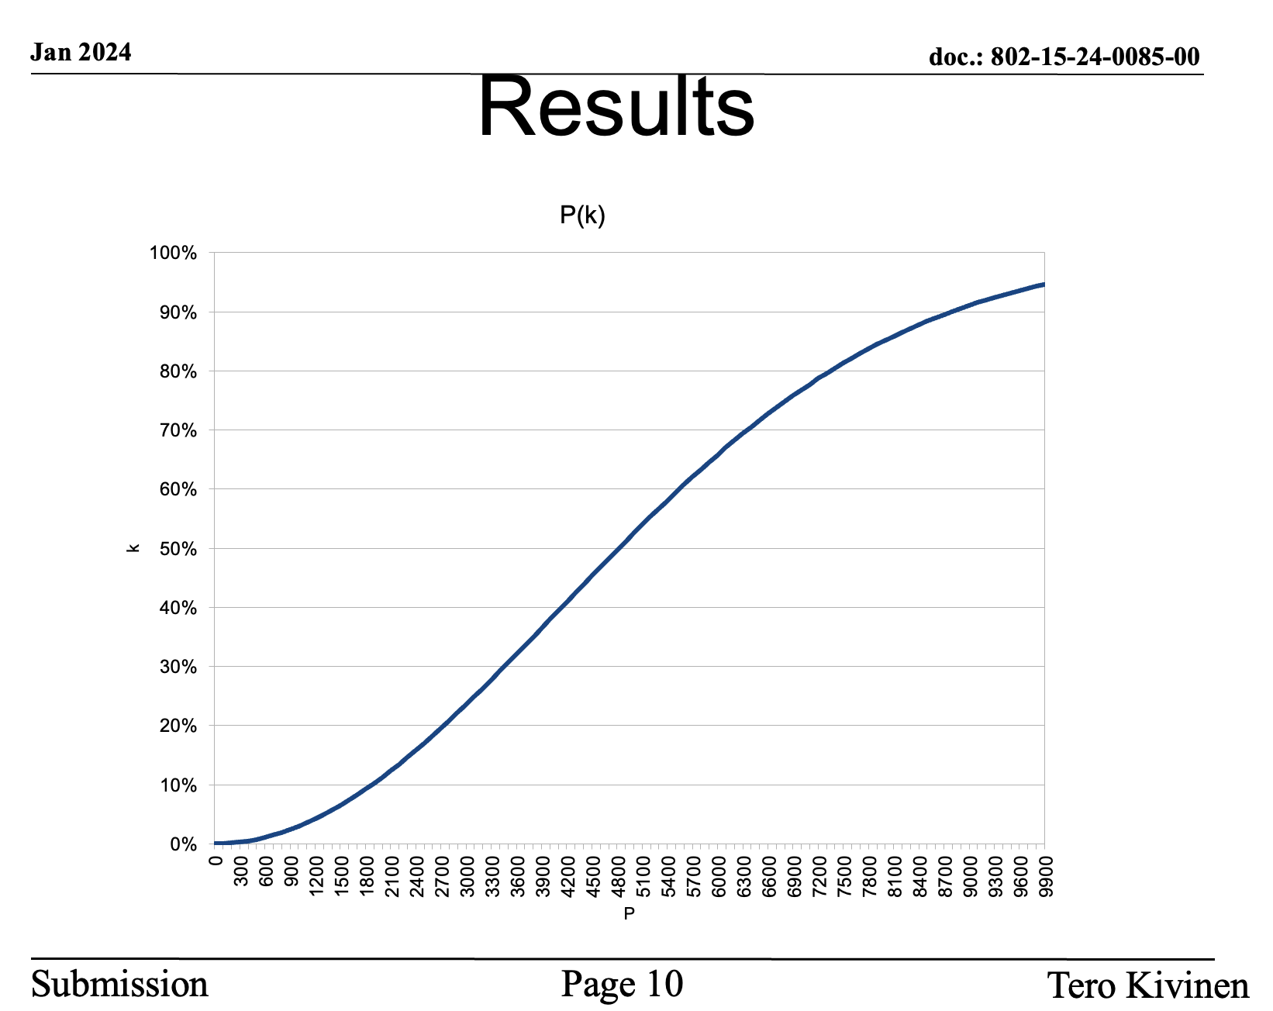
DCN 23-85
What is the operational point for NBA-UWB MMS → how many users can it support w/o RPA_hash collisions?
At the operational point, do RPA_hash collisions cause any effect? If so, what?

Slide 4
Proposal/Assumption/Requirement
The limiting operating point is where ranging does not work after/for
3 seconds

Slide 5
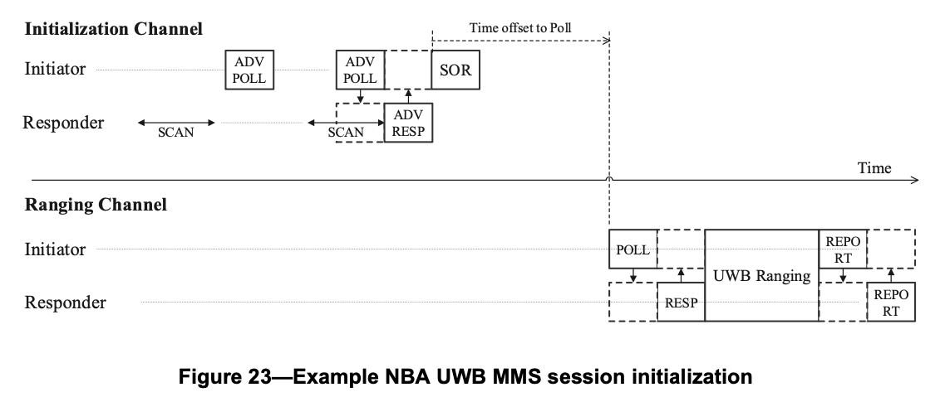
Bottleneck where?
Initialization
  broadcast packet, N receiver listening
  1 channel
  → bottleneck
Ranging
  P2P packet, only 1 receiver listening
  up to 250 ranging channels
  +/-100ppm search window for O-QPSK preamble

Slide 6
How many users < 3 seconds?
Model for packet error rate
  a = ADV-POLL packet duration (e.g. 500us)
  b = Block duration (i.e. advertising interval, e.g. 100ms)
  N = number of initiators broadcasting ADV-POLL packets
  P(N) = min(1, 2*a/b*N)
Model for hash collision rate
  P(k) = 1-n!/(n-k)!/n^k
  approximation from DCN 85 (slide 8) is fine, too
Expected delay until first successful ADV-POLL (first w/o OTA packet collision)
  d = b/(1-P(N))
Expected delay until 3 successful packets (ADV-POLL+RESP+SOR)
  d = b/(1-P(N))^3
  (simplifying assumptions: all packets have same collision probability and collisions are i.i.d.)
  resolve for N to find number of initiators supported at acceptable delay d=3 seconds

Slide 7
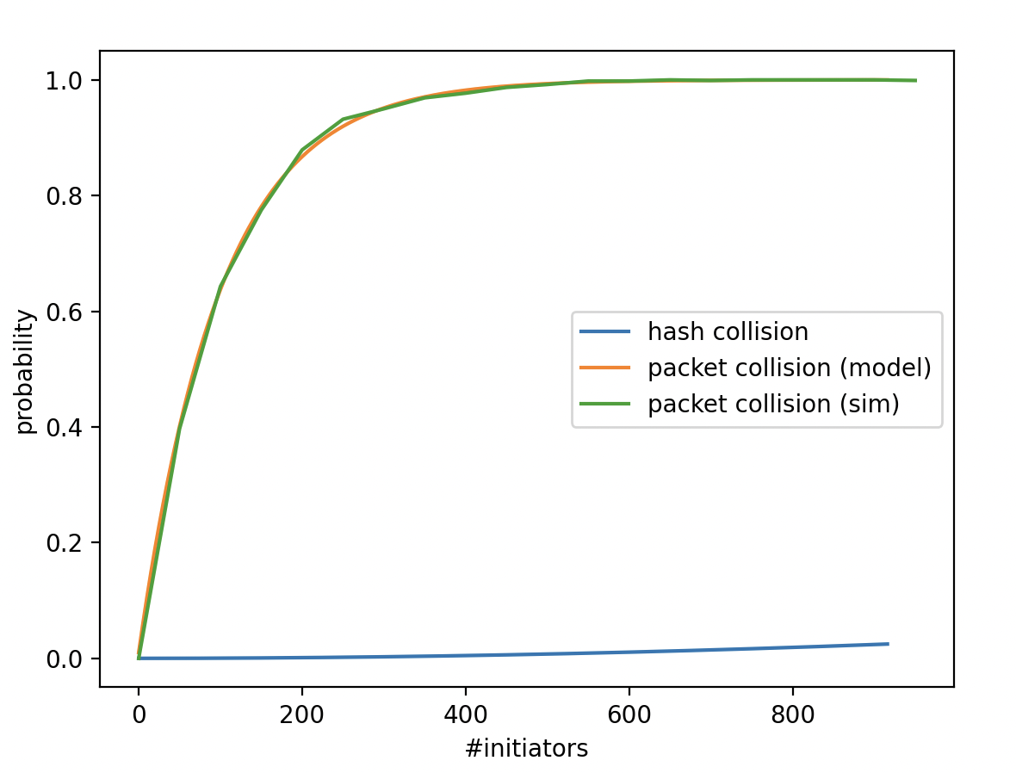
100ms ADV-POLL interval
p=0.99 → 100000s SOR latency
p=0.68 → 3s SOR latency
p=0.0037
p=0.004
113
459

Slide 8
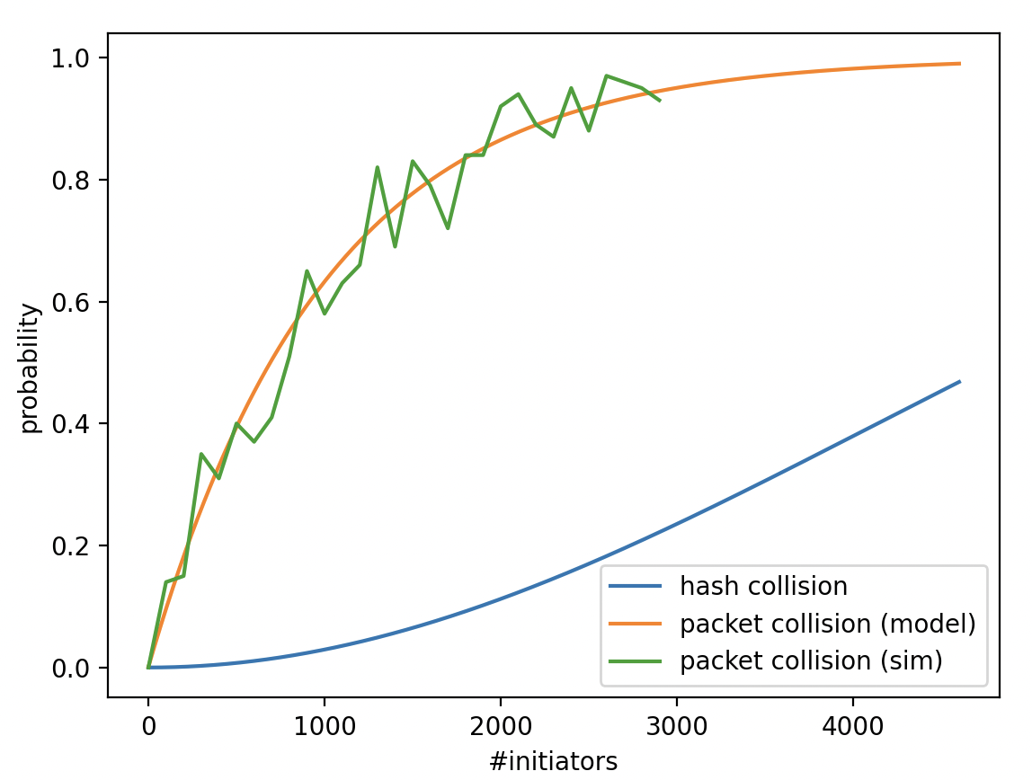
1s ADV-POLL interval
p=1-1/3^(1/3) → 3s SOR latency
p=0.004
367

Slide 9
Okay, 0.4%, but what if???
Let’s ignore that UWB link budget and the UWB channel is limiting the user capacity of the system to fewer than 367...
Then, after an average of 3 seconds an SOR packet reaches the wrong responder and a ranging session is started
The initiator will send a POLL packet with a new RPA_prand
  The probability of the RPA_hash *again* colliding with the *same* value is 1/2^24
  Therefore 0.4% divided by 16777216 is the chance of starting a ranging session with a wrong responder (that fails if RIFs/MICs/etc. are used...)
  Chances are
  1 : 4194304000

Slide 10
Okay, but what about random POLL collisions
POLLs are only sent in 100ppm sync state on up to 250 AES randomized channels
In order to get confused with another POLL
  P = 0.4% * 1/250 * 100ppm = 1/625000000
Also, the genuine POLL needs to drop below -10dB SIR over the interfering POLL which is not accounted in the equation above, as otherwise it would result in a packet collision
Let’s say that’s the case with 100% probability, then with in 1 out of 625million cases
  Ranging succeeds with the wrong responder (RSF only)
  Ranging fails (when RIFs or MICs are used)
Conflict is resolved when (whichever comes first)
  Either initator or responder hop to another channel (typically after 1 ranging block)
  The initiator sets a new RPA_prand

Slide 11
Conclusion
Even with 459 initiators transmitting simultaneously in wireless range, the probability of one or more hash collisions is ~0.4% and probability of this resulting in a ranging error is less than ~0.00000016%
If each of the 459 initiators were transmitting an RPA_hash every 100ms, each initiator would suffer from 1 ranging error only every 723 days
The “RPA hash collision issue” as suggested in DCN 85r0 is insignificant: system performance is limited by OTA packet collisions

Slide 12
Appendix

Slide 13
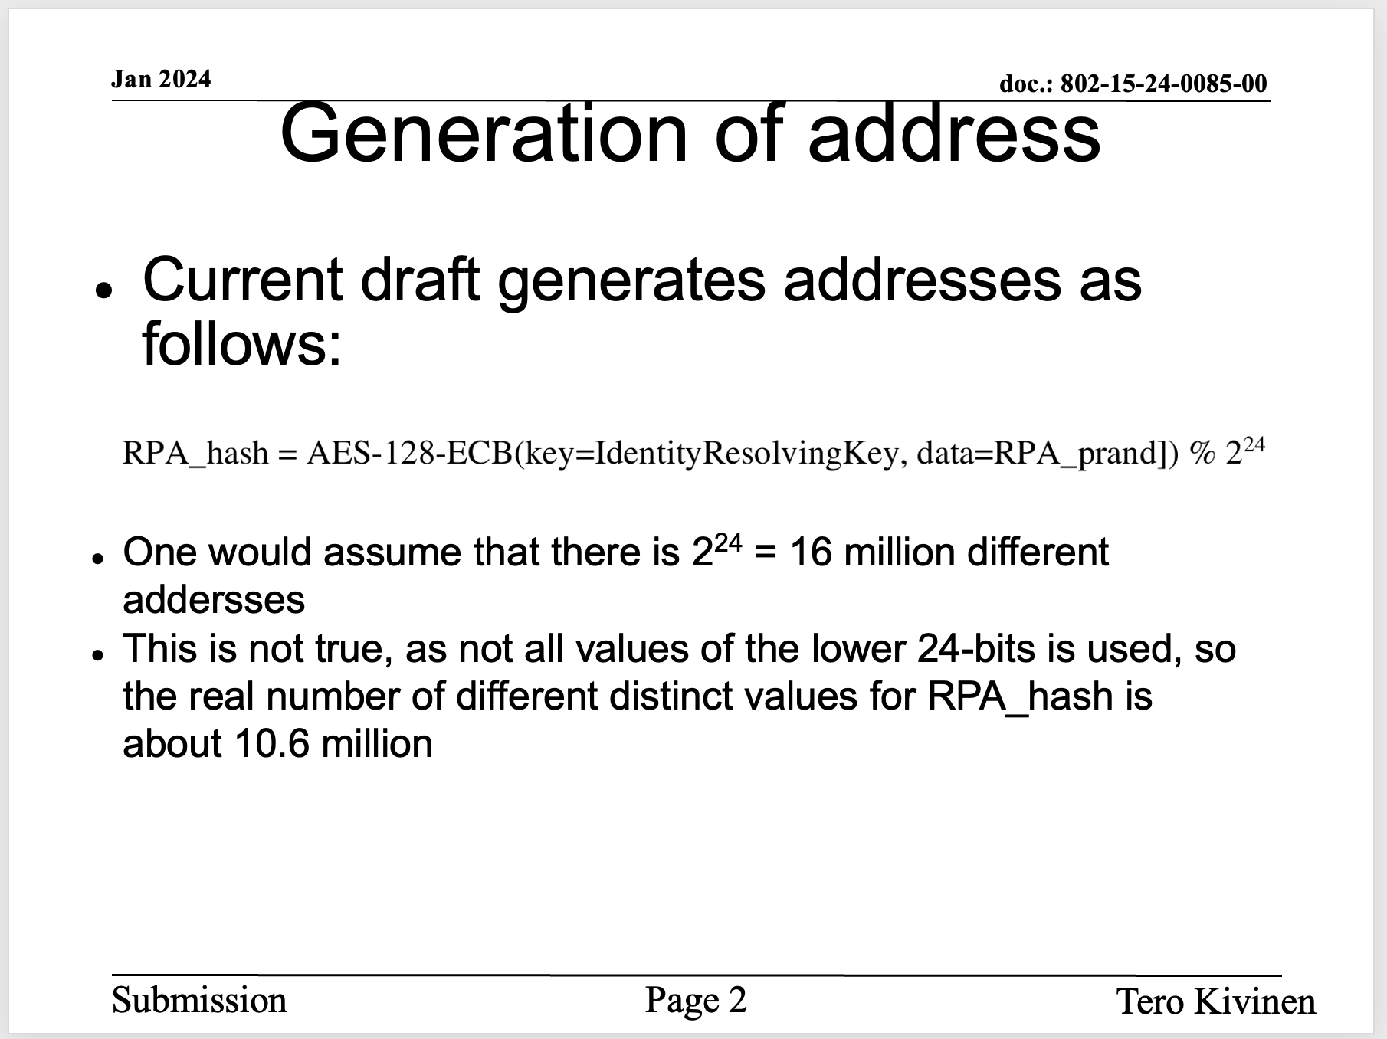
Claim 1:

Slide 14
Proof 1:
FALSE
Assumption: AES input/output bits are i.i.d.
The probability of obtaining M different RPA_hashes when picking N input values is (N picks out of urn with M balls)
p=1-((M-1)/M)^N
Eg. for N=M=2^24: p=~63% (u=M*p=10603244, which is heuristically approximated as 10.6million in DCN 85)
However, other than claimed in DCN 85, there are N=2^(128+24) input values and M=2^24 output values, resulting p=1 and
u=M*p = 16777216

Slide 15
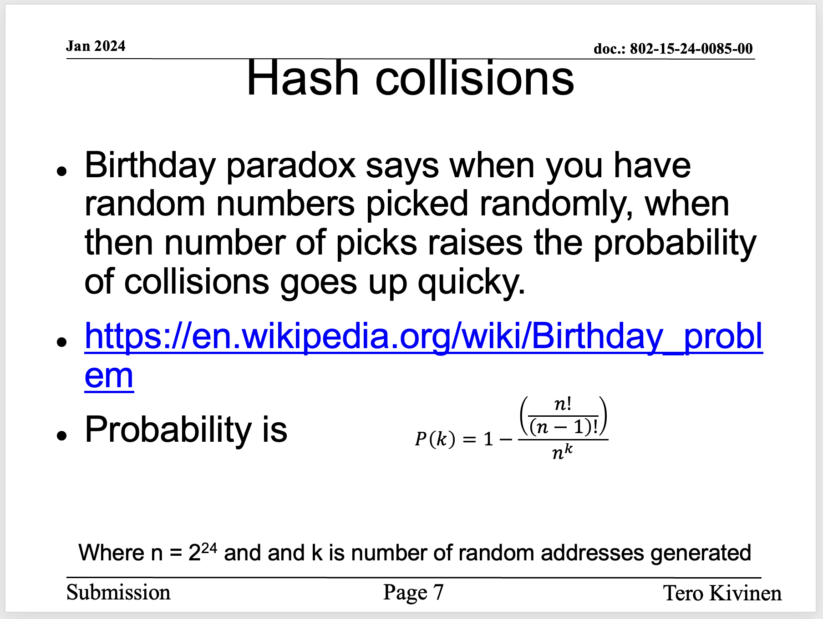
Claim 2:

Slide 16
Proof 2:
FALSE
n!/(n-1)! = n
n/n^k = 1/n^(k-1)
P(k) = 1-1/n^(k-1) is obviously incorrect as it is the complement probability of picking k-1 times the same ball from an urn of n balls (ie. probability of having at least 2 non-colliding RPA_hashes)
The correct formula is the complement probability of k distinct balls picked from an urn of n balls:
  P(k) = 1-n!/(n-k)!/n^k
  (which can easily be computed as
    1 - n/n * (n-1)/n * ... * (n-k)/n
    p=1; for i = 1 to k; do p=p*(n-i)/n; done; print 1-p)

