Slide 1
Project: IEEE P802.15 Working Group for Wireless Specialty Networks (WSN)
Submission Title: Clarifications for Initialization and Setup for One-to-many MMS Ranging
Date Submitted: 5 February, 2024
Source: Rojan Chitrakar, Lei Huang, Bin Qian, David Xun Yang (Huawei Technologies)
Email: rojan.chitrakar@huawei.com
Abstract: Clarifications of Initialization and Setup for One-to-many MMS Ranging in Draft-C
Purpose:
Notice: This document has been prepared to assist the IEEE P802.15. It is offered as a basis for discussion and is not binding on the contributing individual(s) or organization(s). The material in this document is subject to change in form and content after further study. The contributor(s) reserve(s) the right to add, amend or withdraw material contained herein.
Release: The contributor acknowledges and accepts that this contribution becomes the property of IEEE and may be made publicly available by P802.15.
Notes:
Jul 12, 2010
Page 1

Slide 2
PAR Objective | Proposed Solution (how addressed)
Safeguards so that the high throughput data use cases will not cause significant disruption to low duty-cycle ranging use cases
Interference mitigation techniques to support higher density and higher traffic use cases
Other coexistence improvement
Backward compatibility with enhanced ranging capable devices (ERDEVs)
Improved link budget and/or reduced air-time
Additional channels and operating frequencies
Improvements to accuracy / precision / reliability and interoperability for high-integrity ranging
Reduced complexity and power consumption
Hybrid operation with narrowband signaling to assist UWB | Clarification for One-to-many MMS Ranging modes
Enhanced native discovery and connection setup mechanisms
Sensing capabilities to support presence detection and environment mapping
Low-power low-latency streaming
Higher data-rate streaming allowing at least 50 Mbit/s of throughput
Support for peer-to-peer, peer-to-multi-peer, and station-to-infrastructure protocols
Infrastructure synchronization mechanisms

Slide 3
Introduction
During the resolution of comments related to Initialization and Setup phase for one-to-many MMS ranging, we realized that the Initialization and Setup phase for one-to-many MMS ranging is not well defined in 802.15.4ab-draft-C.
Based on offline discussions and study of draft-C, we share our findings and make proposals to clarify the Initialization and Setup phase for one-to-many MMS ranging.

Slide 4
Related comments in Draft C
Name | Index # | Page | Sub-clause | Line # | Comment | Proposed Change | Comments
Li-Hsiang Sun | 11 | 46 | 10.38.3.3 | 22 | "Each Start of Ranging Compact frame specifies the corresponding ranging configurations and the time offset between the first symbol of the Start of Ranging Compact frame and the first symbol of the One-to-one Poll Compact frame addressed to the corresponding responder in the first ranging block" shouldn't it be one-to-many Poll Compact frame? | change to one-to-many Poll Compact frame addressed to all responders | Already rejected by Alex.
Rojan Chitrakar | 606 | 45 | 10.38.3.3 | 17 | Not all Advertising Poll Compact frame carry the CapDuration field that is need for contention; only those with message control 0x20 and 0x30 carry the field. | Rephrase as: "…, the initiator sends an AAdvertising Poll Compact frame with the Message Control field set to 0x20 or 0x30 ..."
Rojan Chitrakar | 607 | 46 | 10.38.3.3 | 14 | Does this mean that if two or more responders are selected, coordination is mandatory? Else, the procedure for one-to-many when coordination is not active should also be described. | Describe the procedure for one-to-many when coordination is not active.
Carl Murray | 687 | 45 | 10.38.3.3 | 14 | The one-to-many without cordination is not handled and may be quite useful as it has less overhead. | Include one-to-many without cordination

Slide 5
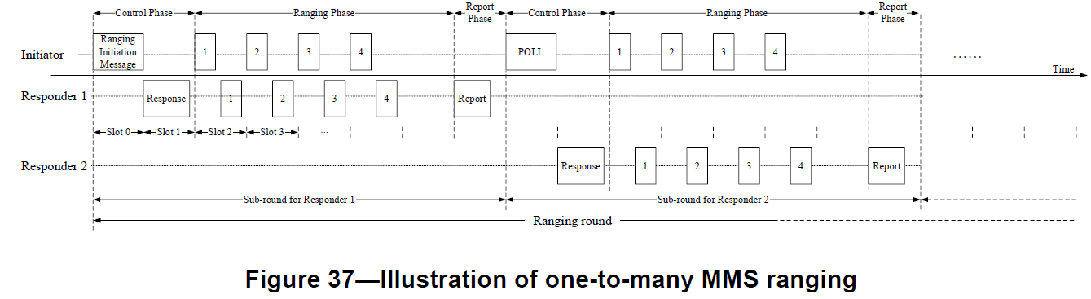
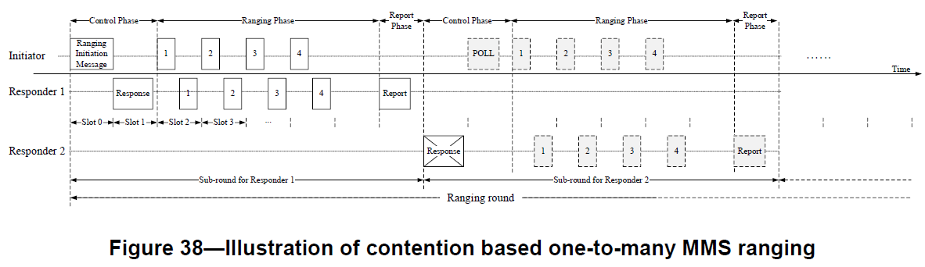
Background: One-to-many MMS Ranging modes (1/2)
Four One-to-many ranging modes are defined in Draft-C (see 10.38.9):
1. Basic Operation
2. Contention based O2M ranging

Slide 6
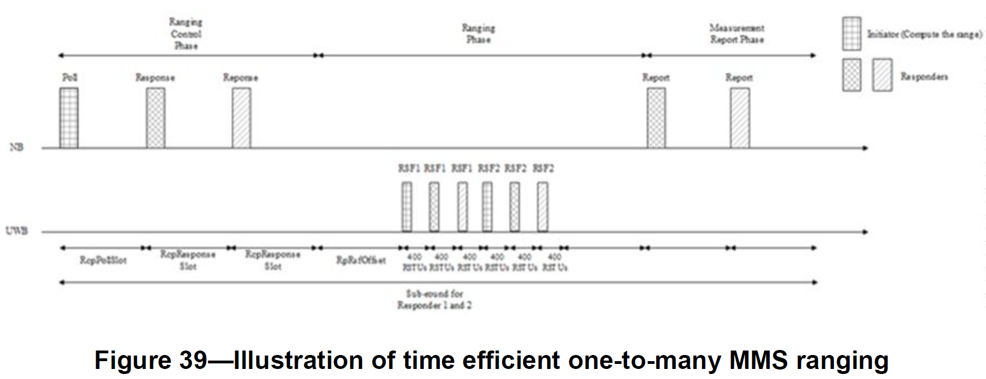
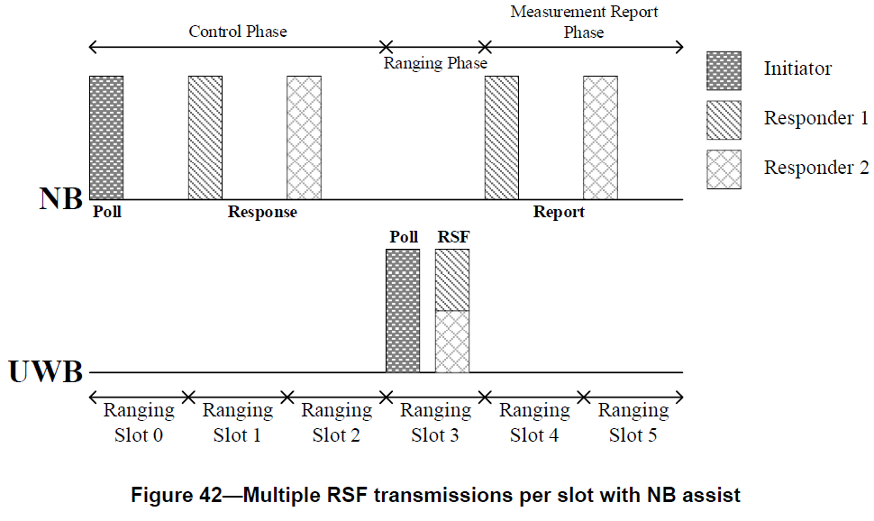
Background: One-to-many MMS Ranging modes (2/2)
3. Time Efficient O2M ranging
4. O2M ranging with multiple RSFs

Slide 7
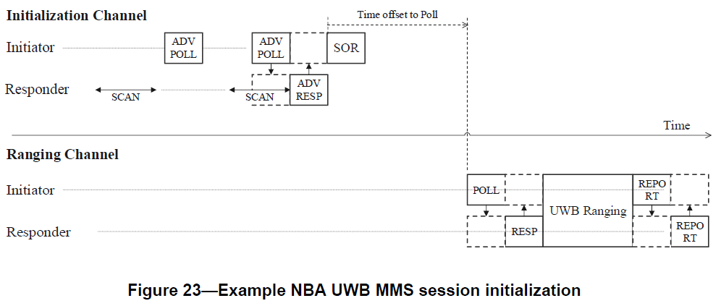
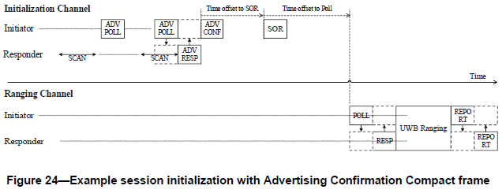
Background: Initialization and Setup for O2O
Following Initialization and Setup (I&S) handshake are defined in Draft-C (see 10.38.3.2 and 10.38.3.4):
1. O2O I&S without coordination + O2O ranging
2. O2O I&S with coordination + O2O ranging

Slide 8
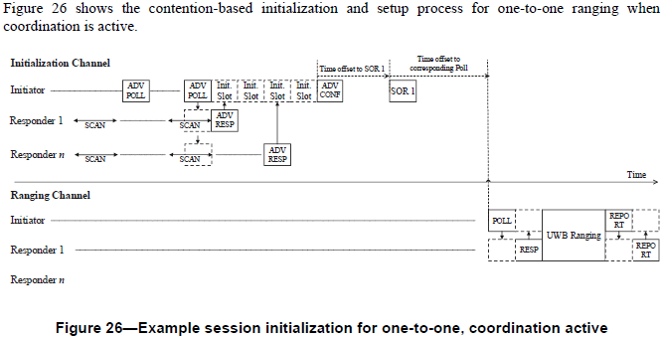
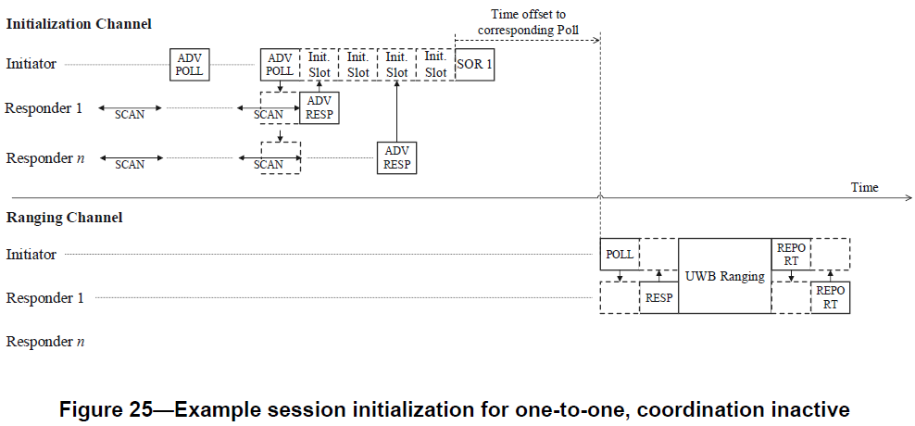
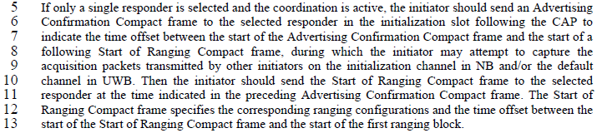

Background: Contention-based initialization and setup (1/2)
Following Contention based Initialization & Setup (I&S) are described in Draft-C (see 10.38.3.3):
1. Contention based I&S without coordination for O2O ranging
2. Contention based I&S with coordination for O2O ranging

Slide 9
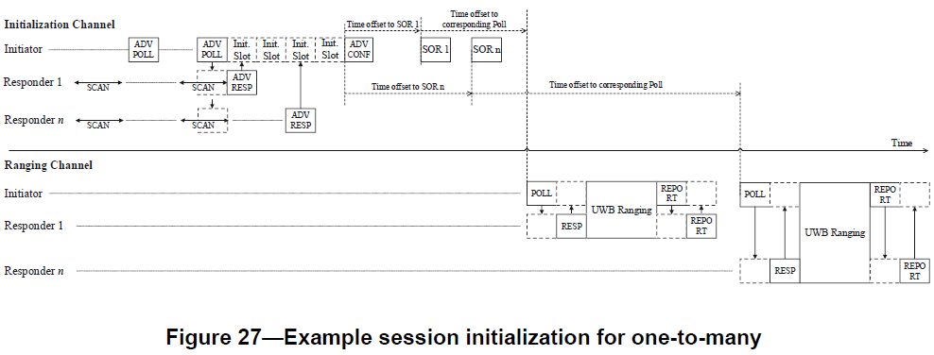
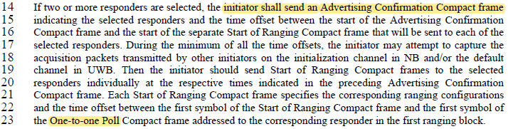
Background: Contention-based initialization and setup (2/2)
3. Contention based I&S when two or more responders are selected for ranging
This is an error. Should have been: “multiple one-to-one”
Text is correct.

Slide 10
Findings
Initialization and Setup Phase
MMS ranging phase
1. O2O I&S without coordination
1. One-to-one ranging
2. O2O I&S with coordination
3. Contention based I&S without coordination
(single responder)
2. Multiple One-to-one ranging
4. Contention based I&S with coordination
(single responder)
3. One-to-many ranging:
A. Basic Operation
5. Contention based I&S
(two or more responders)
B. Contention based O2M ranging
6. ??
C. Time Efficient O2M ranging
D. O2M ranging with multiple RSFs
Initialization and setup phase for O2M is not defined in draft-C!

Slide 11
Proposal 1
1. Clarify the Contention based I&S for multiple responders for the case of multiple O2O ranging
2. Clarify that scanning for acquisition packets may be performed when contention is active.
3. Use the same procedure irrespective of coordination state, i.e., ADV CONF is transmitted first (even if coordination is not active), followed by one SOR for each selected responder.
multiple one-to-one
--------------------
If two or more responders are selected, the initiator shall send an Advertising Confirmation Compact frame indicating the selected responders and the time offset between the start of the Advertising Confirmation Compact frame and the start of the separate Start of Ranging Compact frame that will be sent to each of the selected responders. If coordination is active, dDuring the minimum of all the time offsets, the initiator may attempt to capture the acquisition packets transmitted by other initiators on the initialization channel in NB and/or the default channel in UWB. Then the initiator should send Start of Ranging Compact frames to the selected responders individually at the respective times indicated in the preceding Advertising Confirmation Compact frame. If the initiator intends to perform multiple one-to-one ranging with each of the selected responders, each Start of Ranging Compact frame specifies the corresponding ranging configurations and the time offset between the first symbol of the Start of Ranging Compact frame and the first symbol of the One-to-one Poll Compact frame addressed to all the corresponding responders in the first ranging block.

Slide 12
Proposal 2
Extend the contention based I&S for multiple responders for one-to-many ranging:
1. All SORs point to the same starting time
2. All Compact frames are the O2M variants
Figure 27A – Example session initialization for one-to-many
If two or more responders are selected and the initiator intends to perform one-to-many ranging with the selected responders, each Start of Ranging Compact frame specifies the corresponding ranging configurations and the time offset between the first symbol of the Start of Ranging Compact frame and the first symbol of the first One-to-many Poll Compact frame addressed to all the selected responders in the first ranging block. Figure 27A shows an example contention-based initialization and setup process for one-to-many ranging.

Slide 13
Proposal 3
Reorganize the Initialization and Setup sub-clauses for better clarity:
10.38 UWB Multi-millisecond (MMS) operation
  10.38.1 Introduction
  10.38.2 UWB MMS ranging overview
  10.38.3 Narrowband MMS initialization and setup
    10.38.3.1 Overview
    10.38.3.2 Session initialization
    10.38.3.2.1 Initialization configuration
    10.38.3.3 Contention based initialization setup handshake
    10.38.3.4 Initialization setup handshake
    10.38.3.5 Ranging session configuration
    10.38.3.6 Coordination
  10.38.4 UWB MMS control phase
  10.38.5 UWB MMS ranging phase
  10.38.6 UWB MMS report phase
  10.38.7 UWB MMS ranging session initialization using public addresses
  10.38.8 Narrow band specific functionality
  10.38.9 Procedures for one-to-many MMS ranging
  10.38.10 Control messages for MMS operation
10.38 UWB Multi-millisecond (MMS) operation
  10.38.1 Introduction
  10.38.2 UWB MMS ranging overview
  10.38.3 Narrowband MMS initialization and setup
    10.38.3.1 Overview
    10.38.3.2 Session initialization
    10.38.3.2.1 Initialization configuration
    10.38.3.2.2 Initialization setup handshake for 1 to 1 ranging (CID 690)
    10.38.3.2.3 Contention based initialization setup handshake
    10.38.3.3 UWB MMS ranging Session initialization using public addresses
    10.38.3.5 Ranging session configuration
    10.38.3.6 Coordination
  10.38.4 UWB MMS control phase
  10.38.5 UWB MMS ranging phase
  10.38.6 UWB MMS report phase
  10.38.7 UWB MMS ranging session initialization using public addresses
  10.38.8 Narrow band specific functionality
  10.38.9 Procedures for one-to-many MMS ranging
  10.38.10 Control messages for MMS operation

