Slide 1
Project: IEEE P802.15 Working Group for Wireless Specialty Networks (WSN)
Submission Title: Consensus before resolving ‘non-NBA’ MMS ranging CIDs
Date Submitted: Feb 2024
Source: Carl Murray (Qorvo)
Abstract:
Notice: This document has been prepared to assist the IEEE P802.15. It is offered as a basis for discussion and is not binding on the contributing individual(s) or organization(s). The material in this document is subject to change in form and content after further study. The contributor(s) reserve(s) the right to add, amend or withdraw material contained herein.
Release: The contributor acknowledges and accepts that this contribution becomes the property of IEEE and may be made publicly available by P802.15.
Notes:
Jul 12, 2010
Page 1

Slide 2
Need for Consensus
One issue with the Draft is that we did not reach the appropriate level of consensus on MMS before entering comment resolution.
The MMS CIDs listed below are a consequence of this but cannot be resolved individually. Also, they are incomplete.
CIDs in related groups and in page order
Related to Figure 21 – UWB MMS ranging transmission
318, 683, 894 and 52
Distinction between NBA and ‘non’-NBA
7
MMS configurations
684, 212, 901, 29, 80, 729, 81, 90, 91, 296
Multiple transmissions
624, 332
Related docs of interest - 15-23-0509-04-4ab, 15-24-0025-01-04ab
There are many inconsistencies currently in the Draft that need to be addressed through agreement to give direction on how these CIDs can be properly resolved.

Slide 3
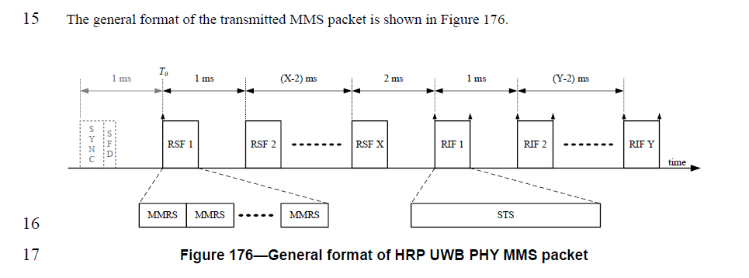
The UWB MMS packet
Figure from Clause 16.2.11.1 (Draft C page 160)
The UWB packet can be utilized by any protocol
It is currently used by the protocol defined in 10.38 UWB Multi-millisecond (MMS) operation
The ranging PHY for this protocol is always UWB
At least 2 of the 3 other phases (see next slide) of this protocol can be implemented by either NB and/or UWB
The optional SYNC+SFD are necessary to enable protocol(s) to implement 10.38.12.5 UWB Only MMS Operating Parameter Sets.

Slide 4
(Simplified) MMS Ranging Phases in 10.38
Initialization and Setup
Ranging Cycle
Control
Ranging
Report

Slide 5
MMS Ranging Mechanisms currently allowed by Draft C Text (but with gaps and inconsistencies)
 | Init & Setup | Control | Ranging | Report
NBA | O-QPSK | O-QPSK | UWB¹ | O-QPSK
NBA (report offload) | O-QPSK | O-QPSK | UWB¹ | UWB²
NBA (control offload) | O-QPSK | UWB² | UWB³ | O-QPSK
NBA (ranging offload) | O-QPSK | UWB² | UWB³ | UWB²
UWB-driven | NS* | UWB | UWB⁴ | UWB
OOB mechanism | NS* | NS* | UWB⁴ | NS
* Not Specified
No SYNC+SFD in MMS ranging Packet
UWB uses 1 of the 2 mandatory 1.95 Mbps SP0 packets signalled in the Management PHY Config
Status of the SYNC+SFD inclusion in the MMS packet is currently not well defined
The SYNC+SFD inclusion in the MMS packet is configured/agreed by the relevant protocol
Hybrid modes are also technically allowed as short-term parameters sent in the POLL “… take effect at the end of the poll Compact frame and are only applicable to the current ranging round.”
Need to agree on what was the actual intention is and encapsulate it within a coherent framework

Slide 6
Areas that need Consensus 1 of 2
Need to agree on the configurations TG4ab want to support in the text.
What configurations do we wish to support?
Need to agree the UWB packet format in the Control phase
Are these HPRF SP0 only packets?
Note that there is no such thing as a SYNC+SFD only packet in clause 16
Need to agree when the optional SYNC+SFD of the MMS packet is enabled
Need to agree if the configurations are static? (i.e. do not allow to dynamically switch between them)
This would impact the short-term parameters in some way
Currently short-term parameters in Management PHY config allows switching between various flavours of NBA
What happens if ADV-RESP signals a Management PHY Config that the Initiator does not support? Is there a single mandatory mode for NBA that the Initiator can insist on?
Is the same UWB channel used for all phases?
(e.g. do Report and Control use the same channel as ranging)?

Slide 7
Areas that need Consensus 2 of 2
What preamble code is used in the UWB SP0 packets?
Should it be independent of ‘Sequence Code Index’ field in the Ranging PHY Config
Note that this field can contain BPRF and HPRF codes but SP0 is HPRF only
Mapping from a complementary set code may not be flexible enough
What is the configuration of the MMS Packet SYNC+SFD
Note that the MMS Packet SYNC+SFD possibly should not ‘copy’ the SYNC and SFD of SP0 because SP0 is HPRF only whereas the RSF can be BPRF and HPRF preambles

Slide 8
Backup
 | SP0 | MMS Packet SYNC+SFD | RSF
Channel | undefined | R-PHY Config | R-PHY Config
Preamble Code | undefined | fn(SCI) | R-PHY Config
SYNC | M-PHY Config | undefined | N\A
SFD | M-PHY Config | undefined | N\A
Data Config0 | M-PHY Config | N\A | N\A
Data Config1 | M-PHY Config | N\A | N\A
M-PHY = Management PHY
R-PHY = Ranging PHY
SCI = ‘Sequence Code Index’ field of the R-PHY Config

