Slide 1

149th Session of meetings of the
IEEE 802.15 Working Group for Wireless Specialty Networks (WSN)
Opening Report
March 10-15, 2024
Held in Denver & Hybrid via Webex

Slide 2
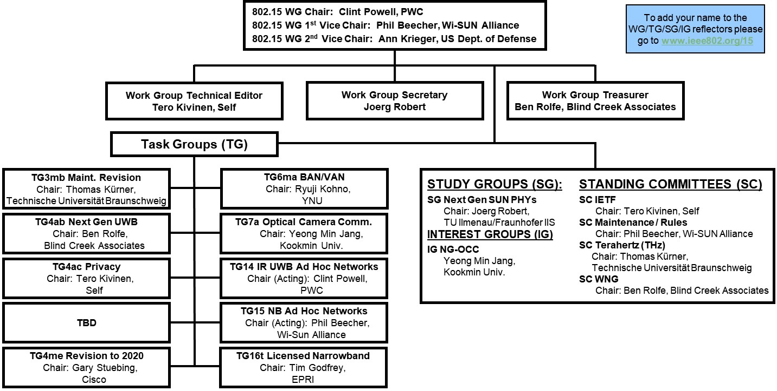
802.15 WG Org. Chart

Slide 3
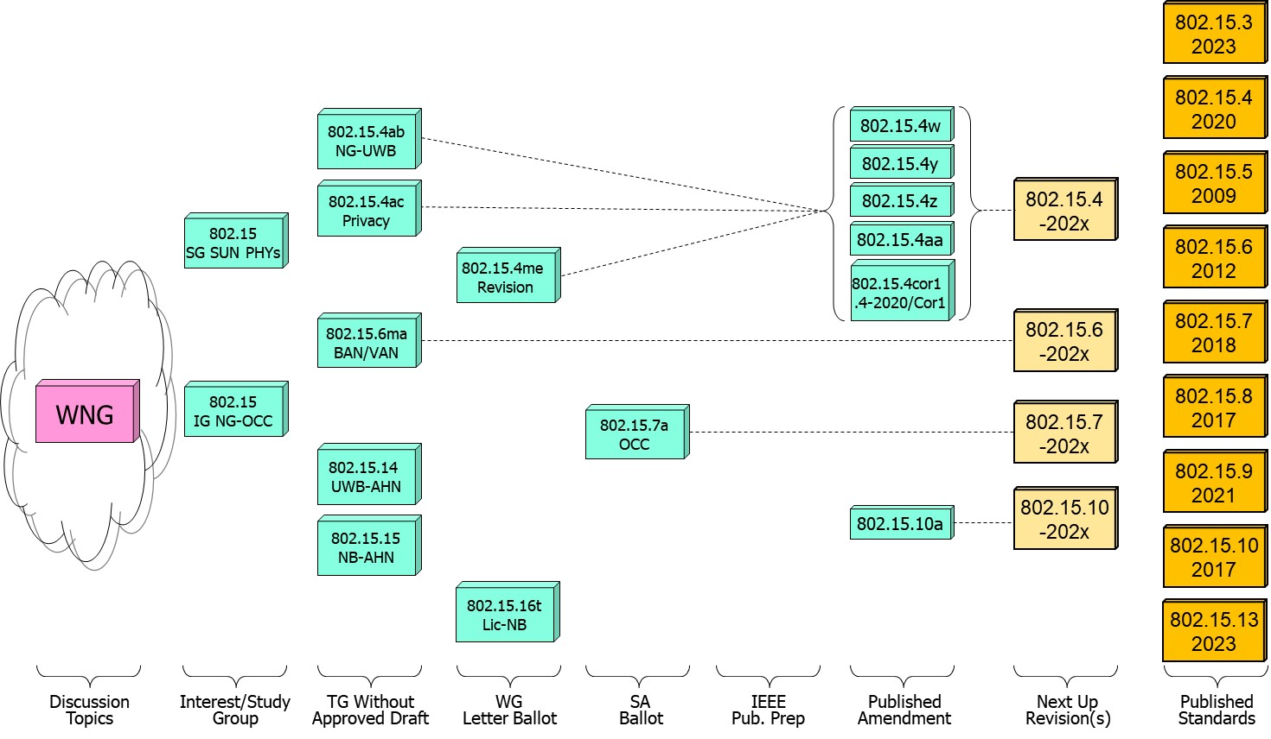
802.15 WG Standards Pipeline

Slide 4
802.15 WG Administrative
Voting members: 138
Nearly voting members: 5
Aspirant voting member: 20
802.15 WG Officer Elections
Clint Powell - Chair (elected March 2022)
Phil Beecher - 1st Vice-Chair (elected March 2022)
Ann Krieger - 2nd Vice-Chair (elected Nov. 2022)
WG Secretary needed
James Gilb - Tech. Editor (appointed March 2023)
Ben Rolfe - Treasurer (appointed March 2023)

Slide 5
Meeting Slots for 802.15 WG March Plenary

Slide 6
2.6a: 2024 January Designation of Individual experts
Individual experts who attend electronically for a specific purpose/presentation can be designated as such by the WG Chair and receive a registration fee waiver and limited attendance rights.
See section 5 in https://mentor.ieee.org/802-ec/dcn/17/ec-17-0090-25-0PNP-ieee-802-lmsc-operations-manual.pdf ,
  The Working Group Chair may designate specific individual experts who are allowed to participate in Working Group discussions via electronic means during an in-person meeting for the benefit of the group. These individuals are not considered to be attending the meeting and so they are not required to pay meeting fees and they do not get participation credit. The participation of these individuals should be limited to specific technical topics. Such participation shall be documented in the minutes of the Working Group meeting.
The individuals listed below are hereby designated as specific individual experts on their respective topics and subject to the restrictions and benefits described in the 802 OM.
  Example: Name, Affiliation, Specific mtg.
  n/a
  n/a
  n/a
  n/a
For WNG, attendance for each is limited to the WNG timeslot in which the respective presentation is scheduled.

Slide 7
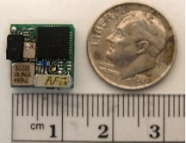

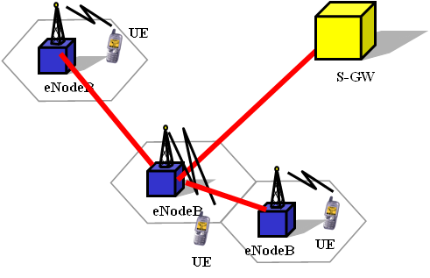

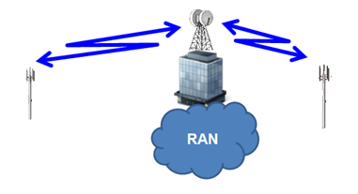



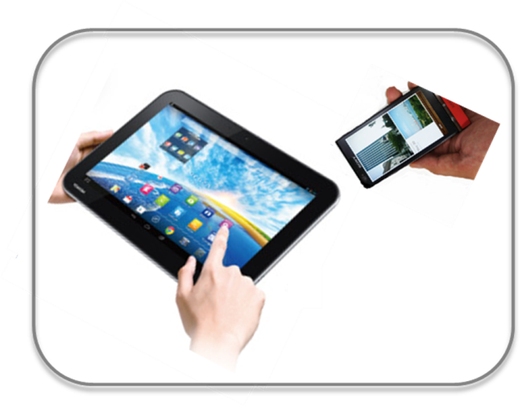



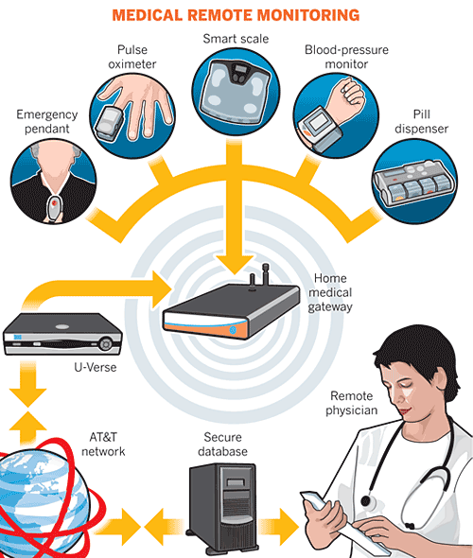
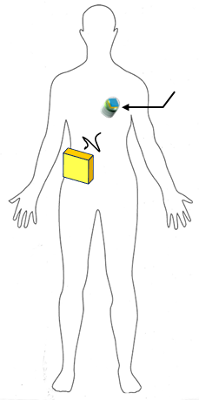

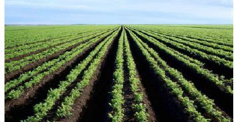

IEEE 802.15 Standards & their Applications
802.15.16
802.15.4
Locating and Tracking
Ultra-low Power Sensors
Automotive
FAN/MAN/RAN
802.15.4
Multi-media networks
&
High Speed
Interconnect
802.15.3
Industrial Networks
802.15.7
802.15.13
Medical
802.15.6
Critical Infrastructure Networks
Consumer Devices
Optical
Communications
Agricultural Sensing
Structural Monitoring
Slide 7

Slide 8
802.15 WG
Subgroups Objectives

Slide 9
TG3mb (HSD) - Revision of IEEE Std 802.15.3-2016
Chair: Thomas Kürner
Objective:
Revision of IEEE Std 802.15.3-2016
TG3mb Webpage
Areas being worked on include:
Roll-up of all amendments since the last revision
Include all new frequency bands above 275 GHz identified by WRC 2019
Fix RIFS timing parameter issue
Replace reference to IEEE Std 802.1D by reference to IEEE Std 802.1Q
Introduce two new modulation schemes (16-APSK, 32-APSK)
IEEE Std 802.15.3-2023 was approved in September 2023 and published in February 2024

Slide 10
TG4ab (NG-UWB) - Next Generation Ultra WideBand Amendment
Chair: Ben Rolfe
Objective:
Enhancements to 802.15.4 Ultra Wideband (UWB) physical layers (PHYs) media access control (MAC), and associated ranging techniques while retaining backward compatibility with enhanced ranging capable devices (ERDEVs).
TG4ab Webpage
Areas being worked on include:
Ranging
Link budget improvements
Improvements to accuracy, precision and reliability
Sensing
Pulse shape improvements
Channel impulse response reporting to support multistatic sensing
To better support presence detection, environment mapping and other uses
Data
Higher data rates for shorter transmission duration and power savings
Channel coding and packet format improvements for robustness
Additional options for even greater power savings
Protocol enhancements to support very low latency, low energy communications
Interference mitigation techniques to support:
Greater device density
Coexistence in the presence of other users
This amendment builds on top of the existing 802.15.4 standard and the 802.15.4z amendment.

Slide 11
TG4ac (Privacy) - Privacy Amendment
Chair: Tero Kivinen
Objective:
This amendment specifies modifications to the IEEE Std 802.15.4 MAC specification to specify mechanisms that address and improve user privacy. These mechanisms include randomized addresses, and exchanges that support session continuity. This amendment maintains backward compatibility with the base standard.
TG4ac Webpage
This amendment builds on top of the existing 802.15.4 standard.

Slide 12
TG4me (Revision) - Revision to IEEE Std 802.15.4-2020
Chair: Gary Stuebing
Objective:
This project is needed to incorporate accumulated maintenance changes and corrigenda (editorial and technical corrections) into the standard and to include approved amendments.
TG4me Webpage
This is a roll up revision incorporating the following amendments:
IEEE Std 802.15.4w
IEEE Std 802.15.4y
IEEE Std 802.15.4z,
IEEE Std 802.15.4aa which are approved.
One additional amendment, P802.15.4ab, is currently under development.
This amendment builds on top of the existing 802.15.4-2020 standard.

Slide 13
TG6ma (BAN/VAN) - BAN with Enhanced Dependability Revision
Chair: Ryuji Kohno
Objective:
Enhancements to the Body Area Networks (BAN) Ultra Wideband (UWB) physical layer (PHY) and media access control (MAC) to support enhanced dependability to a human BAN (HBAN), adding support for vehicle BAN (VBAN.
TG6ma Webpage
Areas being worked on include:
Channel Modeling
Precise modeling of radio propagation of implant and wearable human BANs and around vehicle BANs for dependable data transmission
Classified modeling of multiple BANs and coexistence with other radios for resolution in PHY and MAC
Data transmission
Cognition of channel environment and coexistence
Initial acquisition and synchronization in coexisting BANs
FEC and hybrid ARQ according to QoS levels of data packets for various channel models and coexistence classes
Packet contention
Control and data channels, superframe formant, and MAC function to avoid packet contention in various classes of coexistence
Hybrid protocol of contention-free and contention access according to required QoS levels of data packets
Inter coordinators or hubs negotiation among coexisting BANs
Interference mitigation in coexistence
Interference surprising and canceling technologies for theoretical and feasible implementation in coexistence
Result in simpler classes of coexistence by mitigation of interference from non-BAN
Ranging
Optional ranging for cognition of dynamism of coexisting BANs
This revision builds on the existing standard 802.15.6-2012 with enhanced dependability for human BAN and additional vehicle BAN

Slide 14
TG7a (OCC) - Higher Rate, Longer Range Optical Camera Communications
Chair: Yeong Min Jang
Objective:
This standard offers a global, secure, high-speed optical communication solution up to 100 Mbps and 200 m, with advantages like access to unlicensed spectrum, inherent security, and AI-enhanced features, promising for commercial and business markets.
TG7a Webpage
Areas being worked on include:
Wavelength range: 10000 nm to 190 nm in optically transparent media.
Data rate: Capable of delivering up to 100 Mbit/s.
Communication types: Designed for point-to-point and point-to-multipoint communication.
Adaptation features:
Adaptation to varying channel conditions.
Maintaining connectivity during high mobility (up to 350 km/h).
Flicker mitigation.
Radio Frequency (RF) co-existence.
Communication range: Up to 200 m.
Technology utilized:
Multiple-Input-Multiple-Output (MIMO).
MIMO-Orthogonal frequency-division multiplexing (MIMO-OFDM) for dealing with high levels of optical interference while maintaining high-rate data transmission.
Additional mechanisms:
Relaying mechanisms for enabling heterogeneous operation with existing RF wireless data communications standards.
Safety and regulation: Adheres to applicable eye safety regulations.
This amendment builds on the existing IEEE 802.15.7-2011 standard and the IEEE 802.15.7-2018 revision.

Slide 15
TG14 (UWB-AHN) - Impulse Radio UWB Wireless Ad Hoc Networks
Chair: Clint Powell
Objective:
Focused on impulse radio (IR) Ultra Wideband (UWB) PHY and MAC providing precision ranging capability that is accurate to the centimeter level by including (via. referencing) the 802.15.4 IR UWB functionality into a simple focused specification.
TG14 Webpage
Objective
This TG is currently in hibernation awaiting the outcome/conclusion of the TG4me revision, to see if has satisfied the objective of this project.
This project is for a new standards that references 802.15.4.

Slide 16
TG15 (NB-AHN) - Narrow Band Wireless Ad Hoc Networks
Chair: Phil Beecher
Objective:
Focused on narrow band ad hoc network PHY and MAC by including (via referencing) functionality and features of 802.15.4 into a simple focused specification.
TG15 Webpage
Objective
This TG is currently in hibernation awaiting the outcome/conclusion of the TG4me revision, to see if has satisfied the objective of this project.
This project is for a new standards that references 802.15.4.

Slide 17
TG16t (Lic-NB) - Licensed Narrowband Amendment
Chair: Tim Godfrey
Objective:
Enhancements to IEEE 802.16-2017 physical layer (PHYs) and media access control (MAC) to enable operation in licensed spectrum with channel bandwidths greater than or equal to 5 kHz and less than 100 kHz. The amendment is frequency independent but focuses on spectrum less than 2 GHz. The range and data rate supported by the narrower channels are commensurate with those of the base standard, as scaled by the reduced channel bandwidth. The project also amends IEEE Std 802.16 as required to support aggregated operation in adjacent and non-adjacent channels.
TG16t Webpage
Areas being worked on include:
Definition of the Wireless MAN-NB PHY to enable operation in narrow channels
Aggregation of non-contiguous narrow channels to provide higher capacity
Enhancements to MAC to improve efficiency and reduce control overhead
Definition of a Direct Peer-to-Peer (DPP) mode to support operation without fixed infrastructure
Updates to security protocols
This amendment is to the IEEE 802.16-2017 base standard.

Slide 18
SG (NG-SUN PHY) - Next Generation SUN PHY
Chair: Joerg Robert
Objective:
The Study Group Next Gen SUN PHY prepares the work for the development of a second-generation physical layer (PHY) for Smart Utility Networks (SUN). The primary focus is the improvement of the OFDM (Orthogonal Frequency Division Multiplexing) modes for higher data rates and longer-range communication, particularly in congested license-exempt frequency bands.
Areas being worked on include:
Definition of use-cases
Number of devices in given area
Max. payload bit-rate
Latency requirements
Definition of frequency bands
…
Channel Models
Channel models for indoor and outdoor use
Interference models for license-exempt band operation
…
This project will end up being an amendment to the latest 802.15.4 standard.

Slide 19
IG (NG-OCC) - Next Generation Optical Camera Communication
Chair: Yeong Min Jang
Objective:
Development of next-generation optical camera communication (NG-OCC) characteristics and its future applications.
Areas being worked on include:
Artificial Intelligence (AI) for NG-OCC
Integration of various AI technologies into the OCC system
Lightweight AI utilization for each developed AI technology
Channel modelling for NG-OCC
Integration of machine-learning for channel estimation
Utilization of machine learning for channel estimation for dynamic and complex channel conditions
Future applications of NG-OCC
NG-OCC encompasses fields such as IoT, underwater communication, joint communication, sensing, and localization (V2V, M2M, Drone/UAV, etc.)
NG-OCC for OCC based drone Networks
NG-OCC for Indoor/Outdoor Positioning through OCC and LiDAR integration
Deep learning-based OCC to support high mobility vehicle
Preferred camera types for OCC
Resolution: Minimum 720x540 (single-link), maximum 3840 x 2160 (multi-link)
Frame rate: Minimum 30 FPS, preferred more than 120 FPS
Spectrum: Mono, color
Light sources: IR, VL, and UV
This group will evaluate the interest in developing Next Gen OCC capabilities

Slide 20
SC IETF -
Internet Engineering Task Force
Chair: Tero Kivinen
Objective:
This standing committee brings in the information from the Internet Engineering Task Force (IETF) to the 802.15 working group. It concentrates on the IETF working groups that might be of interest to the 802.15 working group members.
IETF working groups followed include:
6lo, lake, suit
SC IETF Webpage

Slide 21
SC MAINT -
802.15 Maintenance Activities
Chair: Phil Beecher
Objective:
Maintain 802.15 Operations Manual
Answer questions concerning 802.15 Standards and Recommended Practices
Review 802 PARs and ICAIDs
SC MAINT Webpage
Areas being worked on include:
Ongoing maintenance of operations manual
802 WG PAR reviews.

Slide 22
SC THz -
THz Standing Committee
Chair: Thomas Kürner
Objective:
The IEEE 802.15 Standing Committee Terahertz is chartered to explore the feasibility of Terahertz for wireless communications. The Terahertz frequency band runs roughly from 300 GHz to 3 THz, a staggering 2700 GHz of bandwidth.
SC THz Webpage
Areas being worked on include:
The IEEE 802.15 Standing Committee Terahertz is soliciting, and hearing, contributions that address numerous THz issues.
There are no immediate plans to transition the group to a study group or a task group; rather, we want to fully understand the technology status in regards to a further amendment of IEEE Std. 805.15.3-2023 or a completely new standard.
Apart from the implementation aspects of THz Communications there are important regulatory aspects to be considered. For example the allocation and identification of THz spectrum especially in conjunction with the agenda items at WRC-27 and WRC-31 are topics of the THz standing committee.

Slide 23
SC WNG -
Wireless Next Generation
Chair: Ben Rolfe
Objective:
The IEEE 802.15 Standing Committee Wireless Next Generation is chartered to facilitate discussions on new Wireless related Technologies that may be of interest to the 802.15 community, and that may lead to new 802.15 standardization projects. The WNG also provides the opportunity to address the whole 802.15 work group with issues or concerns with current techniques or technologies.
SC WNG Webpage
Areas being worked on include:
WNG topics are not limited to only the PHY layer and/or the MAC sublayer since information on the layers above the MAC including the application is very important to making sure that the PHY and MAC are appropriate, especially in the WSN environment.
Presenters in WNG are usually asked to relate the material presented and/or discussed to the work of the WG via the “usual question”:
  What do you propose the Working Group do next?
The answer usually falls into one of these categories:
Information for the group
Form an interest group to pursue
Consider in the future a new project

Slide 24
Session Objectives March 10-15, 2024
TG 4ab (NG-UWB)
  Identify draft missing pieces and determine work assignments
  Resolve comments and address feedback on pre draft
  Assess readiness to start Initial Letter Ballot
TG 4ac (Privacy)
  Continue preparing draft
TG 4me (Revision)
  Finalize package seeking approval to go to Sponsor Ballot
TG 6ma (Revision + BAN/VAN)
  Resolve comments from pre ballot review
  Assess readiness to start Initial Letter Ballot
TG 7a (OCC)
  Conduct comment resolution for Initial Sponsor Ballot
  Assess readiness to start 1st Sponsor Ballot Recirc

Slide 25
Session Objectives March 10-15, 2024
TG 14 (UWB-AHN) – in hibernation, no meetings
TG 15 (NB-AHN) – in hibernation, no meetings
TG 16t (Lic-NB)
  Conduct comment resolution from Initial Letter Ballot
  Assess readiness to start 1st Letter Ballot Recirc
Joint 802.1/802.15
  Meeting
SG NG-SUN PHYs
  Hear additional presentations and develop plan while awaiting NesCom approval to become a Task Group
IG NG-OCC
  Hear additional presentations
  Assess readiness to start Study Group

Slide 26
Session Objectives March 10-15, 2024
SC MAINTENANCE
  Review draft of detailed development process steps checklist
  Identify list of all templates for WG15 Subpage
  Review PARs submitted by other WG’s
SC IETF
  Discuss IETF activities related to 802/802.15 at WG15 mid-week
SC THz
  Hearing presentations on THz related topics
SC WNG
  Hearing presentations on WSN related topics

