Slide 1
Project: IEEE P802.15 Working Group for Wireless Specialty Networks (WSN)
Submission Title: TG 15.4ab TG4ab Closing Report January 2024
Date Submitted: 18 January 2024
Source: Benjamin A. Rolfe (Blind Creek Associates)
Contact:
Voice: +1 408 395 7207, E-Mail: ben.rolfe @ ieee.org
Re: Task Group 4ab: 802.15.4 UWB Next Generation
Abstract: TG4ab Closing Report for the Wireless Interim Session, January 2024
Purpose: Continue project progress and continue the illusion of organization
Notice: This document has been prepared to assist the IEEE P802.15. It is offered as a basis for discussion and is not binding on the contributing individual(s) or organization(s). The material in this document is subject to change in form and content after further study. The contributor(s) reserve(s) the right to add, amend or withdraw material contained herein.
Release: The contributor acknowledges and accepts that this contribution becomes the property of IEEE and may be made publicly available by P802.15.

Slide 2


Task Group 15.4ab
Next Generation UWB Amendment
January 2024 802 Wireless Interim Session
Mixed Mode
Live from Panama City, Panama

Slide 3
5.2.b Scope of the project (As approved):
This amendment enhances the Ultra Wideband (UWB) physical layers (PHYs) medium access control (MAC), and associated ranging techniques while retaining backward compatibility with enhanced ranging capable devices (ERDEVs).
Areas of enhancement include:
  additional coding, preamble and modulation schemes to additional coding, preamble and modulation schemes to support improved link budget and/or reduced air-time relative to IEEE Std 802.15.4 UWB;
  additional channels and operating frequencies;
  interference mitigation techniques to support greater device density and higher traffic use cases relative to the IEEE Std 802.15.4 UWB;
  improvements to accuracy, precision and reliability and interoperability for high-integrity ranging; schemes to reduce complexity and power consumption;
  definitions for tightly coupled hybrid operation with narrowband signaling to assist UWB;
  enhanced native discovery and connection setup mechanisms;
  sensing capabilities to support presence detection and environment mapping;
  and mechanisms supporting low-power low-latency streaming as well as high data-rate streaming allowing at least 50 Mb/s of throughput.
Support for peer-to-peer, peer-to-multi-peer, and station-to-infrastructure protocols are in scope, as are infrastructure synchronization mechanisms. This amendment includes safeguards so that the high throughput data use cases do not cause significant disruption to low duty-cycle ranging use cases.
https://development.standards.ieee.org/myproject-web/app#viewpar/9081

Slide 4

Agenda
https://mentor.ieee.org/802.15/dcn/23/15-23-0637-08-04ab-tg4ab-agenda-january-2024.xlsx

Slide 5
Session Objectives
In Progress
Resolve collected comments
Complete the draft!
Commence WG Letter Ballot when:
  We have a technically complete draft
  We have a draft that is ready to ballot
  We have completed WG pre-requirements

Slide 6
Project Schedule (working baseline)
Proposed project schedule | Nov -22 | Dec-22 | Jan-23 | Feb-23 | Mar-23 | Apr-23 | May-23 | Jun-23 | Jul-23 | Aug-23 | Sep-23 | Oct-23 | Nov-23 | Dec-23 | Jan-24 | Feb-24 | Mar-24 | Apr-24 | May-24 | Jun-24 | Jul-24 | Aug-24 | Sep-24 | Oct-24 | Nov24 | Dec 24 | Jan 25 | Feb 25 | Mar 25 | Apr 25 | May 25 | June 25 | July 25
Integrate poposals/contributions into TFD
Develop draft from TFD
Draft 0
TG draft review and revision
Working group pre-ballot review
Pre-ballot review and comment resolution
First letter ballot
LB Comment Resolution
WG Recirculatoin
Comment resolution, 1st recirc
Conditional approval for SA ballot
WG Recirculatoin
Comment resolution, 2nd recirc and final recirc
First SA ballot
Comment resolution, first SA ballot
SA Resirculation
Comment resolution, SA recirculation
SA Resirculation
Comment resolution, 2nd SA recirc
Conditional or unconditional approval to RevCom
Optional 3rd SA recirc if needed
 |  |  |  |  |  |  |  |  |  |  |  |  |  |  |  |  |  |  |  |  |  |  |  |  |  |  |  |  |  |  |  |  |  |  |  |  |  | `
You are Here

Slide 7
Near Term Working Milestones
 | Original Schedule | Current Schedule
Call for proposals | November 2021
Cut-off for new features (high level feature set), PHY | May 2022
Cut-off for new features (high level feature set), MAC | July 2022
Draft 0 | Post-January 2023 | Post March July Sept 2023
TG draft review and revision complete | February - March 2023 | Mar-June 2023 Sept 2023 Oct 2023
Working group pre-ballot review commence | March – May 2023 (following March meeting) | July August Sept Start: Nov 2023 Close: 2 Jan 2024
Comment Resolution |  | Start: Jan 2024 Done: March 2024
First letter ballot | June 2023 (following meeting) | Oct Nov 2023 Jan 2024 March 2024
Initial LB comment resolution |  | Start: May 2024 Done: TBD
DONE
We are here
Heading towards

Slide 8
Completing the Draft
Goal: create a technically complete draft that is ready for balloting
Complete:
  NO TBDs or implied TBDs
  Sufficient detail to be understood and (maybe) implementable
  Not perfect: that’s what balloting is for!
To get there: Identify and fill holes
  Resolve comments with technically complete content and sufficient details for TE to execute
  Approve changes to enable editor to create ballotable draft

Slide 9
Steps up to Letter Ballot Summary
Complete draft, posted to drafts area
  Comment resolutions documented and approved (TG motion)
  TG technical editor has applied all resolutions
TEG Review:
  WG chair assigns Technical Expert Group
  TEG reviews for technical consistency with base standard
WG Technical Editor review
  WGTE reviews for editorial consistency with base standard
Request: WG Chair establish TEG for P802.15.4ab and initiate TEG and WGTE reviews
Reference: https://mentor.ieee.org/802.15/dcn/23/15-23-0083-05-0mag-project-task-list.xlsx for tasks and OM xref
TG. in process
WG chair initiates

Slide 10
Technical Contributions
TG Agenda | 15-23-0637 | https://mentor.ieee.org/802.15/dcn/23/15-23-0637-09-04ab-tg4ab-agenda-january-2024.xlsx
Meeting Slide | 15-24-0047 | https://mentor.ieee.org/802.15/dcn/24/15-24-0047-02-04ab-meeting-slides-january-2024.pptx
Consolodated Comments | 15-24-0010 | https://mentor.ieee.org/802.15/dcn/24/15-24-0010-05-04ab-consolidated-comments-draft-c.xlsx
Technical Analysis of new frame format | 15-24-0050 | https://mentor.ieee.org/802.15/dcn/24/15-24-0050-00-04ab-background-for-the-newframe-format-discussion.pptx
proposed resolutions for non security Key ID field | 15-24-0017 | https://mentor.ieee.org/802.15/dcn/24/15-24-0017-01-04ab-proposed-resolutions-for-draft-c-non-security-key-id-field-comments.docx
proposed resolutions for Security Part1 (Key ID) | 15-24-0018 | https://mentor.ieee.org/802.15/dcn/24/15-24-0018-00-04ab-proposed-resolutions-for-security-comments-part1-key-id.docx
propose comment resolution compact frame | 15-24-0024 | https://mentor.ieee.org/802.15/dcn/24/15-24-0024-00-04ab-proposed-comments-resolution-on-compact-frame.docx
Frequency stitching in ranging | 15-24-0026 | https://mentor.ieee.org/802.15/dcn/24/15-24-0026-01-04ab-frequency-stitching-in-ranging.pptx
proposed resolutions for Security Part2 | 15-24-0019 | https://mentor.ieee.org/802.15/dcn/24/15-24-0019-02-04ab-proposed-resolutions-for-security-comments-part2-key-lookup-and-source.docx
proposed resolutions for Security Part3 (Misc) | 15-24-0020 | https://mentor.ieee.org/802.15/dcn/24/15-24-0020-03-04ab-proposed-resolutions-for-security-comments-part3-misc.docx
Proposed resolutions for MMS - Synchronized Responders | 15-24-0021 | https://mentor.ieee.org/802.15/dcn/24/15-24-0021-00-04ab-proposed-resolutions-for-mms-synchronized-responders.docx
proposed comments resolution on 10.39.7.3 | 15-24-0022 | https://mentor.ieee.org/802.15/dcn/24/15-24-0022-00-04ab-proposed-comments-resolution-on-10-39-7-3.docx
propose comment resolution on 10.39.7.4 | 15-24-0023 | https://mentor.ieee.org/802.15/dcn/24/15-24-0023-00-04ab-proposed-comments-resolution-on-10-39-7-4.docx

Slide 11
Technical Contributions
propose comment resolution on sensing comments part1 | 15-24-0025 | https://mentor.ieee.org/802.15/dcn/24/15-24-0025-01-04ab-proposed-comments-resolution-on-sensing-comments-part-11.docx
Low hanging fruit Draft C resolution proposals | 15-24-0065 | https://mentor.ieee.org/802.15/dcn/24/15-24-0065-00-04ab-low-hanging-fruit-draft-c-resolution-proposals.pptx
Proposed comment resolution for RSS related | 15-24-0063 | https://mentor.ieee.org/802.15/dcn/24/15-24-0063-01-04ab-proposed-comment-resolution-for-rss-related-comment-ids-503-506-598-599-and-926.docx
Proposed 4ab Draft C Comments Resolution for SSBD | 15-22-0066 | https://mentor.ieee.org/802.15/dcn/24/15-24-0066-01-04ab-proposed-4ab-draft-c-comments-resolution-for-ssbd.xlsx
Proposed 4ab draft C Comments Resolution for LE UWB PHY | 15-24-0077 | https://mentor.ieee.org/802.15/dcn/24/15-24-0077-01-04ab-proposed-4ab-draft-c-comments-resolution-for-le-uwb-phy.xlsx
proposed resolutions for Security Part3 (Misc) | 15-24-0020 | https://mentor.ieee.org/802.15/dcn/24/15-24-0020-04-04ab-proposed-resolutions-for-security-comments-part3-misc.docx

Slide 12

Next Steps

Slide 13
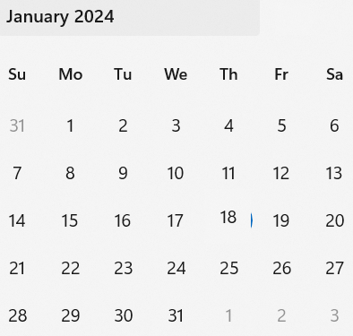
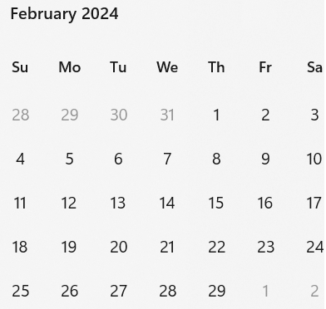
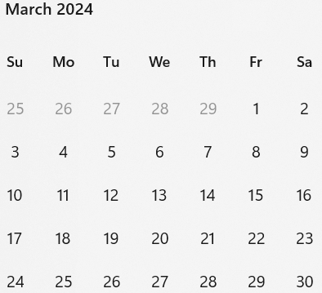
Call schedule, January thru March
Weekly on Tuesdays 2 hours split:
  6am PT (1 hour)
  3pm PT (1 hour)
Commencing January 30th 2024
Note: due to the major new year holiday in China, we will skip February 13th.

Slide 14
Spherical Earth Model
First Hour
Second Hour
Location | Local Time | Time Zone | UTC Offset
San Diego (USA – California) | Tuesday, 30 January 2024, 06:00:00 | PST | UTC-8 hours
Boston (USA – Massachusetts) | Tuesday, 30 January 2024, 09:00:00 | EST | UTC-5 hours
Dublin (Ireland) | Tuesday, 30 January 2024, 14:00:00 | GMT | UTC
Berlin (Germany) | Tuesday, 30 January 2024, 15:00:00 | CET | UTC+1 hour
Beijing (China) | Tuesday, 30 January 2024, 22:00:00 | CST | UTC+8 hours
Seoul (South Korea) | Tuesday, 30 January 2024, 23:00:00 | KST | UTC+9 hours
Corresponding UTC (GMT) | Tuesday, 30 January 2024, 14:00:00
Location | Local Time | Time Zone | UTC Offset
San Diego (USA – California) | Tuesday, 30 January 2024, 15:00:00 | PST | UTC-8 hours
Boston (USA – Massachusetts) | Tuesday, 30 January 2024, 18:00:00 | EST | UTC-5 hours
Dublin (Ireland) | Tuesday, 30 January 2024, 23:00:00 | GMT | UTC
Berlin (Germany) | Wednesday, 31 January 2024, 00:00:00 | CET | UTC+1 hour
Beijing (China) | Wednesday, 31 January 2024, 07:00:00 | CST | UTC+8 hours
Seoul (South Korea) | Wednesday, 31 January 2024, 08:00:00 | KST | UTC+9 hours
Corresponding UTC (GMT) | Tuesday, 30 January 2024, 23:00:00

