Slide 1
Project: IEEE P802.15 Working Group for Wireless Personal Area Networks (WPANs)
Submission Title: [TG15.6ma Closing Report for January 2024]
Date Submitted: [17th January 2024]
Source: [Ryuji Kohno1,2,] [1;Yokohama National University, 2;YRP International Alliance Institute(YRP-IAI)]
Address [1; 79-5 Tokiwadai, Hodogaya-ku, Yokohama, 240-8501 Japan
2; YRP1 Blg., 3-4 HikarinoOka, Yokosuka-City, Kanagawa, 239-0847 Japan]
Voice:[1; +81-90-5408-0611], FAX: [+81-45-383-5528],
Email:[1: kohno@ynu.ac.jp, 2: kohno@yrp-iai.jp] Re: []
Abstract: [This document contains closing report for TG15.6ma for Revision of P802.15.6-2012 with Enhanced Dependability January 2024.]
Purpose: [information]
Notice: This document has been prepared to assist the IEEE P802.15. It is offered as a basis for discussion and is not binding on the contributing individual(s) or organization(s). The material in this document is subject to change in form and content after further study. The contributor(s) reserve(s) the right to add, amend or withdraw material contained herein.
Release: The contributor acknowledges and accepts that this contribution becomes the property of IEEE and may be made publicly available by P802.15.

Slide 2
IEEE 802.15 TG6ma
(Revision of IEEE802.15.6-2012)
Closing Report
In Personal and Virtual Hybrid Interim Session
Panama
January 18th, 2024
Ryuji Kohno
Yokohama National University(YNU),
YRP International Alliance Institute(YRP-IAI)

Slide 3
1. Objectives of TG 6ma – Enhanced Dependability Body Area Network (ED-BAN)
Objective: Enhancements to the BAN Ultra Wideband (UWB) physical layer (PHY) and media access control (MAC) to support enhanced dependability to a human BAN (HBAN) and adds support for vehicle body area networks (VBAN), a coordinator in a vehicle with devices around the vehicular cabin.
Action:
•Update draft#1.11 of Draft Proposals for Pre-Ballot
•Comment resolution for draft#1.11
•Performance Evaluation of Technologies in PHY; Channel Coding According to 8 QoS Levels of Packets and Coexistence Levels, Interference Mitigation, etc.
•Performance Evaluation of Technologies in MAC; Channel Management, CCA, Hybrid Contention Free/Access Protocol According to 8 QoSs and Coexistences.
•Harmonization or Commonality with 4ab in Coexistence and Feasible Implementation of 6ma and 4ab
•Feasibility of TSN of 802.1 in MAC
Next Things to Do：
Finalize draft#1 for Letter Ballot

Slide 4
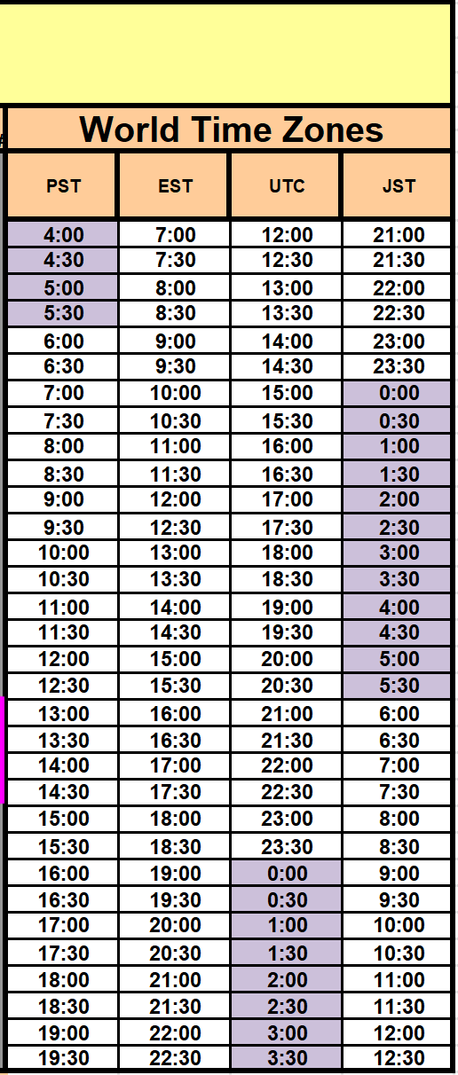
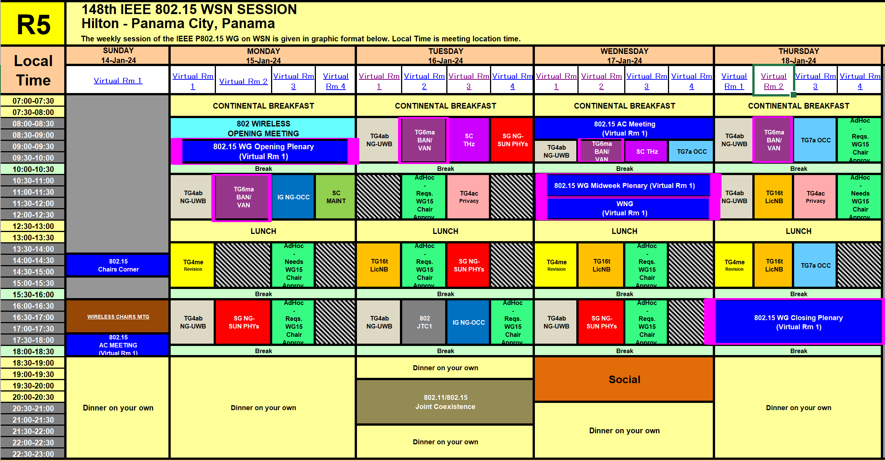
2. TG15.6ma Interim Session Schedule for 14-17th, Jan. 2024
TG15.6ma has three own sessions such as
Session1(Virtual RM#2) AM2 10:30-12:30 Jan. 15(MON) in Panama time, 0:30 - 2:30 Jan. 16(TUE) in JST/KST
Session2(Virtual RM#2) AM1 8:00-10:00 Jan. 16(TUE) in Panama time, 22:00-24:00 Jan. 16(TUE) in JST/KST
Session3(Virtual RM#2) AM1 9:00-10:00 Jan. 17(WED) in Panama time, 23:00-24:00 Jan. 17(WED)in JST/KST
Session4(Virtual RM#2) AM1 8:00-10:00 Jan. 18(THU) in Panama time, 22:00-24:00 Jan. 16(TUE) in JST/KST

Slide 5
3. Agenda items for the week
TG15.6ma meeting call to order
TG15.6ma Opening Information for January 2024 doc.#15-23-0638-01-06ma
Approve last meeting minutes: TG 15.6ma Meeting Minutes for November 2023 doc.#15-23-0608-00-06ma
Agenda of TG15.6ma January 2024 Meeting doc.#15-23-0636-08-06ma
Review and Summary
  Basic Consensus in MAC and PHY of Revision of IEEE802.15.6-2012(IEEE802.15.6ma) doc.#15-23-0557-01-06ma
  2. Progress and Action Items for Draft#1 doc.#15-23-0360-03-06ma
  Draft pre-ballot comment resolution doc.#15-23-0476-11-06ma
  Rescheduling Timeline doc.#15-23-0361-03-06ma
  Presentation
  MAC superframe structure for coexisting multiple dependable BANs doc.#15-24-0013-01-06ma
  MAC frame formats based on harmonization agreements doc.#15-24-0054-00-06ma
  Progress and Action Items for Draft#1 (Draft#1.19) doc.#15-23-0360-03-06ma
  Draft PAR and CSD 802.1ACea: Amendment to IEEE Standard 802.1AC-2016 doc.#15-23-0453-01&454-01-06ma
  Resolution Database for Pre-Ballot WG doc.#15-23-0476-01-06ma
  Hybrid ARQ Scheme for High QoS Packets in High Class of Coexistence of IEEE 802.15.6ma 0576-01-06ma
  Preliminary Evaluation on Ranging Accuracy with Interference Cancellation in Coexistence Environments 24-057-00
  Evaluation of IEEE 802.15.6 Ultra-wideband Physical Layer Utilizing Super Orthogonal Convolutional Code
  doc.#15-24-0051-00-06ma
  Simulation results for Nagoya I. T. and YRP-IAI MAC proposal Based on TG6ma Channel Model -0352-03-06ma
  UWB Positioning in 15.6ma for Multiple BAN Adjacent Scenarios doc.#15-23-0560-01-06ma
  Performance Evaluation of Channel Coding under Various Channel Models in Some
  Classes of Coexistence in TG6ma doc.#15-23-0577-01-06ma
  10. Interference Mitigation Schemes in Class 3, 5, 6, and 7 of Coexisitence in TG6ma doc.#15-24-0073-00-06ma
  11 TG6ma Channel Model Document for Enhanced Dependability doc.#15-22-0519-05-06ma
  13. Overview and convergence of MAC proposals for 15.6ma doc.#15-24-0078-00-06ma
  14. Progress Report of TG6ma doc.#15-23-0056-06-06ma
  15. Timeline of TG6ma doc.#15.23-0407-03-06ma
  16. TG15.6ma Closing Report for January 2024 doc.#15-24-0074-00-06ma
  17. TG15.6ma Meeting Minutes for January 2024 doc.#15-24-0075-00-06ma

Slide 6
4. Basic Agreement(1/2)
IEEE802.15.6ma; revision of IEEE802.15.6-2012 focuses on enhanced dependability in data transmission and ranging in classified environments of coexistence with the same and other frequency shared wireless networks.
15.6ma covers new and conventional channel models of major use cases of 802.15.6ma Body Area Networks (BAN) are for human and vehicle bodies in medical and automotive applications for enhanced dependability.
15.6ma supports some backward compatibility with 15.6-2012 as much as possible but not all of them in PHY and MAC. 15.6ma aims to replace 15.6-2012 for enhanced dependability. For instance, 15.6ma focuses on only UWB in PHY and only time structure mode in MAC.

Slide 7
4. Basic Agreement(2/2)
In order to perform enhaced dependability in revision of IEEE802.15.6-2012(IEEE802.15.6ma), coexistence environments have been classified. Some classes of multiple new and legacy BANs coexistence are focused to manage packet contention in MAC layer while other classes are taken care by mitigation of interference in Physical layer(PHY) and manage contention in MAC.
Ranging in 802.15.6ma is optional but ranging between coordinators of neibouring or coverage overlaid BANs is helpful to identify geographical overlay and mobility of incoming and outgoing to determine coexistence class stataes. Ranging between BAN coordinator and its nodes in star topology in 802.15.6ma is the same as 802.15.4z and its amendment.

Slide 8
5. 15.6ma PHY and MAC New Features(1/2)
Since IEEE802.15.6-2012 has too many modes in PHY and MAC, 15.6ma chooses a few modes to simplify specification of PHY and MAC while introduces new error-controlling schemes of FEC and HARQ, and management and data channels for enhanced dependability in various channel models and 8 classes of coexistence models for 8 levels of QoS priority order packets such as
  PHY
    Various channel coding and decoding matched with QoS priority levels of packets and coexistence classes
    Interference mitigation schemes according to various environment of coexistence classes
  MAC
    Two channels using two UWB band channels are applied for management channel to control frames of coexisting networks and data transmission channel. Its alternative mode is two channels for management and data transmission using a single UWB band channel.
    Coordinator-to-coordinator(C2C) negotiation of existing networks
  Cross Layer of PHY and MAC
    Hybrid ARQ for higher priority of packets in high class of coexistence

Slide 9
5. 15.6ma PHY and MAC New Features(2/2)
  3. Cross Layer of PHY and MAC
    Hybrid ARQ for higher priority of packets in high class of coexistence
    For the sake of easy implementation, hybrid ARQ is optional in limited high classes of coexistene.
    Ranging between coexisting BANs’ coordinators could be proceeded by C2C(coordinator-to-coordinator) functionality.
    Ranging information in PHY is applied for identifying coexistence class states in which appropriate MAC is selected.

Slide 10
6.1 Definition of Coexistence Environment Classes
Coexistence Class | Coexisting system(s) |  |  |  |  | Category
Level | 802.15.6ma | 802.15.6-2012 | Non-UWB (ex. Wi-Fi / Unlicensed / 3GPP) | 802.15 UWB (ex. 802.15.4) | Non-802.15 UWB (ex. ETSI SmartBAN) | Category
0 | - | - | - | - | - | Single BAN
1 (1a) | ✓ | - | - | - | - | Multiple 15.6 BANs
2 (1b) | ✓ | ✓ | - | - | -
3 | ✓ | - | ✓ | - | - | Non-UWB
4 (2a) | ✓ | - | - | ✓ | - | Multiple UWB systems
5 (2b) | ✓ | - | - | - | ✓
6 (2c) | ✓ | - | - | ✓ | ✓
7 | ✓ | ✓ | ✓ | ✓ | ✓ | Final Boss
The coexistence class has been redefied to 8 levels, which can be represented by 3 bits and would be suitable to include in PHY or MAC headers.

Slide 11
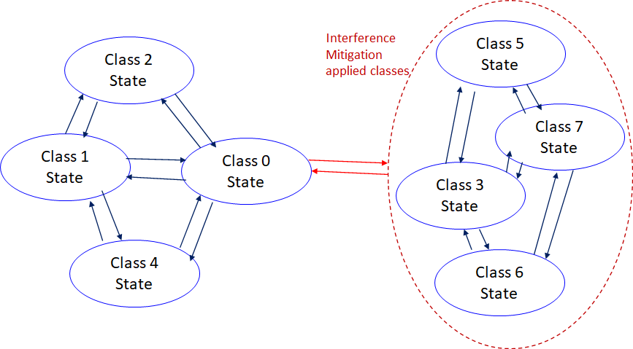
    6.2 Coexistence Class States Transition(1/2)
The standard's revision supports BANs operating with high reliability (coexistence class 0) and coexisting in dense environments with intra-interference and inter-interference (coexistence class 1 to 7). Figure 6 shows the state transition between several classes of coexistence environments defined in above –mentioned table.
Class 0: 6ma BAN alone
Class 1: Multiple 6ms BANs
Class 2: 6ma BAN with old 6 BAN
Class 4: 6ma BAN with other
802.15 UWB WSNs e.x. 4z, 4ab
Class 3: 6ma BAN with other
narrowband Nets WSNs
Class 5: 6ma BAN with other
UWB Nets e.x. ESTI SmartBAN
Class 6: 6ma with 802.15 other WSN
Class 7: 6ma with any frequency
shared networks
Figure 6 Diagram of state transitions for coexistence class environments.

Slide 12
    6.2 Coexistence Class States Transition(2/2)
The standard's revision focuses on the dependability mechanisms for a single HBAN or VBAN (Class 0) and the scenario with multiple HBANs or VBANS (Class 1).
Class 2 supports compatibility with legacy BANs (IEEE 802.15.6-2012 Std).
Class 4 supports coexistence with other IEEE 802.15 UWB Stds, and amendments such as 15.4, 15.8, 15.4z, and 4ab, via the PHY and MAC specification.
Classes 3, 5, 6, and 7 support coexistence with other wireless systems can result in Class 0, 1, and 2 by mitigation technology to cancel interference from other radios except regacy 15.6 at the receiver side (see clause 4.7.2 of draft#1.11.
During CCA, a BAN coordinator may analyze the type of synchronization preamble detected from a 15.6ma, 15.6, or 15.4 system.
In Figure 6, the state transition probabilities are approximated in consecutive superframes. Furthermore, the duration of the CAP and CFP are determined by statistics of various QoS level of packets in previous consecutive superframes for every coming superframe.
The draft revision #1.11 supports BANs operating with high reliability in dense environments coexisting with intra-interference and inter-interference due to other wireless systems in the same frequency band. Figure 6 shows state transition among several classes of coexistence environment defined in Table 1.

Slide 13
6.3 QoS Levels of Packets corresponding to User Priority
In Std.15.6 WBAN systems, a various data such as vital signs, skin temperature, blood pressure, ECG, EEG, ECoG, and vehicle controlling commons have different QoS levels corresponding to user priority.
In 15.6ma for dependable WBAN for human and vehicles, data packet transmission should be dependable according to QoS levels even in various classes of coexistence environment.
Therefore, appropriate sets of error controlling scheme with FEC and hybrid ARQ corresponding to QoS levels have been standardized in 15.6ma,
User priority | Traffic designation | Frame type
0 | Background (BK) | Data
1 | Best effort (BE) | Data
2 | Excellent effort (EE) | Data
3 | Video (VI) | Data
4 | Voice (VO) | Data
5 | Medical data or network control | Data or management
6 | High-priority medical data or network control | Data or management
7 | Emergency or medical implant event report | Data

Slide 14
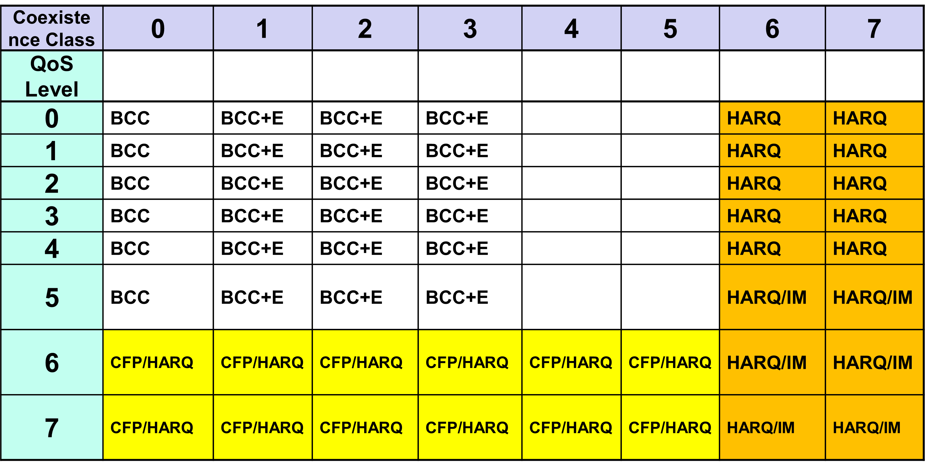
6.4 FEC/HARQ for 64 Combinations of 8 Coexistence Classes × 8 QoS Packet Levels
FEC codes and Hybrid ARQ have been designed for 8 × 8 = 64 combinations for QoS levels and Coexistence classes under various standard of channel models.

Slide 15
Common with IEEE802.15.4ab
Error-correcting codes corresponding to QoS levels
Channel Coding Table #1
User priority | Inner code | Outer code | HARQ
0 | 15.4ab LDPC code (R=1/2) |  | -
1 | 15.4ab LDPC code (R=1/2) |  | -
2 | 15.4ab LDPC code (R=1/2) |  | -
3 | 15.4ab LDPC code (R=1/2) |  | -
4 | 15.4ab LDPC code (R=1/2) | (54, 46) shortened RS code | -
5 | 15.4ab LDPC code (R=1/2) | (54, 38) shortened RS code | -
6 | 15.4ab LDPC code (R=1/2) | (54, 28) shortened RS code | -
7 | 15.4ab LDPC code (R=1/2) | (54, 14) shortened RS code | -
As an outer code, shortened Reed-Solomon (RS) codes with N=54 (original code length N=63) will be selected to correct burst errors due to interference from other WBANs and the coding rates are changed according to each QoS and channel condition
As an inner code, 15.4ab LDPC codes (K=324, 648, 972, R=1/2) will be selected for the coexistence of 15.6ma and 15.4ab
This updated concept table is considered as the first priority

Slide 16
TG 6ma Timeline(expected)
EC approval to SB, SB submission
May 2024
SB recirculation
June 2024
Tech Req Doc(TRD) July 2022
TRD,CMD
Call Proposals Sept 2022
Presentation of proposalsNov2022 Jan.2023
Harmonization of Proposals
Mar 2023
^{Std Draft V0}
May 2023
Upload preliminary draft v1 on WG repository to revise for finalizing v1
July2023
WG pre-ballot
Sept 2023
Comments and resolution for pre-ballot.
Nov 2023
WG letter ballot (LB)
Jan. 2024
Revcom Approve
Sept 2024
^{Finalize Std Draft V1}
August 2023
SB recirculation if required
July 2024
RevcomSubmission
Aug. 2024
Notes: SASB/RevCom scheduled for 2024 a guess

Slide 17
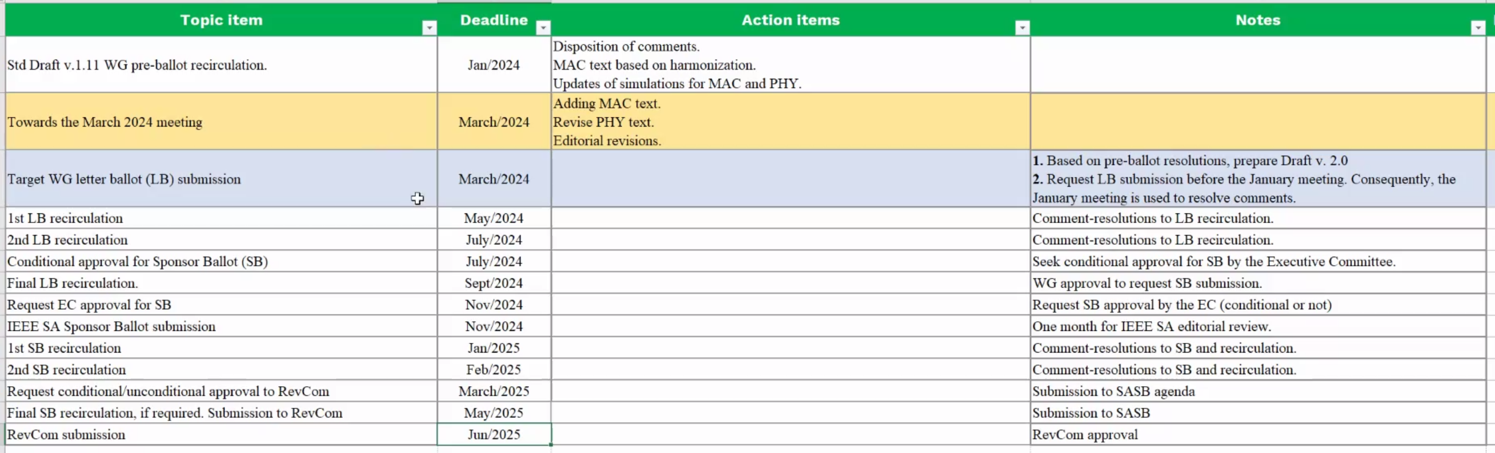
Expecting Timeline detail
Note: the deadlines are subject to change.

Slide 18
Contributions
・TG15.6ma opening report for January 2024 meeting 15-23-0638-01-06ma
・TG15.6ma Agenda of January Meeting in 2024 15-23-0636-08-06ma
・Progress and Action Items for Draft#1 15-23-0360-03-06ma
・Draft pre-ballot comment resolution 15-23-0476-10-06ma
・Rescheduling Timeline 15-23-0361-02-06ma
・Basic Consensus in MAC and PHY of Revision of IEEE802.15.6-2012 15-23-0557-01-06ma
・MAC superframe structure for coexisting multiple dependable BANs 15-24-0013-01-06ma
・MAC frame formats based on harmonization agreements 15-24-0054-00-06ma
・Preliminary Evaluation on Ranging Accuracy with Interference Cancellation in Coexistence Environments
15-24-0057-00-06ma
・Evaluation of IEEE 802.15.6 Ultra-wideband Physical Layer Utilizing Super Orthogonal Convolutional Code
15-24-0051-00-06ma
・Simulation results for Nagoya I. T. and YRP-IAI MAC proposal 15-23-0242-03-06ma
・Hybrid ARQ Scheme for High QoS Packets in High Class of Coexistence of IEEE 802.15.6ma 0474-01-06ma
・Evaluation of IEEE 802.15.6 Ultra-wideband Physical Layer Utilizing Super Orthogonal Convolutional Code
15-22-0562-05-06ma
・Preliminary performance evaluation of ranging in coexistence environment 15-23-0353-04-06ma
・Performance Evaluation of Channel Coding under Various Channel Models in Some Classes of Coexistence in TG6ma 15-23-0577-00-06ma
・TG6ma Channel Model Document for Enhanced Dependability 15-22-0519-05-06ma
・Draft pre-ballot comment resolution 15-23-0476-13-06ma
・Interference Mitigation Schemes in Class 3, 5, 6, and 7 of Coexisitence in TG6ma 15-24-0073-00-06ma
・Overview and convergence of MAC proposals for 15.6ma 15-24-0078-00-06ma
・Progress Report of TG6ma 15-23-0056-05-06ma
・TG15.6ma closing report for January 2024 meeting 15-24-0074-00-06ma
・TG15.6ma January 2024 meeting minutes 15-24-0075-00-06ma /

Slide 19
Contacts and Conference call
January 2024
Chair; Ryuji Kohno, YNU/YRP-IAI
kohno@ynu.ac.jp, kohno@yrp-iai.jp
1st Vice-Chair; Marco Hernandez, YRP-IAI/CWC
marco.hernandez@ieee.org
2nd Vice-Chair; Daisuke Anzai, NIT
anzai@nitech.ac.jp
3. Secretary; Takumi Kobayashi, YNU/TCU
kobayashi-takumi@yrp-iai.jp, kobayashi@nitech.ac.jp
Technical Editors;
Minsoo Kim, YRP-IAI minsoo@minsookim.com
Seong-Soon Joo, KPST wowbk@kpst.co.kr
Kento Takabayashi, Toyo U. takabayashi.kento.xp@gmail.com
Marco Hernandez, YRP-IAI/CWC marco.hernandez@ie ee.org
Jussi Haapola, CWC jussi.haapola@oulu.fi

Slide 20
Thank You !
Any Questions ?

