Slide 1
Project: IEEE P802.15 Working Group for Wireless Specialty Networks
Submission Title: Interference Mitigation Schemes in Class 3, 5, 6, and 7 of Coexistence in TG6ma
Date Submitted: January 15th, 2025
Source: Takumi Kobayashi^{1,2}, Minsoo Kim², Marco Hernandez^{2,3}, Ryuji Kohno^{2,4},
Company: [¹Nagoya Institute of Technology, ²YRP International Alliance Institute, ³CWC, University of Oulu, ⁴Yokohama National University]
Address [1; Gokiso-cho, Showa-ku, Nagoya 466-8555 Japan, 2: YRP1 Blg., 3-4 HikarinoOka, Yokosuka-City, Kanagawa, 239-0847 Japan, 3: University of Oulu Pentti Kaiteran katu 1, 90570 Oulu, Finland, 4: 79-5 Tokiwadai, Hodogaya-ku, Yokohama, 240-8501 Japan]
Voice:[+81-90-5408-0611] E-Mail:[kobayashi@nitech.ac.jp, minsoo@minsookim.com, marco.hernandez@ieee.org, kohno@ynu.ac.jp, Kohno@yrp-iai.jp]
Re: In response to call for technical contributions
Abstract: This provides considerations of radio environment surrounding human body area network(HBAN) and vehicle body area network(VBAN) for enhanced dependability. As an example of PHY layer countermeasure technology of these co-existence and EMC/EMI issues, signal processing technology on space and time domains based on orthogonal matched filter is introduced.
Purpose: Material for discussion in P802.15 TG6ma
Notice: This document has been prepared to assist the IEEE P802.15. It is offered as a basis for discussion and is not binding on the contributing individual(s) or organization(s). The material in this document is subject to change in form and content after further study. The contributor(s) reserve(s) the right to add, amend or withdraw material contained herein.
Release: The contributor acknowledges and accepts that this contribution becomes the property of IEEE and may be made publicly available by P802.15.

Slide 2
Interference Mitigation Schemes in
Class 3, 5, 6, and 7 of Coexistence in TG6ma
Takumi Kobayashi^{1,2}, Minsoo Kim², Marco Hernandez^{2,3}, Daisuke Anzai¹, Ryuji Kohno^{2,4}
¹ Nagoya Institute of Technology
² YRP International Alliance Institute
³ CWC, University of Oulu
⁴ Yokohama National University

Slide 3
In 4.7.1, 4.7.2 and 6.5 of standard document draft D03, coexistence environments are explaind and defined as class 0 to 7. It seems that the inteference in classes 1 and 2 can be reduced by MAC technologies and control schemes. On the other hand, interference in case of classes 3 to 7 (interference from NOT802.15.6 series wireless and/or the other electro-magnetic radiative systems) should be reduced and mitigated in the PHY layer and/or signal processing.
In Annex G, interference mitigation technologies on physical layer and signal processing are explained more focusing on the interference mitigation for coexistence level 3 to 7 that cannot be mitigated by only MAC technique.

Slide 4
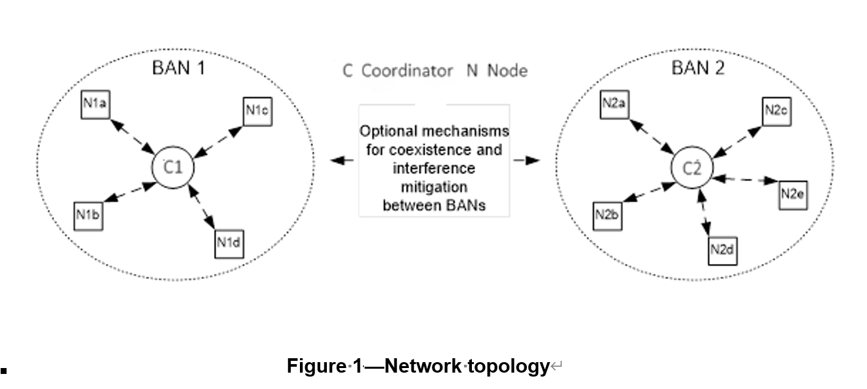
Network topology and coexistence environment assumed in TG6ma

Slide 5
Various Interference in Coexistence
＊ IEEE 802.11a (wi-fi) （5GHz） overlaps
UWB-WBAN
IEEE 802.15.6
User “B”
Other BAN
Other UWB system.
e.g. IEEE 802.15.4-2020
IEEE 802.15.4z
Other UWB-BAN
user ？
interference
user ？
Other NB-BAN
interference
User “A”.
A wants to connect to “B”.
user ？
Inter-user interference
“IUI”
Inter-system interference
Inter-BAN interference
“IBI?”
“ISI”
Interference from a system using
the same standard.
Interference from a system using
overlapped frequency
VBAN ⬄ HBAN interference
Unknown signal.
EMI / EMC issues
Known signal.
Pre-knowledge can be used to mitigation

Slide 6
EMC (Electro-Magnetic Compatibility)
Thunder,
Electrostatic discharge; ESD
Pulse noise,
Colored noise etc..
BAN device
Other devices e.g. Medical devices
Other radio devices
e.g. cellular phone, cellular base station
Power electronics
motors
Microwave oven
Interference
Emission

Slide 7
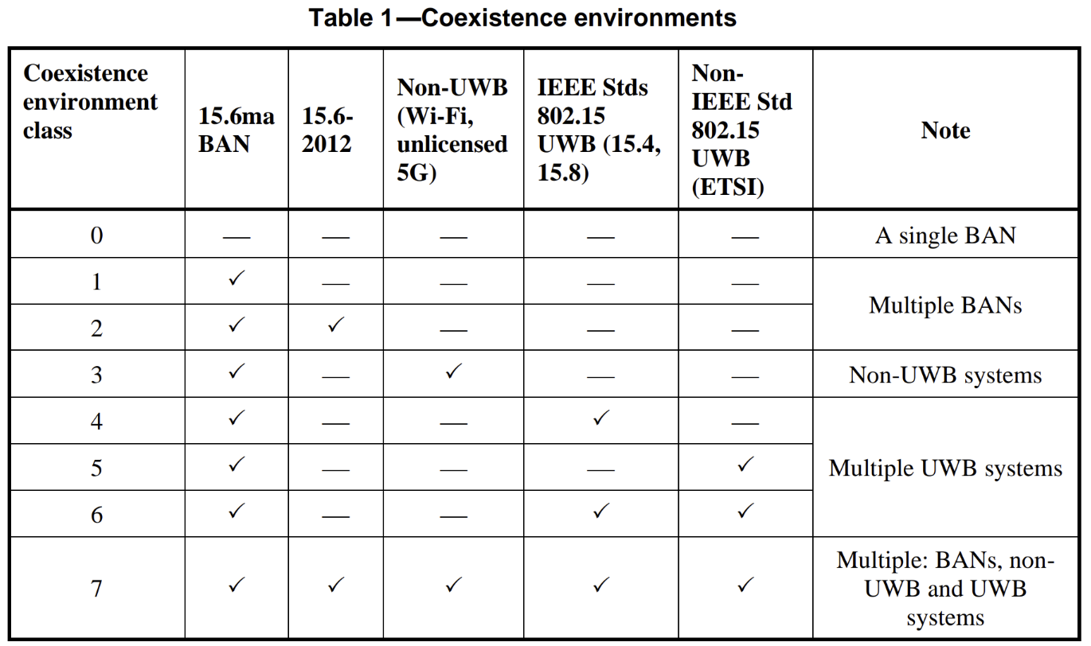
Coexistence environments in TG6ma

Slide 8
Example of coexistence class 1

Slide 9
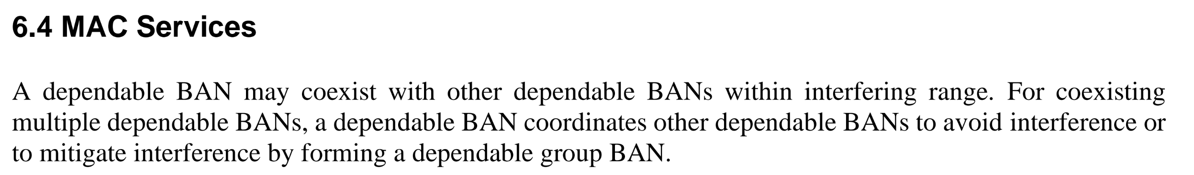
Coexistence with…
Multiple BANs --- Can be achieved by MAC interference mitigation.
Multiple UWB systems (not BAN systems) ---
Multiple non-UWB systems
  The systems may share the same or overlapping frequency band.
  Cannot use MAC interference mitigation due to limited compatibility.
Needed to be applied interference mitigation on PHY technologies.

Slide 10
Interference mitigation or rejection in…
MAC: Basically, interference mitigation on MAC needs communication. MAC technology cannot remove interference from the other system which cannot be detected in the receiver of new TG6ma nodes or coordinators.
PHY: Partially applicable by using PHY technology such as FEC, HARQ, etc…
Lower level signal processing can be effective to remove the effect of unknown interference from unknown various source.

Slide 11
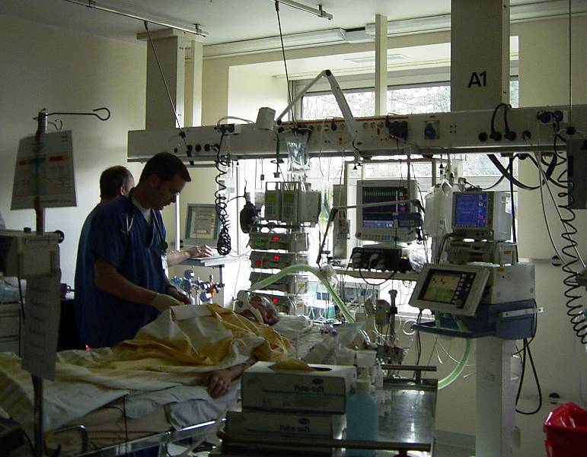
Medical room radio environment
Cardiac output monitor
Infusion pumps
Vital monitor
Artificial respirator

Slide 12
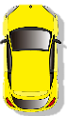

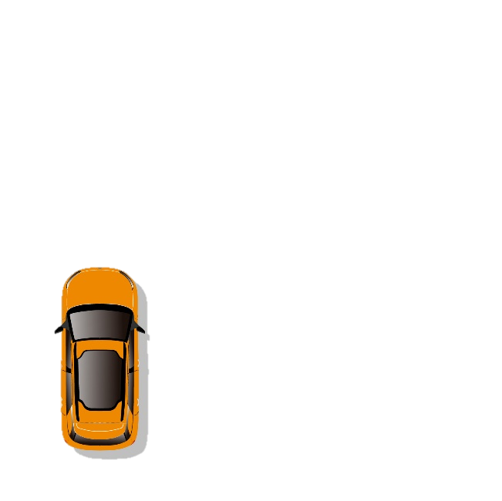
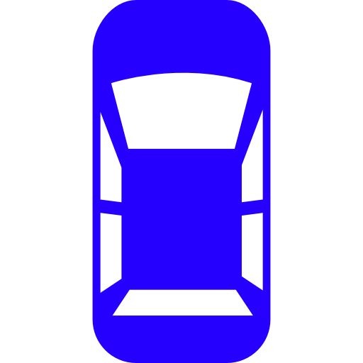

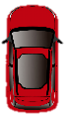

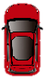


Multiple VBAN Situation
Desired user
Undesired users
Own vehicle
Desired vehicle
Interference vehicle

Slide 13
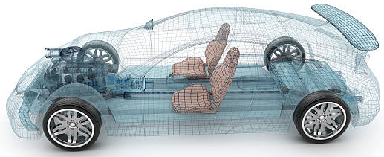
Environment Model in Vehicle
Engine/Motor room environment model
Engine/motor diagnostic sensor and controller
Air pressure sensor, wheel health sensor and controller
Transmission monitoring sensor and controller
Cabin environment sensor (temperature, brightness, humidity etc.)
Sheet sensor, health care sensors for driver
Sheet sensor, health care sensors for passenger
Cabin room environment model
Note:
Various type of car/vehicles
Bus, Bulldozer, Heavy construction equipment needed each different sensors.
4
2
5
1
3
6
https://media.istockphoto.com/photos/transparent-car-design-wire-model3d-illustration-my-own-car-design-picture-id594040008?k=6&m=594040008&s=612x612&w=0&h=XE8LiBjpM51aB4pH2CFt6-MT6IvALRPnlxPcac0RXhg=

Slide 14
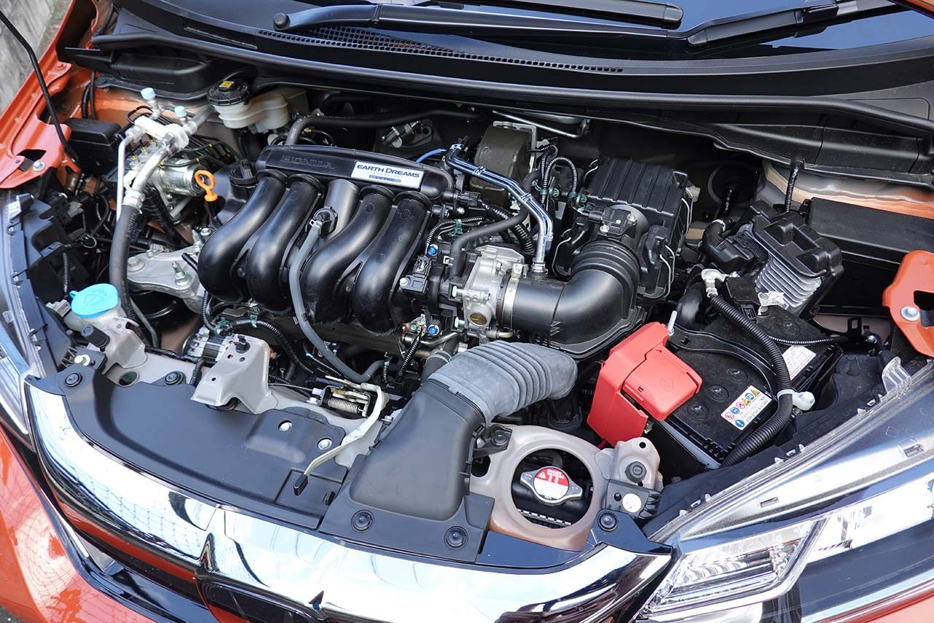
Engine/Motor Room Environment
Many metallic components
Components existing in densely
Ignition noise, motor noise
Larger path-loss than free propagation
A lot of reflection of RF signal
Electro-magnetic interference, EMI issues
Especially EV
https://www.as-web.jp/car/575374/attachment/03a_sub_dsc01273
Ignition coil
Spark plug
Electric generator
Electric motor
High current battery and cable

Slide 15
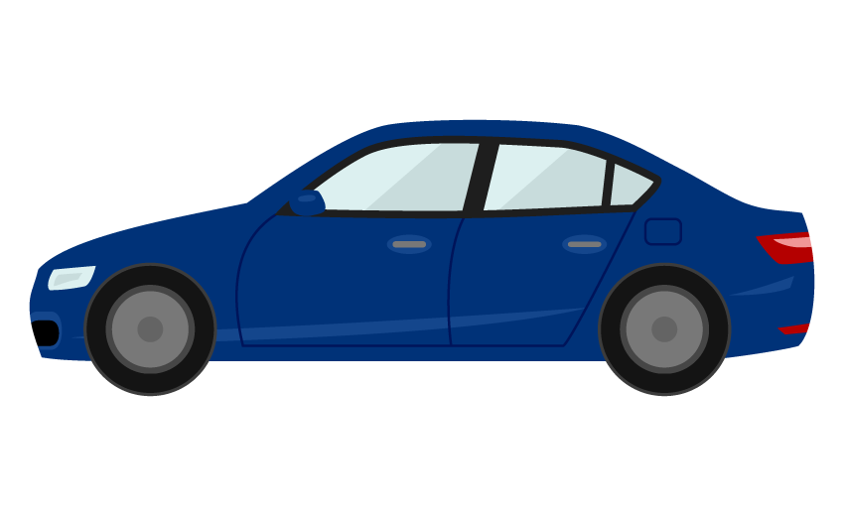
Electromagnetic Environment
Front object CCD camera
Rear object monitor CCD camera
Lane departure system
Night vision
Blind spot detection
Front airbag sensors
Nighttime pedestrian warning
Rear camera
Cross traffic alert
Drowsiness sensos
Rear object laser radar
Front object laser radar
Side airbag SRS
Tire pressure sensor
Tire pressure sensor
Automatic brake actuator
Steering angle sensor
Central computer
Wheel speed sensor
Wheel speed sensor
Active park assist
Adaptive cruise control
Nighttime pedestrian warning IR sensor
Sensors, monitors and vehicle controlling systems in modern vehicle

Slide 16
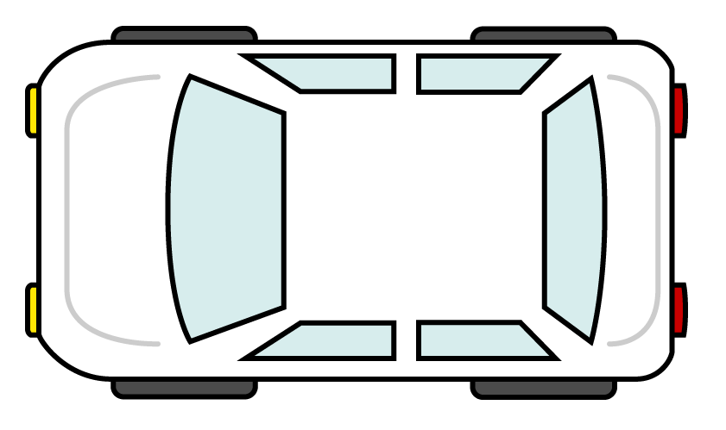
EMC model
Source
Path
Sink
Sources of EM near and far field: may be off board and on-board sources
Path: radiated or conducted
Sink: intended receiver or unintended receiver
Camera application
Radar application
Engine control application
Camera application
Multimedia application
Head unit
Dashboard application
rear seat entertainment
Body control applicaition
Radar application
Camera application
Camera application

Slide 17
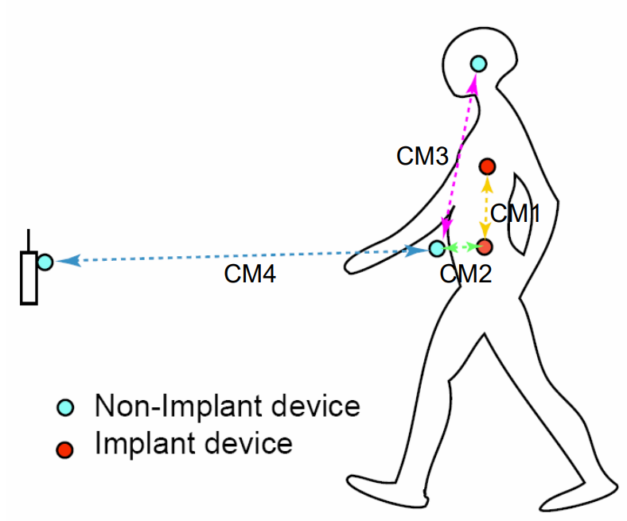
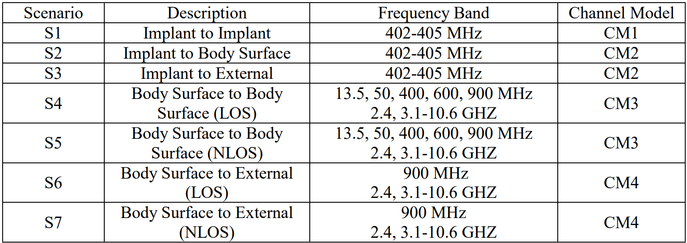
Channel models and scenarios in IEEE802.15.6-2012
IEEE P802.15-08-0780-12-0006-TG6
IEEE 802.15.6-2012 channel models considered
Fading ( Small scale/ large scale)
Path loss
Shadowing
Power delay profile
In-body (implant)
On-body (body surface)
CM1, 2, 3, 4
Scenario 1, to Scenario 7. (S1 – S7)

Slide 18
Channel model
Channel model
Path loss
Reflection
Multipath
Fading
LOS / NLOS model
White Gaussian noise
Source
Sink

Slide 19
Environmental model
Interference to the other devices
Interference from the other devices
Channel model
Source
Path loss
Reflection
Multipath
Fading
LOS / NLOS model
White Gaussian noise
Sink
Human impact
Colored noise

Slide 20
Environmental model
EMI from vehicle system
Colored noise
EV Switching noise
Ignition noise
etc…
Standard antenna
Standard antenna
Channel model
Propagation Model （based on S-V Model）
RF
ANT
+
ANT
RF
Distance dependent function
Interference from the other Wireless systems
Interference from the other BAN
Interference from the other UWB (not BAN)
Distance dependent function
We propose to define environmental models including antenna effect. Parameter measurements will be performed by using standard antennas which will be defined separately.

Slide 21
Classification of Channel and Environment Models for Human and Vehicle Body Area Networks (HBAN&VBAN)
Channel model
※Covered by
IEEE 802.15.6-2012
HBAN model
In-body (Implant)
※
On-body
※
Channel model
With environment
Around body
Outdoor
※Around means;
Desk, WiFi AP in the room etc.
Indoor
※
Home
Implanted BCI model
Office
※
On skull BCI model
Medical (e.g. Hospital)
※
capsule endoscopy
※not covered in 2012
VBAN model
In-vehicle
Engine compartment
Note:
HBAN-model:
-Environment with co-existing systems is not considered.
VBAN model:
Key-less entry system
Localization in-body, on-body
Most dominant model should be defined and separatory defined as Mandatory and Optional.
Cabin
Through Engine compartment and cabin
On-vehicle
Roof
Around vehicle
Side Right/Left/Front/back
Bottom
Static vehicle

Slide 22
Radio environment
15.6ma
15.6ma
EMI source
15.4z
15.6ma
15.6ma
15.6
15.4ab
15.4

Slide 23
Interference sources example
Interference from the other 15.6ma devices (not controlled)
  From the other BAN networks, hidden devices etc.
Interference from the other UWB systems
  For example: 15.4, 15.4ab and 15.4z
Interference from the other wireless systems
  Such as 802.11 series, 802.15.x (narrowband) systems operating in the UWB band.
Interference from the other electric and electronic components
  Such as medical components, vehicle components, electric motor, spark plug etc.

Slide 24
Contributions in TG6ma from attendees
PHY Layer Technologies
FEC, channel coding
Kento Takabayashi, “Evaluation of IEEE 802.15.6ma Ultra-wideband Physical Layer Utilizing Super Orthogonal Convolutional Code, IEEE P802.15-22-562-13-006a
Daisuke Anzai et al, “Performance Evaluation of Channel Coding with Interleaver Based on TG6ma Channel Model for Some Classes of Coexistence, IEEE P802.15-24-247-03-006a
ARQ, HARQ
Kento Takabayashi, “Hybrid ARQ Scheme for High QoS Packets in High Class of Coexistence of IEEE 802.15.6ma, IEEE P802.15-23-576-07-006a
Kento Takabayashi, “QoS-aware Hybrid ARQ Scheme Utilizing Decomposable Error Correcting Codes for Wireless Body Area Networks, IEEE P802.15-22-561-02-006a

Slide 25
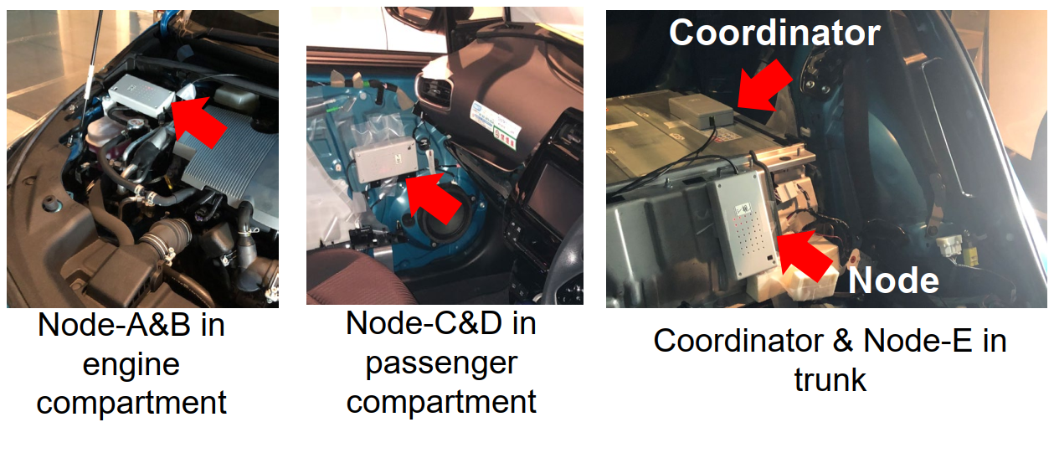
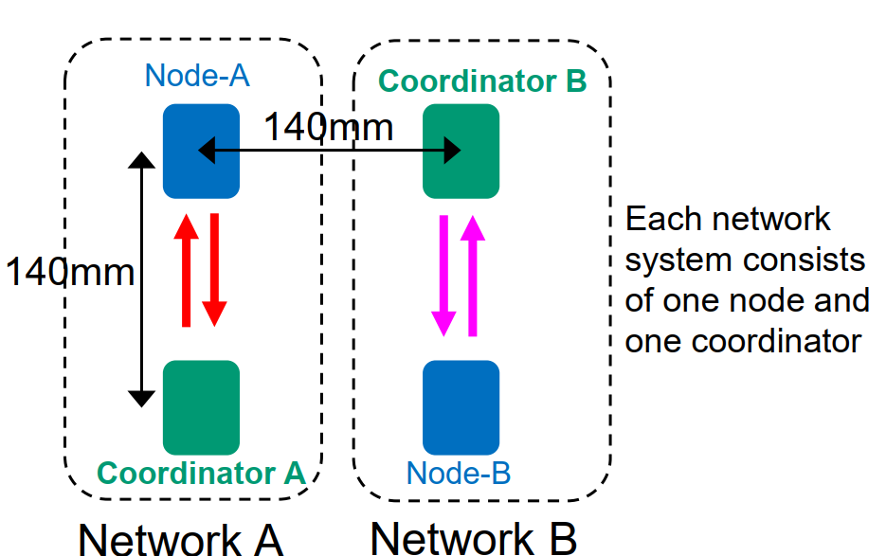
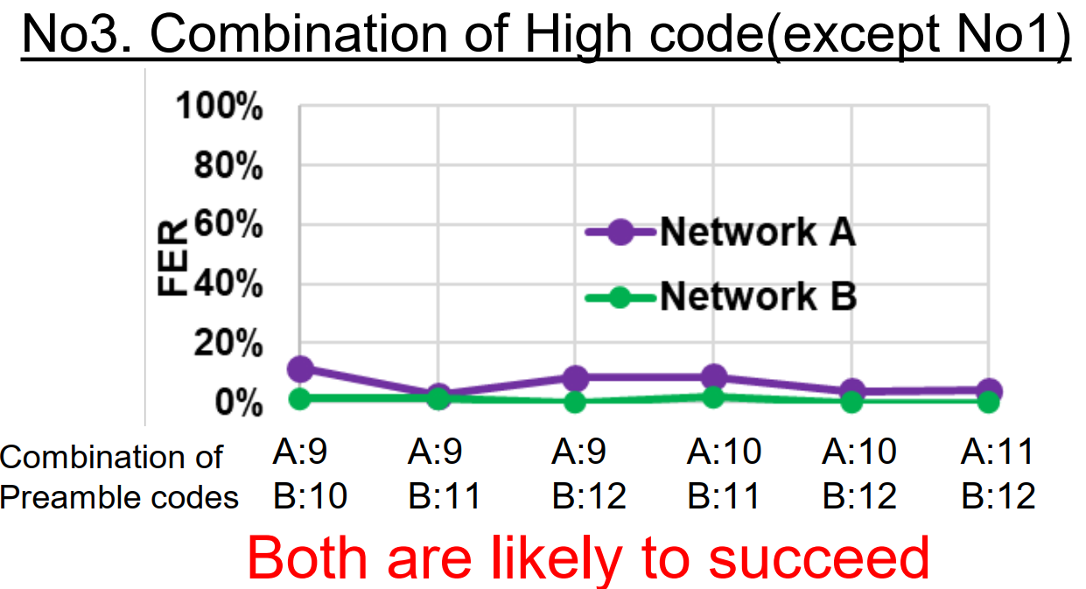
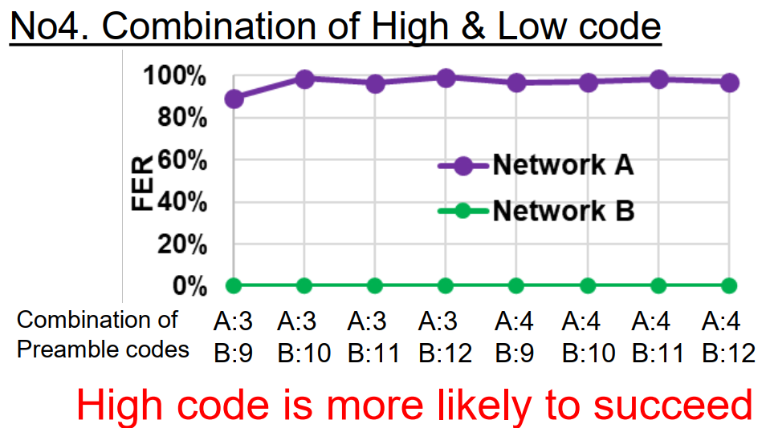
Contributions in TG6ma from attendees
Code orthogonality, signal processing
H. Yoshitake, T. Nomura, M. Okuhara, “Performance Improvement by Proper Set of Preamble Codes in UWB Wireless Communications in a Presence of Multiple Coexisting VBANs” IEEE P802.15-24-0567-00-006a
H. Yoshitake, T. Nomura, M. Okuhara, “Performance Improvement by Proper Set of Preamble Codes in UWB Wireless Communications in a Presence of Multiple Coexisting VBANs” IEEE P802.15-24-0567-00-006a

Slide 26
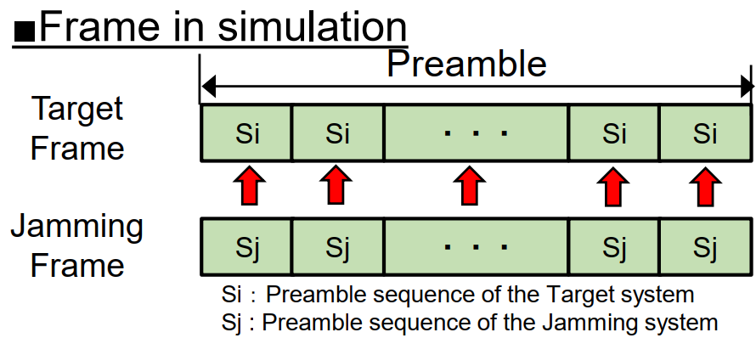
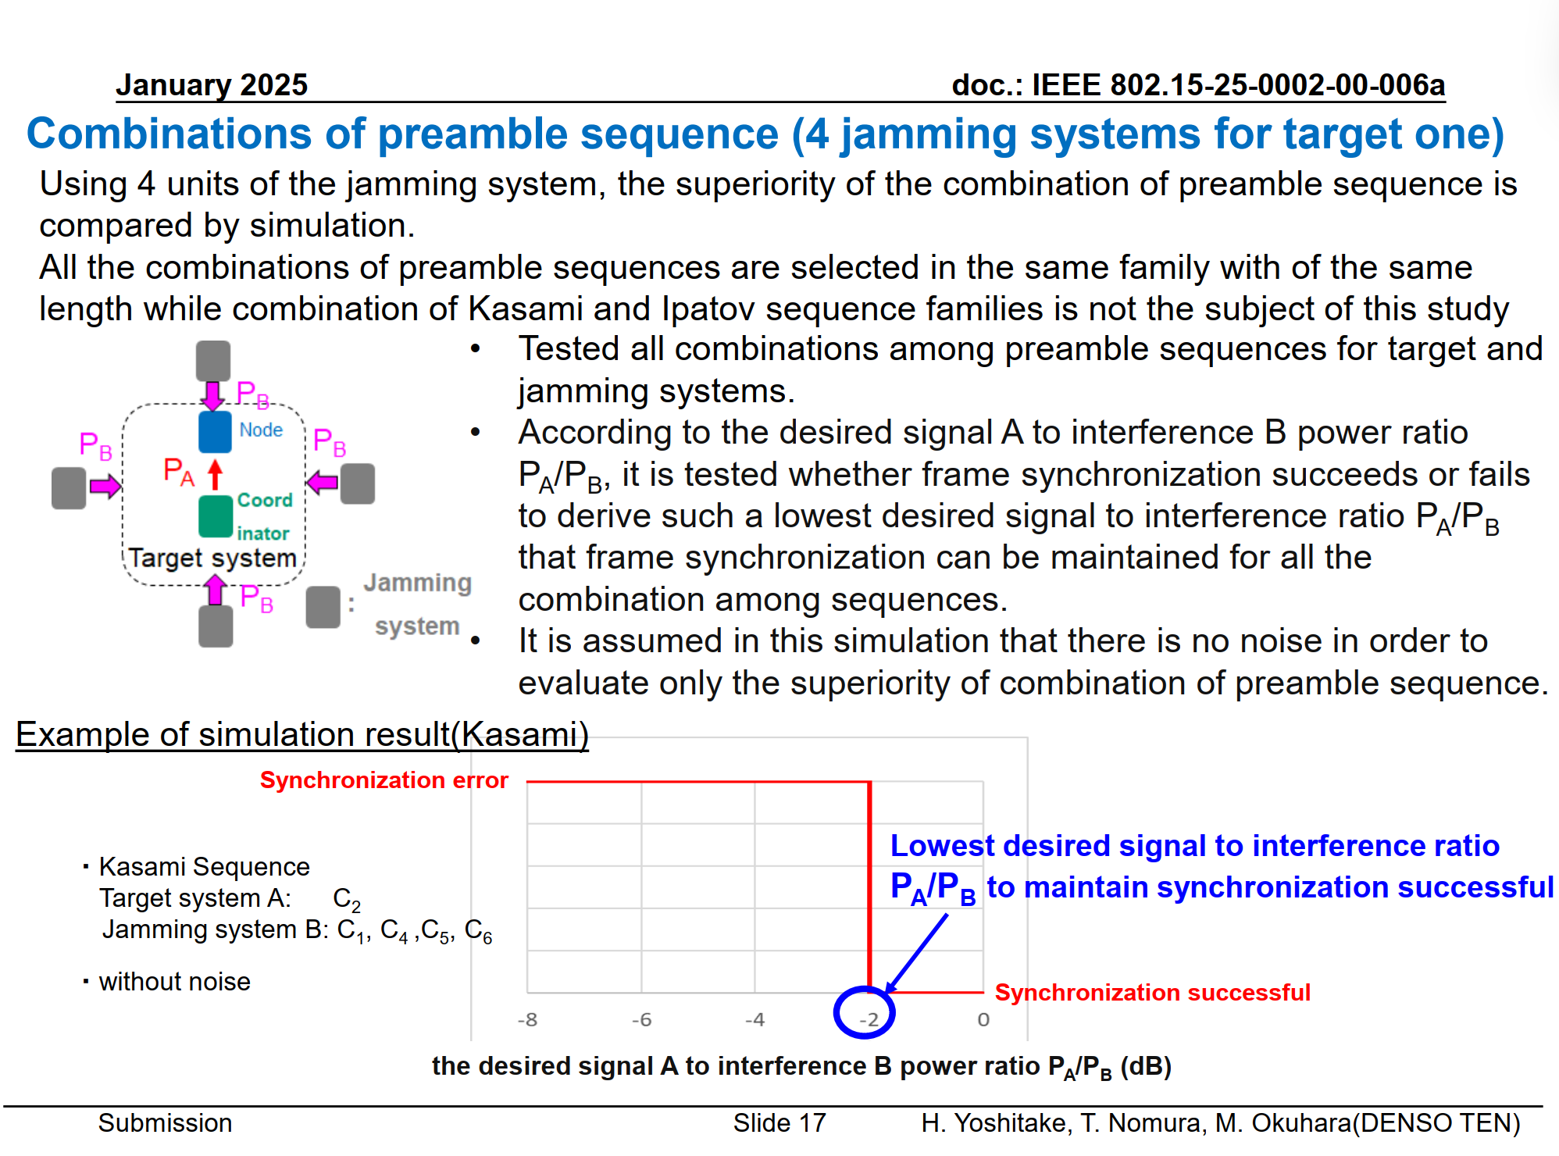
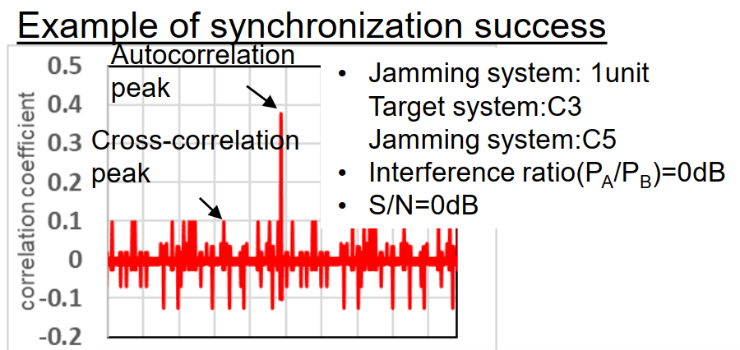
Contributions in TG6ma from attendees
Code orthogonality, signal processing
H. Yoshitake, T. Nomura, M. Okuhara, “Selection of Suitable Preamble Sequence Sets in UWB Wireless Communications in the Presence of Multiple Coexisting VBANs,” IEEE P802.15-25-0002-00-006a
H. Yoshitake, T. Nomura, M. Okuhara, “Selection of Suitable Preamble Sequence Sets in UWB Wireless Communications in the Presence of Multiple Coexisting VBANs,” IEEE P802.15-25-0002-00-006a

Slide 27
Unknown interference
Some interference sources have known characteristics:
  Example: frequency, pulse reputation rate, modulation method, etc.
  Interference from the other 15.6ma and legacy 15.6 devices may be controlled by the MAC
  Interference from the other UWB devices is mostly overlapped in the same frequency band. However, we can exploit the knowledge of the signal specification.
Some interference sources emit unknown electromagnetic radiation:
  Electromagnetic interference from the electric and electronic components, i.e., electric motor in EV, HEV, and spark plugs on engine radiate strong electromagnetic waves.
  Legacy narrowband wireless radiate unknown radiowave.

Slide 28
Issues on multiple BAN environment
  Inter-user interference
    IR-UWB uses the same pulse as all users signal in the same standard.
    Other users signal and/or the other network signal would be interference.
  Inter-system interference
    Interference from the other wireless system using overlapped frequency band. ⇒ Unknown
＊ 802.11a (wi-fi) （5GHz） overlaps
UWB-WBAN
IEEE 802.15.6ma
user B
Other UWB system.
e.g. IEEE 802.15.4a
user ？
user C
interference
user ？
interference
User A wants to connect to“B”.
user ？

Slide 29
Purpose and Suggestion
  Sparate and Recognize each interference from different source.
  ⇒ Apply suitable interference mitigation method according to source of interference.
  Using both of Spatial and Temporal signal processing.
Inter-user interference
Recognize and demodulate
known
“IUI” in this presentation
Interference from a system using
the same pulse
Pulse shape multiple access
Multi-user detection
Inter-system interference
unknown
“ISI” in this presentation
Remove
Interference from a system using
overlapped frequency
Interference canceller
Notes:
29

Slide 30
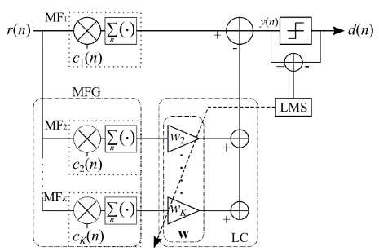
OMF； orthogonal matched filter
  consists a matched filter （MF₁） and MF Group（MFG）
  Tap coefficients of MF₁ are the same as sequence of desired signal.
  Coefficients of MF₁ and each MF_{k} that constituting MFG are orthogonal.
  Desired signal does not go through MF_{2～K-1} because orthogonality.
  →only interference can go through.
  MFG makes a replica of the interference signal by linear combination with weight vector w of the linear combiner; LC.
  Subtract interference replica from the output of MF₁ .
_{Principle of OMF}
  OMF can remove interference without any pre-knowledge of interference.
Notes:
30

Slide 31
Antenna
Desired signal + interference
Desired signal + interference
+
Matched Filter (MF) 1
Replica of interferences
subtract
Orthogonal
Matched Filter (MF) 2
W1
Orthogonal
Matched Filter (MF) 3
W2
Orthogonal
Adaptive algorithm
e.g. LMS
Matched Filter (MF) 4
W3
Orthogonal
Matched Filter (MF) k
Wk
Linear combiner
Mixed signal EXCEPT desired signal.

Slide 32
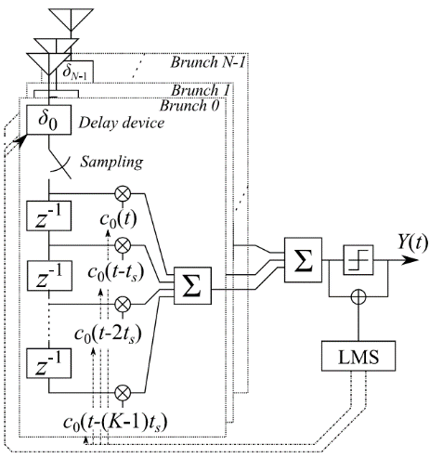
Apply pulse based OMF to spatial signal processing
  TDL array antenna
    Configured by multiple antennas and tapped delay line （TDL）
    TDL-AA can separate the signals which comes from the same direction by using time-domain signal processing.
  By applying OMF to TDL-AA
    Interference reduction is performed on both domains: time and space.
Space-temporal signal processing
Notes:
32
therefore

Slide 33
Gain≠0
Gain≠0
No gain
TDL-AA without null-steering（ SC.6）
Space-temporal interference reduction (SC.7)
System has gain against an interference
→residual interference
Interference signal is reduced
Notes:
33

Slide 34
Gain≠0
No gain
MHP orthogonality
TDL-AA without null-steering （ SC.6）
Space-temporal interference reduction(SC.7)
System has gain against an interference
→residual interference
Interference signal is reduced
Notes:
34

Slide 35


Multiple VBAN Situation
Desired user
10$°$
10$°$
Undesired users

Slide 36
Simulation
modulation | BPSK
Spread spectrum | DSSS
code | 31bit Gold-sequence
Tx power | 10[mW]
Center freq. | 760[MHz]
Antenna | 5 elements circular array
channel | AWGN (-103.8[dBm])
User number | 4 30
Data size | 1000[bit]
Arrival angle | Desired signal: 0 deg. Interference ±180 deg. or ±10deg
Own vehicle
Desired vehicle
Interference vehicle

Slide 37
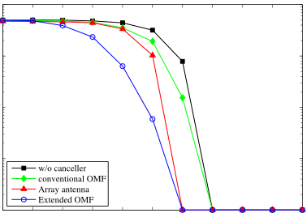
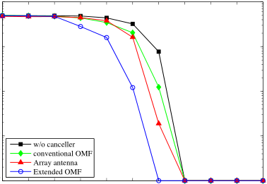









BER-DIR performance
30 users, ( 1 desired user, 29 interference)
DIR : Desired signal and Interference power Ratio
$${10}^{0}$$
$${10}^{0}$$
Space-temporal signal processing
Space-temporal signal processing
Bit error rate
$${10}^{−2}$$
$${10}^{−2}$$
$${10}^{−4}$$
$${10}^{−4}$$
$$−50$$
$$−40$$
$$−30$$
$$−20$$
$$−10$$
$$0$$
$$−50$$
$$−40$$
$$−30$$
$$−20$$
$$−10$$
$$0$$
DIR[dB]
DIR[dB]
interference：±180 deg.
interference：±10 deg.
Extended OMF can improve BER performance.

Slide 38
Conclusion
  Importance of consideration of interference. EMC/EMI issues included as environmental models as well as channel models.
  Human and Vehicular BANs environmental model.
  OMF based signal processing to interference reduction have been proposed.
    Interference reduction against unknown interference.
    =>Interference mitigation (reduction) against unknown source in Time-domain.
  OMF and its extension in space and time domain signal processing
    Interference mitigation on Time and space domains signal processing.
    => Space-time domain interference mitigation.
Notes:
38

Slide 39
References (1/2)
H. Yoshitake, T. Nomura, M. Okuhara, “Selection of Suitable Preamble Sequence Sets in UWB Wireless Communications in the Presence of Multiple Coexisting VBANs,” IEEE P802.15-25-0002-00-006a
Kento Takabayashi, “Hybrid ARQ Scheme for High QoS Packets in High Class of Coexistence of IEEE 802.15.6ma, IEEE P802.15-24-576-07-006a
Daisuke Anzai, Kosei Nagai, Takumi Kobayashi, Marco Hernandez, Ryuji Kohno, “MAC Performance Evaluation of Multiple BAN Coexistence Under TG6ma Channel Model,” doc.#15-24-0246-03-006a
Takumi Kobayashi Chika Sugimoto, Ryuji Kohno, “Theoretical analysis of interference canceler using modified hermite polynomials based orthogonal matched filter for IR-UWB systems in AWGN and interference channel,” Proc. 2017 20th International Symposium on Wireless Personal Multimedia Communications (WPMC) 2017, DOI: 10.1109/WPMC.2017.8301793
Takumi Kobayashi, Masato Suzuki, Chika Sugimoto, Ryuji Kohno, “Space temporal interference cancellation using TDL array antenna and waveform based OMF for IR-UWB systems,” ICT Express, Volume 1, Issue 2, pp.71-75, 2015. ISSN 2405-9595, https://doi.org/10.1016/j.icte.2015.09.006.

Slide 40
References (2/2)
Kento Takabayashi, Shuhei Harada, Takumi Kobayashi, Katsumi Sakakibara, Ryuji Kohno, "Low-Computational Extended Orthogonal Matched Filter Structure for Multiuser Detection," Telecom, 2020, vol.1, issue.1, pp. 32-47, Jun. 2020. doi: 10.3390/telecom1010004
Shuhei Harada, Kento Takabayashi, Takumi Kobayashi, Katsumi Sakakibara, Ryuji Kohno, "Theoretical Analysis of Interference Cancellation System Utilizing an Orthogonal Matched Filter and Adaptive Array Antenna for MANET," Journal of Sensor and Actuator Networks. 2019, 8(3) 48; September, 2019. https://doi.org/10.3390/jsan8030048
Takumi KOBAYASHI Chika SUGIMOTO Ryuji KOHNO, “Interference Cancellation for Intra and Inter UWB Systems Using Modified Hermite Polynomials Based Orthogonal Matched Filter,” IEICE TRANSACTIONS on Communications Vol.E99-B No.3 pp.569-577, 2016.

Slide 41
Thank you for your attention.

