Slide 1
Project: IEEE P802.15 Working Group for Wireless Personal Area Networks (WPANs)
Submission Title: Wireless Next Generation Agenda and Meeting Slides
Date Submitted: 16 January 2024
Source: Benjamin A. Rolfe (Blind Creek Associates)
Contact:
Voice: +1 408 395 7207, E-Mail: ben.rolfe @ ieee.org
Re: Wireless Next Generation
Abstract: Agenda and Meeting Slides for the January 2024 Interim Session.
Purpose: Support the illusion of organization.
Notice: This document has been prepared to assist the IEEE P802.15. It is offered as a basis for discussion and is not binding on the contributing individual(s) or organization(s). The material in this document is subject to change in form and content after further study. The contributor(s) reserve(s) the right to add, amend or withdraw material contained herein.
Release: The contributor acknowledges and accepts that this contribution becomes the property of IEEE and may be made publicly available by P802.15.
Notes:
Jul 12, 2010
Page 1

Slide 2
January 2024 802 Wireless Interim

Slide 3
Hybrid Meeting
Registration is required
Please remember to enter your attendance in IMAT
Reminder:
This is a non-PAR activity
All the rules of conduct apply https://grouper.ieee.org/groups/802/sapolicies.shtml

Slide 4
Agenda 15 November 2023
Opening and Meeting Reminders
Presentations and discussion
What’s next for OCC (Yeong Min Jang)
What’s happening in THz! (Thomas Kürner)
Any other business
Adjourn

Slide 5
References
https://mentor.ieee.org/802.15/dcn/24/15-24-0068-00-wng0-future-directions-of-next-generation-occ-standard.pptx
https://mentor.ieee.org/802.15/dcn/24/15-24-0030-01-0thz-overview-on-the-results-of-wrc-2023-relevant-for-thz-communications.pptx

Slide 6
The usual question
What do you propose the Working Group do next?

Slide 7
The usual question
Options:
Information for the group
Form an interest group to pursue
Consider in the future a new project

Slide 8
Any Other Business

Slide 9
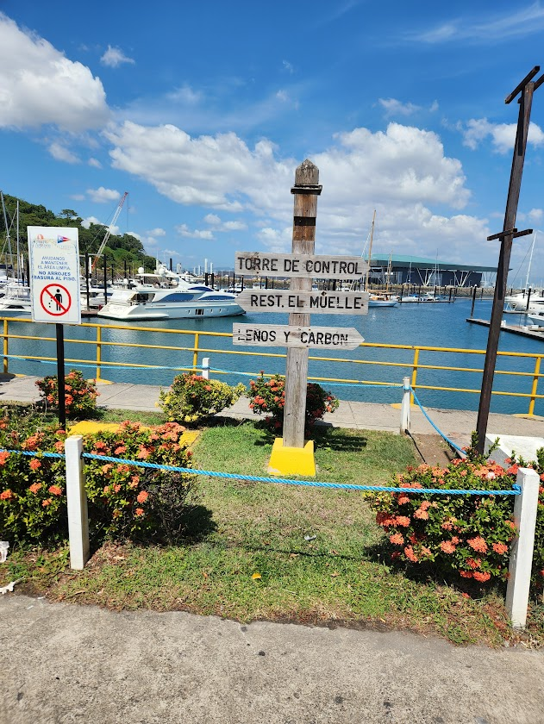
Adjourned

