Slide 1
Study Group SUN PHY Next Generation SUN PHY’s
Hybrid Meeting
January, 2024

Slide 2
Agenda
FCC regulations discussion on how to evaluate that OFDM-LR with its sparse sub channel hopping actually is compliant with spread spectrum modulation measurement techniques defined in the FCC.

Slide 3
FCC rule interpretation prepared for IEEE meeting (please always refer to official documents)
“Operation under the provisions of this Section is limited to frequency hopping and digitally modulated intentional radiators that comply with the following provisions:”
Operating in the 902–928 MHz band:
Fixed frequency < 0dBm
20dB Bandwidth < 250kHz
> 50 hopping frequencies, dwell time 400ms over a 20s period
Peak conduction power < 1W (30dBm)
20dB Bandwidth > 250kHz
> 25 hopping frequencies, dwell time 400ms over a 10s period
Peak conduction power < 125mW (21dBm)
Systems using digital modulation techniques may operate in the 902–928 MHz, 2400–2483.5 MHz, and 5725–5850 MHz bands. The minimum 6 dB bandwidth shall be at least 500 kHz. Peak conduction power < 1W (30dBm)

Slide 4
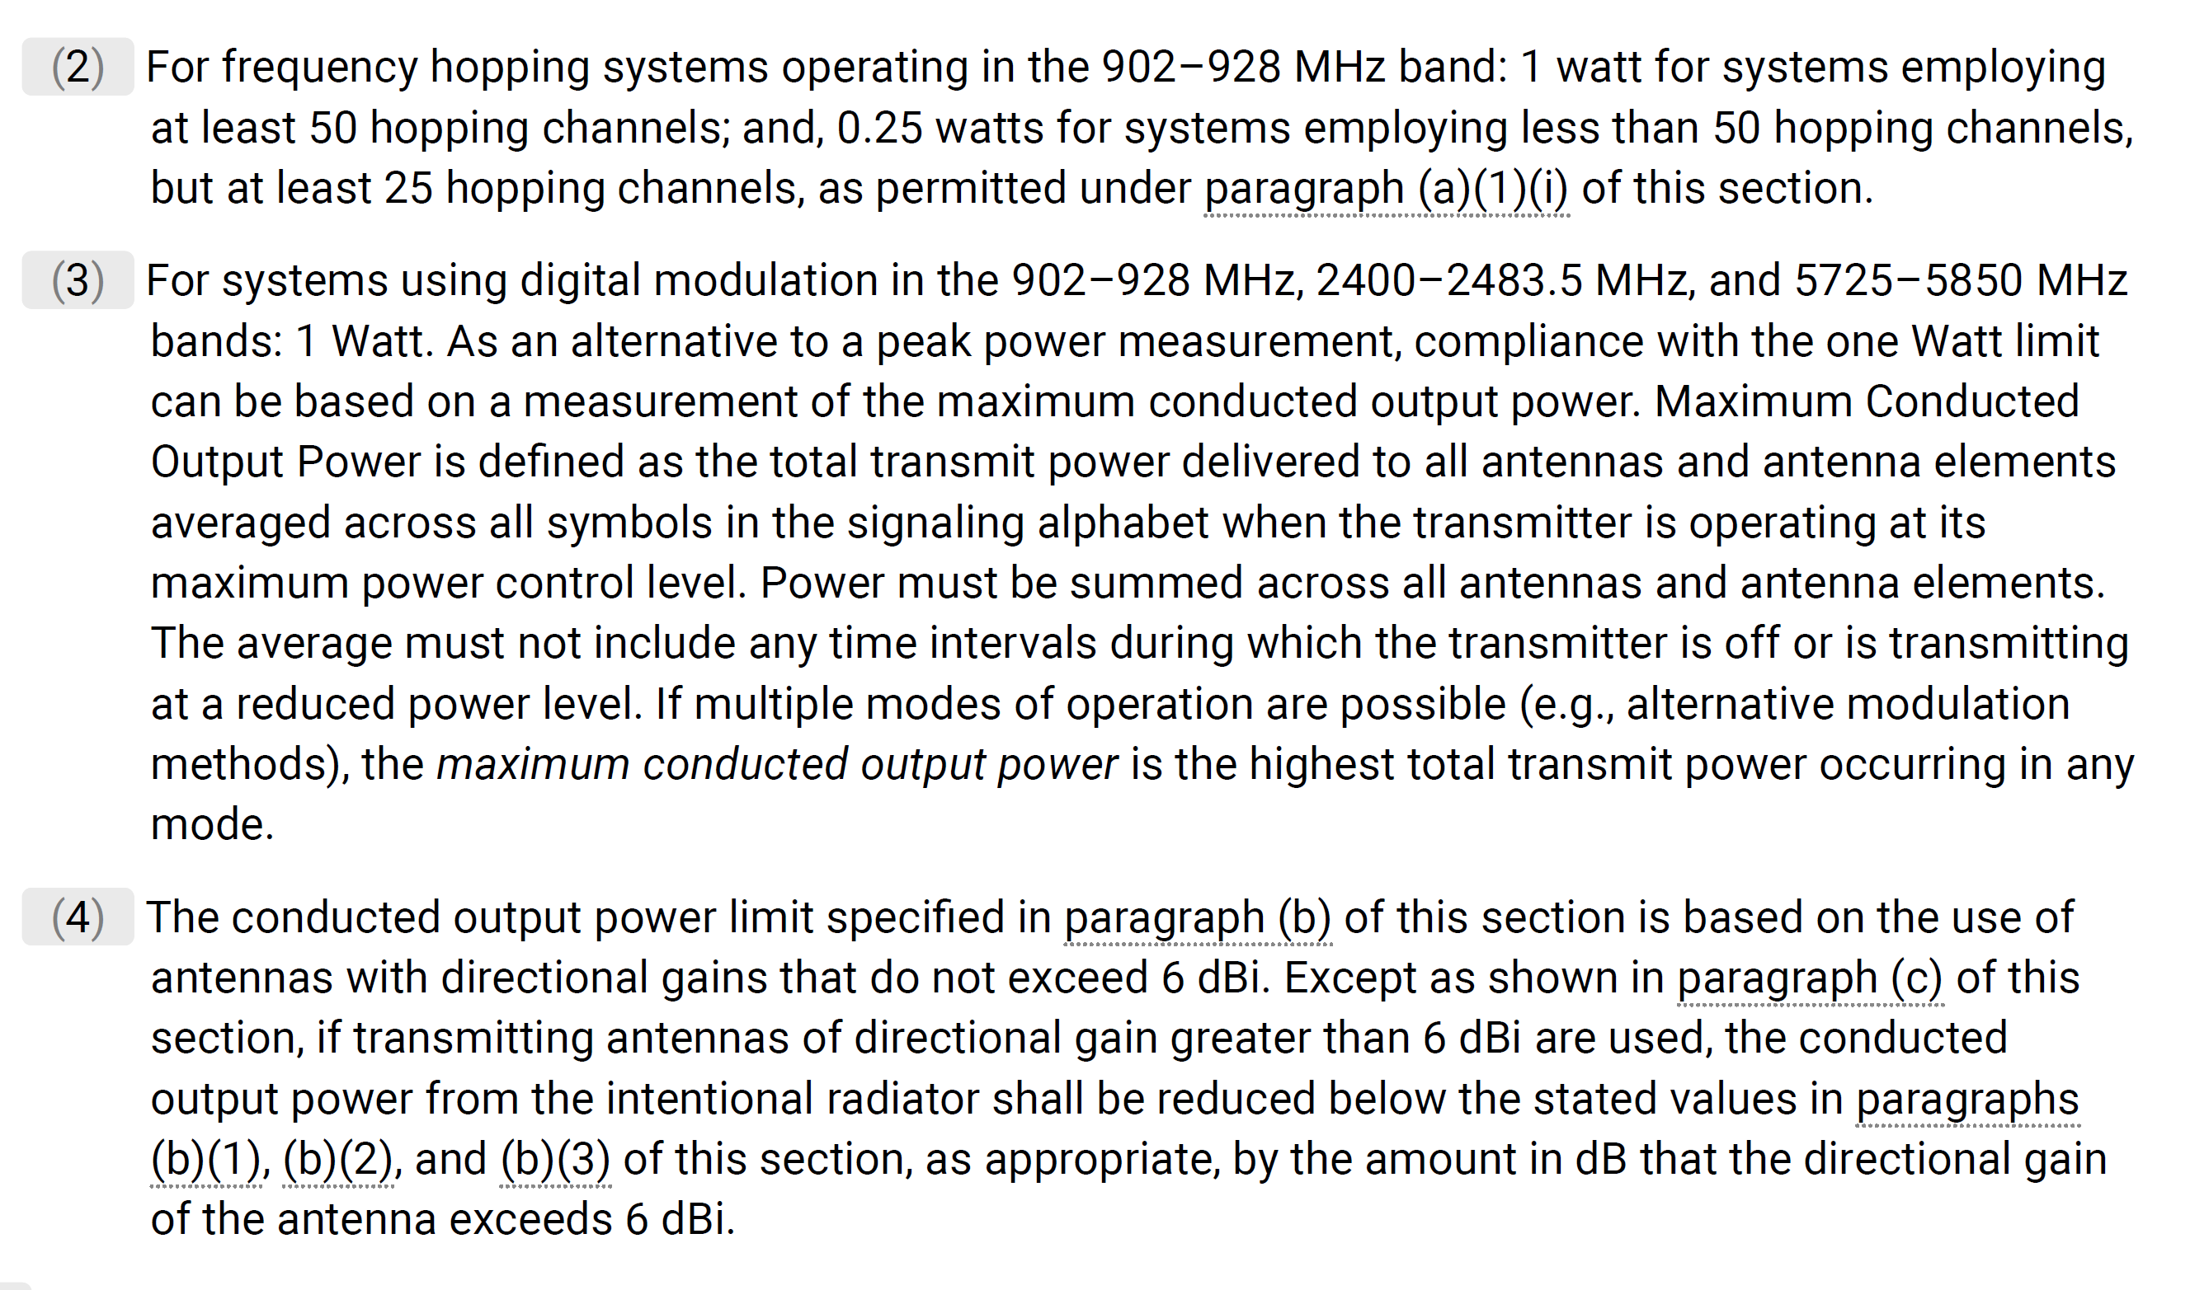
FCC 15.247 rules are public
https://www.ecfr.gov/current/title-47/chapter-I/subchapter-A/part-15/subpart-C/subject-group-ECFR2f2e5828339709e/section-15.247

Slide 5
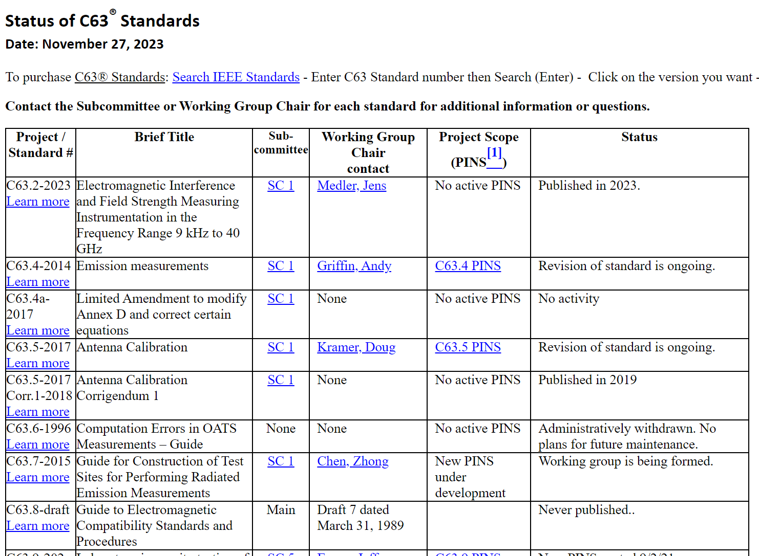
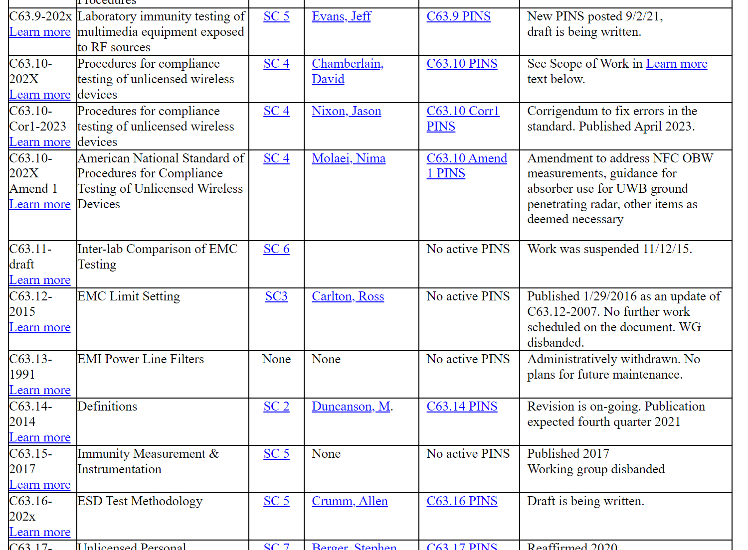
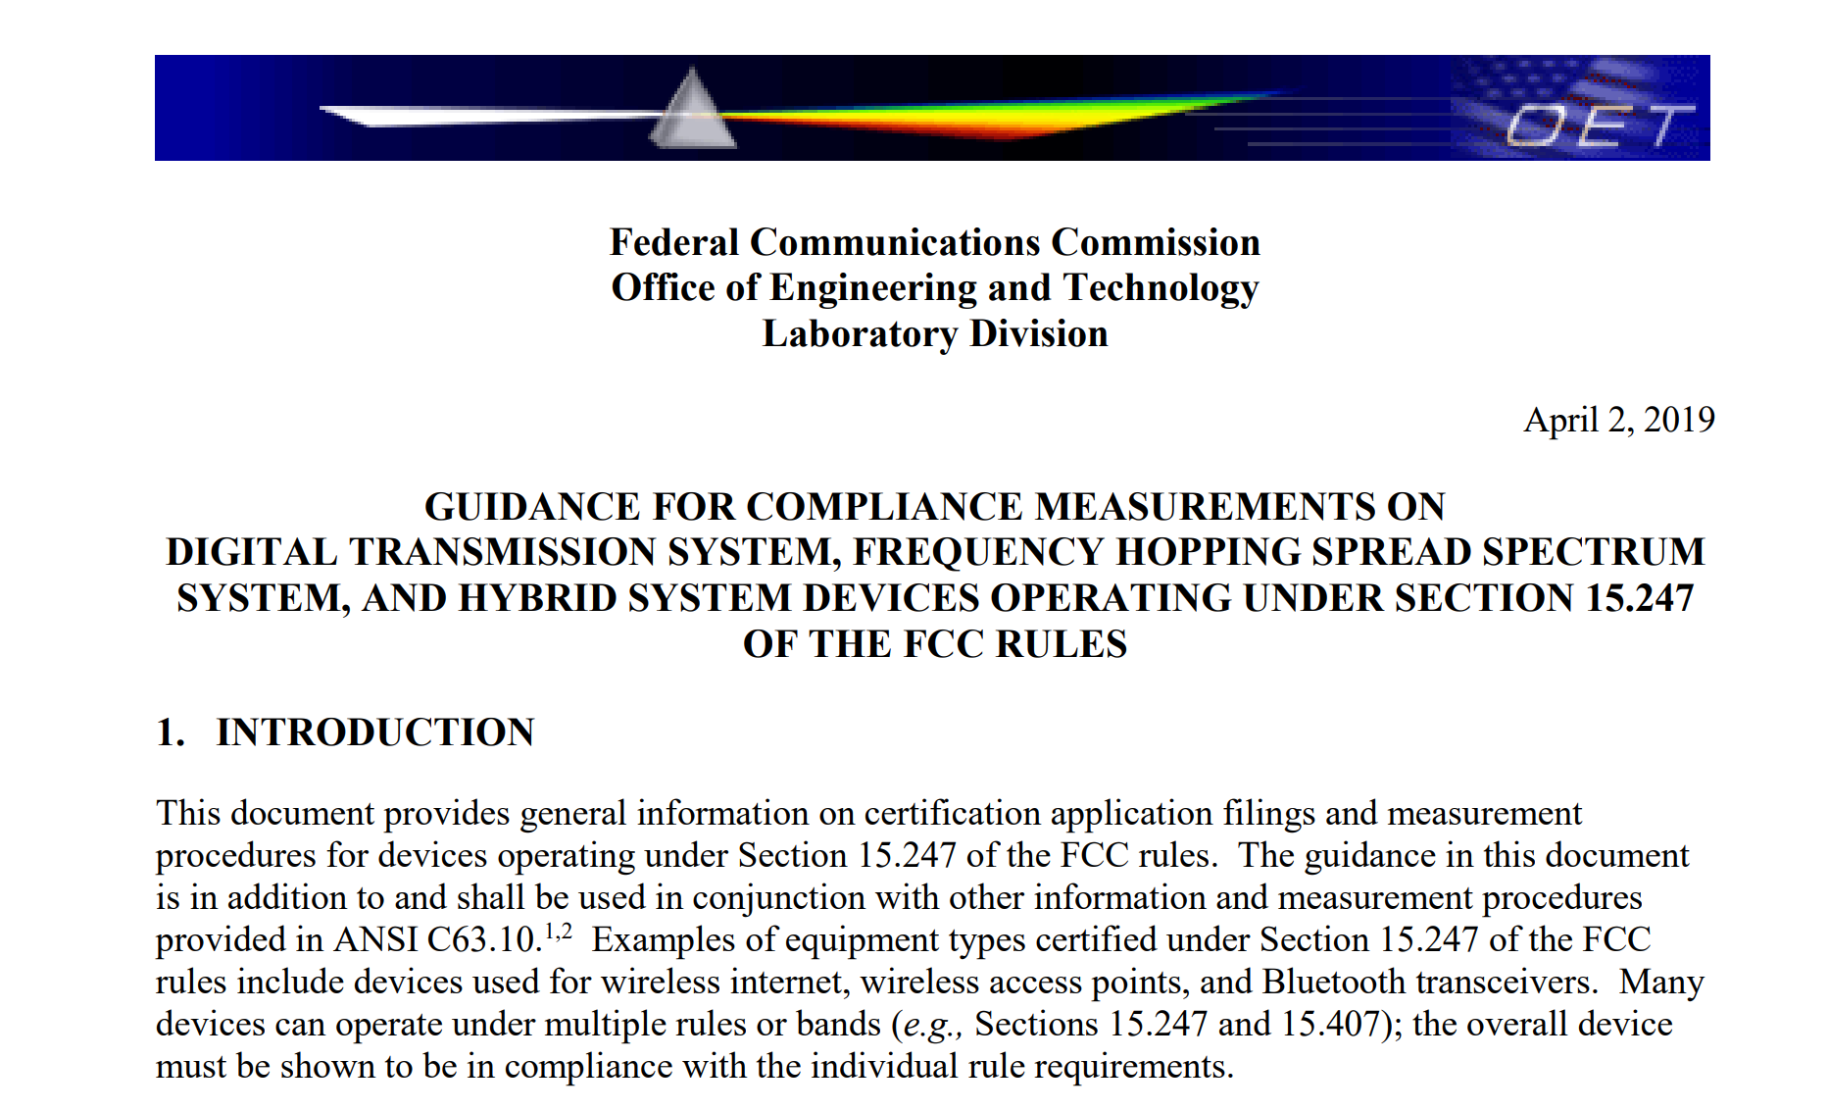
How to test for TX power
Test methods are defined in ANSI C63, but which one?
So the FCC made a guide
There is 3 more pages… this is incredibly comprehensive… and all of the documents can be found on IEEE (Mentor)
https://apps.fcc.gov/kdb/GetAttachment.html?id=tylb5MMggvhIlVMK75RrRQ%3D%3D&desc=558074%20D01%2015.247%20Meas%20Guidance%20v05r02&tracking_number=21124
And this guides calls for ANSI 63.10

Slide 6
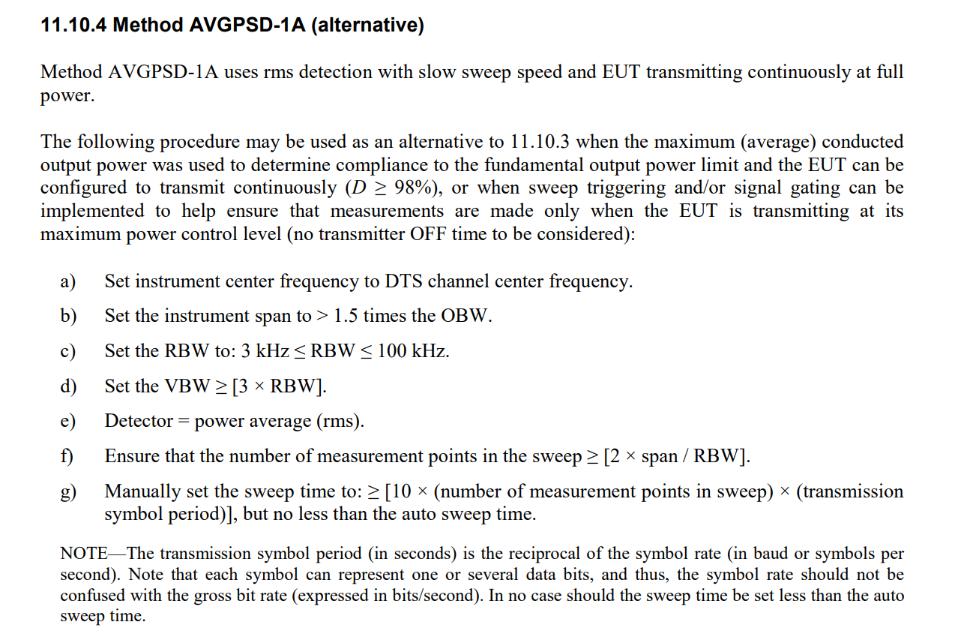
There are 5 different PSD testing methods, we have found AVGPSK-1A to provide best results for OFDM Long Range
Link to document
https://ieeexplore.ieee.org/document/9340083

Slide 7
Proposed OFDM-LR modes
Using SUN-OFDM as a baseline, the proposed OFDM-LR also includes a significant number of options to enable world wide deployment.
In the follow pages we are showing the FCC PSD measurements on
Symbol duration = 60us, Option 2, DSSS=6 => 550KHz wide signal with 1.4kbps effective data rate
Sensitivity on HW was measured at -124dBm
Symbol Duration | Channel Spacing | # Active Tones O1 (1 MHz) | Data Rates (DSSS=2/4/6/8) | # Active Tones O2 (500 kHz) | Data Rates (DSSS=2/4/6/8) | # Active Tones O3 (250 kHz) | Data Rates (DSSS=2/4/6/8) | # Active Tones O4 (125 kHz) | Data Rates (DSSS=2/4/6/8)
120 us | 10.416 kHz | 104 | 2 / 1 / 0.7 / 0.5 | 52 | 2 / 1 / 0.7 / 0.5 | 26 | 2 / 1 / 0.7 / 0.5 | 14 | 2 / 1 / 0.7 / 0.5
60 us | 20.833 kHz | 52 | 4 / 2 / 1.4 / 1 | 26 | 4 / 2 / 1.4 / 1 | 12 | 4 / 2 / 1.4 / 1 | 6 | 4 / 2 / 1.4 / 1
30 us | 41.666 kHz | 26 | 8 / 4 / 3 / 2 | 12 | 8 / 4 / 3 / 2 | 6 | 8 / 4 / 3 / 2 | - | -
15 us | 83.333 kHz | 12 | 17 / 8 / 6 / 4 | 6 | 17 / 8 / 6 / 4 | - | - | - | -

Slide 8
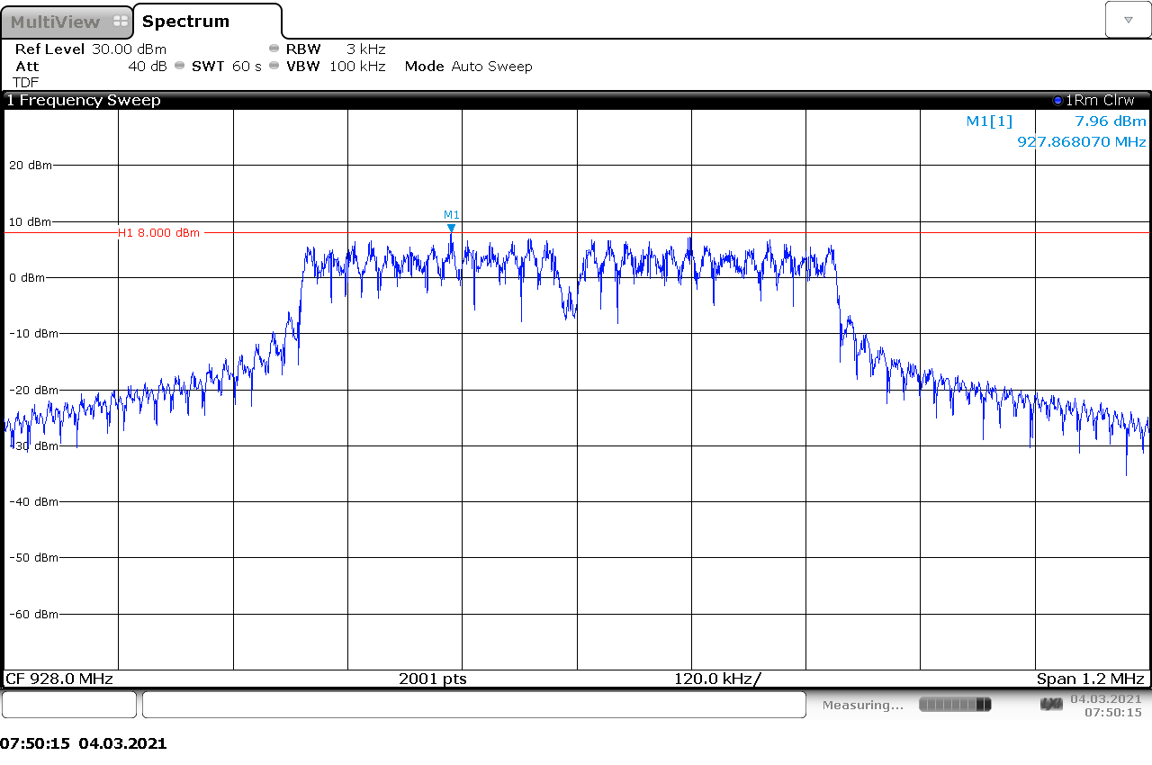
There are 5 different PSD testing methods, we have found AVGPSK-1A to provide best results
Measured at 27dBm total power, so at -124dBm sensitivity this will result in a link budget of 151dB

Slide 9
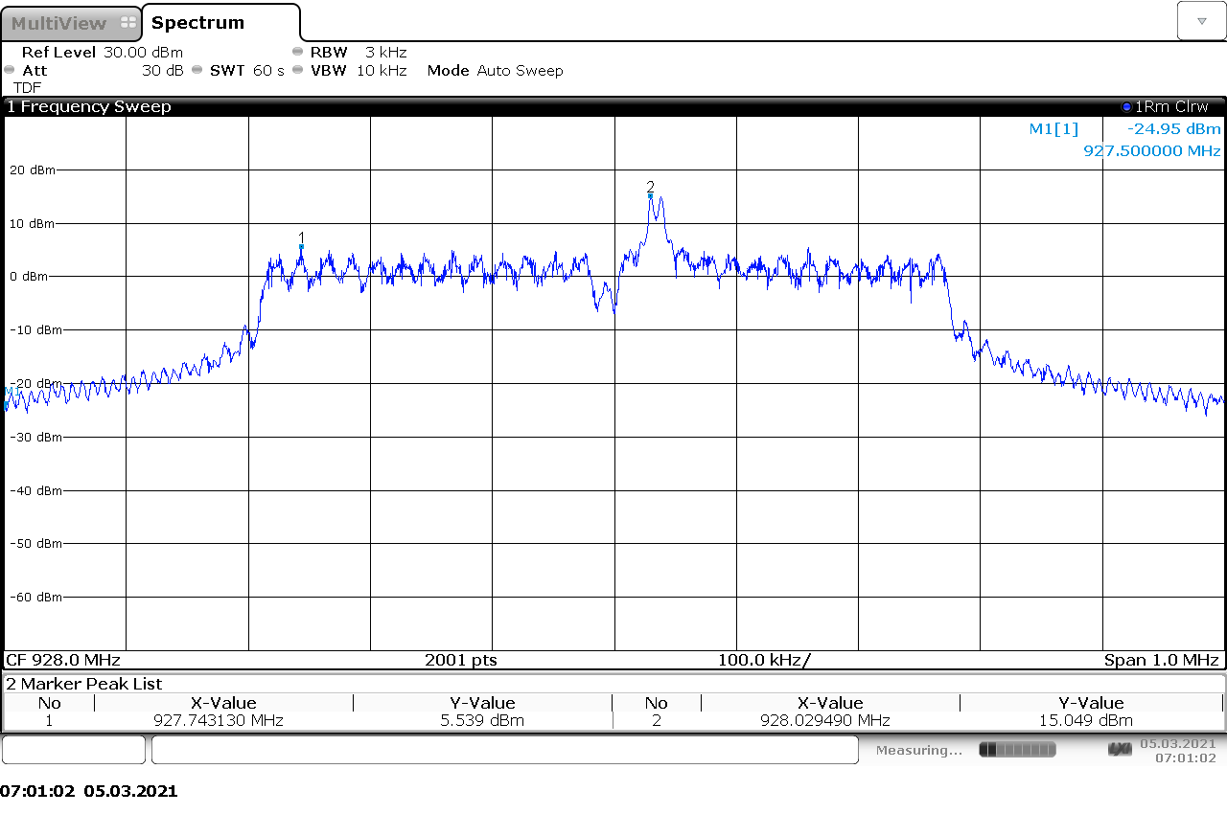
PSD measurement including the preamble/sync word
Measured at 27dBm total power

