Slide 1
Project: IEEE P802.15 Working Group for Wireless Personal Area Networks (WPANs)
Submission Title: OCC channel model to support high mobility under adverse condition
Date Submitted: January 14, 2024
Source: Al-Imran, Nguyen Ngoc Huy, Yeong Min Jang [Kookmin University]
Address: Room #603 Mirae Building, Kookmin University, 77 Jeongneung-Ro, Seongbuk-Gu, Seoul, 02707, Republic of Korea
Voice: +82-2-910-5068 E-Mail: yjang@kookmin.ac.kr
Re:
Abstract: OCC Channel model to support high mobility under adverse conditions.
Purpose: Presentation for contribution on IEEE 802.15 IG NG-OCC
Notice: This document has been prepared to assist the IEEE 802.15 IG NG-OCC. It is offered as a basis for discussion and is not binding on the contributing individual(s) or organization(s). The material in this document is subject to change in form and content after further study. The contributor(s) reserve(s) the right to add, amend or withdraw material contained herein.
Release: The contributor acknowledges and accepts that this contribution becomes the property of IEEE and may be made publicly available by IEEE 802.15 IG NG-OCC.

Slide 2
OCC channel model to support high mobility under adverse condition
January 14, 2024

Slide 3
Outline
Introduction
Optical Camera Communication
Channel Modeling
Non line of Sight (nLOS)

Slide 4
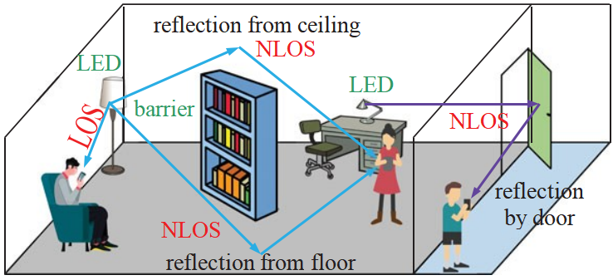
Introduction
Optical Camera Communication (OCC) is a novel form of optical wireless communication that utilizes the camera and image sensor capabilities of electronic devices to transmit and receive data using modulated light signals.
Channel modeling is a fundamental aspect of wireless communication system design. It refers to the process of creating mathematical or statistical models to simulate the behavior and characteristics of a communication channel.
Environmental-Specific Models:
1. Indoor Model
  Line of Sight (LOS)
  Non-line of Sight (nLOS)
  Diffuse
2. Outdoor Model
Notes:
Deep Learning Techniques: Employ deep learning methods, requiring diverse data types to ensure effective learning tailored to specific user requirements.
Weather Data Utilization: Focus primarily on utilizing weather data as the fundamental input for predicting weather conditions. Parameters encompass Temperature, Humidity, Wind Speed, Insolation Slope, and Insolation Horizon.
Target Variable: Predict power generation data for the subsequent day following the prediction.
Collaboration with PV Power Company: Collaborate with PV Power company to obtain necessary input and target data. This company has amassed daily data in hourly format from multiple South Korean locations between March 23, 2023, and May 31, 2023.
Central Objective: Examine predicted outcomes of a solar power plant at distinct times: 10 am and 4 pm.
Precise Predictions: Aim to provide accurate forecasts for the next 24-hour period, beginning from 12 am to 12 am the following day.
Time-Specific Accuracy Assessment: Emphasize evaluating prediction accuracy specifically at the aforementioned time points.
API Development Strategy: Develop an easily accessible API after obtaining prediction results.
API Transformation: Transform the predictive model into an API format to enable direct user access to output without requiring any training.
API Design Focus: Design the API to handle user requests, including PV factory ID, date, and selected AI model.
Comprehensive Output: Generate detailed hourly forecasts for PV power plant performance throughout the ensuing day (00:00 to 23:00).
Visual Representation: Refer to Figure 1 for a visual representation of the complete methodology.

Slide 5
Channel Modeling
Conventional Channel Estimation
  Least Square Estimation (LS)(1)
  Least Minimum Mean Squared Error (LMMSE)(2)
  Maximum Likelihood Estimation (ML)
Machine Learning Based Channel Estimation
  Deep learning based (3)
  Conventional Neural Network based (4)
  Deep Residual Learning (5)
  FFDNet-based (6)
  ResCBDNet
References
1.Y. S. Hussein, M. Y. Alias, and A. A. Abdulkafi, “On performance analysis of LS and MMSE for channel estimation in VLC systems,” in Proc. IEEE 12th Int. Colloq. Signal Process. Appl. (CSPA), Melaka, Malaysia, 2016, pp. 204–209.
2. X. Shi, S.-H. Leung, and J. Min, “Adaptive least squares channel estimation for visible light communications based on tap detection,” Opt. Commun., vol. 467, Jul. 2020, Art. no. 125712
3. C.-J. Chun, J.-M. Kang, and I.-M. Kim, “Deep learning-based channel estimation for massive MIMO systems,” IEEE Commun. Lett., vol. 8, no. 4, pp. 1228–1231, Aug. 2019.
4. G. Fan, J. Sun, G. Gui, H. Gacanin, B. Adebisi, and T. Ohtsuki, “Fully convolutional neural network-based CSI limited feedback for FDD massive MIMO systems,” IEEE Trans. Cogn. Commun. Netw., vol. 8, no. 2, pp. 672–682, Jun. 2022
5. C. Liu, X. Liu, D. W. K. Ng, and J. Yuan, “Deep residual learning for channel estimation in intelligent reflecting surface-assisted multiuser communications,” IEEE Trans. Wireless Commun., vol. 21, no. 2, pp. 898–912, Feb. 2022.
6. Z. Gao, Y. Wang, X. Liu, F. Zhou, and K.-K. Wong, “FFDNet-based channel estimation for massive MIMO visible light communication systems,” IEEE Wireless Commun. Lett., vol. 9, no. 3, pp. 340–343, Mar. 2020.
.
Notes:
Deep Learning Techniques: Employ deep learning methods, requiring diverse data types to ensure effective learning tailored to specific user requirements.
Weather Data Utilization: Focus primarily on utilizing weather data as the fundamental input for predicting weather conditions. Parameters encompass Temperature, Humidity, Wind Speed, Insolation Slope, and Insolation Horizon.
Target Variable: Predict power generation data for the subsequent day following the prediction.
Collaboration with PV Power Company: Collaborate with PV Power company to obtain necessary input and target data. This company has amassed daily data in hourly format from multiple South Korean locations between March 23, 2023, and May 31, 2023.
Central Objective: Examine predicted outcomes of a solar power plant at distinct times: 10 am and 4 pm.
Precise Predictions: Aim to provide accurate forecasts for the next 24-hour period, beginning from 12 am to 12 am the following day.
Time-Specific Accuracy Assessment: Emphasize evaluating prediction accuracy specifically at the aforementioned time points.
API Development Strategy: Develop an easily accessible API after obtaining prediction results.
API Transformation: Transform the predictive model into an API format to enable direct user access to output without requiring any training.
API Design Focus: Design the API to handle user requests, including PV factory ID, date, and selected AI model.
Comprehensive Output: Generate detailed hourly forecasts for PV power plant performance throughout the ensuing day (00:00 to 23:00).
Visual Representation: Refer to Figure 1 for a visual representation of the complete methodology.

Slide 6
Channel Modeling
Difference between conventional and machine learning base channel estimation
Using ML for channel estimation can offer advantages in scenarios where traditional methods may struggle to adapt to changing and complex channel conditions like (atmospheric turbulence or mobility of optical sources).
DRL algorithms have the capability to learn and adapt to non-linear and non-stationary channel conditions, which may be difficult for traditional estimation techniques such as Least Squares Estimation, Maximum Likelihood Estimation (MLE) that assume linearity and stationarity.
Traditional estimation methods may assume Gaussian noise(electronic and thermal noise). which may not accurately represent real-world noise characteristics in FSO/OCC systems. ML can learn to handle non-Gaussian noise distributions(Atmospheric turbulence).
Traditional methods often rely on assumptions about the channel, noise, or environmental conditions. ML, being a model-free approach, can learn directly from data without making strong assumptions.
Notes:
Deep Learning Techniques: Employ deep learning methods, requiring diverse data types to ensure effective learning tailored to specific user requirements.
Weather Data Utilization: Focus primarily on utilizing weather data as the fundamental input for predicting weather conditions. Parameters encompass Temperature, Humidity, Wind Speed, Insolation Slope, and Insolation Horizon.
Target Variable: Predict power generation data for the subsequent day following the prediction.
Collaboration with PV Power Company: Collaborate with PV Power company to obtain necessary input and target data. This company has amassed daily data in hourly format from multiple South Korean locations between March 23, 2023, and May 31, 2023.
Central Objective: Examine predicted outcomes of a solar power plant at distinct times: 10 am and 4 pm.
Precise Predictions: Aim to provide accurate forecasts for the next 24-hour period, beginning from 12 am to 12 am the following day.
Time-Specific Accuracy Assessment: Emphasize evaluating prediction accuracy specifically at the aforementioned time points.
API Development Strategy: Develop an easily accessible API after obtaining prediction results.
API Transformation: Transform the predictive model into an API format to enable direct user access to output without requiring any training.
API Design Focus: Design the API to handle user requests, including PV factory ID, date, and selected AI model.
Comprehensive Output: Generate detailed hourly forecasts for PV power plant performance throughout the ensuing day (00:00 to 23:00).
Visual Representation: Refer to Figure 1 for a visual representation of the complete methodology.

Slide 7
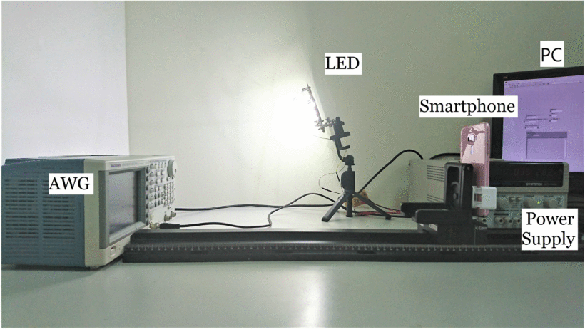
Non-Line of Sight (non-LOS)
For non-directed LOS and diffuse links, the optical path loss is more complex to predict since it is dependent on a multitude of factors, such as room dimensions, the reflectivity of the ceiling, walls and objects within the room, and the position and orientation of the transmitter and receiver, window size and place and other physical matters within a room.
The reflection characteristics of object surfaces within a room depend on several factors including, the transmission wavelength, surface material, the angle of incidence θi and roughness of the surface relative to the wavelength.
System setup of the NLOS OCC testbed.
Notes:
Deep Learning Techniques: Employ deep learning methods, requiring diverse data types to ensure effective learning tailored to specific user requirements.
Weather Data Utilization: Focus primarily on utilizing weather data as the fundamental input for predicting weather conditions. Parameters encompass Temperature, Humidity, Wind Speed, Insolation Slope, and Insolation Horizon.
Target Variable: Predict power generation data for the subsequent day following the prediction.
Collaboration with PV Power Company: Collaborate with PV Power company to obtain necessary input and target data. This company has amassed daily data in hourly format from multiple South Korean locations between March 23, 2023, and May 31, 2023.
Central Objective: Examine predicted outcomes of a solar power plant at distinct times: 10 am and 4 pm.
Precise Predictions: Aim to provide accurate forecasts for the next 24-hour period, beginning from 12 am to 12 am the following day.
Time-Specific Accuracy Assessment: Emphasize evaluating prediction accuracy specifically at the aforementioned time points.
API Development Strategy: Develop an easily accessible API after obtaining prediction results.
API Transformation: Transform the predictive model into an API format to enable direct user access to output without requiring any training.
API Design Focus: Design the API to handle user requests, including PV factory ID, date, and selected AI model.
Comprehensive Output: Generate detailed hourly forecasts for PV power plant performance throughout the ensuing day (00:00 to 23:00).
Visual Representation: Refer to Figure 1 for a visual representation of the complete methodology.

Slide 8
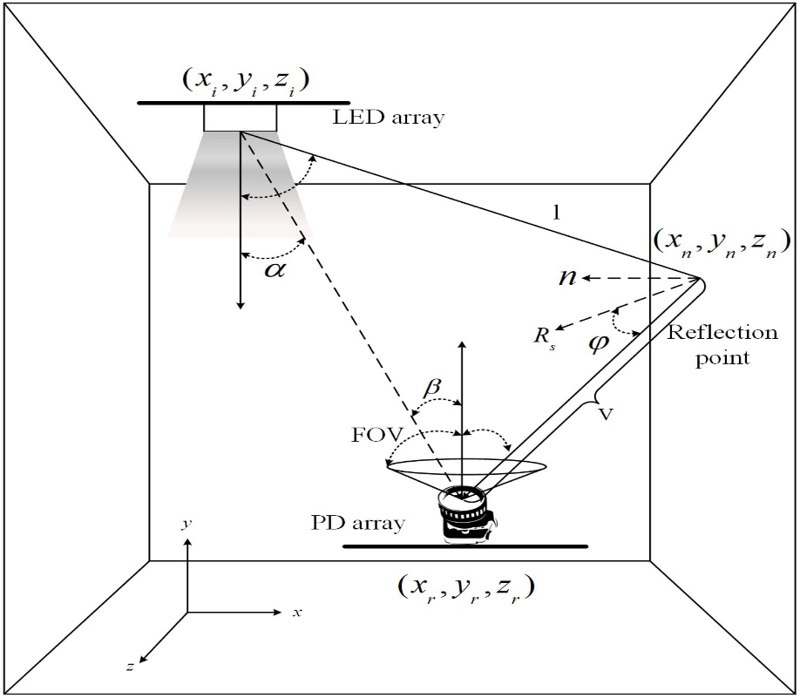
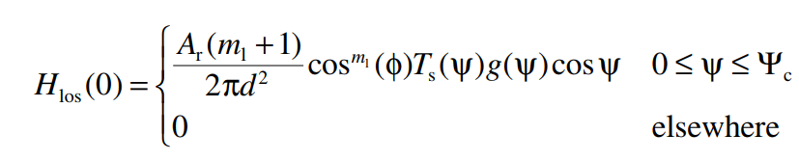
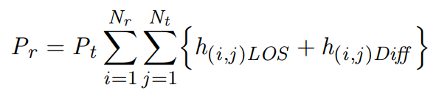

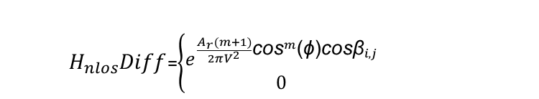
Non Line of Sight (non-LOS)
$H_{nlos}Diff$=$\left\{\begin{aligned}e^{\frac{A_{r}(m+1)}{2πV^{2}}{\text{cos}}^{m}\text{(}\text{ϕ}\text{)}\text{cos}{\text{β}}_{i,j}} \\ 0\end{aligned}\right.$
$$H_{total}=H_{los}+H_{nlos}$$
Notes:
Deep Learning Techniques: Employ deep learning methods, requiring diverse data types to ensure effective learning tailored to specific user requirements.
Weather Data Utilization: Focus primarily on utilizing weather data as the fundamental input for predicting weather conditions. Parameters encompass Temperature, Humidity, Wind Speed, Insolation Slope, and Insolation Horizon.
Target Variable: Predict power generation data for the subsequent day following the prediction.
Collaboration with PV Power Company: Collaborate with PV Power company to obtain necessary input and target data. This company has amassed daily data in hourly format from multiple South Korean locations between March 23, 2023, and May 31, 2023.
Central Objective: Examine predicted outcomes of a solar power plant at distinct times: 10 am and 4 pm.
Precise Predictions: Aim to provide accurate forecasts for the next 24-hour period, beginning from 12 am to 12 am the following day.
Time-Specific Accuracy Assessment: Emphasize evaluating prediction accuracy specifically at the aforementioned time points.
API Development Strategy: Develop an easily accessible API after obtaining prediction results.
API Transformation: Transform the predictive model into an API format to enable direct user access to output without requiring any training.
API Design Focus: Design the API to handle user requests, including PV factory ID, date, and selected AI model.
Comprehensive Output: Generate detailed hourly forecasts for PV power plant performance throughout the ensuing day (00:00 to 23:00).
Visual Representation: Refer to Figure 1 for a visual representation of the complete methodology.

Slide 9
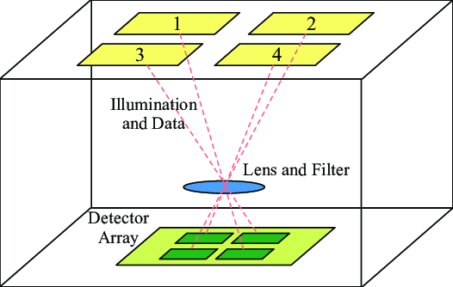
MIMO in OCC
Recently, MIMO technology has also been applied to NLOS-OCC to improve system throughput. Similarly with visible light communication, the applications and service of camera are combination of lighting purpose and communication function.
In addition, there are still a few challenges in NLOS-OCC including (i) higher levels of attenuation due to diffuse reflections, thus lower signal to noise ratio (SNR); (ii) increased levels of interference due to light signals from other sources.
Notes:
Deep Learning Techniques: Employ deep learning methods, requiring diverse data types to ensure effective learning tailored to specific user requirements.
Weather Data Utilization: Focus primarily on utilizing weather data as the fundamental input for predicting weather conditions. Parameters encompass Temperature, Humidity, Wind Speed, Insolation Slope, and Insolation Horizon.
Target Variable: Predict power generation data for the subsequent day following the prediction.
Collaboration with PV Power Company: Collaborate with PV Power company to obtain necessary input and target data. This company has amassed daily data in hourly format from multiple South Korean locations between March 23, 2023, and May 31, 2023.
Central Objective: Examine predicted outcomes of a solar power plant at distinct times: 10 am and 4 pm.
Precise Predictions: Aim to provide accurate forecasts for the next 24-hour period, beginning from 12 am to 12 am the following day.
Time-Specific Accuracy Assessment: Emphasize evaluating prediction accuracy specifically at the aforementioned time points.
API Development Strategy: Develop an easily accessible API after obtaining prediction results.
API Transformation: Transform the predictive model into an API format to enable direct user access to output without requiring any training.
API Design Focus: Design the API to handle user requests, including PV factory ID, date, and selected AI model.
Comprehensive Output: Generate detailed hourly forecasts for PV power plant performance throughout the ensuing day (00:00 to 23:00).
Visual Representation: Refer to Figure 1 for a visual representation of the complete methodology.

Slide 10
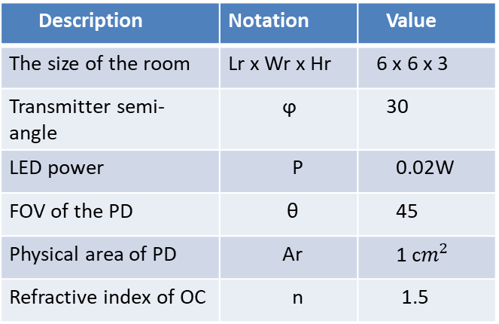
MIMO in OCC
In our experiment, an m-MIMO VLC system is considered with Nt light-emitting diodes (LEDs) as the transmitters and Nr photodetectors (PDs) as the receivers. It is assumed that the specifications and performance of all LEDs are identical, as are the PDs.
The m-MIMO channel matrix is denoted by H with the dimension of Nr × Nt, ρ is the responsivity of the PD (in Amperes/watt), and Nr × 1 vector N represents real-valued AWGN including the ambient light shot noise and thermal noise with zero mean and variance.
Nr × Nt = 100 x 100
Description | Notation | Value
The size of the room | Lr x Wr x Hr | 6 x 6 x 3
Transmitter semi-angle | ϕ | 30
LED power | P | 0.02W
FOV of the PD | θ | 45
Physical area of PD | Ar | 1 c$m^{2}$
Refractive index of OC | n | 1.5
Notes:
Deep Learning Techniques: Employ deep learning methods, requiring diverse data types to ensure effective learning tailored to specific user requirements.
Weather Data Utilization: Focus primarily on utilizing weather data as the fundamental input for predicting weather conditions. Parameters encompass Temperature, Humidity, Wind Speed, Insolation Slope, and Insolation Horizon.
Target Variable: Predict power generation data for the subsequent day following the prediction.
Collaboration with PV Power Company: Collaborate with PV Power company to obtain necessary input and target data. This company has amassed daily data in hourly format from multiple South Korean locations between March 23, 2023, and May 31, 2023.
Central Objective: Examine predicted outcomes of a solar power plant at distinct times: 10 am and 4 pm.
Precise Predictions: Aim to provide accurate forecasts for the next 24-hour period, beginning from 12 am to 12 am the following day.
Time-Specific Accuracy Assessment: Emphasize evaluating prediction accuracy specifically at the aforementioned time points.
API Development Strategy: Develop an easily accessible API after obtaining prediction results.
API Transformation: Transform the predictive model into an API format to enable direct user access to output without requiring any training.
API Design Focus: Design the API to handle user requests, including PV factory ID, date, and selected AI model.
Comprehensive Output: Generate detailed hourly forecasts for PV power plant performance throughout the ensuing day (00:00 to 23:00).
Visual Representation: Refer to Figure 1 for a visual representation of the complete methodology.

Slide 11
Reference
[1] G. Fan, J. Sun, G. Gui, H. Gacanin, B. Adebisi, and T. Ohtsuki, “Fully convolutional neural network-based CSI limited feedback for FDD massive MIMO systems,” IEEE Trans. Cogn. Commun. Netw., vol. 8, no. 2, pp. 672–682, Jun. 2022.
[2] J. Fan, P. Liang, Z. Jiao, and X. Han, “A compressive sensing and deep learning-based time-varying channel estimation for FDD massive MIMO systems,” IEEE Trans. Veh. Technol., vol. 71, no. 8, pp. 8729–8738, Aug. 2022.
[3] A. Yesilkaya, O. Karatalay, A. S. Ogrenci, and E. Panayirci, “Channel estimation for visible light communications using neural networks,” in Proc. Int Joint Conf. Neural Netw. (IJCNN), 2016, pp. 320–325.

