Slide 1
Project: IEEE P802.15 Working Group for Wireless Personal Area Networks (WPANs)
Submission Title: OCC MAC and Network Layer for Bidirectional communications
Date Submitted: January 14, 2024
Source: Muhammad Miftah Faridh, Nguyen Ngoc Huy, Yeong Min Jang [Kookmin University]
Address: Kookmin University, 77 Jeongneung-Ro, Seongbuk-Gu, Seoul, 02707, Republic of Korea
Voice: +82-2-910-5068 E-Mail: yjang@kookmin.ac.kr
Re:
Abstract: Present the use case of OCC for MAC/Network layer and Bidirectional Communication
Purpose: Presentation for contribution on IEEE 802.15 IG NG-OCC
Notice: This document has been prepared to assist the IG NG-OCC. It is offered as a basis for discussion and is not binding on the contributing individual(s) or organization(s). The material in this document is subject to change in form and content after further study. The contributor(s) reserve(s) the right to add, amend or withdraw material contained herein.
Release: The contributor acknowledges and accepts that this contribution becomes the property of IEEE and may be made publicly available by IG NG-OCC.

Slide 2
OCC MAC and Network Layer for Bidirectional communications
January 16, 2024

Slide 3
Contents
Background
Methodology
Conclusion

Slide 4
Background
Challenges of Bidirectional OCC:
  Limited field of view and hidden node problem
  High computational demands for real-time processing
  Security concerns with visible light transmissions
Current MAC Mechanisms:
  Need for efficient collision avoidance and hidden node mitigation

Slide 5
Methodology:
New MAC Protocol for OCC (CSMA with collision detection and hidden avoidance; CSMA/CD-HA)
CSMA/CD-HA protocol: This protocol addresses the hidden node problem and ensures fair access to the channel.
Intra-frame bidirectional transmission: Data is exchanged within the same frame, allowing for faster and more efficient communication.
Directional communication: Devices can focus their light beams on specific receivers, improving efficiency and reducing interference.
Adaptive backoff mechanism: This mechanism helps to avoid collisions and further improves channel utilization.
  Increasing the backoff time after a collision: This gives other devices more time to access the channel.
  Adapting the backoff time based on channel conditions: In congested networks, backoff times are increased to avoid further collisions.

Slide 6
Methodology:
Comparison between the CSMA/CD-HA and the current MAC standardization CSMA/CA
Feature | CSMA/CD-HA | CSMA/CA
Collision Handling | Detection and Hidden Area Avoidance | Avoidance through carrier sensing and backoff
Hardware Complexity | Higher | Lower
Latency | Higher | Lower
Suitability | High reliability, collision avoidance | Low latency, tolerable collisions

Slide 7
Methodology:
2. PRU-Based Architecture
Programmable Realtime Unit (PRU) Integration: Offloads real-time OCC tasks from the main processor for improved performance and reduced latency.
Functions Handled by PRU:
  Real-time signal processing
  Modulation and demodulation
  Collision detection and hidden node identification
  Packet scheduling and transmission
Shared Memory Communication: Enables efficient data exchange between the PRU and the main processor.

Slide 8
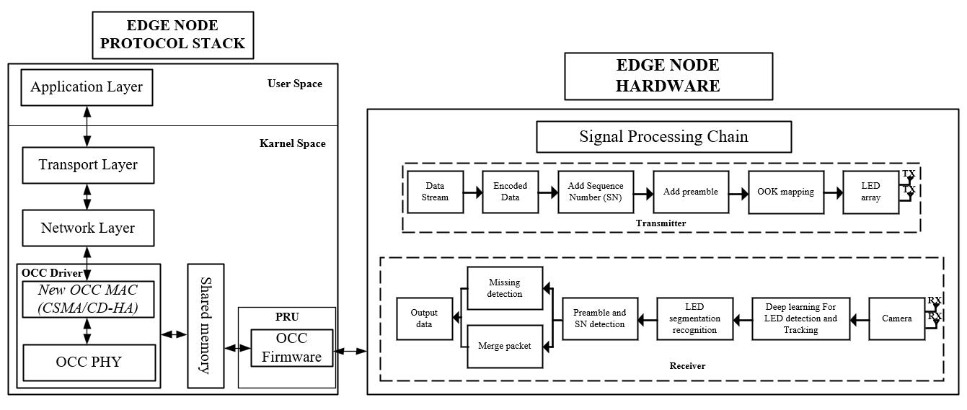
Methodology
(OCC MAC and Network Layer for Bidirectional communications)
Conduct a controlled experiment to validate the OCC prototype's performance.

Slide 9
Conclusion
The CSMA/CD-HA protocol enhances efficiency by detecting hidden nodes and employing directional communication, while adaptive backoff dynamically adjusts transmission attempts.
PRU integration offloads real-time tasks, optimizing performance. Improved reliability is ensured through collision detection, hidden area avoidance, and intra-frame bidirectional transmission.
The system's greater scalability is facilitated by a flexible protocol design and shared memory communication, accommodating diverse network configurations and fostering wider adoption.

Slide 10
References :
B. G. Guzman, M. S. Mir, D. F. Fonseca, A. Galisteo, Q. Wang, and D. Giustiniano, “Prototyping visible light communication for the internet of things using OpenVLC,” IEEE Commun. Mag., vol. 61, no. 5, pp. 122–128, 2023.

