Slide 1
Project: IEEE P802.15 Working Group for Wireless Personal Area Networks (WPANs)
Submission Title: Artificial Intelligence for NG-OCC
Date Submitted: January 14, 2024
Source: Muhammad Rangga Aziz Nasution, Nguyen Ngoc Huy, Yeong Min Jang, Kookmin University
Address: Kookmin University, 77 Jeongneung-Ro, Seongbuk-Gu, Seoul, 02707, Republic of Korea
Voice: +82-2-910-5068 E-Mail: yjang@kookmin.ac.kr
Re:
Abstract: Present the use case AI for IEEE 802.15 IG NG-OCC
Purpose: Presentation for contribution on IEEE 802.15 IG NG-OCC
Notice: This document has been prepared to assist the IG NG-OCC. It is offered as a basis for discussion and is not binding on the contributing individual(s) or organization(s). The material in this document is subject to change in form and content after further study. The contributor(s) reserve(s) the right to add, amend or withdraw material contained herein.
Release: The contributor acknowledges and accepts that this contribution becomes the property of IEEE and may be made publicly available by IG NG-OCC.

Slide 2
Artificial Intelligence for
NG-OCC January 14, 2024

Slide 3
Contents
Background
AI for NG-OCC
CNN-based Deep Learning
RNN-based Deep Learning
DRL-based Deep Learning
Conclusion

Slide 4
Background
Artificial Intelligence (AI) has been growing rapidly in recent years.
The AI technology integration into many sectors has been trending topic research.
The ability of AI to make its own decision based on available data is potential for automation and assistance for recently developed technology.
Currently deep learning, a subset of AI, has become the most researched field. Deep learning can be categorized into several subsets: CNN for visual data, RNN for sequence data and DRL for networking.
In the application, OCC employs visual data as transmission medium and sequence data for the signal. OCC can also be implemented networking for more complex communication system.

Slide 5
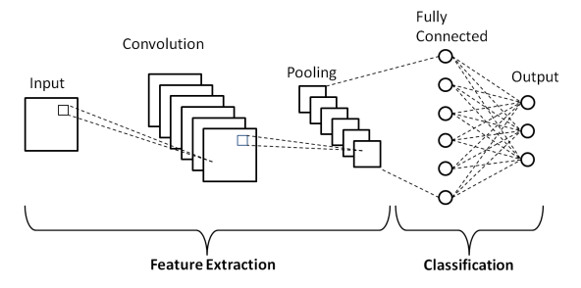
CNN-based Deep Learning for NG-OCC​
CNN is a type of deep neural network designed for processing and analyzing visual data. CNNs are particularly effective in tasks related to image recognition, object detection, and other visual data processing applications.
OCC, which utilizes images to represent its transmitted signal, can be enhanced by using CNN-based deep learning to process the transmitted through the images.
In line with that, several recent research utilizes CNN-based deep learning such as object detection and object segmentation to enhance the performance of OCC.

Slide 6
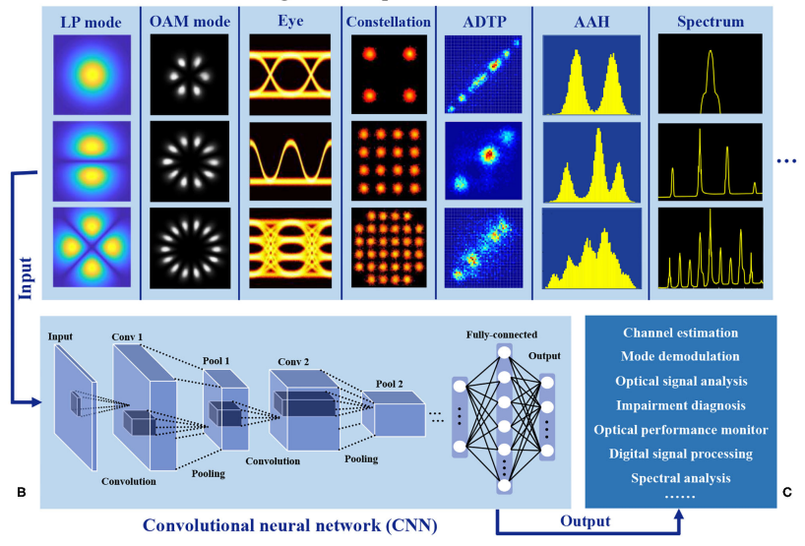
CNN-based Deep Learning for NG-OCC​
CNN proves valuable in optical communication for tasks such as channel estimation, mode demodulation, signal analysis, diagnosing issues, and handling operations like Optical Power Monitoring (OPM), Digital Signal Processing (DSP), and spectral analysis.
CNN is helpful in detecting light sources, predicting Regions of Interest (RoI) motions, and fixing blurry images.

Slide 7
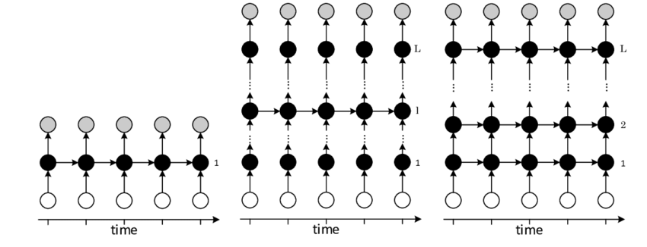
RNN-based Deep Learning for NG-OCC​
Recurrent Neural Networks (RNNs) are specifically designed for sequential data, capturing temporal correlations across various timescales. Unlike feedforward neural networks, RNNs with cyclic connections provide neural networks with memory, enabling them to consider both current and past inputs.
RNNs have proven successful in sequence modelling and prediction tasks, such as speech recognition, handwriting recognition, language translation, and stock price forecasting. The architecture involves input vectors, hidden layers, and the mapping of input sequences to output sequences.

Slide 8
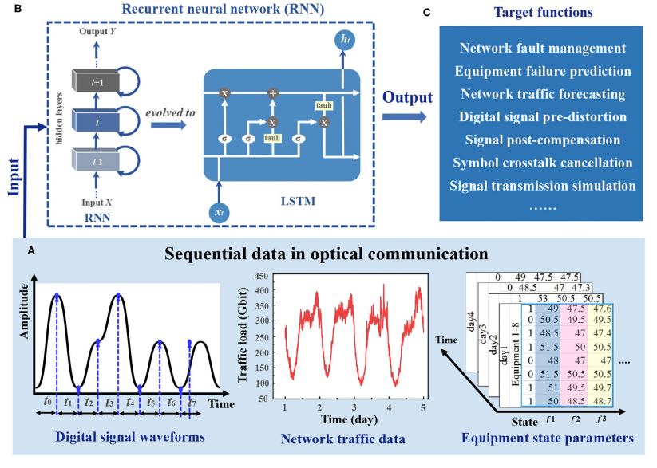
RNN-based Deep Learning for NG-OCC​
In optical communication, Recurrent Neural Networks (RNNs) are handy for tasks like fixing signal issues, predicting network traffic, and managing equipment failures.
Optical signals, represented as time-domain data, can benefit from RNNs for pre-distortion before transmission and post-compensation after reception. RNNs prove effective in mitigating system impairments and identifying crosstalk between adjacent symbols.

Slide 9
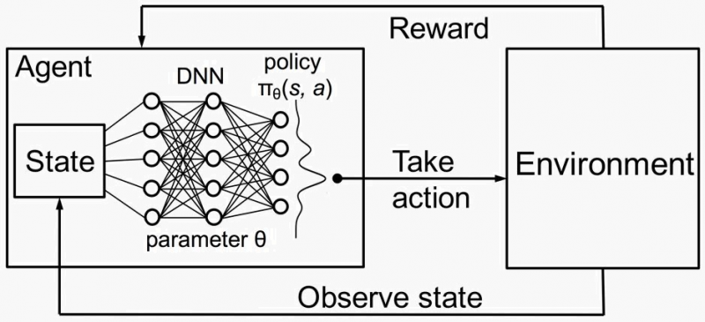
DRL-based Deep Learning for NG-OCC​
The DRL schematic involves two main elements (agent and environment) and two core steps (observation and action). Observations provide current state information, and actions represent adjustments made by the DRL agent based on rewards or punishments from the environment. DRL reflects the machine learning from failures and growing through corrections, akin to learning from rewards and punishments.​
A DRL-based routing solution for the Optical Transport Network (OTN) captures crucial relationships among lightpaths and paths in OTN topologies.

Slide 10
DRL-based Deep Learning for NG-OCC​
In optical communication, DRL is particularly valuable for network control and automation. It has been applied to automate resolutions in routing, resource allocation, orchestration, and configuration, showcasing its effectiveness in handling complex optical network scenarios.
Deep Reinforcement Learning (DRL) is used to make elastic optical networks (EON) work better. It helps assign spectrum more flexibly, ensuring good virtual network services even in changing situations.
DRL is also applied to improve the setup of optical devices in data centers and passive networks. This means using flexible transceivers that adapt to the network's needs, making things better for different users and improving transmission quality and speed.

Slide 11
Conclusion
Due to its potential, the usage of AI, especially deep learning, can be vital for the NG-OCC
CNN-based deep learning in NG-OCC can be utilized mainly for processing image from the usage of camera in OCC. The CNN is also used to detect light source and predict RoI.
RNN-based deep learning in NG-OCC is mainly employed in before and after transmission phase. The RNN‘s role is to mitigate errors and manage network traffic.
DRL-based deep learning in OCC is mainly used in a network, especially Optical Transport Network (OTN), where the task of the DRL is to optimize pathing and routing of the network. DRL is also functional in a dynamic and flexible optical networks.

Slide 12
Reference
Wang, D.; Zhang, M. Artificial Intelligence in Optical Communications: From Machine Learning to Deep Learning. Frontiers in Communications and Networks 2021, 2.
Sasaki, Y.; Maruta, K.; Kojima, S.; Hisano, D.; Nakayama, Y. Light Source Tracking System for A-QL Based Display-Camera Communication. In Proceedings of the 2023 IEEE 97th Vehicular Technology Conference (VTC2023-Spring); June 2023; pp. 1–6.​
Younus, O.I.; Bani Hassan, N.; Ghassemlooy, Z.; Haigh, P.A.; Zvanovec, S.; Alves, L.N.; Minh, H.L. Data Rate Enhancement in Optical Camera Communications Using an Artificial Neural Network Equaliser. IEEE Access 2020, 8, 42656–42665, doi:10.1109/ACCESS.2020.2976537.​

