Slide 1

147th Session of meetings of the
IEEE 802.15 Working Group for Wireless Specialty Networks (WSN)
Closing Report
November 12-17, 2023
Held in Honolulu & Hybrid via Webex

Slide 2
802.15 WG Org. Chart

Slide 3
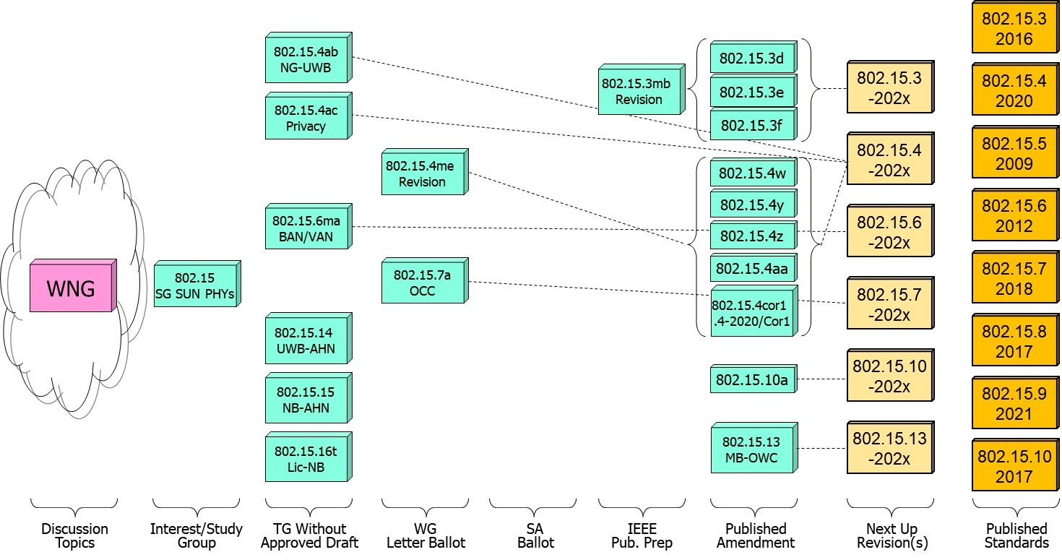
802.15 WG Standards Pipeline

Slide 4
802.15 WG Administrative
Voting members: 137
Nearly voting members: 10
Aspirant voting member: 22
802.15 WG Officer Elections
Clint Powell - Chair (elected March 2022)
Phil Beecher - 1st Vice-Chair (elected March 2022)
Ann Krieger - 2nd Vice-Chair (elected Nov. 2022)
Thomas Almholt - Secretary (appointed May 2023)
James Gilb - Tech. Editor (appointed March 2023)
Ben Rolfe - Treasurer (appointed March 2023)

Slide 5
Meeting Slots for 802.15 WG Sept. Interim

Slide 6








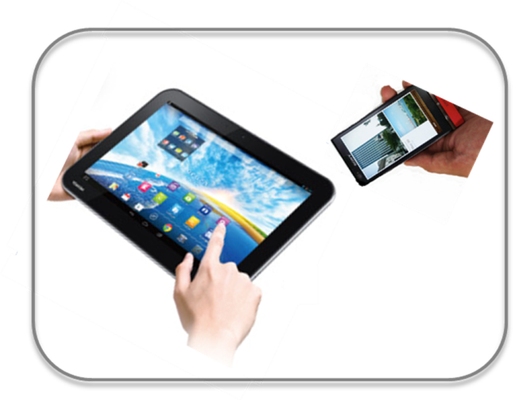








IEEE 802.15 Standards & their Applications
802.15.16
802.15.4
Locating and Tracking
Ultra-low Power Sensors
Automotive
FAN/MAN/RAN
802.15.4
Multi-media networks
&
High Speed
Interconnect
802.15.3
Industrial Networks
802.15.7
802.15.13
Medical
802.15.6
Critical Infrastructure Networks
Consumer Devices
Optical
Communications
Agricultural Sensing
Structural Monitoring
6

Slide 7
802.15 WG Subgroups/Objectives
TG 3mb – Revision b, Maintenance (mb)
Objective: revision for 802.15.3, extension of the frequency range to 300 GHz and review the 802.1D references and replace them with 802.1Q as appropriate
TG 4ab – Next Generation Ultra WideBand (NG-UWB) Amendment
Objective: enhancements to 802.15.4 Ultra Wideband (UWB) physical layers (PHYs) media access control (MAC), and associated ranging techniques while retaining backward compatibility with enhanced ranging capable devices (ERDEVs)
TG 4ac – Privacy Amendment
Objective: modifications to the IEEE Std 802.15.4 medium access control (MAC) specification to specify mechanisms that address and improve user privacy

Slide 8
802.15 WG Subgroups/Objectives
TG 4me – Revision e, Maintenance (me)
Objective: revision to 802.15.4-2020, rolling up amendments 802.15.4w, 802.15.4y, 802.15.4z, and 802.15.4aa and work on errors, omissions, updates, etc.
TG 6ma – Revision a, Maintenance (ma)
Objective: enhancements to the BAN Ultra Wideband (UWB) physical layer (PHY) and media access control (MAC) to support enhanced dependability to a human BAN (HBAN) and adds support for vehicle body area networks (VBAN), a coordinator in a vehicle with devices around the vehicular cabin
TG 7a – Optical Camera Communication (OCC) Amendment
Objective: high-rate OCC Physical Layer (PHY) using light wavelengths from 10,000 nm to 190 nm delivering data rates up to 100 Mb/s for point-to-point and point-to-multipoint communication

Slide 9
802.15 WG Subgroups/Objectives
TG 14 – Impulse Radio Ultra Wideband Wireless Ad Hoc Networks (UWB-AHN) ---IN HIBERNATION---
Objective: focused on impulse radio (IR) Ultra Wideband (UWB) PHY and MAC providing precision ranging capability that is accurate to the centimeter level by including (via. referencing) the 802.15.4 IR UWB functionality into a simple focused specification
TG 15 – Narrow Band Wireless Ad Hoc Networks (NB-AHN)
---IN HIBERNATION---
Objective: focused on narrow band ad hoc network PHY and MAC by including (via referencing) functionality and features of 802.15.4 into a simple focused specification
TG 16t – Licensed Narrowband (Lic-NB)
Objective: specify new PHY in licensed spectrum with channel bandwidths greater than or equal to 5 kHz and less than 100 kHz focusing on spectrum less than 2 GHz.

Slide 10
802.15 WG Subgroups/Objectives
SG Next Generation SUN PHYs
Objective: Develop a PAR & CSD for extending the SUN PHYs

Slide 11
802.15 WG Subgroups/Objectives
SC Maintenance/Rules
Objective: review errors noted in published standards providing a response/proposal to the 802.15 WG; review the 802.15 WG operations manual and general P&P and suggest changes to 802.15 WG; review PARs submitted by other WGs
SC IETF – Internet Engineering Task Force standing committee
Objective: provides an 802.15 liaison to IETF for projects associated with 802.15 standards
SC THz – Terahertz (THz)
Objective: communicate THz communications developments, providing input to the regulatory framework for THz comms. in close cooperation IEEE 802.18 TAG; trigger the start of projects to amend existing and develop new standards for THz comms.
SC WNG – Wireless Next Generation (WNG)
Objective: provides an opportunity to individuals to make technical presentations to the 802.15 WG on new technologies and/or proposals for new projects

Slide 12
Session Objectives Nov. 12-17, 2023
TG 3mb (Revision)
  Not meeting – at IEEE Editors
TG 4ab (NG-UWB)
  Identify draft missing pieces and determine work assignments
  Resolve comments and address feedback on pre draft
  Preparation to start Initial Letter Ballot
TG 4ac (Privacy)
  Continue preparing draft
TG 4me (Revision)
  Conduct comment resolution from 1st Letter Ballot Recirc
  Assess readiness to start 2nd Letter Ballot Recirc
TG 6ma (Revision + BAN/VAN)
  Resolve comments from pre ballot review

Slide 13
Session Objectives Sept. 11-14, 2023
TG 7a (OCC)
  Conduct comment resolution for 4th Letter Ballot Recirc
  Prepare package to go to WG and LMSC to start Sponsor Ballot
TG 14 (UWB-AHN) – in hibernation, no meetings
TG 15 (NB-AHN) – in hibernation, no meetings
TG 16t (Lic-NB)
  Finalize resolving comments from pre ballot review
  Start Initial Letter Ballot
Joint 802.1/802.15
  Address comments/feedback received on PAR for 802.1 project supporting TG6ma

Slide 14
Session Objectives Sept. 11-14, 2023
SG NG-SUN PHYs
  Address comments/feedback received on PAR and CSD submitted for Nov. LMSC approval
SC MAINTENANCE
  Review draft of detailed development process steps checklist
  Identify list of all templates for WG15 Subpage
  Review any PARs/CSDs submitted for Nov. LMSC approval and provide feedback/comments
SC IETF
  Discuss IETF activities related to 802/802.15 at WG15 mid-week
SC THz
  Not meeting
SC WNG
  Hearing presentations on WSN related topics

Slide 15
Adjournment
Thanks…
for going fast enough to get there, but slow enough to see.

Slide 16
WG15 November 2023 Honolulu Mtg. Recap
WG15,
I'm happy to announce that all 3 WG15 motions were approved by the LMSC at its Nov. Closing Plenary on Fri., Nov. 17th.
- The LMSC approved the 1st Reformation of the Study Group on Next Generation Smart Utility Networks (SUN) PHY, as well as the PAR and CSD for the Task Group TG4ad on the same. The PAR is now off to NesCom for approval.
- The LMSC also approved the start of the IEEE SA (Sponsor) Ballot series for the amendment to 802.15.7 on Optical Camera Communications (OCC).
Several project milestones were achieved by WG15 during the Nov. 802 Plenary. Below are highlights from each group.
- TG4ab, defining the Next Gen. UWB amendment to 802.15.4, is finishing up pre-draft B comment resolution and is preparing to release pre-draft C for review and commenting, with the intent of going out for Initial Letter Ballot after the Jan. 802 Wireless Interim.
- TG4ac, working on the 802.15.4 amendment on Privacy, continues to hear presentations and work with various 15.4 Task Groups in preparing draft text.
- TG4me, preparing the revision to 802.15.4 2020 rolling up several amendments to 802.15.4, as well as restructuring the document to make it more readable, completed its 1st Letter Ballot Recirc. and is wrapping up comment resolution and preparing to go out for a 2nd Letter Ballot Recirc. before the EOY.
- TG6ma, drafting a BAN/VAN revision to the 802.15.6 Standard on Body Area Networks (BAN), continues to work on pre-drafts in preparation for going out for Initial Letter Ballot. A joint 802.1/802.15 mtg. was also held in November, in which the participants worked on resolving and responding to comments submitted on the draft PAR for an 802.1 amendment project addressing an 802.15.6 need.
- TG7a, drafting an amendment to the 802.15.7 Standard on OCC, prepared the package supporting the request to the LMSC for approval to move to SA (Sponsor) Ballot. Once the Sponsor Ballot Pool formation has completed, TG7a will start its Initial Sponsor Ballot.
- TG16t, working on a Licensed Narrow Band amendment to 802.16, completed resolutions to comments collected on its pre-draft. WG15 approved the start of the Initial Letter Ballot at its closing plenary.
- The Standing Committee on IETF gave an update on IETF activities during the WG15 midweek plenary. WG15 will use this format going forward, versus a standalone mtg., to convey IETF activity updates to the WG.
- The Standing Committee on Maintenance and Rules (M&R) reviewed the PARs submitted for approval by the LMSC this mtg. and prepared and submitted comments and feedback on them. M&R also looked at changes to the attendance policy for gaining and maintaining voting rights in our new hybrid (mixed-mode) meeting era.
- The Standing Committee on Tera Hertz (THz) did not meet in Nov.
- The Standing Committee on Wireless Next Generation (WNG) heard a presentation on extensions to the 802.15.7 standard on OCC (Optical Camera Communications). Enough interest was expressed by the WG that the WG15 Chair initiated an Interest Group to further look at the possibility of a future amendment to the 802.15.7 standard.

Slide 17
WG15 November 2023 Honolulu Mtg. Recap
- The Study Group on Next Generation Smart Utility Networks (NG-SUN) PHY, worked on responses to the comments received from the other 802 Work Groups and LMSC members, on the PAR and CSD submitted to the LMSC requesting the formation of a Task Group to start the work on a project on the same.
- The TG3mb, a revision draft of the 802.15.3 Standard on High Data Rate (HDR), is currently at the IEEE Editors preparing for publication.
- The group of WG15 participants that gave a GEPS presentation on UWB during the July 2023 802 Plenary was invited to prepare a submission to the IEEE Journal on Vehicular Technology and met to draft an outline and divide responsibilities for drafting the article.
Wishing happy end of year holidays to everyone, and looking forward to another productive meeting in January.

Slide 18
TG3mb (HDR)
November 2023
Closing Report
Did not meet - Draft at IEEE Editor

Slide 19
TG4ab (NG-UWB)
November 2023
Closing Report

Slide 20
Overview
Pre-draft draft
  Current draft: P802.15.4ab™/D (pre-ballot) B
  Received some comments from TG comment collection
  Resolved comments
  Comments in doc 15-23-0475
  Ready for TE to produce next draft
Next: Produce Pre-ballot draft C and complete working group comment collection cycle
  To commence 1-2 week following plenary session

Slide 21
Session Objectives
Complete comment resolution
Provide TE with details to update
Commence working group comment collection

Slide 22
Presentations during plenary
Doc | Ver | Link
502 | 3 | https://mentor.ieee.org/802.15/dcn/23/15-23-0502-03-04ab-group-consensus-on-operating-parameter-sets.docx
505 | 6 | https://mentor.ieee.org/802.15/dcn/23/15-23-0505-06-04ab-text-for-ptf-report-ie.docx
539 | 2 | https://mentor.ieee.org/802.15/dcn/23/15-23-0539-01-04ab-proposed-resolution-for-10-146-147-148.docx
549 | 1 | https://mentor.ieee.org/802.15/dcn/23/15-23-0549-01-04ab-proposed-resolutions-for-draft-b-comments-140-225-226.docx
552 | 4 | https://mentor.ieee.org/802.15/dcn/23/15-23-0552-04-04ab-proposed-updates-on-ac-ie-and-cir-report-ie.docx
561 | 0 | https://mentor.ieee.org/802.15/dcn/23/15-23-0561-00-04ab-proposed-resolution-for-nb-channel-map.docx
562 | 0 | https://mentor.ieee.org/802.15/dcn/23/15-23-0562-00-04ab-cir-report-ie-format.pptx
563 | 0 | https://mentor.ieee.org/802.15/dcn/23/15-23-0563-00-04ab-proposed-text-for-cir-report-format.docx
573 | 0 | https://mentor.ieee.org/802.15/dcn/23/15-23-0573-00-04ab-balanced-wireless-in-device-coexistence.pptx
575 | 2 | https://mentor.ieee.org/802.15/dcn/23/15-23-0575-01-04ab-resolution-proposals-for-comments-21-22-25-26-28-99-155-164-166.docx
579 | 0 | https://mentor.ieee.org/802.15/dcn/23/15-23-0579-00-04ab-privacy-addressing-requirements-in-4ab.pptx
581 | 0 | https://mentor.ieee.org/802.15/dcn/23/15-23-0581-00-04ab-proposed-resolution-on-ac-ie-comments-part-three.docx
591 | 0 | https://mentor.ieee.org/802.15/dcn/23/15-23-0591-00-04ab-proposed-resolutions-ci-53-235-236.pptx
604 | 0 | https://mentor.ieee.org/802.15/dcn/23/15-23-0604-00-04ab-resolutions-to-cids-183-230-234-240.xlsx
285 | 1 | https://mentor.ieee.org/802.15/dcn/23/15-23-0285-01-04ab-effect-of-no-lbt-nb-on-802-11-devices.pdf

Slide 23
Motion
Adopt the comment resolutions in 15-23-0475-31 and instruct the technical editor to apply to produce pre-ballot draft C. Direct the TG chair to request WG chair initiate working group comment collection on pre-ballot draft C as soon as possible.
Moved by: Clint Chaplin (SRA)
Second by: Billy Verso (Qorvo)

Slide 24

Next Steps

Slide 25
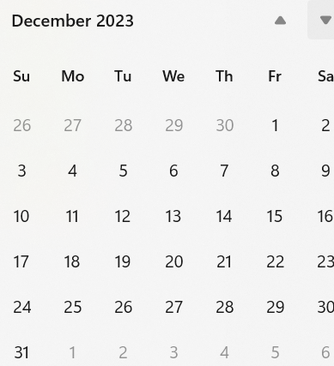
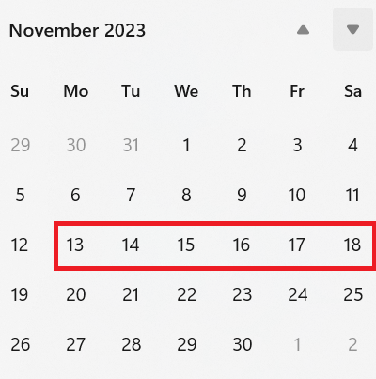
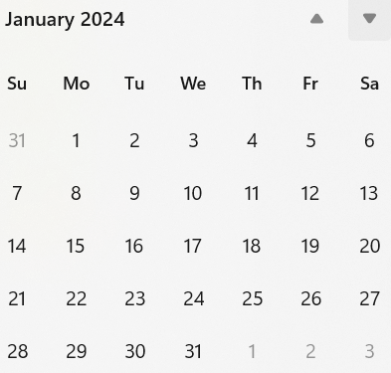
Interim telecon/Webex schedule
TG4AB Teleco schedule
Weekly on Tuesday commencing 5-December 06:00 PT
If no agenda items by COB Friday before, call will be cancelled

Slide 26
TG4ac (Privacy)
November 2023
Closing Report

Slide 27
Agenda for November
Continue working on the issue list: 15-23-0422-02

Slide 28
Detailed Agenda for November
Tuesday 14th of November 1330-1530
    Opening slides
    Approve agenda (this document) 15-23-0578-00
    Approve minutes 15-23-0485-00
    Go through submissions
    Continue working on the issues list
Thursday 16th of November 1330-1530
    Continue working on the issues list
    Closing report

Slide 29
More information
List of issues can be found in the document 15-23-0422
Project task list: 15-23-0397
Old WNG presentation 15-22-0477

Slide 30
Timeline
Finalize the list of issues to be solved | Jan 2024
First version of the draft for WG pre-ballot commenting | Mar 2024
Draft ready for letter ballot | May 2024
Draft ready for SA ballot | Sep 2024
SA ballot start | Nov 2024
SA ballot done | Jan 2024
Submit to RevCom | Mar 2025
Standard published | Sep 2025

Slide 31
Meeting achievements
Created timeline
Updated the issue list

Slide 32
Agenda for TG4ac for January
Two sessions
Try to coordinate so it does not overlap TG4ab, 802.11bi, or 802.11bh
Have a joint one hour meeting with TG4ab
    Perhaps at the end of week, so we can update what has happened
  Finish the issue document, start workin on the solutions

Slide 33
TG4me (Revision to 802.15.4 2020)
November 2023
Closing Report

Slide 34
15.4me Sessions this Week
 | Monday | Tuesday | Wednesday | Thursday
AM 1 | Opening 802 Plenary |  | 802.15.4me Session 3 (9am)
AM 2 | Opening 802.15 Plenary | 802.15.4me Session 2 | Midweek Plenary | 802.15.4me Session 4
PM 1 | 802.15.4me Session 1
PM 2 |  |  |  | 802.15 Closing Plenary
6:30p
4 Sessions will be scheduled

Slide 35
Agenda
Agenda
  Call for Patents
  Approve Agenda
  Approve Minutes
  Ballot Results
  Comments
  Next Steps
  Review Draft Timeline
  Update Checklist (DCN 15.23.0400.03)
  Next meetings

Slide 36
TG Motion for CRG
Move that TG4me formally request that 802.15 WG approve the formation of a Comment Resolution Group (CRG) for the WG balloting of the P802.15.04.me_D02 with the following membership: Gary Stuebing(chair), Tero Kivinen, Phil Beecher, Billy Verso, Ann Krieger and Ben Rolfe. The 802.15.4me CRG is authorized to approve comment resolutions, edit the draft according to the comment resolutions, and to approve the start of recirculation ballots of the revised draft on behalf of the 802.15 WG. Comment resolution on recirculation ballots between sessions will be conducted via reflector email and via teleconferences announced to the reflector as per the LMSC 802 WG P&P.
Moved: Ann Krieger
Second: Tero Kivinen

Slide 37
WG Motion for CRG
Move that 802.15 WG approve the formation of a Comment Resolution Group (CRG) for the WG balloting of the P802.15.04.me_D01 with the following membership: Gary Stuebing(chair), Tero Kivinen, Phil Beecher, Billy Verso, Ann Krieger and Ben Rolfe. The 802.15.4me CRG is authorized to approve comment resolutions, edit the draft according to the comment resolutions, and to approve the start of recirculation ballots of the revised draft on behalf of the 802.15 WG. Comment resolution on recirculation ballots between sessions will be conducted via reflector email and via teleconferences announced to the reflector as per the LMSC 802 WG P&P.
Moved: Gary Stuebing
Second:

Slide 38
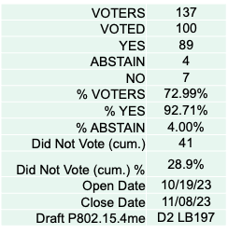
Results of last ballot:
Comments Received: 310 – Rogue 3
Latest Spreadsheet: 15-23-0497-13-04me

Slide 39
Minutes: 15-23-0610-00-04me
CRG Formed – Notification via reflector
Sponsor Pool and MEC review to be requested
After next Ballot
Checklist: 15-23-0400-03-04me
Next meeting draft agenda: 15-23-0613-00-04me

Slide 40
Draft Timeline
Nov/23 – Comment Resolution and Recirc of Letter Ballot
Nov/23 – Request Sponsor Ballot Group
Jan/24 – Working Group Motion to SA Ballot and CRG (LMSC Package Created)
Jan/Feb 24 – Optimistic SA Ballot (EC Call?)
Mar/24 – SA Ballot comment resolution and CRG
Jul/24 – SA Recirc (CRG)
Sep/24 – Optimistic SA to Revcom
Dec/24 – SA to Revcom

Slide 41
TG6ma (BAN/VAN)
November 2023
Closing Report

Slide 42
Objectives of TG 6ma – Enhanced Dependability Body Area Network (ED-BAN)
Objective: Enhancements to the BAN Ultra Wideband (UWB) physical layer (PHY) and media access control (MAC) to support enhanced dependability to a human BAN (HBAN) and adds support for vehicle body area networks (VBAN), a coordinator in a vehicle with devices around the vehicular cabin.
Action:
•Update draft#1.9 of Draft Proposals for Pre-Ballot
•Comment resolution for draft#1.9
•Performance Evaluation of Technologies in PHY; Channel Coding According to 8 QoS Levels of Packets and Coexistence Levels, Interference Mitigation, etc.
•Performance Evaluation of Technologies in MAC; Channel Management, CCA, Hybrid Contention Free/Access Protocol According to 8 QoSs and Coexistences.
•Harmonization or Commonality with 4ab in Coexistence and Feasible Implementation of 6ma and 4ab
Feasibility of TSN of 802.1 in MAC → Joint IEEE802.1&15 PAR&CSD for TSN
Next Things to Do：
Finalize draft for initial Letter Ballot

Slide 43
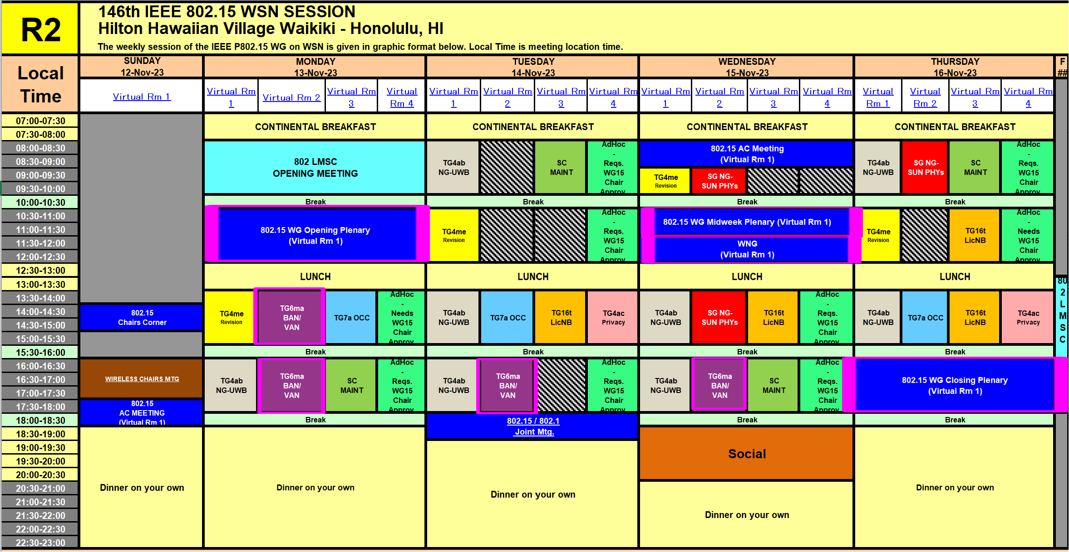
TG15.6ma Interim Session Schedule for 13-16th, Nov. 2023
TG15.6ma has three own sessions such as
Session1(Virtual RM#2) PM1 13:30-15:30 Nov.13(MON) in Honolulu time, 8:30 - 10:30 Nov.14(TUE) in JST/KST
Session2(Virtual RM#2) PM2 16:00-18:00 Nov.13(MON) in Honolulu time, 11:00-13:00 Nov.14(TUE) in JST/KST
Session3(Virtual RM#2) PM2 16:00-18:00 Nov.13(MON) in Honolulu time, 11:00-13:00 Nov.14(TUE) in JST/KST
Session4(Virtual RM#2) PM2 16:00-18:00 Nov.13(MON) in Honolulu time, 11:00-13:00 Nov.14(TUE) in JST/KST

Slide 44
TG15.6ma Interim Session Schedule for 13-16th, Nov. 2023
TG15.6ma has three own sessions such as
Session1(Virtual RM#2) PM1 13:30-15:30 Nov.13(MON) in Honolulu time, 8:30 - 10:30 Nov.14(TUE) in JST/KST
Session2(Virtual RM#2) PM2 16:00-18:00 Nov.13(MON) in Honolulu time, 11:00-13:00 Nov.14(TUE) in JST/KST
Session3(Virtual RM#2) PM2 16:00-18:00 Nov.13(MON) in Honolulu time, 11:00-13:00 Nov.14(TUE) in JST/KST
Session4(Virtual RM#2) PM2 16:00-18:00 Nov.13(MON) in Honolulu time, 11:00-13:00 Nov.14(TUE) in JST/KST
Virtual RM#2
Meeting link: https://ieeesa.webex.com/ieeesa/j.php?MTID=mca39b1aeaf9ee5b85bb81cd3fcf994b1
Meeting number: 2340 662 2743
Password: 80215novmtgrm2

Slide 45
Agenda items for the week
TG15.6ma meeting call to order
Call for essential patents and policies & procedures reminder
Approve last meeting minutes: TG 15.6ma Meeting Minutes for September 2023 doc.#15-23-0513-00-06ma
Agenda of TG15.6ma November Meeting doc.#15-23-0555-03-06ma
Review and Summary
  Basic Consensus in MAC and PHY of Revision of IEEE802.15.6-2012(IEEE802.15.6ma) doc.#15-23-0557-00-06ma
  2. Progress and Action Items for Draft#1 doc.#15-23-0360-02-06ma
  Draft pre-ballot comment resolution doc.#15-23-0476-05-06ma
  Rescheduling Timeline doc.#15-23-0361-02-06ma
  Comment Resolution Database for Pre-Ballot-WG doc.#15-23-0476-10-06ma
  Presentation
  MAC features for operating coexisting multiple dependable BANs doc.#15-23-0558-00-06ma
  Overview and convergence of MAC proposals for 15.6ma doc.#15-23-0408-02-06ma
  Progress and Action Items for Draft#1 (Draft#1.9) doc.#15-23-0360-02-06ma
  Hybrid ARQ Scheme for High QoS Packets in High Class of Coexistence of IEEE 802.15.6ma 0474-01-06ma
  Evaluation of IEEE 802.15.6 Ultra-wideband Physical Layer Utilizing Super Orthogonal Convolutional Code 0562-05
  Simulation results for Nagoya I. T. and YRP-IAI MAC proposal Based on TG6ma Channel Model -0352-01-06ma
  UWB Positioning in 15.6ma for Multiple BAN Adjacent Scenarios doc.#15-23-0560-00-06ma
  Preliminary performance evaluation of ranging in coexistence environment doc.#15-23-0353-04-06ma
  Performance Evaluation of Channel Coding under Various Channel Models in Some
  Classes of Coexistence in TG6ma doc.#15-23-0577-00-06ma
  10. TG6ma Channel Model Document for Enhanced Dependability doc.#15-22-0519-01-06ma
  11.Comments to channel-model-document doc.#15-23-0605-00-06ma
  12.Interference Mitigation Schemes in Class 3, 5, 6, and 7 of Coexisitence in TG6ma doc.#15-22-0571-01-06ma
  13. Proposed text for 6ma MAC General Framework Elements & Beacon Access Phase doc.#15-23-0367-02-06ma
  14. MAC Protocol Proposal for Multiple BAN Environment (Level 1,2,3) doc.#15-23-0639-03-06ma
  15. Proposal of MAC Revision for for IEEE802.15.6ma in Class 1 of Coexistence of Multiple BANs 23-0593-00-06ma
  16. Overview and convergence of MAC proposals for 15.6ma doc.#15-23-0408-02-06ma
  17. Progress Report of TG6ma doc.#15-23-0056-05-06ma
  18. Timeline of TG6ma doc.#15.23-0407-02-06ma
  19. TG15.6ma Closing Report for November 2023 doc.#15-23-0594-00-06ma
  20. TG15.6ma Meeting Minutes for November 2023 doc.#15-23-0608-00-06ma
Joint work between 802.1 and 802.15
1. PAR-par-review-sc-meeting-agenda-and-comment-slides-november-2023-plenary-Honolulu doc.:802.11-23-1690r1

Slide 46
15.6ma PHY and MAC New Features
Since IEEE802.15.6-2012 has too many modes in PHY and MAC, 15.6ma chooses a few modes to simplify specification of PHY and MAC while introduces new error-controlling schemes of FEC and HARQ, and management and data channels for enhanced dependability in various channel models and 8 classes of coexistence models for 8 levels of QoS priority order packets such as
  PHY
    Various channel coding and decoding matched with QoS priority levels of packets and coexistence classes
    Interference mitigation schemes according to various environment of coexistence classes
  MAC
    Two channels using two UWB band channels are applied for management channel to control frames of coexisting networks and data transmission channel. Its alternative mode is two channels for management and data transmission using a single UWB band channel.
    Coordinator-to-coordinator(C2C) negotiation of existing networks
  Cross Layer of PHY and MAC
    Hybrid ARQ for higher priority pf packets in high class of coexistence

Slide 47
QoS Levels of Packets
corresponding to User Priority
In Std.15.6 WBAN systems, a various data such as vital signs, skin temperature, blood pressure, ECG, EEG, ECoG, and vehicle controlling commons have different QoS levels corresponding to user priority.
In 15.6ma for dependable WBAN for human and vehicles, data packet transmission should be dependable according to QoS levels even in various classes of coexistence environment.
Therefore, appropriate sets of error controlling scheme with FEC and hybrid ARQ corresponding to QoS levels have been standardized in 15.6ma,
User priority | Traffic designation | Frame type
0 | Background (BK) | Data
1 | Best effort (BE) | Data
2 | Excellent effort (EE) | Data
3 | Video (VI) | Data
4 | Voice (VO) | Data
5 | Medical data or network control | Data or management
6 | High-priority medical data or network control | Data or management
7 | Emergency or medical implant event report | Data

Slide 48
Definition of Coexistence Environment Classes
Coexistence Class | Coexisting system(s) |  |  |  |  | Category
Level | 802.15.6ma | 802.15.6-2012 | Non-UWB (ex. Wi-Fi / Unlicensed / 3GPP) | 802.15 UWB (ex. 802.15.4) | Non-802.15 UWB (ex. ETSI SmartBAN) | Category
0 | - | - | - | - | - | Single BAN
1 (1a) | ✓ | - | - | - | - | Multiple 15.6 BANs
2 (1b) | ✓ | ✓ | - | - | -
3 | ✓ | - | ✓ | - | - | Non-UWB
4 (2a) | ✓ | - | - | ✓ | - | Multiple UWB systems
5 (2b) | ✓ | - | - | - | ✓
6 (2c) | ✓ | - | - | ✓ | ✓
7 | ✓ | ✓ | ✓ | ✓ | ✓ | Final Boss
The coexistence class has been redefied to 8 levels, which can be represented by 3 bits and would be suitable to include in PHY or MAC headers.

Slide 49
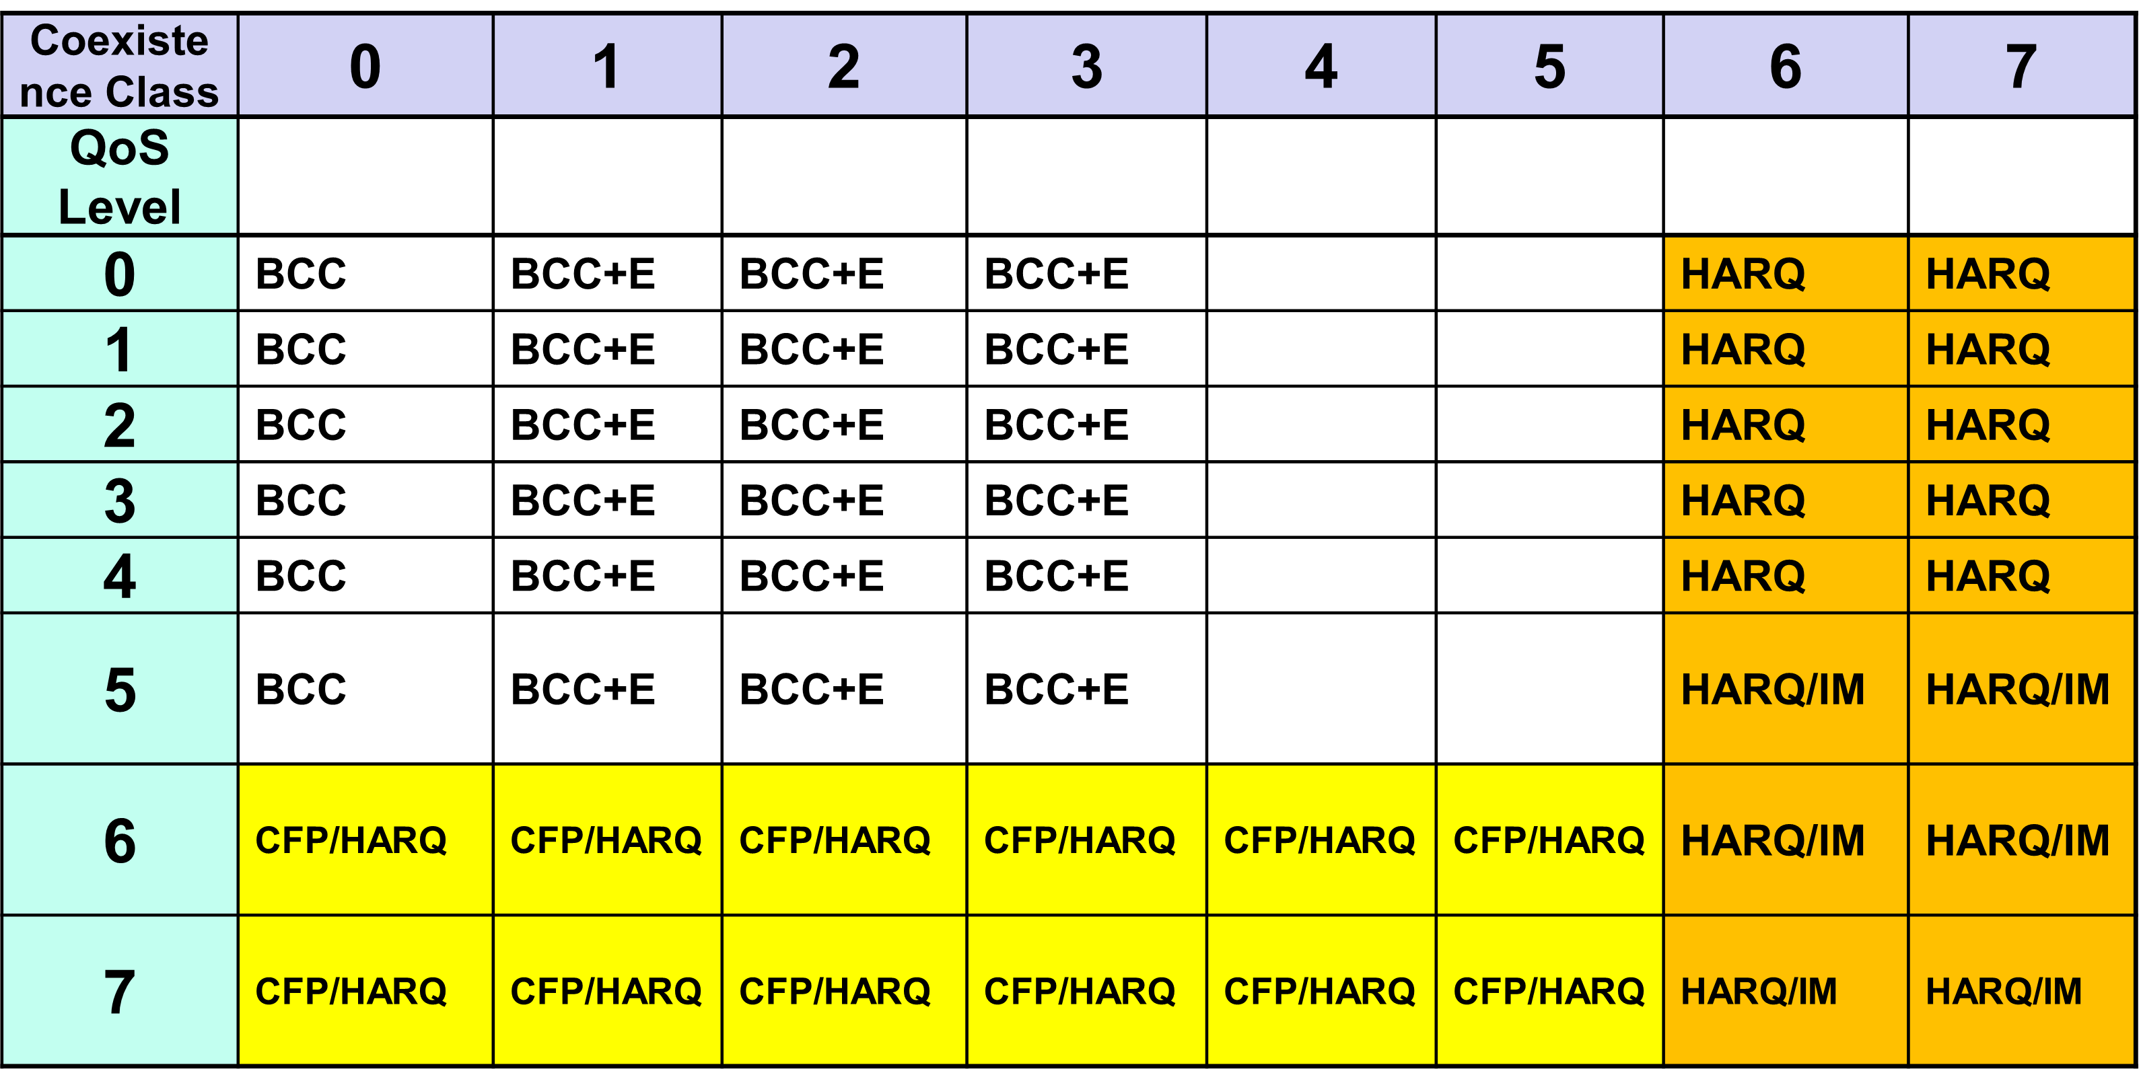
FEC/HARQ for 8 Coexistence Classes × 8 QoS Packet Levels
FEC codes and Hybrid ARQ have been designed for 8 × 8 = 64 combinations for QoS levels and Coexistence classes under various standard of channel models.

Slide 50
Common with IEEE802.15.4ab
Error-correcting codes corresponding to QoS levels
Channel Coding Table #1
User priority | Inner code | Outer code | HARQ
0 | 15.4ab LDPC code (R=1/2) |  | -
1 | 15.4ab LDPC code (R=1/2) |  | -
2 | 15.4ab LDPC code (R=1/2) |  | -
3 | 15.4ab LDPC code (R=1/2) |  | -
4 | 15.4ab LDPC code (R=1/2) | (54, 46) shortened RS code | -
5 | 15.4ab LDPC code (R=1/2) | (54, 38) shortened RS code | -
6 | 15.4ab LDPC code (R=1/2) | (54, 28) shortened RS code | -
7 | 15.4ab LDPC code (R=1/2) | (54, 14) shortened RS code | -
As an outer code, shortened Reed-Solomon (RS) codes with N=54 (original code length N=63) will be selected to correct burst errors due to interference from other WBANs and the coding rates are changed according to each QoS and channel condition
As an inner code, 15.4ab LDPC codes (K=324, 648, 972, R=1/2) will be selected for the coexistence of 15.6ma and 15.4ab
This updated concept table is considered as the first priority

Slide 51
TG 6ma Timeline
EC approval to SB, SB submission
May 2024
SB recirculation
June 2024
Tech Req Doc(TRD) July 2022
TRD,CMD
Call Proposals Sept 2022
Presentation of proposalsNov2022 Jan.2023
Harmonization of Proposals
Mar 2023
^{Std Draft V0}
May 2023
Upload preliminary draft v1 on WG repository to revise for finalizing v1
July2023
WG pre-ballot
Sept 2023
Comments and resolution for pre-ballot.
Nov 2023
WG letter ballot (LB)
Jan. 2024
Revcom Approve
Sept 2024
^{Finalize Std Draft V1}
August 2023
SB recirculation if required
July 2024
RevcomSubmission
Aug. 2024
Notes: SASB/RevCom scheduled for 2024 a guess

Slide 52
Timeline Details
Topic | Deadline | Notes
Technical Requirements Document (TRD). Channel Model Document (CMD). Call for Proposals. | Sept. 2022 | TRD describes the technical requirements baseline for the evaluation of proposals. The CMD contains the channel models for different use cases targeted by the Std. Announcement of call for proposals.
Due day for proposals | March 10th, 2023 | Postponed from January 2023
Presentation of proposals | Nov. 2022, January, March, May 2023 | Start of discussions for harmonization of proposals.
Harmonization of Proposals | July 2023 | Agreements on key technologies.
Std Draft v.1.7 | September 2023 | Mostly editorial revisions and start integrating text of agreed proposals.
Preliminary Std Draft v. 1.9 | November 2023 | Upload preliminary draft V1 in WG private repository and collecting comments to be used for revision.
Std Draft v. 2.0 | January 2024 | TG approval
WG pre-ballot | January 2024 | WG pre-ballot submission.
Comments and resolution for pre-ballot. | January 2024 | Finish resolutions to pre-ballot comments and recirculation.
WG letter ballot (LB) | March 2024 | LB submission
LB recirculation | March 2024 | Comment-resolutions to LB recirculation
Conditional approval for Sponsor Ballot (SB) | March 2024 | Seek conditional approval
Final LB recirculation. EC approval | May 2024 | Just before the March meeting.
EC approval to SB | May 2024
SB submission | June 2024
SB recirculation | July 2024 | Resolutions to SB.
Conditional/unconditional approval to RevCom | July 2024 | Submission to SASB agenda
SB recirculation if required | August 2024
RevCom submission | September 2024 | RevCom approval

Slide 53
Contributions
・TG15.6ma opening report for Novenber 2023 meeting 15-23-0556-01-06ma
・TG15.6ma Agenda of November Meeting in 2023 15-23-0555-02-06ma
・Progress and Action Items for Draft#1 15-23-0360-01-06ma
・Draft pre-ballot comment resolution 15-23-0476-10-06ma
・Rescheduling Timeline 15-23-0361-02-06ma
・Basic Consensus in MAC and PHY of Revision of IEEE802.15.6-2012 15-23-0557-00-06ma
・MAC features for operating coexisting multiple dependable BANs 15-23-0558-00-06ma
・Overview and convergence of MAC proposals for 15.6ma 15-23-0408-02-06ma
・Simulation results for Nagoya I. T. and YRP-IAI MAC proposal 15-23-0242-03-06ma
・Hybrid ARQ Scheme for High QoS Packets in High Class of Coexistence of IEEE 802.15.6ma 0474-01-06ma
・Evaluation of IEEE 802.15.6 Ultra-wideband Physical Layer Utilizing Super Orthogonal Convolutional Code
15-22-0562-05-06ma
・UWB Positioning in 15.6ma for Multiple BAN Adjacent Scenarios 15-23-0560-00-06ma
・Preliminary performance evaluation of ranging in coexistence environment 15-23-0353-04-06ma
・Performance Evaluation of Channel Coding under Various Channel Models in Some
Classes of Coexistence in TG6ma 15-23-0577-00-06ma
・TG6ma Channel Model Document for Enhanced Dependability 15-22-0519-01-06ma
・Comments to channel-model-document 15-23-0605-00-06ma
・Interference Mitigation Schemes in Class 3, 5, 6, and 7 of Coexisitence in TG6ma 15-22-0571-01-06ma
・Proposed text for 6ma MAC General Framework Elements & Beacon Access Phase 15-23-0367-02-06ma
・MAC Protocol Proposal for Multiple BAN Environment (Level 1,2,3) 15-23-0639-03-06ma
・Preliminary Performance Evaluation of Channel Coding in TG6ma 15-23-0521-01-06ma
・Progress Report of TG6ma 15-23-0056-05-06ma
・Timeline of TG6ma 15.23-0407-02-06ma
・TG15.6ma closing report for November 2023 meeting 15-23-0594-00-06ma
・TG15.6ma November 2023 meeting minutes 15-23-0608-00-06ma

Slide 54
Contacts and Conference call
Chair; Ryuji Kohno, YNU/YRP-IAI
kohno@ynu.ac.jp, kohno@yrp-iai.jp
1st Vice-Chair; Marco Hernandez, YRP-IAI/CWC
marco.hernandez@ieee.org
2nd Vice-Chair; Daisuke Anzai, NIT
anzai@nitech.ac.jp
3. Secretary; Takumi Kobayashi, YNU/TCU
kobayashi-takumi@yrp-iai.jp, kobayashi@nitech.ac.jp
Technical Editors;
Minsoo Kim, YRP-IAI minsoo@minsookim.com
Seong-Soon Joo, KPST wowbk@kpst.co.kr
Kento Takabayashi, Toyo U. takabayashi.kento.xp@gmail.com
Marco Hernandez, YRP-IAI/CWC marco.hernandez@ie ee.org
Jussi Haapola, CWC jussi.haapola@oulu.fi

Slide 55
TG7a (HR LR OCC)
November 2023
Closing Report

Slide 56
Accomplishment for the meeting
3 Slots (on Mon., Tues., and Thurs.)
1st Slot (Mon.):
  Meeting Objectives and Agenda Approval (566-01)
  Current status of IEEE 802.15.7a Task Group (572-00)
  Discussion of TG and WG Motion
2nd Slot (Tues.):
  Meeting Objectives and Agenda Approval (566-01)
  Report to EC for Approval of P802.15.7a-D6 to go to SA Ballot
  Discussion of TG and WG Motion
  3rd Slot (Thurs.):
  Comment resolution for Report to EC for Approval of P802.15.7a-D6 to go to SA Ballot
  Plan for January meeting

Slide 57
TG Motion
Move that TG7a formally request that 802.15 reviews and approves the CSD [15-19-0297-03-0vat], and the CA document [15-22-0292-r3]; and requests unconditional approval from the EC to submit P802.15.7a_D6 to Standards Association ballot
Moved By: Phil Beecher
Seconded By: Yeong Min Jang
Approved by unanimous consent

Slide 58
WG Motion
WG 802.15 has reviewed and approved the CSD document [15-19-0297-03-0vat], and the CA document [15-22-0292-r3], and requests unconditional approval from the EC to submit P802.15.7a_D6 to Standards Association ballot.
Moved By: Yeong Min Jang
Seconded By: Phil Beecher
Vote: 36/0/0(Y/N/A)

Slide 59
Plan for January Meeting
3 slots (AM1 on Tue., Wed., and Thur.)
Complete comment resolution for 1st SA Ballot
Prepare the D7 document for 2nd SA Ballot

Slide 60
TG16t (Lic-NB)
November 2023
Closing Report

Slide 61
Opening
Introductions
Secretary for meeting
  Vishal
Agenda review and Approval

Slide 62
Plan for week
Tuesday PM1 1:30pm HST
Wednesday AM1 09:00am HST
Wednesday PM1 1:30pm HST
Thursday AM2 10:30am HST
Thursday PM1 1:30pm HST

Slide 63
November Meeting Start Status
Comment Collection 2 on D0.94 conducted in October
Comment resolution conducted in October 16th and 30th Teleconferences

Slide 64
Teleconference Summary
Minutes in: 15-23-0551-00-016t-tg16t-october-2023-teleconference-minutes.docx
2023-10-16
  Comments discussed uploaded as 15-23-543-00-016t
  Comments through row 15 have been discussed and resolved.
2023-10-30
  Discussing comments in “Copy of 15-23-0456-00-016t-tg16t-preballot-comment-entry-form-Juha”
  Discussed and resolved through Line 27
  Uploaded as “15-23-0550-00-016t-preballot-comment-entry-form-Juha-with resolutions.xlsx”

Slide 65
Presentation of contributions
Wednesday AM1
15-23-0595-00-016t-ptmp-security-presentation
15-23-0582-00-016t-new-security-doc-for-802-16t-ptmp

Slide 66
Editing instructions for D1.0
15-23-0603-01-016t-consolidated-comment-resolutions-for-16t-comment-collection-2.xlsx comment resolutions applied to draft.
15-23-0582-03-016t-new-security-doc-for-802-16t-ptmp.docx uploaded as text changes to apply to draft.
15-23-0611-00-016t-Comments-response.docx uploaded as text changes to apply to draft.

Slide 67
Letter ballot
TG Motion to start Letter Ballot
  Move that TG16t formally request that the 802.15 WG start a WG Letter Ballot requesting approval of document P802-15-16t_D1.0 and to forward document P802-15-16_D1.0, to Standards Association ballot.
    Moved - Vishal
    Second - Menashe
    TG Vote - Approved with unanimous consent
  Note – there is no CA document. From the CSD 24-19-0030-01-0000-licensed-narrowband-amendment-csd:
    …explain why the CA document is not applicable.
    The scope is to exclusively support operation in licensed spectrum.
Motion text for WG:
  Move that 802.15 WG start a WG Letter Ballot requesting approval of document P802-15-16t_D1.0 and to forward document P802-15-16t_D1.0, to Standards Association ballot.

Slide 68
Project Timeline
Milestone | Date
Task Group Start | Jan 2020
SRD Approval | April 2021
SDD Approval | Jan 2022
Draft Development
Informal TG review of draft | Mar 2023
Working Group Letter Ballot | Nov 2023
Working Group Recirculation Letter Ballot | Jan 2024
SA Ballot | Mar 2024
Forward to RevCom | Nov 2024
Request PAR Extension July 2024
PAR Expiration Date: 31 Dec 2024

Slide 69
IG (NG-SUN PHYs)
November 2023
Closing Report

Slide 70
Agenda

Slide 71
SG November Closing Report
Comment resolution PAR and CSD
  15-23-0606-00-04ad
Comment resolution on CSD
  Received comments from 802.1, 802.11 and 802.3
  Comment resolution submission prepared: 15-23-0606-00-04ad
  Updated CSD: 15-23-0494-03-04ad
Comment resolution on PAR
  Received comments from 802.1, 802.11 and 802.3
  Comment resolution submission prepared: 15-23-0606-00-04ad
  Updated PAR: 15-23-0436-08-04ad
Two contributions were provided
  “A Potential application for the Next Generation SUN PHYs” (15-23-0583-00-04ad)
  “Use cases for Next Generation SUN” (15-23-0597-00-04ad)
Motions : 3 motions, see following pages
Next steps:
SG requests 2 meetings during the January-24 interim meeting in PM slots
Ask for a WEBEX call on Thursday December 7th at 8AM (CST, Dallas, TX)

Slide 72
Motions
SG4ad - extend Study Group
Motion: that the 802.15 Working Group seeks approval from the IEEE 802 LMSC to extend the study group in 802.15 to develop the PAR and CSD documents for SG SUN PHYs.
Moved by: Thomas Almholt
Seconded by: Phil Beecher
Result: 34/0/2

Slide 73
Motions
SG4ad - Approve comment responses
Request that the responses to received PAR and CSD review comments contained in document [15-23-0606-00-04ad] be approved for submission to the EC. The 802.15 working group chair and technical editor are authorized to make additional modifications to the responses as needed.
Moved by: Thomas Almholt
Seconded by: Phil Beecher
Result: 33/0/6

Slide 74
Motions
SG4ad - Approve PAR and CSD
Move that the PAR and CSD contained in documents [15-23-0436-08-04ad] and [15-23-0494-03-04ad], respectively, be approved by the IEEE 802.15 WG and that the EC be requested to forward the PAR to NesCom. The 802.15 working group chair and technical editor are authorized to make additional modifications to the PAR and CSD as needed to reflect EC discussion at its closing meeting.
Moved by: Thomas Almholt
Seconded by: Phil Beecher
Result: 34/1/4

Slide 75
SC IETF
November 2023
Closing Report

Slide 76
Agenda for November
Discuss what happened on IETF 118 in Prague (November 04 – 10, 2023)

Slide 77
IETF 118
IETF 118 was held in Prague between 4th of November and 10th of November, 2023
The proceedings are being collected:
  https://datatracker.ietf.org/meeting/118/proceedings

Slide 78
IETF 119
IETF 117 will be held in Brisbane, Australia between 16th of March and 22th of March, 2024
Registration is not yet open, but should open early December

Slide 79
Working groups to cover
Raw – Reliable and Available Wireless
6lo – IPv6 over Networks of Resource-constrained Nodes
Lpwan – IPv6 over Low Power Wide-Area Networks
Lake – Lightweight Authenticated Key Exchange
Suit – Software Updates for Internet of Things

Slide 80
Raw – Reliable and Available Wireless
Has been concluded in October 2023.
Document Status
  Reliable and Available Wireless (RAW) Use Cases was published as RFC 9450
  Publication requested
    https://datatracker.ietf.org/doc/draft-ietf-raw-technologies/

Slide 81
Raw WG Documents
WG Documents should be moving to the DetNet
  https://datatracker.ietf.org/doc/draft-ietf-raw-architecture/
  https://datatracker.ietf.org/doc/draft-ietf-raw-oam-support/

Slide 82
6lo – IPv6 over Networks of Resource-constrained Nodes
Did meet in 118
  Minutes
  Meetecho recording
Document status
  Applicability and Use Cases for IPv6 over Networks of Resource-constrained Nodes (6lo) was published as RFC9453
  Transmission of IPv6 Packets over Near Field Communication was published as RFC9428

Slide 83
6lo Work in progress
  Publication requested
    IPv6 ND Multicast Address Listener Registration
      https://datatracker.ietf.org/doc/draft‐ietf‐6lo‐multicast‐registration/
  Work in progress
    Transmission of SCHC-compressed Packets over IEEE 802.15.4
      https://datatracker.ietf.org/doc//draft-gomez-6lo-schc-15dot4/
    Path-Aware Semantic Addressing (PASA) for Low power and Lossy Networks
      https://datatracker.ietf.org/doc/draft-ietf-6lo-path-aware-semantic-addressing/
    IPv6 Neighbor Discovery Prefix Registration
      https://datatracker.ietf.org/doc/draft-ietf-6lo-prefix-registration/
    Transmission of IPv6 Packets over Short-Range OWC
      https://datatracker.ietf.org/doc/html/draft-choi-6lo-owc-01

Slide 84
Lpwan – IPv6 over Low Power Wide-Area Networks
Has been concluded in July 2023.
Document status
  Static Context Header Compression (SCHC) Compound Acknowledgement (ACK) was published as RFC9441
  Static Context Header Compression (SCHC) over Sigfox Low-Power Wide Area Network (LPWAN) was published as RFC9442

Slide 85
Lake – Lightweight Authenticated Key Exchange
Did meet in 118
  Minutes
  Meetecho recording
Lake was rechartered July 2023 to include new work.
Document status
  In RFC editor queue
    https://datatracker.ietf.org/doc/draft-ietf-lake-edhoc/
    https://datatracker.ietf.org/doc/draft-ietf-lake-traces/
  Working documents
    https://datatracker.ietf.org/doc/draft-ietf-lake-authz/

Slide 86
Suit – Software Updates for Internet of Things
Did meet in 118
  Minutes
  Meetecho recording
Document status
  Publication requested
        https://datatracker.ietf.org/doc/draft-ietf-suit-manifest/
        https://datatracker.ietf.org/doc/draft-ietf-suit-mud/
Work in Progress (most of then almost done in WG)
  https://datatracker.ietf.org/doc/draft-ietf-suit-firmware-encryption/
  https://datatracker.ietf.org/doc/draft-ietf-suit-report/
  https://datatracker.ietf.org/doc/draft-ietf-suit-trust-domains/
  https://datatracker.ietf.org/doc/draft-ietf-suit-update-management/
  https://datatracker.ietf.org/doc/draft-moran-suit-mti/

Slide 87
BoFs in IETF 118
List of requested BoFs can be found from https://datatracker.ietf.org/doc/bof-requests
List of approved BoFs can be found from https://datatracker.ietf.org/wg/bofs/
BoFs for IETF 118
  wimse
  spice
  dult
  vcon

Slide 88
Workload Identity in Multi System Environments (wimse)
Non-WG forming BoF.
  Will gauge the activity today to determine next steps - BoF in Brisbane or creating a WG between 118 and 119
  One challenge today is that customers run workloads in multiple clouds with no mechanisms to reason over the identity systems across these clouds
  Need standards for a variety of things, eg. authN, authZ, federation, attestation, monitoring, worload federations, etc
  Many existing standards that we could leverage, including other organizations' standards (see Pieter's slide for a description of the various standards)

Slide 89
Secure Patterns for Internet CrEdentials (spice)
  Group describes various use cases related to credential exchange in a three party model (issuer, holder, verifier). These use cases aid in the identification of which Secure Patterns for Internet CrEdentials (SPICE) are most in need of specification or detailed documentation.
  Privacy: Selective Disclosure and Unlinkability
  There was enough interest to start working on the issue.

Slide 90
Detecting Unwanted Location Trackers (dult)
This document’s goal is to, in part, help protect the privacy of individuals from unwanted tracking by location-tracking accessories. Location-tracking accessories provide numerous benefits to consumers, but, as with all technology, it is possible for them to be misused. Misuse of location-tracking accessories can result in unwanted tracking of individuals or items for nefarious purposes such as stalking, harassment, and theft. Formalizing a set of best practices for manufacturers will allow for scalable compatibility with unwanted tracking detection technologies on various smartphone platforms and improve privacy and security for individuals.
Unwanted tracking detection can both detect and alert individuals that a location tracker separated from the owner's device is traveling with them, as well as provide means to find and disable the tracker. This document outlines technical best practices for location tracker manufacturers, which will allow for their compatibility with unwanted tracking detection and alerting technology on platforms.
Second BoF, will form a working group

Slide 91
Vcon (vcon)
The vCon working group is about passing conversational data. Such data is commonly generated and collected in business environments, from chat logs to transcripts to recordings. Most systems provide a way to store such information, but there are not many standards or interoperability within the storage or transmission mechanisms or formats.

Slide 92
SC MAIN/RULES
November 2023
Closing Report

Slide 93
SC Main/Rules Meeting Objectives – Agenda
    Meetings 1&2 (Monday and Tuesday)
    Policy and Procedure
    Approve Agenda
    Review 802 PAR Requests
    Recess
    Meeting 3 Wednesday
    Review any change requests for Operations Manual - none
    Recess
    Meeting 4 Thursday
    Discussion on rules and voting credit
    A.o.B.
    Adjourn

Slide 94
PAR Review SCM
PARs to be considered at November 2023 Plenary (Nov 12-17) Honolulu, HI, USA
  802.1CB-2017/Cor1 - FRER Corrigendum 1, PAR
  802.1ACea - Amendment - Support for IEEE Std 802.15.6 , PAR and CSD
  802.1AXdz - Amendment - YANG for Link Aggregation , PAR and CSD
  802.15.4ad - Amendment - Data rate and range extensions to IEEE 802.15.4 Smart Utility Network (SUN) Physical layer (PHY), PAR and CSD
  802.19.3a - Recommended Practice Amendment: Enhanced sub-1GHz Coexistence , PAR and CSD
802.15 Comments are due Tuesday 14 November 18:00
Comments submitted as document:
https://mentor.ieee.org/802.15/dcn/23/15-23-0580-00-0mag-802-15-comments-on-pars-csds-november-2023.pptx

Slide 95
SCM other items
    No urgent changes to operations manual – see next slide

Slide 96
General discussion
  Evening meetings should be optional, i.e. not counted in denominator of voting credit
Discussion about Operations Manual, Rules, Hybrid meetings and increasing participation
Recommendations from attendees:
  Assign 2 meeting credits for attending closing plenary
  Gain and retain voting rights using the same criteria as current rules, but MUST be in-person attendance
  Task group/standing committee chair/vice chair, must be voting members of 802.15 – need to clarify in operations manual
  Sub - group chair or vice chair (or designated voting member) must be present in-person to run the meetings during a hybrid session.

Slide 97
SC THz
November 2023
Closing Report
Did not meet

Slide 98
SC WNG
November 2023
Closing Report

Slide 99

Agenda 15 November 2023
Opening and Meeting Reminders
Presentations and discussion
    Channel Measurements, sub-1GHz bands (Robert)
    Next Generation Optical Camera Communication Standard (Yeong Min Jang)
Any other business
Adjourn

Slide 100
References
Sub-GHz license-exempt frequency use in Atlanta
15-23-0589-00
TBD

Slide 101

The usual question
What do you propose the Working Group do next?

Slide 102
The usual question
The Answer for 2.a):
Sharing information with the group

Slide 103
The usual question
What do you propose the Working Group do next?

Slide 104
The usual question
The Answer for 2.b):
Request that WG15 initiate Interest Group for the Next Optical Camera Communication Standard

