Slide 1
Why change PtMP security?
IEEE 15-23-0595-00-016t
Security methods that are not approved by regulations
Includes out of date cryptographic algorithms: DES, SHA-1
Missing more secured algorithms:
256 bits AES / AES-GCM
SHA-2 and SHA-3 (256 bit, 384 bits)
ECC public key method
Proprietary methods in key exchange and key derivation function
High overhead
Security negotiation on each reauthentication
3-way handshake over follows standard authentication (e.g. TLS 4 way handshake)

Slide 2
PKM v3
IEEE 15-23-0595-00-016t
Reduced number of strong cryptographic suites (taken from TLS 1.3)
AES_256_GCM_SHA384, AES_128_GCM_SHA256, AES_128_CCM_8_SHA256, AES_128_CCM_SHA256
Authentication:
Mutual EAP-TLS v1.3 (AAA exist) or mutual TLS v1.3 (BS acts as TLS server)
Keys are not generated in BS but are derived from PMK
Main Key exchange is in the TLS stage, less messages, less risky
Optional use the 0-RTT option of TLS 1.3 in reauthentication / reentry
Message authentication: HMAC with SHA-2 or SHA-3
Standard key exchange (within TLS): Diffie Hellman
Standard strong key derivation function: HKDF (RFC 5869)
Messages: from PKMv2 (with less attributes)

Slide 3
PKM v3 Keys
IEEE 15-23-0595-00-016t
PMK
Is the master security key (MSK) which is the output of EAP-TLS / TLS authentication
AK / KEK
AK and KEK derived from PMK
KEK is used to encrypt multicast keys (GKEK) only
TEK
Is derived from AK using the nonce generated by the SS and transmitted in the Key Request
GKEK
Generated in the BS, and transmitted encrypted by the SS KEK to each SS in multicast group
GTEK
Generated in the BS and transmitted encrypted by GTEK to all SSs in the group

Slide 4
Simplifications and efficiency
IEEE 15-23-0595-00-016t
Security negotiation (except PKM type and authentication type) is within TLS
Traffic keys (unicast) are not transferred over the air
The following messages only sent on initial authentication:
PKMv2 SA-TEK-Challenge, PKMv2 SA-TEK-Request, SA-TEK-Response
The 0-RTT option of TLSv1.3 can significantly reduce reauthentication overhead
Certificate signature: ECC option (on top of RSA)
ECC signature is ~0.1 length with RSA signature of same strength
This significantly shortens the certificate messages

Slide 5
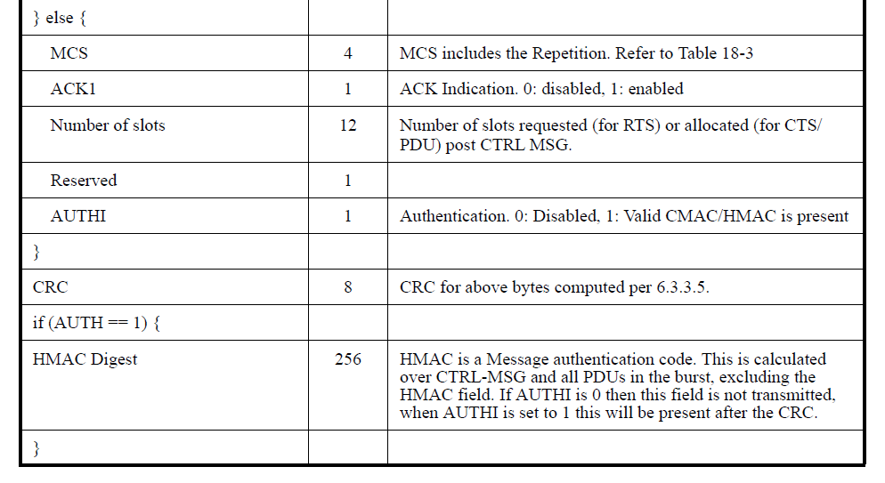
DPP anti-replay solution
IEEE 15-23-0595-00-016t
Add nonce field to CTRL message (PDU type)
Nonce = truncate (previous HMAC, 8)
Receiving SS saves last N truncated HMACs
Receiving SS looks for the new nonce in its list.
If in the list, accept and remove nonce from list.
Else, reject (a replay)
Nonce 8

