Slide 1
Project: IEEE P802.15 Working Group for Wireless Personal Area Networks (WPANs)
Submission Title: [TG15.6ma Closing Report for November 2023]
Date Submitted: [15th November 2023]
Source: [Ryuji Kohno1,2,] [1;Yokohama National University, 2;YRP International Alliance Institute(YRP-IAI)]
Address [1; 79-5 Tokiwadai, Hodogaya-ku, Yokohama, 240-8501 Japan
2; YRP1 Blg., 3-4 HikarinoOka, Yokosuka-City, Kanagawa, 239-0847 Japan]
Voice:[1; +81-90-5408-0611], FAX: [+81-45-383-5528],
Email:[1: kohno@ynu.ac.jp, 2: kohno@yrp-iai.jp] Re: []
Abstract: [This document contains closing report for TG15.6ma for Revision of P802.15.6-2012 with Enhanced Dependability November 2023.]
Purpose: [information]
Notice: This document has been prepared to assist the IEEE P802.15. It is offered as a basis for discussion and is not binding on the contributing individual(s) or organization(s). The material in this document is subject to change in form and content after further study. The contributor(s) reserve(s) the right to add, amend or withdraw material contained herein.
Release: The contributor acknowledges and accepts that this contribution becomes the property of IEEE and may be made publicly available by P802.15.

Slide 2
IEEE 802.15 TG6ma
(Revision of IEEE802.15.6-2012)
Closing Report
In Personal and Virtual Hybrid Interim Session
Honolulu, Hawaii, USA
November 15th, 2023
Ryuji Kohno
Yokohama National University(YNU),
YRP International Alliance Institute(YRP-IAI)

Slide 3
Objectives of TG 6ma – Enhanced Dependability Body Area Network (ED-BAN)
Objective: Enhancements to the BAN Ultra Wideband (UWB) physical layer (PHY) and media access control (MAC) to support enhanced dependability to a human BAN (HBAN) and adds support for vehicle body area networks (VBAN), a coordinator in a vehicle with devices around the vehicular cabin.
Action:
•Update draft#1.9 of Draft Proposals for Pre-Ballot
•Comment resolution for draft#1.9
•Performance Evaluation of Technologies in PHY; Channel Coding According to 8 QoS Levels of Packets and Coexistence Levels, Interference Mitigation, etc.
•Performance Evaluation of Technologies in MAC; Channel Management, CCA, Hybrid Contention Free/Access Protocol According to 8 QoSs and Coexistences.
•Harmonization or Commonality with 4ab in Coexistence and Feasible Implementation of 6ma and 4ab
Feasibility of TSN of 802.1 in MAC → Joint IEEE802.1&15 PAR&CSD for TSN
Next Things to Do：
Finalize draft#1 for Letter Ballot

Slide 4
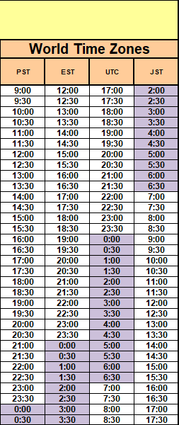
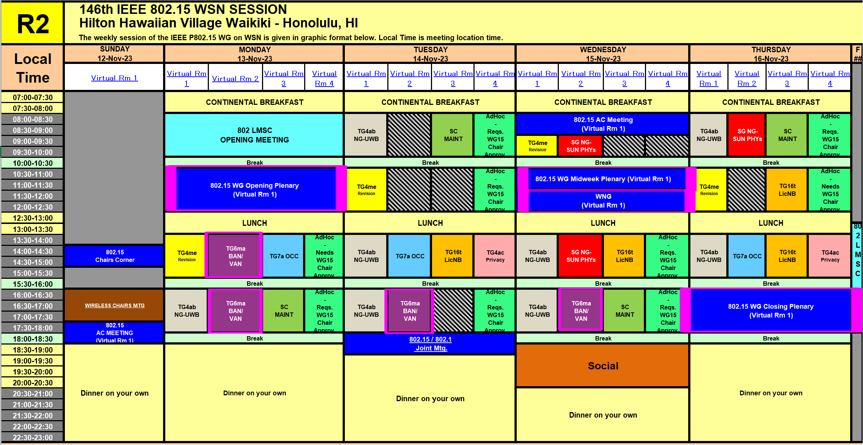
TG15.6ma Interim Session Schedule for 13-16th, Nov. 2023
doc.:IEEE802.15.23-0469-01-06ma
TG15.6ma has three own sessions such as
Session1(Virtual RM#2) PM1 13:30-15:30 Nov.13(MON) in Honolulu time, 8:30 - 10:30 Nov.14(TUE) in JST/KST
Session2(Virtual RM#2) PM2 16:00-18:00 Nov.13(MON) in Honolulu time, 11:00-13:00 Nov.14(TUE) in JST/KST
Session3(Virtual RM#2) PM2 16:00-18:00 Nov.13(MON) in Honolulu time, 11:00-13:00 Nov.14(TUE) in JST/KST
Session4(Virtual RM#2) PM2 16:00-18:00 Nov.13(MON) in Honolulu time, 11:00-13:00 Nov.14(TUE) in JST/KST

Slide 5
TG15.6ma Interim Session Schedule for 13-16th, Nov. 2023
doc.:IEEE802.15.23-0469-01-06ma
TG15.6ma has three own sessions such as
Session1(Virtual RM#2) PM1 13:30-15:30 Nov.13(MON) in Honolulu time, 8:30 - 10:30 Nov.14(TUE) in JST/KST
Session2(Virtual RM#2) PM2 16:00-18:00 Nov.13(MON) in Honolulu time, 11:00-13:00 Nov.14(TUE) in JST/KST
Session3(Virtual RM#2) PM2 16:00-18:00 Nov.13(MON) in Honolulu time, 11:00-13:00 Nov.14(TUE) in JST/KST
Session4(Virtual RM#2) PM2 16:00-18:00 Nov.13(MON) in Honolulu time, 11:00-13:00 Nov.14(TUE) in JST/KST
Virtual RM#2
Meeting link: https://ieeesa.webex.com/ieeesa/j.php?MTID=mca39b1aeaf9ee5b85bb81cd3fcf994b1
Meeting number: 2340 662 2743
Password: 80215novmtgrm2

Slide 6
Agenda items for the week
TG15.6ma meeting call to order
Call for essential patents and policies & procedures reminder
Approve last meeting minutes: TG 15.6ma Meeting Minutes for September 2023 doc.#15-23-0513-00-06ma
Agenda of TG15.6ma November Meeting doc.#15-23-0555-03-06ma
Review and Summary
  Basic Consensus in MAC and PHY of Revision of IEEE802.15.6-2012(IEEE802.15.6ma) doc.#15-23-0557-00-06ma
  2. Progress and Action Items for Draft#1 doc.#15-23-0360-02-06ma
  Draft pre-ballot comment resolution doc.#15-23-0476-05-06ma
  Rescheduling Timeline doc.#15-23-0361-02-06ma
  Comment Resolution Database for Pre-Ballot-WG doc.#15-23-0476-10-06ma
  Presentation
  MAC features for operating coexisting multiple dependable BANs doc.#15-23-0558-00-06ma
  Overview and convergence of MAC proposals for 15.6ma doc.#15-23-0408-02-06ma
  Progress and Action Items for Draft#1 (Draft#1.9) doc.#15-23-0360-02-06ma
  Hybrid ARQ Scheme for High QoS Packets in High Class of Coexistence of IEEE 802.15.6ma 0474-01-06ma
  Evaluation of IEEE 802.15.6 Ultra-wideband Physical Layer Utilizing Super Orthogonal Convolutional Code 0562-05
  Simulation results for Nagoya I. T. and YRP-IAI MAC proposal Based on TG6ma Channel Model -0352-01-06ma
  UWB Positioning in 15.6ma for Multiple BAN Adjacent Scenarios doc.#15-23-0560-00-06ma
  Preliminary performance evaluation of ranging in coexistence environment doc.#15-23-0353-04-06ma
  Performance Evaluation of Channel Coding under Various Channel Models in Some
  Classes of Coexistence in TG6ma doc.#15-23-0577-00-06ma
  10. TG6ma Channel Model Document for Enhanced Dependability doc.#15-22-0519-01-06ma
  11.Comments to channel-model-document doc.#15-23-0605-00-06ma
  12.Interference Mitigation Schemes in Class 3, 5, 6, and 7 of Coexisitence in TG6ma doc.#15-22-0571-01-06ma
  13. Proposed text for 6ma MAC General Framework Elements & Beacon Access Phase doc.#15-23-0367-02-06ma
  14. MAC Protocol Proposal for Multiple BAN Environment (Level 1,2,3) doc.#15-23-0639-03-06ma
  15. Proposal of MAC Revision for for IEEE802.15.6ma in Class 1 of Coexistence of Multiple BANs 23-0593-00-06ma
  16. Overview and convergence of MAC proposals for 15.6ma doc.#15-23-0408-02-06ma
  17. Progress Report of TG6ma doc.#15-23-0056-05-06ma
  18. Timeline of TG6ma doc.#15.23-0407-02-06ma
  19. TG15.6ma Closing Report for November 2023 doc.#15-23-0594-00-06ma
  20. TG15.6ma Meeting Minutes for November 2023 doc.#15-23-0608-00-06ma
Joint work between 802.1 and 802.15
1. PAR-par-review-sc-meeting-agenda-and-comment-slides-november-2023-plenary-Honolulu doc.:802.11-23-1690r1

Slide 7
15.6ma PHY and MAC New Features
Since IEEE802.15.6-2012 has too many modes in PHY and MAC, 15.6ma chooses a few modes to simplify specification of PHY and MAC while introduces new error-controlling schemes of FEC and HARQ, and management and data channels for enhanced dependability in various channel models and 8 classes of coexistence models for 8 levels of QoS priority order packets such as
  PHY
    Various channel coding and decoding matched with QoS priority levels of packets and coexistence classes
    Interference mitigation schemes according to various environment of coexistence classes
  MAC
    Two channels using two UWB band channels are applied for management channel to control frames of coexisting networks and data transmission channel. Its alternative mode is two channels for management and data transmission using a single UWB band channel.
    Coordinator-to-coordinator(C2C) negotiation of existing networks
  Cross Layer of PHY and MAC
    Hybrid ARQ for higher priority pf packets in high class of coexistence

Slide 8
QoS Levels of Packets corresponding to User Priority
In Std.15.6 WBAN systems, a various data such as vital signs, skin temperature, blood pressure, ECG, EEG, ECoG, and vehicle controlling commons have different QoS levels corresponding to user priority.
In 15.6ma for dependable WBAN for human and vehicles, data packet transmission should be dependable according to QoS levels even in various classes of coexistence environment.
Therefore, appropriate sets of error controlling scheme with FEC and hybrid ARQ corresponding to QoS levels have been standardized in 15.6ma,
User priority | Traffic designation | Frame type
0 | Background (BK) | Data
1 | Best effort (BE) | Data
2 | Excellent effort (EE) | Data
3 | Video (VI) | Data
4 | Voice (VO) | Data
5 | Medical data or network control | Data or management
6 | High-priority medical data or network control | Data or management
7 | Emergency or medical implant event report | Data

Slide 9
Definition of Coexistence Environment Classes
Coexistence Class | Coexisting system(s) |  |  |  |  | Category
Level | 802.15.6ma | 802.15.6-2012 | Non-UWB (ex. Wi-Fi / Unlicensed / 3GPP) | 802.15 UWB (ex. 802.15.4) | Non-802.15 UWB (ex. ETSI SmartBAN) | Category
0 | - | - | - | - | - | Single BAN
1 (1a) | ✓ | - | - | - | - | Multiple 15.6 BANs
2 (1b) | ✓ | ✓ | - | - | -
3 | ✓ | - | ✓ | - | - | Non-UWB
4 (2a) | ✓ | - | - | ✓ | - | Multiple UWB systems
5 (2b) | ✓ | - | - | - | ✓
6 (2c) | ✓ | - | - | ✓ | ✓
7 | ✓ | ✓ | ✓ | ✓ | ✓ | Final Boss
The coexistence class has been redefied to 8 levels, which can be represented by 3 bits and would be suitable to include in PHY or MAC headers.

Slide 10
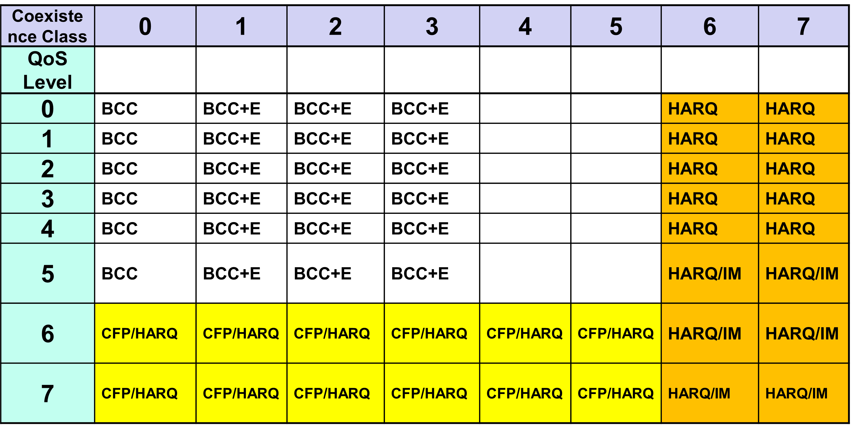
FEC/HARQ for 8 Coexistence Classes × 8 QoS Packet Levels
FEC codes and Hybrid ARQ have been designed for 8 × 8 = 64 combinations for QoS levels and Coexistence classes under various standard of channel models.

Slide 11
Common with IEEE802.15.4ab
Error-correcting codes corresponding to QoS levels
Channel Coding Table #1
User priority | Inner code | Outer code | HARQ
0 | 15.4ab LDPC code (R=1/2) |  | -
1 | 15.4ab LDPC code (R=1/2) |  | -
2 | 15.4ab LDPC code (R=1/2) |  | -
3 | 15.4ab LDPC code (R=1/2) |  | -
4 | 15.4ab LDPC code (R=1/2) | (54, 46) shortened RS code | -
5 | 15.4ab LDPC code (R=1/2) | (54, 38) shortened RS code | -
6 | 15.4ab LDPC code (R=1/2) | (54, 28) shortened RS code | -
7 | 15.4ab LDPC code (R=1/2) | (54, 14) shortened RS code | -
As an outer code, shortened Reed-Solomon (RS) codes with N=54 (original code length N=63) will be selected to correct burst errors due to interference from other WBANs and the coding rates are changed according to each QoS and channel condition
As an inner code, 15.4ab LDPC codes (K=324, 648, 972, R=1/2) will be selected for the coexistence of 15.6ma and 15.4ab
This updated concept table is considered as the first priority

Slide 12
TG 6ma Timeline
EC approval to SB, SB submission
May 2024
SB recirculation
June 2024
Tech Req Doc(TRD) July 2022
TRD,CMD
Call Proposals Sept 2022
Presentation of proposalsNov2022 Jan.2023
Harmonization of Proposals
Mar 2023
^{Std Draft V0}
May 2023
Upload preliminary draft v1 on WG repository to revise for finalizing v1
July2023
WG pre-ballot
Sept 2023
Comments and resolution for pre-ballot.
Nov 2023
WG letter ballot (LB)
Jan. 2024
Revcom Approve
Sept 2024
^{Finalize Std Draft V1}
August 2023
SB recirculation if required
July 2024
RevcomSubmission
Aug. 2024
Notes: SASB/RevCom scheduled for 2024 a guess

Slide 13
Timeline details.
Topic | Deadline | Notes
Technical Requirements Document (TRD). Channel Model Document (CMD). Call for Proposals. | Sept. 2022 | TRD describes the technical requirements baseline for the evaluation of proposals. The CMD contains the channel models for different use cases targeted by the Std. Announcement of call for proposals.
Due day for proposals | March 10th, 2023 | Postponed from January 2023
Presentation of proposals | Nov. 2022, January, March, May 2023 | Start of discussions for harmonization of proposals.
Harmonization of Proposals | July 2023 | Agreements on key technologies.
Std Draft v.1.7 | September 2023 | Mostly editorial revisions and start integrating text of agreed proposals.
Preliminary Std Draft v. 1.9 | November 2023 | Upload preliminary draft V1 in WG private repository and collecting comments to be used for revision.
Std Draft v. 2.0 | January 2024 | TG approval
WG pre-ballot | January 2024 | WG pre-ballot submission.
Comments and resolution for pre-ballot. | January 2024 | Finish resolutions to pre-ballot comments and recirculation.
WG letter ballot (LB) | March 2024 | LB submission
LB recirculation | March 2024 | Comment-resolutions to LB recirculation
Conditional approval for Sponsor Ballot (SB) | March 2024 | Seek conditional approval
Final LB recirculation. EC approval | May 2024 | Just before the March meeting.
EC approval to SB | May 2024
SB submission | June 2024
SB recirculation | July 2024 | Resolutions to SB.
Conditional/unconditional approval to RevCom | July 2024 | Submission to SASB agenda
SB recirculation if required | August 2024
RevCom submission | September 2024 | RevCom approval
Note: the deadlines are subject to change.

Slide 14
Contributions
・TG15.6ma opening report for Novenber 2023 meeting 15-23-0556-01-06ma
・TG15.6ma Agenda of November Meeting in 2023 15-23-0555-02-06ma
・Progress and Action Items for Draft#1 15-23-0360-01-06ma
・Draft pre-ballot comment resolution 15-23-0476-10-06ma
・Rescheduling Timeline 15-23-0361-02-06ma
・Basic Consensus in MAC and PHY of Revision of IEEE802.15.6-2012 15-23-0557-00-06ma
・MAC features for operating coexisting multiple dependable BANs 15-23-0558-00-06ma
・Overview and convergence of MAC proposals for 15.6ma 15-23-0408-02-06ma
・Simulation results for Nagoya I. T. and YRP-IAI MAC proposal 15-23-0242-03-06ma
・Hybrid ARQ Scheme for High QoS Packets in High Class of Coexistence of IEEE 802.15.6ma 0474-01-06ma
・Evaluation of IEEE 802.15.6 Ultra-wideband Physical Layer Utilizing Super Orthogonal Convolutional Code
15-22-0562-05-06ma
・UWB Positioning in 15.6ma for Multiple BAN Adjacent Scenarios 15-23-0560-00-06ma
・Preliminary performance evaluation of ranging in coexistence environment 15-23-0353-04-06ma
・Performance Evaluation of Channel Coding under Various Channel Models in Some
Classes of Coexistence in TG6ma 15-23-0577-00-06ma
・TG6ma Channel Model Document for Enhanced Dependability 15-22-0519-01-06ma
・Comments to channel-model-document 15-23-0605-00-06ma
・Interference Mitigation Schemes in Class 3, 5, 6, and 7 of Coexisitence in TG6ma 15-22-0571-01-06ma
・Proposed text for 6ma MAC General Framework Elements & Beacon Access Phase 15-23-0367-02-06ma
・MAC Protocol Proposal for Multiple BAN Environment (Level 1,2,3) 15-23-0639-03-06ma
・Preliminary Performance Evaluation of Channel Coding in TG6ma 15-23-0521-01-06ma
・Progress Report of TG6ma 15-23-0056-05-06ma
・Timeline of TG6ma 15.23-0407-02-06ma
・TG15.6ma closing report for November 2023 meeting 15-23-0594-00-06ma
・TG15.6ma November 2023 meeting minutes 15-23-0608-00-06ma

Slide 15
Contacts and Conference call
November 2023
Chair; Ryuji Kohno, YNU/YRP-IAI
kohno@ynu.ac.jp, kohno@yrp-iai.jp
1st Vice-Chair; Marco Hernandez, YRP-IAI/CWC
marco.hernandez@ieee.org
2nd Vice-Chair; Daisuke Anzai, NIT
anzai@nitech.ac.jp
3. Secretary; Takumi Kobayashi, YNU/TCU
kobayashi-takumi@yrp-iai.jp, kobayashi@nitech.ac.jp
Technical Editors;
Minsoo Kim, YRP-IAI minsoo@minsookim.com
Seong-Soon Joo, KPST wowbk@kpst.co.kr
Kento Takabayashi, Toyo U. takabayashi.kento.xp@gmail.com
Marco Hernandez, YRP-IAI/CWC marco.hernandez@ie ee.org
Jussi Haapola, CWC jussi.haapola@oulu.fi

Slide 16
Thank You !
Any Questions ?

Slide 17
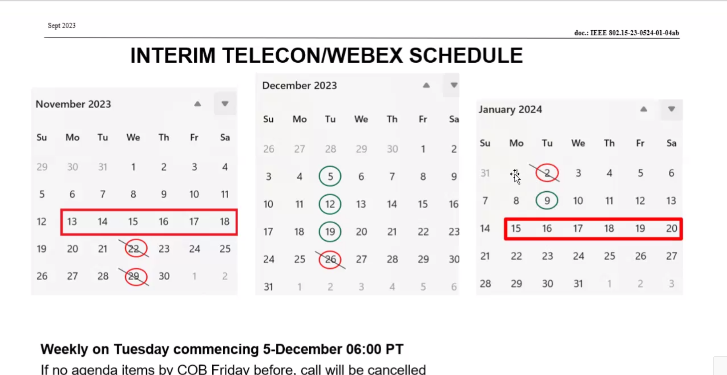
4ab Teleco schedule

