Slide 1
Project: IEEE P802.15 Working Group for Wireless Personal Area Networks (WPANs)
Submission Title: [Proposal of MAC Revision for for IEEE802.15.6ma in Class 1 of Coexistence of Multiple BANs]
Date Submitted: [15th November 2023]
Source: [Ryuji Kohno^{1,2}] [1;Yokohama National University(YNU), 2;YRP International Alliance Institute(YRP-IAI).]
Address [1; 79-5 Tokiwadai, Hodogaya-ku, Yokohama, 240-8501 Japan
2; YRP1 Blg., 3-4 HikarinoOka, Yokosuka-City, Kanagawa, 239-0847 Japan]
Voice:[1; +81-90-5408-0611], FAX: [+81-45-383-5528],
Email:[1: kohno@ynu.ac.jp, 2: kohno@yrp-iai.jp] Re: []
Abstract: [This document contains proposal of MAC revision for comment ersolution in Class 1 of coexistence of multiple new BANs.]
Purpose: [information]
Notice: This document has been prepared to assist the IEEE P802.15. It is offered as a basis for discussion and is not binding on the contributing individual(s) or organization(s). The material in this document is subject to change in form and content after further study. The contributor(s) reserve(s) the right to add, amend or withdraw material contained herein.
Release: The contributor acknowledges and accepts that this contribution becomes the property of IEEE and may be made publicly available by P802.15.

Slide 2
Proposal of MAC Revision for for IEEE802.15.6ma in Class 1 of Coexistence of Multiple BANs
November 15th, 2023
Ryuji Kohno
Yokohama National University(YNU),
YRP International Alliance Institute(YRP-IAI)

Slide 3
Motivation and Purpose
doc.:IEEE802.15.23-0469-01-06ma
In a current draft#1.9 of IEEE802.15.6ma, for class 1 of coexistene of multiple new BANs, it seems that a group coordinator or coordinator hub transmits only information of starting point of access phase of CAP and CFP to other coordinators of coexisting BANs in a group or a leaf hub. Individual leaf hubs control their own access phase of CAP and CFP by individual B-Beacons independently.
In order to perform enhanced dependabiity, a group coordinator or coordinator hub should manage or control all access phases of other coordinators or leaf coordinators in the same group in class 1 of coexistence.

Slide 4
Proposal of D-Beacon Modification in Class 1 of Coexstence of Multiple 15.6ma BANs
A scheme of a group coordimato's or coordinator hub's controlling all access phase of CFP and CAP of all other coordinators or leaf hubs in the same group of coexisting BANs in class 1 by adding some information in D-Beacon.
Since CAP is a period in which contention must be assumed, any temporal overlap of CAPs in both a group coordinator and other coordinators in the same group of coexisting BANs may be no probem. However, when packet traffic increases according to increase of nodes, PER(Packet Error Ratio) must increase. So, an extra scheme to assign CAP into other periods such as non access period(NAP) may be better,
In order to perform enhanced dependability, a group coordinator or coordinator hub should control all CAPs of the same group of coexisting BANs be assigned within the same time slot or into other new periods such as NAP.
The following figure A shows a our proposal of revised Access Offse.

Slide 5
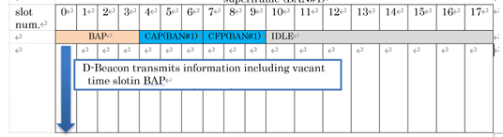
Proposal of D-Beacon Modification in Class 1 of Coexstence of Multiple 15.6ma BANs
b0 | b11 | b0 | b11 | b0 | b11 | b0 | b11
CAP start offset |  | CAP length |  | CFP start offset |  | CFP length
※Assumed that maximum superframe length =4096slots
Figure A
1)Detect D-Beacon of BAN#1 by group coordinator or coordinator hub of BAN#2
FIgure B

Slide 6
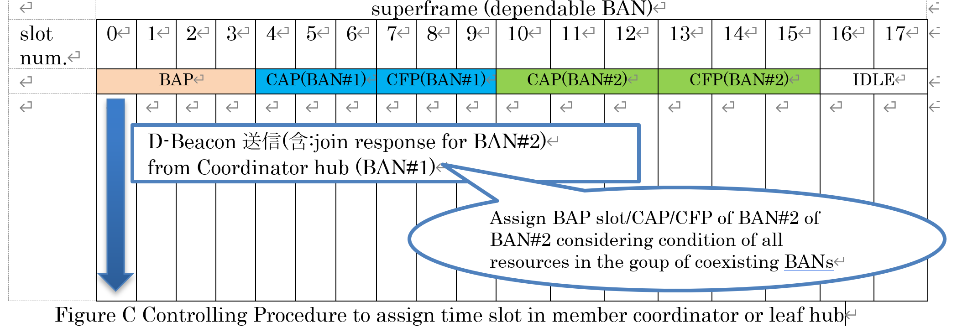
Proposal of D-Beacon Modification in Class 1 of Coexstence of Multiple 15.6ma BANs
2) In case that coordinator of BAN#2 transmits request to join in a group of coexisting BANs as a leaf hub which is not a group coordinator

Slide 7
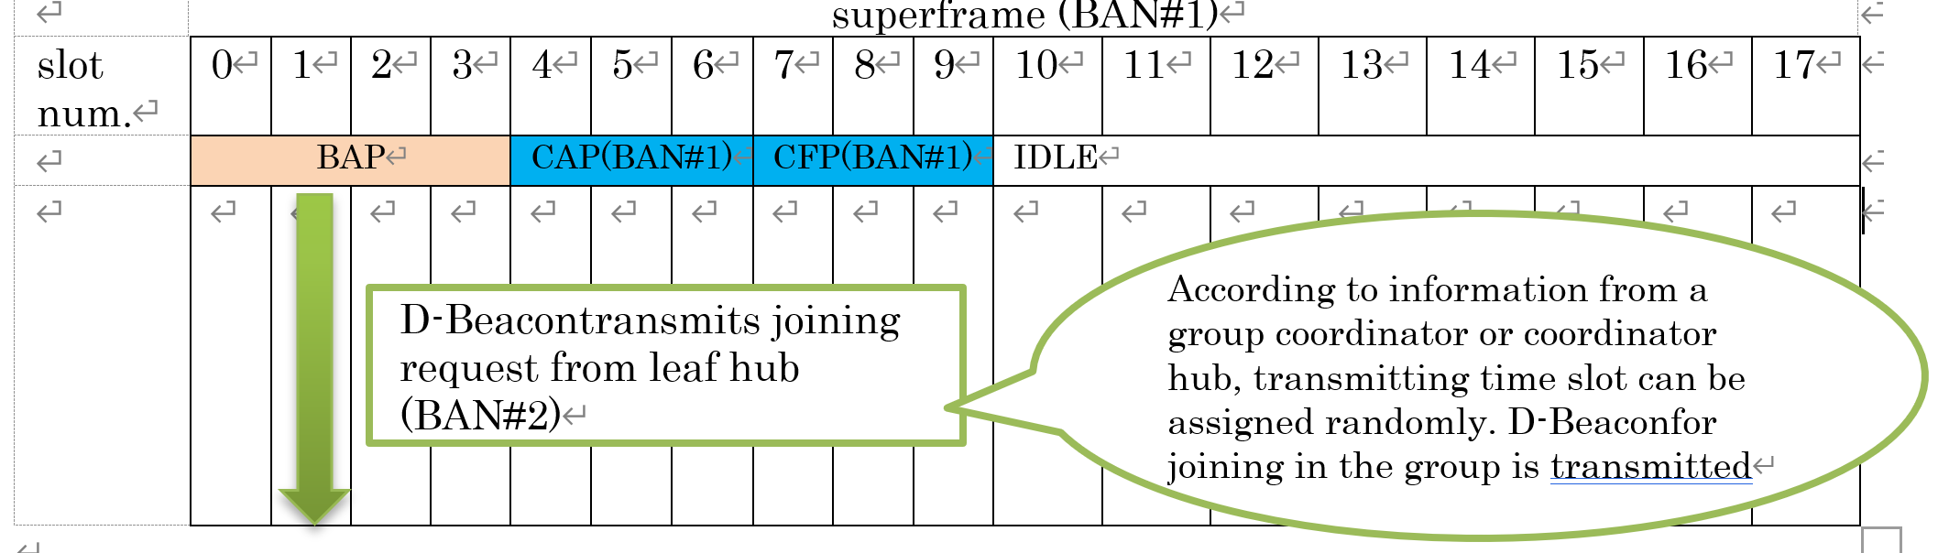
Proposal of D-Beacon Modification in Class 1 of Coexstence of Multiple 15.6ma BANs
3 ) Group coordinator or coordinator hub of BAN#1 accepts a request of coordinator of BAN#2 asamember coordinator or leaf hub

Slide 8
Proposal of Group Coordinator or Coordinator Hub in Class 1 of Coexstence of Multiple 15.6ma BANs
The current draft describes only using Access Request of D-Beacon but no detail to join in a group of coexisting BANs in Class 1 of coexistence.
In order to improve dependability of data transmission and ranging in Class 1 of coexistence, it is important to determine assignment of resourcce or number of slots according to the number of nodes or maximum number of high QoS packets in all coexisting BANs.

Slide 9
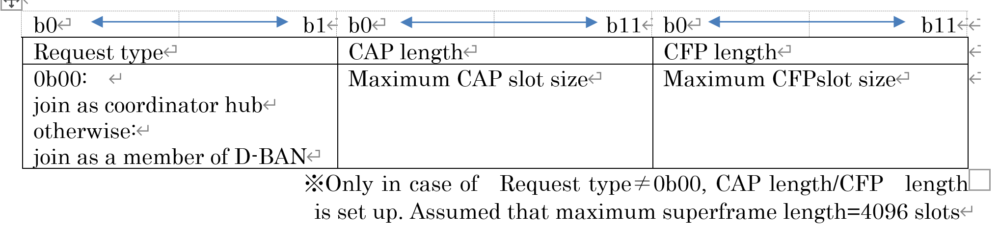
Proposal of Group Coordinator or Coordinator Hub in Class 1 of Coexstence of Multiple 15.6ma BANs
We propose all coordinators in a group of coexisting BANs in Class 1 should broadcast the number of covering nodes or maximum number of high QoS packets when a BAN comes to join in a group of coexisting BANs as shown in figure D.
Figure D Image of Revised Access Reques

Slide 10
Proposal of Group Coordinator or Coordinator Hub in Class 1 of Coexstence of Multiple 15.6ma BANs
In transition of incoming and outgoing BANs in a group of coexiting BANs, structure of superframes may be changed. The meanwhile, temporally packet loss may increase. So, before coordinators transmit information of joinining in a group or leaving from a group to a group coordinator or coordimnator hub, member coordinator or leaf hub should transmit request for all nodestemporally to stop packet transmission in order to resuce packet loss. Instead of individual request to stop packet transmission, it is more efficient to add information for stop packet transmission into D-Beacon.
We propose that a scheme of extending D-Beacon Subtype field and a new Resource suspend indicator field in order to stop all packet transmission from all nodes. in efficient.
Moreover, each node which is stopped packet transmission
in Resource suspend indicator field should transmit Connection Request management frame when member coordinators or leaf hubs will transmit Superframe Adjust field.

Slide 11
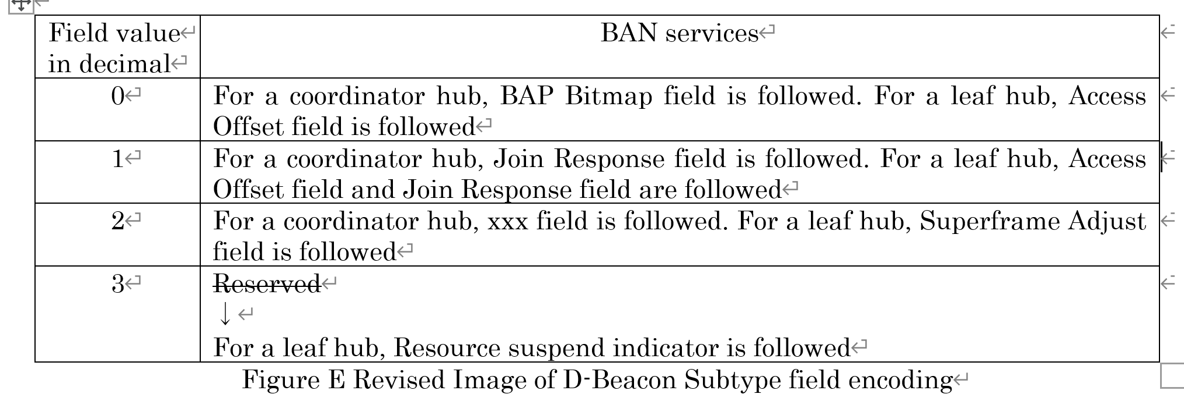
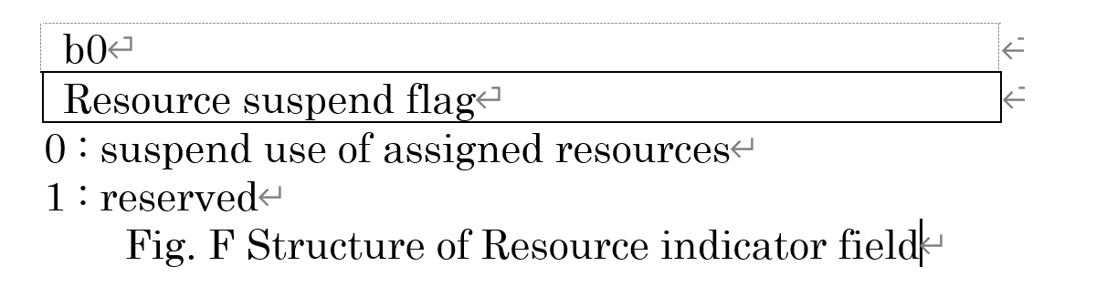
Proposal of Group Coordinator or Coordinator Hub in Class 1 of Coexstence of Multiple 15.6ma BANs

Slide 12
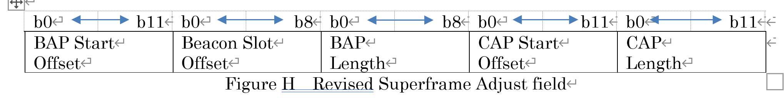
Proposal of Group Coordinator or Coordinator Hub in Class 1 of Coexstence of Multiple 15.6ma BANs
In the current draft, when a new BAN joins in a group of coexisting BANs and a new superframe is synchronized, each member coordinator or leaf hub transmits Superframe Adjust field to all nodes. The Superframe Adjust field in the current draft as shown in Figure G. Beacon Slot Offset and BAP Length in each BAN are defined.
However, since starting points of BAP is not always the same in each BAN, it seems difficult to coexist together. We propose to revise Superframe Adjust field as shown in Figure H in order to synchronize all BANs. During BAP Start Offset, number of slots for offset between current D-Beacon location and a new BAP can be determined.

Slide 13
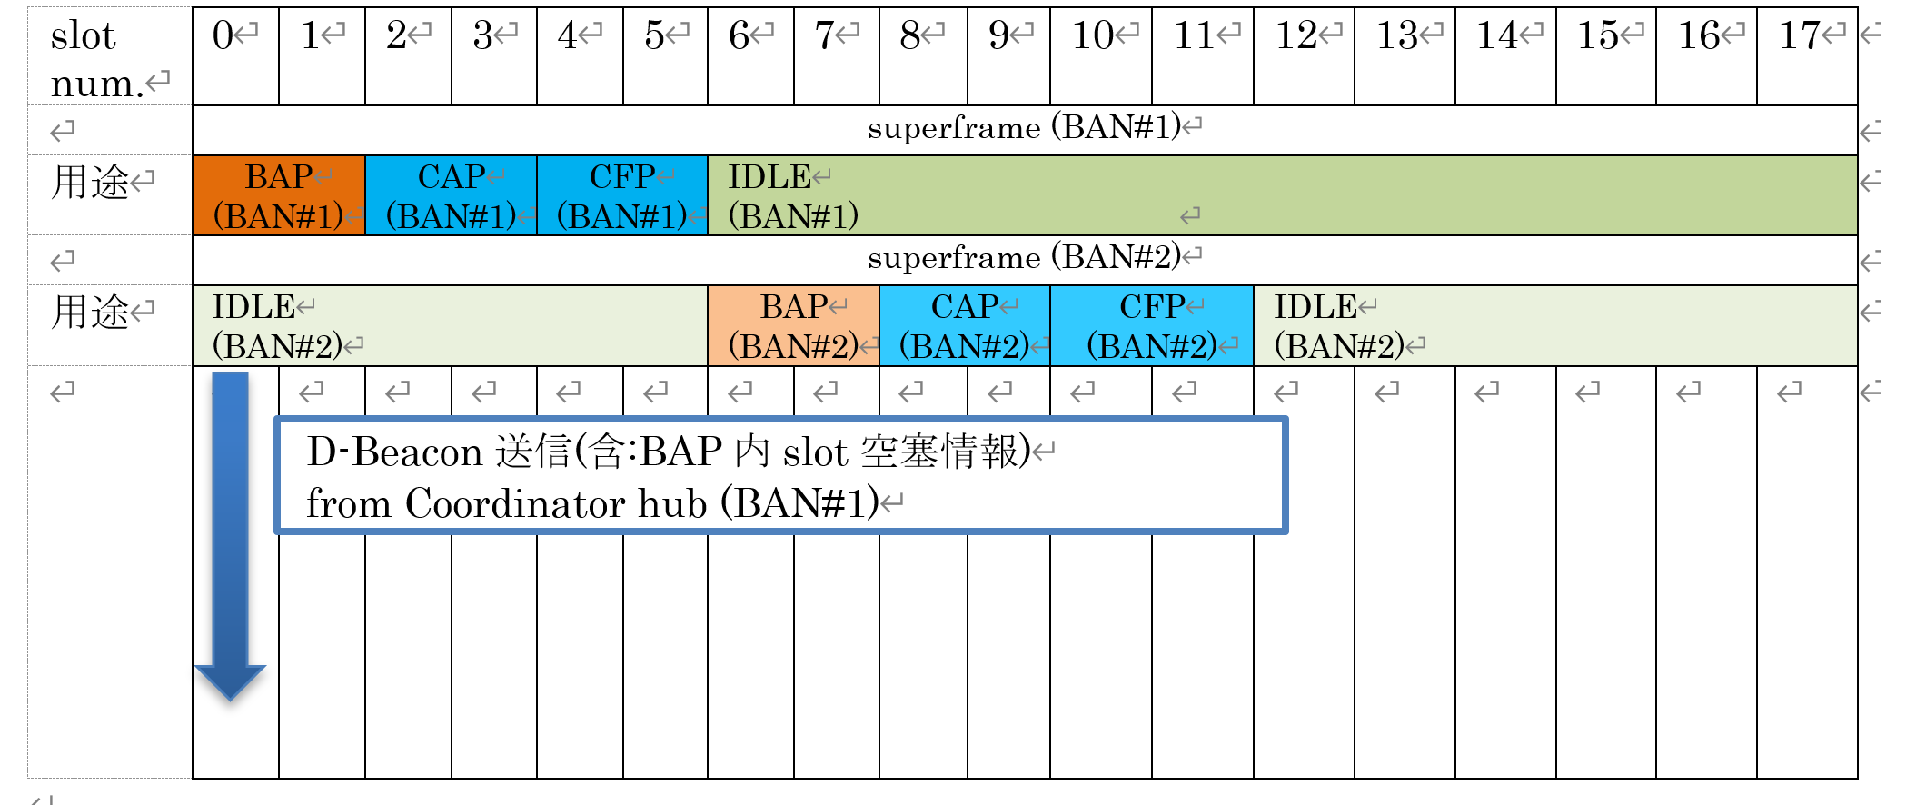
Proposal of Group Coordinator or Coordinator Hub in Class 1 of Coexstence of Multiple 15.6ma BANs
1) Group coordinato or coordinator hub of BAN#2 detects D-Beacon of BAN#1

Slide 14
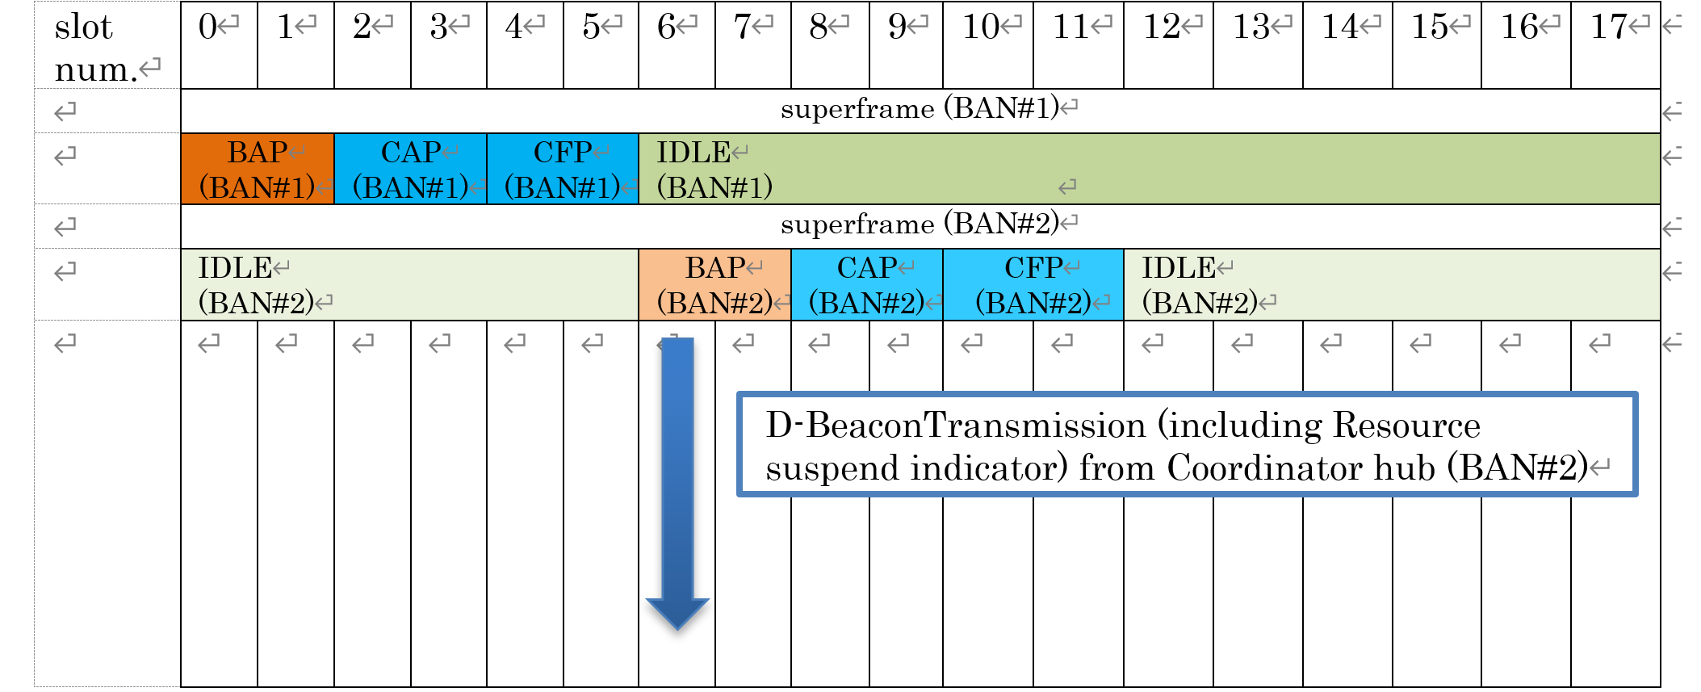
Proposal of Group Coordinator or Coordinator Hub in Class 1 of Coexstence of Multiple 15.6ma BANs
2) Notice of Temporal Stopping Packets form all Nodes in Group Coordinator or Coordinator Hub of BAN#2

Slide 15
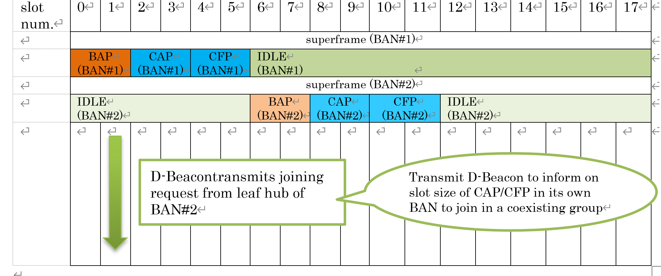
Proposal of Group Coordinator or Coordinator Hub in Class 1 of Coexstence of Multiple 15.6ma BANs
3) Coordinator of BAN#2 Broadcasts Information to Group Coordinator or Coordinator Hub to Join in a Group

Slide 16
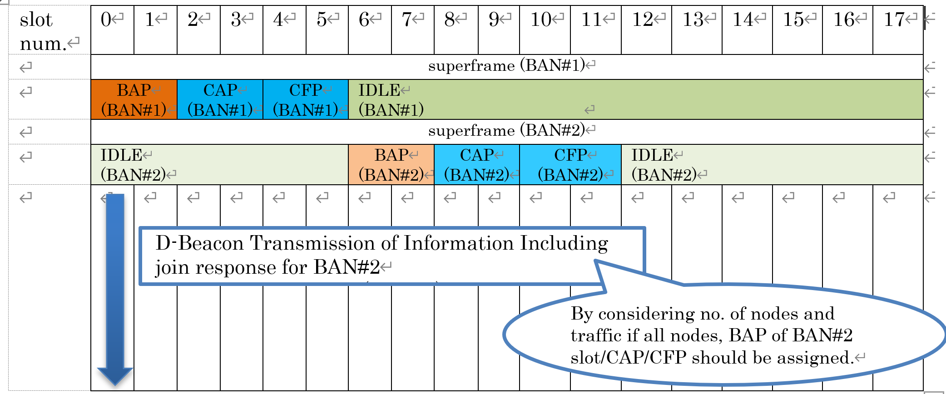
Proposal of Group Coordinator or Coordinator Hub in Class 1 of Coexstence of Multiple 15.6ma BANs
4) Group Coordinator or Coordinator Hub of BAN#1 Accepts a Request to Join in a Group of Coexisting BANs

Slide 17
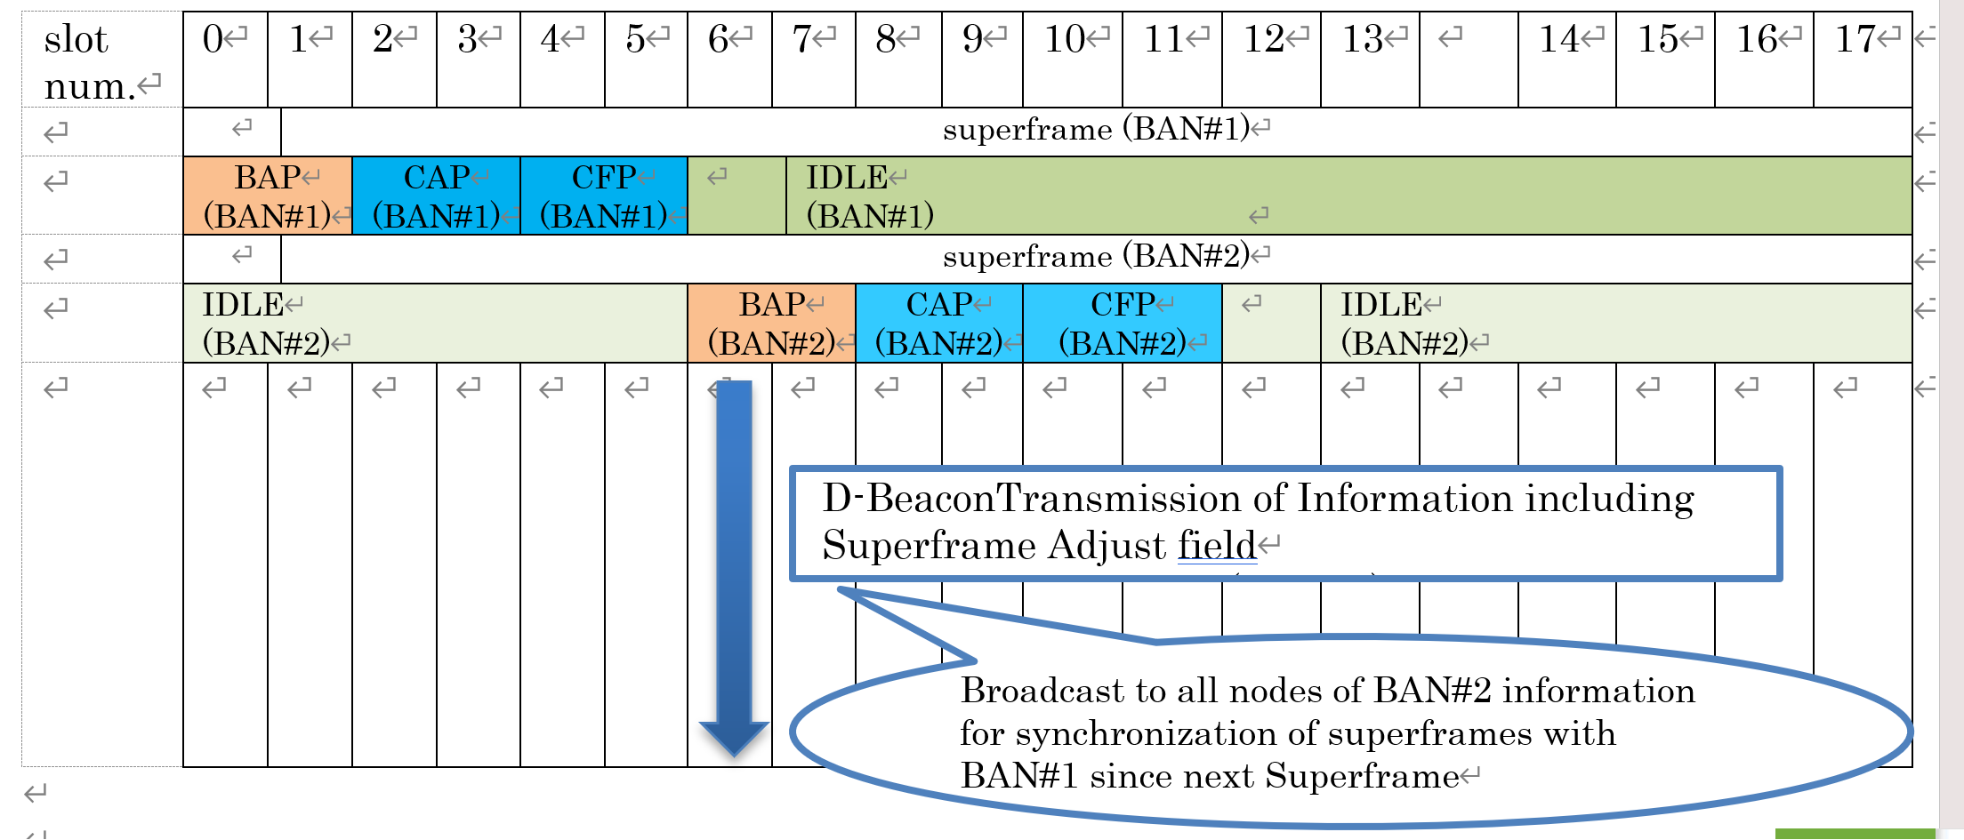
Proposal of Group Coordinator or Coordinator Hub in Class 1 of Coexstence of Multiple 15.6ma BANs
5) Coordinator of BAN#2 Broadcasts Change of Superframe to all Nodes

Slide 18
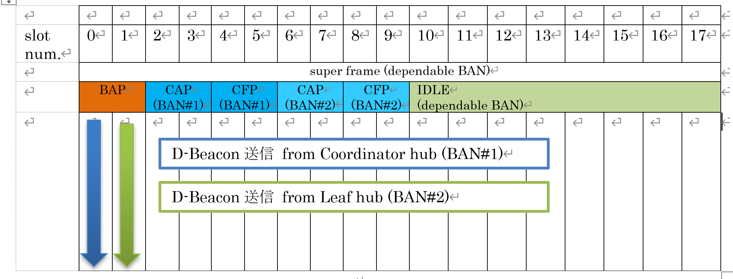
Proposal of Group Coordinator or Coordinator Hub in Class 1 of Coexstence of Multiple 15.6ma BANs
6) All Coordinators in a group of coexisting BANs collaborate by C2C

Slide 19
This slides explain comments for draft#1.9
Thank you for your attention

