Slide 1
Project: IEEE P802.15 Working Group for Wireless Personal Area Networks (WPANs)
Submission Title: A Potential application for the Next Generation SUN PHYs
Date Submitted: November 14, 2023
Source: Sangsunng Choi (KMU), Tae-Joon Park, Jaesun Cha, Kyeseon Lee (ETRI)
Re: SG Next Generation SUN PHYs
Abstract: This contribution describes a potential application for Next Generation SUN PHYs.
Purpose: Discussion
Notice: This document has been prepared to assist the IEEE P802.15. It is offered as a basis for discussion and is not binding on the contributing individual(s) or organization(s). The material in this document is subject to change in form and content after further study. The contributor(s) reserve(s) the right to add, amend or withdraw material contained herein.
Release: The contributor acknowledges and accepts that this contribution becomes the property of IEEE and may be made publicly available by P802.15.
Notes:
Jul 12, 2010
Page 1

Slide 2
Industrial Applications(I)
Industrial communications area with increasing requirements
  Condition monitoring (CM)
    State monitoring by monitoring a large number of different sensors
    Synchronization for consistent time base for all signals form the sensors is more important than the real-time aspect.
    ZigBee, Bluetooth
  Process automation (PA)
    Continuous production processes for large quantities of a certain product
    For quality assurance, high data rates must be allowed to recode and/or transmit very large amounts of data
    WirelessHART, WSAN
  Factory automation (FA)
    Discrete manufacturing processes for machining, assembling, testing, packing, etc
    Closed loop feedback systems for each distinct stpes are automated and controlled by a variable number of sensors and actuators
    Very short and fast movements have to be controlled in a limited spatial extent
    No standardized wireless technologies yet

Slide 3
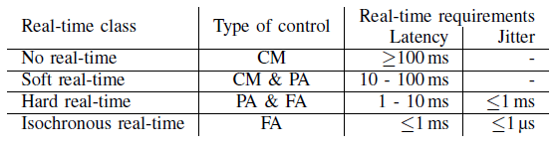
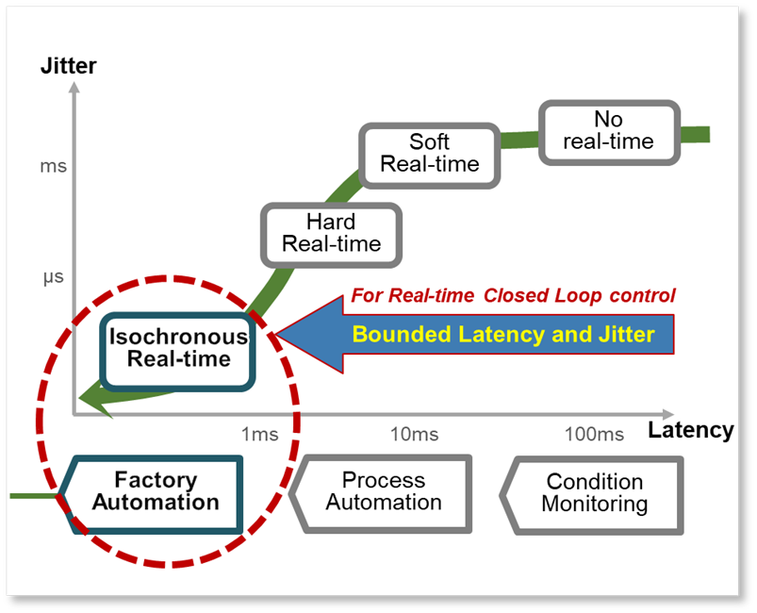
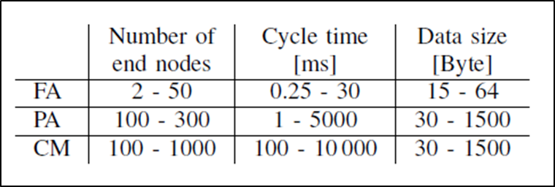
Industrial Applications(II)
Requirements for industrial applications
  Requirements of industrial real-time classes
  Requirements of industrial applications
    ※ Source: Steven Dietrich et al., “Performance Indicators and Use Case Analysis for Wireless Networks in Factory Automation“, IEEE ETFA 2017

Slide 4
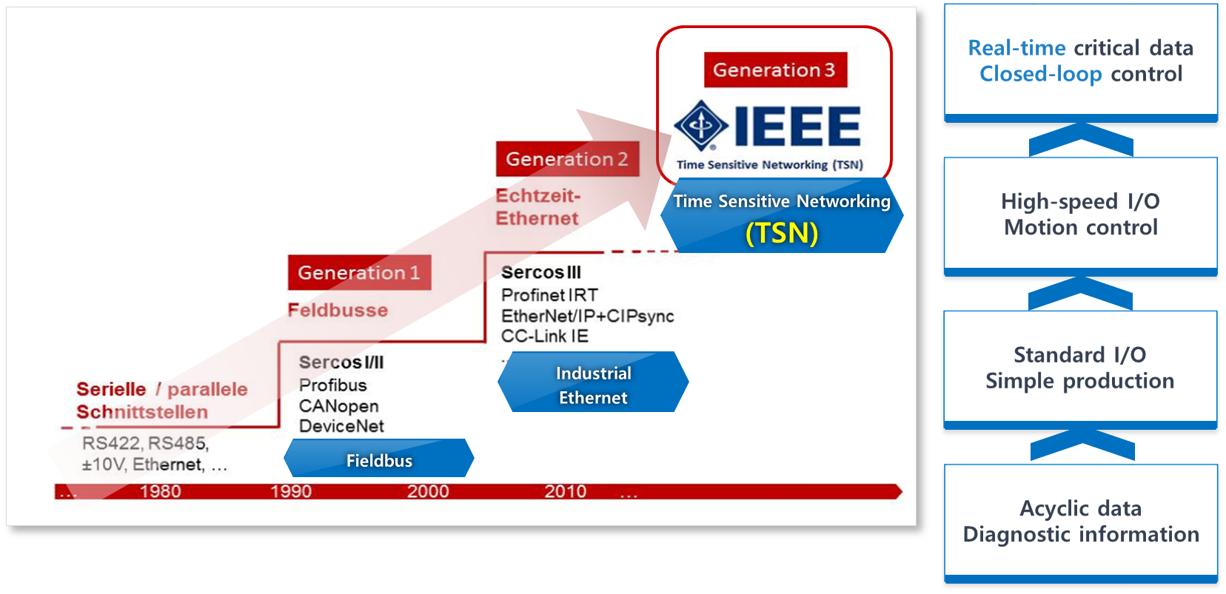
Standardization on Industrial Network(I)
Evolution of wired industrial network
  Isochronous real-time for closed-loop control is an essential requirements for industrial network
source: www.sercos.org

Slide 5
Standardization on Industrial Network(II)
Wireless industrial network for providing isochronous real-time service
  Not yet standardized
Latency(Variation)
ZigBee
IEEE802.15.4-2006
Condition
Monitoring
ISA100.11a
WirelessHART
IEEE802.15.4-2006
Wi-SUN
IEEE802.15.4g/e
Process
Automation
?
Factory
Automation
Reliability

Slide 6
Media Specific MAC/PHY Support for TSN
Application
Transport
IP
IEEE 802.1 TSN
Time sync, time-aware, reservations, …
L2 TSN protocols for reservation, scheduling, … need MAC/PHY support
Link Layer
IEEE 802.3
Ethernet
Wireless TSN
IEEE 802.15.4
(Wi-SUN)
or IEEE 802.11
(WiFi)
5G TSN
3GPP URLLC
MAC/PHY
Media Specific Support required for TSN Capabilities
Source : Mikhail Galeev et al., Next-Generation Wi-Fi Networks for TimeCritical Applications, Intel, 2019.
Industrial Ethernet Book Issue 117 / 8, Wireless TSN use cases and standards challenges

Slide 7
Why is IEEE 802.15.4ad for w-TSN?
Wireless Specialty Networks(WSN) for Industrial IoT(w-TSN)
  Low rate, Short packet
    10’s, 100’s, … Devices
    ex) WiFi : High rate, Long packet, Sparse…
  Deterministic Latency(with15.4e)
    Isochronous Real Time for w-TSN
    ex) WiFi : No Latency control
The IEEE Std 802.15.4 is widely used in a variety of applications supporting Field Area Networks (FANs). Current users and product manufacturers have identified the need for longer range and additional data rates, both lower and higher than those currently defined, in order to expand the usefulness of the standard for applications such as Smart Metering, Smart cities and other industrial Internet of Things (IoT) markets. The PHY enhancements address the needs of emerging applications and a wider set of applications where additional data rates can expand the usefulness of the SUN PHYs.

Slide 8
Thank you for listening !
Comment/Discussion

