Slide 1
Project: IEEE P802.15 Working Group for Wireless Specialty Networks
Submission Title: Hybrid ARQ Scheme for High QoS Packets in High Class of Coexistence of IEEE 802.15.6ma
Date Submitted: 11 March 2025
Source: Kento Takabayashi¹, Daisuke Anzai², Ryuji Kohno^{3,4}
Company: (1) Toyo University (2) Nagoya Institute of Technology (3)Yokohama National University (4) YRP International Alliance Institute
Address: (1) 2100 Kujirai, Kawagoe, Saitama, Japan 351-8585, (3)79-5 Tokiwadai, Hodogaya-ku, Yokohama, 240-8501 Japan,
(4) YRP1 Blg., 3-4 Hikarinooka, Yokosuka-City, Kanagawa, 239-0847 Japan
Voice:[(1) +81-866-94-2104 , (3) +81-90-5408-0611] E-Mail:[takabayashi.kento.xp@gmail.com, kohno@ynu.ac.jp, kohno@yrp-iai.jp]
Re: In response to call for technical contributions
Abstract: The HARQ mechanism for IEEE 802.15.6ma is provided. IEEE 802.15.6ma will deal with various QoS level data. Hence, it is required to consider an error control scheme corresponding to these QoS. We introduce the HARQ for the highest coexistence environment class and the high QoS level data.
Purpose: Material for discussion in P802.15.6ma TG corresponding to comments in EC Meeting
Notice: This document has been prepared to assist the IEEE P802.15. It is offered as a basis for discussion and is not binding on the contributing individual(s) or organization(s). The material in this document is subject to change in form and content after further study. The contributor(s) reserve(s) the right to add, amend or withdraw material contained herein.
Release: The contributor acknowledges and accepts that this contribution becomes the property of IEEE and may be made publicly available by P802.15.

Slide 2
Hybrid ARQ Scheme for High QoS Packets in High Class of Coexistence of IEEE 802.15.6ma
March 2025,
Hybrid Session ,
Atlanta Hilton, Atlanta, US
Kento Takabayashi ⁽¹⁾, Daisuke Anzai⁽²⁾, Ryuji Kohno^{(3,4)}
(1) Toyo University (2) Nagoya Institute of Technology (3)Yokohama National University (4) YRP International Alliance Institute

Slide 3
Coexistence environment level
Coexistence environment class | Environment
0 | 6ma BAN only
1 [1a] | Multiple 6ma BANs 1a
2 [1b] | Multiple 15.6 & 6ma BANs
3 | Multiple 6ma BANs & non-UWB systems (Wi-Fi & Unlicensed 3GPP)
4 [2a] | Multiple 6ma BANs & 802.15 UWB systems
5 [2b] | Multiple 6ma BANs, non-802.15 UWB systems (ETSI UWB systems)
6 [2c] | Multiple 6ma BANs & 802.15 UWB & non-802.15 UWB systems (ETSI UWB)
7 | Multiple 6ma BANs & non-UWB systems (Wi-Fi & Unlicensed 3GPP) & 802.15 UWB & non-802.15 UWB systems (ETSI UWB)
  A hybrid ARQ (HARQ) shall be utilized at the highest class “7”
  15.6ma considers the half-rate BCC and LDPC as an error correcting code
    A HARQ scheme using those FEC is introduced

Slide 4
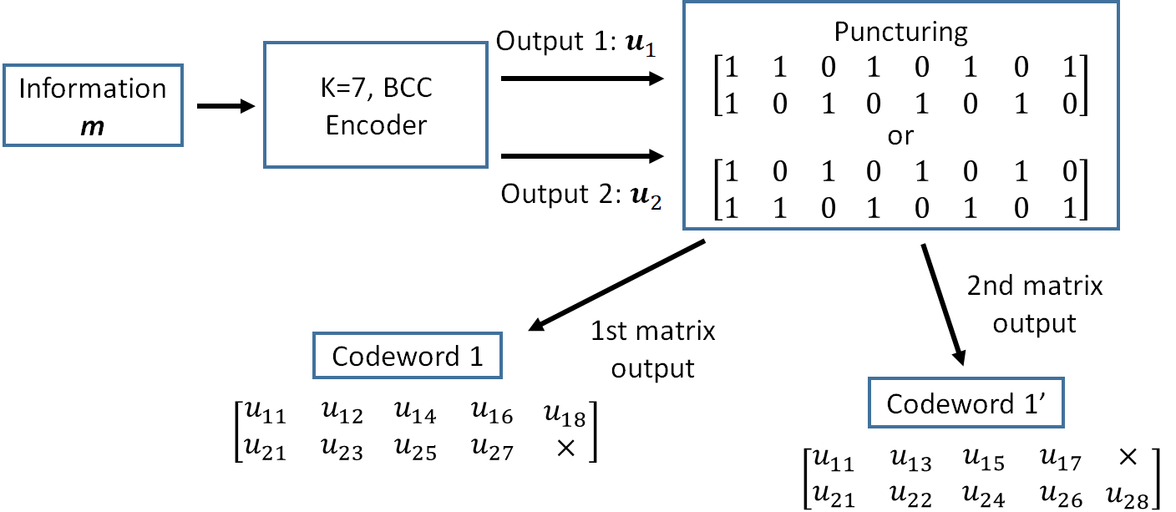
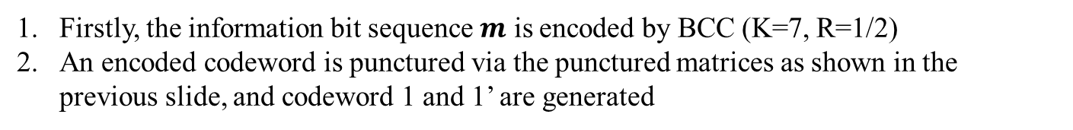
Hybrid ARQ mechanism (BCC case)
Firstly, the information bit sequence $m$ is encoded by BCC (K=7, R=1/2)
An encoded codeword is punctured via the punctured matrices as shown in the previous slide, and codeword 1 and 1’ are generated

Slide 5
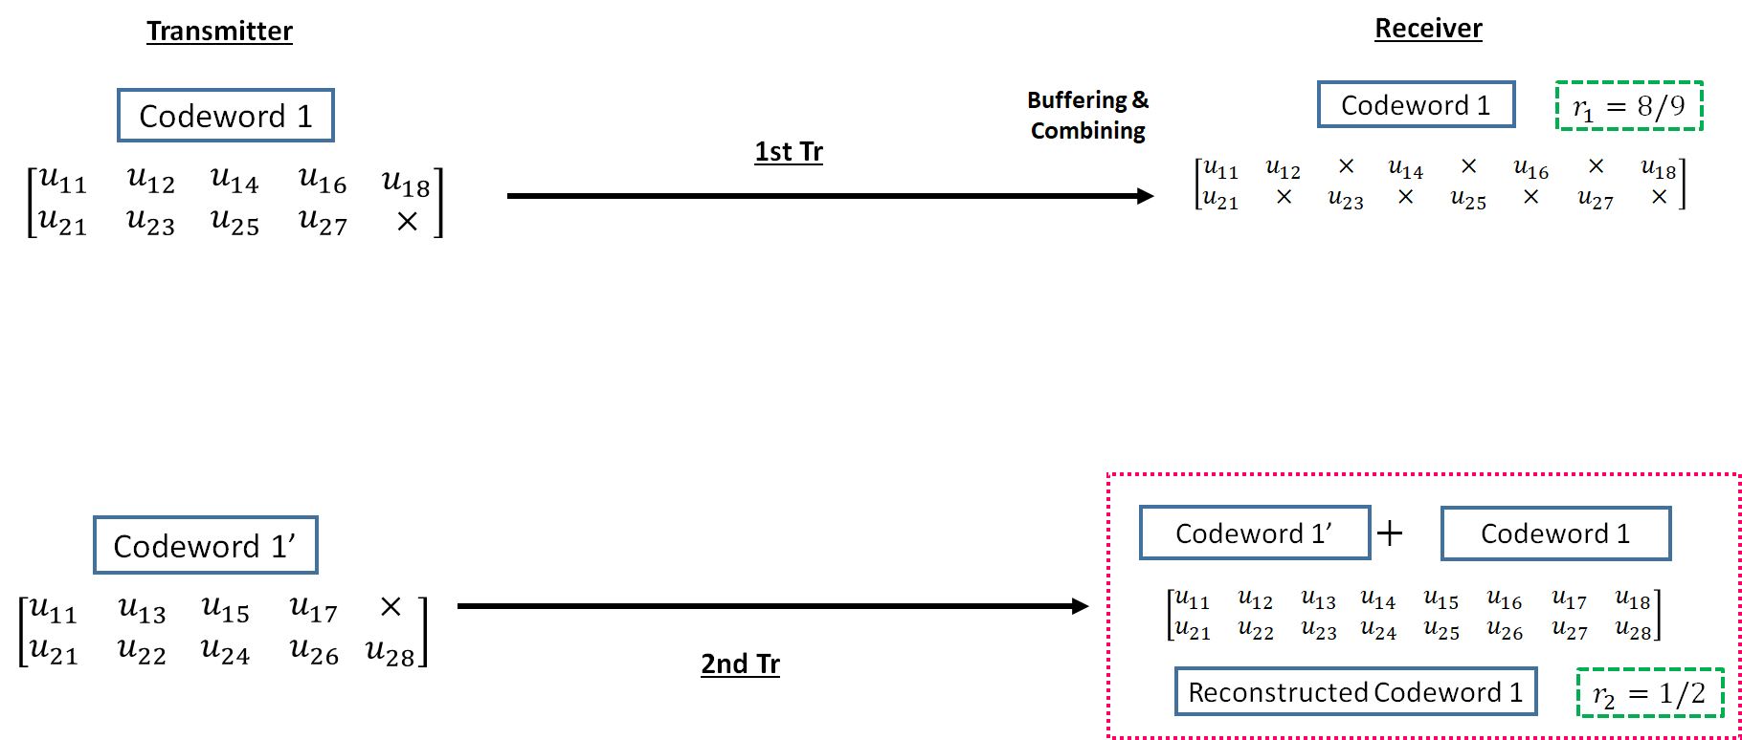
Hybrid ARQ mechanism (BCC case)
3. The codeword 1 is transmitted to a receiver
4. If bit errors are detected after decoding the codeword 1, a receiver buffers the transmitted codeword 1, and a transmitter re-sends the codeword 1’ to a receiver
5. At the receiver, transmitted codeword 1’ is combined with a buffered codeword 1, and a reconstructed codeword 1 (R=1/2) is generated

Slide 6
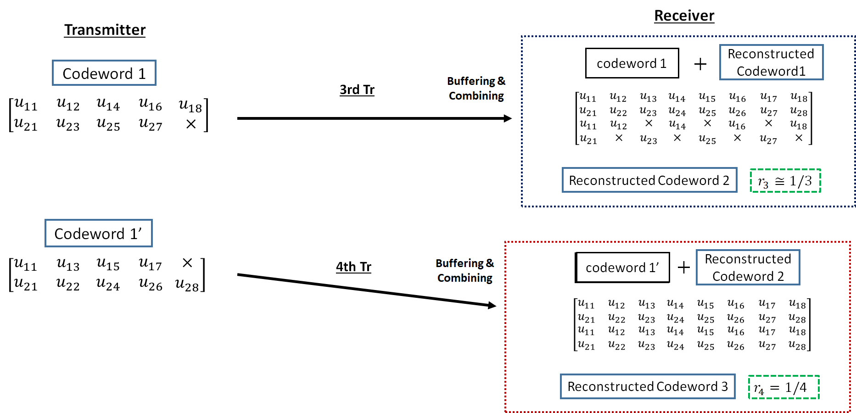
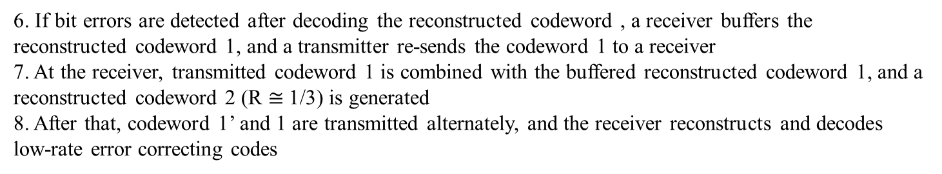
Hybrid ARQ mechanism (BCC case)
6. If bit errors are detected after decoding the reconstructed codeword , a receiver buffers the reconstructed codeword 1, and a transmitter re-sends the codeword 1 to a receiver
7. At the receiver, transmitted codeword 1 is combined with the buffered reconstructed codeword 1, and a reconstructed codeword 2 (R $≅$1/3) is generated
8. After that, codeword 1’ and 1 are transmitted alternately, and the receiver reconstructs and decodes low-rate error correcting codes

Slide 7
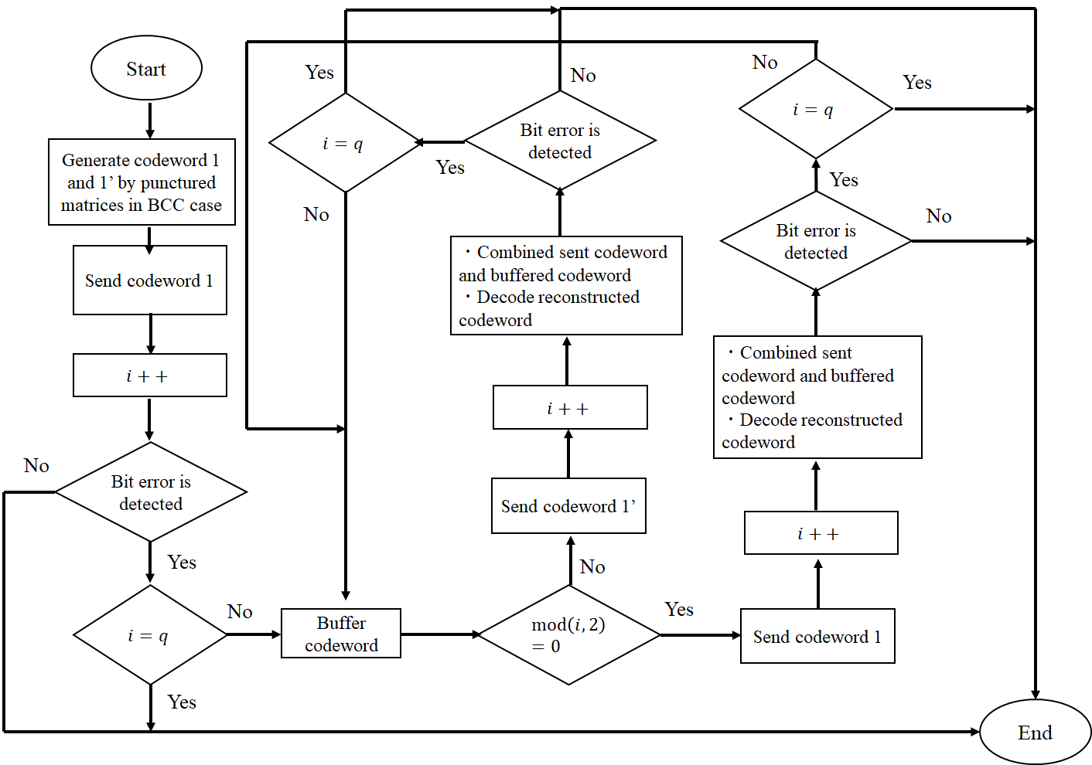
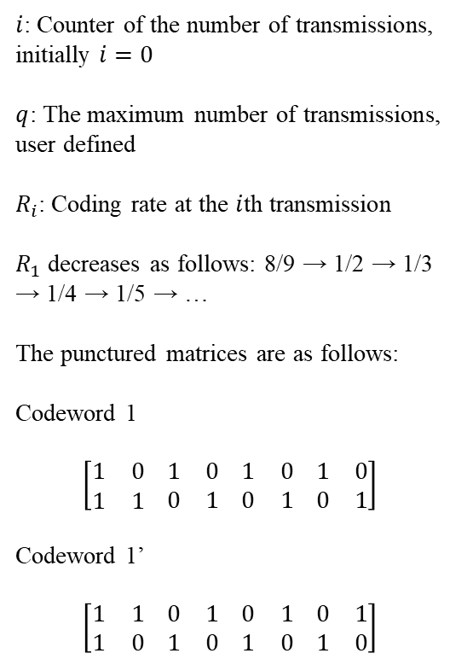
Hybrid ARQ mechanism (BCC case)
$i$: Counter of the number of transmissions, initially $i=0$
$q$: The maximum number of transmissions, user defined
$R_{i}$: Coding rate at the $i$th transmission
$R_{1}$ decreases as follows: 8/9 → 1/2 → 1/3 → 1/4 → 1/5 → …
The punctured matrices are as follows:
Codeword 1
$$\left[\begin{matrix}1 & 0 \\ 1 & 1\end{matrix} \begin{matrix}1 & 0 \\ 0 & 1\end{matrix} \begin{matrix}1 & 0 \\ 0 & 1\end{matrix} \begin{matrix}1 & 0 \\ 0 & 1\end{matrix}\right]$$
Codeword 1’
$$\left[\begin{matrix}1 & 1 \\ 1 & 0\end{matrix} \begin{matrix}0 & 1 \\ 1 & 0\end{matrix} \begin{matrix}0 & 1 \\ 1 & 0\end{matrix} \begin{matrix}0 & 1 \\ 1 & 0\end{matrix}\right]$$

Slide 8
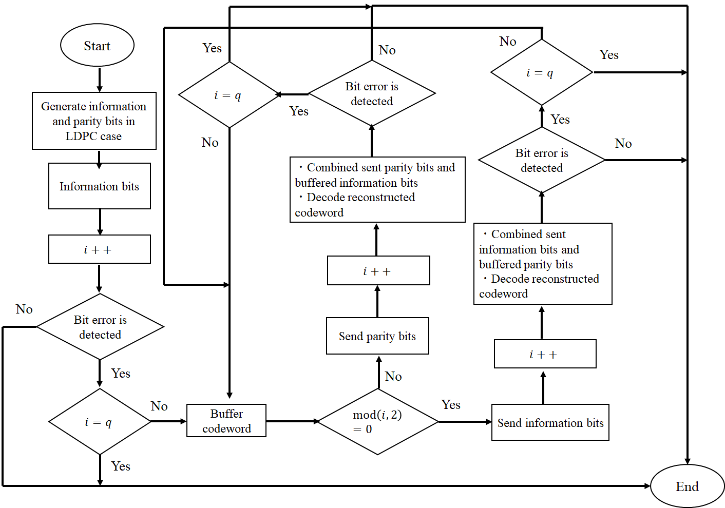
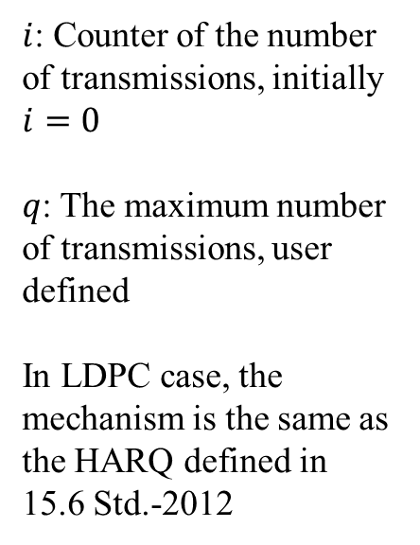
Hybrid ARQ mechanism (LDPC case)
$i$: Counter of the number of transmissions, initially $i=0$
$q$: The maximum number of transmissions, user defined
In LDPC case, the mechanism is the same as the HARQ defined in 15.6 Std.-2012

Slide 9
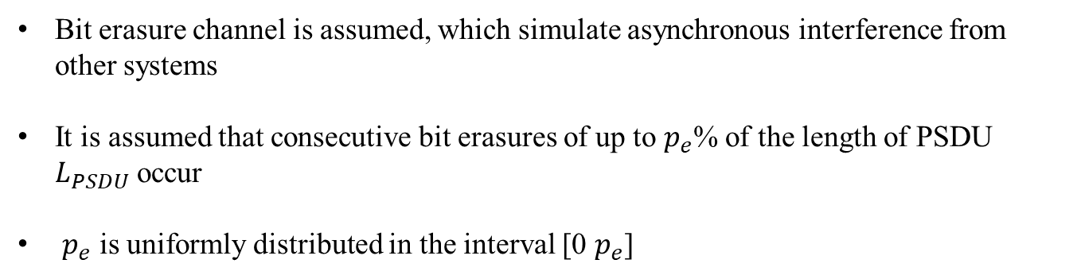
Bit erasure channel
0 1 1 0 0 1 0 0 1・・・0 1 1 1 ✕ ✕ ✕ ✕ ✕ ✕ ・・・0 1 1 0 0 0 1 1
Consecutive bit erasures
Bit erasure channel is assumed, which simulate asynchronous interference from other systems
It is assumed that consecutive bit erasures of up to $p_{e}$% of the length of PSDU $L_{PSDU}$ occur
$p_{e}$ is uniformly distributed in the interval [0 $p_{e}$]

Slide 10
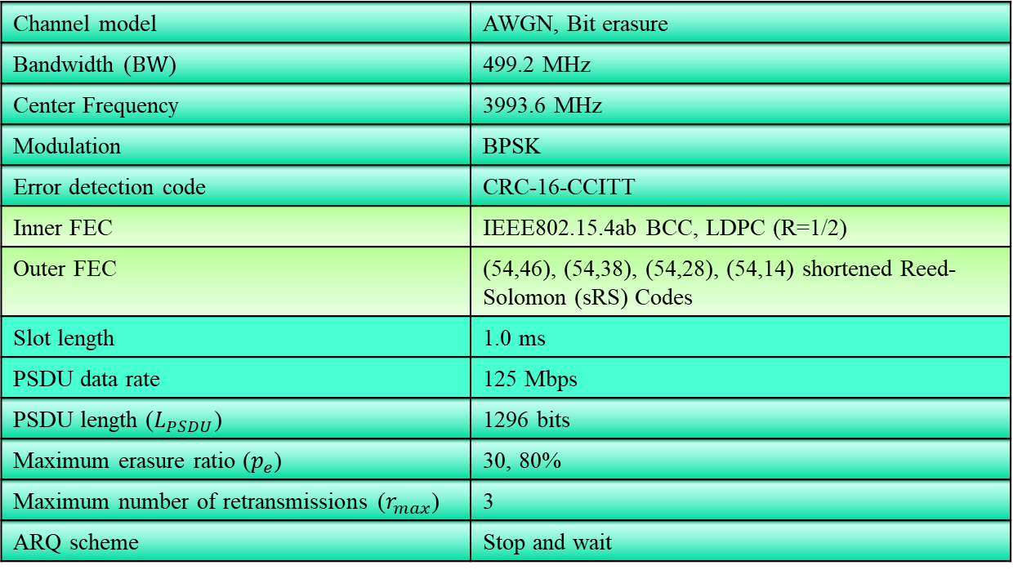
Evaluation
Channel model | AWGN, Bit erasure
Bandwidth ($BW$) | 499.2 MHz
Center Frequency | 3993.6 MHz
Modulation | BPSK
Error detection code | CRC-16-CCITT
Inner FEC | IEEE802.15.4ab BCC, LDPC (R=1/2)
Outer FEC | (54,46), (54,38), (54,28), (54,14) shortened Reed-Solomon (sRS) Codes
Slot length | 1.0 ms
PSDU data rate | 125 Mbps
PSDU length ($L_{PSDU}$) | 1296 bits
Maximum erasure ratio ($p_{e}$) | 30, 80%
Maximum number of retransmissions ($r_{max}$) | 3
ARQ scheme | Stop and wait
This presentation evaluated several metrices under strong interference condition

Slide 11
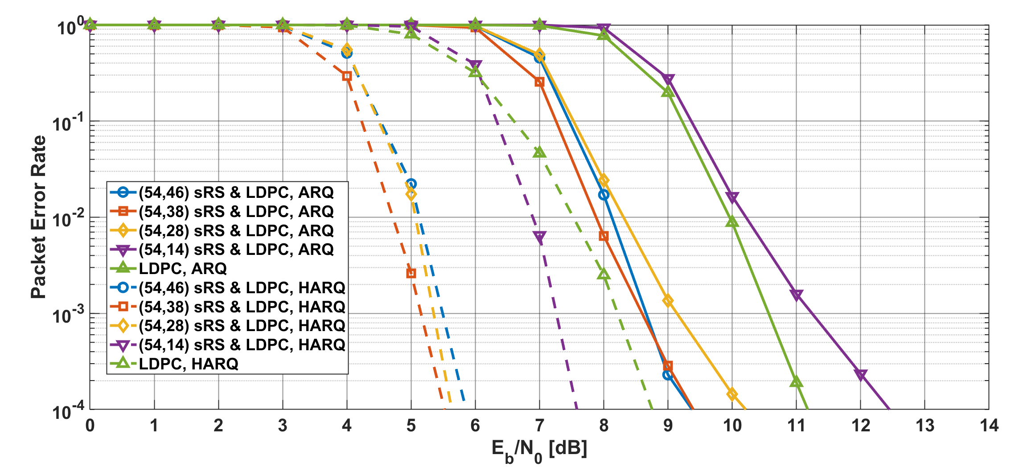
Results
Packet error ratio as a function of $E_{b}/N_{0}$ in the case of LDPC, $p_{e}=30$%
Notes:
Compared with ARQ and HARQ, the PER of HARQ has better improved.

Slide 12
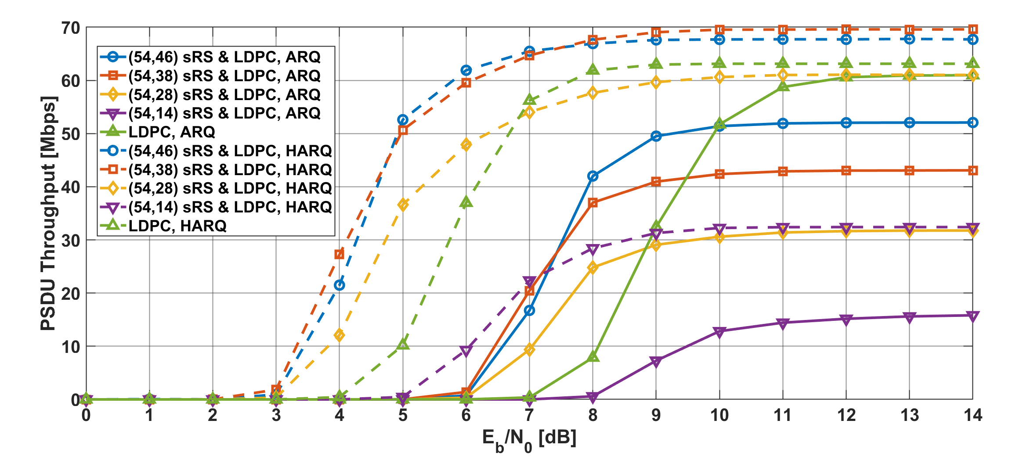
Results
PSDU Throughput as a function of $E_{b}/N_{0}$ in the case of LDPC, $p_{e}=30$%
Notes:
Additionally, the PSDU throughput of HARQ is about twice that of ARQ.

Slide 13
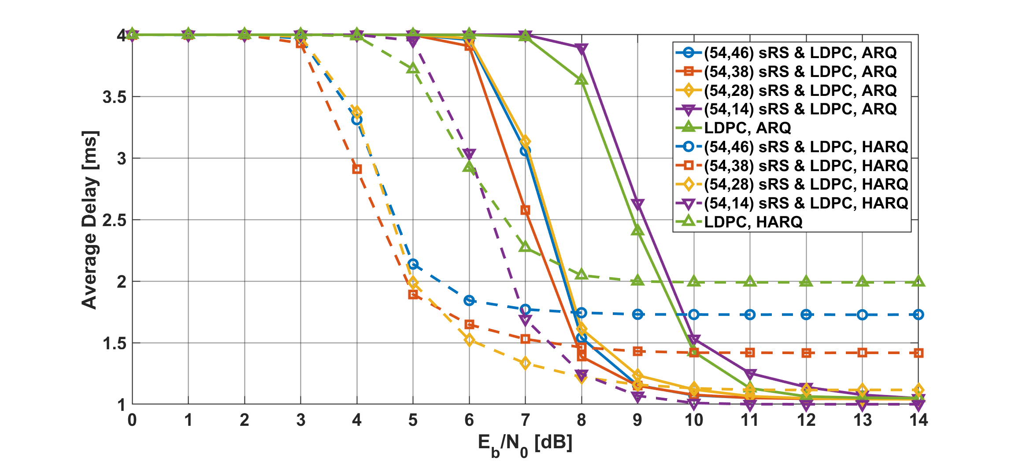
Results
Average delay as a function of $E_{b}/N_{0}$ in the case of LDPC, $p_{e}=30$%
Notes:
The average delay of HARQ has good performance even in low EbN0 regions.

Slide 14
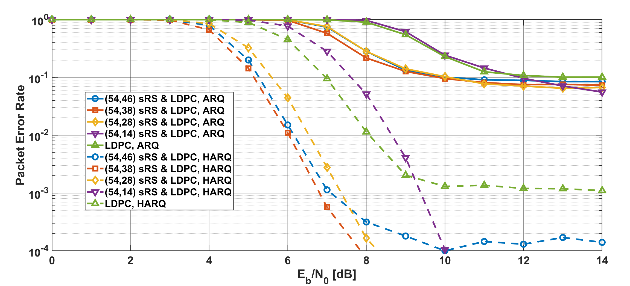
Results
Packet error ratio as a function of $E_{b}/N_{0}$ in the case of LDPC, $p_{e}=80$%
Notes:
In the strong interference case, compared with ARQ and HARQ, the HARQ has much better performance.

Slide 15
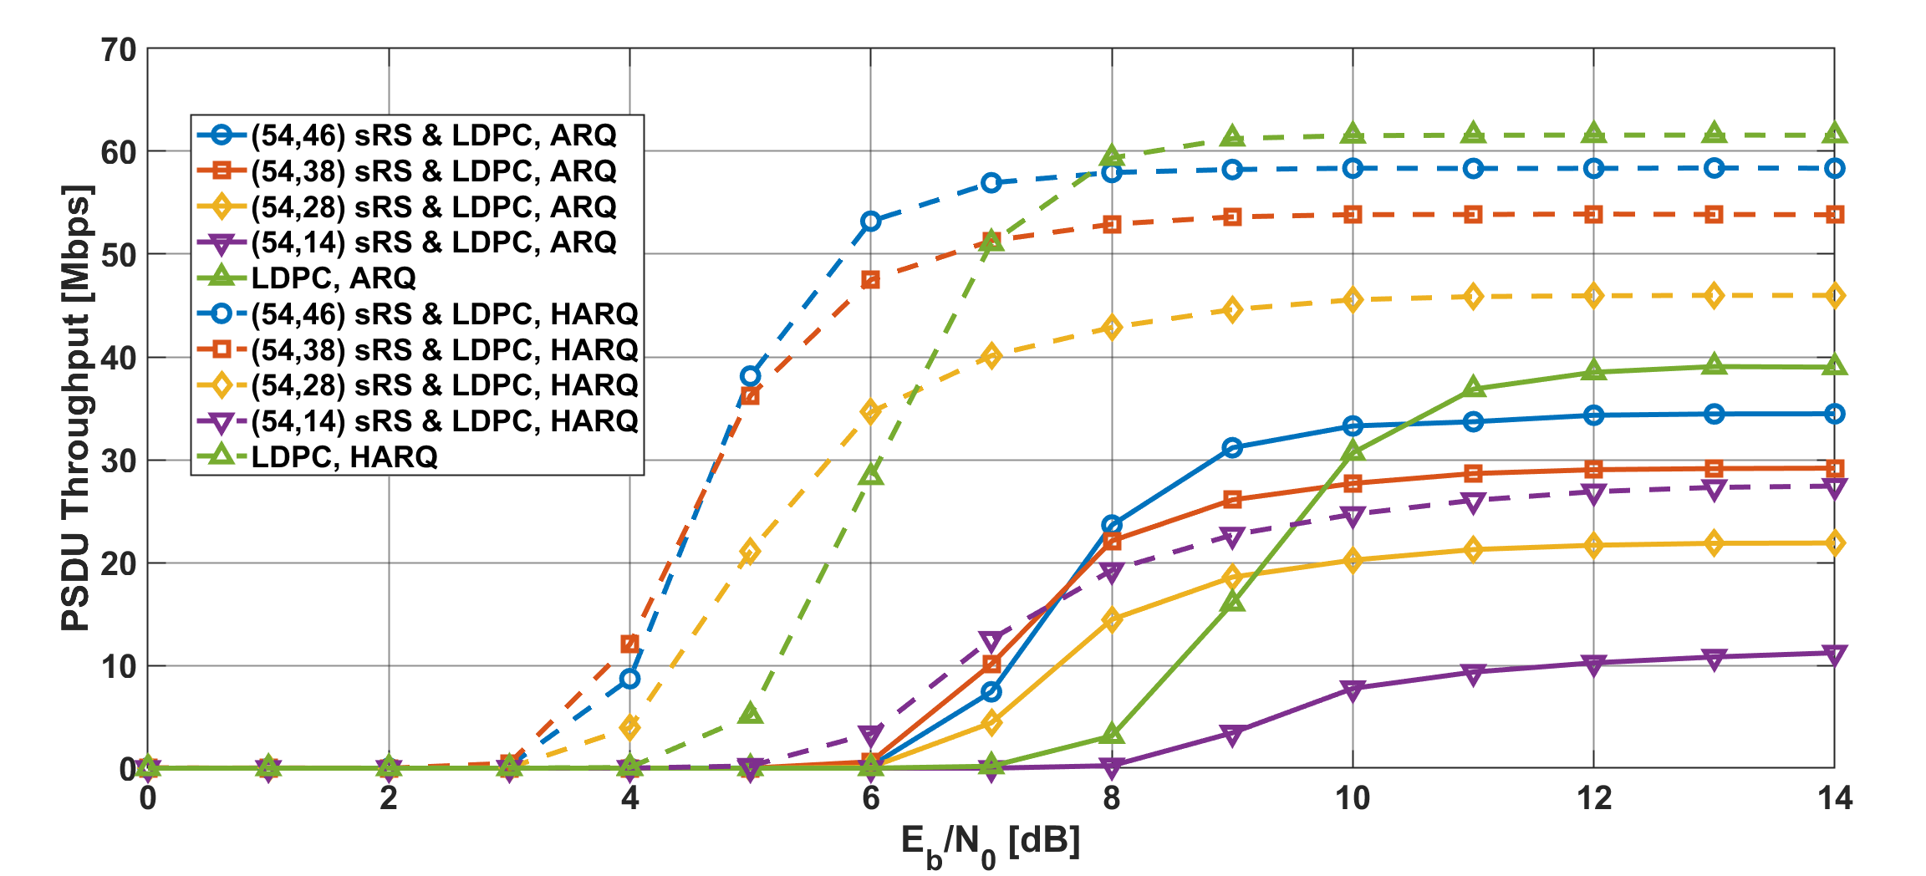
Results
PSDU Throughput as a function of $E_{b}/N_{0}$ in the case of LDPC, $p_{e}=80$%
Notes:
Additionally, the PSDU throughput of HARQ is also better that of ARQ in the case.

Slide 16
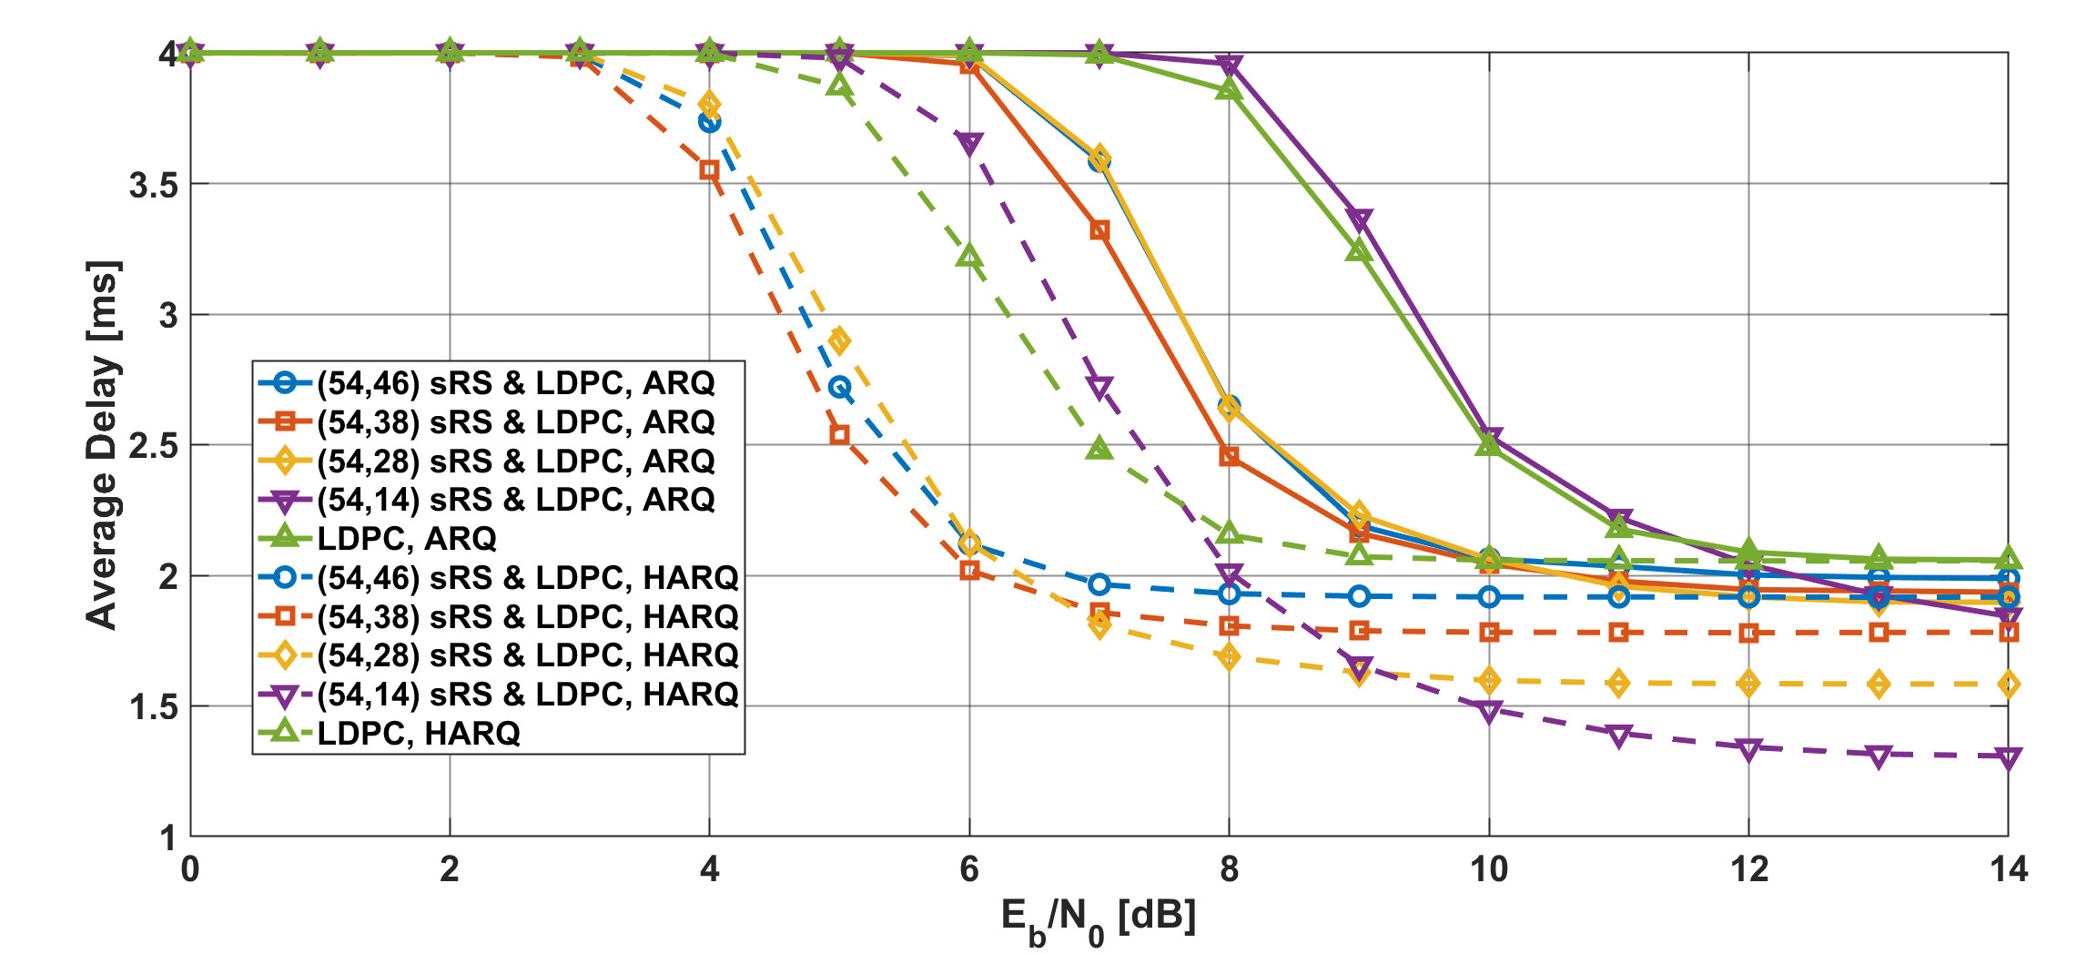
Results
Average delay as a function of $E_{b}/N_{0}$ in the case of LDPC, $p_{e}=80$%
Notes:
Also, the average delay of HARQ has better performance in that condition.

Slide 17
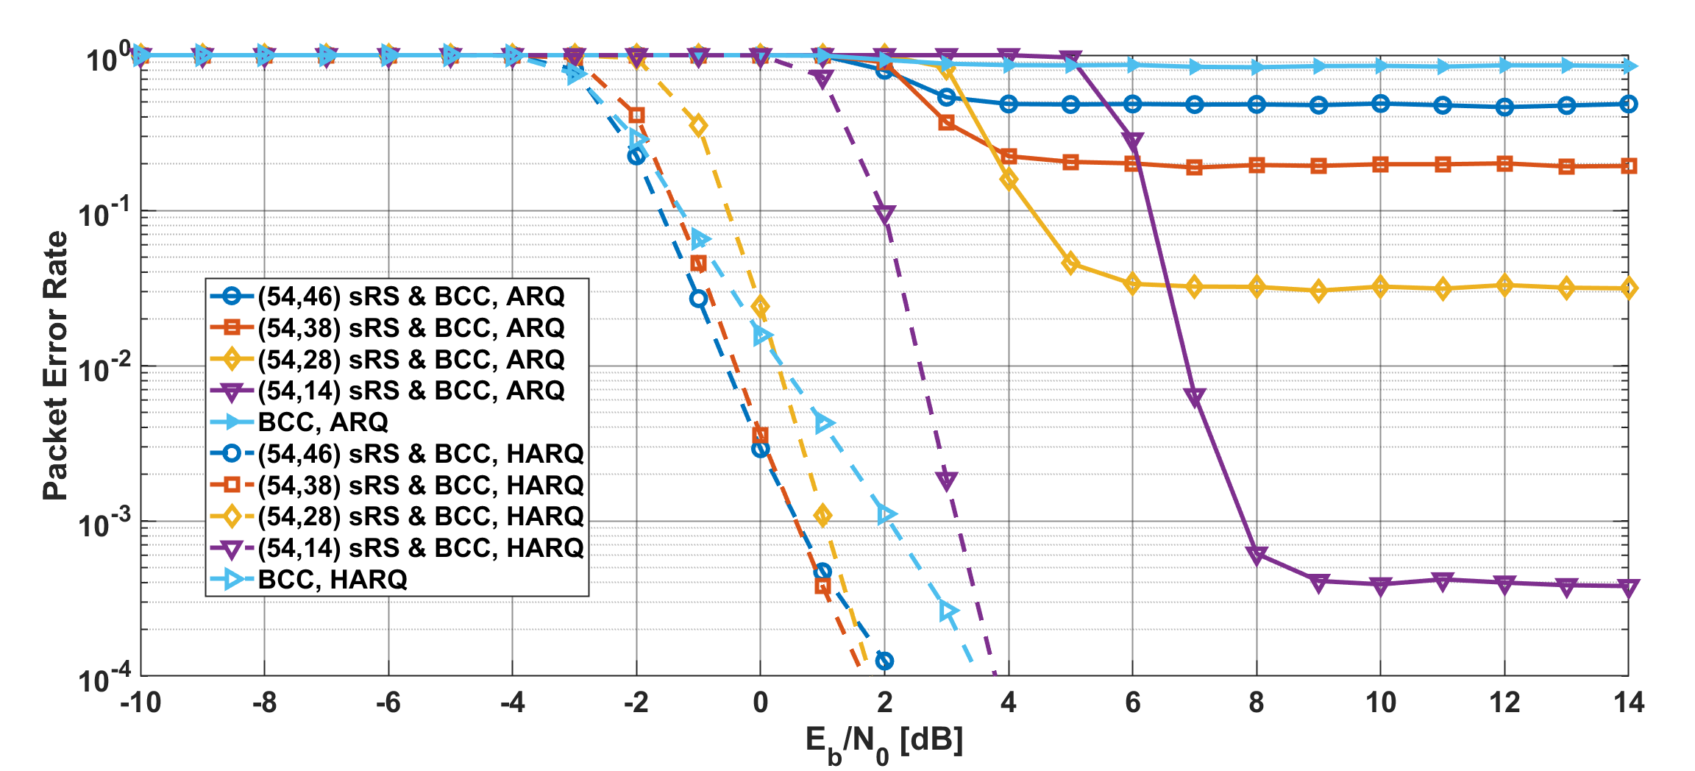
Results
Packet error ratio as a function of $E_{b}/N_{0}$ in the case of BCC, $p_{e}=30$%
Notes:
In this case, the PER of HARQ has much better improved in very low EbN0 areas.

Slide 18
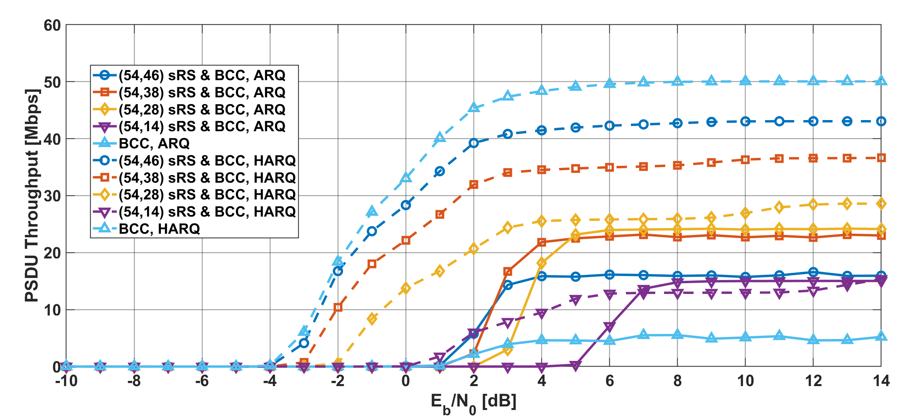
Results
PSDU Throughput as a function of $E_{b}/N_{0}$ in the case of BCC, $p_{e}=30$%
Notes:
Also, the PSDU throughput of HARQ is much better than that of ARQ.

Slide 19
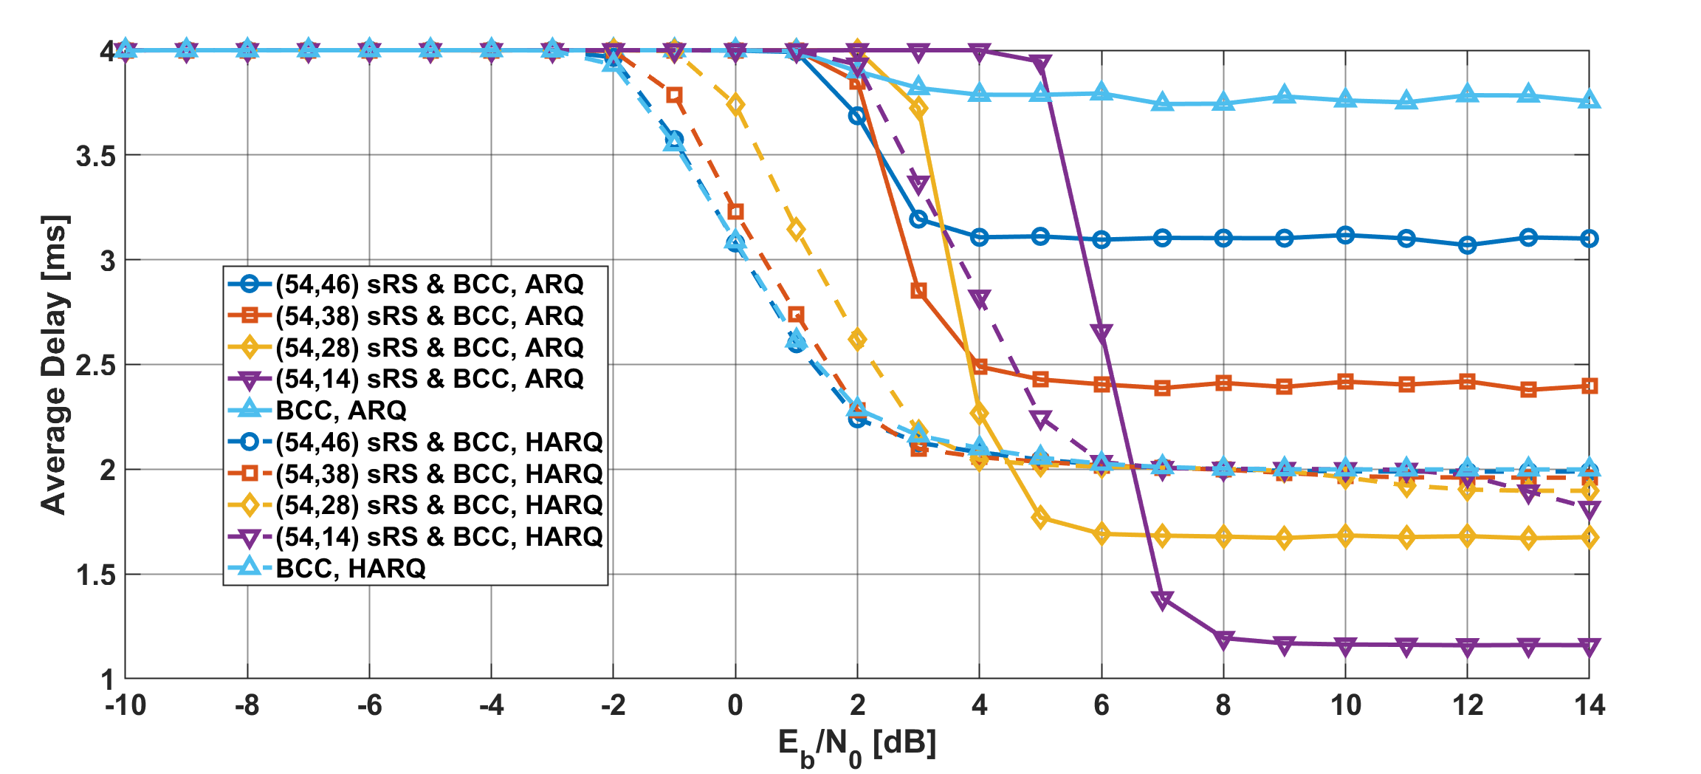
Results
Average delay as a function of $E_{b}/N_{0}$ in the case of BCC, $p_{e}=30$%
Notes:
In addition, the average delay of HARQ is much lower than that of ARQ in low EbN0 regions.
However, at least one retransmission is required.

Slide 20
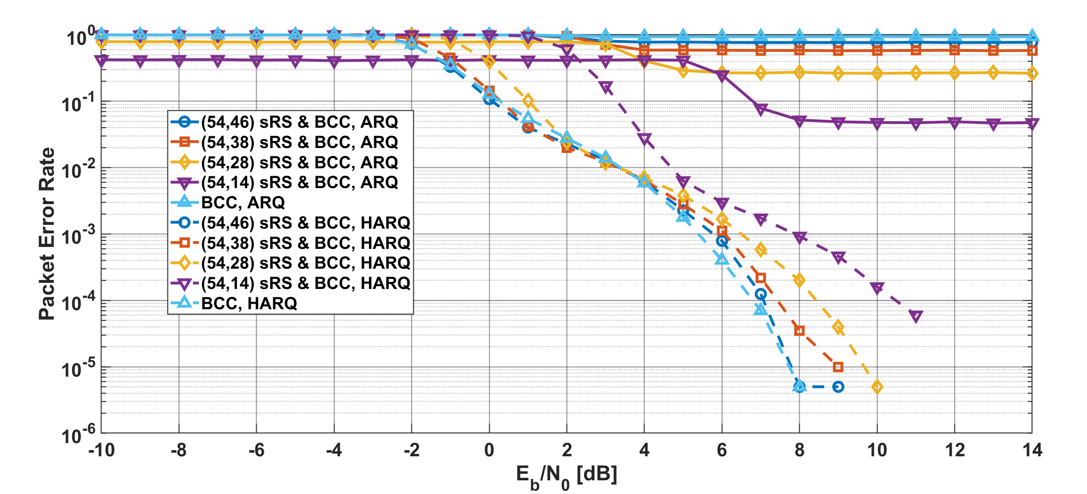
Results
Packet error ratio as a function of $E_{b}/N_{0}$ in the case of BCC, $p_{e}=80$%
Notes:
In the strong interference case, the PER of HARQ has much better improved than that of ARQ.

Slide 21
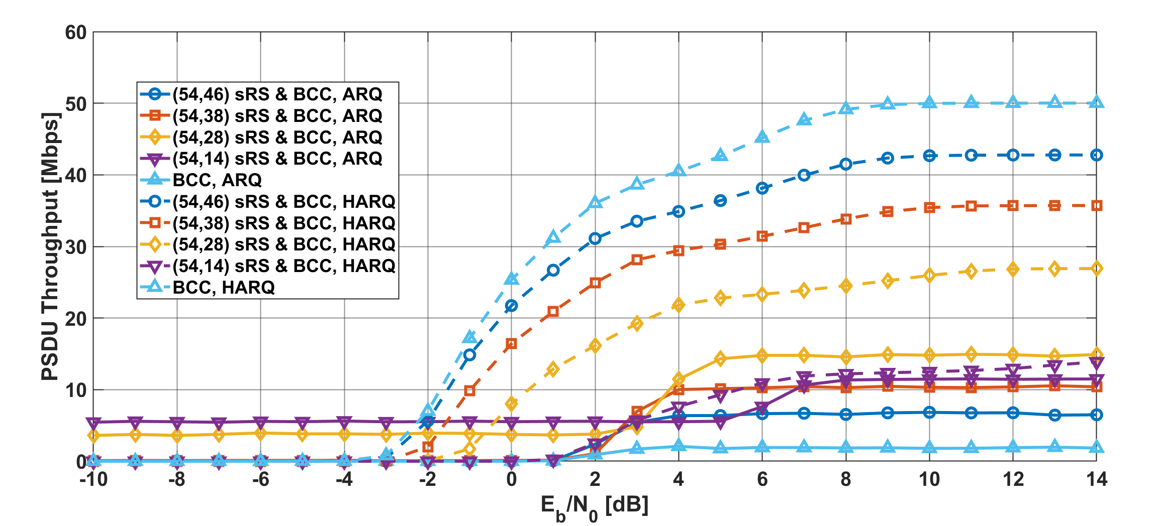
Results
PSDU Throughput as a function of $E_{b}/N_{0}$ in the case of BCC, $p_{e}=80$%
Notes:
Additionally, the PSDU throughput of HARQ is also better that of ARQ in the case.

Slide 22
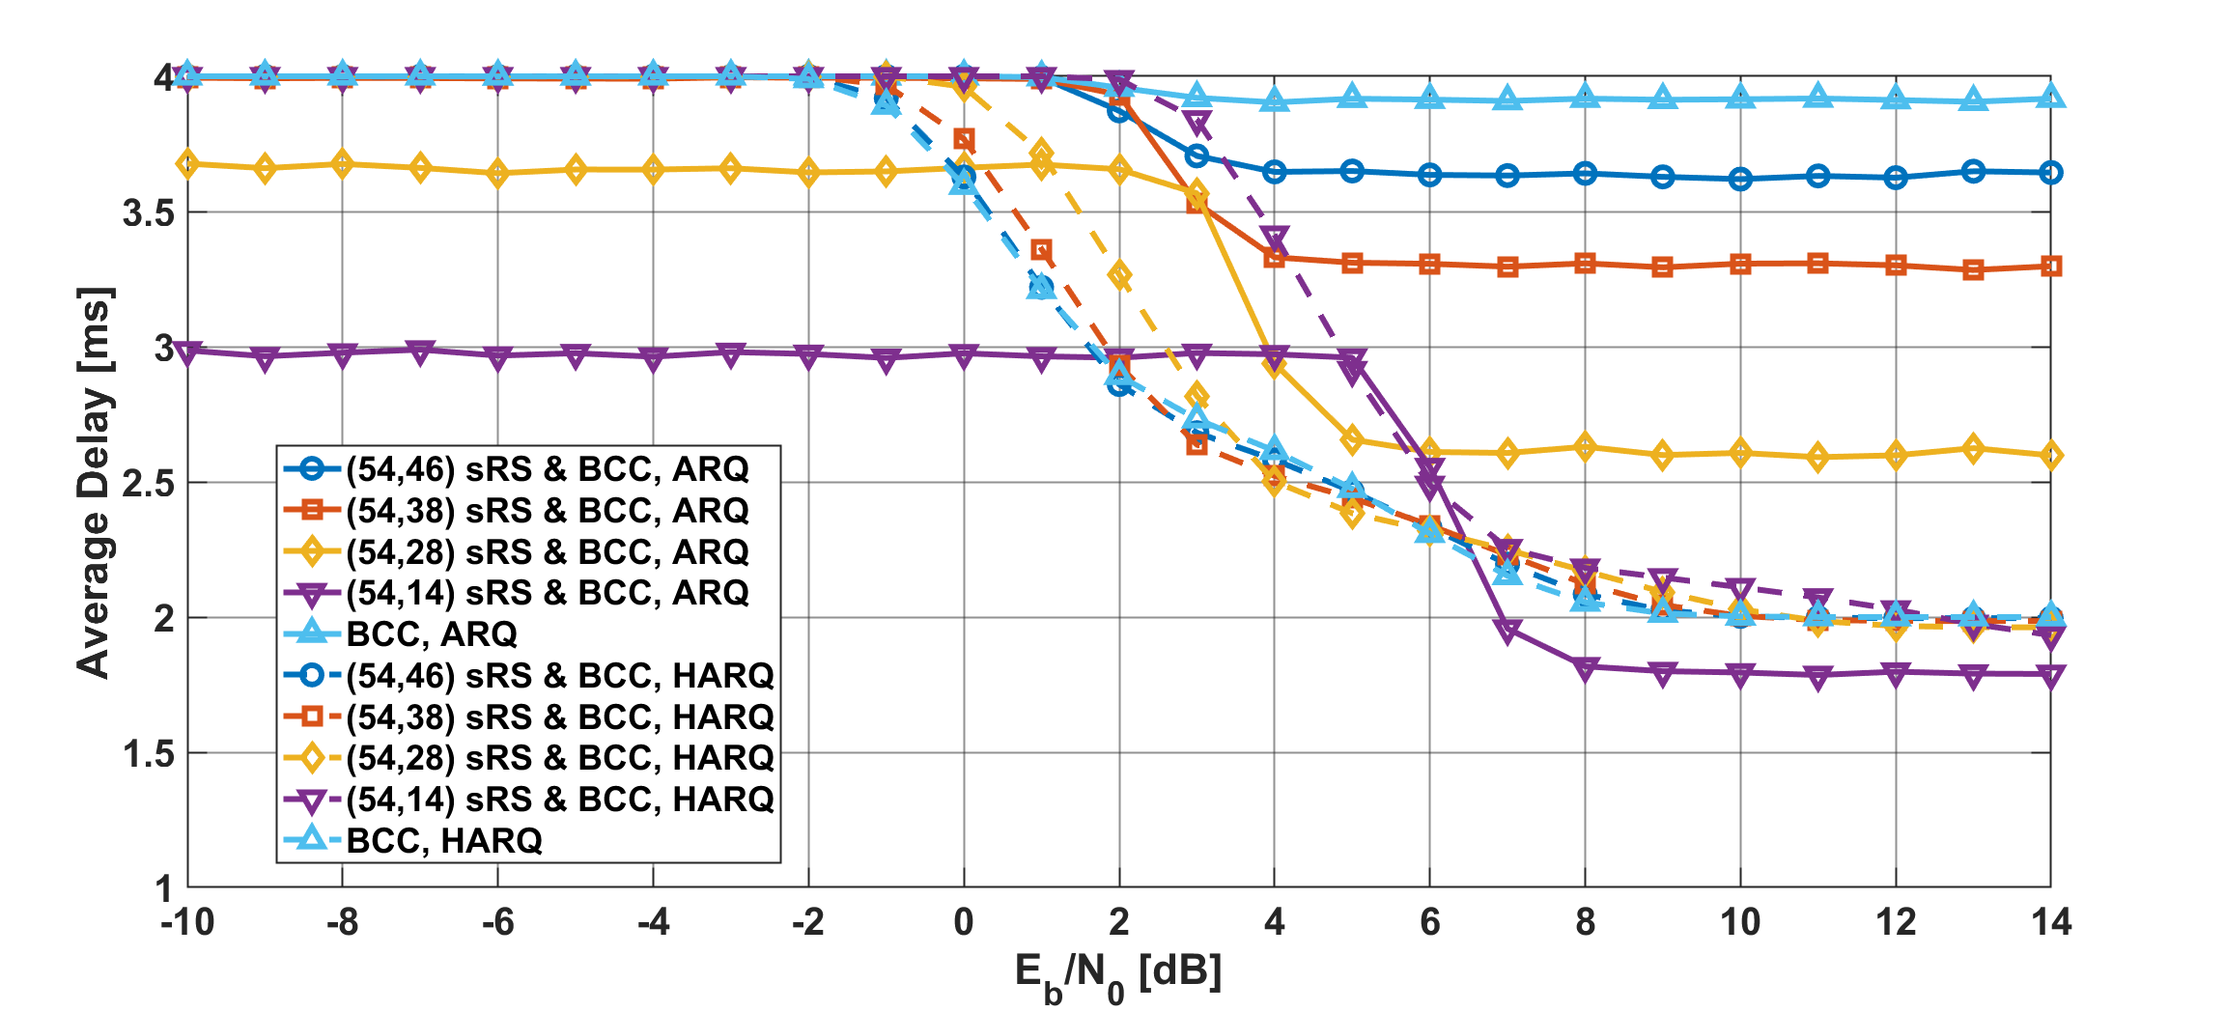
Results
Average delay as a function of $E_{b}/N_{0}$ in the case of BCC, $p_{e}=80$%
Notes:
Also, the average delay of HARQ has basically better performance in that condition.

Slide 23
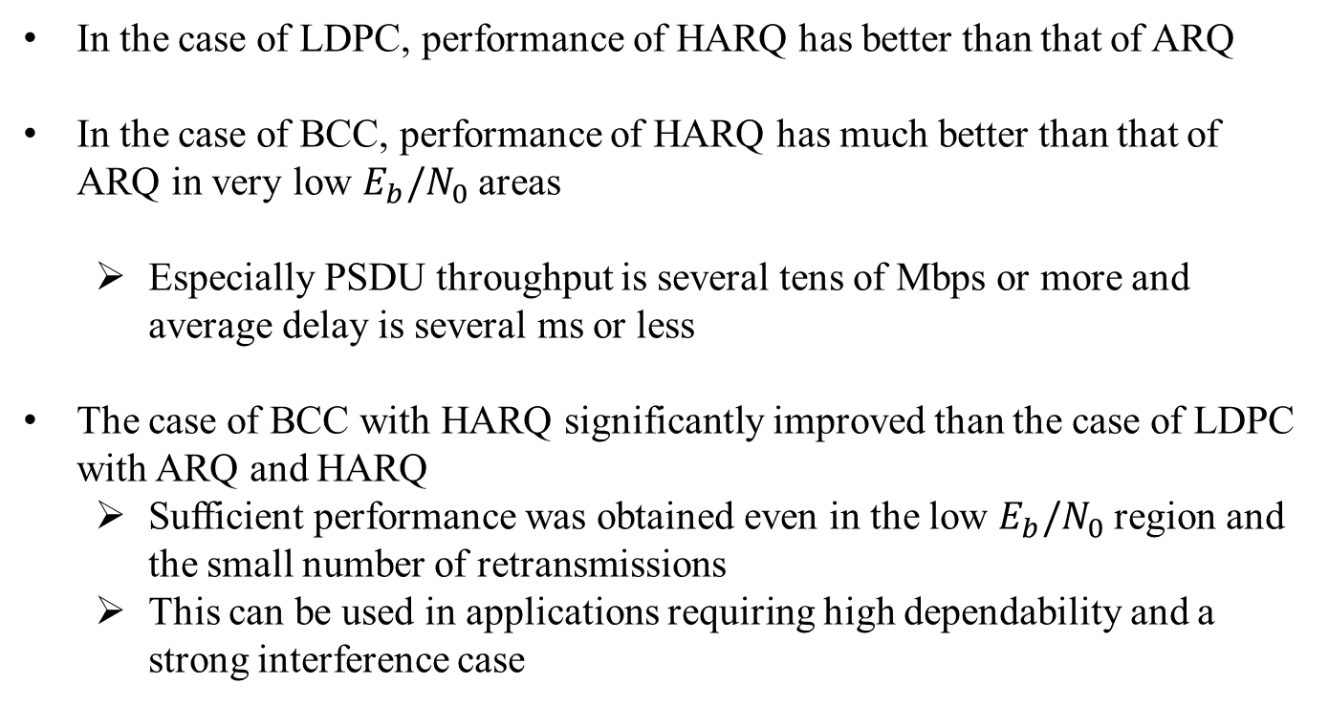
Conclusion
In the case of LDPC, performance of HARQ has better than that of ARQ
In the case of BCC, performance of HARQ has much better than that of ARQ in very low $E_{b}/N_{0}$ areas
  Especially PSDU throughput is several tens of Mbps or more and average delay is several ms or less
The case of BCC with HARQ significantly improved than the case of LDPC with ARQ and HARQ
  Sufficient performance was obtained even in the low $E_{b}/N_{0}$ region and the small number of retransmissions
  This can be used in applications requiring high dependability and a strong interference case

Slide 24
Thank you for your attention ! ! !

Slide 25
Concept of Hybrid ARQ mechanism
Advantages of the hybrid ARQ mechanism
  The coding rate is very wide
    Bit errors are sufficiently eliminated at the high coding rate under very good channel conditions
    Very low coding rates remove bit errors under bad channel conditions
    A coding rate at the first transmission may be changed according to channel conditions
  In the case of the small number of retransmissions, it is sufficient to transmit the small number of redundant bits
    This characteristic leads to improvement of energy efficiency and reduction of transmission delay at retransmission

Slide 26
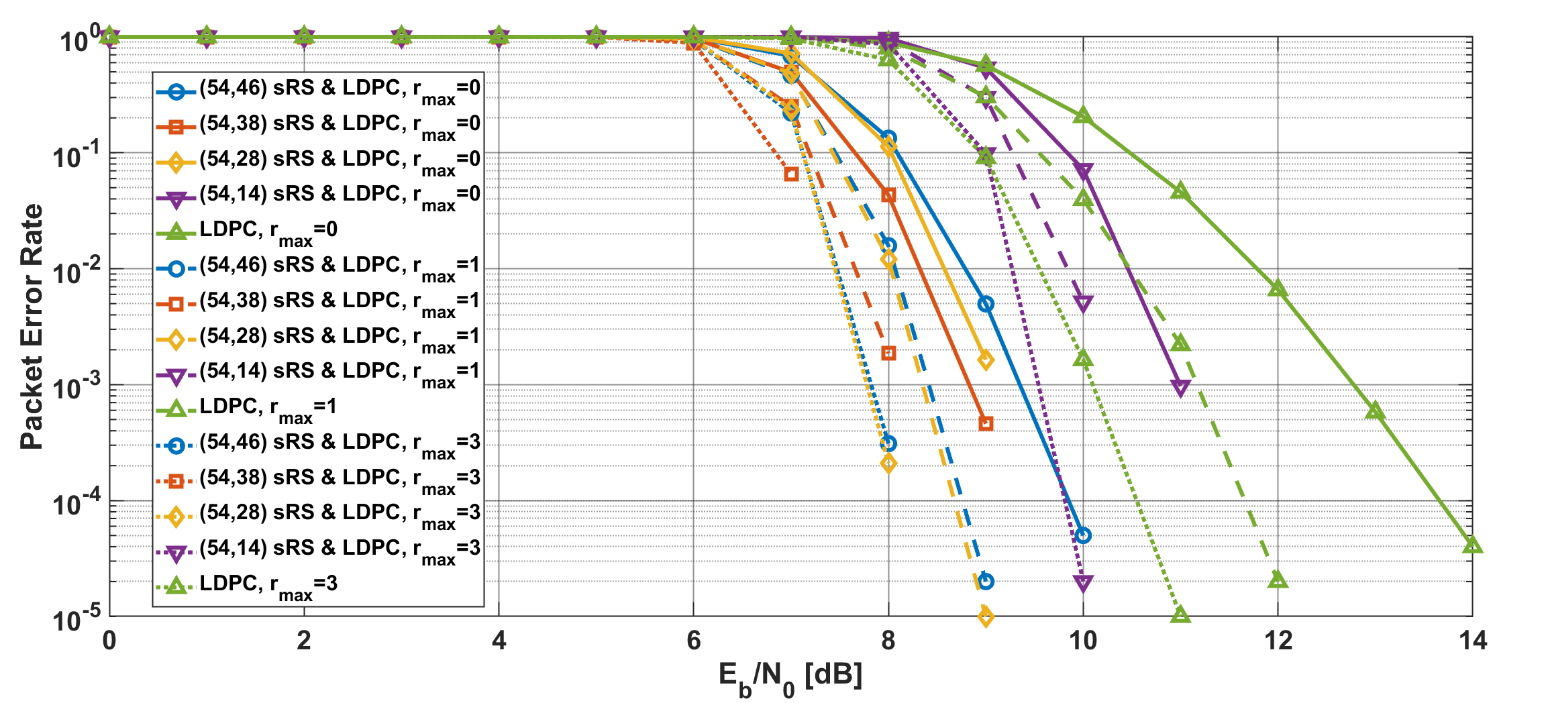
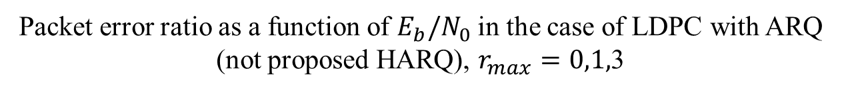
Results
Packet error ratio as a function of $E_{b}/N_{0}$ in the case of LDPC with ARQ (not proposed HARQ), $r_{max}=0,1,$3
Notes:
Basically, as $r_{max}$ increased, the PER has improved.

Slide 27
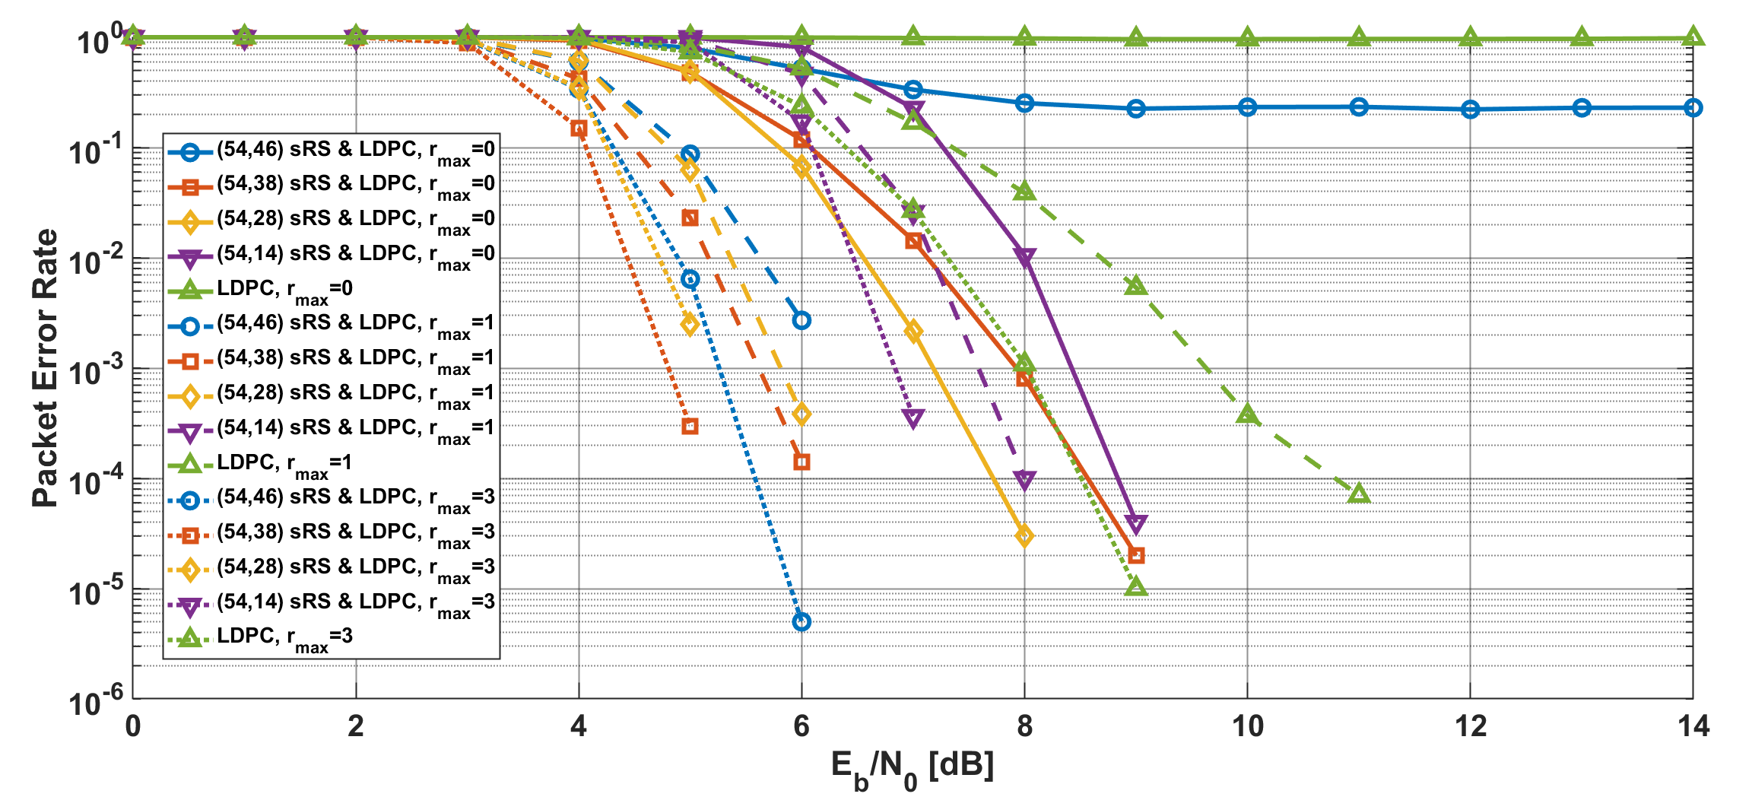
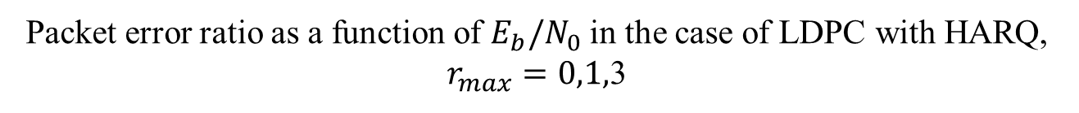
Results
Packet error ratio as a function of $E_{b}/N_{0}$ in the case of LDPC with HARQ, $r_{max}=0,1,$3
Notes:
As compared with a simple ARQ case, HARQ using LDPC could improved the performance

Slide 28
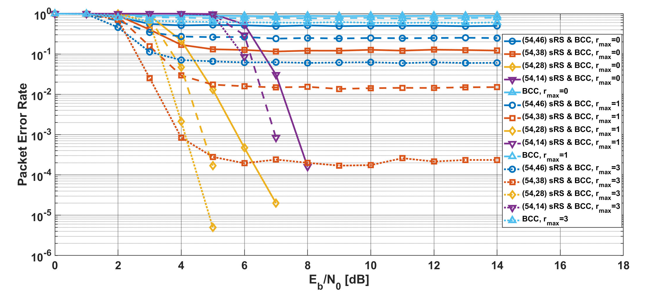
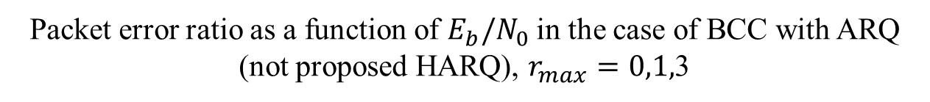
Results
Packet error ratio as a function of $E_{b}/N_{0}$ in the case of BCC with ARQ (not proposed HARQ), $r_{max}=0,1,$3
Notes:
In case of BCC with a simple ARQ, as $r_{max}$ increased, the PER has improved, however an error floor appeared

Slide 29
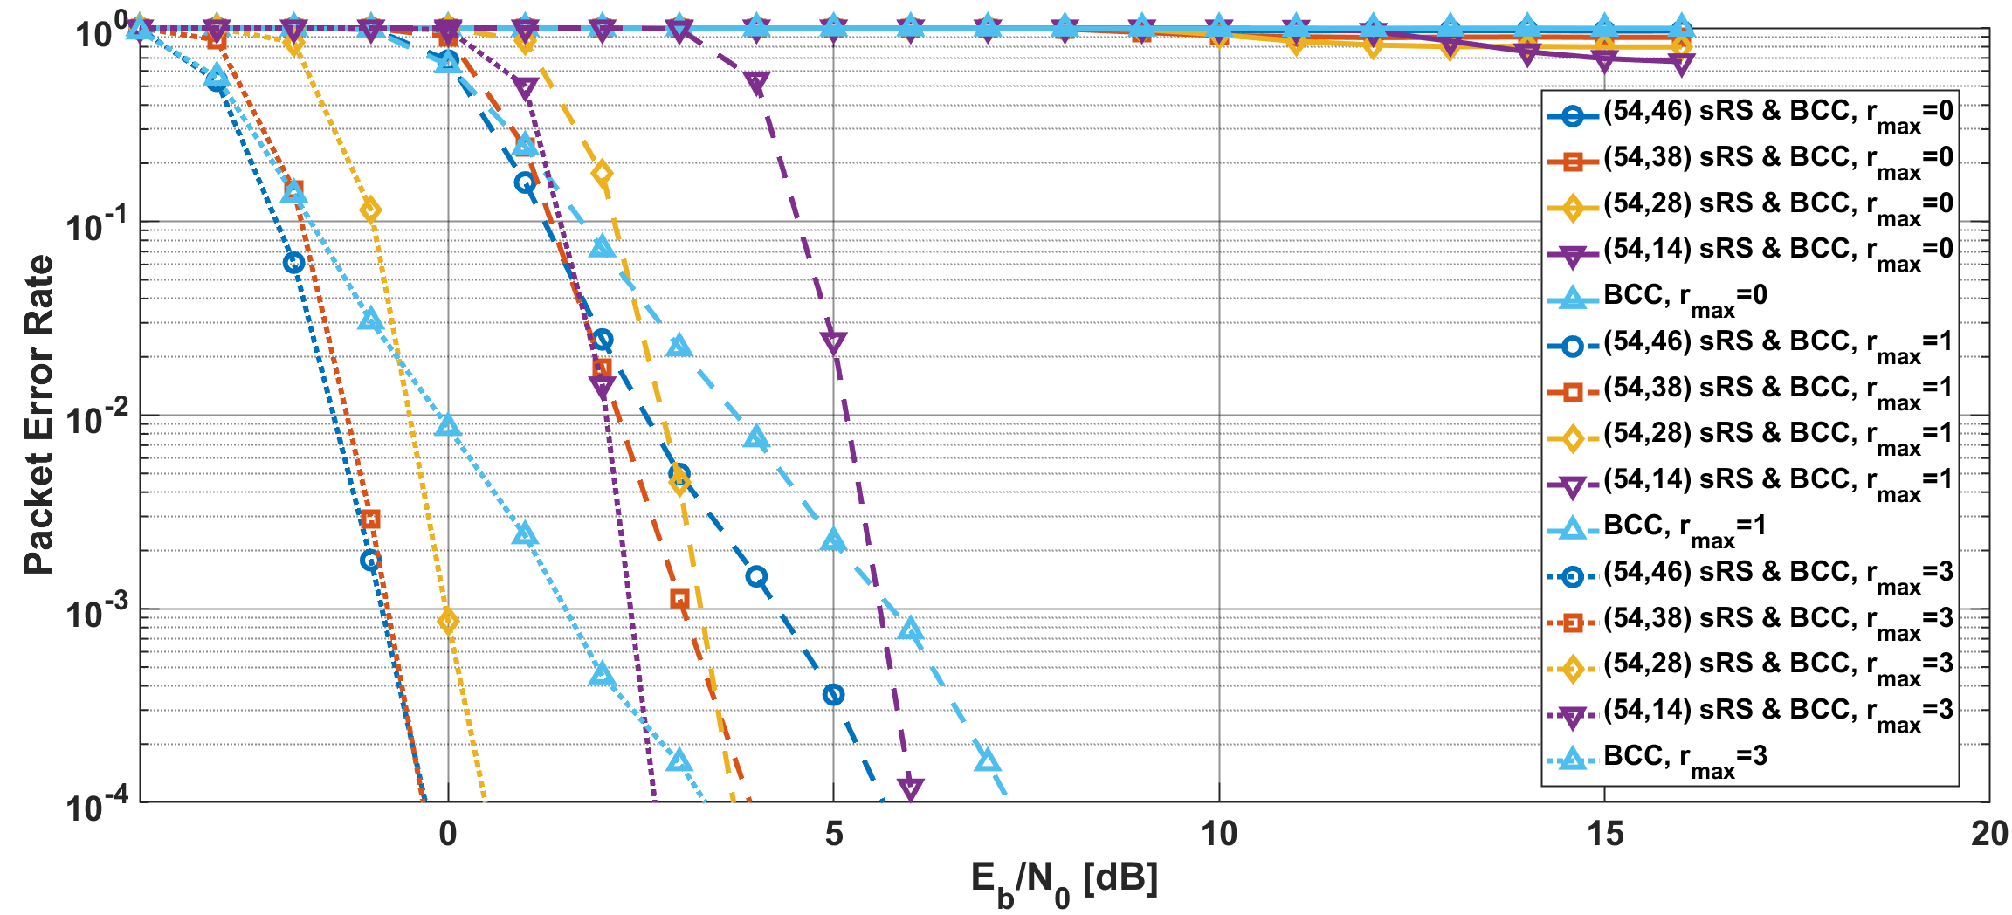
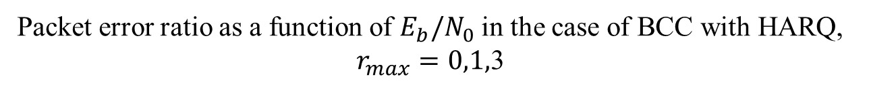
Results
Packet error ratio as a function of $E_{b}/N_{0}$ in the case of BCC with HARQ, $r_{max}=0,1,$3
Notes:
In case of BCC with HARQ, as $r_{max}$ increased, the PER has greatly improved compared with other schemes

