Slide 1
Project: IEEE P802.15 Working Group for Wireless Specialty Networks
Submission Title: Hybrid ARQ Scheme for High QoS Packets in High Class of Coexistence of IEEE 802.15.6ma
Date Submitted: 9 September 2024
Source: Kento Takabayashi¹, Daisuke Anzai², Ryuji Kohno^{3,4}
Company: (1) Toyo University (2) Nagoya Institute of Technology (3)Yokohama National University (4) YRP International Alliance Institute
Address: (1) 2100 Kujirai, Kawagoe, Saitama, Japan 351-8585, (3)79-5 Tokiwadai, Hodogaya-ku, Yokohama, 240-8501 Japan,
(4) YRP1 Blg., 3-4 Hikarinooka, Yokosuka-City, Kanagawa, 239-0847 Japan
Voice:[(1) +81-866-94-2104 , (3) +81-90-5408-0611] E-Mail:[takabayashi.kento.xp@gmail.com, kohno@ynu.ac.jp, kohno@yrp-iai.jp]
Re: In response to call for technical contributions
Abstract: The HARQ mechanism for IEEE 802.15.6ma is provided. IEEE 802.15.6ma will deal with various QoS level data. Hence, it is required to consider an error control scheme corresponding to these QoS. We introduce the HARQ for the highest coexistence environment class and the high QoS level data.
Purpose: Material for discussion in P802.15.6ma TG corresponding to comments in EC Meeting
Notice: This document has been prepared to assist the IEEE P802.15. It is offered as a basis for discussion and is not binding on the contributing individual(s) or organization(s). The material in this document is subject to change in form and content after further study. The contributor(s) reserve(s) the right to add, amend or withdraw material contained herein.
Release: The contributor acknowledges and accepts that this contribution becomes the property of IEEE and may be made publicly available by P802.15.

Slide 2
Hybrid ARQ Scheme for High QoS Packets in High Class of Coexistence of IEEE 802.15.6ma
September 2024,
Hybrid Session,
Hyatt Regency - Vancouver, BC
Kento Takabayashi ⁽¹⁾, Daisuke Anzai⁽²⁾, Ryuji Kohno^{(3,4)}
(1) Toyo University (2) Nagoya Institute of Technology (3)Yokohama National University (4) YRP International Alliance Institute

Slide 3
Coexistence environment level
Coexistence environment class | Environment
0 | 6ma BAN only
1 [1a] | Multiple 6ma BANs 1a
2 [1b] | Multiple 15.6 & 6ma BANs
3 | Multiple 6ma BANs & non-UWB systems (Wi-Fi & Unlicensed 3GPP)
4 [2a] | Multiple 6ma BANs & 802.15 UWB systems
5 [2b] | Multiple 6ma BANs, non-802.15 UWB systems (ETSI UWB systems)
6 [2c] | Multiple 6ma BANs & 802.15 UWB & non-802.15 UWB systems (ETSI UWB)
7 | Multiple 6ma BANs & non-UWB systems (Wi-Fi & Unlicensed 3GPP) & 802.15 UWB & non-802.15 UWB systems (ETSI UWB)
  A hybrid ARQ (HARQ) shall be utilized at the highest class “7”
  15.6ma considers the half-rate BCC and LDPC as an error correcting code
    A HARQ scheme using those FEC is introduced

Slide 4
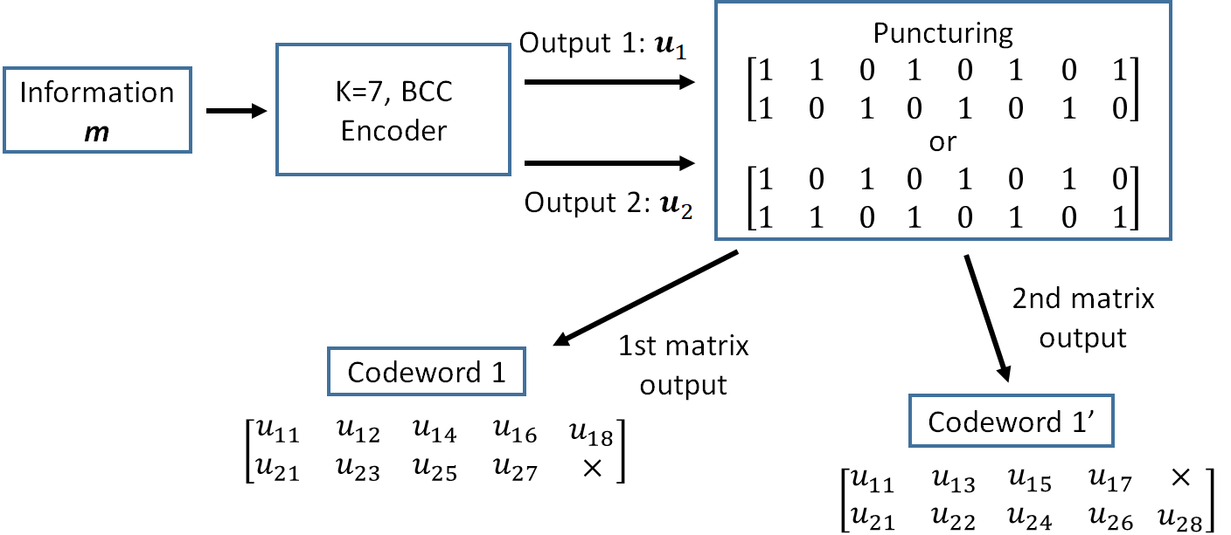
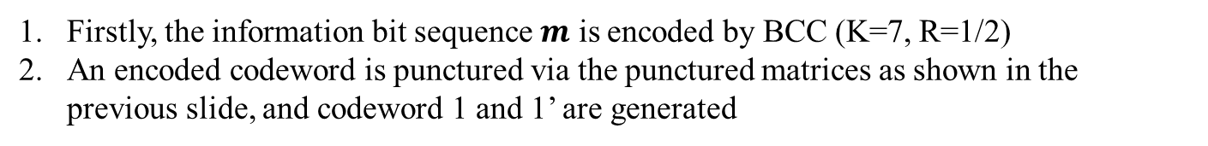
Hybrid ARQ mechanism (BCC case)
Firstly, the information bit sequence $m$ is encoded by BCC (K=7, R=1/2)
An encoded codeword is punctured via the punctured matrices as shown in the previous slide, and codeword 1 and 1’ are generated

Slide 5
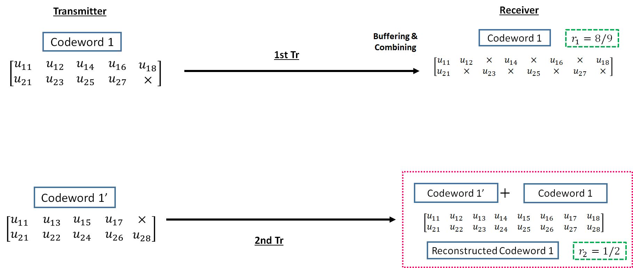
Hybrid ARQ mechanism (BCC case)
3. The codeword 1 is transmitted to a receiver
4. If bit errors are detected after decoding the codeword 1, a receiver buffers the transmitted codeword 1, and a transmitter re-sends the codeword 1’ to a receiver
5. At the receiver, transmitted codeword 1’ is combined with a buffered codeword 1, and a reconstructed codeword 1 (R=1/2) is generated

Slide 6
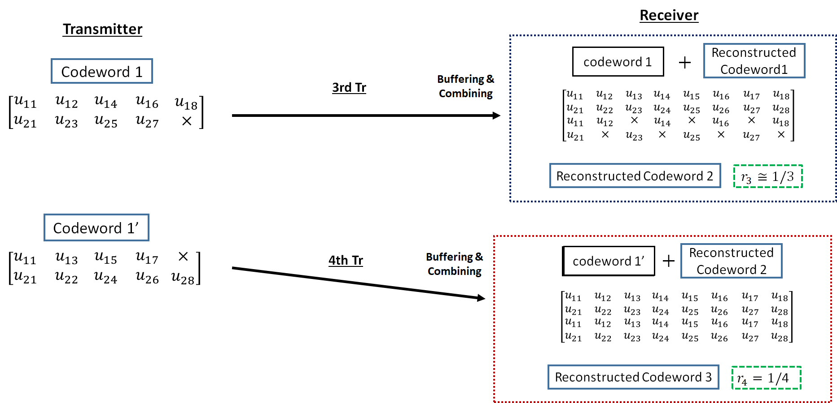
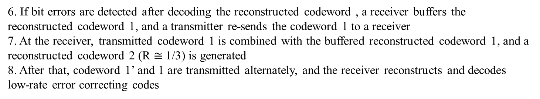
Hybrid ARQ mechanism (BCC case)
6. If bit errors are detected after decoding the reconstructed codeword , a receiver buffers the reconstructed codeword 1, and a transmitter re-sends the codeword 1 to a receiver
7. At the receiver, transmitted codeword 1 is combined with the buffered reconstructed codeword 1, and a reconstructed codeword 2 (R $≅$1/3) is generated
8. After that, codeword 1’ and 1 are transmitted alternately, and the receiver reconstructs and decodes low-rate error correcting codes

Slide 7
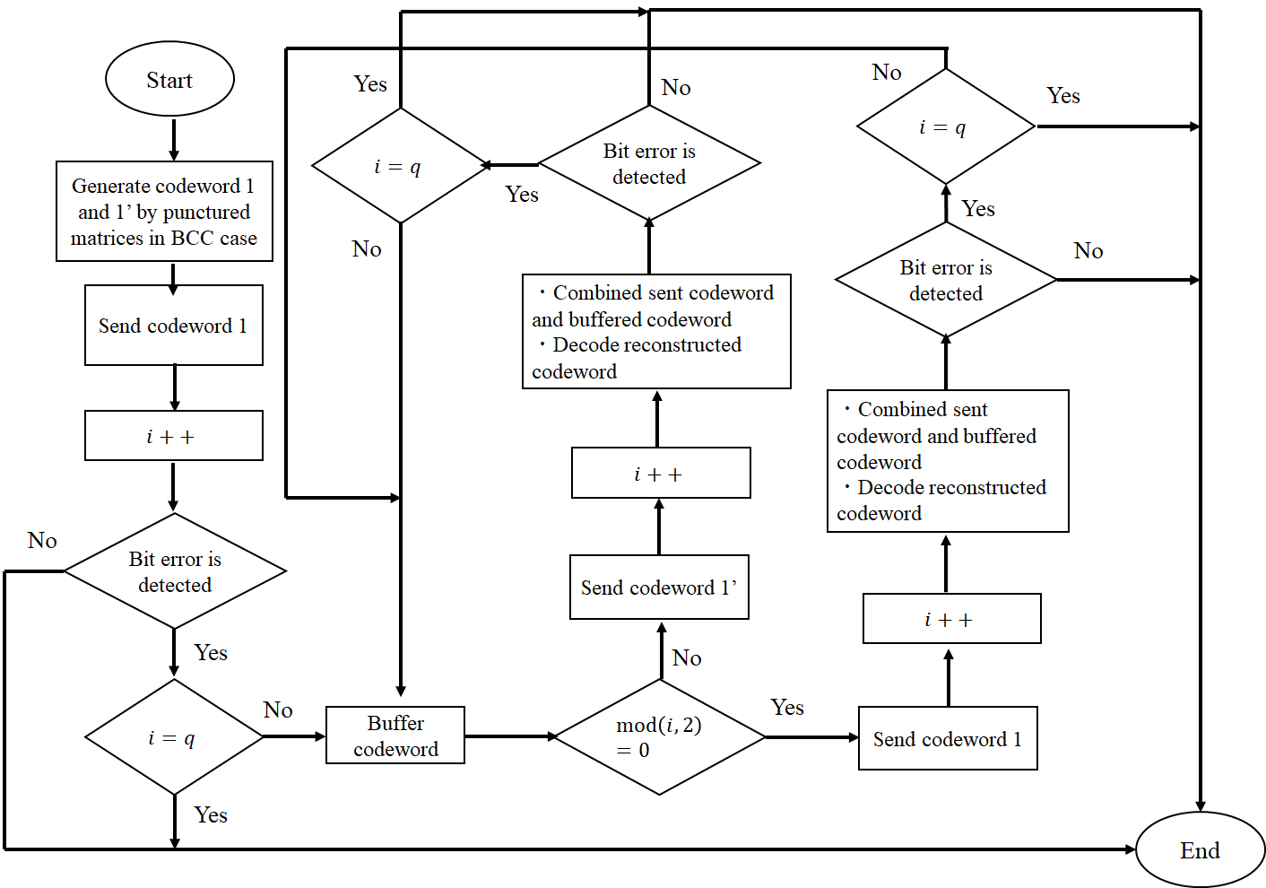
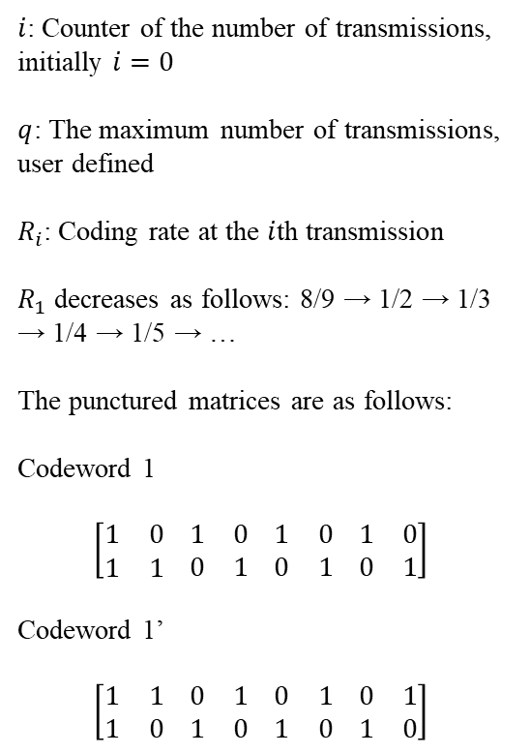
Hybrid ARQ mechanism (BCC case)
$i$: Counter of the number of transmissions, initially $i=0$
$q$: The maximum number of transmissions, user defined
$R_{i}$: Coding rate at the $i$th transmission
$R_{1}$ decreases as follows: 8/9 → 1/2 → 1/3 → 1/4 → 1/5 → …
The punctured matrices are as follows:
Codeword 1
$$\left[\begin{matrix}1 & 0 \\ 1 & 1\end{matrix} \begin{matrix}1 & 0 \\ 0 & 1\end{matrix} \begin{matrix}1 & 0 \\ 0 & 1\end{matrix} \begin{matrix}1 & 0 \\ 0 & 1\end{matrix}\right]$$
Codeword 1’
$$\left[\begin{matrix}1 & 1 \\ 1 & 0\end{matrix} \begin{matrix}0 & 1 \\ 1 & 0\end{matrix} \begin{matrix}0 & 1 \\ 1 & 0\end{matrix} \begin{matrix}0 & 1 \\ 1 & 0\end{matrix}\right]$$

Slide 8
Concept of Hybrid ARQ mechanism
Advantages of the hybrid ARQ mechanism
  The coding rate is very wide
    Bit errors are sufficiently eliminated at the high coding rate under very good channel conditions
    Very low coding rates remove bit errors under bad channel conditions
    A coding rate at the first transmission may be changed according to channel conditions
  In the case of the small number of retransmissions, it is sufficient to transmit the small number of redundant bits
    This characteristic leads to improvement of energy efficiency and reduction of transmission delay at retransmission

Slide 9
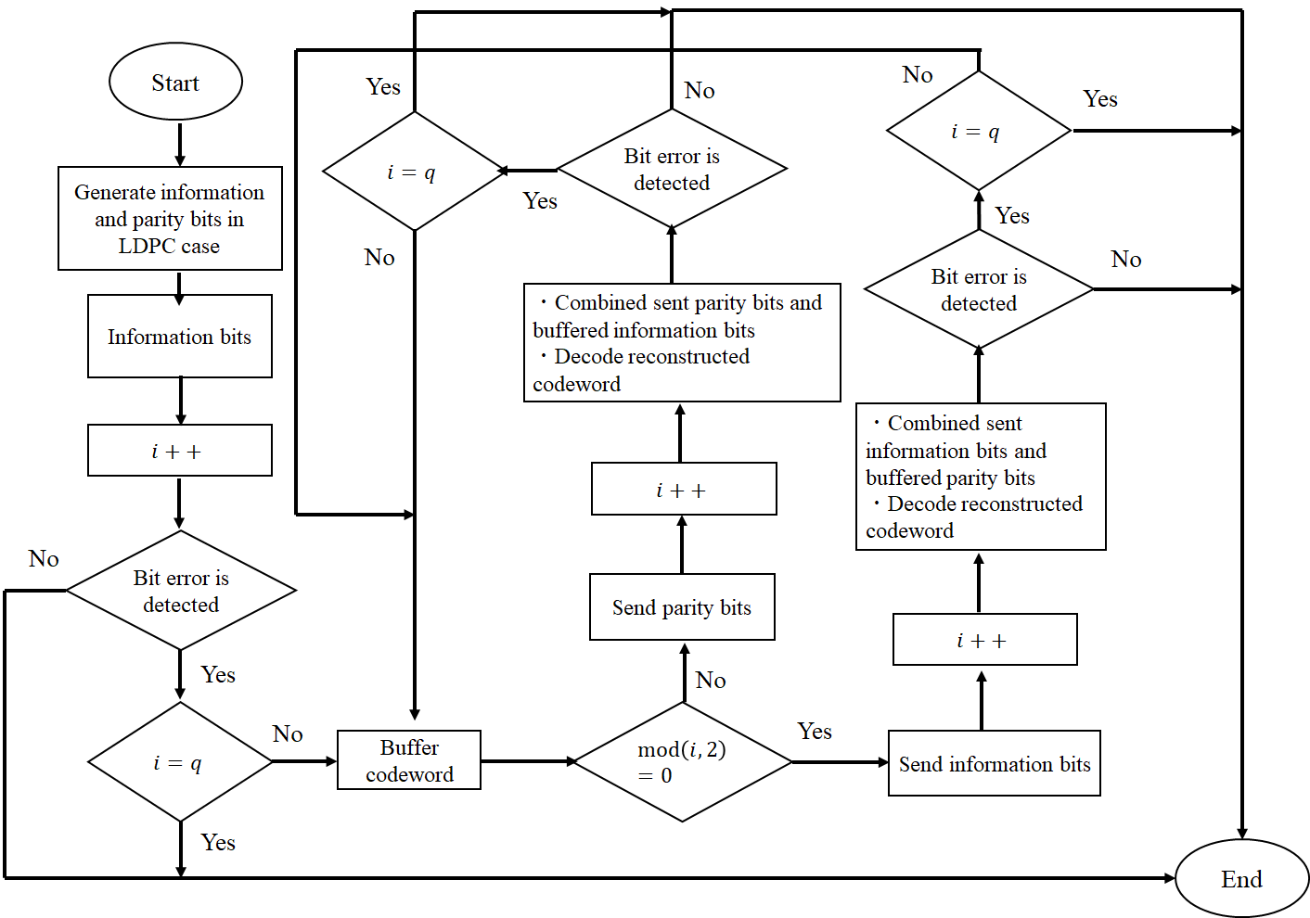
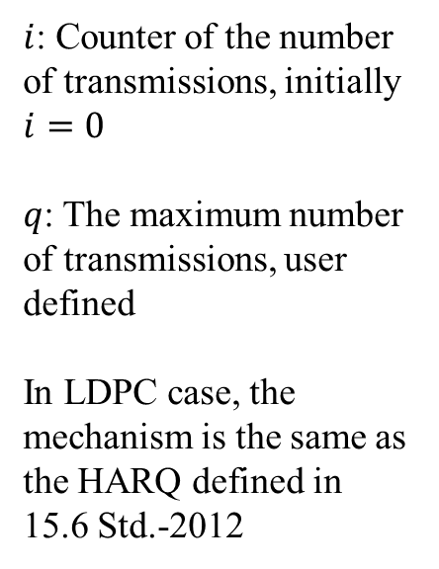
Hybrid ARQ mechanism (LDPC case)
$i$: Counter of the number of transmissions, initially $i=0$
$q$: The maximum number of transmissions, user defined
In LDPC case, the mechanism is the same as the HARQ defined in 15.6 Std.-2012

Slide 10
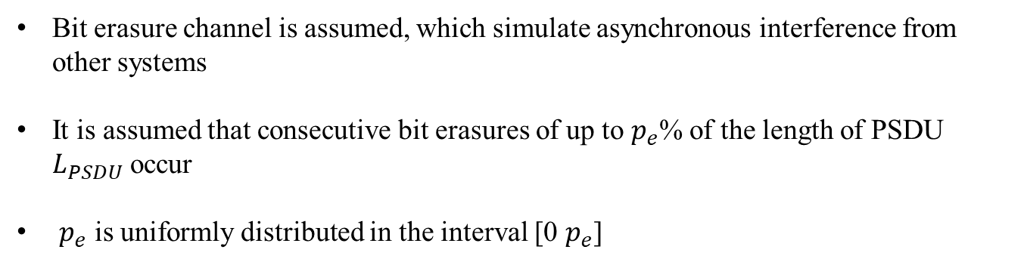
Bit erasure channel
0 1 1 0 0 1 0 0 1・・・0 1 1 1 ✕ ✕ ✕ ✕ ✕ ✕ ・・・0 1 1 0 0 0 1 1
Consecutive bit erasures
Bit erasure channel is assumed, which simulate asynchronous interference from other systems
It is assumed that consecutive bit erasures of up to $p_{e}$% of the length of PSDU $L_{PSDU}$ occur
$p_{e}$ is uniformly distributed in the interval [0 $p_{e}$]

Slide 11
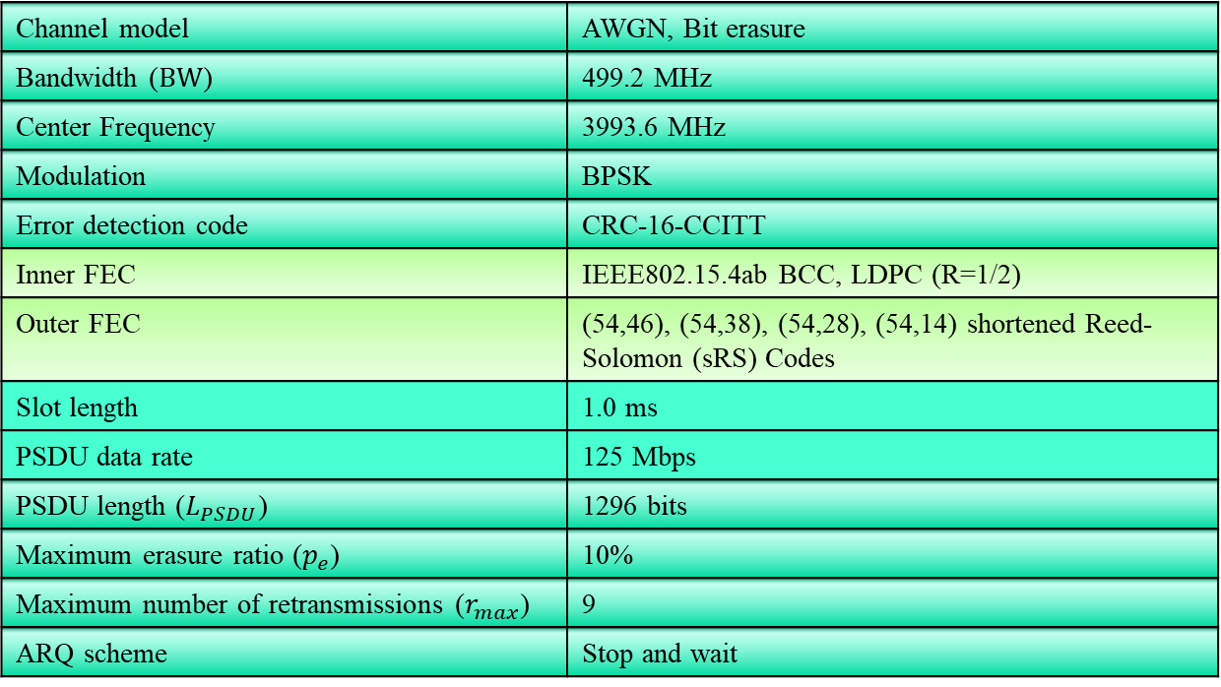
Evaluation
Channel model | AWGN, Bit erasure
Bandwidth ($BW$) | 499.2 MHz
Center Frequency | 3993.6 MHz
Modulation | BPSK
Error detection code | CRC-16-CCITT
Inner FEC | IEEE802.15.4ab BCC, LDPC (R=1/2)
Outer FEC | (54,46), (54,38), (54,28), (54,14) shortened Reed-Solomon (sRS) Codes
Slot length | 1.0 ms
PSDU data rate | 125 Mbps
PSDU length ($L_{PSDU}$) | 1296 bits
Maximum erasure ratio ($p_{e}$) | 10%
Maximum number of retransmissions ($r_{max}$) | 9
ARQ scheme | Stop and wait
This presentation evaluated average delay and PSDU throughput in addition to previous one

Slide 12
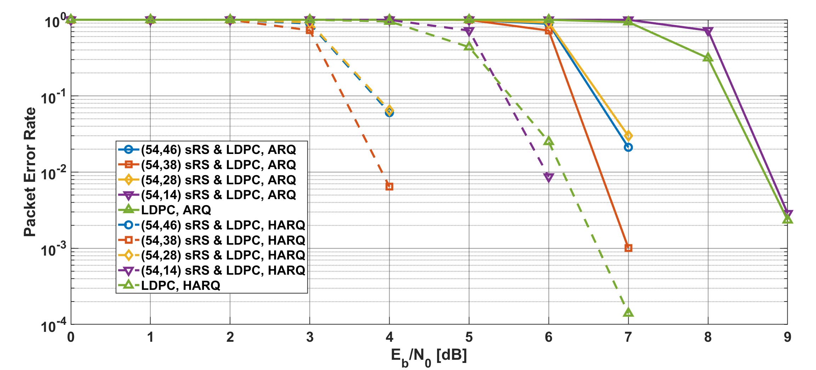
Results
Packet error ratio as a function of $E_{b}/N_{0}$ in the case of LDPC
Notes:
Compared with ARQ and HARQ, the PER of HARQ has better improved.

Slide 13
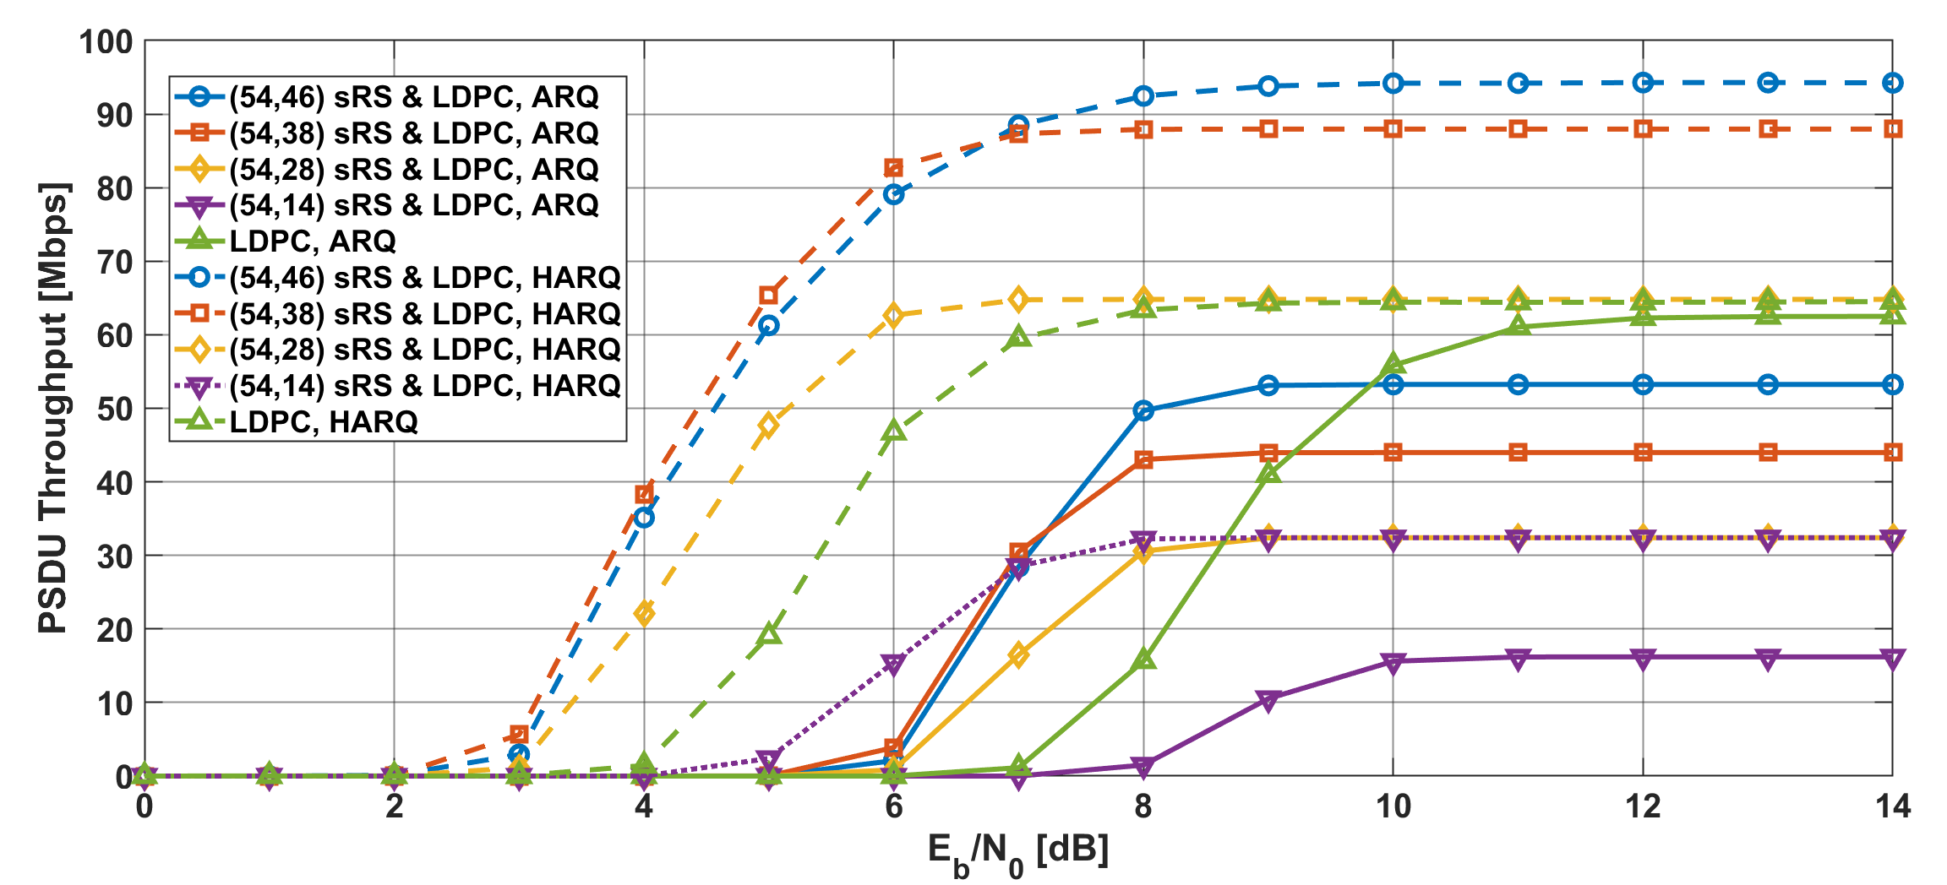
Results
PSDU Throughput as a function of $E_{b}/N_{0}$ in the case of LDPC
Notes:
Additionally, the PSDU throughput of HARQ is about twice that of ARQ.

Slide 14
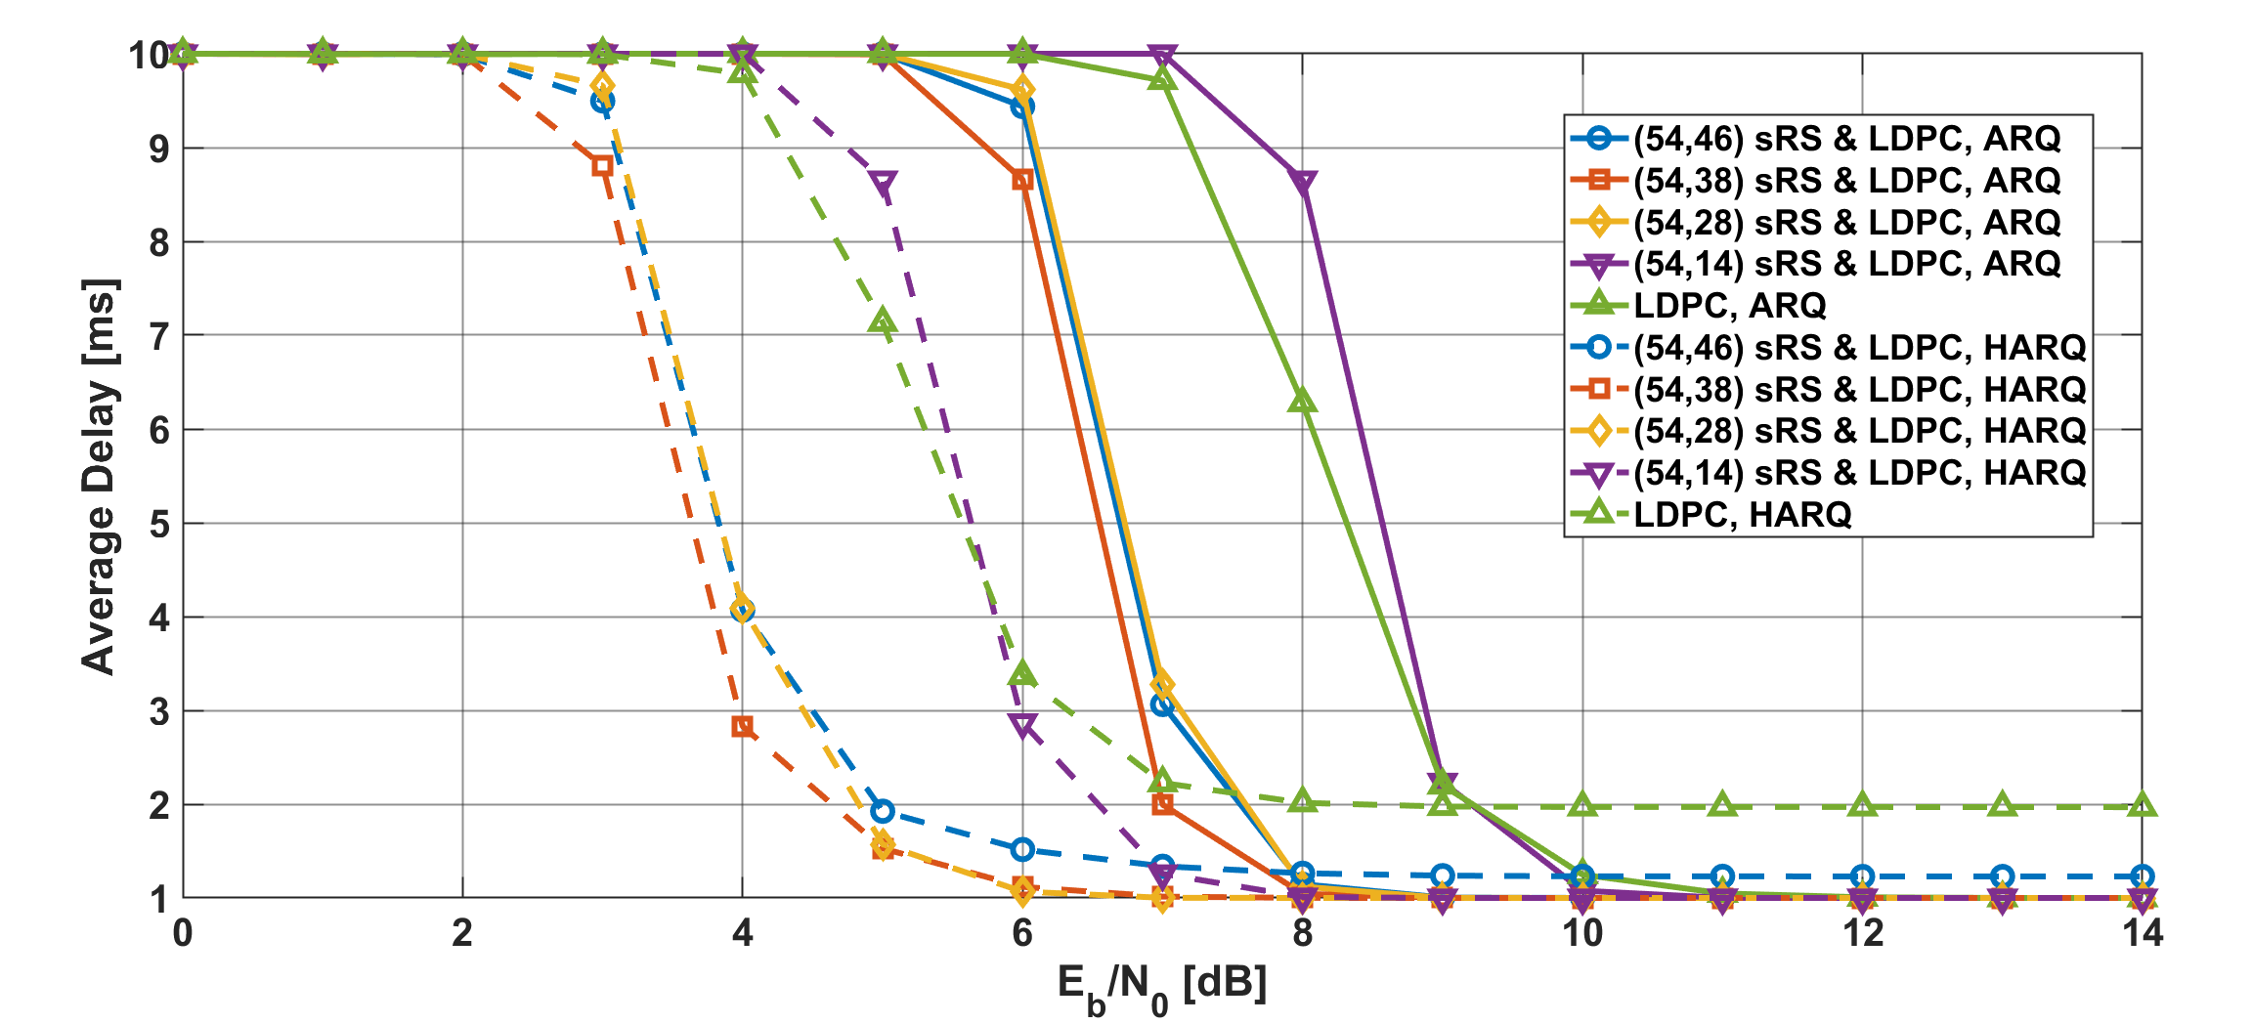
Results
Average delay as a function of $E_{b}/N_{0}$ in the case of LDPC
Notes:
The average delay of HARQ has good performance even in low EbN0 regions.

Slide 15
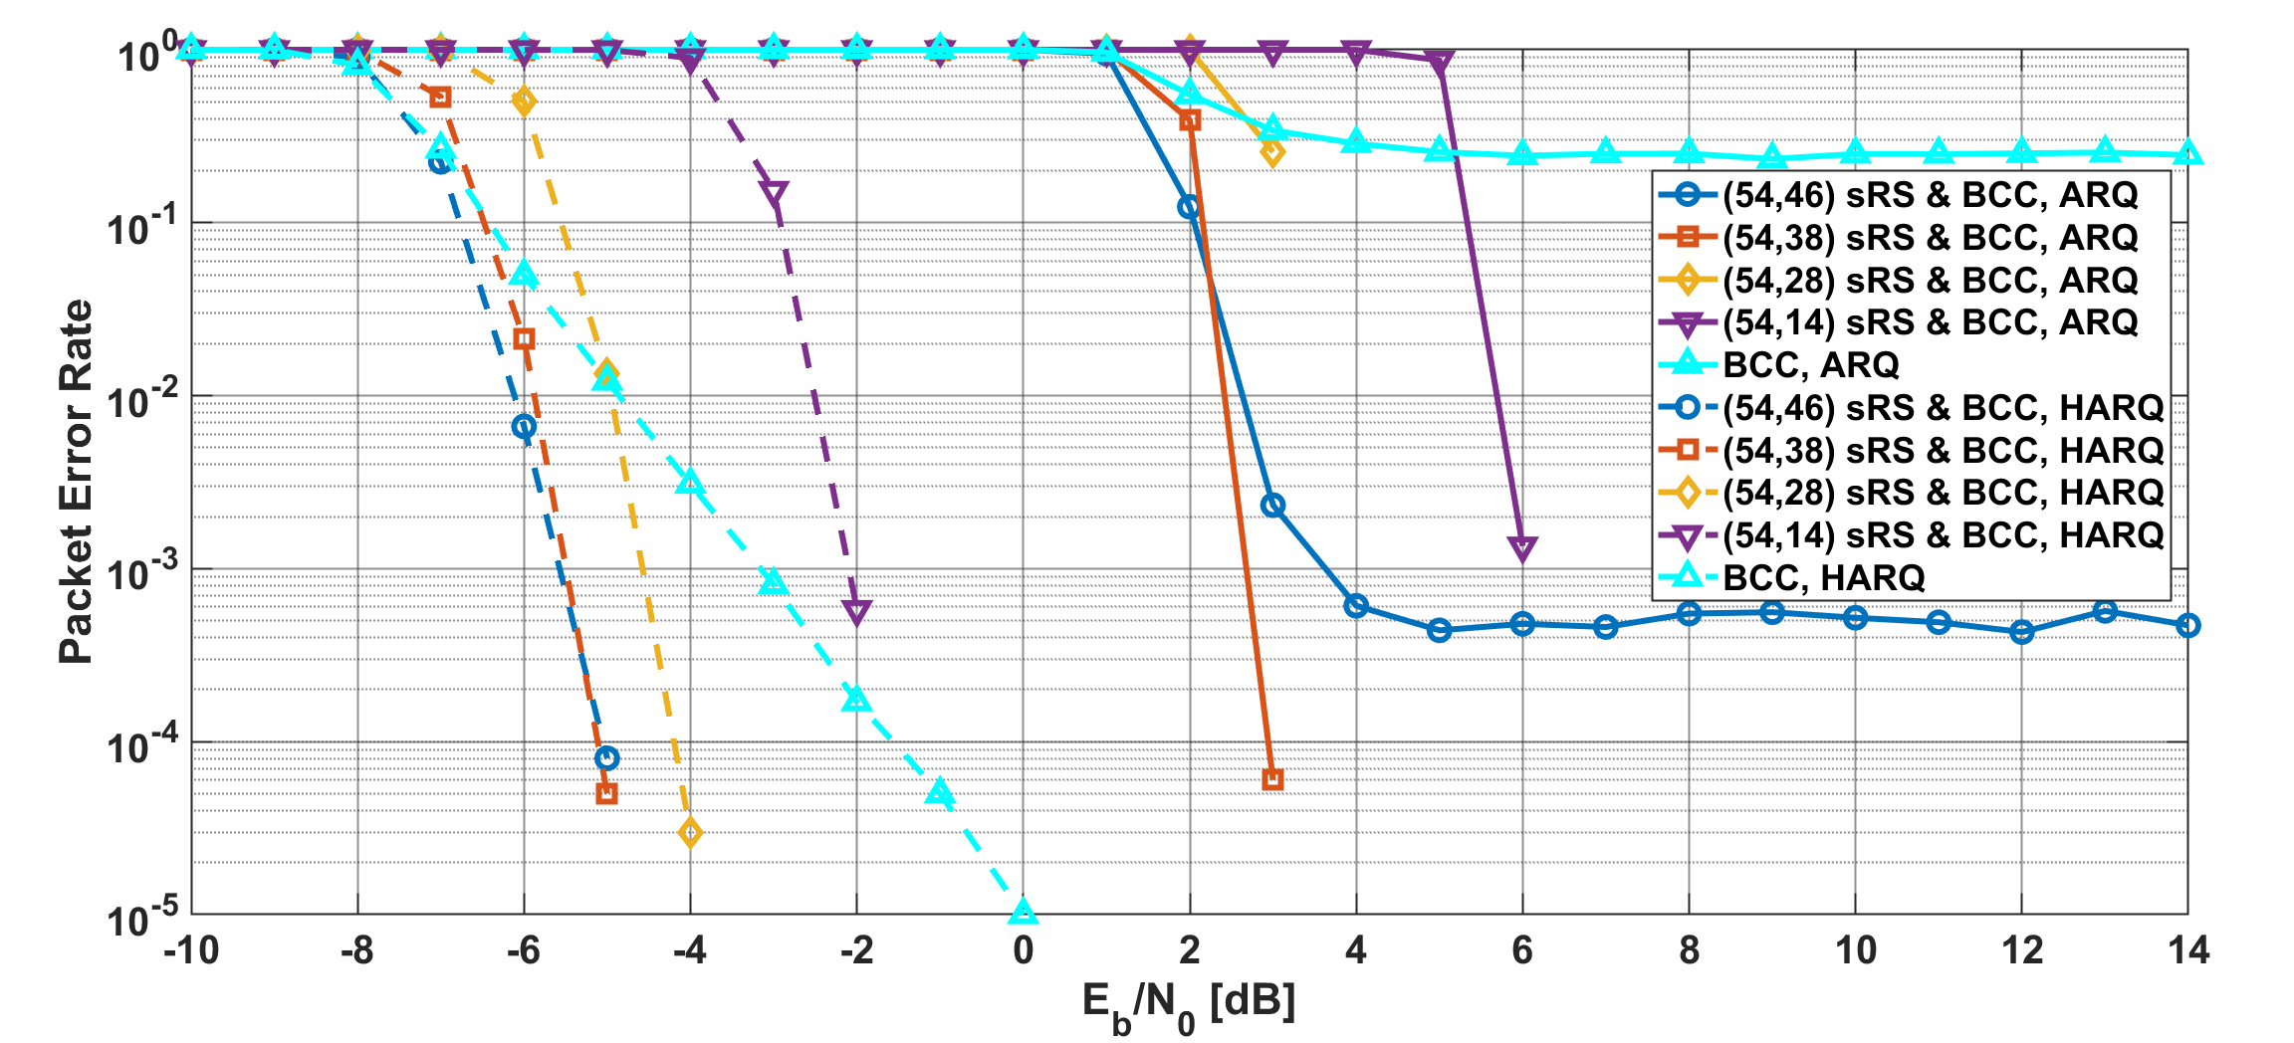
Results
Packet error ratio as a function of $E_{b}/N_{0}$ in the case of BCC
Notes:
In this case, the PER of HARQ has much better improved in very low EsN0 areas.

Slide 16
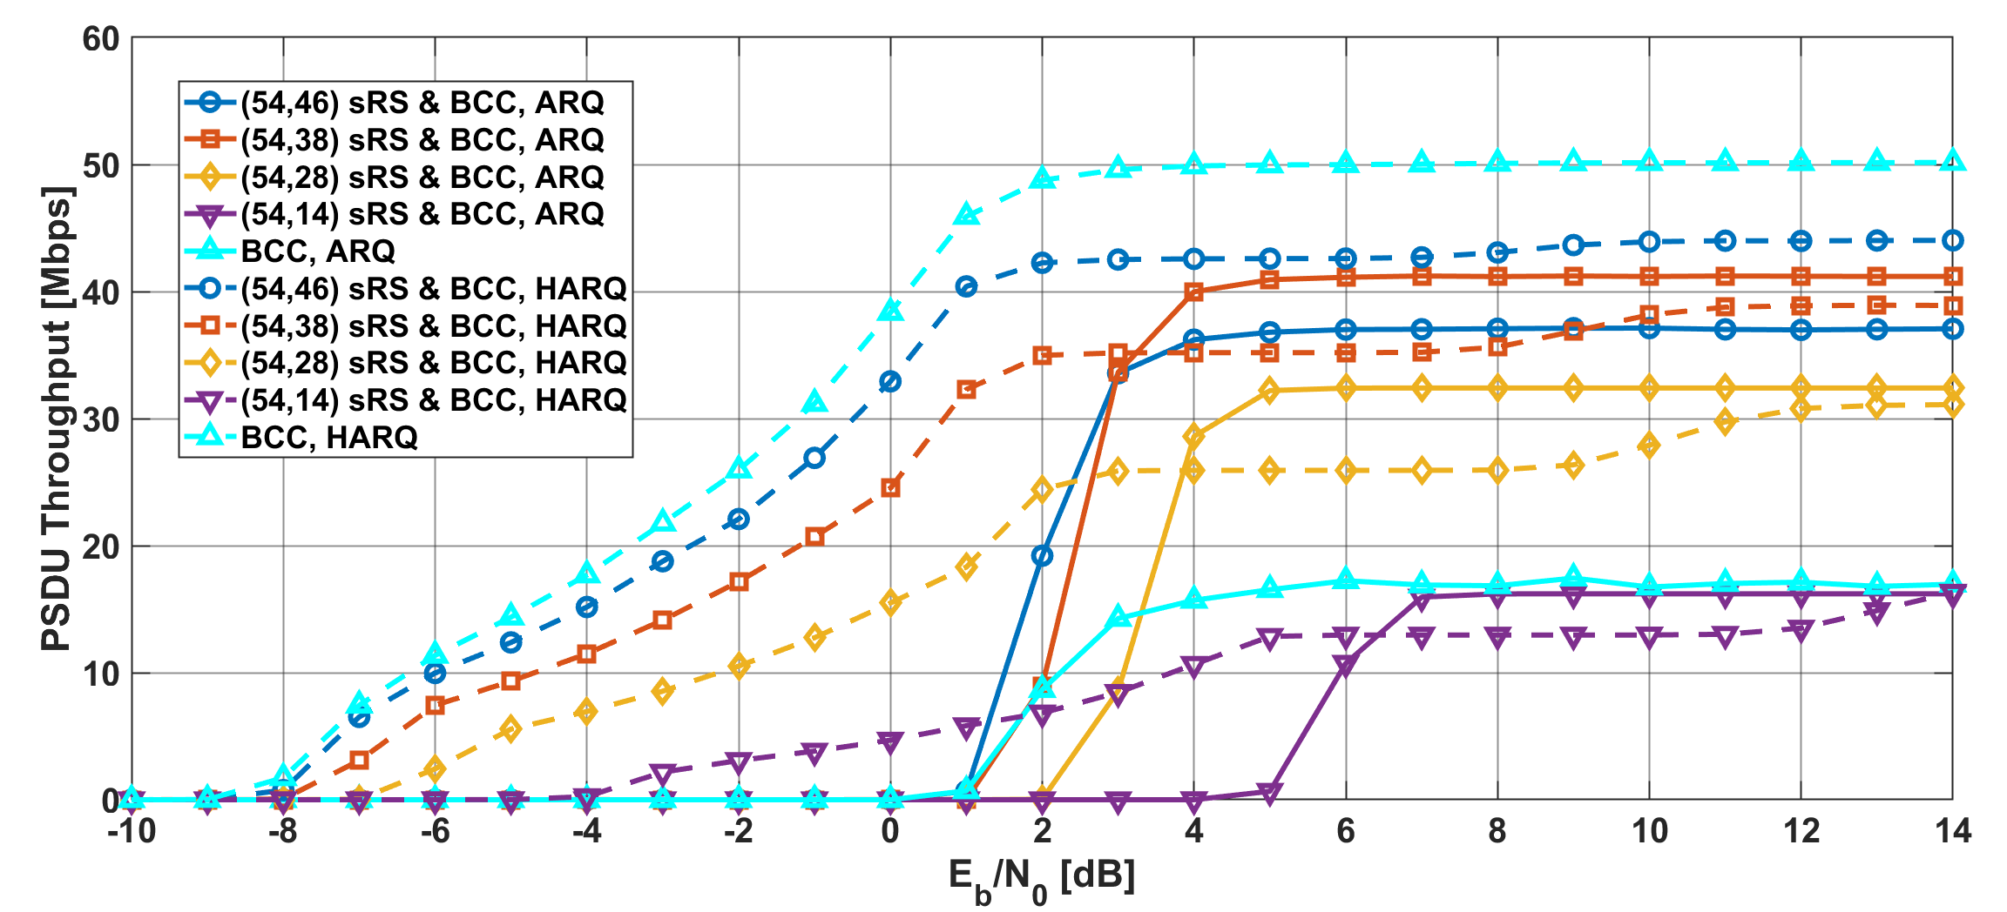
Results
PSDU Throughput as a function of $E_{b}/N_{0}$ in the case of BCC
Notes:
Also, the PSDU throughput of HARQ is much better than that of ARQ in low EsN0 regions.

Slide 17
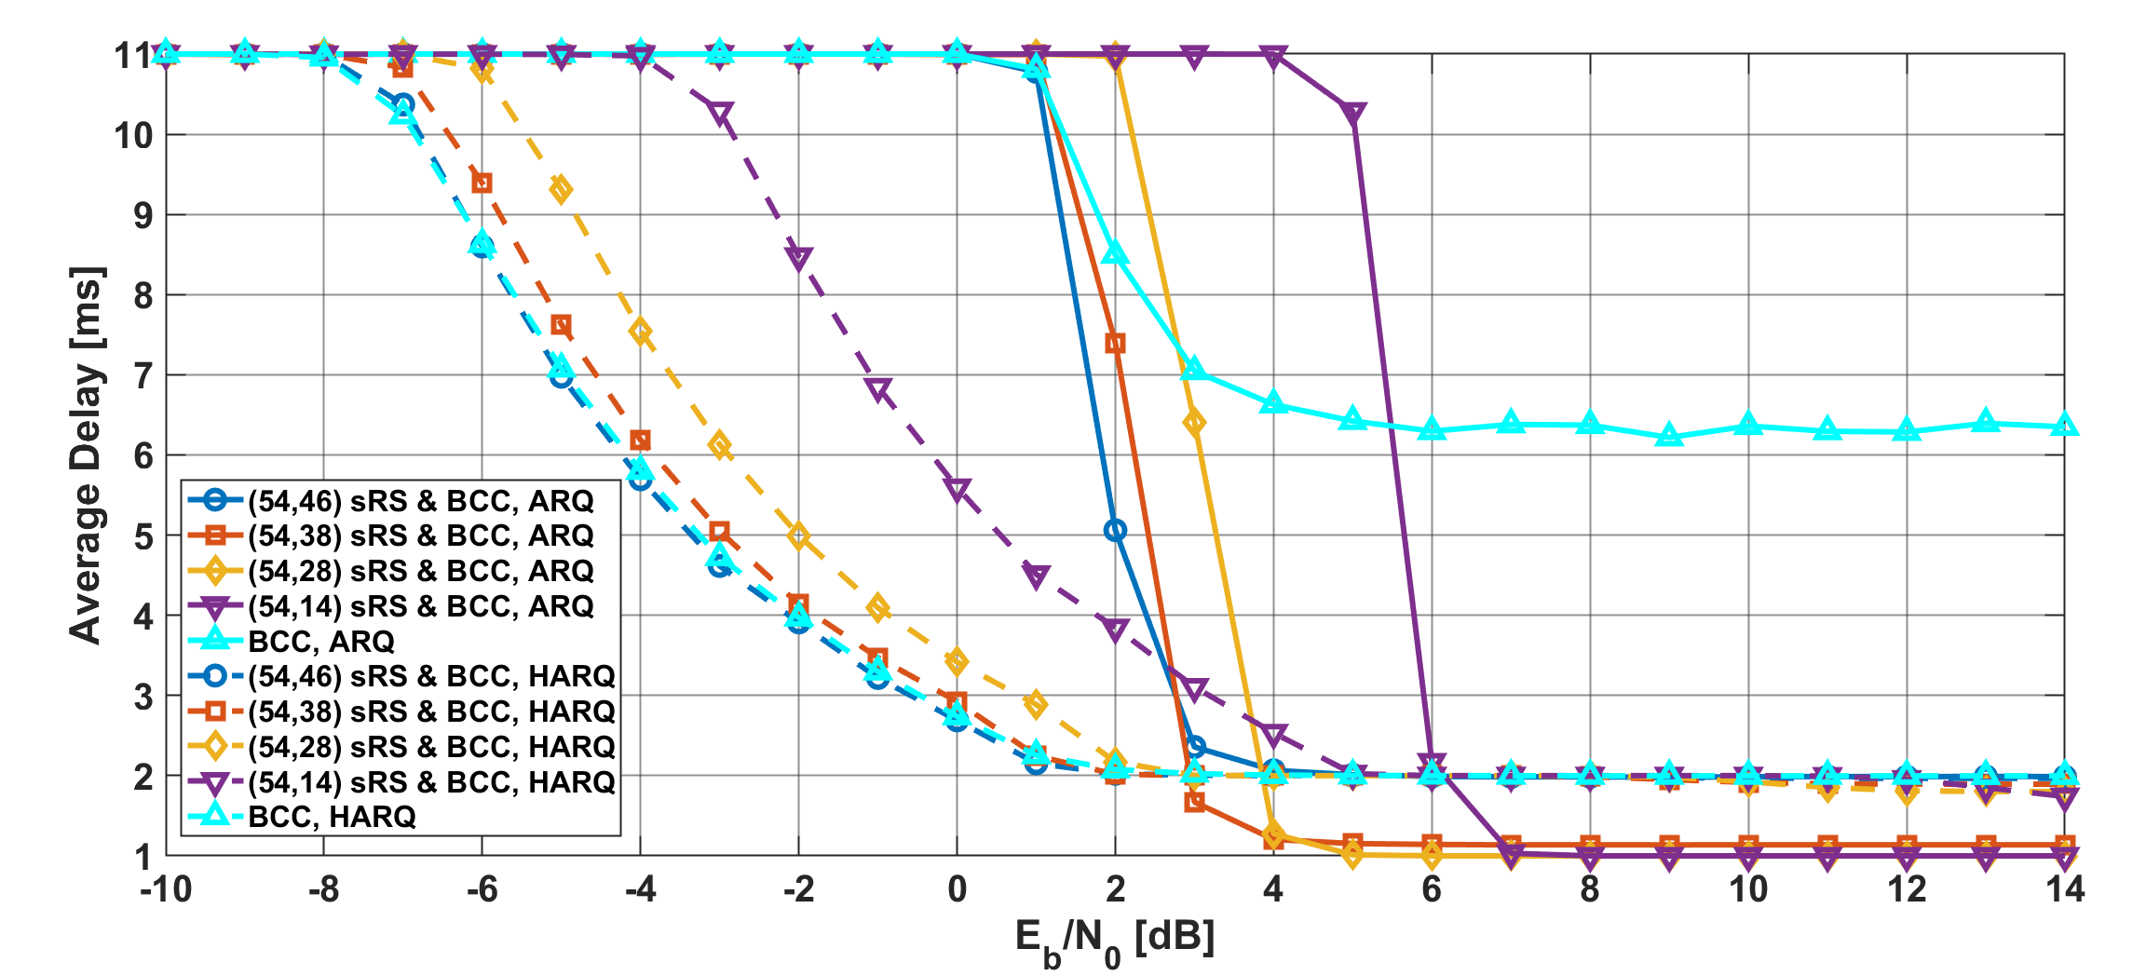
Results
Average delay as a function of $E_{b}/N_{0}$ in the case of BCC
Notes:
In addition, the average delay of HARQ is much lower than that of ARQ in low EsN0 regions.

Slide 18
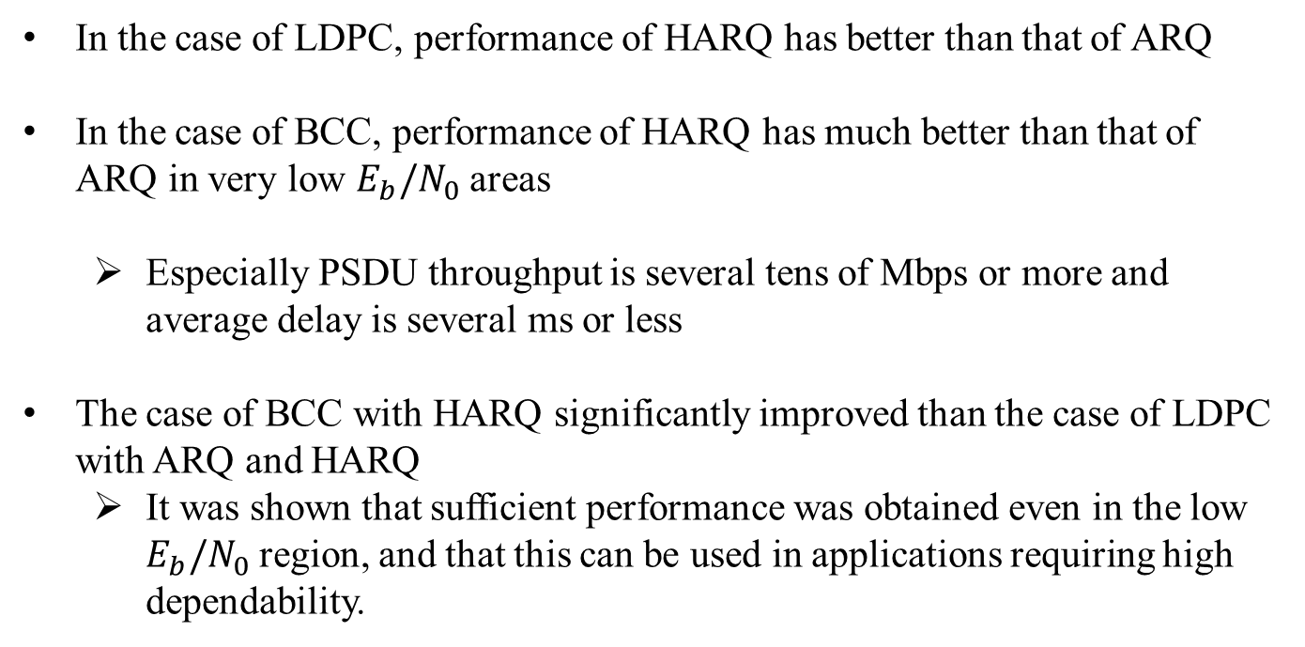
Conclusion
In the case of LDPC, performance of HARQ has better than that of ARQ
In the case of BCC, performance of HARQ has much better than that of ARQ in very low $E_{b}/N_{0}$ areas
  Especially PSDU throughput is several tens of Mbps or more and average delay is several ms or less
The case of BCC with HARQ significantly improved than the case of LDPC with ARQ and HARQ
  It was shown that sufficient performance was obtained even in the low $E_{b}/N_{0}$ region, and that this can be used in applications requiring high dependability.

Slide 19
Thank you for your attention ! ! !

Slide 20
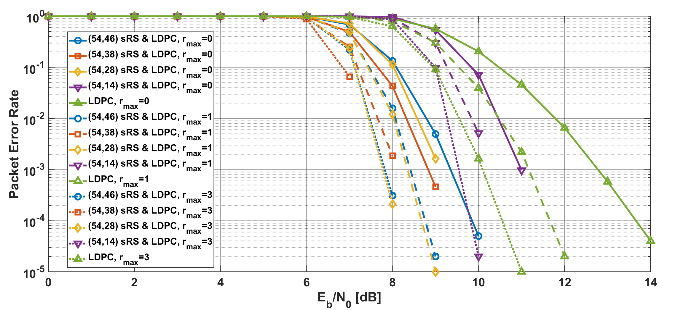
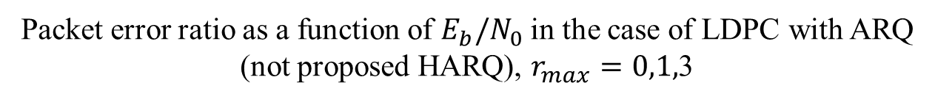
Results
Packet error ratio as a function of $E_{b}/N_{0}$ in the case of LDPC with ARQ (not proposed HARQ), $r_{max}=0,1,$3
Notes:
Basically, as $r_{max}$ increased, the PER has improved.

Slide 21
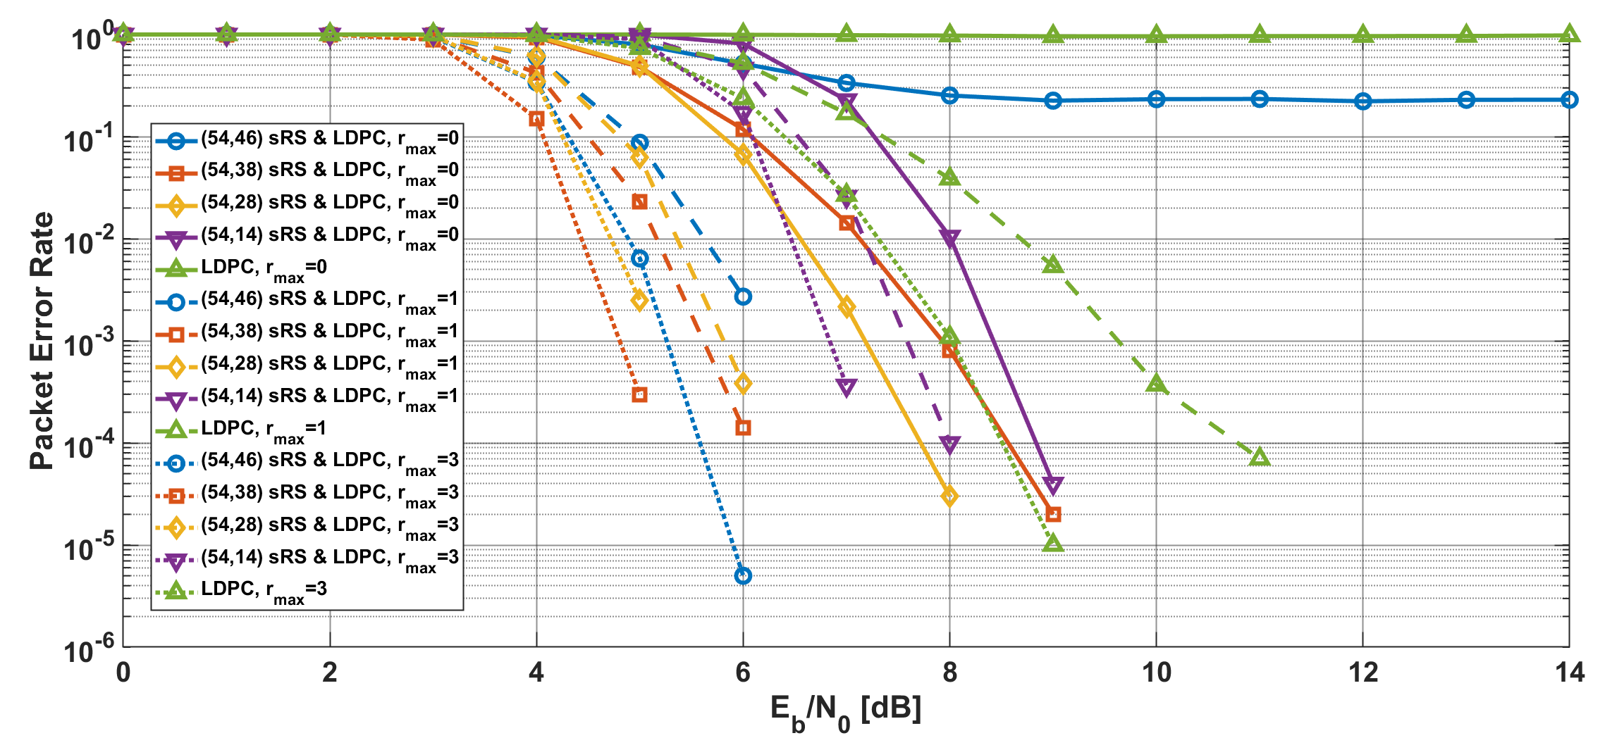
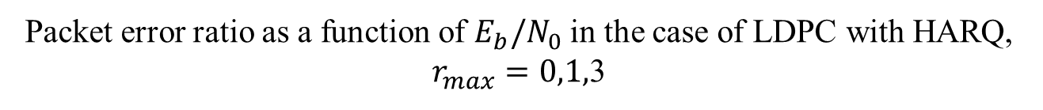
Results
Packet error ratio as a function of $E_{b}/N_{0}$ in the case of LDPC with HARQ, $r_{max}=0,1,$3
Notes:
As compared with a simple ARQ case, HARQ using LDPC could improved the performance

Slide 22
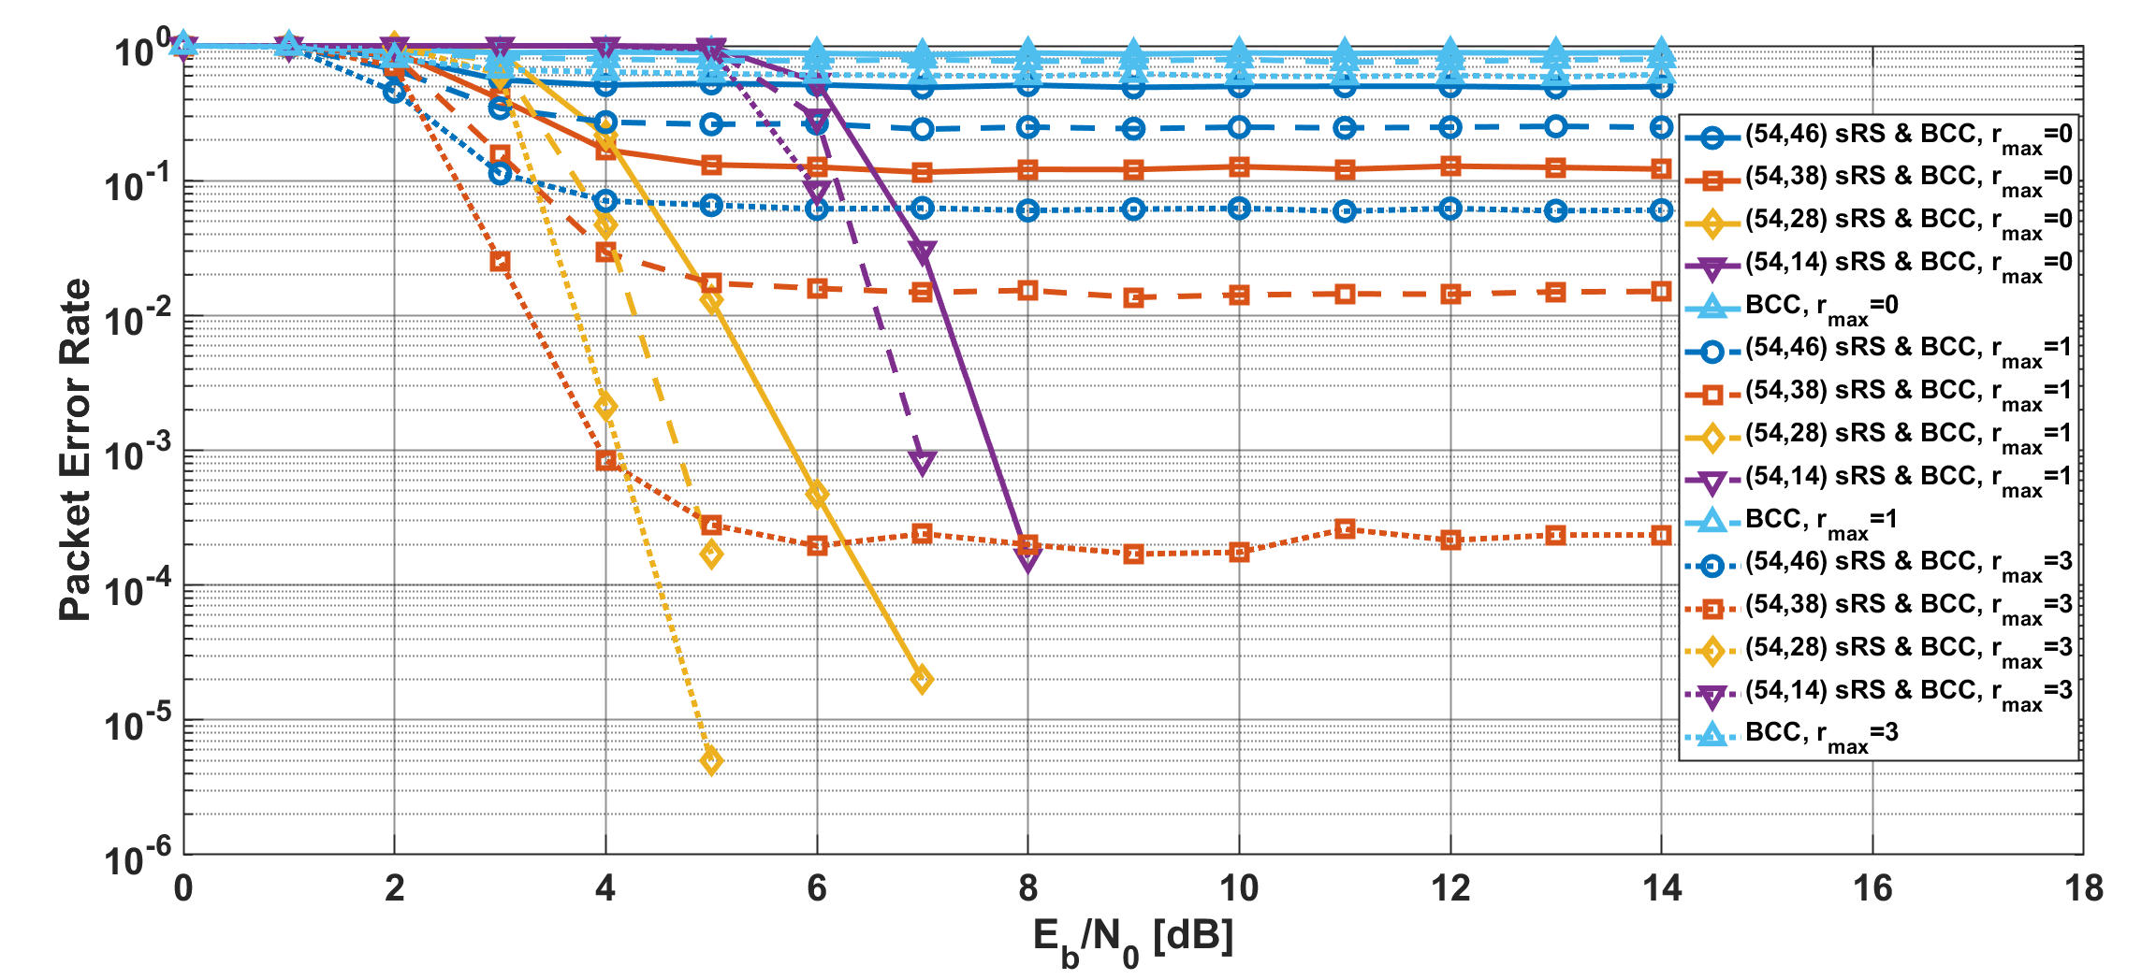

Results
Packet error ratio as a function of $E_{b}/N_{0}$ in the case of BCC with ARQ (not proposed HARQ), $r_{max}=0,1,$3
Notes:
In case of BCC with a simple ARQ, as $r_{max}$ increased, the PER has improved, however an error floor appeared

Slide 23
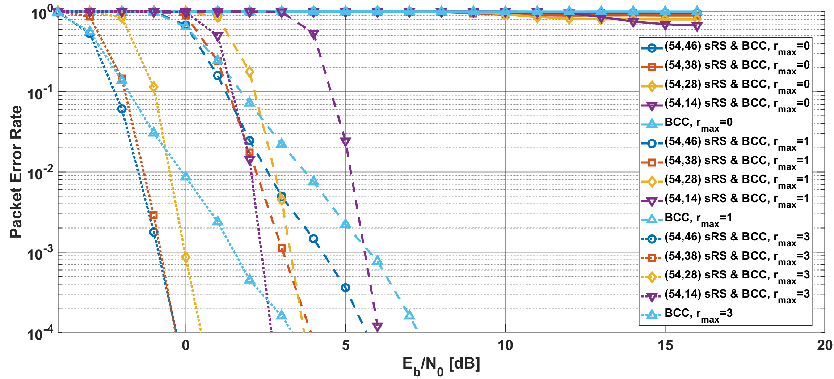
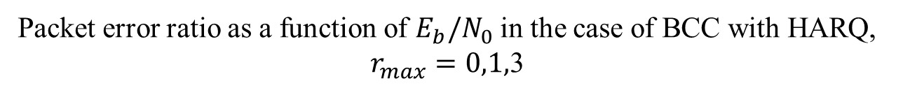
Results
Packet error ratio as a function of $E_{b}/N_{0}$ in the case of BCC with HARQ, $r_{max}=0,1,$3
Notes:
In case of BCC with HARQ, as $r_{max}$ increased, the PER has greatly improved compared with other schemes

Slide 24
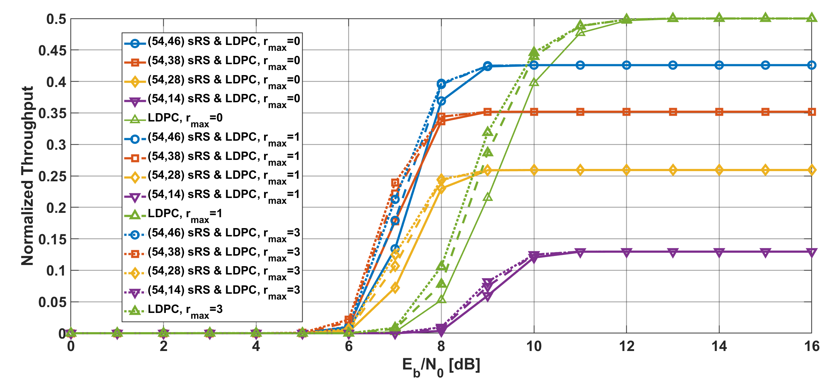
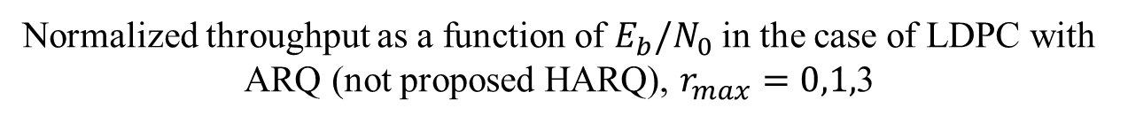
Results
Normalized throughput as a function of $E_{b}/N_{0}$ in the case of LDPC with ARQ (not proposed HARQ), $r_{max}=0,1,$3

Slide 25
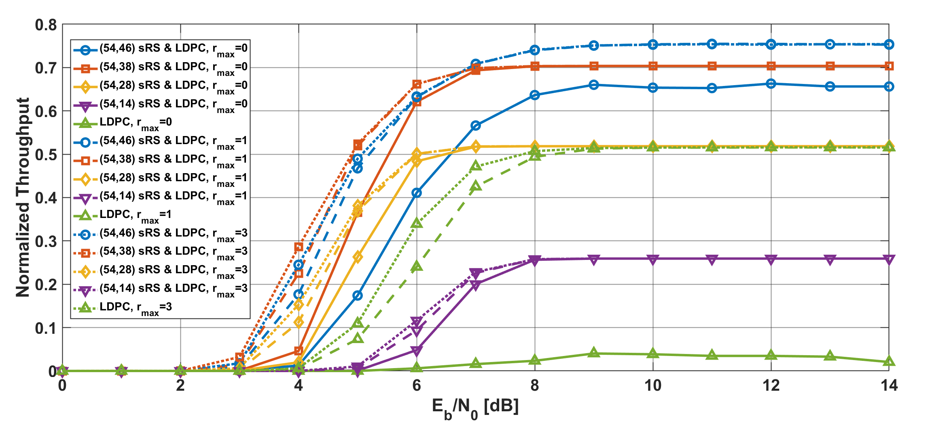
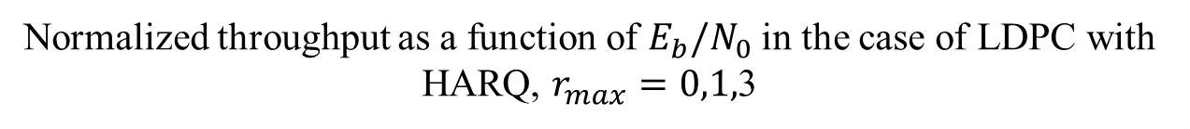
Results
Normalized throughput as a function of $E_{b}/N_{0}$ in the case of LDPC with HARQ, $r_{max}=0,1,$3
Notes:
As compared with a simple ARQ case, HARQ using LDPC could obtained the higher throughput

Slide 26
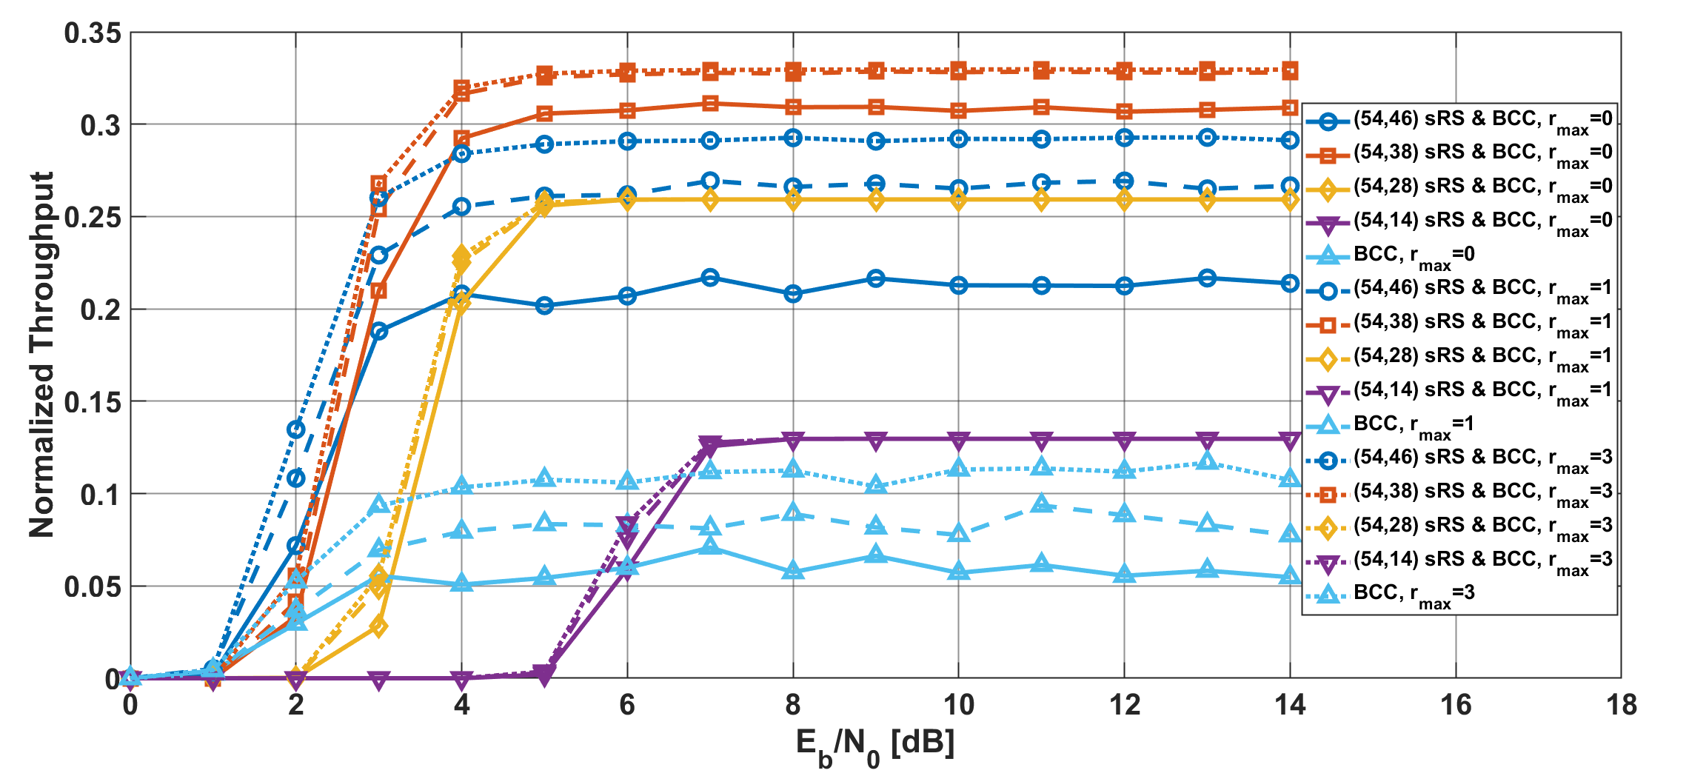
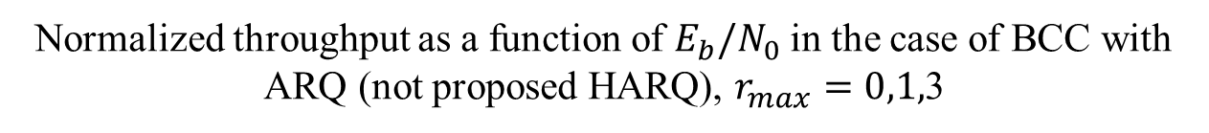
Results
Normalized throughput as a function of $E_{b}/N_{0}$ in the case of BCC with ARQ (not proposed HARQ), $r_{max}=0,1,$3

Slide 27
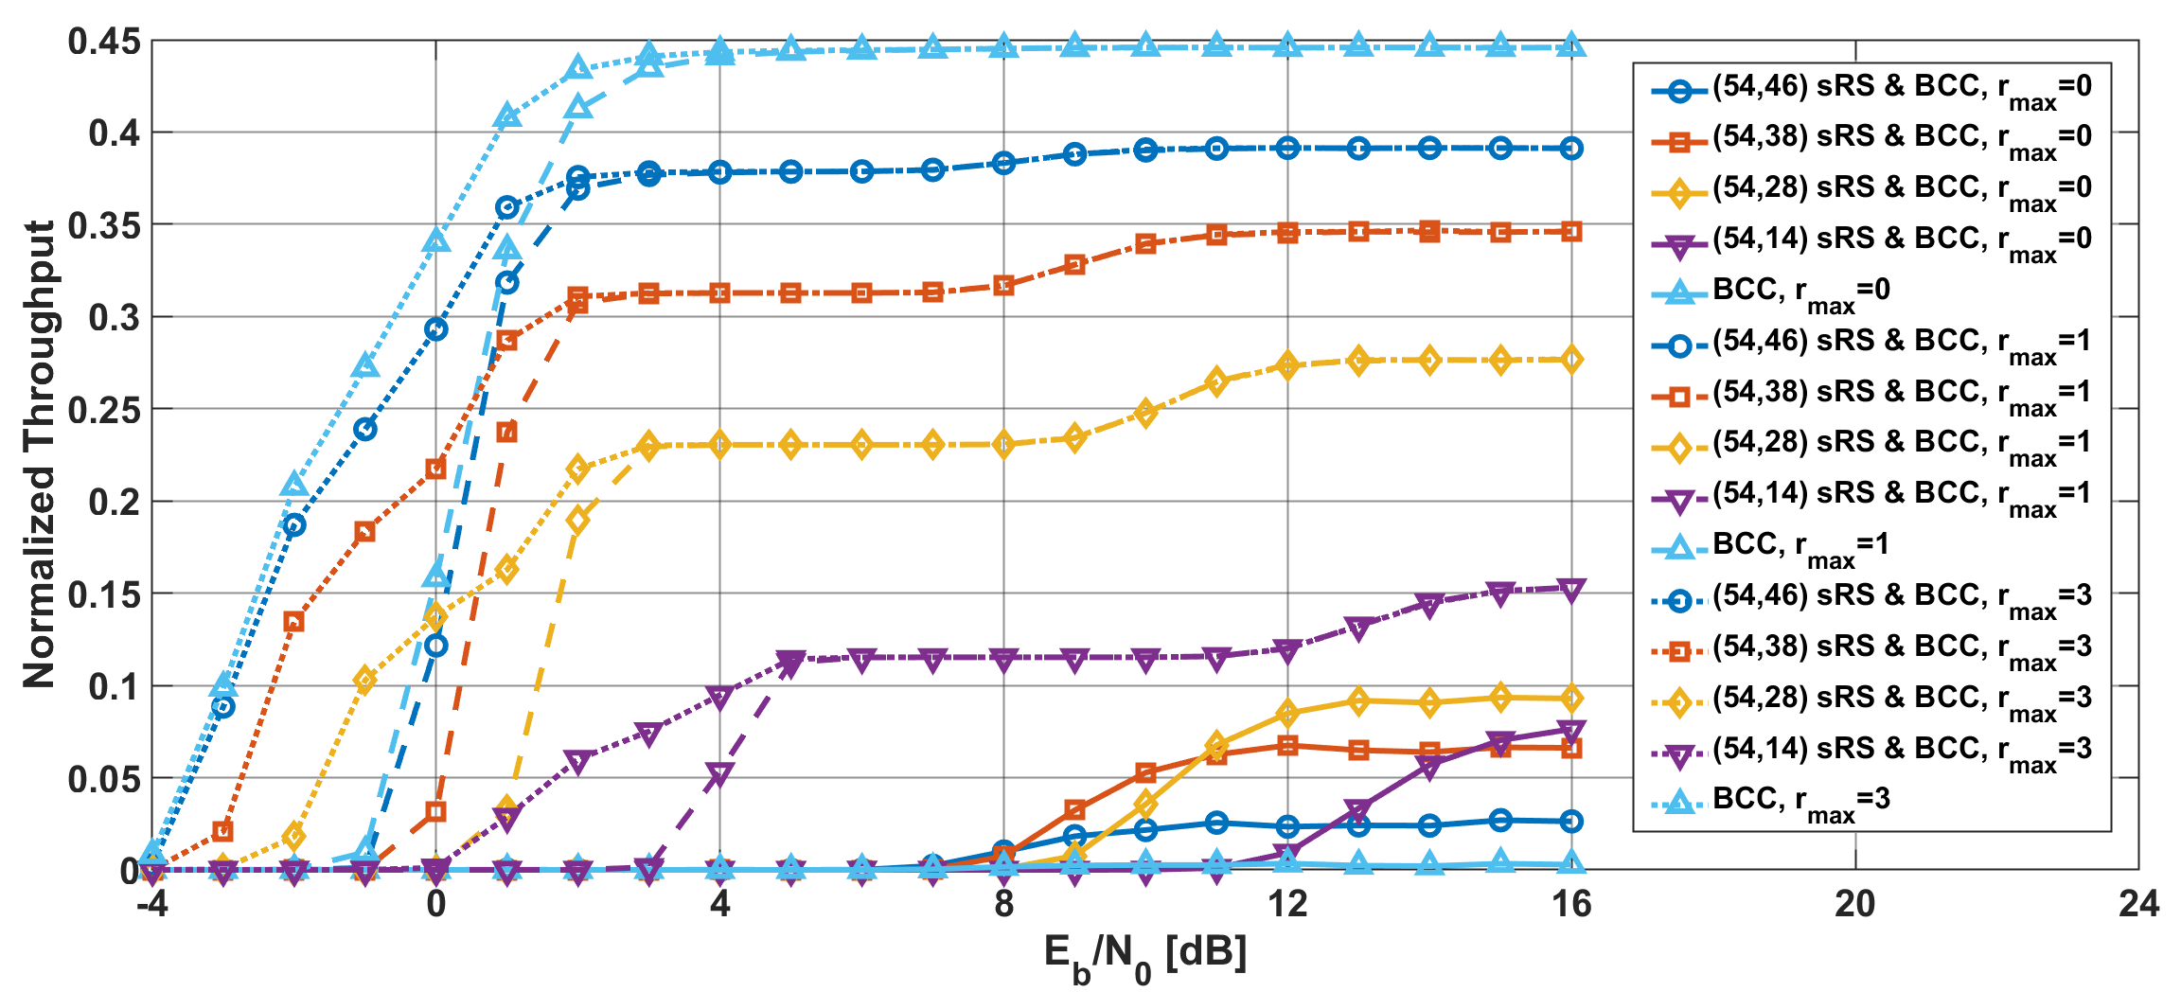
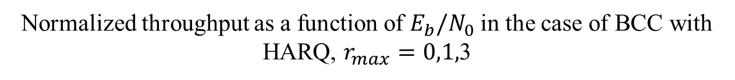
Results
Normalized throughput as a function of $E_{b}/N_{0}$ in the case of BCC with HARQ, $r_{max}=0,1,$3
Notes:
HARQ using BCC obtained the higher throughput than a simple ARQ with BCC and LDPC

