Slide 1
Project: IEEE P802.15 Working Group for Wireless Specialty Networks
Submission Title: Hybrid ARQ Scheme for High QoS Packets in High Class of Coexistence of IEEE 802.15.6ma
Date Submitted: 16 July 2024
Source: Kento Takabayashi¹, Daisuke Anzai², Ryuji Kohno^{3,4}
Company: (1) Toyo University (2) Nagoya Institute of Technology (3)Yokohama National University (4) YRP International Alliance Institute
Address: (1) 2100 Kujirai, Kawagoe, Saitama, Japan 351-8585, (3)79-5 Tokiwadai, Hodogaya-ku, Yokohama, 240-8501 Japan,
(4) YRP1 Blg., 3-4 Hikarinooka, Yokosuka-City, Kanagawa, 239-0847 Japan
Voice:[(1) +81-866-94-2104 , (3) +81-90-5408-0611] E-Mail:[takabayashi.kento.xp@gmail.com, kohno@ynu.ac.jp, kohno@yrp-iai.jp]
Re: In response to call for technical contributions
Abstract: The HARQ mechanism for IEEE 802.15.6ma is provided. IEEE 802.15.6ma will deal with various QoS level data. Hence, it is required to consider an error control scheme corresponding to these QoS. We introduce the HARQ for the highest coexistence environment class and the high QoS level data.
Purpose: Material for discussion in P802.15.6ma TG corresponding to comments in EC Meeting
Notice: This document has been prepared to assist the IEEE P802.15. It is offered as a basis for discussion and is not binding on the contributing individual(s) or organization(s). The material in this document is subject to change in form and content after further study. The contributor(s) reserve(s) the right to add, amend or withdraw material contained herein.
Release: The contributor acknowledges and accepts that this contribution becomes the property of IEEE and may be made publicly available by P802.15.

Slide 2
Hybrid ARQ Scheme for High QoS Packets in High Class of Coexistence of IEEE 802.15.6ma
July 2024,
Hybrid Session,
Sheraton Le Centre Montreal, Montreal, Quebec, Canada
Kento Takabayashi ⁽¹⁾, Daisuke Anzai⁽²⁾, Ryuji Kohno^{(3,4)}
(1) Toyo University (2) Nagoya Institute of Technology (3)Yokohama National University (4) YRP International Alliance Institute

Slide 3
Importance of QoS control
In WBAN systems, a wearable vital sign sensor node can include various types of sensors with different data rates, the allowable communication error ratio and delay
IEEE 802.15.6 based WBAN may deal with 8 levels of user priority data
Those data have a wide range of quality of service (QoS)
Therefore, optimal error control for input data is an important feature in sensor data transmission procedures
User priority | Traffic designation | Frame type
0 | Background (BK) | Data
1 | Best effort (BE) | Data
2 | Excellent effort (EE) | Data
3 | Video (VI) | Data
4 | Voice (VO) | Data
5 | Medical data or network control | Data or management
6 | High-priority medical data or network control | Data or management
7 | Emergency or medical implant event report | Data

Slide 4
Coexistence environment level
Coexistence environment class | Environment
0 | 6ma BAN only
1 [1a] | Multiple 6ma BANs 1a
2 [1b] | Multiple 15.6 & 6ma BANs
3 | Multiple 6ma BANs & non-UWB systems (Wi-Fi & Unlicensed 3GPP)
4 [2a] | Multiple 6ma BANs & 802.15 UWB systems
5 [2b] | Multiple 6ma BANs, non-802.15 UWB systems (ETSI UWB systems)
6 [2c] | Multiple 6ma BANs & 802.15 UWB & non-802.15 UWB systems (ETSI UWB)
7 | Multiple 6ma BANs & non-UWB systems (Wi-Fi & Unlicensed 3GPP) & 802.15 UWB & non-802.15 UWB systems (ETSI UWB)
  A hybrid ARQ (HARQ) shall be utilized at the highest class “7”
  15.6ma considers the half-rate BCC and LDPC as an error correcting code
    A HARQ scheme using those FEC is introduced

Slide 5
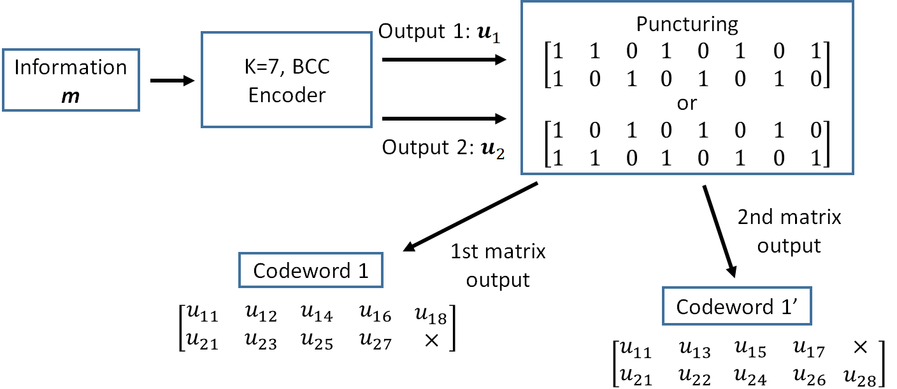
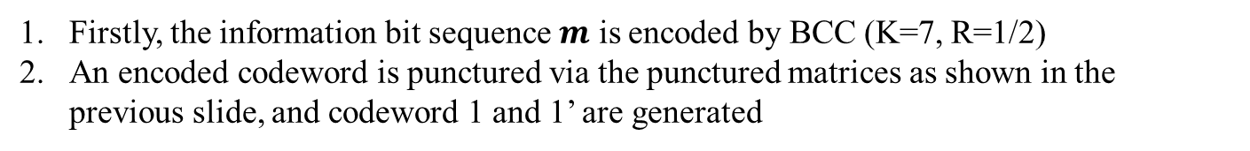
Hybrid ARQ mechanism (BCC case)
Firstly, the information bit sequence $m$ is encoded by BCC (K=7, R=1/2)
An encoded codeword is punctured via the punctured matrices as shown in the previous slide, and codeword 1 and 1’ are generated

Slide 6
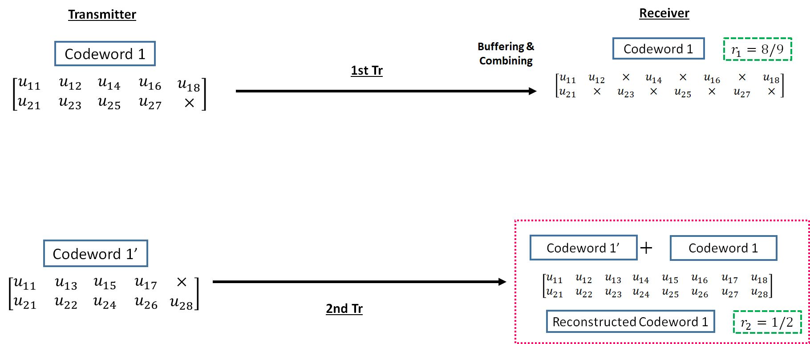
Hybrid ARQ mechanism (BCC case)
3. The codeword 1 is transmitted to a receiver
4. If bit errors are detected after decoding the codeword 1, a receiver buffers the transmitted codeword 1, and a transmitter re-sends the codeword 1’ to a receiver
5. At the receiver, transmitted codeword 1’ is combined with a buffered codeword 1, and a reconstructed codeword 1 (R=1/2) is generated

Slide 7
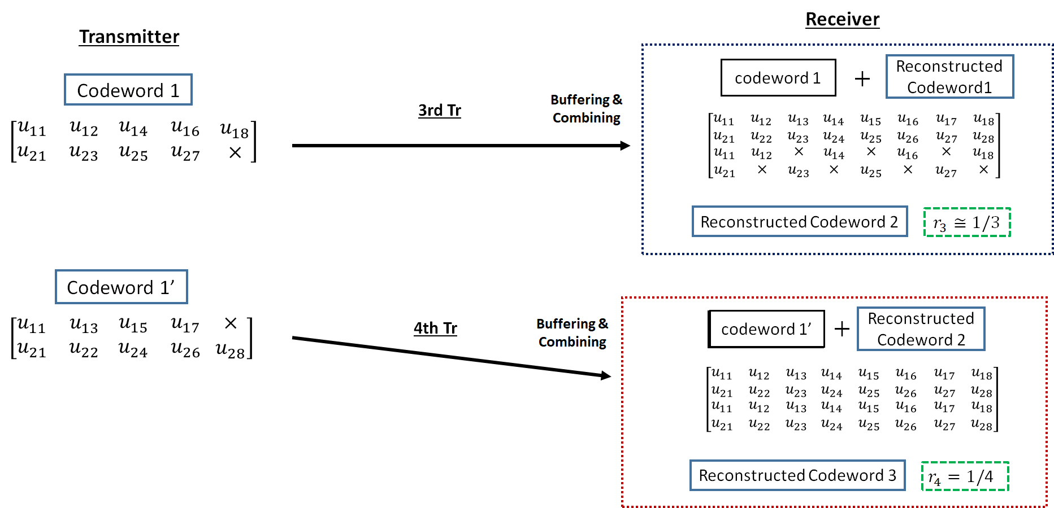
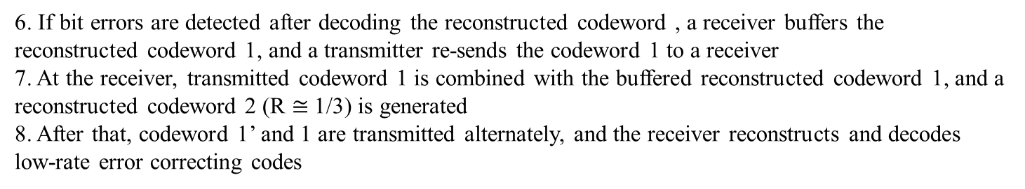
Hybrid ARQ mechanism (BCC case)
6. If bit errors are detected after decoding the reconstructed codeword , a receiver buffers the reconstructed codeword 1, and a transmitter re-sends the codeword 1 to a receiver
7. At the receiver, transmitted codeword 1 is combined with the buffered reconstructed codeword 1, and a reconstructed codeword 2 (R $≅$1/3) is generated
8. After that, codeword 1’ and 1 are transmitted alternately, and the receiver reconstructs and decodes low-rate error correcting codes

Slide 8
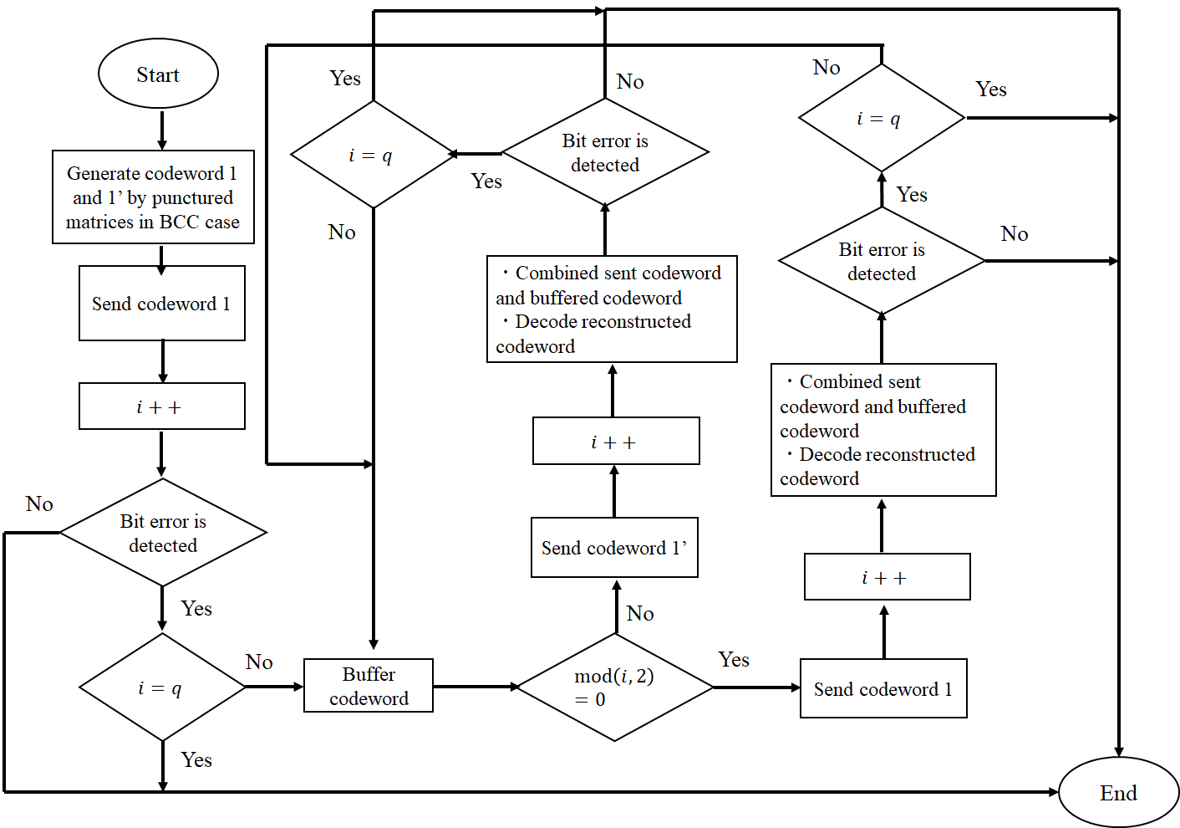
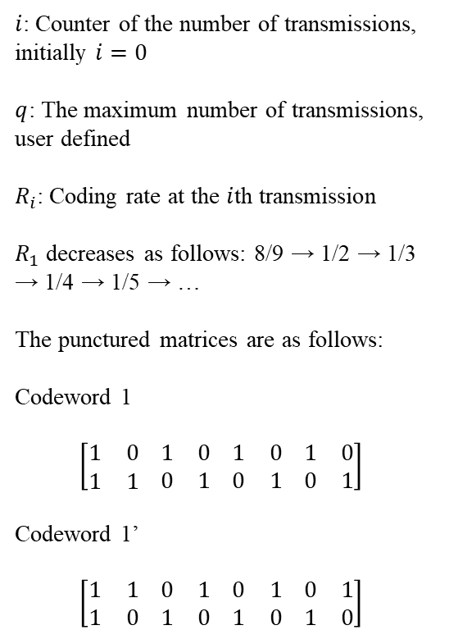
Hybrid ARQ mechanism (BCC case)
$i$: Counter of the number of transmissions, initially $i=0$
$q$: The maximum number of transmissions, user defined
$R_{i}$: Coding rate at the $i$th transmission
$R_{1}$ decreases as follows: 8/9 → 1/2 → 1/3 → 1/4 → 1/5 → …
The punctured matrices are as follows:
Codeword 1
$$\left[\begin{matrix}1 & 0 \\ 1 & 1\end{matrix} \begin{matrix}1 & 0 \\ 0 & 1\end{matrix} \begin{matrix}1 & 0 \\ 0 & 1\end{matrix} \begin{matrix}1 & 0 \\ 0 & 1\end{matrix}\right]$$
Codeword 1’
$$\left[\begin{matrix}1 & 1 \\ 1 & 0\end{matrix} \begin{matrix}0 & 1 \\ 1 & 0\end{matrix} \begin{matrix}0 & 1 \\ 1 & 0\end{matrix} \begin{matrix}0 & 1 \\ 1 & 0\end{matrix}\right]$$

Slide 9
Concept of Hybrid ARQ mechanism
Advantages of the hybrid ARQ mechanism
  The coding rate is very wide
    Bit errors are sufficiently eliminated at the high coding rate under very good channel conditions
    Very low coding rates remove bit errors under bad channel conditions
    A coding rate at the first transmission may be changed according to channel conditions
  In the case of the small number of retransmissions, it is sufficient to transmit the small number of redundant bits
    This characteristic leads to improvement of energy efficiency and reduction of transmission delay at retransmission

Slide 10
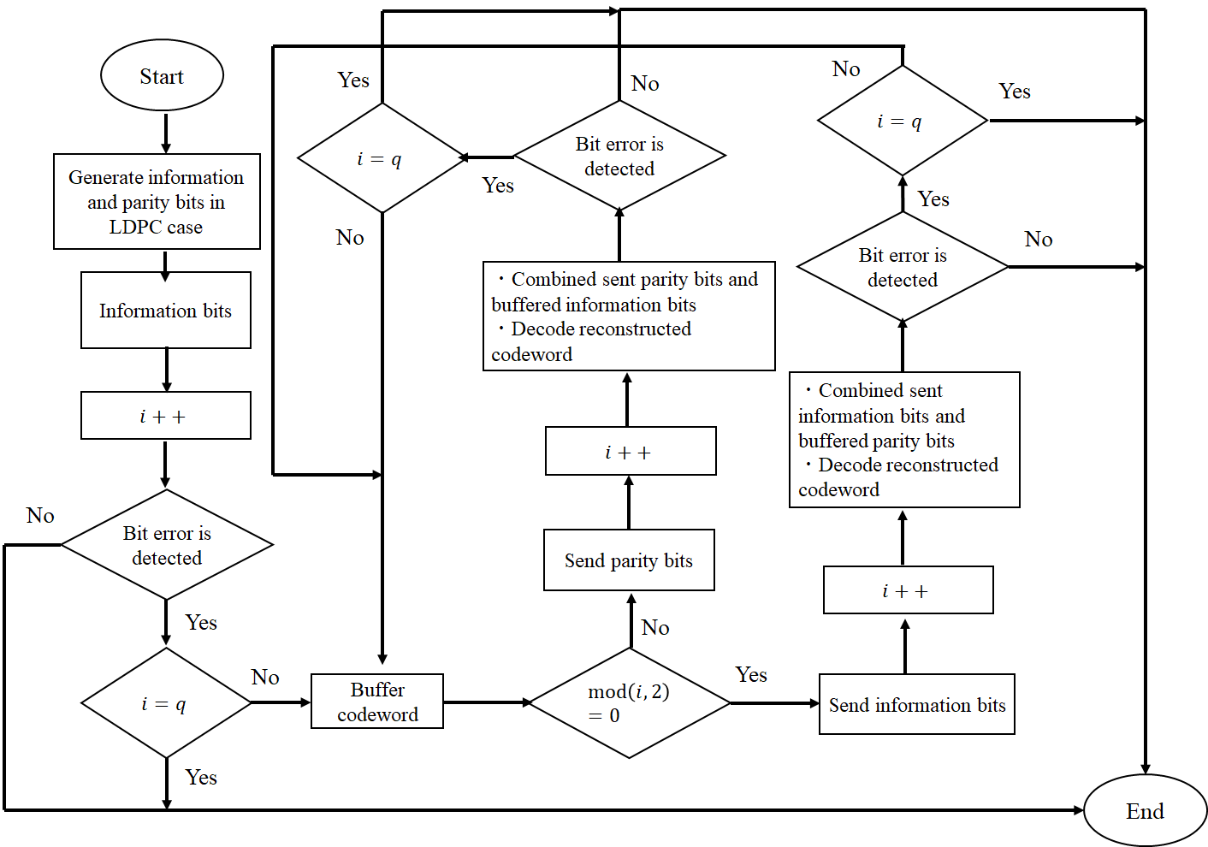
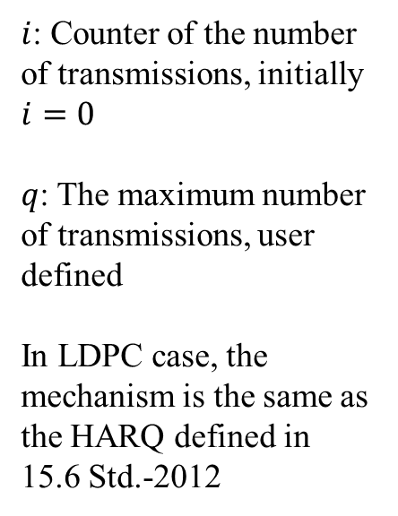
Hybrid ARQ mechanism (LDPC case)
$i$: Counter of the number of transmissions, initially $i=0$
$q$: The maximum number of transmissions, user defined
In LDPC case, the mechanism is the same as the HARQ defined in 15.6 Std.-2012

Slide 11
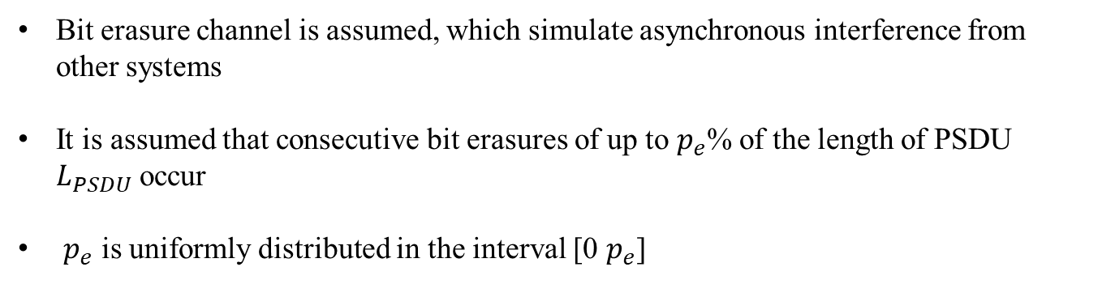
Bit erasure channel
0 1 1 0 0 1 0 0 1・・・0 1 1 1 ✕ ✕ ✕ ✕ ✕ ✕ ・・・0 1 1 0 0 0 1 1
Consecutive bit erasures
Bit erasure channel is assumed, which simulate asynchronous interference from other systems
It is assumed that consecutive bit erasures of up to $p_{e}$% of the length of PSDU $L_{PSDU}$ occur
$p_{e}$ is uniformly distributed in the interval [0 $p_{e}$]

Slide 12
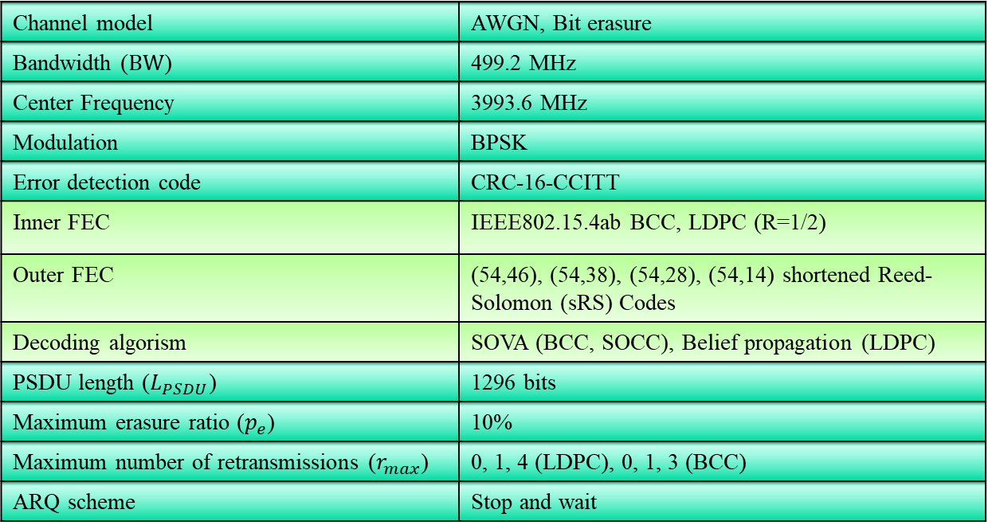
Evaluation
Channel model | AWGN, Bit erasure
Bandwidth ($BW$) | 499.2 MHz
Center Frequency | 3993.6 MHz
Modulation | BPSK
Error detection code | CRC-16-CCITT
Inner FEC | IEEE802.15.4ab BCC, LDPC (R=1/2)
Outer FEC | (54,46), (54,38), (54,28), (54,14) shortened Reed-Solomon (sRS) Codes
Decoding algorism | SOVA (BCC, SOCC), Belief propagation (LDPC)
PSDU length ($L_{PSDU}$) | 1296 bits
Maximum erasure ratio ($p_{e}$) | 10%
Maximum number of retransmissions ($r_{max}$) | 0, 1, 4 (LDPC), 0, 1, 3 (BCC)
ARQ scheme | Stop and wait
Those simulations applied those FEC and a simple ARQ, not the proposed HARQ

Slide 13
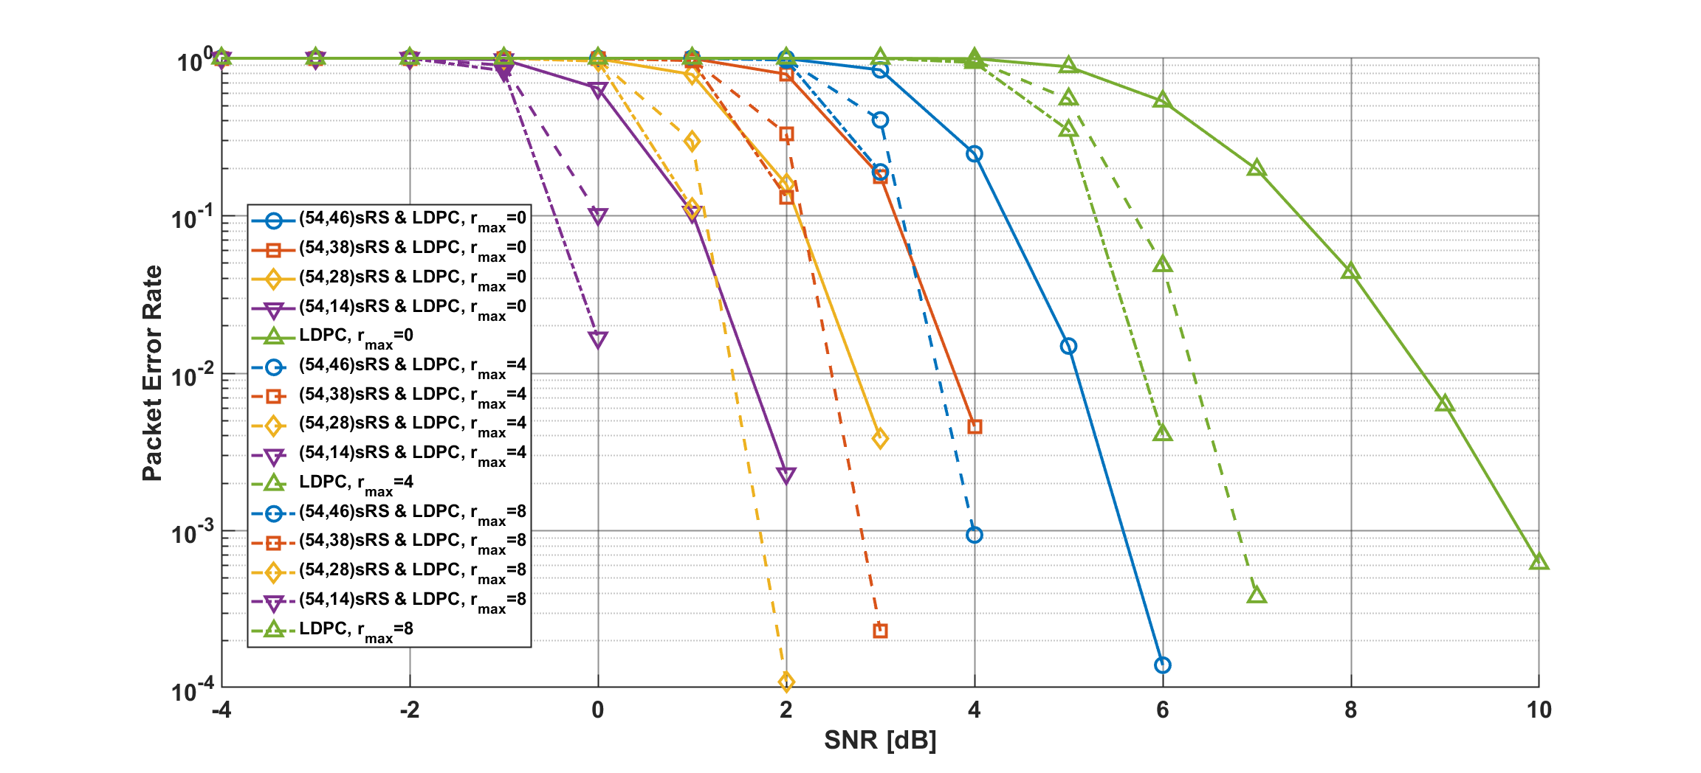
Results
Packet error ratio in the case of LDPC and ARQ, $r_{max}=0,4,8$
Notes:
In the case of LDPC and ARQ, PER improved as $r_{max}$ increased, and no error floor occurred

Slide 14
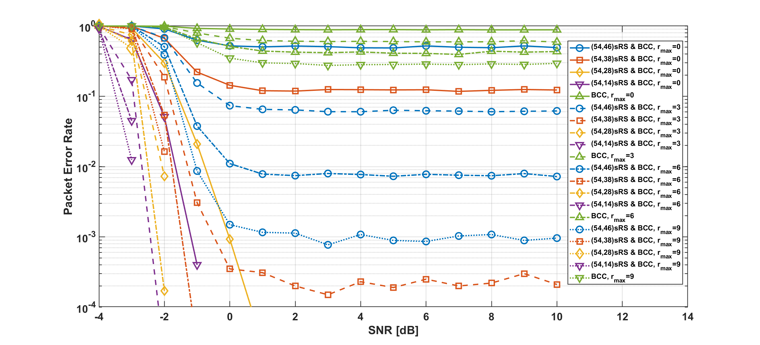
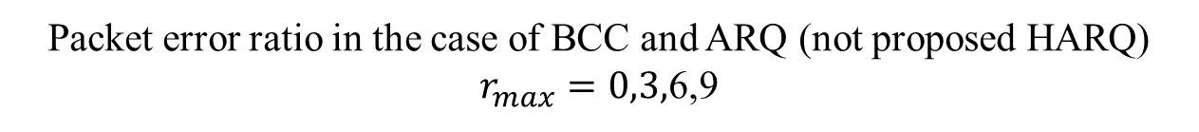
Results
Packet error ratio in the case of BCC and ARQ (not proposed HARQ)
$r_{max}=0,3,$6,9
Notes:
As $r_{max}$ was increased, BCC and high-rate shortened RS code archived PER of less than 10 to the power of -3
However, error floor occurred depending on the coding rate of RS codes and whether RS codes is applied

Slide 15
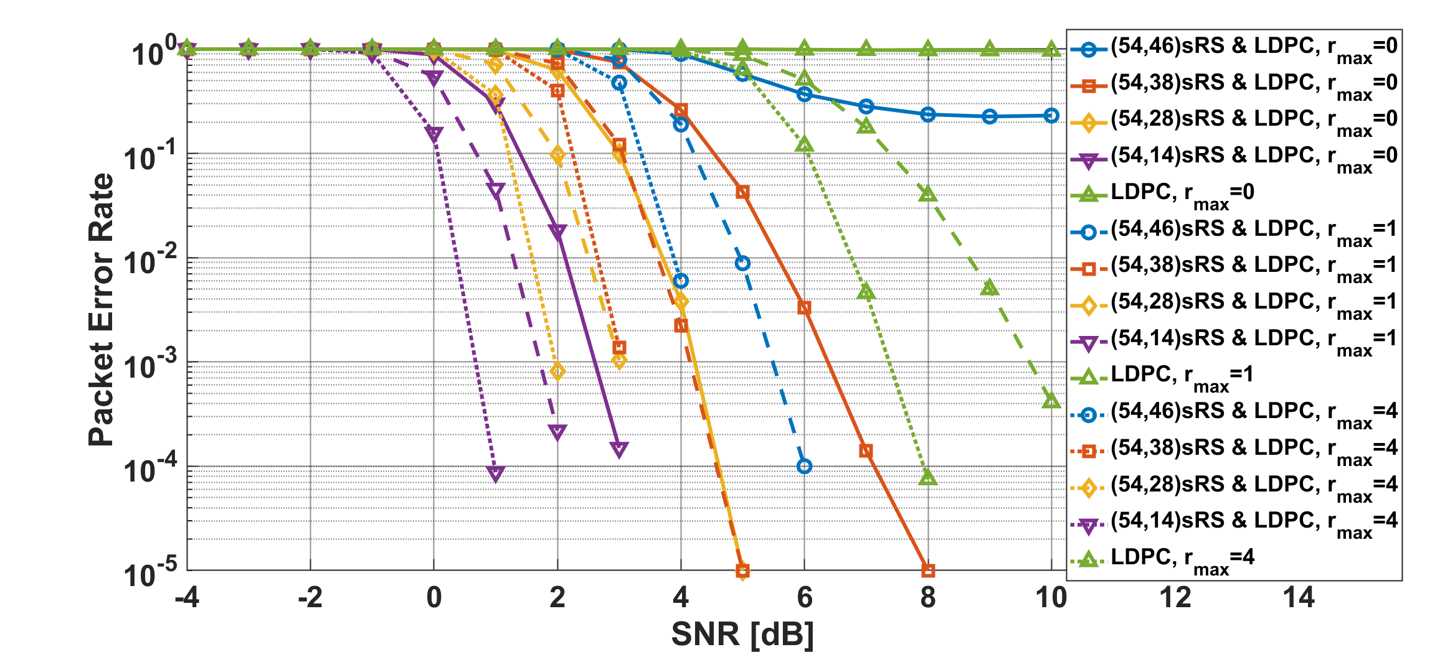
Results
Packet error ratio in the case of LDPC and HARQ, $r_{max}=0,1,4$
Notes:
In the case of LDPC and ARQ, PER improved as $r_{max}$ increased, and no error floor occurred

Slide 16
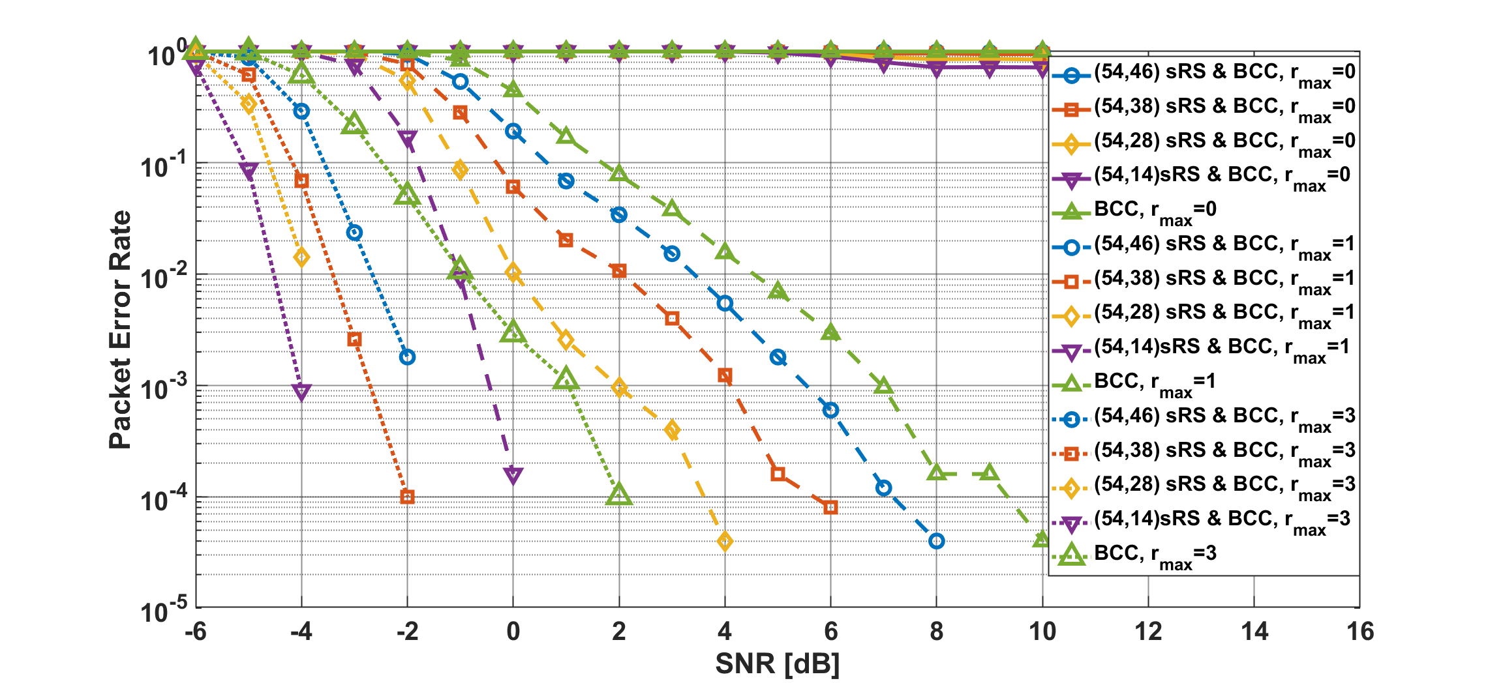
Results
Packet error ratio in the case of BCC and HARQ, $r_{max}=0,1,$3
Notes:
In the case of BCC and ARQ, PER significantly improved as $r_{max}$ increased, and no error floor occurred because of decreasing the coding rate

Slide 17
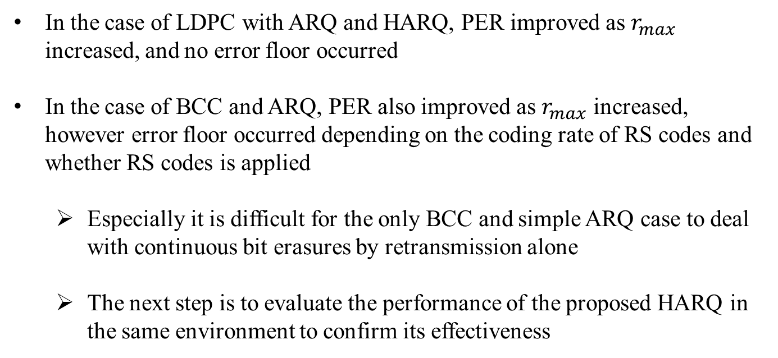
Summary
In the case of LDPC with ARQ and HARQ, PER improved as $r_{max}$ increased, and no error floor occurred
In the case of BCC and ARQ, PER also improved as $r_{max}$ increased, however error floor occurred depending on the coding rate of RS codes and whether RS codes is applied
  Especially it is difficult for the only BCC and simple ARQ case to deal with continuous bit erasures by retransmission alone
  The next step is to evaluate the performance of the proposed HARQ in the same environment to confirm its effectiveness

Slide 18
Thank you for your attention ! ! !

