Slide 1
Project: IEEE P802.15 Working Group for Wireless Specialty Networks
Submission Title: Hybrid ARQ Scheme for High QoS Packets in High Class of Coexistence of IEEE 802.15.6ma
Date Submitted: 13 March 2024
Source: Kento Takabayashi¹, Ryuji Kohno^{2,3}
Company: (1) Toyo University (2)Yokohama National University (3) YRP International Alliance Institute
Address: (1) 2100 Kujirai, Kawagoe, Saitama, Japan 351-8585, (2)79-5 Tokiwadai, Hodogaya-ku, Yokohama, 240-8501 Japan,
(3) YRP1 Blg., 3-4 Hikarinooka, Yokosuka-City, Kanagawa, 239-0847 Japan
Voice:[(1) +81-866-94-2104 , (2) +81-90-5408-0611] E-Mail:[takabayashi.kento.xp@gmail.com, kohno@ynu.ac.jp, kohno@yrp-iai.jp]
Re: In response to call for technical contributions
Abstract: The HARQ mechanism for IEEE 802.15.6ma is provided. IEEE 802.15.6ma will deal with various QoS level data. Hence, it is required to consider an error control scheme corresponding to these QoS. We introduce the HARQ for the highest coexistence environment class and the high QoS level data.
Purpose: Material for discussion in P802.15.6ma TG corresponding to comments in EC Meeting
Notice: This document has been prepared to assist the IEEE P802.15. It is offered as a basis for discussion and is not binding on the contributing individual(s) or organization(s). The material in this document is subject to change in form and content after further study. The contributor(s) reserve(s) the right to add, amend or withdraw material contained herein.
Release: The contributor acknowledges and accepts that this contribution becomes the property of IEEE and may be made publicly available by P802.15.

Slide 2
Hybrid ARQ Scheme for High QoS Packets in High Class of Coexistence of IEEE 802.15.6ma
March 2024,
Hybrid Session,
Hyatt Regency Convention Center - Denver, Co
Kento Takabayashi ⁽¹⁾, Ryuji Kohno^{(2, 3)}
⁽¹⁾ Toyo University
⁽²⁾ Yokohama National University,
⁽³⁾ YRP-International Alliance Institute

Slide 3
Importance of QoS control
In WBAN systems, a wearable vital sign sensor node can include various types of sensors with different data rates, the allowable communication error ratio and delay
IEEE 802.15.6 based WBAN may deal with 8 levels of user priority data
Those data have a wide range of quality of service (QoS)
Therefore, optimal error control for input data is an important feature in sensor data transmission procedures
User priority | Traffic designation | Frame type
0 | Background (BK) | Data
1 | Best effort (BE) | Data
2 | Excellent effort (EE) | Data
3 | Video (VI) | Data
4 | Voice (VO) | Data
5 | Medical data or network control | Data or management
6 | High-priority medical data or network control | Data or management
7 | Emergency or medical implant event report | Data

Slide 4
Error control in current IEEE 802.15.6
IEEE 802.15.6 shall use a (63, 51) BCH code as an error correcting code in narrowband, UWB and HBC PHY
Only user priority 6 data in UWB-PHY may use a hybrid ARQ with a (126, 63) shortened BCH code
However, the error control scheme of the current IEEE 802.15.6 cannot deal with the QoS because of lack of flexibility
In IEEE 802.15.6ma, we indicate a concept of channel coding technique to deal with various types of QoS data as shown in a next figure

Slide 5
Coexistence environment level
Coexistence environment class | Environment
0 | 6ma BAN only
1 [1a] | Multiple 6ma BANs 1a
2 [1b] | Multiple 15.6 & 6ma BANs
3 | Multiple 6ma BANs & non-UWB systems (Wi-Fi & Unlicensed 3GPP)
4 [2a] | Multiple 6ma BANs & 802.15 UWB systems
5 [2b] | Multiple 6ma BANs, non-802.15 UWB systems (ETSI UWB systems)
6 [2c] | Multiple 6ma BANs & 802.15 UWB & non-802.15 UWB systems (ETSI UWB)
7 | Multiple 6ma BANs & non-UWB systems (Wi-Fi & Unlicensed 3GPP) & 802.15 UWB & non-802.15 UWB systems (ETSI UWB)
  A hybrid ARQ (HARQ) shall be utilized at the highest class “7”
  15.6ma considers the half-rate BCC and LDPC as an error correcting code
    A HARQ scheme using those ECC is introduced

Slide 6
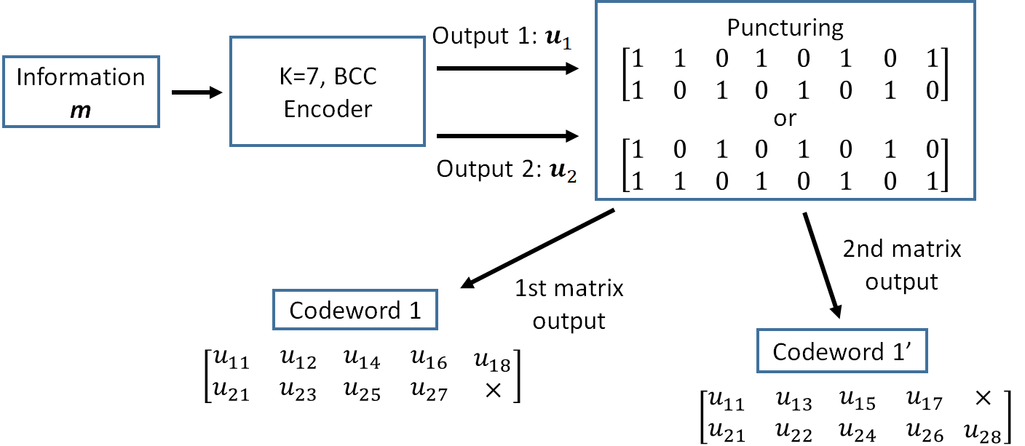
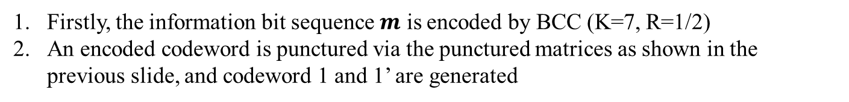
Hybrid ARQ mechanism (BCC case)
Firstly, the information bit sequence $m$ is encoded by BCC (K=7, R=1/2)
An encoded codeword is punctured via the punctured matrices as shown in the previous slide, and codeword 1 and 1’ are generated

Slide 7
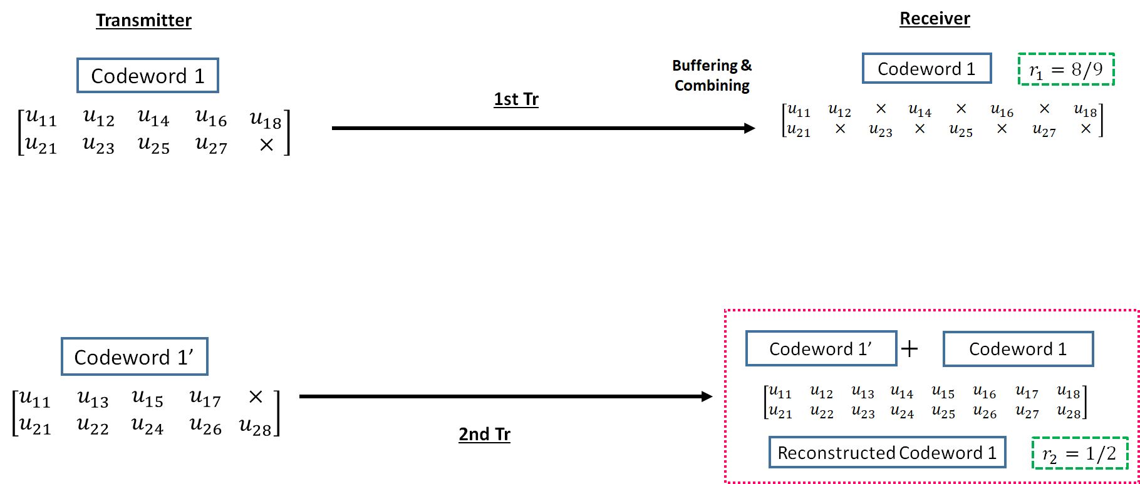
Hybrid ARQ mechanism (BCC case)
3. The codeword 1 is transmitted to a receiver
4. If bit errors are detected after decoding the codeword 1, a receiver buffers the transmitted codeword 1, and a transmitter re-sends the codeword 1’ to a receiver
5. At the receiver, transmitted codeword 1’ is combined with a buffered codeword 1, and a reconstructed codeword 1 (R=1/2) is generated

Slide 8
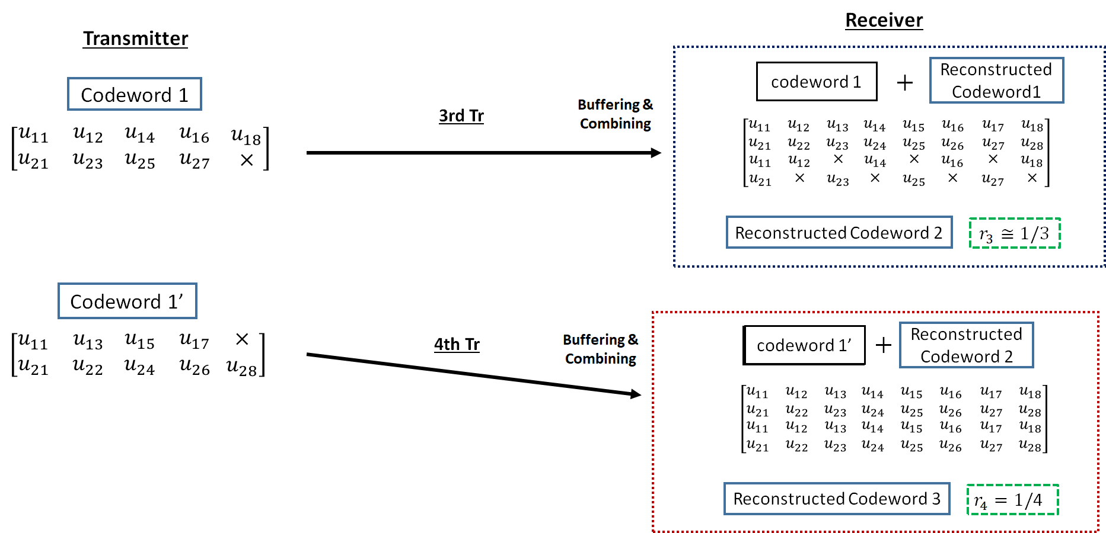
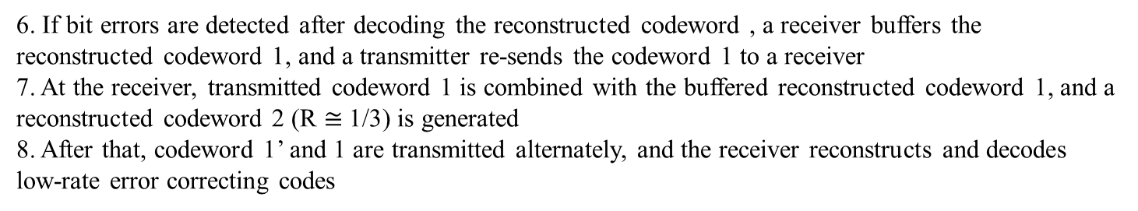
Hybrid ARQ mechanism (BCC case)
6. If bit errors are detected after decoding the reconstructed codeword , a receiver buffers the reconstructed codeword 1, and a transmitter re-sends the codeword 1 to a receiver
7. At the receiver, transmitted codeword 1 is combined with the buffered reconstructed codeword 1, and a reconstructed codeword 2 (R $≅$1/3) is generated
8. After that, codeword 1’ and 1 are transmitted alternately, and the receiver reconstructs and decodes low-rate error correcting codes

Slide 9
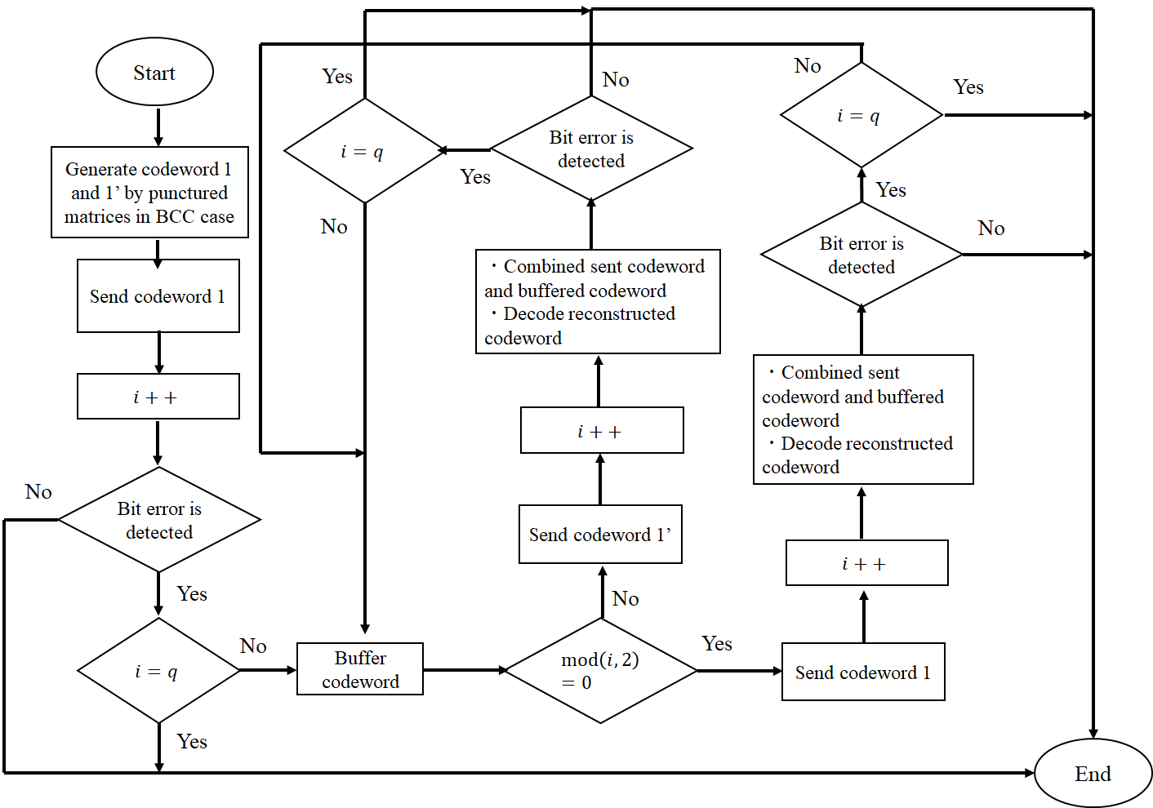
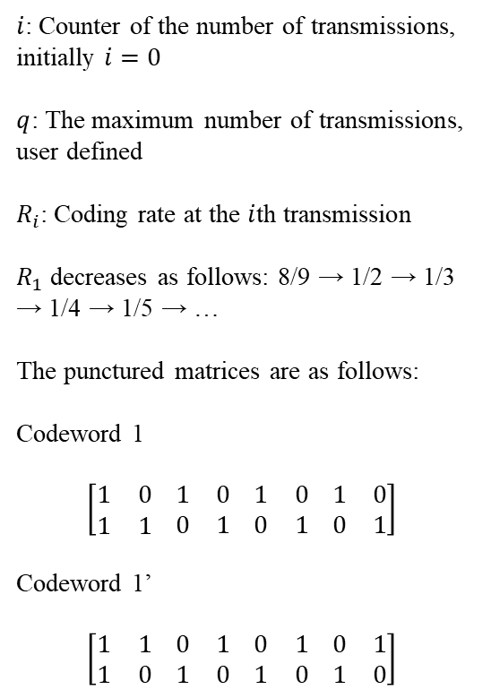
Hybrid ARQ mechanism (BCC case)
$i$: Counter of the number of transmissions, initially $i=0$
$q$: The maximum number of transmissions, user defined
$R_{i}$: Coding rate at the $i$th transmission
$R_{1}$ decreases as follows: 8/9 → 1/2 → 1/3 → 1/4 → 1/5 → …
The punctured matrices are as follows:
Codeword 1
$$\left[\begin{matrix}1 & 0 \\ 1 & 1\end{matrix} \begin{matrix}1 & 0 \\ 0 & 1\end{matrix} \begin{matrix}1 & 0 \\ 0 & 1\end{matrix} \begin{matrix}1 & 0 \\ 0 & 1\end{matrix}\right]$$
Codeword 1’
$$\left[\begin{matrix}1 & 1 \\ 1 & 0\end{matrix} \begin{matrix}0 & 1 \\ 1 & 0\end{matrix} \begin{matrix}0 & 1 \\ 1 & 0\end{matrix} \begin{matrix}0 & 1 \\ 1 & 0\end{matrix}\right]$$

Slide 10
Concept of Hybrid ARQ mechanism
Advantages of the hybrid ARQ mechanism
  The coding rate is very wide
    Bit errors are sufficiently eliminated at the high coding rate under very good channel conditions
    Very low coding rates remove bit errors under bad channel conditions
    A coding rate at the first transmission may be changed according to channel conditions
  In the case of the small number of retransmissions, it is sufficient to transmit the small number of redundant bits
    This characteristic leads to improvement of energy efficiency and reduction of transmission delay at retransmission

Slide 11
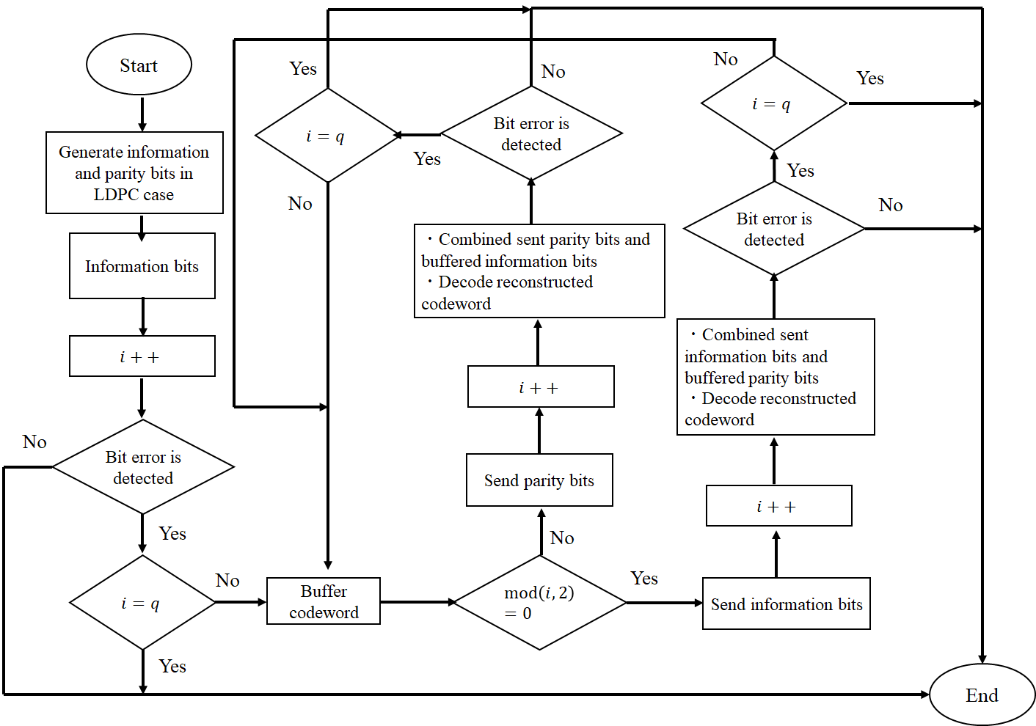
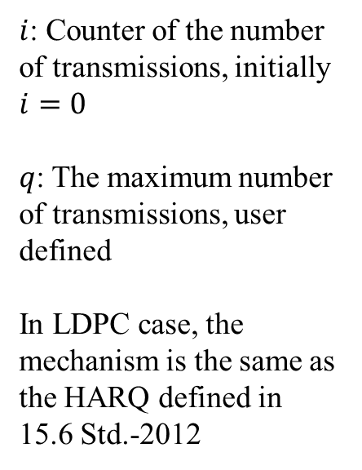
Hybrid ARQ mechanism (LDPC case)
$i$: Counter of the number of transmissions, initially $i=0$
$q$: The maximum number of transmissions, user defined
In LDPC case, the mechanism is the same as the HARQ defined in 15.6 Std.-2012

Slide 12
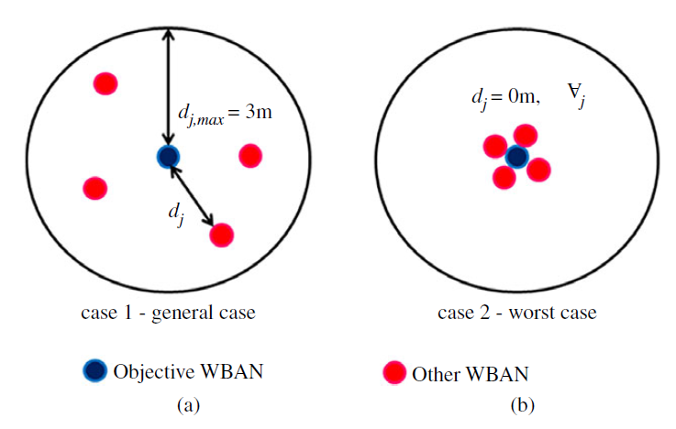
Two types of cases
and (b) present Case 1 (general case) and Case 2 (worst case)
Those cases are like class 7 case, and CM3 and CM4 are applied to those cases
Notes:
In Case 1, other WBANs followed a uniform distribution within 3 m of the objective WBAN
In Case 2, the other WBANs were placed more closely to the objective WBAN

Slide 13
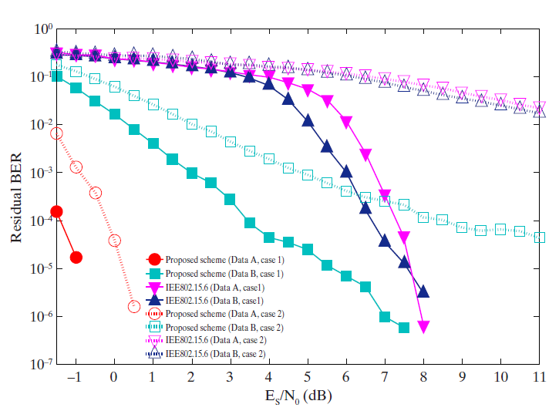
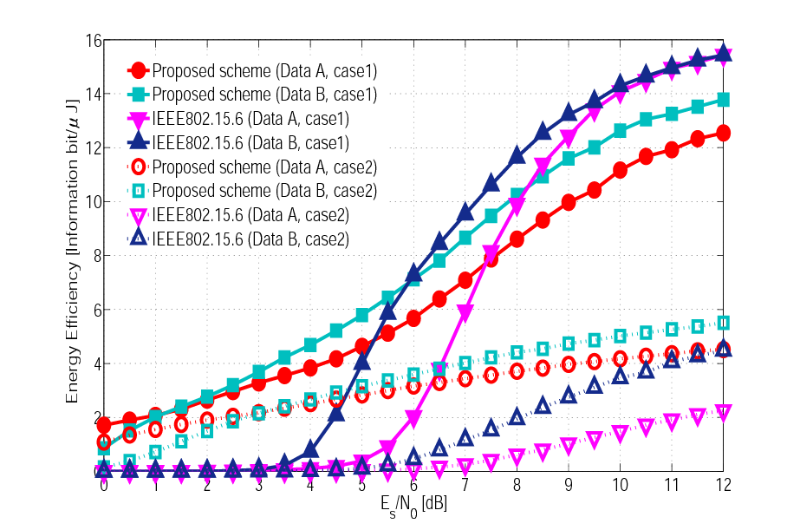
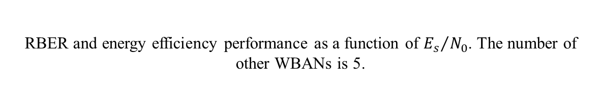
Previous results
(a)
(b)
RBER and energy efficiency performance as a function of ${E_{s}}/{N_{0}}$. The number of other WBANs is 5.
RBER means the bit error ratio at which the transmission failed beyond the maximum number of retransmissions

Slide 14
Summary
A hybrid ARQ shall be applied to coexistence class 7 (the highest class)
The BCC case decreases the coding rate depending on the number of retransmissions
The LDPC case is basically the same as the HARQ mechanism defined in 15.6 Std.-2012
We are currently building a simulator for those HARQ mechanism in a simple case and aim to present those result
  Previous results show that 15.6ma HARQ schemes are expected to be effective in class 7 case

Slide 15
Thank you for your attention ! ! !

