Slide 1
Project: IEEE P802.15 Working Group for Wireless Personal Area Networks (WPANs)
Submission Title: Wireless Next Generation Agenda and Meeting Slides
Date Submitted: November 13, 2023
Source: Benjamin A. Rolfe (Blind Creek Associates)
Contact:
Voice: +1 408 395 7207, E-Mail: ben.rolfe @ ieee.org
Re: Wireless Next Generation
Abstract: Agenda and Meeting Slides for the November 2023 Plenary Session.
Purpose: Support the illusion of organization.
Notice: This document has been prepared to assist the IEEE P802.15. It is offered as a basis for discussion and is not binding on the contributing individual(s) or organization(s). The material in this document is subject to change in form and content after further study. The contributor(s) reserve(s) the right to add, amend or withdraw material contained herein.
Release: The contributor acknowledges and accepts that this contribution becomes the property of IEEE and may be made publicly available by P802.15.
Notes:
Jul 12, 2010
Page 1

Slide 2
November 2023 802 Plenary

Slide 3
Hybrid Meeting
Registration is required
Please remember to enter your attendance in IMAT
Reminder:
This is a non-PAR activity
All the rules of conduct apply https://grouper.ieee.org/groups/802/sapolicies.shtml

Slide 4
Agenda 15 November 2023
Opening and Meeting Reminders
Presentations and discussion
Channel Measurements, sub-1GHz bands (Robert)
Next Generation Optical Camera Communication Standard (Yeong Min Jang)
Any other business
Adjourn

Slide 5
References
Sub-GHz license-exempt frequency use in Atlanta 15-23-0589-00
TBD

Slide 6
The usual question
What do you propose the Working Group do next?

Slide 7
The usual question
The Answer for 2.a):
Sharing information with the group

Slide 8
The usual question
What do you propose the Working Group do next?

Slide 9
The usual question
The Answer for 2.b):
Request that WG15 initiate Interest Group for the Next Optical Camera Communication Standard

Slide 10
Any Other Business

Slide 11
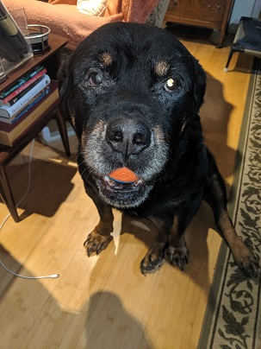
Adjourned

