Slide 1
Project: IEEE P802.15 Working Group for Wireless Specialty Networks
Submission Title: Basic Consensus in MAC and PHY of Revision of IEEE802.15.6-2012(IEEE802.15.6ma)
Date Submitted: May 13th , 2024
Source: Ryuji Kohno^{1,2}, Minsoo Kim¹, Takumi Kobayashi^{1,4}, Marco Hernandez^{1,3}, Seong-Soon Joo⁶, Daisuke Anzai⁴, Kento Takebayashi⁵, Jussi Happola³
Company: ¹Yokosuka Research Park International Alliance Institute (YRP-IAI), ²Yokohama National University (YNU), Japan, ³Centre for Wireless Communications(CWC), University of Oulu, Finland, ⁴Nagoya Institute of Technology, ⁵Toyo University, ⁶Korea Platform Service Technology (KPST), Korea
Address: ¹YRP 1, 3-4 Hikarino-oka, Yokosuka, 239-0847 Japan; ²79-5 Tokiwadai, Hodogaya-ku, Yokohama, 240-8501 Japan, ³PO Box 4500, FI-90014 University of Oulu, Finland
Voice: ²+81-90-5408-0611, Fax: ²+81-45-383-5528, E-Mail:[kohno@yrp-iai.jp, minsoo@minsookim.com; kobayashi-takumi@yrp-iai.jp, anzai@nitech.ac.jp, Marco.Hernandez@ieee.org, petrucciniyng@gmail.com, wowbk@kpst.co.kr, jussi.haapola@oulu.fi]
Re: In response to call for technical contributions
Abstract: This document contains a basic consensus of MAC of IEEE802.15.6ma to realize the enhanced reliability of P802.15.6ma.
Purpose: Material for discussion in P802.15.6ma TG
Notice: This document has been prepared to assist the IEEE P802.15.6ma. It is offered as a basis for discussion and is not binding on the contributing individual(s) or organization(s). The material in this document is subject to change in form and content after further study. The contributor(s) reserve(s) the right to add, amend or withdraw material contained herein.
Release: The contributor acknowledges and accepts that this contribution becomes the property of IEEE and may be made publicly available by P802.15.6ma.

Slide 2
Basic Consensus in MAC and PHY of Revision of IEEE802.15.6-2012 (IEEE802.15.6ma)
Ryuji Kohno^{1,2} ,Minsoo Kim¹, Takumi Kobayashi^{1,4},
Marco Hernandez^{1,3}, Seong-Soon Joo⁶, Daisuke Anzai⁴, Kento Takebayashi⁵, Jussi Haapola³
¹Yokosuka Research Park International Alliance Institute (YRP-IAI)
²Yokohama National University (YNU), Japan
³Centre for Wireless Communications(CWC), University of Oulu, Finland,
⁴Nagoya Institute of Technology(NIT) Japan,
⁵Toyo University(TU), Japan,
⁶Korea Platform Service Technology (KPST), Korea

Slide 3
1. Basic Consensus
IEEE802.15.6ma; revision of IEEE802.15.6-2012 focuses on enhanced dependability in data transmission and ranging in classified environments of coexistence with the same and other frequency shared wireless networks.
15.6ma covers new and conventional channel models of major use cases of 802.15.6ma Body Area Networks (BAN) are for human and vehicle bodies in medical and automotive applications for enhanced dependability.
15.6ma supports some backward compatibility with 15.6-2012 as much as possible but not all of them in PHY and MAC. 15.6ma aims to replace 15.6-2012 for enhanced dependability. For instance, 15.6ma focuses on only UWB in PHY and only time structure mode in MAC.

Slide 4
1. Basic Consensus(2/2)
In order to perform enhaced dependability in revision of IEEE802.15.6-2012(IEEE802.15.6ma), coexistence environments have been classified. Some classes of multiple new and legacy BANs coexistence are focused to manage packet contention in MAC layer while other classes are taken care by mitigation of interference in Physical layer(PHY) and manage contention in MAC.
Ranging in 802.15.6ma is optional but ranging between coordinators of neibouring or coverage overlaid BANs is helpful to identify geographical overlay and mobility of incoming and outgoing to determine coexistence class stataes. Ranging between BAN coordinator and its nodes in star topology in 802.15.6ma is the same as 802.15.4z and its amendment.

Slide 5
2. 15.6ma PHY and MAC New Features(1/2)
Since IEEE802.15.6-2012 has too many modes in PHY and MAC, 15.6ma chooses a few modes to simplify specification of PHY and MAC while introduces new error-controlling schemes of FEC and HARQ, and management and data channels for enhanced dependability in various channel models and 8 classes of coexistence models for 8 levels of QoS priority order packets such as
  PHY
    Various channel coding and decoding matched with QoS priority levels of packets and coexistence classes
    Interference mitigation schemes according to various environment of coexistence classes
  MAC
    Two channels using two UWB band channels are applied for management channel to control frames of coexisting networks and data transmission channel. Its alternative mode is two channels for management and data transmission using a single UWB band channel.
    Coordinator-to-coordinator(C2C) negotiation of existing networks
  Cross Layer of PHY and MAC
    Hybrid ARQ for higher priority of packets in high class of coexistence

Slide 6
2. 15.6ma PHY and MAC New Features(2/2)
  3. Cross Layer of PHY and MAC
    Hybrid ARQ for higher priority of packets in high class of coexistence
    For the sake of easy implementation, hybrid ARQ is optional in limited high classes of coexistene.
    Ranging between coexisting BANs’ coordinators could be proceeded by C2C(coordinator-to-coordinator) functionality.
    Ranging information in PHY is applied for identifying coexistence class states in which appropriate MAC is selected.

Slide 7
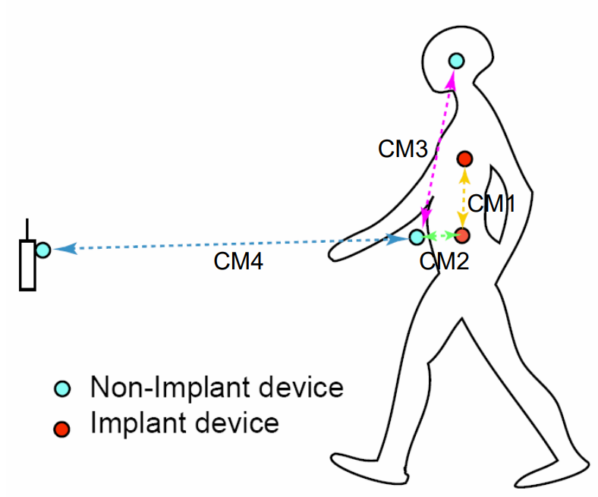
3. Channel models and scenarios in IEEE802.15.6ma
Scenario | Description | Frequency Band | Channel Model
S2 | Implant to Body Surface | 402-405 MHz, | CM2
S2.1 | Implant (upper body) to Body Surface | 3.1-10.6 GHz UWB | CM2.1
S2.2 | Implant (head) to Body Surface | 3.1-10.6 GHz UWB | CM2.2
S3 | Implant to External | 402-405 MHz, 3.1-10.6 GHz UWB | CM2
S4 | Body Surface to Body Surface (LOS) | 400, 600, 900 MHz 2.4, 3.1-10.6 GHz | CM3
S4.1 | Body Surface to Body Surface (LOS) | 3.1-10.6 GHz CM4.1 | CM4.1
S5 | Body Surface to Body Surface (NLOS) | 400, 600, 900 MHz 2.4, 3.1-10.6 GHz | CM3
S6 | Body Surface to External (LOS) | 900 MHz 2.4, 3.1-10.6 GHz | CM4
S6.1 | Body Surface (head) to External (LOS) | 3.1-10.6 GHz | CM6.1
S7 | Body Surface to External (NLOS) | 900 MHz 2.4, 3.1-10.6 GHz | CM4
Path loss (Mandatory)
Optional;
  Fading ( Small scale/ large scale)
  Shadowing
  Power delay profile
Specific use cases
Implant to Body Surface for BCI
Implant to External for BCI
Body surface to body surface for BCI
Body Surface to External for BCI
Implant to body surface for capsule endoscopy

Slide 8
3.1 Classification of Channel and Environment Models for Human and Vehicle Body Area Networks (HBAN&VBAN)
Channel model
※Covered by
IEEE 802.15.6-2012
HBAN model
In-body (Implant)
※
On-body
※
Channel model
With environment
Around body
Outdoor
※Around means;
Desk, WiFi AP in the room etc.
Indoor
※
Home
Implanted BCI model
Office
※
On skull BCI model
Medical (e.g. Hospital)
※
capsule endoscopy
※not covered in 2012
VBAN model
In-vehicle
Engine compartment
Note:
HBAN-model:
-Environment with co-existing systems is not considered.
VBAN model:
Key-less entry system
Localization in-body, on-body
Most dominant model should be defined and separatory defined as Mandatory and Optional.
Cabin
Through Engine compartment and cabin
On-vehicle
Roof
Around vehicle
Side Right/Left/Front/back
Bottom
Static vehicle
Moving vehicle

Slide 9
4. 8 Levels of Packets corresponding to User Priority of QoS in IEEE802.15.6 and 6ma
In Std.15.6 WBAN systems, a various data such as vital signs, skin temperature, blood pressure, ECG, EEG, ECoG, and vehicle controlling commons have different QoS levels corresponding to user priority.
In 15.6ma for dependable WBAN for human and vehicles, data packet transmission should be dependable according to QoS levels even in various classes of coexistence environment.
Therefore, appropriate sets of error controlling scheme with FEC and hybrid ARQ corresponding to QoS levels have been standardized in 15.6ma,
User priority | Traffic designation | Frame type
0 | Background (BK) | Data
1 | Best effort (BE) | Data
2 | Excellent effort (EE) | Data
3 | Video (VI) | Data
4 | Voice (VO) | Data
5 | Medical data or network control | Data or management
6 | High-priority medical data or network control | Data or management
7 | Emergency or medical implant event report | Data

Slide 10
5. 8 Classes of Coexistence Environment Models
Coexistence Class | Coexisting system(s) |  |  |  |  | Category
Level | 802.15.6ma | 802.15.6-2012 | Non-UWB (ex. Wi-Fi / Unlicensed / 3GPP) | 802.15 UWB (ex. 802.15.4) | Non-802.15 UWB (ex. ETSI SmartBAN) | Category
Class 0 | - | - | - | - | - | Single BAN
Class 1 (1a) | ✓ | - | - | - | - | Multiple 15.6 BANs
Class 2 (1b) | ✓ | ✓ | - | - | -
Class 3 | ✓ | - | ✓ | - | - | Non-UWB
Class 4 (2a) | ✓ | - | - | ✓ | - | Multiple UWB systems
Class 5 (2b) | ✓ | - | - | - | ✓
Class 6 (2c) | ✓ | - | - | ✓ | ✓
Class 7 | ✓ | ✓ | ✓ | ✓ | ✓ | Final Boss
The coexistence class has been redefied to 8 levels, which can be represented by 3 bits and would be suitable to include in PHY or MAC headers.

Slide 11
MAC Proposal of TG15.6ma
(Revision of IEEE802.15.6-2012)
Definition of Coexistence Classes and How to Support Higher Classes
May 15th, 2022
Minsoo Kim, Takumi Kobayashi, Marco Hernandez, and Ryuji Kohno
Yokohama National University(YNU),
YRP International Alliance Institute(YRP-IAI)

Slide 12
Introduction
The goal of this revision is to enhance dependability.
This presentation focuses on the challenges of coexistence, among other obstacles we face in achieving this goal.
There is no one-size-fits-all solution to manage any coexistence scenario.
To start with, we are outlining the various Classes of coexistence scenarios we anticipate in an environment where one or more Body Area Networks (BANs) and other radios are operating within the same coverage area.
TG6ma is working on defining specification at the Physical (PHY) and Media Access Control (MAC) layers to enhance dependability at each the Class, maintaining a specific Quality of Service (QoS).

Slide 13
Definition of Coexistence Environment Classes
Coexistence Class | Coexisting system(s) |  |  |  |  | Category
Level | 802.15.6ma | 802.15.6-2012 | Non-UWB (ex. Wi-Fi / Unlicensed / 3GPP) | 802.15 UWB (ex. 802.15.4) | Non-802.15 UWB (ex. ETSI SmartBAN) | Category
0 | - | - | - | - | - | Single BAN
1 (1a) | ✓ | - | - | - | - | Multiple 15.6 BANs
2 (1b) | ✓ | ✓ | - | - | -
3 | ✓ | - | ✓ | - | - | Non-UWB
4 (2a) | ✓ | - | - | ✓ | - | Multiple UWB systems
5 (2b) | ✓ | - | - | - | ✓
6 (2c) | ✓ | - | - | ✓ | ✓
7 | ✓ | ✓ | ✓ | ✓ | ✓ | Final Boss
We’ve redefined coexistence into 8 Classes, each of which can be represented using just 3 bits. This make them suitable to include in PHY or MAC headers.

Slide 14
Definition of Coexistence Environment Classes (cont.)
Class 0 (no other systems)
  In this scenario, there is only one BAN operating within a specific area, with no other systems coexisting.
  The required dependability in terms of throughput and latency should be met.

Slide 15
Definition of Coexistence Environment Classes (cont.)
Class 1-2 (BANs Only)
  In these Classes, multiple BANs, all based on 15.6ma revision (Class 1) or IEEE Std. 802.15.6 (Class 2), are operating within a specific area.
  If the BANs are based on the 15.6ma revision, they could be Human BANs or Vehicle BANs.
  These networks follow established communication protocols, allowing BANs to receive and decode frames from other coexisting BANs.
  Each BAN should meet the required dependability.
  The proposed 15.6ma MAC supports Class 1-2 using only mandatory features.

Slide 16
Definition of Coexistence Environment Classes (cont.)
Class 3 (BANs Plus Other Wireless Systems)
  Here, several BANs are operating alongside other wireless systems within a specific area.
  The proposed 15.6ma MAC supports Class 3 on a best-effort basis using some optional features.

Slide 17
Definition of Coexistence Environment Classes (cont.)
Class 4-6 (BANs Plus Other UWB Systems)
  In these Classes, several BANs are operating alongside multiple non-BAN Ultra-Wideband (UWB) systems.
  These UWB systems may follow other standards such as 15.4 or ETSI SmartBAN.
  Although they follow known communication schemes, a BAN might not fully decode their frames due to hardware limitation.
  However, note that 15.6ma devices may be able to decode 15.4ab frames.
  All coexisting BANs should meet the required dependability.
  The proposed 15.6ma MAC supports Class 4-6 with the help of optional features.

Slide 18
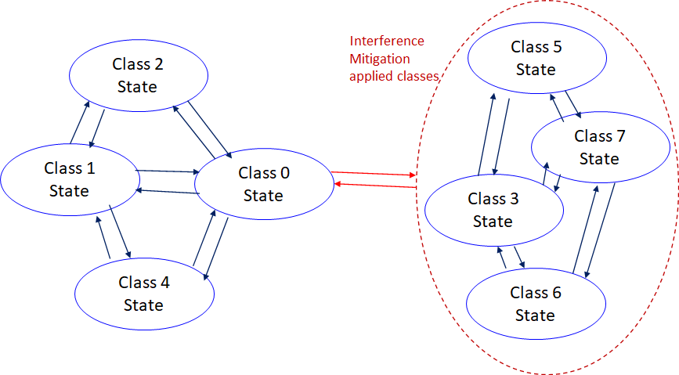
    6.2 Coexistence Class States Transition(1/2)
The standard's revision supports BANs operating with high reliability (coexistence class 0) and coexisting in dense environments with intra-interference and inter-interference (coexistence class 1 to 7). Figure 6 shows the state transition between several classes of coexistence environments defined in above –mentioned table.
Class 0: 6ma BAN alone
Class 1: Multiple 6ms BANs
Class 2: 6ma BAN with old 6 BAN
Class 4: 6ma BAN with other
802.15 UWB WSNs e.x. 4z, 4ab
Class 3: 6ma BAN with other
narrowband Nets WSNs
Class 5: 6ma BAN with other
UWB Nets e.x. ESTI SmartBAN
Class 6: 6ma with 802.15 other WSN
Class 7: 6ma with any frequency
shared networks
Figure 6 Diagram of state transitions for coexistence class environments.

Slide 19
    6.2 Coexistence Class States Transition(2/2)
The standard's revision focuses on the dependability mechanisms for a single HBAN or VBAN (Class 0) and the scenario with multiple HBANs or VBANS (Class 1).
Class 2 supports compatibility with legacy BANs (IEEE 802.15.6-2012 Std).
Class 4 supports coexistence with other IEEE 802.15 UWB Stds, and amendments such as 15.4, 15.8, 15.4z, and 4ab, via the PHY and MAC specification.
Classes 3, 5, 6, and 7 support coexistence with other wireless systems can result in Class 0, 1, and 2 by mitigation technology to cancel interference from other radios except regacy 15.6 at the receiver side (see clause 4.7.2 of draft#1.11.
During CCA, a BAN coordinator may analyze the type of synchronization preamble detected from a 15.6ma, 15.6, or 15.4 system.
In Figure 6, the state transition probabilities are approximated in consecutive superframes. Furthermore, the duration of the CAP and CFP are determined by statistics of various QoS level of packets in previous consecutive superframes for every coming superframe.
The draft revision #1.11 supports BANs operating with high reliability in dense environments coexisting with intra-interference and inter-interference due to other wireless systems in the same frequency band. Figure 6 shows state transition among several classes of coexistence environment defined in Table 1.

Slide 20
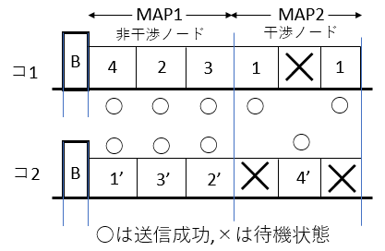
Supporting higher coexistence Classes
Allocate time slots (or periods) for each BAN to prevents collisions.
  This requires coordination between networks and increase system complexity.
Not overlapping nodes
Overlapping nodes
C1
C2

Slide 21
Supporting higher coexistence Classes (cont.)
Use multiple channels in frequency domain to support more networks.
  This requires multi-UWB-channel compatible hardware, potentially increasing hardware cost.
Band group | Channel number | Central frequency (MHz) | Bandwidth (MHz) | Channel attribute in 802.15.6-2012 | Channel attribute for the revision
Low band | 0 | 3494.4 | 499.2 | Optional | Control | Optional
 | 1 | 3993.6 | 499.2 | Mandatory | Control/Data | Mandatory
 | 2 | 4492.8 | 499.2 | Optional |  | Optional
High band | 3 | 6489.6 | 499.2 | Optional | Control/Data | Optional
 | 4 | 6988.8 | 499.2 | Optional |  | Optional
 | 5 | 7488.0 | 499.2 | Optional | Control | Optional
 | 6 | 7987.2 | 499.2 | Mandatory | Control/Data | Mandatory
 | 7 | 8486.4 | 499.2 | Optional |  | Optional
 | 8 | 8985.6 | 499.2 | Optional |  | Optional
 | 9 | 9484.8 | 499.2 | Optional |  | Optional
 | 10 | 9984.0 | 499.2 | Optional |  | Optional

Slide 22
Balancing dependability and cost
Achieving higher dependability inevitably comes with increased costs, which may pose challenges for widespread adoption.
The parameters of the coexistence environment, such as the number of coexisting systems, need to be set at a feasible Class, taking both complexity and cost into account.
One possible solution is to classify coexistence algorithms into mandatory and optional features.
  Users who need higher dependability can opt for devices that support higher Classes of coexistence environment by offering optional features.

Slide 23
Summary
We have categorized coexistence environments into 8 distinct Classes based on the variety of coexisting systems.
To manage more complex coexistence environments, we propose strategies in both the time and frequency domains.
In order to manage increased costs, we suggest classifying certain coexistence features as optional, allowing for tailored solutions based on specific user requirements.

Slide 24
References
[1] 15-19-0503-01-0dep, MAC Protocol with Interference Mitigation Using Negotiation among Coordinators in Multiple Wireless Body Area Networks (BANs)
[2] 15-22-0277-04-006a, MAC ideas for BAN with Enhanced Dependability

Slide 25
Physical Layer(PHY) Specification

Slide 26
6. PHY Specification of Error-Control Defined Corresponding Combination of 8 QoS Levels and 8 Coexistence Classes
Coexistence Class | 0 | 1 | 2 | 3 | 4 | 5 | 6 | 7
QoS Level
0 | BCC | BCC+E | BCC+E | BCC+E |  |  | HARQ | HARQ
1 | BCC | BCC+E | BCC+E | BCC+E |  |  | HARQ | HARQ
2 | BCC | BCC+E | BCC+E | BCC+E |  |  | HARQ | HARQ
3 | BCC | BCC+E | BCC+E | BCC+E |  |  | HARQ | HARQ
4 | BCC | BCC+E | BCC+E | BCC+E |  |  | HARQ | HARQ
5 | BCC | BCC+E | BCC+E | BCC+E |  |  | HARQ/IM | HARQ/IM
6 | CFP/HARQ | CFP/HARQ | CFP/HARQ | CFP/HARQ | CFP/HARQ | CFP/HARQ | HARQ/IM | HARQ/IM
7 | CFP/HARQ | CFP/HARQ | CFP/HARQ | CFP/HARQ | CFP/HARQ | CFP/HARQ | HARQ/IM | HARQ/IM

Slide 27
Common with IEEE802.15.4ab
Error-correcting codes corresponding to QoS levels
6.1 Channel Coding Table #1
User priority | Inner code | Outer code | HARQ
0 | 15.4ab LDPC code (R=1/2) |  | -
1 | 15.4ab LDPC code (R=1/2) |  | -
2 | 15.4ab LDPC code (R=1/2) |  | -
3 | 15.4ab LDPC code (R=1/2) |  | -
4 | 15.4ab LDPC code (R=1/2) | (54, 46) shortened RS code | -
5 | 15.4ab LDPC code (R=1/2) | (54, 38) shortened RS code | -
6 | 15.4ab LDPC code (R=1/2) | (54, 28) shortened RS code | -
7 | 15.4ab LDPC code (R=1/2) | (54, 14) shortened RS code | -
As an outer code, shortened Reed-Solomon (RS) codes with N=54 (original code length N=63) will be selected to correct burst errors due to interference from other WBANs and the coding rates are changed according to each QoS and channel condition
As an inner code, 15.4ab LDPC codes (K=324, 648, 972, R=1/2) will be selected for the coexistence of 15.6ma and 15.4ab
This updated concept table is considered as the first priority

Slide 28
Evaluation of Channel Codes Assigned Corresponding to Different QoS Priority Levels
Bit error ratio of (54,46), (54,38), (54,28), (54,14) shortened RS codes and no encoding were evaluated under an
AWGN channel and BPSK modulation
Performances were improved as the coding rate decreased
LDPC simulator is currently checked and will be combined with the RS simulator

Slide 29
Error-correcting codes corresponding to QoS levels
Common with IEEE802.15.4ab
6.2 Channel Coding Table #2
User priority | Inner code | Outer code | HARQ
0 | - | 15.4ab LDPC code (R=1/2) | -
1 | - | 15.4ab LDPC code (R=1/2) | -
2 | - | 15.4ab LDPC code (R=1/2) | -
3 | - | 15.4ab LDPC code (R=1/2) | -
4 | 15.4a/z based convolutional code, R=4/5 | 15.4ab LDPC code (R=1/2) | ◯
5 | 15.4a/z based convolutional code, R=2/3 | 15.4ab LDPC code (R=1/2) | ◯
6 | 15.4a/z convolutional code, R=1/2 | 15.4ab LDPC code (R=1/2) | ◯
7 | 15.4a/z based convolutional code, R=1/4 | 15.4ab LDPC code (R=1/2) | ◯
As an outer code, 15.4ab LDPC (K=324, 648, 972, R=1/2) codes will be selected for the coexistence of 15.6ma and 15.4ab
As an inner code, 15.4a/z based convolutional codes (which are almost the same of our proposed decomposable codes) will be selected, and the coding rates are changed according to each QoS and channel condition, which can be applied to hybrid ARQ
This table is considered as the second choice

Slide 30
7. PHY Intra and Inter System Interference among BAN and Other PANs
Inter-user interference
Inter-system interference
Interference from the other wreless system using overlapped frequency band. ⇒ Unknown
IR-UWB uses the same pulse as all users signal in the same standard.
Other users signal and/or the other network signal would be interference.
＊ 802.11a (wi-fi) （5GHz） overlaps
UWB-WBAN
IEEE 802.15.6
user B
Other UWB system.
e.g. IEEE 802.15.4a
user ？
user C
interference
user ？
interference
User A wants to connect to“B”.
user ？

Slide 31
7.1 Approach for Intra and Inter System Interference among BAN and Other PANs
Sparate and Recognize each interference from different source.
* Apply suitable interference mitigation method according to source of interference.
Using both of Spatial and Temporal signal processing.
Inter-user interference
“IUI” in this presentation
Recognize and demodulate
Pulse shape multiple access Multi-user detection
known
Interference from a system using the same pulse
Inter-system interference
“ISI” in this presentation
unknown
Remove
Interference canceller
Interference from a system using overlapped frequency

Slide 32
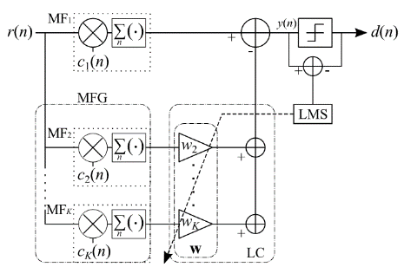
7.1.1 Time Domain Interference Mitigation
OMF； orthogonal matched filter
consists a matched filter （MF₁） and MF Group（MFG）
Tap coefficients of MF₁ are the same as sequence of desired signal.
Coefficients of MF₁ and each MF_{k} that constituting MFG are orthogonal.
Desired signal does not through MF_{2～K-1} because orthogonality.
→only interference can through.
MFG makes replica of interference signal by lenear combination with weight vector w of linear combiner; LC.
Subtract interference replica from the output of MF₁ .
Principle of OMF
OMF can remove interference without any pre-knowledge of interference.

Slide 33
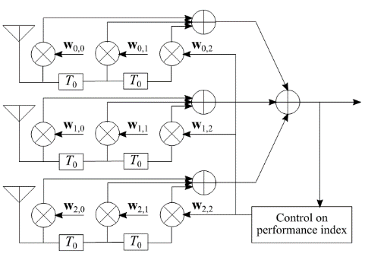

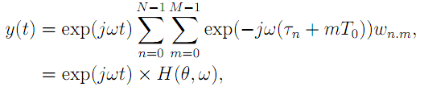

7.1.2 Space Domain Interference Mitigation
TDL-AA；Tapped delay line array antenna
Array antenna by using multiple antenna elements and tapped delay line.
Each antenna branch has coefficients.
Transfer function of this antenna has parameters of signal incoming angle;θ and frequency; ω.
⇒has characteristics of both of spatial and time domain.
（Tapped delay line array antenna）
Principle of TDL-AA
TDL-AA can work as interference canceller on both of time and space domains

Slide 34
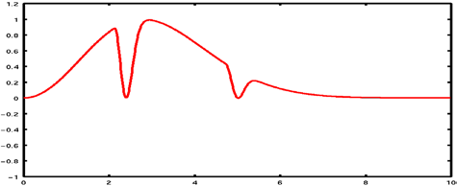
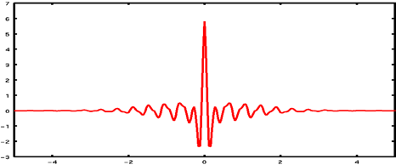
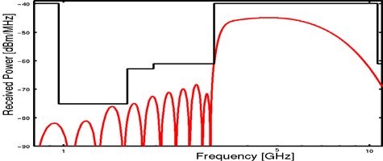
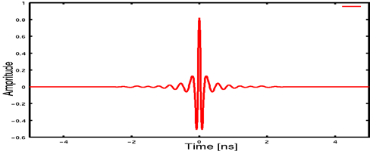
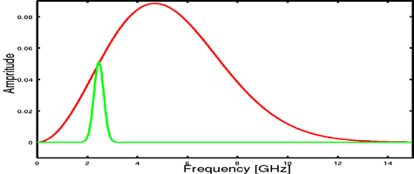
7.1.3 Interference Mitigation among Other Radios
2.4GHz
5.2GHz
Frequency（Hz) Time（sec）
(a) Time Waveform of Pulse (right figure) and its Frequency Spectrum with notches in 2.4 and 5.2GHz for WLAN (left figure)
∝ 1
τ _{m}
ω₀
Frequency（Hz)
Time（sec）
(b) Time Waveform of Pulse (right figure) and its Frequency Spectrum satisfying spectrum mask (left figure)
Ref. R.Kohno, H.Zhang, H.Nagasaka, "Ultra Wideband impulse radio using free-verse pulse waveform shaping , Soft-Spectrum adaptation, and local sine template receiving," doc.: IEEE

Slide 35
7.1.4 Integrated Terminal to Avoid Mutual Interference in case of overlaid coexisting BAN and other Radios such as UWB-BAN and 4G/5G
Cellular Base Station
(Primary BS)
BAN Node (Secondary User)
Cellular Terminal (Primary User)
Integrated Terminal
= (Cellular Terminal + BAN Coordinator)
= (Primary User + Secondary BS)
M. Kim, T. Kobayashi, C.Sugimoto, R Kohno, ”Transmission Power Control of UWB -WBAN for Avoidance of Interference to Cellular Networks Using Integrated Terminal for Both Networks,” International Journal of Computer Science and Telecommunications, ISSN
2047-3338 (Online) , Vol. 11, Issue 02, pp.8-15, March 2020

Slide 36
Medica Access Control Layer (MAC) Specification

Slide 37
8. MAC Basic Consensus
Two channels using two UWB band channels are applied for control channel to control frames of coexisting networks and data transmission channel. Its alternative mode is two channels or time slots for control and data transmission using a single UWB band channel.
IEEE802.15.6ma; revision of IEEE802.15.6-2012 focuses on enhanced dependability in data transmission and ranging according to the class 0-7 of coexistence.
  Class 0&1: New 15.6ma MAC is defined primarily to support enhanced dependability of a new 15.6ma BAN (Class 0) and multiple 15.6ma BANs (Class 1).
  Class 2: 15,6ma MAC is defined secondarily to support backward compatibility with a legacy 15.6-2012 BAN as long as enhanced dependability of a new 15.6ma BAN can be performed in Class 2.
  Class 4: 15.6ma MAC is defined to support interoperability with coexisting 15.4ab WSN/PAN in secondary as long as enhanced dependability of 15.6ma BAN can be performed in primary in Class 4.
  Class 3,5,6,7: 15.6ma MAC is defined to support enhanced dependability of 15.6ma BAN while mitigating interference from coexisting other radios.
Hence, new 15.6ma MAC documentation must be good enough by describing mostly in Class 1 including Class 0, and Class 4 while describing a way to recognize class of coexistence and to mitigate interference in other classes.

Slide 38
8.1.1. MSDU format in 15.6-2012
8.1 MAC Frame Structure
The usual: MAC header + MAC payload + MAC footer

Slide 39
8.1.2 15.6ma MAC
Due to the historic background of 15.6, the MSDU format supports several MAC mechanisms (polling, CSMA, slotted Aloha, LBT), and it is up to vendors what specifically to implement.
  However, the result was that the MAC spec is difficult to understand
The revision 15.6ma plans to simplify the MAC mechanism under a UWB PHY:
  LBT & slotted Aloha (CAP) and TDMA (CFP)
  (maybe the support of an Ethertype field)
  Hence, the MSDU Header will change.

Slide 40
8.2 MAC Protocol for Multiple BAN Environment (Class 1) # 15-22-0639 & 15-22-651-01
Utilizes Control Channel.
    Limits transmission privilege on Control Channel only to coordinators.
    Allows more efficient and accurate clear channel assessment by separating control frames and data frames.
    Two mandatory channels for control and data frames are required.
Introduces 3 Periods in Data Channel
    Network Management Period (NMP) for Data Beacons,
    Contention Free Period (CFP) for scheduled data frames,
    And Contention Access Period (CAP) for unscheduled data frames and node connection/disconnection.
Each BAN has its own contention free period while sharing superframes.
    To avoid frame collision between coexisting BANs.
Operating procedures of some MAC functions such as BAN Creation and Superframe Transition are explained.
The newly required fields for performing this procedure have been explained.

Slide 41
8.3 MAC in Class 1 for coexisting dependable BANs
# 15-22-0594 & 15-22-651-01(January 2023)
Dependable BAN Service Classes
    Specifies three classes. Coexisting BANs will coordinates based on the BAN class.
Beacon Period Extension
    Allows flexible configuration of the beacon period.
    Supports large number of nodes while guaranteeing short cycle time.
    Guarantees that nodes can access the channel every cycle time.
Coordinator Hub and Beacon Access Phase
    Defines Beacon Access Phase (BAP) in the beacon period.
    Defines a coordinator hub and a leaf hub and let coordinator hub assigns beacon slots for leaf hubs.
Scheduled Access Extension
    Allows nodes have periodic access multiple ties in a beacon period
Adaptative Superframe Interleaving with Adjustment and Regulation
    Negotiates the structure of beacon period among coexisting dependable BANs and regulates transmissions.

Slide 42
8.4 MAC Function
8.4.1 MAC Mode 1
Two UWB Bands Use for Control and Data Transmission Channels for Enhanced Dependability
According to functionality of used RF devices and modules, the following two modes of MAC function can be chosen. Primarily mode 1 is recommended for highly enhanced dependability if RF devices and modules can use two UWB bands channels while mode 2 is alternative choice if only a single UWB band channel is available.
  MAC Mode 1: Two channels using two UWB band channels are applied for control channel to manage frames of coexisting networks and data transmission channel.
  MAC Mode 2: Another alternative mode is two channels in time slots for control and data transmission using a single UWB band channel.

Slide 43
MAC Proposal of TG15.6ma
(Revision of IEEE802.15.6-2012)
MAC Protocol Proposal for Multiple BAN Environment (Level 1)
May 15th, 2023
Minsoo Kim, Takumi Kobayashi, Marco Hernandez, and Ryuji Kohno
Yokohama National University(YNU),
YRP International Alliance Institute(YRP-IAI)
Doc.#802.15-22-0639-03-06a (May 2023)
Class 1

Slide 44
Introduction
In this draft proposal, we are focusing on ensuring high dependability in scenarios where multiple Body Area Networks (BANs) are operating together.
One of our key strategies is to allocate specific time slots (or periods) to each BAN, which helps to prevent frame collisions, even among different BANs.
To achieve this, we are proposing the use of a dedicated channel for exchanging network control frames and coordinator-to-coordinator frames.
This strategy will not only enable efficient time slot allocation to each BAN, but also allow for more precise Clear Channel Assessment (CCA), especially in dense environments.
It is also crucial to maintain backward compatibility and ensure coexistence with devices based on the original standard. We would also like to consider ways to ensure this.

Slide 45
Dedicating a channel for control frames
In the original IEEE Std 802.15.6-2012, both network control and data exchange happen on the same channel, with different frame types distinguishing between the two.
In our proposal, we suggest dedicating one channel exclusively for the exchange of network control frames. There are a few key advantages to this approach:
  Efficient Clear Channel Assessment (CCA): With just one channel to monitor, CCA can be conducted more efficiently.
  Reduced Control Frame Collisions: By transmitting control frames on a less congested channel (where data frames are absent), we can significantly reduce the likelihood of frame collisions.
  Enhanced Dependability: Devices designed for an extra level of dependability may be able to utilize this dedicated control channel, thereby enhancing the overall reliability of the network.

Slide 46
Channel configuration
Band group | Channel number | Central frequency (MHz) | Bandwidth (MHz) | Channel attribute in 802.15.6-2012 | Channel attribute for the revision
Low band | 0 | 3494.4 | 499.2 | Optional | Control | Optional
 | 1 | 3993.6 | 499.2 | Mandatory | Control/Data | Mandatory
 | 2 | 4492.8 | 499.2 | Optional |  | Optional
High band | 3 | 6489.6 | 499.2 | Optional | Control/Data | Optional
 | 4 | 6988.8 | 499.2 | Optional |  | Optional
 | 5 | 7488.0 | 499.2 | Optional | Control | Optional
 | 6 | 7987.2 | 499.2 | Mandatory | Control/Data | Mandatory
 | 7 | 8486.4 | 499.2 | Optional |  | Optional
 | 8 | 8985.6 | 499.2 | Optional |  | Optional
 | 9 | 9484.8 | 499.2 | Optional |  | Optional
 | 10 | 9984.0 | 499.2 | Optional |  | Optional
In the original IEEE Std 802.15.6-2012, one specific channel is designated as mandatory for each band group.
To maintain backward compatibility with the original standard, the mandatory channel configuration remains unchanged in the proposed revision.
Additionally, in the proposed revision, one channel is designated as the control channel, which can be utilized as a common channel shared by multiple systems.

Slide 47
Frame assignments for Control/Data Channels
Channels | Periods | Frames (draft)
 |  | From coordinators | From nodes
Control | n/a | Control Beacon Coordinator-to-coordinator | Not allowed
Data | Network Management | Data Beacon
 | Contention Free | Scheduled Data | Scheduled Data
 | Contention Access | Connection Assignment Disconnection Response Unscheduled Data | Connection Request Disconnection Notification Unscheduled Data
The frame assignments have been developed to account for hardware limitations between the coordinator and the nodes, including processing power, transmitting power, memory capacity, and energy efficiency.

Slide 48
Control Channel
Only coordinators are allowed to transmit on the control channel (C-Channel).
The control channel does not follow a time slot structure.
  Due to the mobility of BANs, there is a possibility that BANs or groups of BANs with different synchronization timings may come across each other.
  Therefore, it is reasonable to design MAC protocol with the assumption that reliable synchronization between multiple BANS is not possible.
  This is particularly important when considering the interoperability of BANs with other UWB systems.

Slide 49
Control Channel (cont.)
A coordinator is required to transmit a control beacon frame (C-Beacon) on the control channel (C-Channel) at regular intervals of T_{C} seconds.
  Prior to emitting the first C-Beacon, the coordinator must perform Clear Channel Assessment (CCA) to ensure the channel is clear.
  The C-Beacon Period, T_{C}, is randomly selected by the coordinator within the range of T_{C,min} to T_{C,max}.

Slide 50
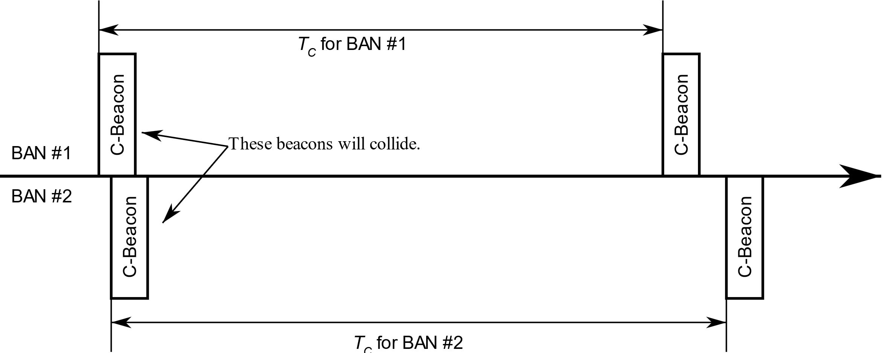
Why is the C-Beacon Period Random?
When all coordinators transmit their C-Beacons at the same interval, a collision between C-Beacons will persist indefinitely, causing ongoing interference.
However, by assigning each coordinator a different interval, collisions can be minimized or eliminated.
It is desirable to choose intervals that are relatively prime or have a large greatest common multiple, as this reduces the likelihood of future collisions and enhances overall network performance.

Slide 51
Data Channel
Both coordinators and nodes have the capability to transmit on the data channel (D-Channel).
The time axis in a D-Channel is divided into superframes, each with a fixed duration of T_{D} seconds.
Within each superframe, the time axis is further divided into time slots, each with a fixed duration of T_{S} seconds.
The superframe consist of four distinct periods:
  Network Management Period (NMP): This period consist of N_{NMP} time slots, which are dedicated to transmitting network management frames, such as data beacons.
  Contention Free Period (CFP): This period consist of N_{CFP} time slots, which are reserved for transmitting scheduled frames.
  Contention Access Period (CAP): This period consist of N_{CAP} time slots, which are used for transmitting unscheduled frames.
  Inactive Period: During this period, no frames are transmitted.

Slide 52
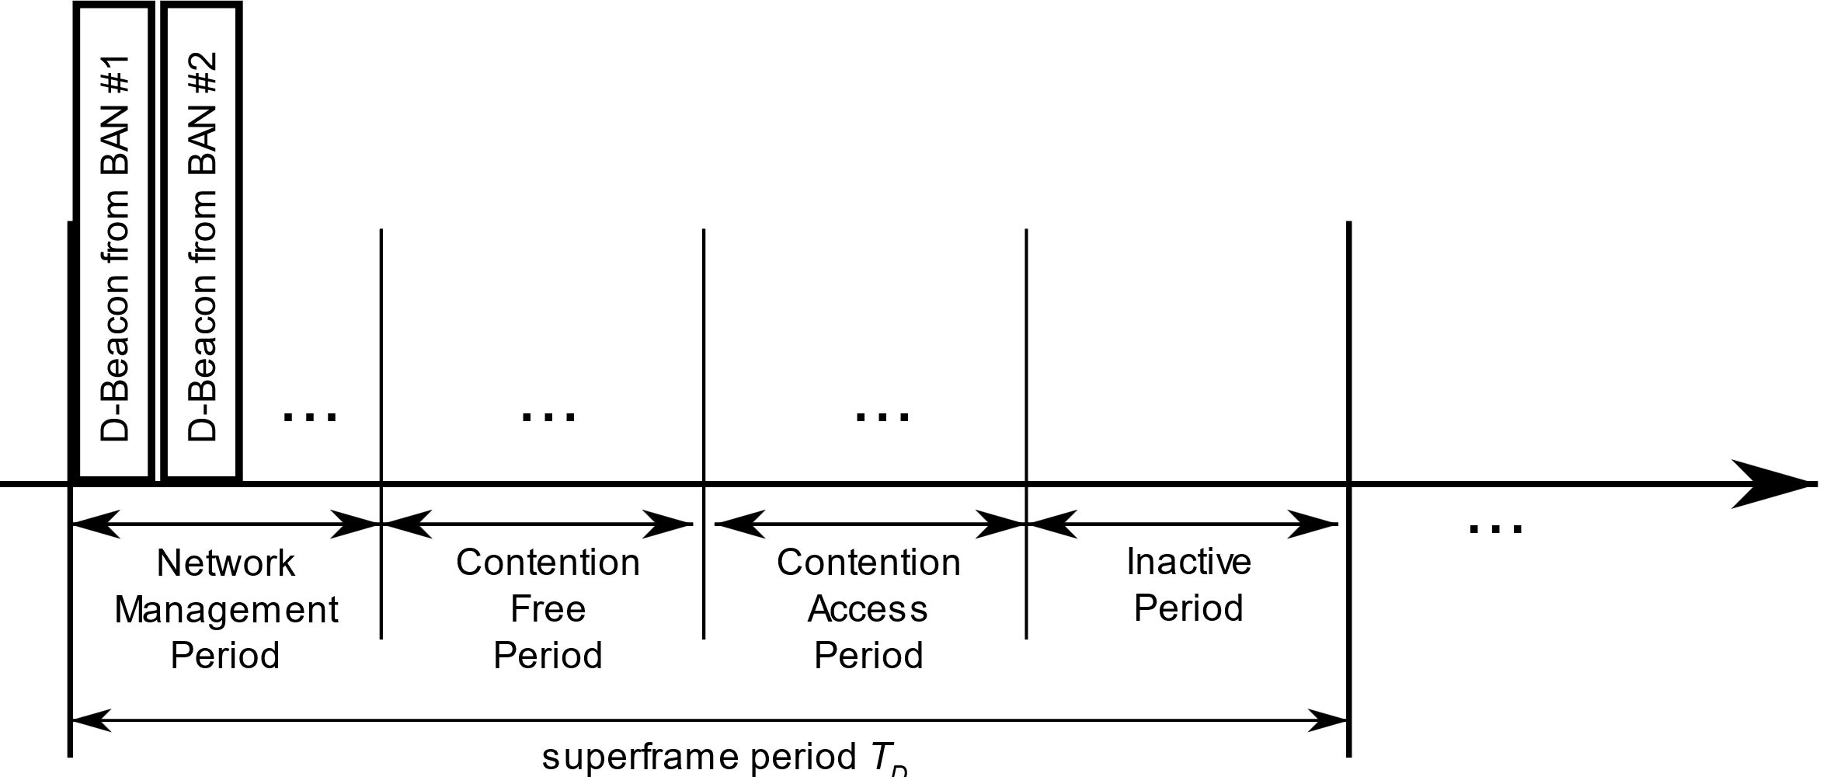
Data Channel (cont.)
Each coordinator is required to select one D-Channel.
To achieve higher dependability, a coordinator may support the use of multiple D-Channels simultaneously.
Within each superframe of the selected D-Channel, a coordinator transmits a data beacon frame (D-Beacon) on a single time slot from the Network Management Period (NMP).

Slide 53
MAC Functions
BAN Creation
Superframe transition due to proximity of BAN piconets
Node Connection/Disconnection
Channel access
  Contention Free Period – TDMA
  Contention Access Period – Slotted aloha

Slide 54
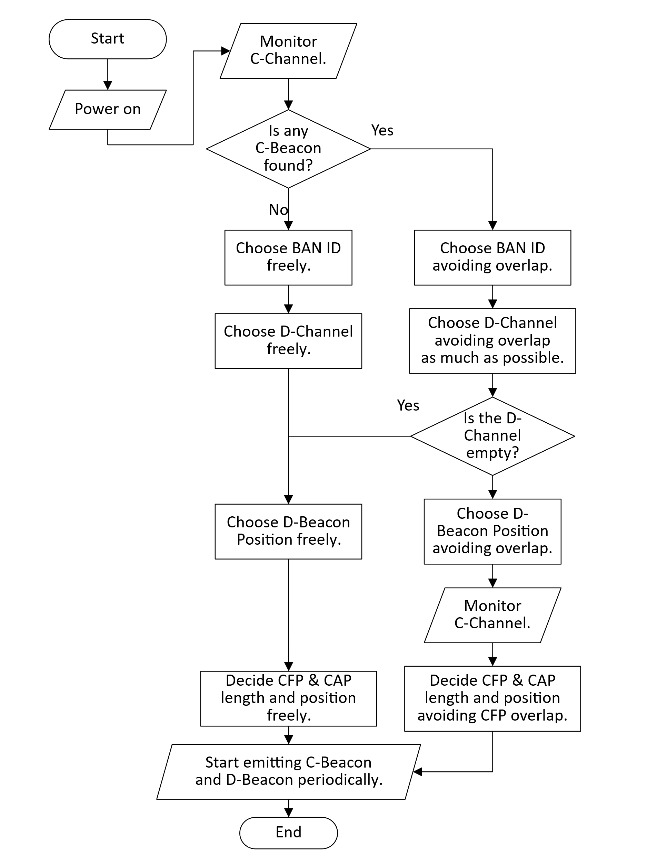
BAN Creation
Neighbor BAN Detection: The coordinator monitors the C-Channel to identify neighboring BANs and determine their presence.
BAN ID Selection: The coordinator selects an available BAN ID that is not currently in use by neighboring BANs to ensure uniqueness within the network.
Data Channel (D-Channel) Selection: The coordinator chooses a suitable D-Channel for communication. D-Channel Occupancy Indexes obtained from neighboring BAN’s C-Beacons can be used to determine which D-Channel to use.
D-Channel Synchronization: If other BANs are using the same D-Channel, the coordinator synchronizes to the superframe of the BAN(s) already using that D-Channel.

Slide 55
BAN Creation (cont.)
D-Beacon Position Selection: The coordinator selects a specific position for the D-Beacon transmission within the Network Management Period (NMP) of the superframe. It ensures that the chosen position does not overlap with neighboring BANs using the same D-Channel.
Periodic Control Beacon (C-Beacon) Transmission: The coordinator transmits Control Beacons periodically on the C-Channel. The C-Beacon includes essential information such as the BAN ID, D-Channel number, and D-Beacon Position in NMP.
Periodic Data Beacon (D-Beacon) Transmission: The coordinator transmits Data Beacons periodically on the D-Channel. The D-Beacon provides slot numbers indicating the start of the Contention Free Period (CFP) and the Contention Access Period (CAP) within each superframe.

Slide 56
Superframe transition due to proximity of BAN piconets
As BANs are mobile, it is possible for multiple BANs that have started independently to come into close proximity with each other.
Since these BANs are likely using different superframes, their frames will interfere each other, causing performance degradation.
To avoid this interference, BANs located in close proximity must transition to using common superframes.
After superframe transition

Slide 57
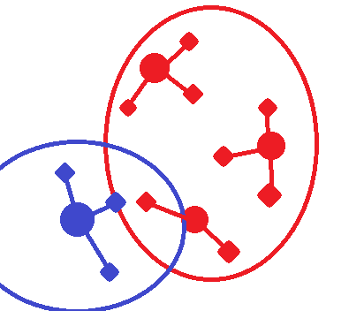
Superframe transition due to proximity of BAN piconets (cont.)
A coordinator continuosly monitors the C-Channel to detect neighboring BANs.
When a coordinator receives a Control Beacon (C-Beacon) with a different Superframe Reference BAN ID value and a Superframe Priority Index grater than its own, it indicates that a new BAN is nearby.
In such cases, the coordinator must transition to using the superframe of the newly met BAN to avoid interference and ensure efficient communication.
BAN ID = 1
Superframe Reference BAN ID = 1
BAN ID = 2
Superframe Reference BAN ID = 1
BAN ID = 4
Superframe Reference BAN ID = 4
BAN ID = 3
Superframe Reference BAN ID = 1

Slide 58
Superframe transition due to proximity of BAN piconets (cont.)
The Superframe Priority Index is used to determine which BAN should continue using its current superframe and which BAN should transition to the superframe of another BAN when multiple BANs come into close proximity.
  The index should be defined in a way that allows BANs with many nodes of high priority to maintain their superframes, while BANs with lower priority nodes can transition to other BAN’s superframe.
Fallback Mechanism: In scenarios where a BAN with a low Superframe Priority Index fails to receive the C-beacon of another BAN, interference cannot be avoided due to the inability to perform superframe transition.
  To address this situation, implementing a fallback mechanism allowing high-priority BANs to initiate superframe transition would be advantageous.

Slide 59
Node Connection/Disconnection
The node monitors the C-Channels to acquire a C-Beacon, which provides essential information.
By receiving the C-Beacon, the node can obtain the BAN ID, D-Channel number, and D-Beacon Position for further communication.
The node also monitors the D-Channels to acquire a D-Beacon, which provides details about the positions of Contention Free Period (CFP) and Contention Access Period (CAP).
During the CAP, the node initiates the Connection Request (C-Request) frame using the Contention Access procedure.
Upon successful reception of the C-Request frame, the coordinator responds by transmiting
  an Acknowledgement,
  and a Connection Assignment (C-Assignment) frame in the next available time slot.
The C-Assignment frame provides information of the allocated resources to the node, including the number of time slots allocated, and the node’s allocated Node ID.

Slide 60
Fields in Control Beacon
BAN ID
  This is a unique identifier assigned to each Body Area Network (BAN).
  It is used to distinguish between BANs operating in the vicinity and facilitate communication between them.
D-Channel number
  This refers to the specific channel utilized for data transmission within a BAN.
  Each BAN is assigned a particular D-Chanel number to avoid interference with other BANs and enable efficient communication.
D-Beacon Position in Network Management Period (NMP)
  This indicates the specific time slot within the NMP where the D-Beacon, which provides network management information, is transmitted.
D-Channel Occupancy Index
  This index is a measure used to inform neighboring BANs about the congestion level of the D-Channel.
  It provides an indication of how busy the channel is, helping BANs make informed decisions regarding D-Channel selection.

Slide 61
Fields in Control Beacon (cont.)
The Superframe Reference BAN ID
  This serves the purpose of informing neighboring BANs about the BAN with which they share the same superframe.
  BANs that share superframes should have the same Superframe Reference BAN ID, allowing synchronization and coordinated operation within the shared superframe.
The Superframe Priority Index
  This is an index used to determine the priority of a BAN in relation to other BANs when multiple BANs come into proximity.
  It enables the orderly transition of superframes, ensuring that BANs with higher priority can maintain their superframes while lower-priority BANs transition to other BAN’s superframes.

Slide 62
Fields in Data Beacon
Position of Contention Free Period (CFP)
  This refers to the specific time slots within the superframes where the Contention Free Period occurs.
  The CFP is a dedicated period during which scheduled frames are transmitted without contention.
  To ensure coexistence an minimize interference among coexisting BANs, the position of the CFP may vary between BANs.
  By assigning different CFP position, BANs can have non-overlapping CFPs, allowing for interference-free transmission of scheduled frames.

Slide 63
Fields in Data Beacon (cont.)
Position of Contention Access Period (CAP)
  This refers to the specific time slots within the superframes where the Contention Access Period occurs.
  The CAP is a period during which unscheduled frames are transmitted using the slotted aloha access mechanism, where nodes contend for access to the channel.
  The specific position of the CAP within the superframe allows nodes to know when to transmit unscheduled frames and participate in the contention process.
  The CAP provides a mechanism for nodes to access the channel when their transmissions are not pre-scheduled during the Contention Free Period (CFP).

Slide 64
List of Frame Type
Channels | Periods | Frames | Sender | Receiver
Control | n/a | Control Beacon | Coordinator | Other Coordinators and Nodes
 |  | Coordinator-to-Coordinator |  | Other Coordinators
Data | Network Management | Data Beacon | Coordinator | Other Coordinators and Nodes
 | Contention Free | Scheduled Downlink Data | Coordinator | Specific Node
 |  |  | Coordinator | Relay Node
 |  |  | Relay Node | Relay Node
 |  |  | Relay Node | Specific Node
 |  | Scheduled Uplink Data | Node | Own Coordinator
 |  |  | Node | Relay Node
 |  |  | Relay Node | Relay Node
 |  |  | Relay Node | Own Coordinator
 | Contention Access | Connection Request | Node | Own Coordinator
 |  | Connection Assignment | Coordinator | Specific Node
 |  | Disconnection Notification | Node | Own Coordinator
 |  | Unscheduled Uplink Data | Specific Node | Own Coordinator

Slide 65
Summary
The proposed solution emphasizes the allocation of time slots to each Body Area Network (BAN) to prevent frame collisions, even when multiple BANs are present.
It suggest utilizing a Control Channel for precise time slot allocation and improved clear channel assessment.
The operating procedures of essential MAC functions, including BAN creation, are presented through a flowchart, along with an explanation of the required fields to facilitate the procedure.

Slide 66
References
[1] 15-22-0277-04-006a, MAC ideas for BAN with Enhanced Dependability

Slide 67
8.4 MAC Function
8.4.2 MAC Mode 2
Two Channels in Time Slots for Control and Data Transmission Using a Single UWB Band Channel.
MAC Mode 1: Two channels in frequency bands using two UWB band channels are applied for control channel to manage frames of coexisting networks and data transmission channel.
MAC Mode 2: Another alternative mode is two channels in time slots for control and data transmission using a single UWB band channel.

Slide 68
Project: P802.15 Working Group for Wireless Specialty Networks
Submission Title: Proposal of control and data channels unification for 6ma MAC
Date Submitted: November 16th, 2022
Source: Minsoo Kim, Takumi Kobayashi, Daisuke Anzai, Marco Hernandez and Ryuji Kohno
Company: YRP-IAI, NIT, CWC Oulu, YNU
Address: 3-4 Hikarino-oka, Yokosuka, 239-0847, Japan
Voice: +81 46-847-5439 Fax: +81 46-847-5431 E-Mail:
Re: In response to the call for technical contributions
Abstract:
Purpose: In response to the call for technical contributions
Notice: This document has been prepared to assist P802.15.6ma. It is offered as a basis for discussion and is not binding on the contributing individual(s) or organization(s). The material in this document is subject to change in form and content after further study. The contributor(s) reserve(s) the right to add, amend or withdraw material contained herein.
Release: The contributor acknowledges and accepts that this contribution becomes the property of IEEE and may be made publicly available by P802.15.6ma.

Slide 69
Unifying Control and Data Channels
Doc.#802.15-23-0387-00-06a (July 2023)
Control Channel
Data Channel
Frames for both Control Channel and Data Channels are accommodated into one single channel.
The time axis is divided into separate time periods for each frame types.
Time period
for C2C frames
Time period
for Coordinator-to-Nodes frames
Time axis
Superframe

Slide 70
Channel usage strategy
Case of low band, according to this proposal
Band group | Channel number | Central frequency (MHz) | Bandwidth (MHz) | Channel attribute in 802.15.6-2012 | Channel attribute for the revision
Low band | 0 | 3494.4 | 499.2 | Optional | Control | Optional
 | 1 | 3993.6 | 499.2 | Mandatory | Control/Data | Mandatory
 | 2 | 4492.8 | 499.2 | Optional | Control/Data | Optional
Band group | Channel number | Central frequency (MHz) | Bandwidth (MHz) | Channel attribute in 802.15.6-2012 | Channel attribute for the revision
Low band | 0 | 3494.4 | 499.2 | Optional | Control/Data | Optional
 | 1 | 3993.6 | 499.2 | Mandatory | Control/Data | Mandatory
 | 2 | 4492.8 | 499.2 | Optional | Control/Data | Optional
All channels carry both Coordinator-to-Coordinator Frames
and Coordinator-to-Node Frames.

Slide 71
Motivation
Low implementation difficulties
  Requires only one UWB RF.
Increase channel efficiency
  All channel can carry Coordinator-to-Node frames.
  Previously we had 1 control channel and n data channels.
  Now we have n+1 channels.

Slide 72
Project: IEEE P802.15 Working Group for Wireless Specialty Networks
Submission Title: Overview and convergence of MAC proposals for 15.6ma
Date Submitted: July 13th, 2023
Source: Minsoo Kim, Seong-Soon Joo, Takumi Kobayashi, Anzai Daisuke, Marco Hernandez, Ryuji Kohno
Company: YRP-IAI, KPST, CWC Oulu Univ, NIT, YNU
Address: (1)79-5 Tokiwadai, Hodogaya-ku, Yokohama, 240-8501 Japan,
(2) YRP1 Blg., 3-4 HikarinoOka, Yokosuka-City, Kanagawa, 239-0847 Japan
Voice:[+81-90-5408-0611] E-Mail:[minsoo@minsookim.com, kobayashi-takumi-ch@ynu.ac.jp, marco.hernandez@ieee.org, kohno@ynu.ac.jp, ssjoo@etri.sci.kr]
Re: In response to call for proposal
Abstract: Overview and convergence of MAC proposals for 15.6ma
Purpose: Material for discussion in P802.15.6ma TG
Notice: This document has been prepared to assist the IEEE P802.15. It is offered as a basis for discussion and is not binding on the contributing individual(s) or organization(s). The material in this document is subject to change in form and content after further study. The contributor(s) reserve(s) the right to add, amend or withdraw material contained herein.
Release: The contributor acknowledges and accepts that this contribution becomes the property of IEEE and may be made publicly available by P802.15.

Slide 73
MAC Protocol Proposal for Multiple BAN Environment (Class 1),
Proposal of control and data channels unification for 6ma MAC
# 15-22-0639, #15-23-0387
Doc.#802.15-23-0408-01-06a (July 2023)
Time period
for C2C frames
Time period
for Coordinator-to-Nodes frames
Time axis
Superframe
Unifying control and data channels into a single channel, instead of utilizing Control Channel, is proposed.
Frames for Coordinator to Coordinator link, previously carried by control channel, is carried by newly defined time period in the single channel.
For networks require higher dependability, feature of simultaneously utilizing multiple channel may still remain as optional.

Slide 74
Proposed text for 6ma MAC – General framework elements, Beacon Access Phase, Frames and IEs for dependable BAN, and Interference Avoidance
# 15-23-0322, # 15-23-0367, # 15-23-0369, # 15-23-0324
New terms are defined.
  beacon access phase (BAP), coordinator hub, dependable BAN, dependable BAN group, leaf hub.
General explanation are modified according to new scope/features.
  The revised standard will specify access coordination at the MAC sublayer between BANs.
Classes (1-3) of dependable BANs are defined.
  In terms of bounded latency, probability of loss, update rate.
Length of superframe should be multiple times of fixed Basic Superframe Length.
Beacon Access Phase (BAP) is introduced.
  A coordinator hub (a.k.a. super-coordinator or coordinator of coordinators) manage beacon slot allocation for leaf hubs. The last slot of BAP is reserved for a BAN of the original std.
New features such as Access offset, Access Phase shifting are introduced.
  For mitigating the interference among coexisting dependable BANs, the start of access phase can be set differently.
Information Elements (IE) are added/defined according to the new features.

Slide 75
Convergence
Proposal # 15-22-0639 is going to be modified. the MAC will be able to use single channel too.
  The fundamental difference of # 15-22-0639 and # 15-23-0322 series is already converged.
  The detailed differences need to be examined more deeply, but the convergence of such differences will be much easier.
The differences in terminology will be also converged.
  The two proposals have become very similar, but there are still many differences in terminology.
The convergence process will continue via teleconference prior to the September interim session, in order to complete the draft within the timeline.

Slide 76
8.5 MAC Function of Synchronization and access control in CCA and Inter-Coordinator Negotiation in Class 1, 2 and 4
In CCA period, if a beacon is detected and a beacon packet preamble is decoded using pre-knowledge of possible coexisting systems, then it is possible to identify class of coexistence by detecting type and number of coexisting systems with MAC address, ID etc.
Reference: cognitive sensing, cognitive radio
If coordinators or hubs of coexisting BANs in class 1, 2 and 4 may communicate each other after identify coexisting systems, the coordinators or hubs can negotiate each other to synchronize system clocks and to manage packets access of individual 15.6ma and 15.6 BANs in class 1 and 2, respectively and 15.4ab WSNs/PANs in class 4.
Even in class 3, 5, 6, and 7, if interference from coexisting systems different from 15.6ma, 15.6, and 15.4ab can be mitigated, then the same MAC function can be proceeded by the same manner as in class 1,2 and 4.

Slide 77
Project: IEEE P802.15 Working Group for Wireless Personal Area Networks (WPANs) Submission Title: [MAC Protocol Using Negotiation among Coordinators in Coexistence of Multiple Wireless BANs]
Date Submitted: [15 November 2022]
Source: [Shunya Ogawa1, Minsoo Kim,2, Ryuji Kohno1,2] [1;Yokohama National University, 2;YRP International Alliance Institute(YRP-IAI)]
Address [1; 79-5 Tokiwadai, Hodogaya-ku, Yokohama, Japan 240-8501
2; YRP1 Blg., 3-4 HikarinoOka, Yokosuka-City, Kanagawa, Japan 239-0847 ]
Voice:[1; +81-45-339-4115, 2:+358-8-553-2849], FAX: [+81-90-5408-0611],
Email:[1: ogawa-shunya-md@ynu.jp, kohno@ynu.ac.jp, 2: Kohno@yrp-iai.jpi] Re: []
Abstract: [This is an updated version of doc.: IEEE 802.15-19-0402-00-0dep for a dependable MAC protocol for wireless body area network(WBAN) in presence of multiple overlaid BANS is introduced, A scheme of negotiation among coordinators could improve overall performance.]
Purpose: [information]
Notice: This document has been prepared to assist the IEEE P802.15. It is offered as a basis for discussion and is not binding on the contributing individual(s) or organization(s). The material in this document is subject to change in form and content after further study. The contributor(s) reserve(s) the right to add, amend or withdraw material contained herein.
Release: The contributor acknowledges and accepts that this contribution becomes the property of IEEE and may be made publicly available by P802.15.

Slide 78
        Doc: IEEE P802.15-23-0557-03-6a
Doc.#802.15-22-0633-00-06a (November 2022)
MAC Protocol Using Negotiation among Coordinators in Coexistence of Multiple Wireless BANs
Shunya Ogawa*, Minsoo Kim†, Ryuji Kohno*†
＊Yokohama National University(YNU)
† YRP International Alliance Institute(YRP-IAI)

Slide 79
1. Introduction
doc.: IEEE 802.15-22-0633-00-06ma

Slide 80
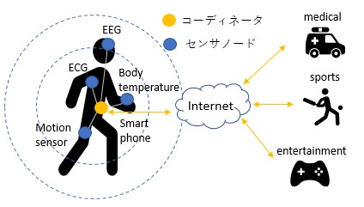
1.1 Introduction
doc.: IEEE 802.15-22-0633-00-06ma
From the development of an aging society and wireless communication technology, researches on medical information communication technology are thriving
One solution is a WBAN (Wireless Body Area Network)
IEEE802.15.6
WBAN
A network consisting of sensor nodes and coordinators installed around the human body
International standard of WBAN Defined for physical layer and MAC layer
Coordinator Sensor Node
This study changes the MAC layer
Hardware already sold
MAC layer can be changed by software
Fig1. Overall picture of WBAN network
WBAN can control priority according to importance of data packet
In this research, we focus on the MAC layer of IEEE 802.15.6 and propose a MAC protocol that reduces inter-BAN interference

Slide 81
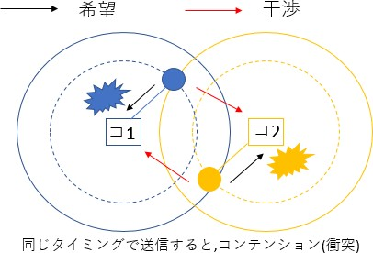
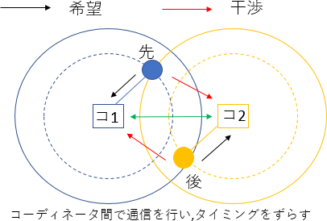
1.2 Issues in the standard
doc.: IEEE 802.15-22-0633-00-06ma
Issue
Interference problem in the case where multiple BANs overlap (specifically, situations where people with BAN approaching)
Because the schedule adjustment between the coordinators has not been done
Proposal
Negotiation between coordinators, scheduling between different BANs, to prevent deterioration due to inter-BAN interference
Desired Packet
Interfering Packet
Desired Packet
Interfering Packet
What is interference at the MAC layer
Sensor nodes within the communication range try to transmit packets at the same timing, causing collisions, making it impossible to communicate correctly
1st
C1
C2
C1
C2
2nd
In case of no negotiation of Coordinators of overlapped BANs, contention happens among packets of the BANs
In case of negotiation of Coordinators of overlapped BANs, contention can be resolved
Fig2. Issue and proposal

Slide 82
2. Proposed method
November 2022
doc.: IEEE 802.15-22-0633-00-06ma

Slide 83
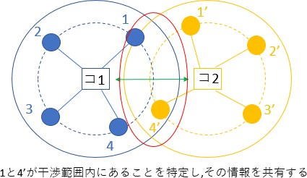
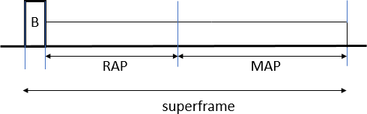
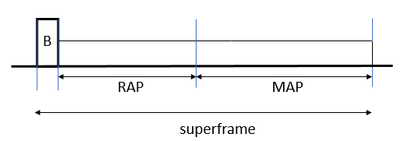
2.1 Outline of proposed method
Purpose
Increase the throughput of each BAN in case of interference
Communication should be guaranteed in descending order of User Priority
Proposal
Negotiate between coordinators, share the overlap situation of the sensor nodes, and identify the sensor nodes that will cause contention
Do not send them at the same time
1 and 4 'are not sent at the same time
コ1
C1
C1
C2
コC22
By detecting overlapped nodes, e.g. 1 and 4, coordinators e.g. C1 and C2 negotiate in order to minimize contentions
Fig3. Outline of proposed method

Slide 84
2.2 Time synchronization method between coordinators
The time difference between receiving the beacon frames of the two coordinators is used as the offset value.
𝑇𝑇_{𝑜𝑜𝑜𝑜𝑜𝑜𝑜𝑜𝑜𝑜𝑜𝑜} = 𝑇𝑇₁ − 𝑇𝑇₀ ⋯ (1)
𝑇𝑇₁:Overlap coordinator beacon time 𝑇𝑇₀:Reference coordinator beacon time
Calculate the amount of time adjustment (𝑇𝑇_{𝐶𝐶𝐶𝐶𝑜𝑜𝐶𝐶𝐶𝐶𝐶𝐶𝐶𝐶𝐶𝐶𝑜𝑜𝑜𝑜}) based on the offset value
^{𝑇𝑇}𝐶𝐶𝐶𝐶𝑜𝑜𝐶𝐶𝐶𝐶𝐶𝐶𝐶𝐶𝐶𝐶𝑜𝑜𝑜𝑜 ^{= 𝑇𝑇}𝑜𝑜𝑜𝑜𝑜𝑜𝑜𝑜𝑜𝑜𝑜𝑜,1 ^{− 𝑇𝑇}𝑜𝑜𝑜𝑜𝑜𝑜𝑜𝑜𝑜𝑜𝑜𝑜,0 ^{⋯ (2)}
𝑇𝑇_{𝑜𝑜𝑜𝑜𝑜𝑜𝑜𝑜𝑜𝑜𝑜𝑜,1} :Offset value obtained from the reception of previous beacon frame
𝑇𝑇_{𝑜𝑜𝑜𝑜𝑜𝑜𝑜𝑜𝑜𝑜𝑜𝑜,0} :Offset value obtained from the reception of the current beacon frame
If the value of 𝑇𝑇_{𝐶𝐶𝐶𝐶𝑜𝑜𝐶𝐶𝐶𝐶𝐶𝐶𝐶𝐶𝐶𝐶𝑜𝑜𝑜𝑜} is greater than 0, stop the time of the reference coordinator by the value of 𝑇𝑇_{𝐶𝐶𝐶𝐶𝑜𝑜𝐶𝐶𝐶𝐶𝐶𝐶𝐶𝐶𝐶𝐶𝑜𝑜𝑜𝑜} and vice versa
Slide 8

Slide 85
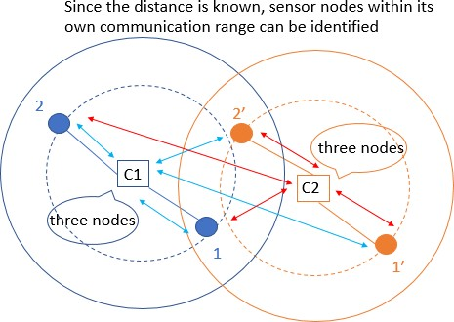
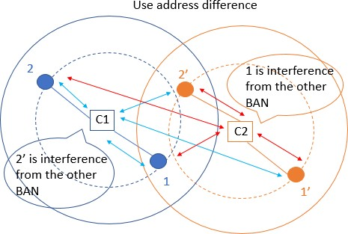
2.3 procedure of how to identify overlap situations
Since BAN uses UWB communication, it uses physical layer information that indicates the distance (between coordinators and sensor nodes)
  By knowing the distance between a sensor node and the coordinator, it is possible to identify whether or not the node is within its communication range
Use the address of the sensor node given for each BAN
  By sharing this address among the coordinators, it is possible to identify whether a sensor node within the trust range is under its own control or under the control of another BAN
Fig4. how to identify overlap situations
9

Slide 86
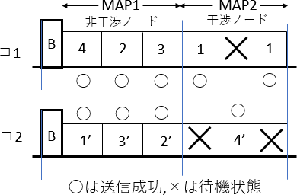
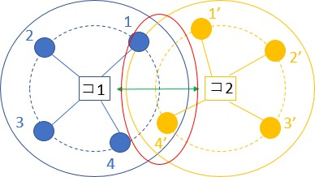
2.4 MAC protocol of MAP(Managed access period)
Proposal
(Adopt polling for MAP)
Divide Superframe's MAP structure into two parts, MAP 1 and MAP 2
In MAP 1, sensor nodes not related to interference are allocated
  Send at the same time
In MAP 2, sensor nodes related to interference are allocated
  When one BAN attempts to transmit at MAP 2, the other BAN is placed in a standby state
Non Overlapped Nodes
Overlapped Nodes
C1
C1
C2
C2
Fig4. MAC protocol of MAP
By separating by interference and non-interference, packet collision does not occur and efficient transmission can be done

Slide 87
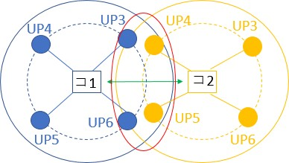
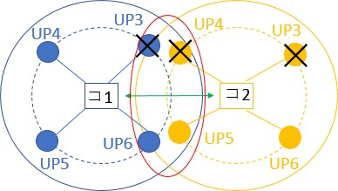
2.5 MAC protocol of RAP(Random Access Period)
Proposal
(Adopt CSMA / CA for RAP)
The Superframe's RAP protocol is as follows
If the interfering node is low UP (4 or less), do not conflict transmission rights (those with lower UP than competing nodes do not compete)
If the interference node is high UP (5 or more), compete transmission rights of normal CSMA/CA
Although contention will occur, it will guarantee in descending order of UP
C1
C2
C1
C2
Fig5. MAC protocol of RAP
It is possible to reduce the contention of packets while guaranteeing in descending order of UP

Slide 88
2.6 Drawback of proposed method
doc.: IEEE 802.15-22-0633-00-06ma
MAC protocol of MAP
  Depending on the number of interfering nodes, the characteristics are degraded
The number of slots of MAP 1 and MAP 2 of Superframe becomes extra
MAC protocol of RAP
  When offeredload is low, the delay characteristic deteriorates
When packet occurrence interval is large, deterioration due to not competing transmission right is large
Even if these two combinations are used, only the average UP as a whole improves, high UP is particularly guaranteed, and low UP is sacrificed can not be controlled for each purpose
We aim to respond by changing parameters according to design policy

Slide 89
3. Measures against drawback
        Doc: IEEE P802.15-23-0557-03-6a

Slide 90
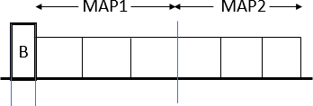
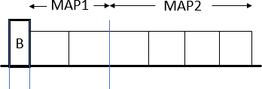
3.1 Measures to drawback MAP
Measures
Change the ratio of the number of slots of MAP 1 and MAP 2 of Superframe
MAP 1 : MAP 2 = number of non-interfering nodes ÷ 2 : to be the number of interference nodes
(It is known from the simulation that this is the optimal solution)
Ex) 4 non-interference nodes, 4 interference nodes and 6 slots
Non Overlapped Nodes
Interfering Nodes
Non Overlapped Nodes
Interfering Nodes
非干渉ノード
干渉ノード
非干渉ノード
干渉ノード
Fig6. Measures to draw back MAP
By changing the ratio of the number of slots of MAP 1 and MAP 2 according to the number of interfering nodes, there is no extra

Slide 91
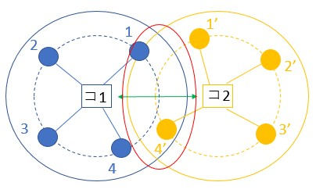
3.2 Measures to drawback MAP
Measures
Switch on whether to use the proposed method for each offeredload
When offeredload is low, competing transmission rights of normal CSMA
/ CA
When the offer load becomes such that packets conflict, countermeasures against interference are made using the proposed
method
Low offeredload High offeredload
switching
C1
C2
C1
C2
Fig7. Measures to drawback MAP
Due to the switching of the proposed scheme, the deterioration at the time of low offeredload decreases
15

Slide 92
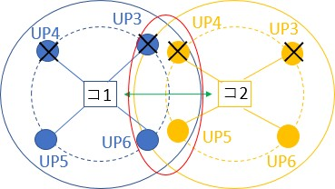
3.3 Control to make the priority higher
We propose a MAC protocol not only giving average performance as a whole, but also differentiating between high UP and low UP
 | RAP
If it is low UP (4 or less) irrespective of interference or non-interference, do not compete transmission right If it is high UP (5 or more) irrespective of interference or non- interference, compete transmission right C1 C2 Fig8. RAP
MAP
How to assign transmission rights
The one with the largest UP value × elapsed time
as usual
We changed the weighting value called UP value
Weighting to make the priority more dominant
By changing parameters, we can cope with each design policy (giving average performance , differentiating between high UP and low UP)

Slide 93
4. Performance evaluation by simulation
        Doc: IEEE P802.15-23-0557-03-6a

Slide 94

4.1 Simulation characteristics
Determining parameters based on the standard (IEEE 802.15.6)
The probability of occurrence for each UP is the same
One type of packet is generated from one node
RAP, MAP handle all packets
The condition for discarding the packet is the case where the number of retransmissions is 4 or more and the case where the number of packets to be crowded becomes 3 or more
There is no EAP for simplicity
Fig9. Superframe structure
Table1. simulation characteristics
Number of nodes | 4(UP高2,低2)
Data rate | 242.9 [kbps]
Payload length | 128 [octets]
Number of BANs | 2
Superframe length | 115 [ms]
Number of slots | RAP=5,MAP=12
Simulation time | 30 [s]
Number of trials | 100
 | Content of evaluation
Overall network throughput characteristics Throughput characteristics per UP Delay characteristics per UP Evaluation is made in two ways such as average performance, differentiating between high UP and low UP

Slide 95
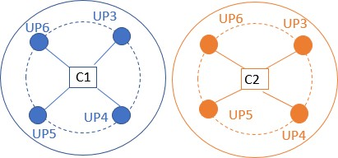
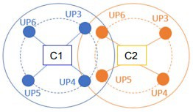
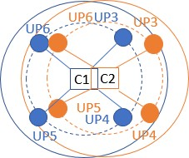
4.2 Simulation scenario
        Doc: IEEE P802.15-23-0557-03-6a
1, there are no interference node each
2, there are two interference nodes each
3, there are four(all) interference nodes each

Slide 96
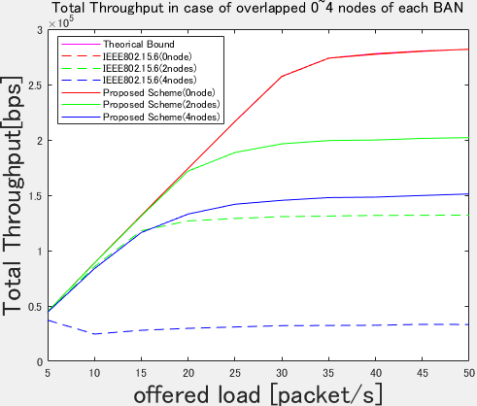
4.3 Simulation result(Total throughput)
Average performance
Differentiating between low UP and high UP
Fig11. Overall network throughput Fig12. Overall network throughput
The theorical bound is the throughput of the entire network in the absence of interference
Compared to the standard, the throughput of the whole network is improved in the proposed method in each case
Since there is no difference in overall throughput by design policy, both are valid

Slide 97
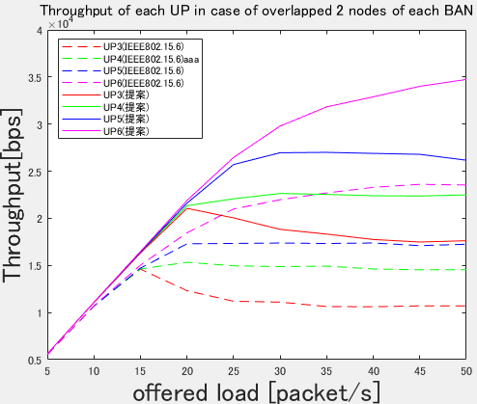
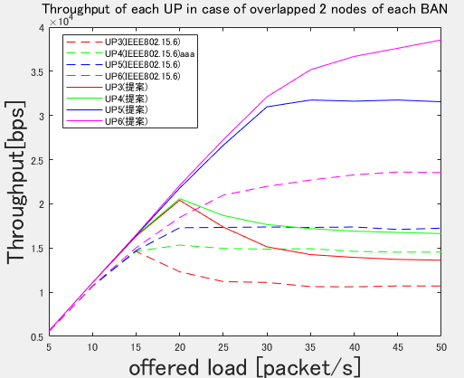
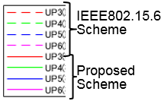
4.3 Simulation result(Throughput of each UP overlapped 2 nodes)
Average performance
Differentiating between low UP and high UP
Solid line: proposed method Dashed line: Standard
Solid line: proposed method Dashed line: Standard
Solid line: proposed method
Dashed line: Standard
Fig13. Throughput of each UP overlapped 2 nodes
Fig14. Throughput of each UP overlapped 2 nodes
Similarly, the proposed method is superior to the throughput for each UP
We can cope with the case where average performance is given and the case where difference is given for each UP

Slide 98
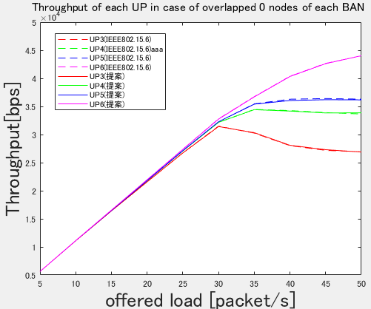
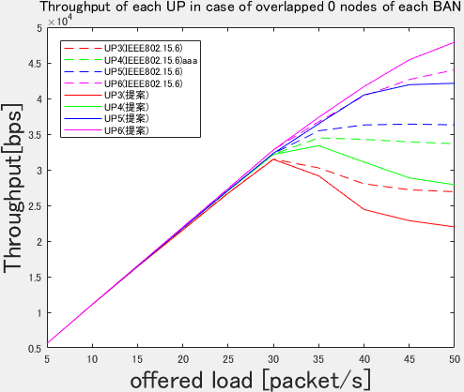
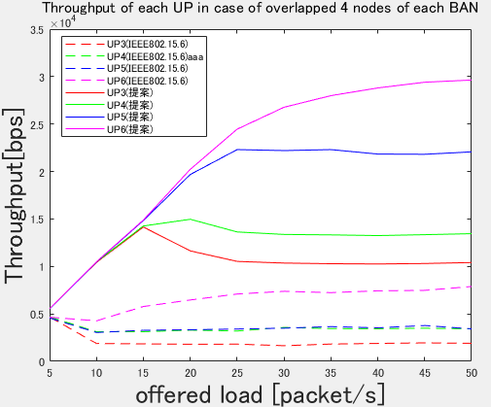
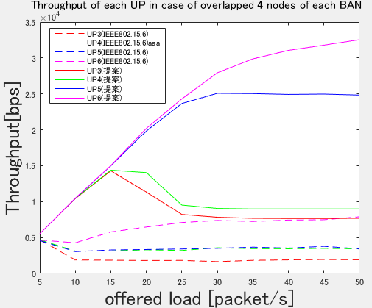
4.3 Simulation result(Throughput of each UP overlapped 0,4 nodes)
Average performance
Differentiating between low UP and high UP
Fig15. Throughput of each UP overlapped 0 node
Fig16. Throughput of each UP overlapped 0 node
Fig17. Throughput of each UP overlapped 4 nodes
Fig18. Throughput of each UP overlapped 4 nodes

Slide 99
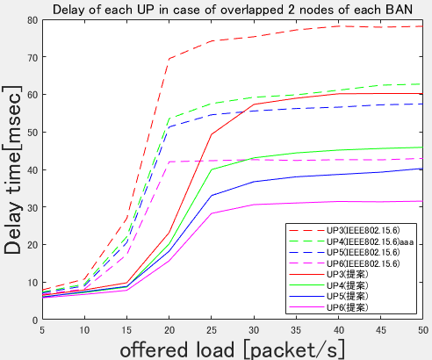
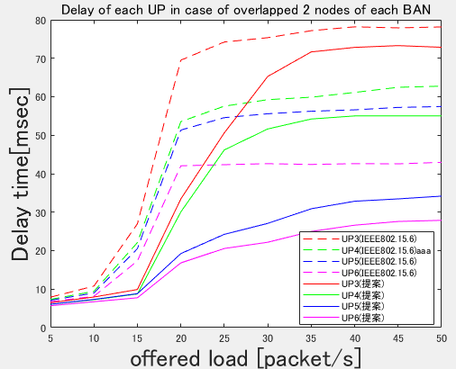
4.3 Simulation result(Delay of each UP overlapped 2 nodes)
Average performance
Differentiating between low UP and high UP
Solid line: proposed method Dashed line: Standard
Fig19. Delay of each UP overlapped 2 nodes
Fig20. Delay of each UP overlapped 2 nodes
Similarly, the proposed method is superior to the throughput for each UP
We can cope with the case where average performance is given and the case where difference is given for each UP

Slide 100
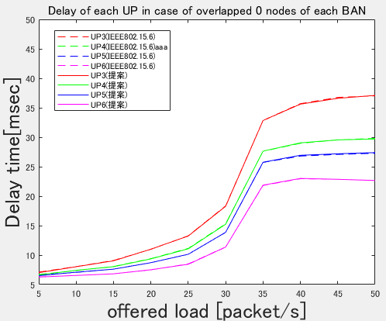
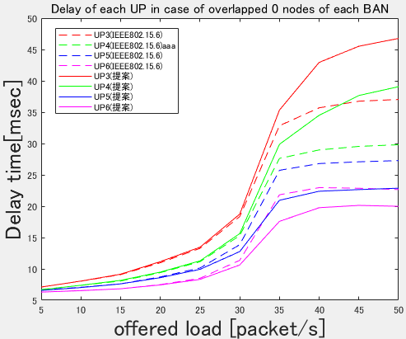

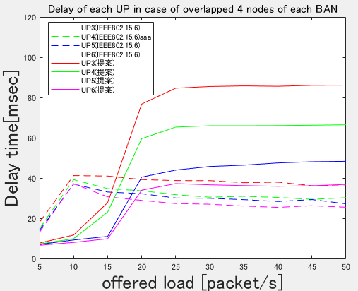
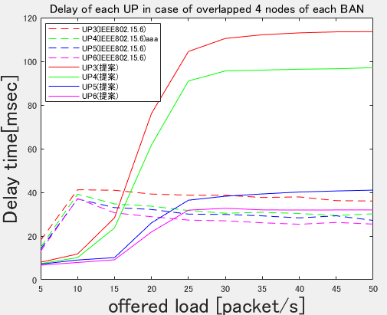
4.3 Simulation result(Throughput of each UP overlapped 0,4 nodes)
Average performance
Differentiating between low UP and high UP
Fig21. Delay of each UP overlapped 0 node
Fig22. Delay of each UP overlapped 0 node
Fig23. Delay of each UP overlapped 4 nodes
Fig24. Delay of each UP overlapped 4 nodes

Slide 101
5. Conclusion
        Doc: IEEE P802.15-23-0557-03-6a

Slide 102
5.1 Conclusion and Future works
Conclusion
We conducted research to mitigate interference against the international standard MAC protocol
In order to reduce interference in multiple BAN environments, we propose to communicate between coordinators to identify and share interfering nodes, and the proposed protocol has improved throughput and delay characteristics over international standards
We showed that we can deal with by changing parameters according to design policy
Future works
Consideration when the number of BAN becomes 3 or more
Consideration when packet occurrence probability changes for each UP
Theoretical analysis on optimum values of various parameters
MAP 1 and MAP 2 ratio, UP weighting etc.

Slide 103
8.6 MAC for Transition among Different Classes of Coexistence
In practical use cases, if mobility of BAN should be taken into account, then MAC function for transition among different classes of coexistence should be defined.
While periodical detection in CCA period, if a beacon is detected and a beacon packet preamble is decoded using pre-knowledge of possible coexisting systems, then it is possible to identify transition of classes of coexistence.
The transition of classes of coexistence can be described with finite state transition diagram such as Markov model.
In practical use cases, the finite state or class transition can be simplified and useful to predict transition using probabilistic approach.
The transition between class 0 and 1 could be covered by above-mentioned MAC. The transition among classes 0, 1, 2 and 4 may be described shortly only in case that legacy 15.6-2012 BAN and 15.4ab can be detectable by new 15,6ma BAN.
Transition to class 3, 5, 6, and 7 can be detectable in periodical CCA, so interference from coexisting systems different from 15.6ma, 15.6, and 15.4ab can be mitigated and then the same MAC could be proceeded by the same manner as in class 1,2 and 4.

Slide 104
Reference
Documents of Minsoo Kim, Seong-Soon Joo, Marco Hernandez, and others

