Slide 1
Project: IEEE P802.15 Working Group for Wireless Specialty Networks (WSN)
Submission Title: TG 15.4ab October 2023 Telecon Meeting Slides
Date Submitted: 17 Oct 2023
Source: Benjamin A. Rolfe (Blind Creek Associates)
Contact:
Voice: +1 408 395 7207, E-Mail: ben.rolfe @ ieee.org
Re: Task Group 4ab: 802.15.4 UWB Next Generation
Abstract: Meeting Slides for interim Webex (TC)
Purpose: Continue project progress
Notice: This document has been prepared to assist the IEEE P802.15. It is offered as a basis for discussion and is not binding on the contributing individual(s) or organization(s). The material in this document is subject to change in form and content after further study. The contributor(s) reserve(s) the right to add, amend or withdraw material contained herein.
Release: The contributor acknowledges and accepts that this contribution becomes the property of IEEE and may be made publicly available by P802.15.
Notes:
Jul 12, 2010
Page 1

Slide 2

Task Group 15.4ab
Next Generation UWB Amendment
October 17th 2023 Interim Webex

Slide 3


Meeting Preamble
Stuff you need to know before we get to the meeting content

Slide 4
Task Group Rules
Discussion: Everyone present is welcome
Straw polls: Everyone present may vote
Formal motions: WG voters
  To make, second and vote
Patent policy for PAR activities applies
All the usual rules of conduct
Please identify yourself on first contact with name and affiliation

Slide 5
IEEE-SA Patent, Copyright, and Participation Policies
See: https://grouper.ieee.org/groups/802/sapolicies.shtml
IEEE-SA Patent Slides for Standards Development Meetings (.pdf)
https://development.standards.ieee.org/myproject/Public/mytools/mob/slideset.pdf
IEEE-SA Standards Board Patent Committee (PatCom) home page
https://standards.ieee.org/content/ieee-standards/en/about/sasb/patcom/index.html
IEEE-SA Participation Policy meeting slide set - individual method (.pdf)
https://standards.ieee.org/content/dam/ieee-standards/standards/web/documents/other/Participant-Behavior-Individual-Method.pdf
Working Group Copyright Materials
https://standards.ieee.org/ipr/copyright-materials.html
https://standards.ieee.org/content/dam/ieee-standards/standards/web/documents/other/ieee-sa-copyright-policy-2019.pdf

Slide 6
Participants have a duty to inform the IEEE
  Participants shall inform the IEEE (or cause the IEEE to be informed) of the identity of each holder of any potential Essential Patent Claims of which they are personally aware if the claims are owned or controlled by the participant or the entity the participant is from, employed by, or otherwise represents
  Participants should inform the IEEE (or cause the IEEE to be informed) of the identity of any other holders of potential Essential Patent Claims
  Early identification of holders of potential Essential Patent Claims is encouraged

Slide 7
Ways to inform IEEE
Cause an LOA to be submitted to the IEEE SA (patcom@ieee.org); or
Provide the chair of this group with the identity of the holder(s) of any and all such claims as soon as possible; or
Speak up now and respond to this Call for Potentially Essential Patents
If anyone in this meeting is personally aware of the holder of any patent claims that are potentially essential to implementation of the proposed standard(s) under consideration by this group and that are not already the subject of an Accepted Letter of Assurance, please respond at this time by providing relevant information to the WG Chair
08 June 2021 – Slide 2

Slide 8
Other Guidelines for IEEE Working Group Meetings
All IEEE SA standards meetings shall be conducted in compliance with all applicable laws, including antitrust and competition laws.
  Don’t discuss the interpretation, validity, or essentiality of patents/patent claims.
  Don’t discuss specific license rates, terms, or conditions.
    Relative costs of different technical approaches that include relative costs of patent licensing terms may be discussed in standards development meetings.
      Technical considerations remain the primary focus.
  Don’t discuss or engage in the fixing of product prices, allocation of customers, or division of sales markets.
  Don’t discuss the status or substance of ongoing or threatened litigation.
  Don’t be silent if inappropriate topics are discussed. Formally object to the discussion immediately.
---------------------------------------------------------------
For more details, see IEEE SA Standards Board Operations Manual, clause 5.3.10 and
Antitrust and Competition Policy: What You Need to Know at http://standards.ieee.org/develop/policies/antitrust.pdf

Slide 9


Slide 10


Slide 11


Slide 12
IEEE SA Copyright Policy
By participating in this activity, you agree to comply with the IEEE Code of Ethics, all applicable laws, and all IEEE policies and procedures including, but not limited to, the IEEE SA Copyright Policy.
    Previously Published material (copyright assertion indicated) shall not be presented/submitted to the Working Group nor incorporated into a Working Group draft unless permission is granted.
    Prior to presentation or submission, you shall notify the Working Group Chair of previously Published material and should assist the Chair in obtaining copyright permission acceptable to IEEE SA.
    For material that is not previously Published, IEEE is automatically granted a license to use any material that is presented or submitted.

Slide 13
IEEE SA Copyright Policy
    The IEEE SA Copyright Policy is described in the IEEE SA Standards Board Bylaws and IEEE SA Standards Board Operations Manual
      IEEE SA Copyright Policy, see
      Clause 7 of the IEEE SA Standards Board Bylaws
      https://standards.ieee.org/about/policies/bylaws/sect6-7.html#7
      Clause 6.1 of the IEEE SA Standards Board Operations Manual
      https://standards.ieee.org/about/policies/opman/sect6.html
    IEEE SA Copyright Permission
      https://standards.ieee.org/content/dam/ieee-standards/standards/web/documents/other/permissionltrs.zip
    IEEE SA Copyright FAQs
      https://standards.ieee.org/faqs/copyrights/
    IEEE SA Best Practices for IEEE Standards Development
    http://standards.ieee.org/content/dam/ieee-standards/standards/web/documents/other/best_practices_for_ieee_standards_development_051215.pdf
    Distribution of Draft Standards (see 6.1.3 of the SASB Operations Manual)
      https://standards.ieee.org/about/policies/opman/sect6.html

Slide 14
IEEE 802 Ground Rules
Respect … give it, get it
NO product pitches
NO corporate pitches
NO prices
NO restrictive notices – (no confidentially notices in email)
Presentations must be openly available

Slide 15

Agenda
Meeting preamble and notices
Consolidated comment work
Editor corner
Next steps
Any other business
Adjourn

Slide 16
Contributions and Links
15-23-0541-01 (Bin Qian)
15-23-0466-01 (Chenchen Liu)
Consolidated comments xls 15-23-0475-20

Slide 17
Objectives for interim calls (Sept-Oct)
Complete the draft
  Provide TE with details to update
  Resolve outstanding comments
Initiate comment collection on revised draft (post-November meeting)

Slide 18

Recap

Slide 19
5.2.b Scope of the project (As approved):
This amendment enhances the Ultra Wideband (UWB) physical layers (PHYs) medium access control (MAC), and associated ranging techniques while retaining backward compatibility with enhanced ranging capable devices (ERDEVs).
Areas of enhancement include:
  additional coding, preamble and modulation schemes to additional coding, preamble and modulation schemes to support improved link budget and/or reduced air-time relative to IEEE Std 802.15.4 UWB;
  additional channels and operating frequencies;
  interference mitigation techniques to support greater device density and higher traffic use cases relative to the IEEE Std 802.15.4 UWB;
  improvements to accuracy, precision and reliability and interoperability for high-integrity ranging; schemes to reduce complexity and power consumption;
  definitions for tightly coupled hybrid operation with narrowband signaling to assist UWB;
  enhanced native discovery and connection setup mechanisms;
  sensing capabilities to support presence detection and environment mapping;
  and mechanisms supporting low-power low-latency streaming as well as high data-rate streaming allowing at least 50 Mb/s of throughput.
Support for peer-to-peer, peer-to-multi-peer, and station-to-infrastructure protocols are in scope, as are infrastructure synchronization mechanisms. This amendment includes safeguards so that the high throughput data use cases do not cause significant disruption to low duty-cycle ranging use cases.
https://development.standards.ieee.org/myproject-web/app#viewpar/9081

Slide 20
Project Schedule (working baseline)
Proposed project schedule | Nov -22 | Dec-22 | Jan-23 | Feb-23 | Mar-23 | Apr-23 | May-23 | Jun-23 | Jul-23 | Aug-23 | Sep-23 | Oct-23 | Nov-23 | Dec-23 | Jan-24 | Feb-24 | Mar-24 | Apr-24 | May-24 | Jun-24 | Jul-24 | Aug-24 | Sep-24 | Oct-24 | Nov24 | Dec 24 | Jan 25 | Feb 25 | Mar 25 | Apr 25 | May 25 | June 25 | July 25
Integrate poposals/contributions into TFD
Develop draft from TFD
Draft 0
TG draft review and revision
Working group pre-ballot review
Pre-ballot review and comment resolution
First letter ballot
LB Comment Resolution
WG Recirculatoin
Comment resolution, 1st recirc
Conditional approval for SA ballot
WG Recirculatoin
Comment resolution, 2nd recirc and final recirc
First SA ballot
Comment resolution, first SA ballot
SA Resirculation
Comment resolution, SA recirculation
SA Resirculation
Comment resolution, 2nd SA recirc
Conditional or unconditional approval to RevCom
Optional 3rd SA recirc if needed
 |  |  |  |  |  |  |  |  |  |  |  |  |  |  |  |  |  |  |  |  |  |  |  |  |  |  |  |  |  |  |  |  |  |  |  |  |  | `
You are Here

Slide 21
Schedule Major Milestones
Near Term Working Milestones
 | Original Schedule | Current Schedule
Call for proposals | November 2021
Cut-off for new features (high level feature set), PHY | May 2022
Cut-off for new features (high level feature set), MAC | July 2022
Draft 0 | Post-January 2023 | Post March July Sept 2023
TG draft review and revision complete | February - March 2023 | Mar-June 2023 Sept 2023 Oct 2023
Working group pre-ballot review commence | March – May 2023 (following March meeting) | July August Sept Nov 2023
First letter ballot | June 2023 (following meeting) | Oct Nov 2023 Jan 2024
…

Slide 22

Completing the Draft

Slide 23
Overview
Pre-draft draft
  Current draft: P802.15.4ab™/D (pre-ballot) B
  Next (eventually) P802.15.4ab™/D (pre-ballot) C
Goal create a technically complete draft
  Complete means NO TBDs or major holes we know about
  Does not mean perfect
Method:
  Resolve remaining content to be technically complete
  Identify and fill holes identified during comment resolution
  Approve changes to pre-ballot B to create C
Initiate informal comment collection by [November ??]
Initiate comment resolution via TC prior to November

Slide 24
Revised Time-line
Other option:
We have not started a new comment collection on Draft C by pre-November timeline
  Continue to work on draft through November session
  Complete CAD during November session
  Commence WG comment collection on Draft C Post November meeting
  First WG LB starts after January meeting
We can still use the extra time to make the draft better

Slide 25
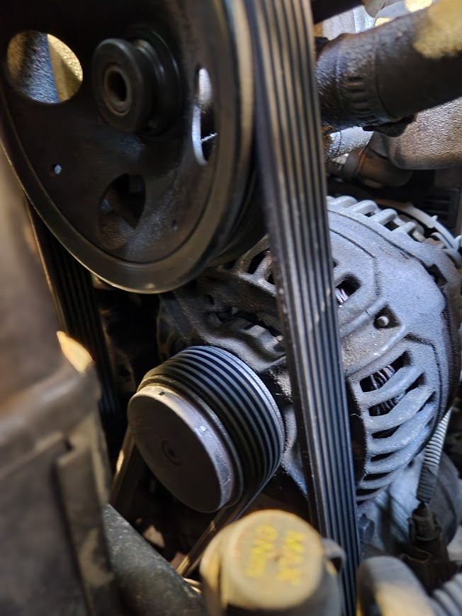
Comment resolution reports and drafting contributions

Slide 26
Contributions
15-23-0541-01 (Bin Qian)
15-23-0466-01 (Chenchen Liu)
Consolidated comments xls 15-23-0475-20 (Verso)

Slide 27

Editor’s Corner

Slide 28
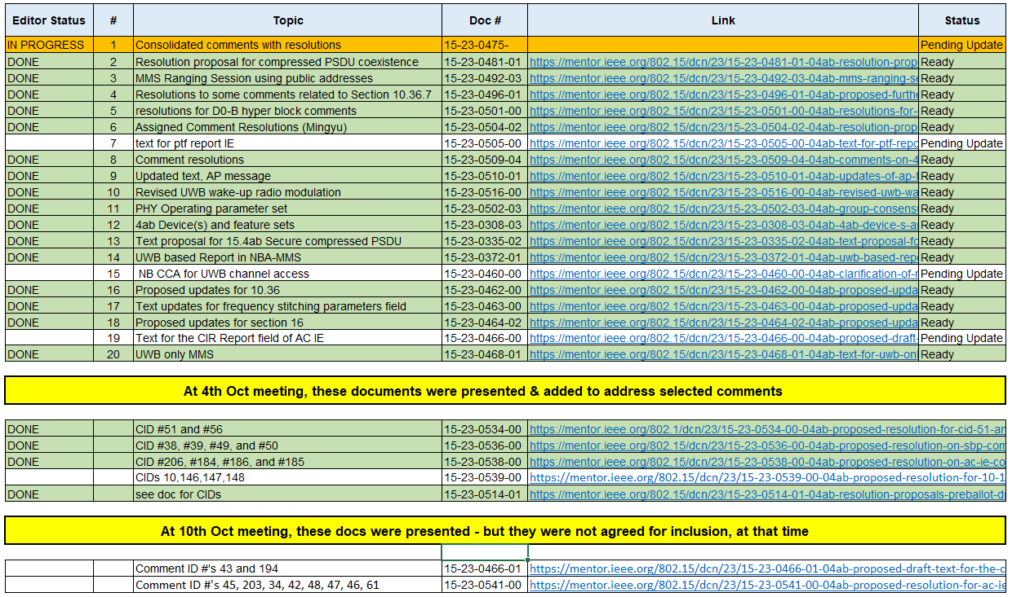
Editor Status

Slide 29
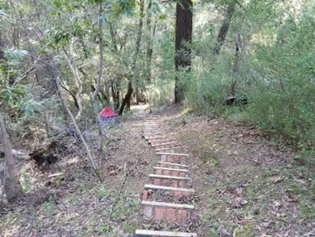
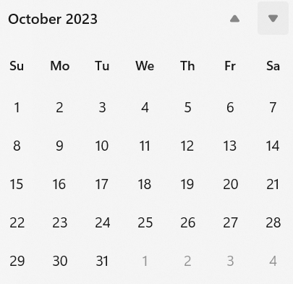
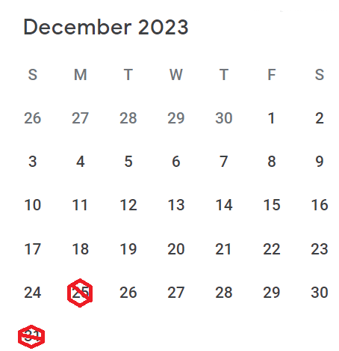
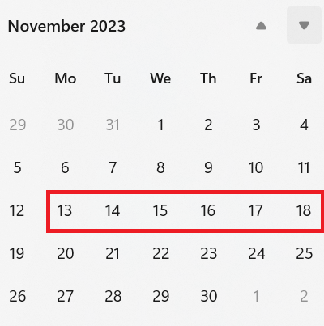
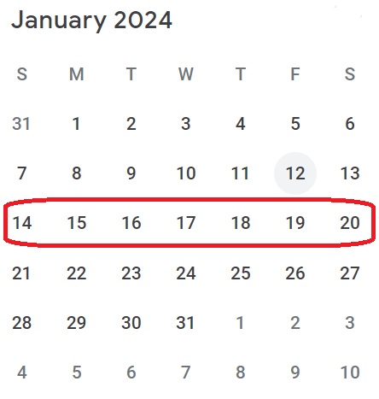
Next Steps

Slide 30
Consideration of Time
Comment Collection |  | Interim telecon/Webex opportunities
Open | Close | 21-Nov | 28-Nov | 05-Dec | 12-Dec | 19-Dec | 26-Dec | 02-Jan | 09-Jan
24-Oct | 23-Nov | --- | CR | CR | CR | CR | CR | CR | CR
31-Oct | 30-Nov | --- | --- | CR | CR | CR | CR | CR | CR
07-Nov | 07-Dec | --- | --- | --- | CR | CR | CR | CR | CR
21-Nov | 21-Dec | --- | --- | --- | --- | CR | CR | CR | CR
28-Nov | 28-Dec | --- | --- | --- | --- | --- | CR | CR | CR
05-Dec | 04-Jan | --- | --- | --- | --- | --- | --- | CR | CR
09-Dec | 08-Jan | --- | --- | --- | --- | --- | --- | --- | CR
Plenary
13-Nov through 18-Nov
When we start -> when we can finish (linear concept of time)

Slide 31
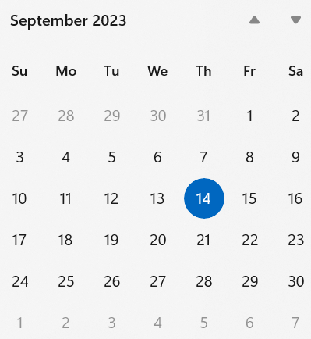
Interim telecon/Webex schedule
Now
Next
Plenary
Weekly on Tuesday commencing 26-September
06:00 PT (Green)
22:00 PT (Orange)

Slide 32
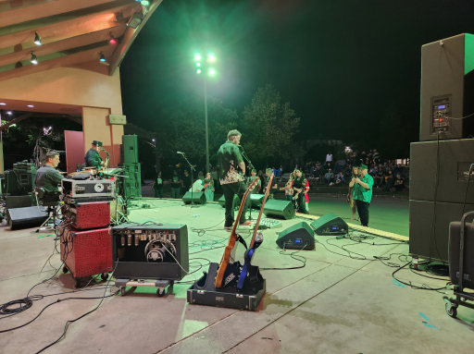
Other Business

Slide 33
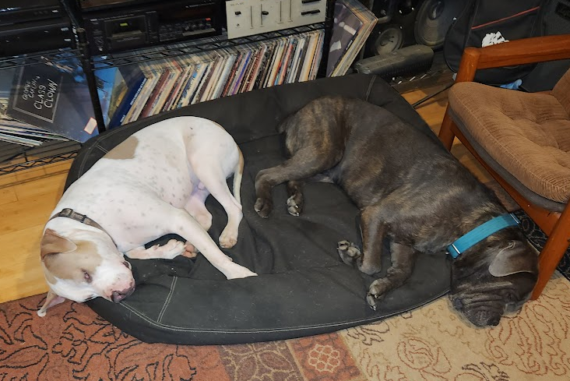
Adjourned
Thanks

