Slide 1
Project: IEEE P802.15 Working Group for Wireless Specialty Networks (WSN)
Submission Title: TG 15.4ab September 2023 Closing Report
Source: Benjamin A. Rolfe (Blind Creek Associates)
Contact:
Voice: +1 408 395 7207, E-Mail: ben.rolfe @ ieee.org
Re: Task Group 4ab: 802.15.4 UWB Next Generation
Abstract: Closing Report summarizing TG accomplishments
Purpose: Continue project progress
Notice: This document has been prepared to assist the IEEE P802.15. It is offered as a basis for discussion and is not binding on the contributing individual(s) or organization(s). The material in this document is subject to change in form and content after further study. The contributor(s) reserve(s) the right to add, amend or withdraw material contained herein.
Release: The contributor acknowledges and accepts that this contribution becomes the property of IEEE and may be made publicly available by P802.15.
Notes:
Jul 12, 2010
Page 1

Slide 2

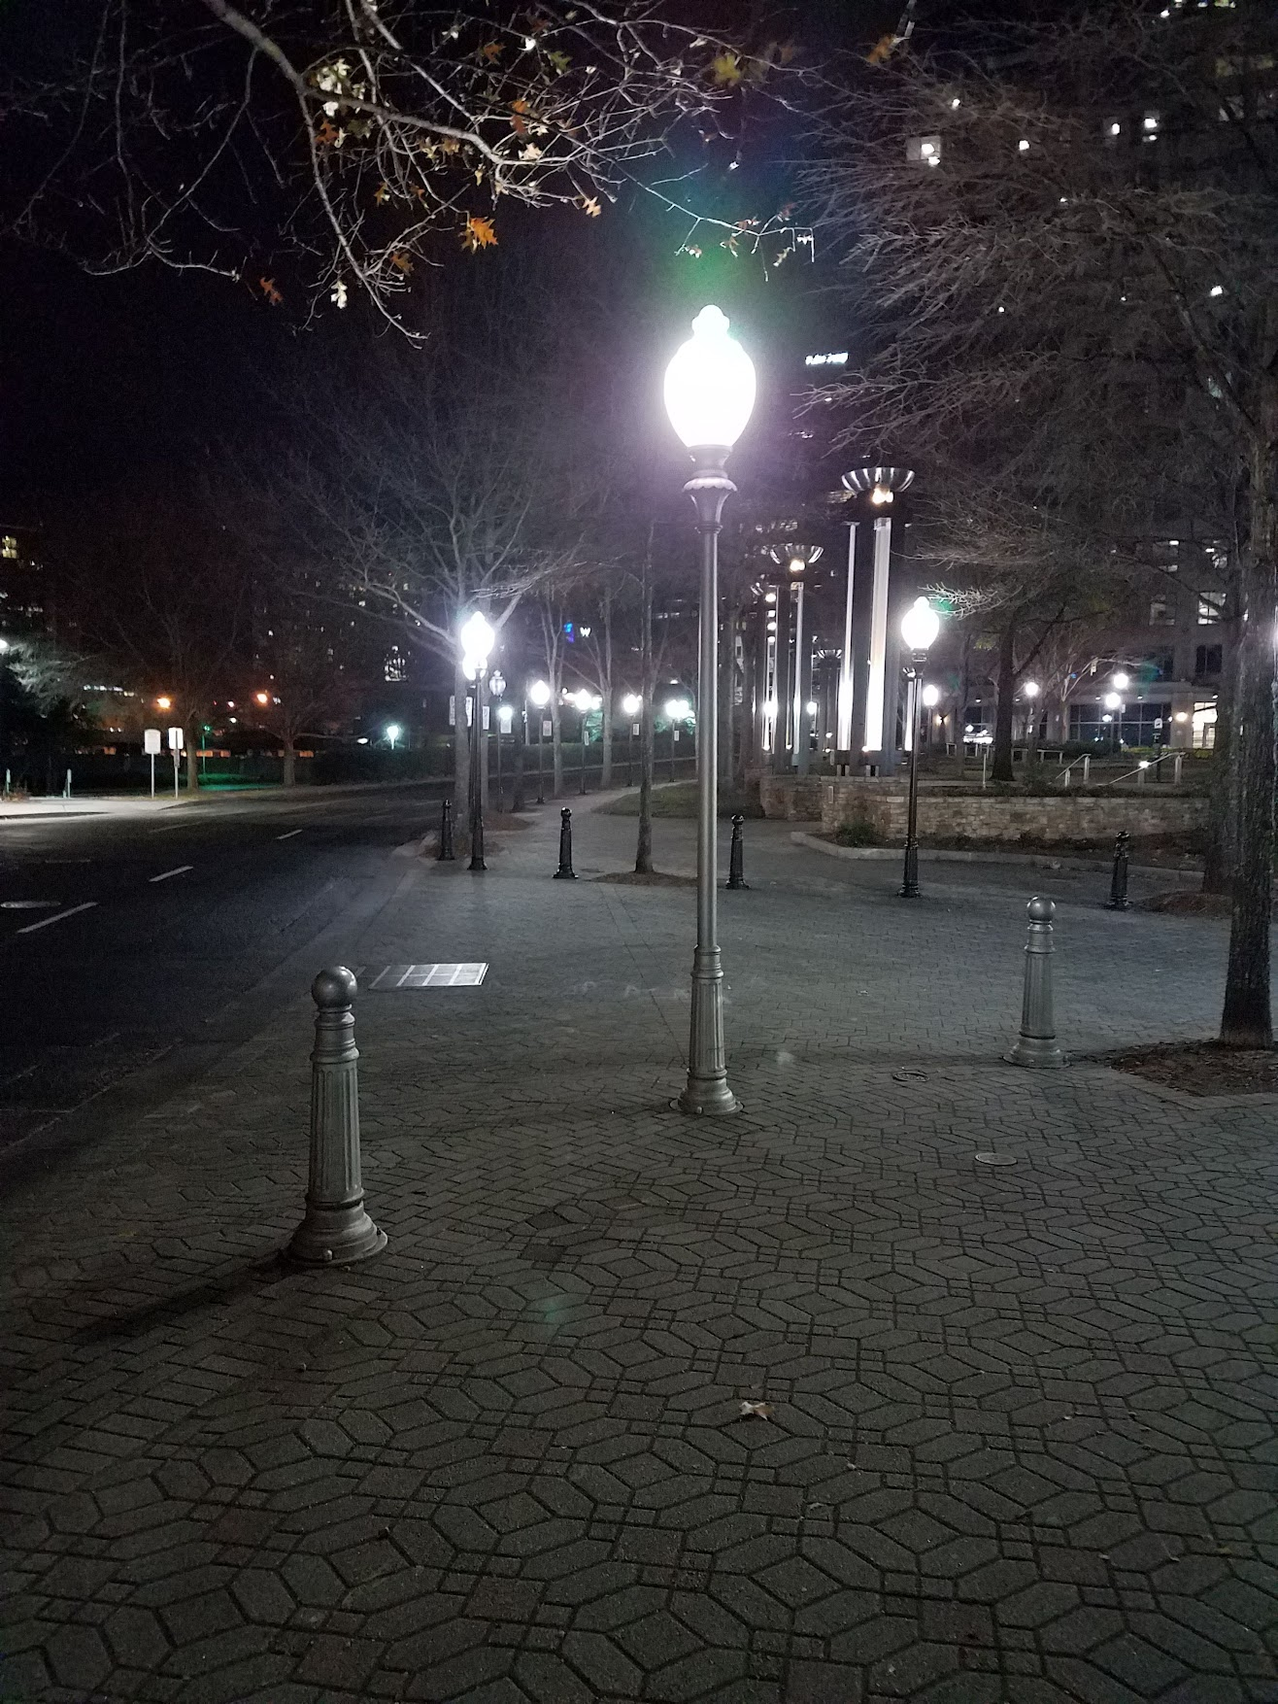
Task Group 15.4ab
Next Generation UWB Amendment
September 2023 802 Wireless Interim Session
Mixed Mode
Live from Atlanta, GA, USA

Slide 3

Agenda
Document:
https://mentor.ieee.org/802.15/dcn/23/15-23-0441-12-04ab-tg4ab-agenda-september-2023.xlsx

Slide 4
Session Objectives
Complete the draft
Provide TE with details to update
Commence informal comment collection following interim session

Slide 5

Completing the Draft

Slide 6
Overview
Pre-draft draft
  Current draft: P802.15.4ab™/D (pre-ballot) B
  Received some comments
  Not full comment collection
Did a lot of work
  Many contributions to update the draft
  More to do
From now to November
  Will continue to work on draft

Slide 7
Documents to update the Draft (Draft 0 C)
“Drafting List” tab of agenda document 15-23-0441-11
Motion
  Move to instruct the technical editor to apply the documents identified in the “Drafting List” in document 15-23-0441-12 to update Draft 0 and the list in 15-23-0374-04 slide 2. Where later versions are given in 15-23-0441-12 use the later version
  Moved by: Alex
  Second by: Carlos
  Approved by unanimous consent

Slide 8
Documents to update the Draft (Draft 0 C)
Updates according to document 15-23-0475-10, Consolidated Comments marked as “Ready” in the “Editor Status” column
Motion
  Move to instruct the technical editor to apply the comment resolutions with Editor Status marked as Ready in document 15-23-0475-10
  Moved by: Clint Chaplin
  Second by: Larry Zakaib
  Approved by unanimous consent

Slide 9
Accepted this session
Topic | Doc # | Link | Status
UWB only MMS | 15-23-0468-01 | https://mentor.ieee.org/802.15/dcn/23/15-23-0468-01-04ab-text-for-uwb-only-mms-ranging.docx | Ready
Proposed updates for 10.36 | 15-23-0462-00 | https://mentor.ieee.org/802.15/dcn/23/15-23-0462-00-04ab-proposed-updates-for-10-36.docx | Ready
Text updates for frequency stitching parameters field | 15-23-0463-00 | https://mentor.ieee.org/802.15/dcn/23/15-23-0463-00-04ab-proposed-updates-for-frequency-stitching-parameters-field.docx | Ready
Comment resolutions | 15-23-0509-04 | https://mentor.ieee.org/802.15/dcn/23/15-23-0509-04-04ab-comments-on-4ab-preballot-draft-b.pptx | Ready
4ab Device(s) and feature sets | 15-23-0308-03 | https://mentor.ieee.org/802.15/dcn/23/15-23-0308-03-04ab-4ab-device-s-and-feature-sets.pptx | Ready
PHY Operating parameter set | 12-23-0502-03 | https://mentor.ieee.org/802.15/dcn/23/15-23-0502-03-04ab-group-consensus-on-operating-parameter-sets.docx | Ready
Resolutions to some comments related to Section 10.36.7 | 15-23-0496-01 | https://mentor.ieee.org/802.15/dcn/23/15-23-0496-01-04ab-proposed-further-updates-for-10-36-7.docx | Ready
Assigned Comment Resolutions (Mingyu) | 15-23-0504-02 | https://mentor.ieee.org/802.15/dcn/23/15-23-0504-02-04ab-resolution-proposals-for-the-assigned-comments.docx | Ready
Updated text, AP message | 15-23-0510-01 | https://mentor.ieee.org/802.15/dcn/23/15-23-0510-01-04ab-updates-of-ap-formats.docx | Ready
MMS Ranging Session using public addresses | 15-23-0492-03 |  | Ready
Text proposal for 15.4ab Secure compressed PSDU | 15-23-0335-02 | https://mentor.ieee.org/802.15/dcn/23/15-23-0335-02-04ab-text-proposal-for-15-4ab-secure-compressed-psdu.docx | Ready
Revised UWB wake-up radio modulation | 15-23-0516-00 | https://mentor.ieee.org/802.15/dcn/23/15-23-0516-00-04ab-revised-uwb-wake-up-radio-modulation.pptx | Ready
Proposed updates for section 16 | 15-23-0464-02 | https://mentor.ieee.org/802.15/dcn/23/15-23-0464-02-04ab-proposed-updates-for-section-16.docx | Ready
resolutions for D0-B hyper block comments | 15-23-0501-00 | https://mentor.ieee.org/802.15/dcn/23/15-23-0501-00-04ab-resolutions-for-d0-b-hyper-block-comments.xlsx | Ready
Resolution proposal for compressed PSDU coexistence | 15-23-0481-01 | https://mentor.ieee.org/802.15/dcn/23/15-23-0481-01-04ab-resolution-proposal-for-compressed-psdu-coexistence.pptx | Ready
UWB based Report in NBA-MMS | 15-23-0372-01 | https://mentor.ieee.org/802.15/dcn/23/15-23-0372-01-04ab-uwb-based-report-in-nba-mms.docx | Ready

Slide 10
Re-affirmed list

Slide 11

Next Steps

Slide 12
Next Milestones
Resolve remaining comments on Draft 0 B
Work on Coexistence Assessment Document

Slide 13
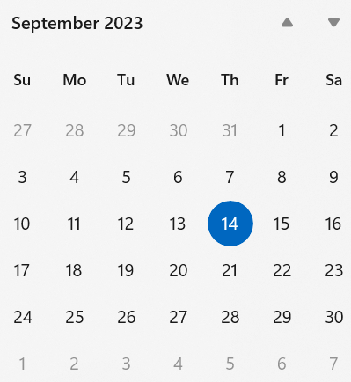
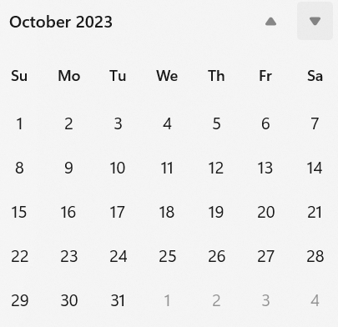
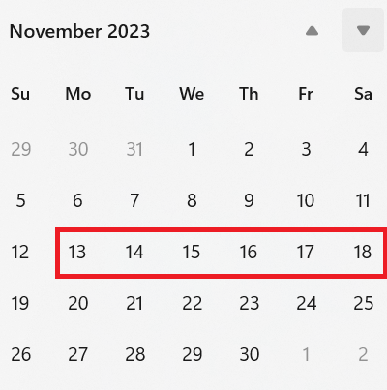
Interim telecon/Webex schedule
Plenary
Weekly on Tuesday commencing 26-September
06:00 PT (Green)
20:00 PT (Orange)

Slide 14
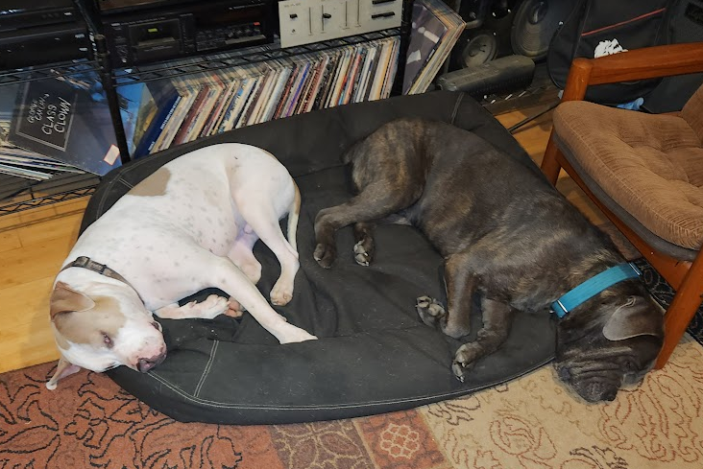
Thanks

