Slide 1
Project: IEEE P802.15 Working Group for Wireless Personal Area Networks (WPANs)
Submission Title: [Revised UWB wake-up radio modulation]
Date Submitted: [Sep 2023]
Sources: Chenchen Liu, Bin Qian, Lei Huang, David Xun Yang. Company:Huawei Technologies.
Michael McLaughlin, Billy Verso. Company: Qorvo Inc.
E-Mail:[liuchenchen1@Huawei.com, Billy dot Verso at Qorvo dot com]
Re: [Task Group 4ab: UWB Next Generation]
Abstract: [A new wake-up burst (WUB) modulation method is proposed, which can work well under interference and has a 3dB BER advantage]
Purpose: [ 4ab Draft Text modification]
Notice: This document has been prepared to assist the IEEE P802.15. It is offered as a basis for discussion and is not binding on the contributing individual(s) or organization(s). The material in this document is subject to change in form and content after further study. The contributor(s) reserve(s) the right to add, amend or withdraw material contained herein.
Release: The contributor acknowledges and accepts that this contribution becomes the property of IEEE and may be made publicly available by P802.15.

Slide 2
Current Scheme
The wake-up message is based on millisecond spaced bursts of BPSK modulated UWB pulses at the 62.4 MHz PRF of the HRP UWB PHY, with each wakeup burst (WUB) consisting of 500 ±5% pulses (i.e., 4000 chips±5%), which is approximately 8.0 µs in duration.
Each WUB signals one bit using OOK where presence of the WUB is a binary 1 and absence of the WUB is a binary 0

Slide 3
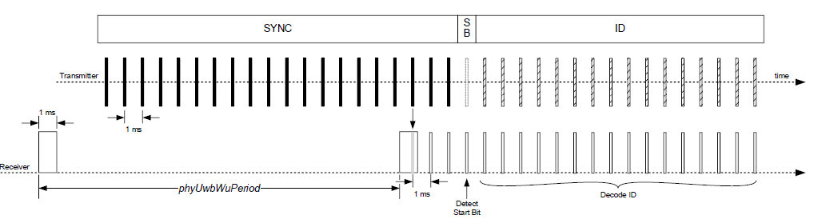
Background
Since the WUB is at the PRF of 62.4 MHz with unknown sequence, any UWB signal at the mean PRF of 62.4*k MHz can be misinterpreted as WUB.
The transmission of binary 0 is susceptible to the interference

Slide 4
New proposed WUB modulation method
Each WUB contains two candidate time intervals for the BPSK modulated UWB pulses
The BPSK modulated UWB pulses are transmitted only in one of the two interval based on the coded wake-up ID bit to send
The receiver demodulates the WUB by comparing the accumulated energy during two candidate time intervals
Note: Symbol time is slightly longer than 1ms to ensure that 2 bursts never appear in the same 1ms period
Time
Time
8μs
16μs
8μs
8
us
1.024ms
1.024ms
Binary 0
Binary 1

Slide 5
Advantages of the proposed modulation
Average power during data phase is doubled (assuming equally likely 1s and 0s
  Also assumes transmitter uses all allowed transmit power
  This gives 3dB SNR advantage = ~41% range increase
Works well under interference (the abs value of E0 and E1 may both increase, but the difference remains the same)
No need to estimate detector threshold
No bias in bit errors since 0 →1 and 1 →0 error probability are equal
Avoid long periods of all zero waveform
Filter relaxation time added between 1 and 0 positions

Slide 6
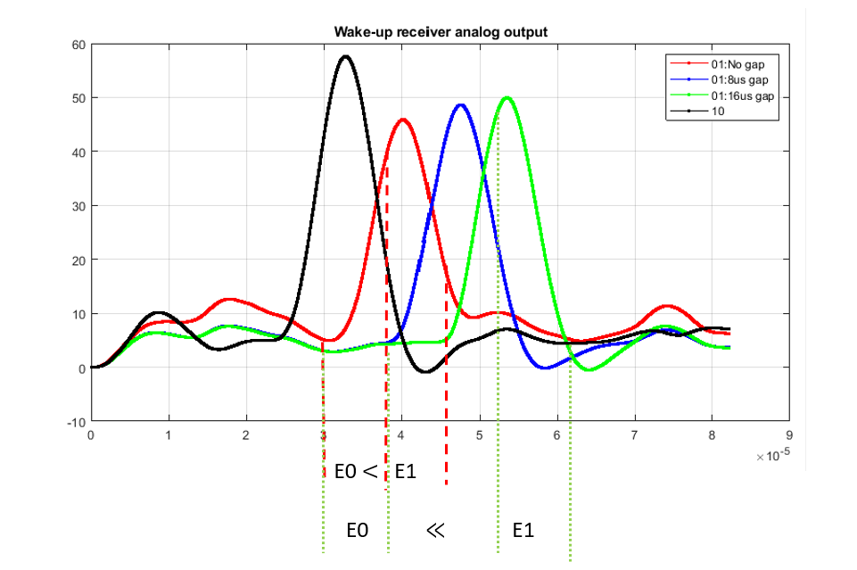
Filter relaxation time
A 16ms filter relaxation gap has been added to the proposal in 23-0330
  This allow the receiver to sample the LPF energy detector output at a relatively low rate with non-ideal sampling time and still give good performance
  Without this gap, the 1 and 0 possibilities can smear into each other, increasing the error rate

Slide 7
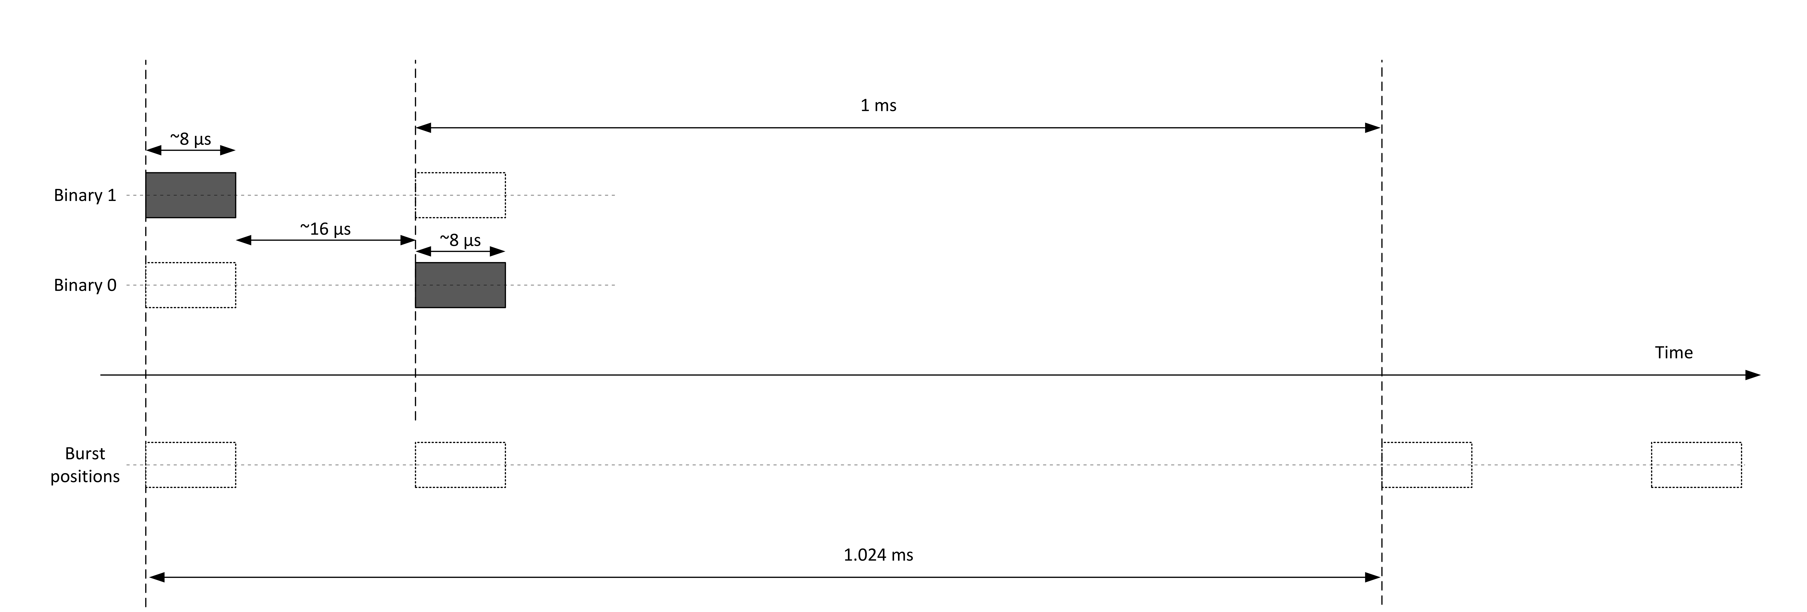
Symbol extension
The symbol time has been extended to 1.024 ms
  This ensures that no 2 bursts ever occur inside the same 1ms time period allowing the transmitter to transmit a full 1ms of energy in each burst
  This slightly reduces the bit rate from 1kbps to ~0.98kbps

Slide 8
Summary of Recommendations
Change modulation scheme from OOK to BPM
Retain 8μs burst time so that pulse power stays the same
Insert 16μs guard interval between valid burst positions
Increase symbol period to 1.024m
  3dB better performance
  Increased interference immunity
  Same pulse power

Slide 9
References
[1] 15-22-0654-00-04ab-draft-text-for-uwb-wake-up-radio
[2] 15-21-0557-01-04ab-uwb-wake-up-signaling
[3] 15-22-0282-01-04ab-the-advantages-of-uwb-wakeup
[4] 15-23-0330-00-04ab-uwb-wake-up-burst-modulation-method
[5] P802.15.4z, Draft Standard for Low-Rate Wireless Networks

