Slide 1
Project: IEEE P802.15 Working Group for Wireless Personal Area Networks (WPANs)
Submission Title: Spectrum use in license-exempt frequency bands
Date Submitted: 14 September 2023
Source: Joerg ROBERT, TU Ilmenau/Fraunhofer IIS
Re:
Abstract: This contribution shows measurement results in the sub-GHz frequency band in the US and potential implications on future 802.15.4 standards
Purpose: Presentation in 802.15.4 Next-Gen SUN PHY SG
Notice: This document has been prepared to assist the IEEE P802.15. It is offered as a basis for discussion and is not binding on the contributing individual(s) or organization(s). The material in this document is subject to change in form and content after further study. The contributor(s) reserve(s) the right to add, amend or withdraw material contained herein.
Release: The contributor acknowledges and accepts that this contribution becomes the property of IEEE and may be made publicly available by P802.15.

Slide 2
Abstract
This presentation shows some measurement results showing the channel use in license exempt frequency bands
The measurements were done during the IEEE 802 Wireless Interim in September 2023 in the Hyatt Regency Atlanta in Buckhead

Slide 3
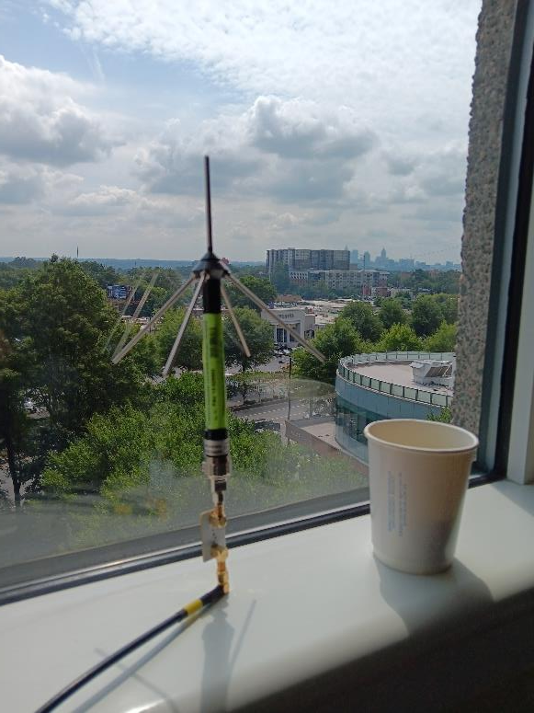
Measurement Location
0 dBd measurement antenna located next to the window in the 9th floor or the Hyatt in Buckhead, view towards downtown Atlanta
A SAW filter (924.5 MHz,
5 MHz bandwidth, ~2 dB attenuation) below the antenna avoid non-linear effects of the pre-amplifiers (very strong cellular and broadcast signals)
Metallized window may reduce RX level by 30 dB
SAW-Filter

Slide 4
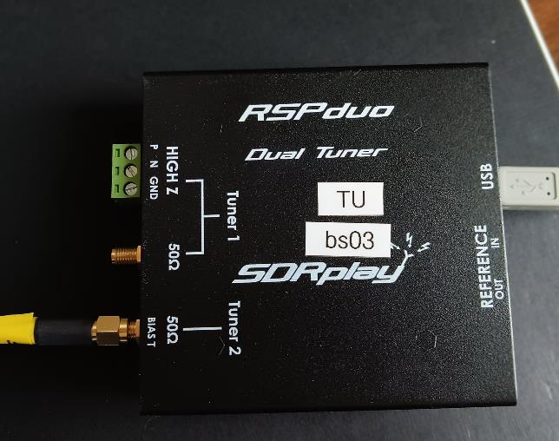
SDR Frontend
An RSPduo Software-Defined Radio Frontend (~250$) equipped sampled the band width 14 bit A/D resolution and 10MS/s
The bandwidth for the later plot is limited to 5 MHz (SAW filter bandwidth of 5 MHz)
Levels are not calibrated yet

Slide 5
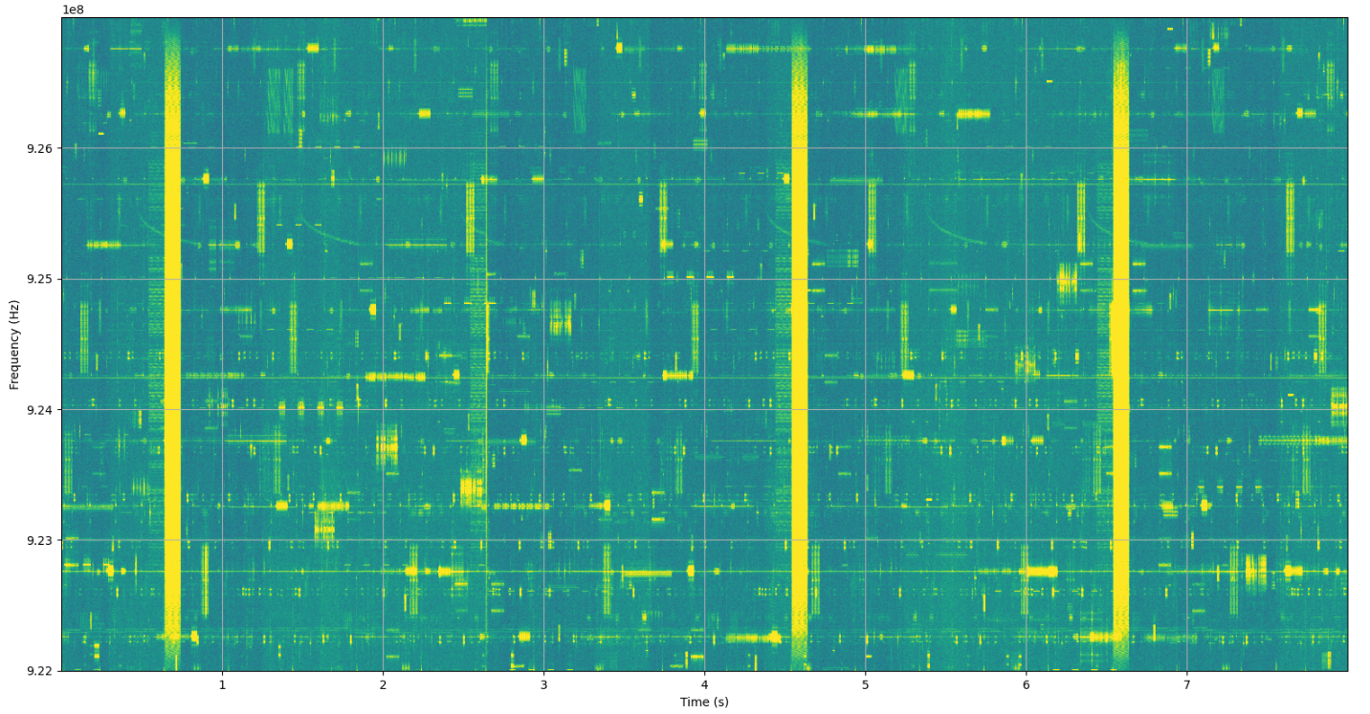
Measured Spectrogram
(922 … 927 MHz, length 8s)

Slide 6
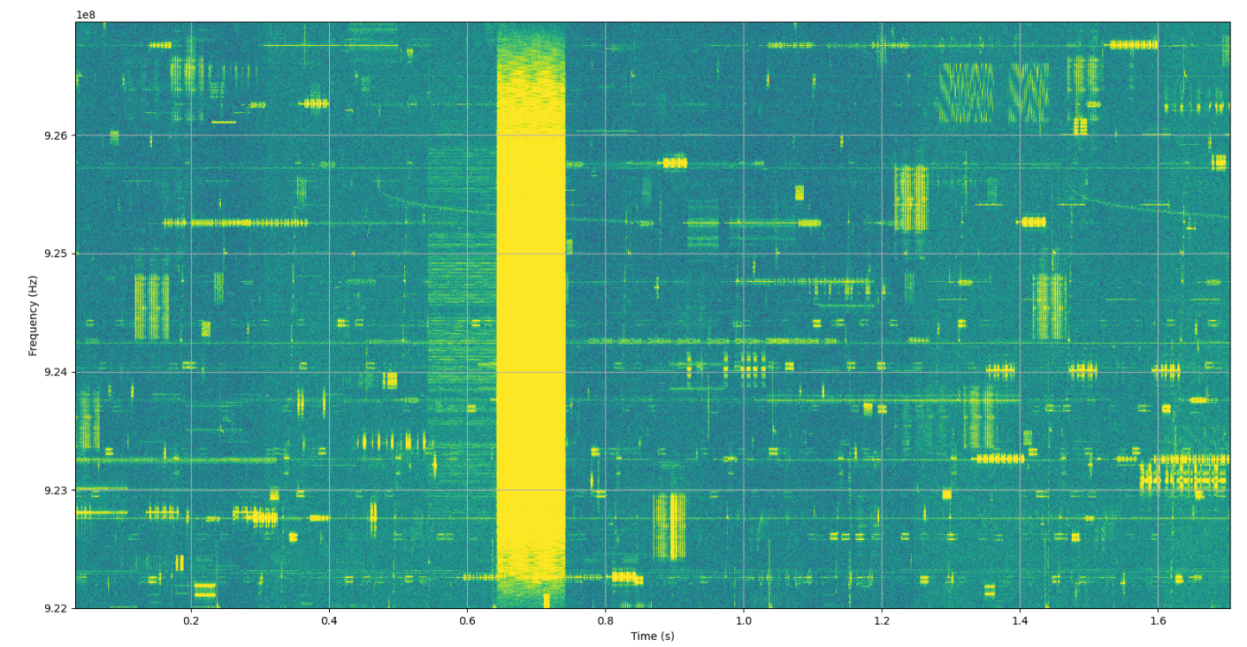
Measured Spectrogram
(922 … 927 MHz, length 1.5s)

Slide 7
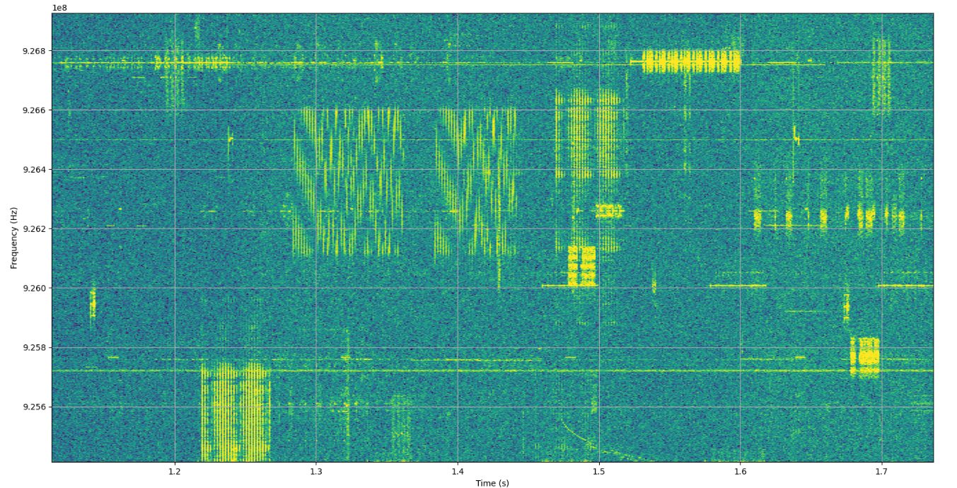
Measured Spectrogram
500kHz LoRa Signals
500kHz
~0.1s

Slide 8
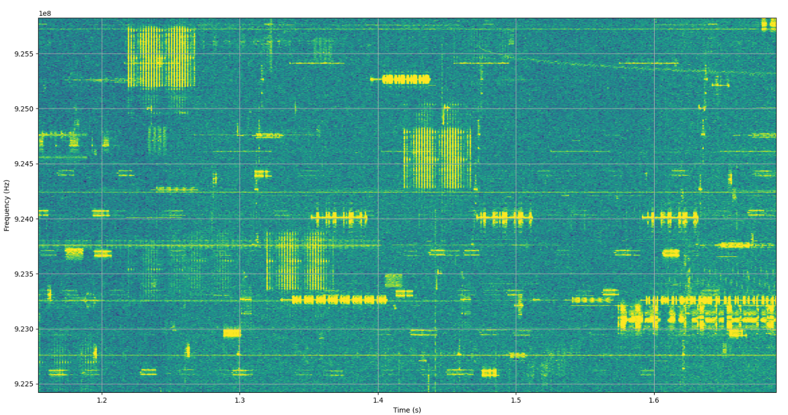
Footprint of a Typical Low-Rate Packet
Approximate footprint of a 64 byte packet
(200kHz bandwidth, 10kBit/s payload rate)

Slide 9
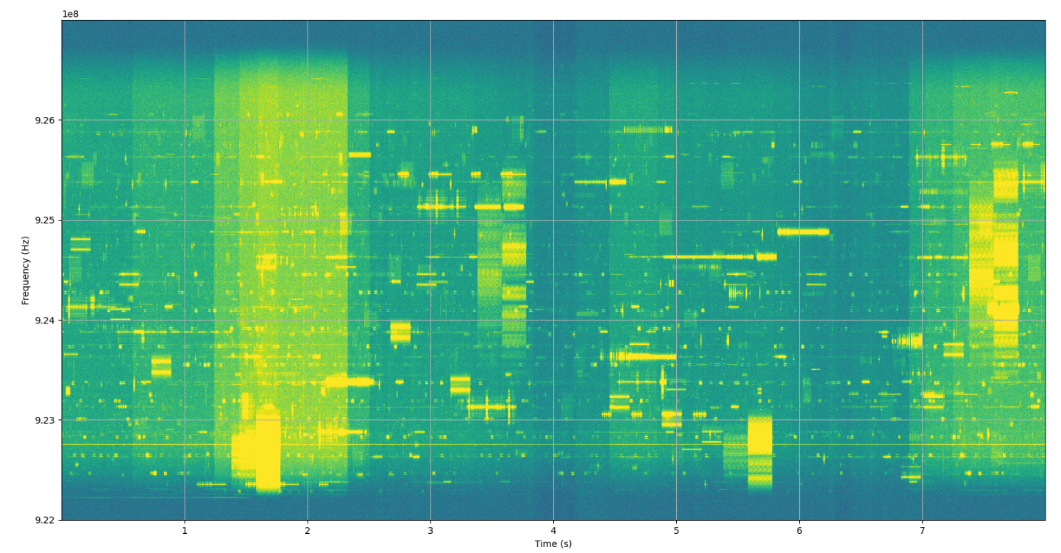
Outdoor Measurements
Hyatt in Buckhead, Terrace on 3rd Floor
Only 5 MS/s → Filter effects at the edges!

Slide 10
Interference Models
Problems due to interference were already addressed during the development of IEEE 802.15.4w
An interference model is given in:
  J. Robert, S. Rauh, H. Lieske and A. Heuberger, "IEEE 802.15 Low Power Wide Area Network (LPWAN) PHY Interference Model," 2018 IEEE International Conference on Communications (ICC), Kansas City, MO, USA, 2018
BUT: Interference characteristics may have to be updated to reflect the increased use of license-exempt frequency bands

Slide 11
Important Findings and Summary
Spreading is bad and consumes more spectrum than actually required
Ensure precise signal generation with minimized out-of-band emissions
Improve the FEC and ensure robustness in interfered channels by means of diversity in time and frequency
High bandwidth signals will always face interference

Slide 12
Thank You!
Time for some demonstrations.

