Slide 1
Project: IEEE P802.15 Working Group for Wireless Personal Area Networks (WPANs)
Submission Title: [TG15.6ma Closing Report for September 2023]
Date Submitted: [14th September 2023]
Source: [Ryuji Kohno1,2,] [1;Yokohama National University, 2;YRP International Alliance Institute(YRP-IAI)]
Address [1; 79-5 Tokiwadai, Hodogaya-ku, Yokohama, 240-8501 Japan
2; YRP1 Blg., 3-4 HikarinoOka, Yokosuka-City, Kanagawa, 239-0847 Japan]
Voice:[1; +81-90-5408-0611], FAX: [+81-45-383-5528],
Email:[1: kohno@ynu.ac.jp, 2: kohno@yrp-iai.jp] Re: []
Abstract: [This document contains closing report for TG15.6ma for Revision of P802.15.6-2012 with Enhanced Dependability September 2023.]
Purpose: [information]
Notice: This document has been prepared to assist the IEEE P802.15. It is offered as a basis for discussion and is not binding on the contributing individual(s) or organization(s). The material in this document is subject to change in form and content after further study. The contributor(s) reserve(s) the right to add, amend or withdraw material contained herein.
Release: The contributor acknowledges and accepts that this contribution becomes the property of IEEE and may be made publicly available by P802.15.

Slide 2
IEEE 802.15 TG6ma
(Revision of IEEE802.15.6-2012)
Closing Report
In Personal and Virtual Hybrid Interim Session
Buckhead, Atlanta, Georgia, USA
September 14th, 2023
Ryuji Kohno
Yokohama National University(YNU),
YRP International Alliance Institute(YRP-IAI)

Slide 3
Objectives of TG 6ma – Enhanced Dependability Body Area Network (ED-BAN)
Objective: Enhancements to the BAN Ultra Wideband (UWB) physical layer (PHY) and media access control (MAC) to support enhanced dependability to a human BAN (HBAN) and adds support for vehicle body area networks (VBAN), a coordinator in a vehicle with devices around the vehicular cabin.
Action:
Update draft#1.7 of Draft Proposals for Pre-Ballot
Comment resolution for draft#1.7
Performance Evaluation of Technologies in PHY; Channel Coding According to 8 QoS Levels of Packets and Coexistence Levels, Interference Mitigation, etc.
Performance Evaluation of Technologies in MAC; Channel Management, CCA, Hybrid Contention Free/Access Protocol According to 8 QoSs and Coexistences.
Harmonization or Commonality with 4ab in Coexistence and Feasible Implementation of 6ma and 4ab
Feasibility of TSN of 802.1 in MAC
Next Things to Do：
Finalize draft#1 for Letter Ballot

Slide 4
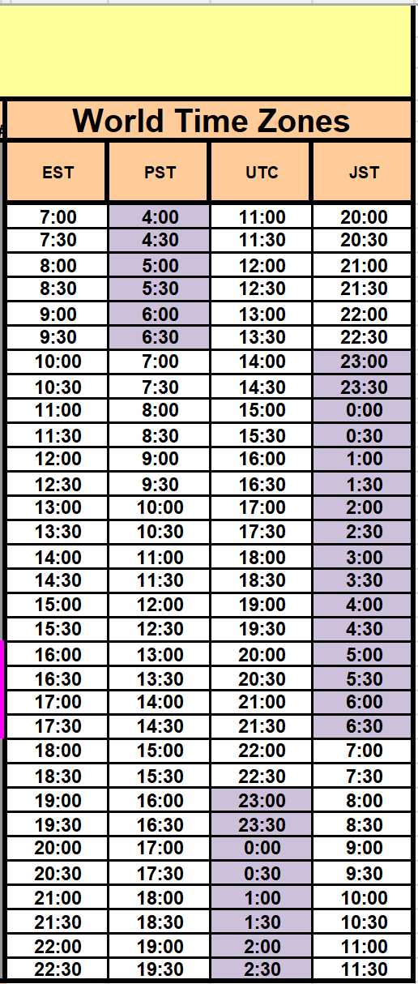
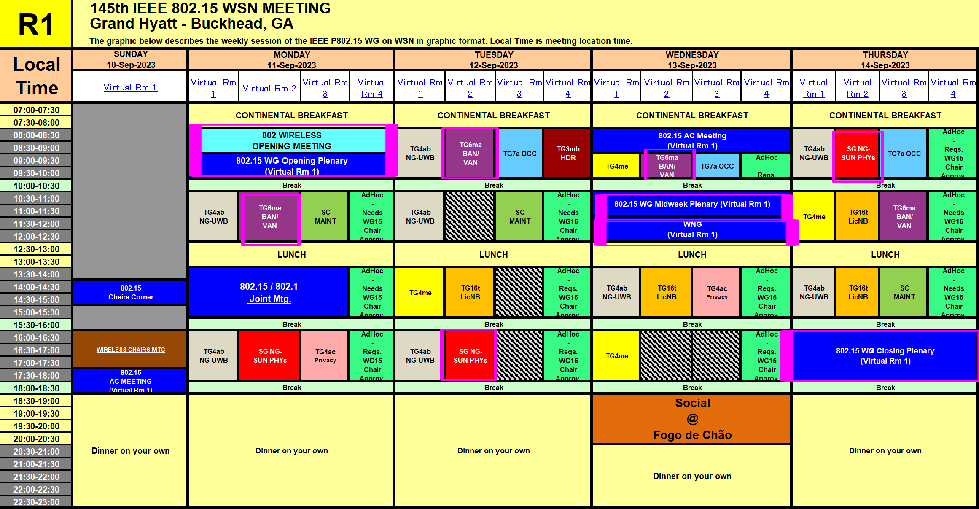
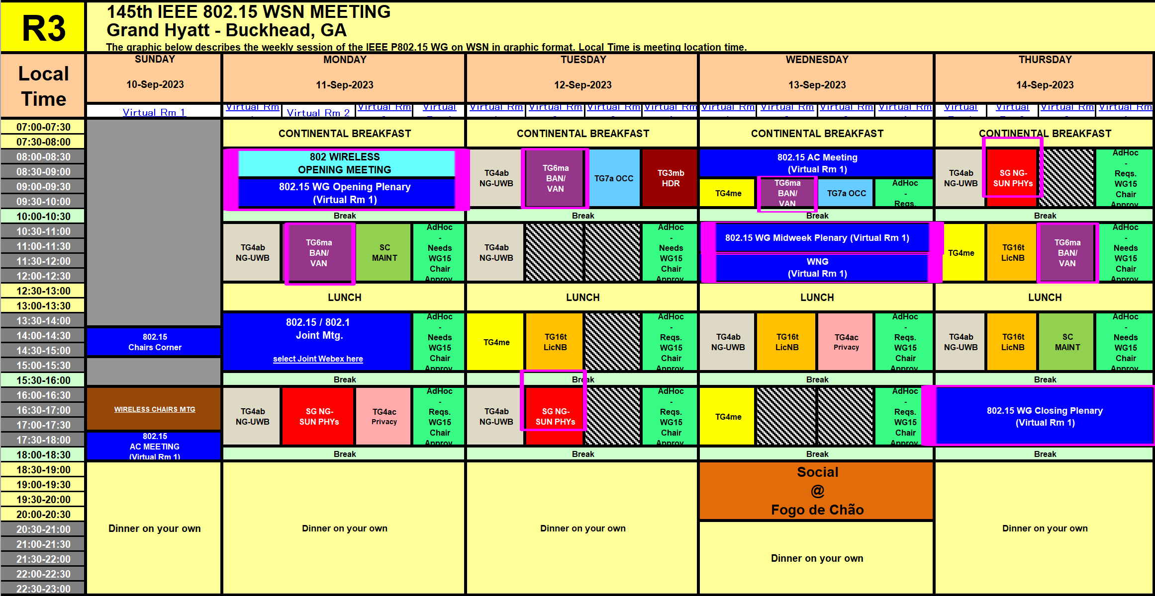
TG15.6ma Interim Session Schedule for 10-14th, Sept. 2023
doc.:IEEE802.15.23-512-00-06ma
TG15.6ma has three own sessions such as
Session1(Virtual RM#2) AM2 10:30-12:30 Sept. 10(MON) in Atlanta time, 23:30 Set.10 -1:30 Sept 11(TUE) in JST/KST
Session2(Virtual RM#2) AM1 8:00-10:00 Sept. 11(TUE) in Atlanta time, 21:00-23:00 Sept. 12(TUE) in JST/KST
Session3(Virtual RM#2) AM1 9:00-10:00 Sept. 12(WED)in Atlanta time, 22:00-23:00 Sept. 12(WED) in JST/KST
Session4(Virtual RM#3) AM2 10:30-12:30 Sept. 13(THU) in Atlanta time, 23:30 Set.13 -1:30 Sept 14(FRI) in JST/KST

Slide 5
TG15.6ma Plenary Session Schedule for 10-14th, Sept. 2023
TG15.6ma has three own sessions such as
Session1(Virtual RM#2) AM2 10:30-12:30 Sept. 10(MON) in Atlanta time, 23:30 Set.10 -1:30 Sept 11(TUE) in JST/KST
Session2(Virtual RM#2) AM1 8:00-10:00 Sept. 11(TUE) in Atlanta time, 21:00-23:00 Sept. 12(TUE) in JST/KST
Session3(Virtual RM#2) AM1 9:00-10:00 Sept. 12(WED)in Atlanta time, 22:00-23:00 Sept. 12(WED) in JST/KST
Session4(Virtual RM#3) AM2 10:30-12:30 Sept. 13(THU) in Atlanta time, 23:30 Set.13 -1:30 Sept 14(FRI) in JST/KST
Virtual Room 2
802.15 - Sept. Mtg. Rm2
Join information
Meeting link: https://ieeesa.webex.com/ieeesa/j.php?MTID=m9dab7419812901713e7c516ee2b4f16f
Meeting number: 2337 494 6802
Password: 80215septmtgrm2
Virtual Room 3
802.15 - Sept. Mtg. Rm3
Join information
Meeting link: https://ieeesa.webex.com/ieeesa/j.php?MTID=me5cd111cc5da92e523b310b681b4f2fc
Meeting number: 2348 594 2905
Password: 80215septmtgrm3

Slide 6
Agenda items for the week
TG15.6ma meeting call to order
Call for essential patents and policies & procedures reminder
Approve last meeting minutes: TG 15.6ma Meeting Minutes for July 2023 doc.#15-23-0405-01-06ma
Agenda of TG15.6ma September Meeting doc.#15-23-0442-02-06ma
Review and Summary
  1. Overview of TG15.6a Activity for Revision of IEEE802.15.6 BAN with Enhanced Dependability
  doc.#15-23-0455-01-06ma
  2. Progress and Action Items for Draft#1 doc.#15-23-0360-01-006ma
  Draft pre-ballot comment resolution doc.#15-23-0457y-00-06ma
  Rescheduling Timeline doc.#15-23-0361-01-06ma
  Presentation
  Qualitative approach to coexistence and QoS mechanisms doc.#15-23-0101-04-06ma
  Definition of Coexistence Levels and How to Support Higher Levels doc.#15-22-0631-05-06ma
  Simulation results for Nagoya I. T. and YRP-IAI MAC proposal doc.#15-23-0242-02-06ma
  Proposed text for 6ma MAC - 4. General framework elements doc.#15-23-0322-01-06ma
  Proposed text for 6ma MAC - Beacon Access Phase doc.#15-23-0367-01-06ma
  Proposal of control and data channels unification for 6ma MAC doc.#15-23-0387-01-06ma
  Ranging and localization in TG6ma doc.#15-23-0402-01-06ma
  Preliminary performance evaluation of ranging in coexience environment doc.#15-23-0353-02-06ma
  TG6ma Channel Model Document for Enhanced Dependability doc.#15-23-0519-04-06ma
  MAC Protocol Proposal for Multiple BAN Environment (Level 1,2,3) doc.#15-23-0639-03-06ma
  Overview of Ranging and Localization of TG6ma doc.#15-23-0AAA-00-06ma
  Overview of FEC proposals for 15.6ma doc.#15-22-0611-05-06ma
  Concept of channel coding for IEEE802.15.6ma doc.#15-23-0244-01-06ma
  14. Evaluation of IEEE 802.15.6 Ultra-wideband Physical Layer Utilizing Super Orthogonal Convolutional Code
  doc.#15-22-0562-05-06ma
  15. MAC Protocol Proposal for Multiple BAN Environment (Level 1,2,3) doc.#15-23-0408-02-06ma
  18. Progress Report of TG6ma doc.#15-23-0056-04-06ma
  19. Timeline of TG6ma doc.#15.23-0407-01-06ma

Slide 7
QoS Levels of Packets corresponding to User Priority
In Std.15.6 WBAN systems, a various data such as vital signs, skin temperature, blood pressure, ECG, EEG, ECoG, and vehicle controlling commons have different QoS levels corresponding to user priority.
In 15.6ma for dependable WBAN for human and vehicles, data packet transmission should be dependable according to QoS levels even in various classes of coexistence environment.
Therefore, appropriate sets of error controlling scheme with FEC and hybrid ARQ corresponding to QoS levels have been standardized in 15.6ma,
User priority | Traffic designation | Frame type
0 | Background (BK) | Data
1 | Best effort (BE) | Data
2 | Excellent effort (EE) | Data
3 | Video (VI) | Data
4 | Voice (VO) | Data
5 | Medical data or network control | Data or management
6 | High-priority medical data or network control | Data or management
7 | Emergency or medical implant event report | Data

Slide 8
Definition of Coexistence Environment Classes
Coexistence Class | Coexisting system(s) |  |  |  |  | Category
Level | 802.15.6ma | 802.15.6-2012 | Non-UWB (ex. Wi-Fi / Unlicensed / 3GPP) | 802.15 UWB (ex. 802.15.4) | Non-802.15 UWB (ex. ETSI SmartBAN) | Category
0 | - | - | - | - | - | Single BAN
1 (1a) | ✓ | - | - | - | - | Multiple 15.6 BANs
2 (1b) | ✓ | ✓ | - | - | -
3 | ✓ | - | ✓ | - | - | Non-UWB
4 (2a) | ✓ | - | - | ✓ | - | Multiple UWB systems
5 (2b) | ✓ | - | - | - | ✓
6 (2c) | ✓ | - | - | ✓ | ✓
7 | ✓ | ✓ | ✓ | ✓ | ✓ | Final Boss
The coexistence class has been redefied to 8 levels, which can be represented by 3 bits and would be suitable to include in PHY or MAC headers.

Slide 9
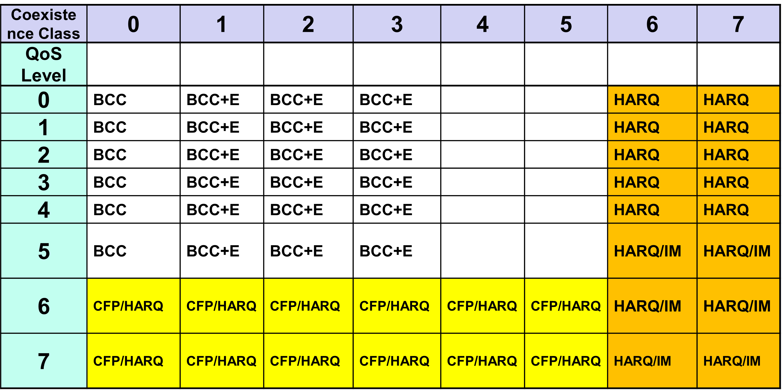
FEC/HARQ for 8 Coexistence Classes × 8 QoS Packet Levels
FEC codes and Hybrid ARQ have been designed for 8 × 8 = 64 combinations for QoS levels and Coexistence classes under various standard of channel models.

Slide 10
TG 6ma Timeline
EC approval to SB, SB submission
Mar 2024
SB recirculation
May 2024
Tech Req Doc(TRD) July 2022
TRD,CMD
Call Proposals Sept 2022
Presentation of proposalsNov2022 Jan.2023
Harmonization of Proposals
Mar 2023
^{Std Draft V0}
May 2023
Upload preliminary draft v1 on WG repository to revise for finalizing v1
July2023
WG pre-ballot
Sept 2023
Comments and resolution for pre-ballot.
Nov 2023
WG letter ballot (LB)
Jan. 2024
Revcom Approve
Jul 2024
^{Finalize Std Draft V1}
August 2023
SB recirculation if required
Jun 2024
RevcomSubmission
June 2024
Notes: SASB/RevCom scheduled for 2024 a guess

Slide 11
Timeline details.
Topic | Deadline | Notes
Technical Requirements Document (TRD). Channel Model Document (CMD). Call for Proposals. | Sept. 2022 | TRD describes the technical requirements baseline for the evaluation of proposals. The CMD contains the channel models for different use cases targeted by the Std. Announcement of call for proposals.
Due day for proposals | March 10th, 2023 | Postponed from January 2023
Presentation of proposals | Nov. 2022, January, March 2023 | Start of discussions for harmonization of proposals.
Harmonization of Proposals | March 2023 | Agreements on key technologies.
Std Draft v.0 | May 2023 | Mostly editorial revisions and start integrating text of agreed proposals.
Preliminary Std Draft v. 1 | July 2023 | Upload preliminary draft V1 in WG private repository and collecting comments to be used for revision.
Std Draft v. 1 | August 2023 | TG approval
WG pre-ballot | September 2023 | WG pre-ballot submission.
Comments and resolution for pre-ballot. | November 2023 | Finish resolutions to pre-ballot comments and recirculation.
WG letter ballot (LB) | January 2024 | LB submission
LB recirculation | January 2024 | Comment-resolutions to LB recirculation
Conditional approval for Sponsor Ballot (SB) | January 2024 | Seek conditional approval
Final LB recirculation. EC approval | March 2024 | Just before the March meeting.
EC approval to SB | March 2024
SB submission | March 2024
SB recirculation | May 2024 | Resolutions to SB.
Conditional/unconditional approval to RevCom | May 2024 | Submission to SASB agenda
SB recirculation if required | June 2024
RevCom submission | June 2024 | RevCom approval
Note: the deadlines are subject to change.

Slide 12
Contributions
・TG15.6ma opening report for September 2023 meeting 15-23-0469-02-06ma
・TG15.6ma Agenda of September Meeting in 2023 15-23-0442-06-06ma
・TG6ma Progress Report 15-23-0056-04-06ma
・Overview of TG15.6a Activity for Revision of IEEE802.15.6 BAN with Enhanced Dependability 455-01-06ma
・Progress and Action Items for Draft#1 15-23-0360-01-006ma
・Draft pre-ballot comment resolution 15-23-0457-00-06ma
・Rescheduling Timeline 15-23-0361-01-06ma
・Qualitative approach to coexistence and QoS mechanisms 15-23-0101-04-06ma
・Definition of Coexistence Levels and How to Support Higher Levels 15-22-0631-05-06ma
・Simulation results for Nagoya I. T. and YRP-IAI MAC proposal 15-23-0242-02-06ma
・Proposed text for 6ma MAC - 4. General framework elements 15-23-0322-01-06ma
・Proposed text for 6ma MAC - Beacon Access Phase 15-23-0367-01-06ma
・Proposal of control and data channels unification for 6ma MAC 15-23-0387-01-06ma
・Ranging and localization in TG6ma 15-23-0402-01-06ma
・Preliminary performance evaluation of ranging in coexience environment 15-23-0353-02-06ma
・TG6ma Channel Model Document for Enhanced Dependability 15-23-0519-04-06ma
・MAC Protocol Proposal for Multiple BAN Environment (Level 1,2,3) 15-23-0639-03-06ma
・Overview of Ranging and Localization of TG6ma 15-23-0AAA-00-06ma
・Overview of FEC proposals for 15.6ma 15-22-0611-05-06ma
・Concept of channel coding for IEEE802.15.6ma 15-23-0244-01-06ma
・Evaluation of IEEE 802.15.6 Ultra-wideband Physical Layer Utilizing Super Orthogonal Convolutional Code
15-22-0562-05-06ma
・MAC Protocol Proposal for Multiple BAN Environment (Level 1,2,3) 15-23-0408-02-06ma
・Progress Report of TG6ma 15-23-0056-04-06ma
・Timeline of TG6ma 15.23-0407-01-06ma
・TG15.6ma closing report for September 2023 meeting 15-23-0512-00-06ma
・ TG15.6ma September 2023 meeting minutes 15-23-0513-00-06ma

Slide 13
Contacts and Conference call
Chair; Ryuji Kohno, YNU/YRP-IAI
kohno@ynu.ac.jp, kohno@yrp-iai.jp
Vice-Chair; Marco Hernandez, YRP-IAI/CWC
Marco.Hernandez@ieee.org
Daisuke Anzai, NIT anzai@nitech.ac.jp
Secretary; Takumi Kobayashi, YNU/TCU
kobayashi-takumi-ch@ynu.ac.jp
Technical Coeditors; Minsoo Kim, YRP-IAI
minsoo@minsookim.com
Seong-Soon Joo, Korea Platform Service Technology (KPST) wowbk@kpst.co.kr

Slide 14
Thank You !
Any Questions ?

