Slide 1
        DOC: 15-23-0509-00-04ab
Project: IEEE P802.15 Working Group for Wireless Personal Area Networks (WPANs)
Submission Title: Comments on 4ab Draft 0 B
Date Submitted: September 12, 2023
Source: Riku Pirhonen (NXP), Pablo Corbalan (NXP), Bernhard Großwindhager (NXP), Wolfgang Küchler (NXP), Stefan Lemsitzer (NXP), Frank Leong (NXP), Srivathsa M. Parthasarathi (NXP)
Address: 6410 Oak Canyon, Ste 200, Irvine, CA 92618
E-Mails: riku.pirhonen@nxp.com
Abstract: Comments on 4ab Draft 0 B
Purpose: Summarize comments made on 4ab Draft 0 B
Notice: This document has been prepared to assist the IEEE P802.15. It is offered as a basis for discussion and is not binding on the contributing individual(s) or organization(s). The material in this document is subject to change in form and content after further study. The contributor(s) reserve(s) the right to add, amend or withdraw material contained herein.
Release: The contributor acknowledges and accepts that this contribution becomes the property of IEEE and may be made publicly available by P802.15.

Slide 2
PAR Objective | Proposed Solution (how addressed)
Safeguards so that the high throughput data use cases will not cause significant disruption to low duty-cycle ranging use cases
Interference mitigation techniques to support higher density and higher traffic use cases
Other coexistence improvement | Tools to minimize interference to / from other 5/6 GHz users
Backward compatibility with enhanced ranging capable devices (ERDEVs)
Improved link budget and/or reduced air-time | Tools to optimize split between link budget and air-time occupancy
Additional channels and operating frequencies
Improvements to accuracy / precision / reliability and interoperability for high-integrity ranging
Reduced complexity and power consumption | Tools to optimized use of PHYs
Hybrid operation with narrowband signaling to assist UWB | Tools to choose between NB and UWB
Enhanced native discovery and connection setup mechanisms | Support for NB discovery in case of minimum band availability
Sensing capabilities to support presence detection and environment mapping
Low-power low-latency streaming
Higher data-rate streaming allowing at least 50 Mbit/s of throughput
Support for peer-to-peer, peer-to-multi-peer, and station-to-infrastructure protocols
Infrastructure synchronization mechanisms

Slide 3
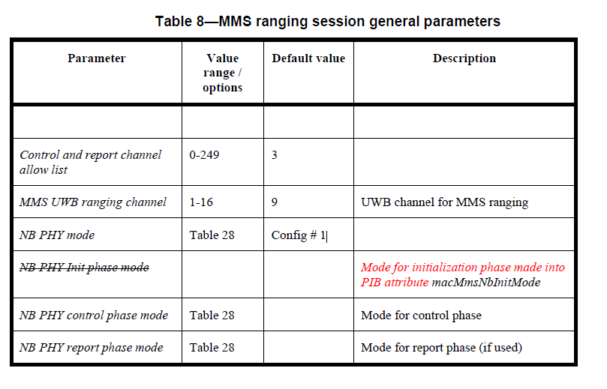
Change
Control and reporting mode configuration, Table 8, page 70, add Value range/options and default values
NB PHY control phase mode | 1-9 (Table 28) 15 (SHR, Figure X) 16 (set #1 Table X) | 1 | Mode for control phase
NB PHY report phase mode | 1-9 (Table 28) 16 (set #1 Table X) | 1 | Mode for report phase (if used)

Slide 4
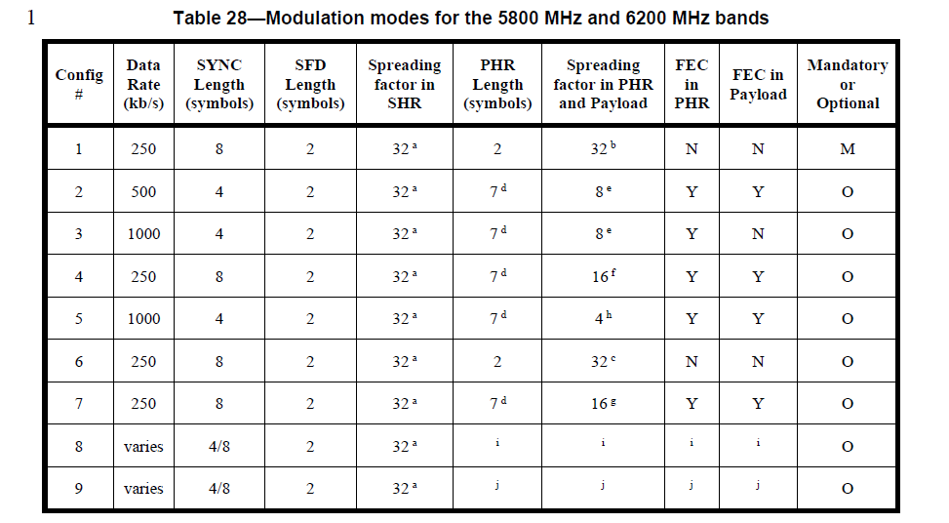
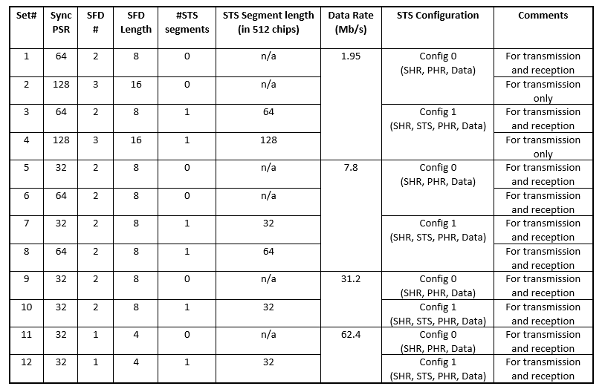
Reference
The tables that previous comments refer to
SHR for MMS will be defined in subchapter 16, Figure X
Table 28, subchapter 13.2.5
Table X, to be added to subchapter 16.7, see dcn 502

Slide 5
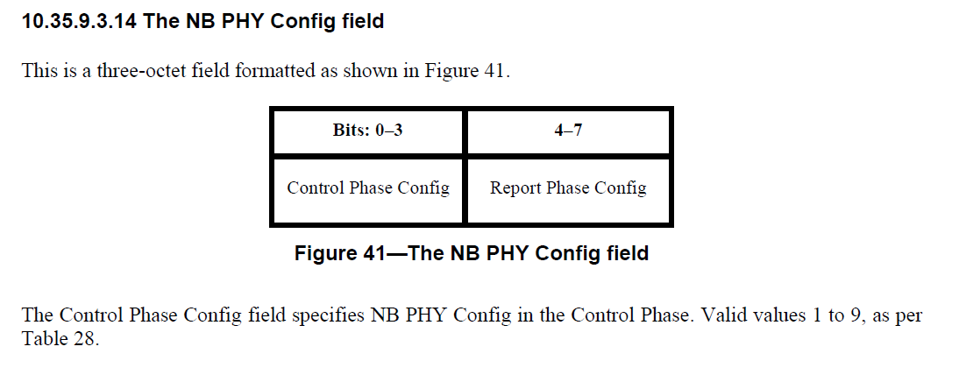
Change
Amend 10.35.9.3.15, page 53, with following text below figure 41
The Control Phase Config field specifies NB PHY Config in the Control Phase. Valid values are 1 to 9, as per Table 28, as well as 15 and 16. If value is set to 15, only UWB SHR [defined subchapter 16] is used. If value is set to 16, a UWB packet using Set #1 from Table X [subchapter 16.7] is sent in the previous slot before the SHR.

Slide 6
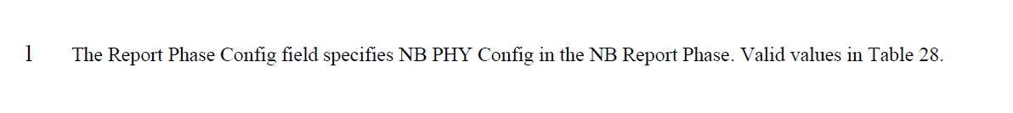
Change
Amend 10.35.9.3.15, page 54, line 1 with following text
The Report Phase Config field specifies the PHY Config in the Report Phase. Valid values are 1 to 9, as per Table 28, and 16. If value is set to 16, a UWB packet using Set #1 from Table X [subchapter 16.7] is used.
When NBA-MMS uses UWB in control and report phase, control and report packet preamble Code Index is the same as defined in the UWB PHY Config Field. If it is Ci 9 - 32. If MMRS code is 33-48, control or report phase preamble code Ci is (MMRS code modulo 8) + 24. See Figure 37.

Slide 7
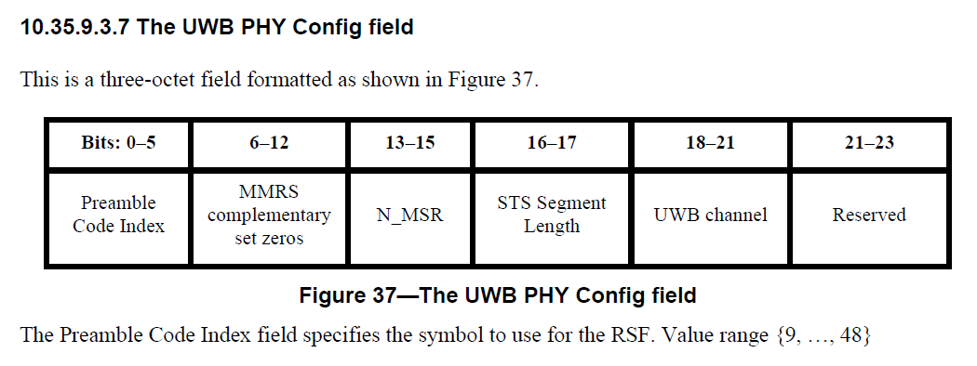
Reference
Figure 37 to which the previous comment refers to
Defines PHY config field including preamble Code Index

Slide 8
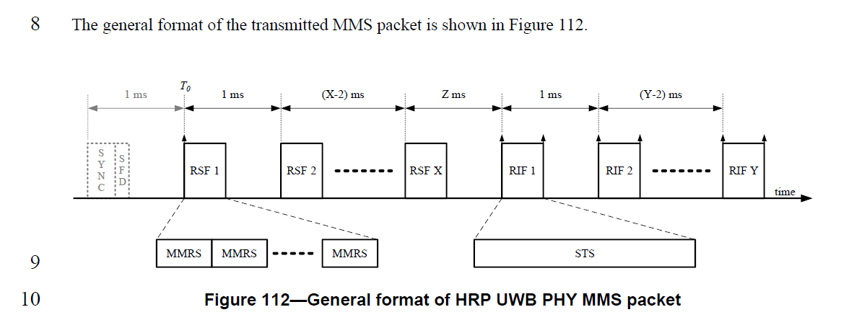
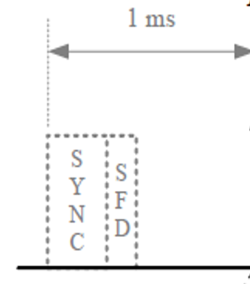
Change
Amend figure 112, page 115, with optional PHR and PHY Payload
SP0
Set#1

Slide 9
Reference
If needed, this figure can be used to clarify the case with UWB SHR
Initialization Channel
t
i
o
me
f
f
se
AD
t
V
AD
Initiator
PO
V
SO
R
Advertising Poll
Advertising Response
Start of Ranging
L
L
PO
L
L
Responder
SCAN
SCAN
AD
R
V
ESP
time
Ranging Channel
NB channel
Initiator
SHR
POLL
REP
OR
T
UWB channel
UWB RANGING
Responder
SHR
RESP
REP
OR
T
Control
Report
Discovery
Initialization
Ranging

Slide 10
Reference
If needed, this figure can be used to clarify the case with UWB SP0 data and SHR
Initialization Channel
t
i
o
me
f
f
se
AD
t
V
AD
Initiator
PO
V
SO
R
Advertising Poll
Advertising Response
Start of Ranging
L
L
PO
L
L
Responder
SCAN
SCAN
AD
R
V
ESP
time
Ranging Channel
NB channel
Initiator
SP0
CTRL
SHR
POLL
REP
OR
T
UWB channel
UWB RANGING
Responder
SP0
CTRL
SHR
RESP
REP
OR
T
Control
Report
Discovery
Initialization
Ranging

