Slide 1
SUN PHY OQPSK pulse shaping options
Hybrid Meeting
September 11th, 2023

Slide 2
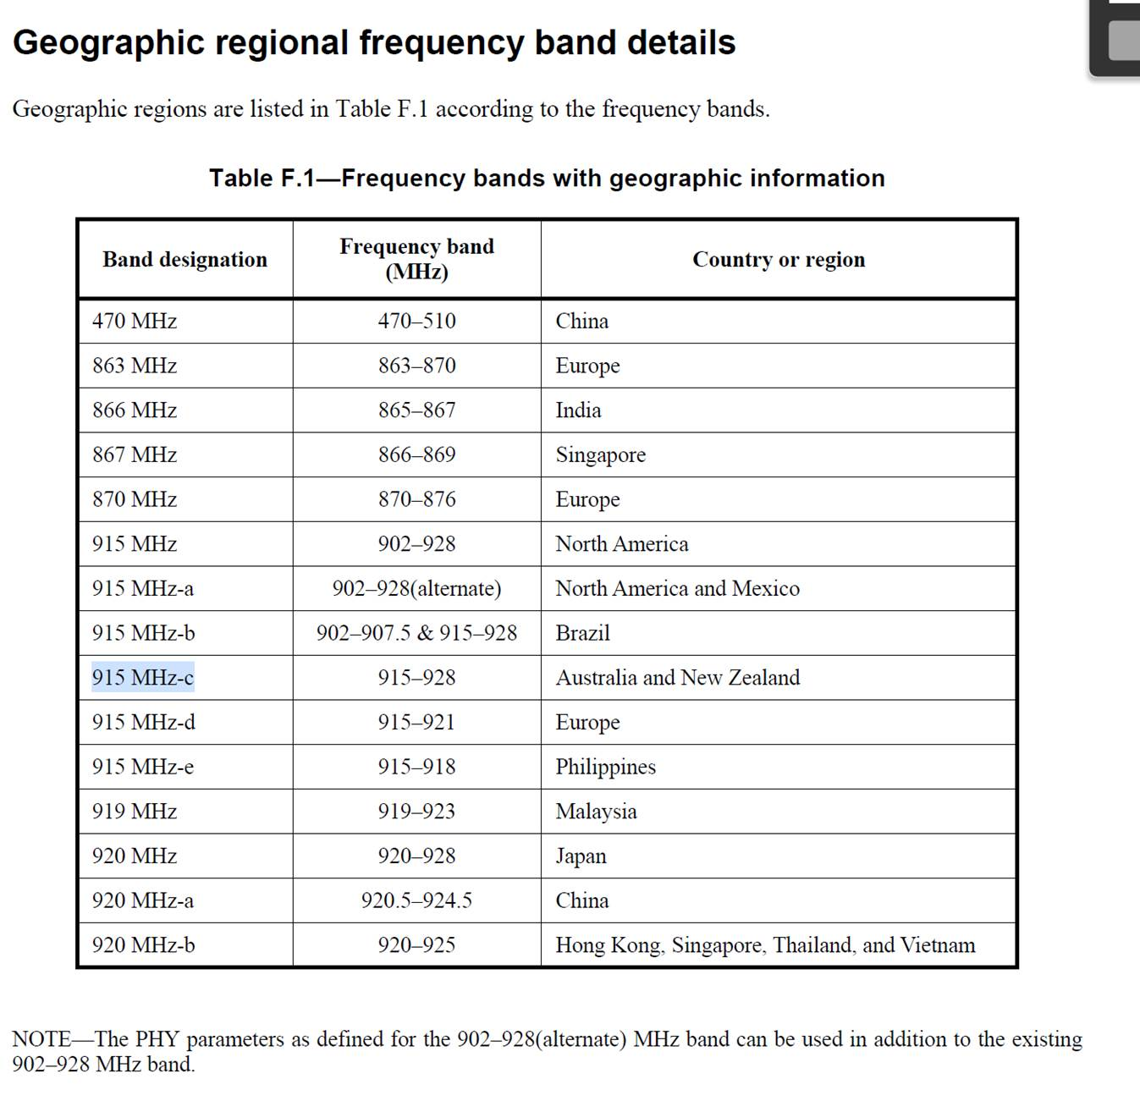
Geographic regional frequency bands

Slide 3
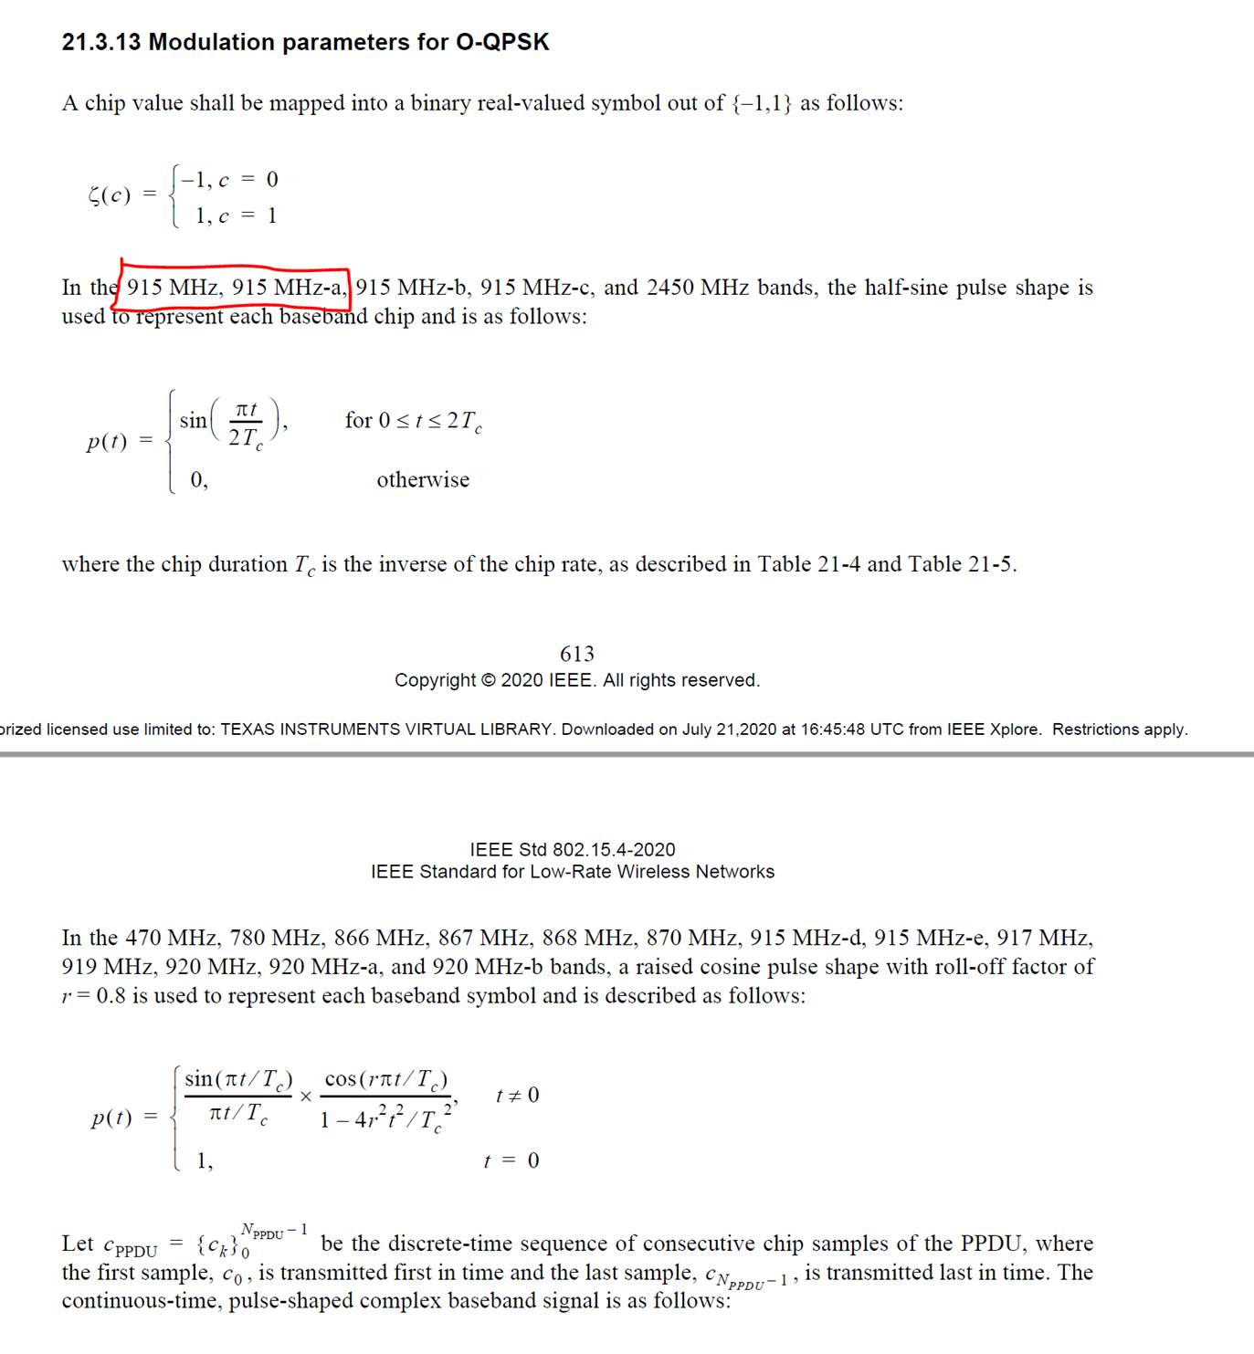
Current SUN-OQPSK pulse shaping
The IEEE 802.15.4-2020 defines two different pulse shaping functions and the application of each is regionally dependent.
This has implications for globally available end equipment manufactures as they would need to know which country it device was in.
Section 21.3.13 defines two pulse shapes: a half-sine pulse and a raised cosine pulse. Only the half-sine is constant envelope. Constant envelop transmitters are significantly more common and lower overall TX power and we to not expect this to change
We recommend to redefine the frequency bands they apply to. Our proposal would be to remove the region specific details and make both option valid.
There might be some issues, though with the bandwidth of the signals for the half-sine pulses (they are wider, precisely like FSK/MSK) and that is why it was decided originally to allow that split

