Slide 1
Project: IEEE P802.15 Working Group for Wireless Personal Area Networks (WPANs)
Submission Title: [Resolution proposal for compressed PSDU coexistence]
Date Submitted: September 11, 2023]
Source: [Alexander Krebs, Moche Cohen, Jinjing Jiang (Apple), Rojan Chitrakar, Lei Huang, Bin Qian, David Xun Yang (Huawei Technologies), Hong Won Lee, Insun Jang, Jinsoo Choi, HanGyu Cho (LG Electronics), Mingyu Lee, Taeyoung Ha, Youngwan So (Samsung Electronics), Bin Tian, Pooria Pakrooh (Qualcomm)]
Email: [a_krebs, jinjing, …]@apple.com
Re: [Input to the Working Group]
Abstract: [Resolution proposal for the discussion on coexistence between legacy 15.4 MHR and newly compressed PSDU frame formats.]
Purpose: []
Notice: This document has been prepared to assist the IEEE P802.15. It is offered as a basis for discussion and is not binding on the contributing individual(s) or organization(s). The material in this document is subject to change in form and content after further study. The contributor(s) reserve(s) the right to add, amend or withdraw material contained herein.
Release: The contributor acknowledges and accepts that this contribution becomes the property of IEEE and may be made publicly available by P802.15.

Slide 2
PAR Objective | Proposed Solution (how addressed)
Safeguards so that the high throughput data use cases will not cause significant disruption to low duty-cycle ranging use cases
Interference mitigation techniques to support higher density and higher traffic use cases
Other coexistence improvement
Backward compatibility with enhanced ranging capable devices (ERDEVs)
Improved link budget and/or reduced air-time
Additional channels and operating frequencies
Improvements to accuracy / precision / reliability and interoperability for high-integrity ranging
Reduced complexity and power consumption
Hybrid operation with narrowband signaling to assist UWB | Resolution proposal for the discussion on coexistence between legacy 15.4 MHR and newly compressed PSDU frame formats
Enhanced native discovery and connection setup mechanisms
Sensing capabilities to support presence detection and environment mapping
Low-power low-latency streaming
Higher data-rate streaming allowing at least 50 Mbit/s of throughput
Support for peer-to-peer, peer-to-multi-peer, and station-to-infrastructure protocols
Infrastructure synchronization mechanisms

Slide 3
Berlin Discussion Summary
The following arguments have been presented in the previous discussions
  Compressed PSDU (cPSDU) and legacy PSDU can not be distinguished by a legacy 15.4 O-QPSK receiver
  A coexistence conflict will possibly occur when compressed and legacy PSDU are operated simultaneously in interfering PHYs
The following resolution proposals have been discussed
  Encapsulation of cPSDU using “Extended” or “Reserved” frame control (DCN 383 B. Verso [1], DCN 338 R. Chitakrar [2])
  Encapsulation of legacy PSDU using cPSDU 0x00 [3,4]
  Distinct CRC register initialization values for cPSDU

Slide 4
Drawbacks of Proposed Solutions
Encapsulation of cPSDU as legacy 15.4 extended/reserved frame [1,2]
  Reserved frame format: reduced 5-bit address space for message IDs
  Extended frame format: reduced, fragmented 2+3 bit address space with some values not usable
Encapsulation of legacy 15.4 as cPSDU 0x00 [3,4]
  +1 byte overhead for legacy 15.4 messages to be used @ 5/6 GHz
  not applicable to 2.4GHz, due to legacy OQPSK devices operating in the field
Distinct CRC register initialization value
  No determination of transmit error vs frame format possible
  Increases implementation complexity

Slide 5
Resolution Proposal
We agree on to resolve the discussion by encapsulating all cPSDU messages by means of the ”Reserved” legacy frame control as presented in [2]
Reasoning
  reduced 5-bit message ID address space is sufficient to all currently proposed MMS messages
  enlarged address space can be allocated via reserved values (for vendor specific and future 802.15.4 enhancements)
  no airtime/coex increase vs cPSDU

Slide 6
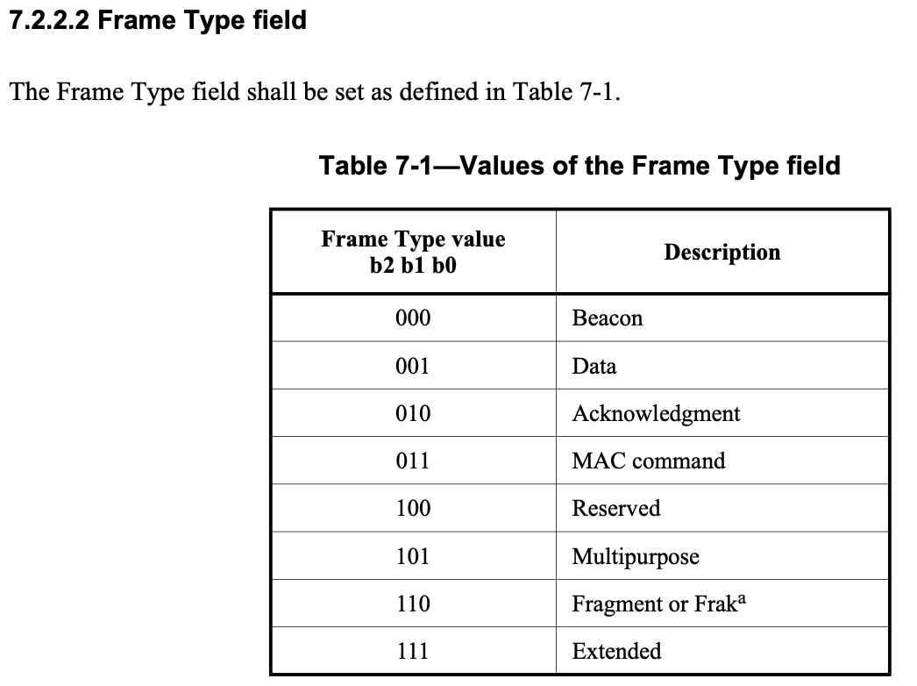
Resolution proposal 1/3
Change the legacy 15.4 frame control [802.15.4-2020] as follows:
Multi-millisecond

Slide 7
Resolution proposal 2/3
Add the following section after section 7.3.6 in [802.15.4-2020]:
7.3.7 Multi-millisecond frame format
The Multi-millisecond (MMS) frame format shall be formatted as illustrated in Figure 7-21.
Figure 7-21-–Multi-millisecond frame format
The Frame Type field shall contain the value that indicates a Multi-millisecond frame, as shown in Table 7-1.
Bits: 0-2 | 3-7 | variable
Frame Type | MMS Message ID | MMS Message Payload

Slide 8
Resolution proposal 3/3
We propose to remap the cPSDU IDs from D0 to the new Multi-millisecond frame format as follows:
Message Name | PSDU octet 0
 | cPSDU bits 0-7 | MMS Message ID (frame control bits 3-7)
ADV-POLL | 0x01 | 0x00
ADV-RESP | 0x02 | 0x01
SOR | 0x03 | 0x02
POLL | 0x04 | 0x03
RESP | 0x05 | 0x04
REPORT (Initiator) | 0x06 | 0x05
REPORT (Responder) | 0x07 | 0x06
ADV-CONF | 0x08 | 0x07
POLL (One-to-many) | 0x10 | 0x08
RESP (One-to-many) | 0x11 | 0x09
REPORT (from responder in one-to-many ranging) | 0x12 | 0x0a
REPORT(from initiator in one-to-many ranging) | 0x13 | 0x0b
PUBLIC-ADV-POLL | 0x21 | 0x0c
PUBLIC-ADV-RESP | 0x22 | 0x0d
PUBLIC-SOR | 0x23 | 0x0e
PUBLIC-ADV-CONF | 0x26 | 0x0f
NB-AP |  | 0x10
Unused/reserved | … | …
Reserved (for vendor specific use) | 0x60-0x7f | 0x1e
Reserved (for 2nd byte ID extension) | 0x80-0xff | 0x1f

Slide 9
Summary/Next Steps
We have summarized the proposals regarding frame format coexistence from the Berlin ad-hoc discussions
We have provided an assessment of technical drawbacks
We have agreed on the solution proposal [2] to encapsulate the cPSDU as a new Multi-millisecond frame type to replace the 15.4 legacy “Reserved” frame control type
We have proposed the necessary text changes to [5] and a remapping of the compressed PSDU messages from DCN 381, 401, and 412 to fit the newly added 5-bit MMS Message ID field
If the group agrees, we propose to amend the 4ab standard text as presented

Slide 10
References
[1] ”Incorporating compressed packet format”, B. Verso (Qorvo), 15-23-0383-00-04ab
[2] “NB Coexistence”, R. Chitrakar (Huawei), 15-23-0338-01-04ab
[3] “NBA-UWB ranging text proposal for 15.4ab TFD”, A. Krebs (Apple) et al., 15-22-0381-05
[4] “Consensus NBA-UWB MMS MAC TFD update proposal”, A. Krebs (Apple) et al., 15-23-0412-00-04ab
[802.15.4-2020] IEEE 802.15.4-2020, IEEE Standard for Low-Rate Wireless Networks

